Slide 1




Key Challenges for Modeling Language Creation by Demonstration
Hyun Cho, Jeff Gray
Department of Computer Science
University of Alabama
Yu Sun
Dept. of Computer and Information science
University of Alabama at Birmingham
Jules White
Bradley Dept. of Electrical and Computer Engineering
Virginia Tech
This work supported in part by NSF CAREER #1052616.

Slide 2
Overview of Presentation
GPMLs vs. DSMLs
Challenges of DSMLs Development
Modeling Language Creation By Demonstration
Demo
Conclusion

Slide 3
Types of Modeling Languages
GPMLs (General-Purpose Modeling Languages)
Example: UML
Rich constructs and expressiveness for all domains
Requires much time and effort for domain experts to understand and use
Many tools are already available (commercial, open)
DSMLs (Domain-Specific Modeling Languages)
Example: Petri Net
Customized to a specific domain
Easier to learn and use by domain experts
Designed and implemented by domain-driven needs and abstractions

Slide 4
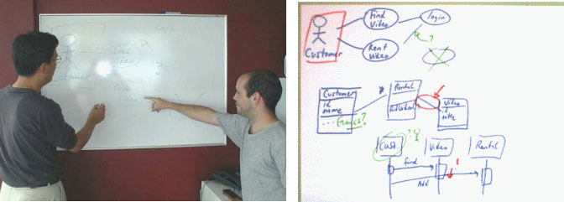
DSMLs Development Challenge 1
Preference to unconstrained environments
Design with whiteboard, papers, or computer with pen-based input system
Easy to capture high-level requirements and communicate with participants
Documents are informal and often not documented
Need to process wide range of open notations for different domains
Figures are excerpted from Chen, Q., Grundy, J.C., and Hosking, J.G. SUMLOW: Early Design-Stage Sketching of UML Diagrams on an E-whiteboard, Software – Practice and Experience, vol. 38 , no. 9, Wiley, July 2008, pp. 961-994

Slide 5
DSML Development Challenge 2
Often requires familiarity of domain knowledge and language design expertise
Domain Experts
Programming Language Development Experts
Quality of Domain Understanding
Quality of DSML Implementations & Maintenance
Experts who have both domain knowledge and language development expertise

Slide 6
DSML Development Challenge 3
Complexity of DSML development
DSML development is often iterative and incremental
Several different stages are often used to develop a DSML
Helps to capture and formalize constantly changing requirements and notations
Can be tedious, error-prone, and time-consuming without tool supports
Identify abstract syntax
Identify concrete syntax
Initial requirements for domain models
Evaluate and feedback
Specify associated semantics
DSML for a domain

Slide 7

DSML Development Challenge 4
Specifying the semantics of a modeling language with formal techniques
Types of semantics
Static semantics: well-formed rules for the model
Dynamic semantic: the meaning of models
Formal specification of modeling language semantics is challenging even for language designers
Static Semantics
- Attribute grammar
Dynamic Semantics
Operational Semantics
Axiomatic Semantics
Denotational Semantics

Slide 8
Resolution of the Challenges
Challenge 1
Preference to unconstrained environment
Resolution 1
Use flexible modeling tool that supports model sketching

Slide 9
Resolution of the Challenges
Challenge 1
Preference to unconstrained environment
Resolution 1
Use flexible modeling tool that supports model sketching
Challenge 2
Familiarity of domain knowledge and language design expertise
Resolution 2
Provide DSML development environment that can create DSML without language design expertise

Slide 10
Resolution of the Challenges
Challenge 1
Preference to unconstrained environment
Resolution 1
Use flexible modeling tool that supports model sketching
Challenge 2
Familiarity of domain knowledge and language design expertise
Resolution 2
Provide DSML development environment that can create DSML without language design expertise
Challenge 3
Complexity of DSML development
Resolution 3
Simplify DSML development through automation

Slide 11
Resolution of the Challenges
Challenge 1
Preference to unconstrained environment
Resolution 1
Use flexible modeling tool that supports model sketching
Challenge 2
Familiarity of domain knowledge and language design expertise
Resolution 2
Provide DSML development environment that can createDSML without language design expertise
Challenge 3
Complexity of DSML development
Resolution 3
Simplify DSML development through automation
Challenge 4
Formal specification of modeling language semantics
Resolution 4
Infer the semantics from DSML model instances

Slide 12
Resolution of the Challenges
Challenge 1
Preference to unconstrained environment
Resolution 1
Use flexible modeling tool that supports model sketching
Challenge 2
Familiarity of domain knowledge and language design expertise
Resolution 2
Provide DSML development environment that can develop DSML without language design expertise
Challenge 3
Complexity of DSML development
Resolution 3
Simplify DSML development through automation
Challenge 4
Formal specification of modeling language semantics
Resolution 4
Infer the semantics from DSML model instances
Modeling Language Creation By Demonstration

Slide 13
Modeling Language Creation By Demonstration
Goals
Aid domain experts, who do not have language design expertise, to create their own DSMLs
Automate DSML development
Key tasks of MLCBD
Capturing Concrete Syntax
Capture concrete syntax of DSML while users demonstrate how to model their domain
Inferring Abstract Syntax
Infer abstract syntax from the captured concrete syntax and domain models
Metamodel of DSML is generated as the result of Abstract Syntax Inference
Inferring Semantics of DSML
Infer semantics of DSML and anchor the inferred semantics into relevant metamodel

Slide 14
MLCBD Process: Concrete Syntax Identification
Model (or Demonstrate) a domain using domain modeling tool
The tool provides predefined shapes and supports users to define new shapes
Capture domain model elements (or concrete syntax) while users demonstrate the domain model
Identify unique modeling elements and their structural pattern

Slide 15
MLCBD Process: Abstraction Syntax Inference
Infer abstract syntax(i.e., metamodel) based on the identified concrete syntax and structural patterns
May require machine learning techniques to infer metamodel

Slide 16
MLCBD Process: Semantics Inference
Infer semantics of modeling language and associate with metamodel

Slide 17
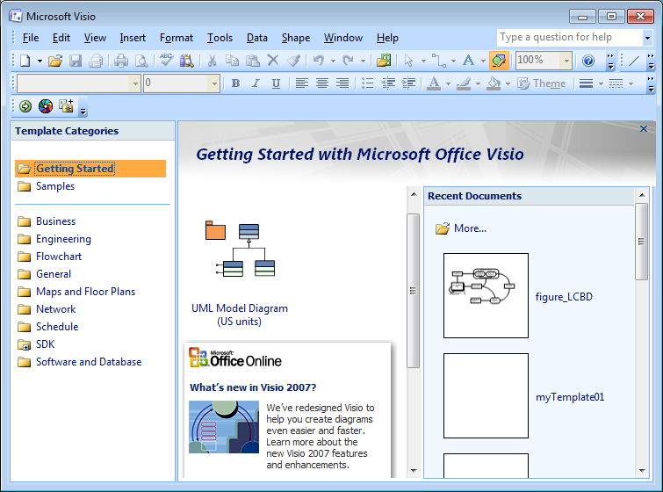
Tool Prototyping
Developed based on Microsoft Visio
Support various shapes and allow to use custom shapes designed by users
Provide SDK (for Office 2007 and 2010) and embedded programming language (VBA)
Very little DK documentation and a lack of general references

Slide 18
Tool Prototyping (cont.)
Capture unique shapes
Place the shapes as master
MS Visio User Interface
Save the master as template
Hook Visio Event
Infer relationship semantics statically

Slide 19
Demonstration
Modeling Language Creation By Demonstration

Slide 20
Future work
Design and implement generic MLCBD framework
Challenges
Designing effective and efficient inference engine
Identifying commonly applicable semantics and domain-specific semantics
Verifying the generated DSMLs
Managing the evolution of DSMLs

Slide 21

Thank you for your attention
This work supported in part by NSF CAREER #1052616.

Slide 22
MLCBD Process

