Slide 1






A Demonstration-based Approach to Support Live Transformations in a Model Editor
Yu Sun | University of Alabama at Birmingham
Jeff Gray | University of Alabama
Christoph Wienands | Siemens Corporate Research
Michael Golm | Siemens Corporate Research
Jules White | Virginia Tech
ICMT @ Zurich, Switzerland
June 27th, 2011
This research is supported by
NSF CAREER award CCF-1052616

Slide 2

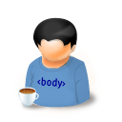

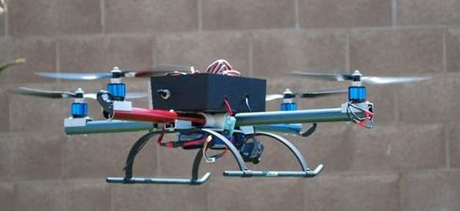
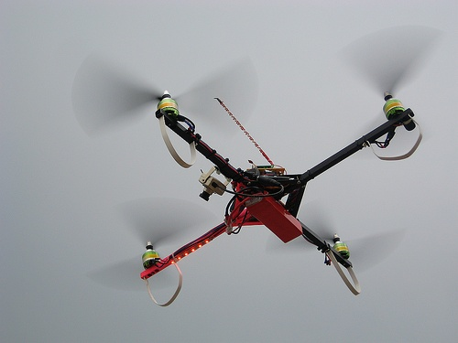
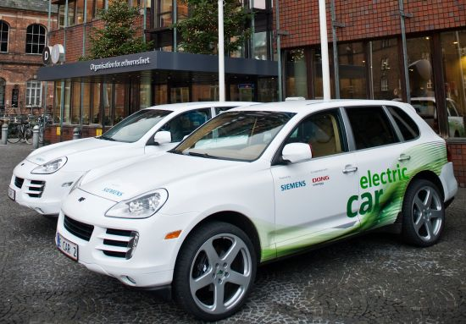
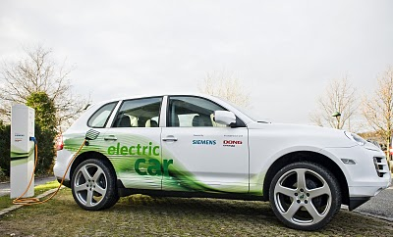
Background
Real-time Embedded System Development
Using Model-Driven Approaches
Yu (CS)
Chris (EE)

Slide 3
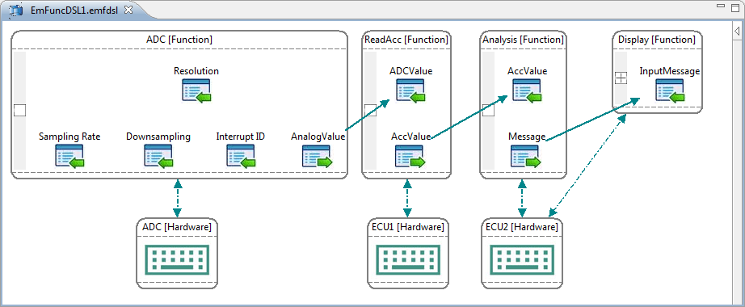
EmFuncML
Embedded Function Modeling Language
model the internal computation process and data flow
model the high-level system HW/SW configurations
generate platform-dependent implementation code
estimate the Worst Case Execution Time (WCET)
Chris (EE)
Yu (CS)

Slide 4
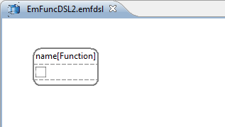
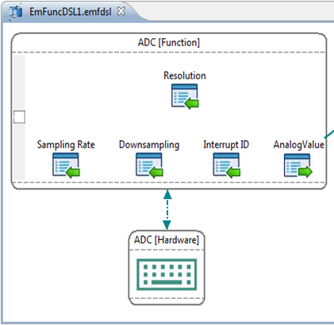
Editing Patterns using EmFuncML
Modeling ADC (Analog-to-Digital Converter)
19 operations
1. Add elements
2. Add connections
3. Setup attributes
Chris (EE)

Slide 5
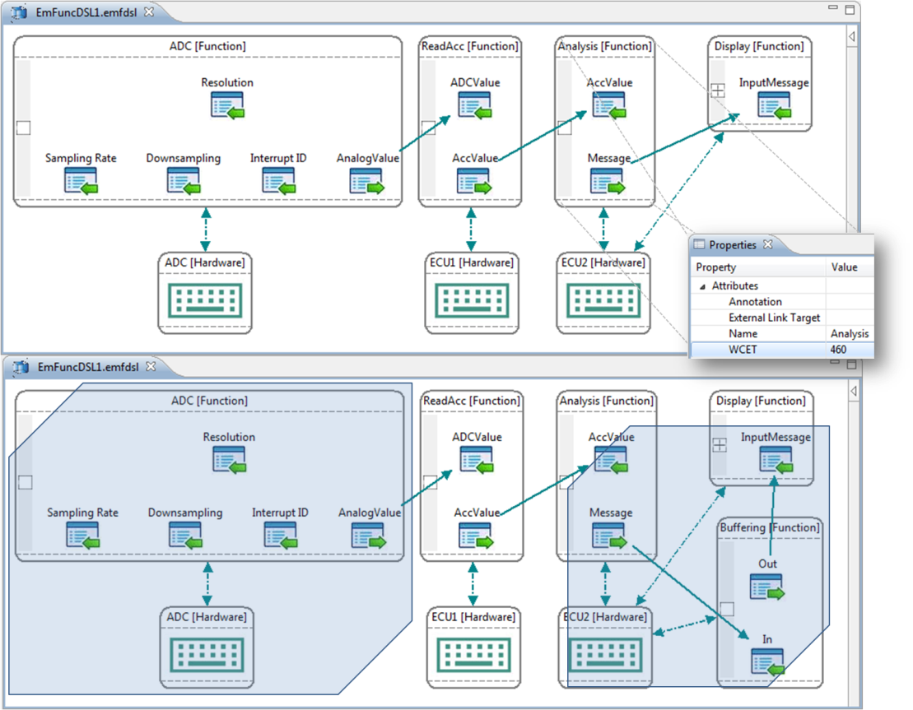
Editing Patterns using EmFuncML
Applying Buffering Function
If a function has a big WCET, other functions that depend on it should apply a buffering function to ensure the correct data flow.
Yu (CS)

Slide 6
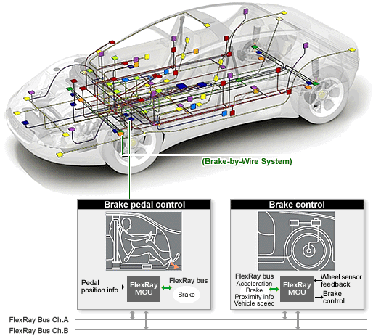
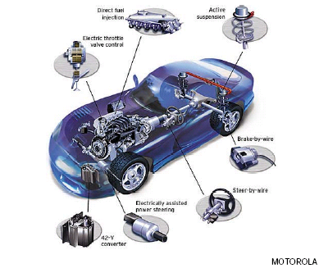
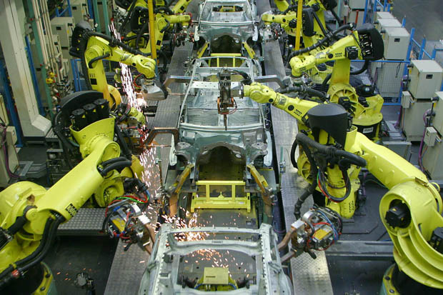
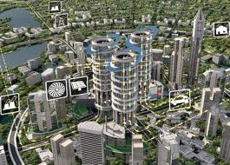

Motivation 1: How to reuse the editing patterns

Slide 7
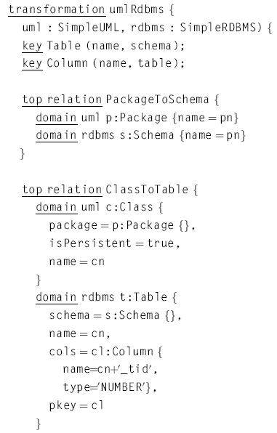
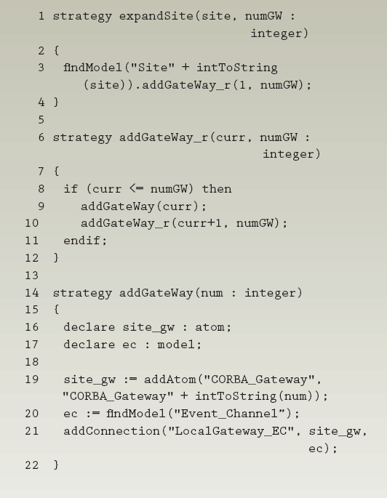
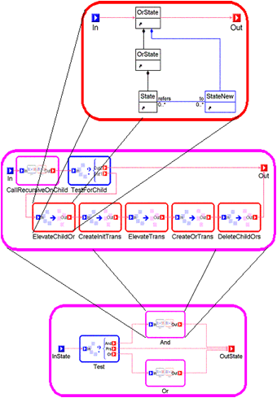

Using Model Transformation Languages
MTLs are specialized languages to implement model transformation tasks
Automate model evolutions by programming
Popular Model Transformation Languages
Challenge 1:
Steep learning curve
Challenge 2:
Deep understanding about the metamodel
QVT
Query/View/Transformation
GReAT
Graph Rewriting and Transformation
ECL
Embedded Constrain Language
Chris (EE)

Slide 8
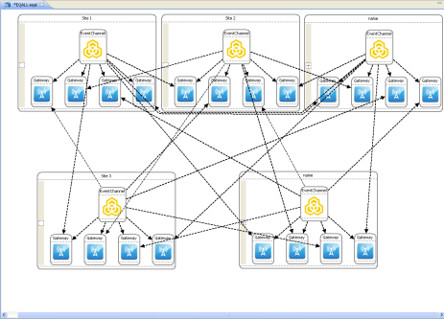
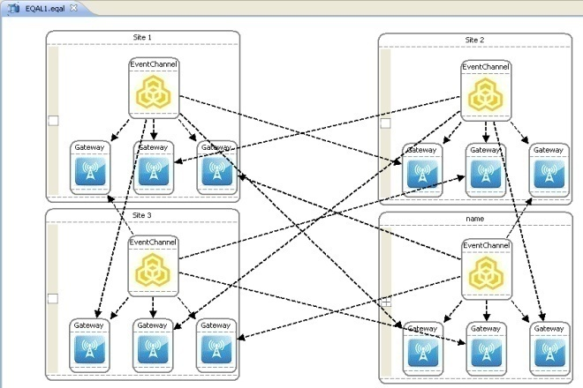



Solution 1: Model Transformation By Demonstration
A complete endogenous model transformation framework
Specify and execute model transformations
Users are fully isolated from MTLs and metamodels
Infer and generate model transformation patterns by demonstrating a transformation of the models using concrete examples
Add, Remove, Update

Slide 9









Basic MTBD Framework
MT Specification
User
Demonstration
Operation
Recording
Operation
Optimization
Pattern
Inference
User
Refinement
MT Execution
Pattern Execution
Pattern
Repository
Correctness Checking
Execution Debugging
Model Transformation by Demonstration Yu Sun, Jules White, and Jeff Gray, MoDELS, Denver, CO, October 2009, pp. 712-726.

Slide 10

Motivation 2: How to avoid re-demonstration
When an editing pattern is identified, users often have to explicitly re-do the editing, and re-demonstrate the pattern.
19 operations
1. Add elements
2. Add connections
3. Setup attributes
Again!
Chris (EE)

Slide 11
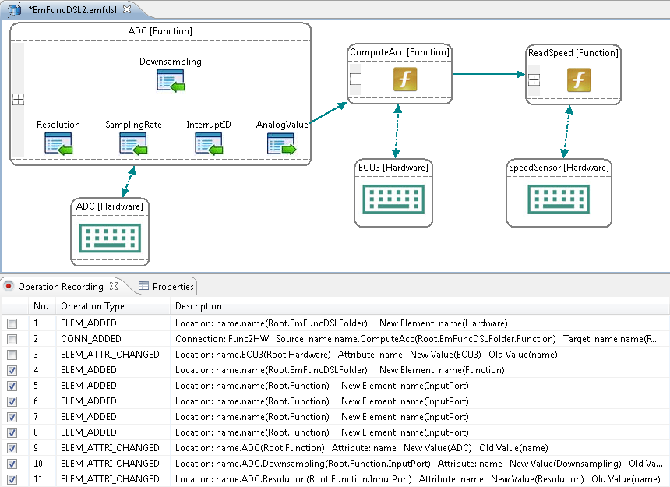
Solution 2: Live Demonstration
Editing process is a live demonstration
Users can choose the history editing operations as a demonstration
Chris (EE)

Slide 12
Solution 2: Live Demonstration
MT Specification
User
Demonstration
Live Demonstration
Operation
Recording
Operation
Optimization
Pattern
Inference
User
Refinement
MT Execution
Pattern Execution
Pattern
Repository
Correctness Checking
Execution Debugging

Slide 13




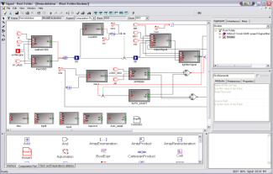



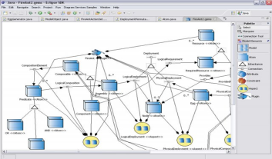
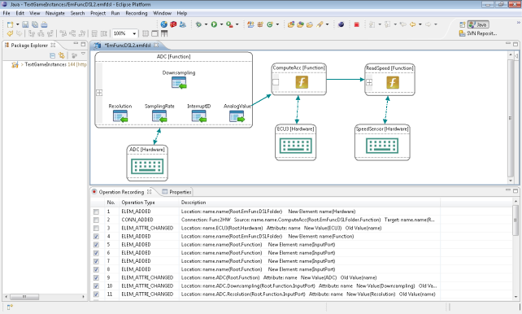

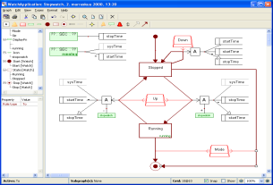





Motivation 3: How to share patterns
Yu (CS)
Chris (EE)

Slide 14
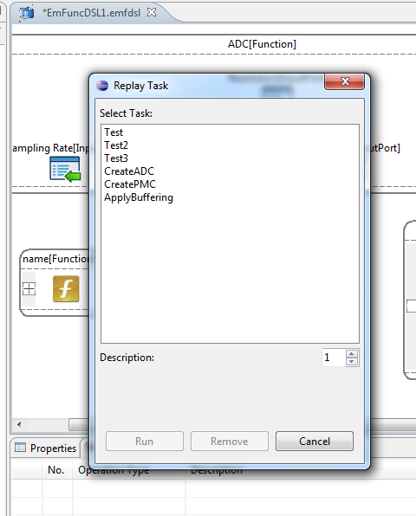
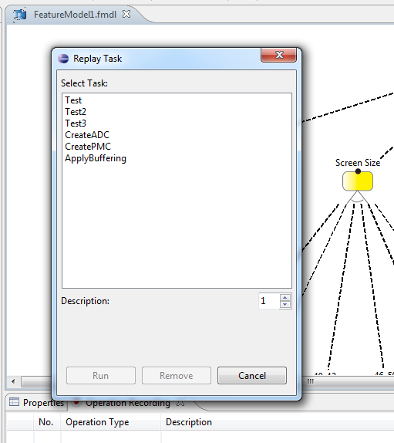

Solution 3: Live Sharing
Generated patterns are saved in a centralized repository
Serialize pattern objects and communicate with server using Java RMI

Slide 15
Solution 3: Live Sharing
Specification
User
Demonstration
Live Demonstration
Operation
Recording
Operation
Optimization
Pattern
Inference
User
Refinement
Execution
Pattern Execution
Live Pattern
Sharing
Correctness Checking
Execution Debugging
Sharing

Slide 16

Motivation 4: How to find applicable patterns
Is there any pattern in the repository that I can reuse?
Yu (CS)
Chris (EE)

Slide 17
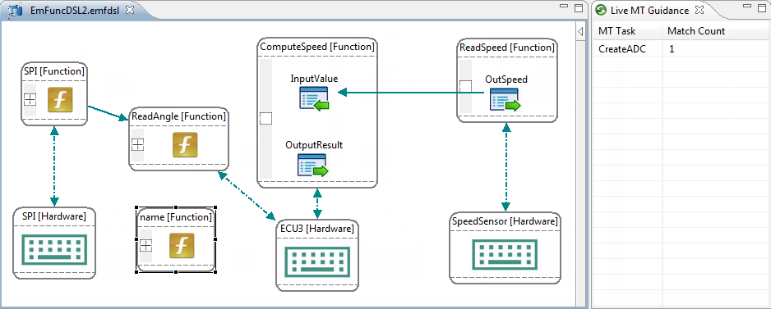
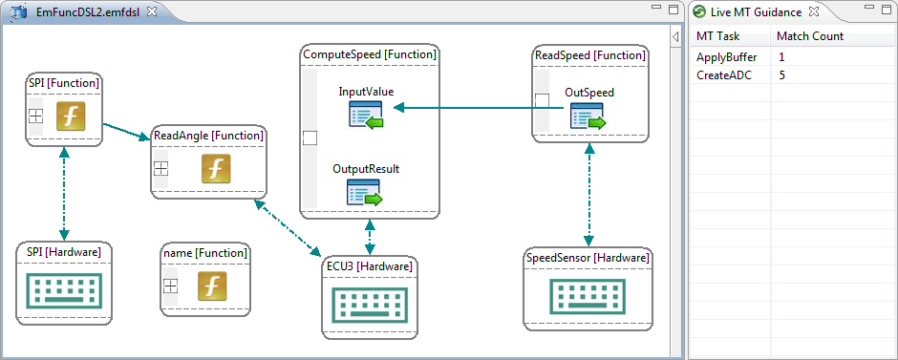
Solution 4: Live Matching
Patterns in the repository are automatically matched based on the current selection in the model editor

Slide 18

Solution 4: Live Matching
Specification
User
Demonstration
Live Demonstration
Operation
Recording
Operation
Optimization
Pattern
Inference
User
Refinement
Execution
Pattern Execution
Live Pattern
Sharing
Live Pattern Matching
Correctness Checking
Execution Debugging
Matching & Sharing

Slide 19
Summary
Live MTBD
Live Demonstration, provides a more general demonstration environment that allows users to specify editing activities based on their editing history
Live Sharing, a centralized model transformation pattern repository, has been built so that transformation patterns can be reused across different editors
Live Matching, automatically match the saved transformation patterns at modeling time, and provides editing suggestions and guidance to users during editing
We believe that integrating all the features together can improve the editing experiences for the end-users

Slide 20

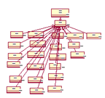
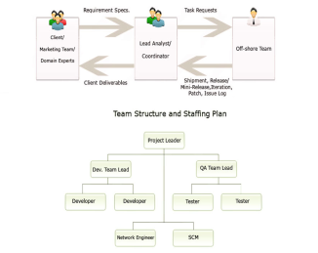
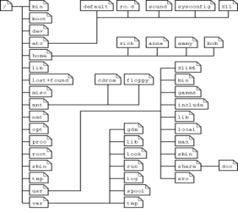
Supporting Model Evolution using MTBD
Model Evolution
Model Scalability
Aspect-Oriented Modeling
Model Management
Model Refactoring
Model Layout
A
B
F
c
d
e
B
B
c
d
e
c
d
e

Slide 21
Related Work
MTBE / MTBD
Varro (’06, ‘09), Wimmer (‘07), Strommer (‘08), Brosch (‘09), Langer (‘10)
Mappings / Exogenous model transformation
Attribute transformation support not always available
Not being integrated with the editor to provide the live features
Model Completion
Sen (‘10) - SAT solver / Alloy specification
Based on the input constraints, rather than end-user customizations
Mazanek (‘09) – Graph grammar production rules
Provide runtime graph complete suggestions
Avoid infinite production loop / Not end-user customization

Slide 22
Related Work (2)
Live Transformation
Balogh (‘06), Rath (‘08) Bergmann (‘09) -VIATRA2
Live model transformation specification
Preserve the full transformation context in the form of pattern matches that improved the performance of the live transformation
Model Transformation Reuse
Iacob (‘08)
Summarized a number of model transformation patterns and enabled reusing and extending these patterns in QVT
Sen (‘10)
A novel approach to adapt a metamodel so that an existing model transformation written for a different Metamodel can be reused

Slide 23
Future Work
Provide an end-user focused mechanism to test the correctness of a live demonstration
Lack of a management feature in the centralized pattern repository
Improve the performance of live matching
An empirical study on the usability of the tool

Slide 24



Thank You
Questions and Comments?
Additional questions
yusun@cis.uab.edu
This research is supported by
NSF CAREER award CCF-1052616
Model Transformation By Demonstration

