Slide 1





A Model-Driven Approach to Support Engineering Changes in Industrial Robotics Software
Yu Sun, Jeff Gray, Karlheinz Bulheller, Nicolaus von Baillou
MODELS 2012
October 4th, 2012
This work is partially supported by
NSF CAREER award CCF-1052616
University of Alabama at Birmingham
University of Alabama
Notes:
left

Slide 2
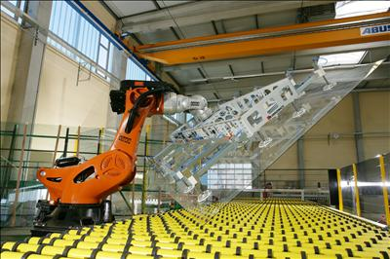
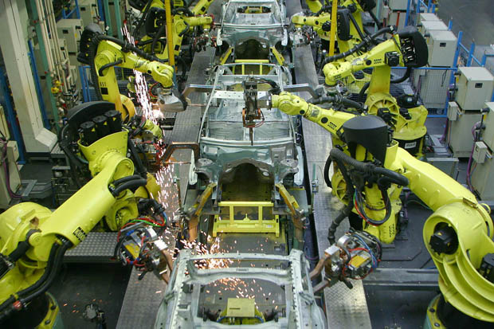
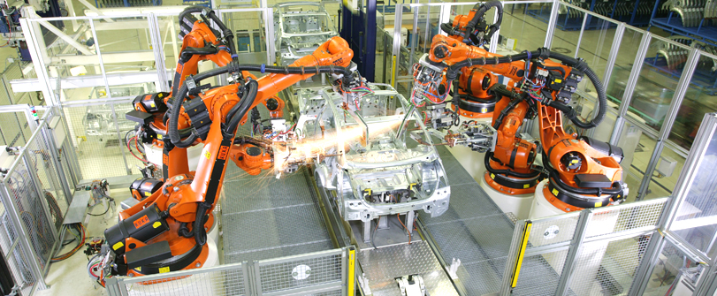
Robotics Development
Robotics development and application is becoming increasingly important and critical in industrial automation contexts.

Slide 3
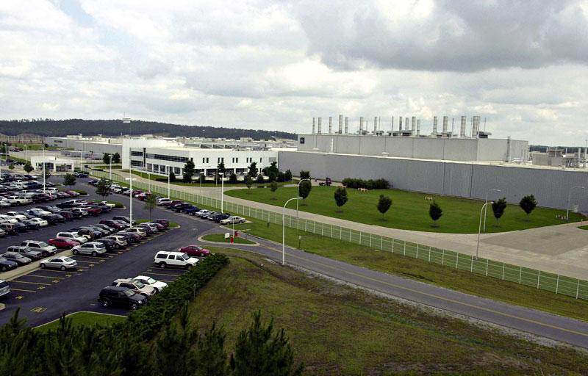
Project Background
Collaboration between academia and a software vendor to a large European auto manufacturer
Over 600 welding robots are used in the plant
3 body variants
4,000 weldspots per body

Slide 4
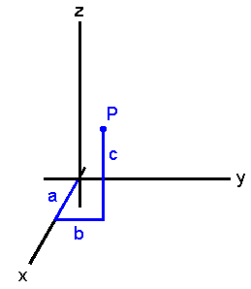
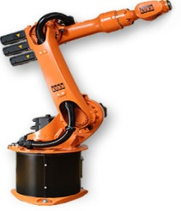

Challenge 1: Adapting Engineering Changes
Many low-level implementation details based on proprietary robot programming languages
Time intensive to maintain joint information (weld spots, studs, seams, etc.)
Change of quantity
Change of locations
Change of configuration
Change of action sequence

Slide 5
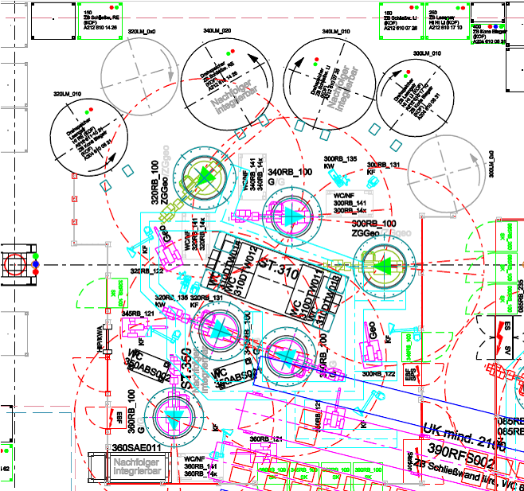
Challenge 2: Satisfying Timing Requirements
Timing and schedule are critical for both safety and efficiency
Timing considerations not native to most robot languages
Optimizations are always needed
Reduce the number of actions
Reduce task completion time
Optimize action sequences
Optimize the movement path

Slide 6
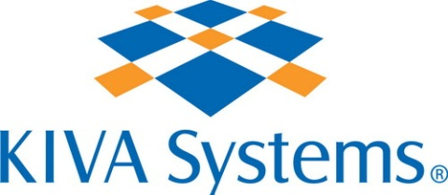

Challenge 3: Supporting Multiple Platforms
Robots from different vendors are used in different plants to produce the same product
The same task logic has to be programmed in different languages
A ripe context for applying MDE!

Slide 7
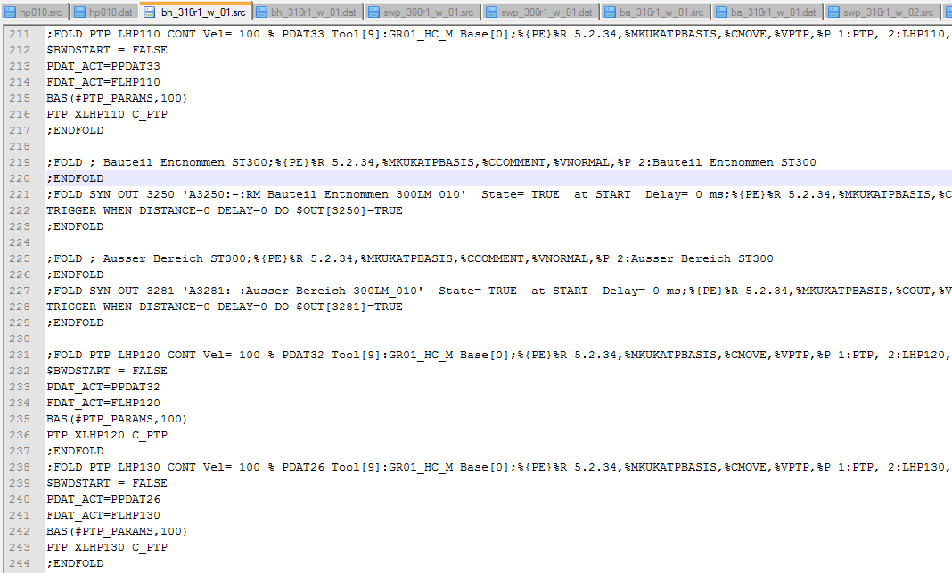
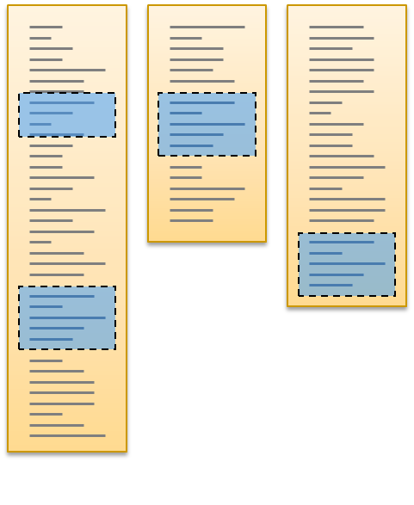
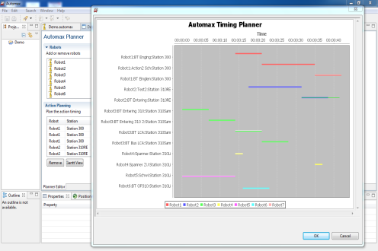
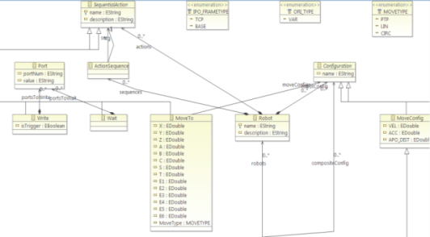
AutoMax Solution
Control Code
AutoMax enables users to plan the schedule, build robot action model, generate code, and analyze timing requirements based on digital master information.
Models
Schedule Planning & Analysis

Slide 8
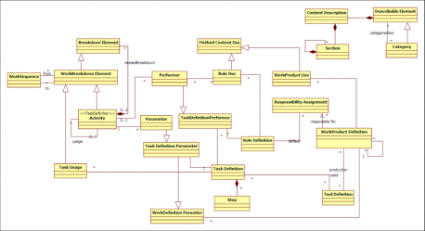
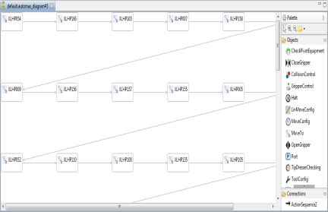
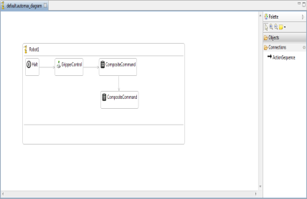
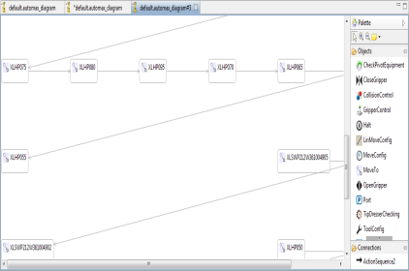
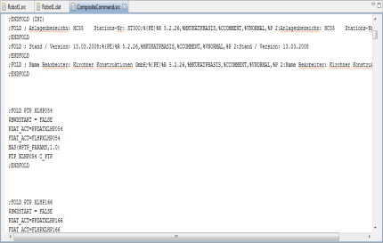
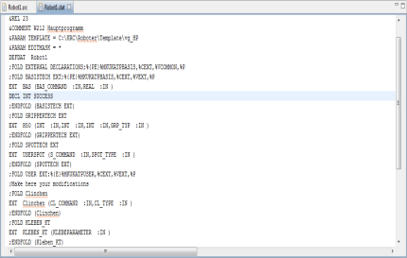
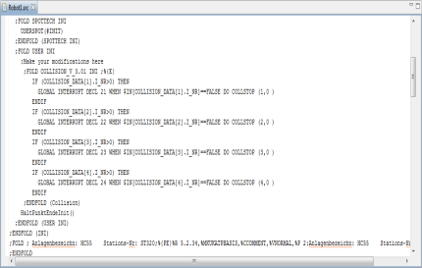
AutoMax MetaModeling
AutoMax
Modeling Environment
AutoMax Metamodel
Conforms To
AutoMax Model
Generates
KUKA Code Framework
KUKA Code

Slide 9
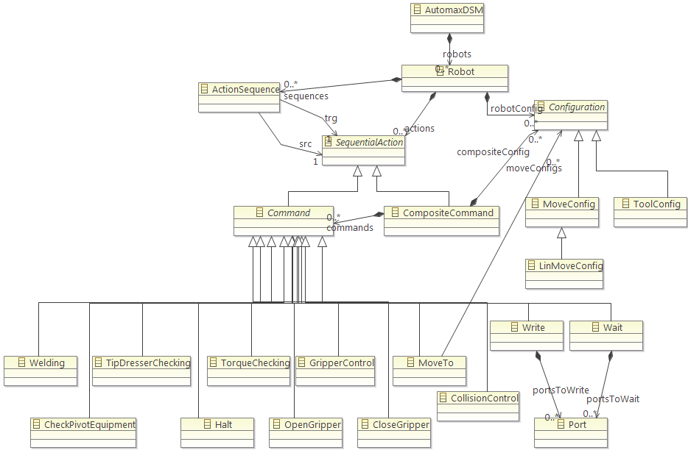
AutoMax MetaModeling
First Step: Manual reverse engineering of legacy robot code to build the metamodel

Slide 10
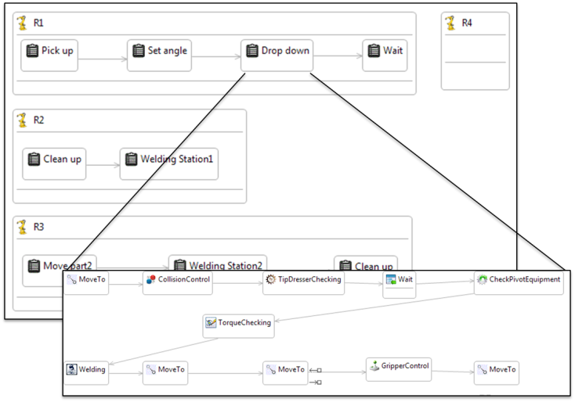
AutoMax MetaModeling
Robot configuration
Robot actions
Action properties

Slide 11
Using Models to Facilitate Engineering Changes
Using MDE, software evolution is realized by model evolution
Change robot models, and re-generate code automatically
Metamodel
ΔM0
ΔM1
ΔM2
…
ΔMn
Modeln
Model0
Model1
Model2
Code0
ΔC0
Code1
ΔC1
Code2
ΔC2
…
ΔCn
Code2

Slide 12
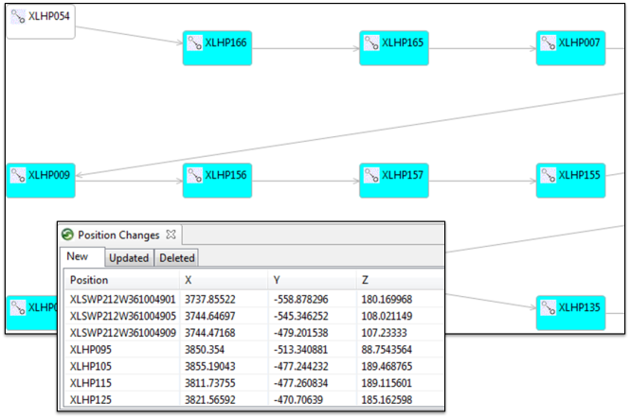
Using Models to Facilitate Engineering Changes
The number of changes on robot programs can be large
With models, changes are recorded and can be easily tracked, compared to tedious nature of Excel-based maintenance

Slide 13
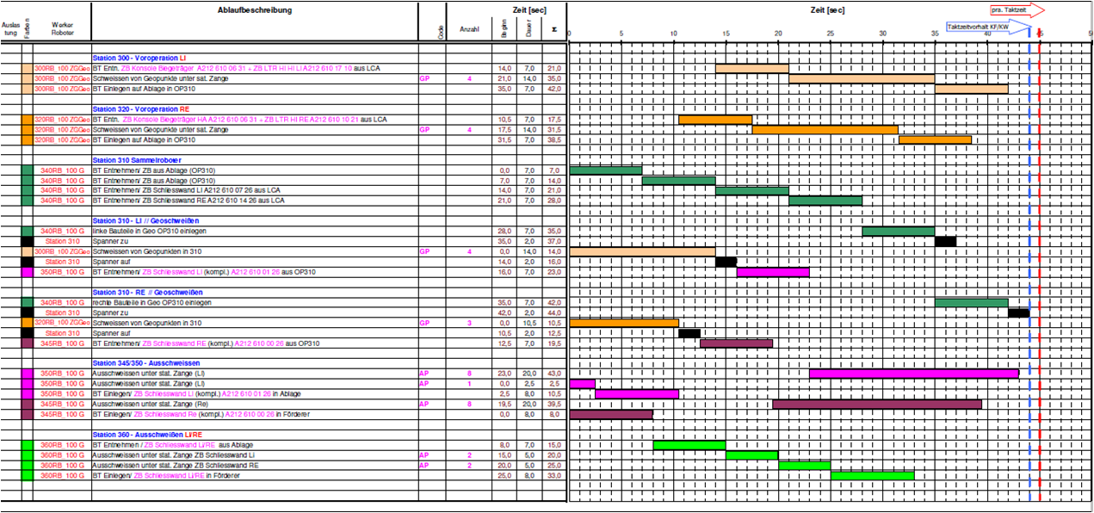
Incorporating Timing Requirements in Models
Traditional planning is still done manually (e.g., Excel)
Programmers take the planning document and implement specifications
Verification is done manually
Changes are needed back and forth

Slide 14
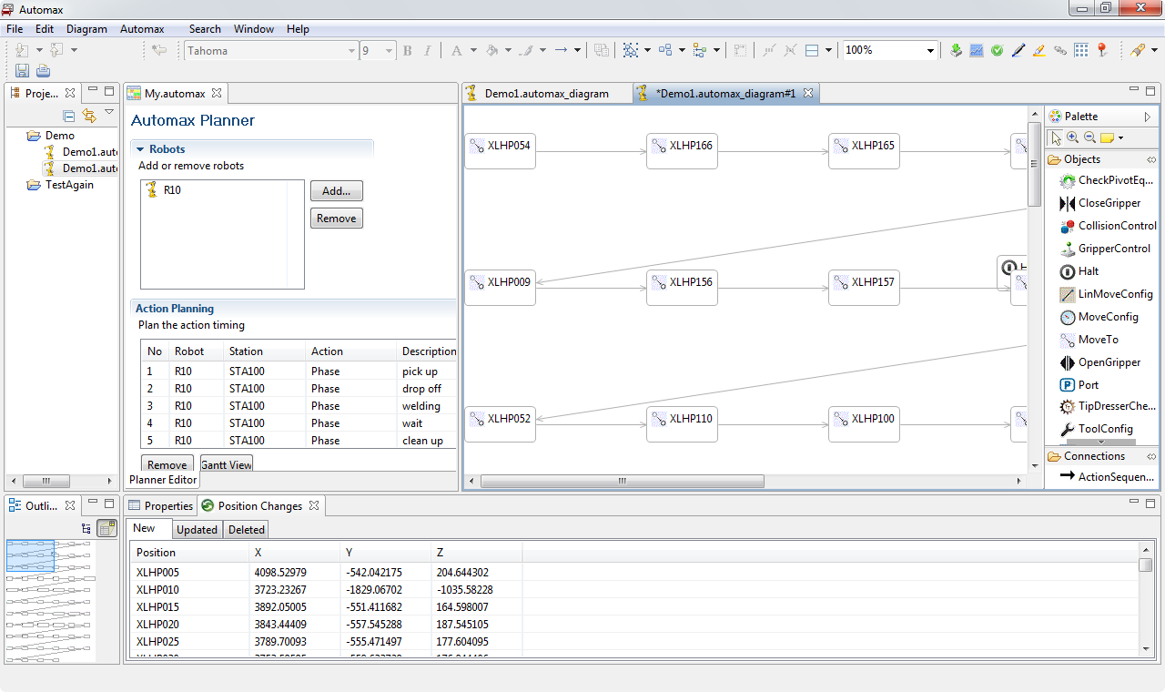
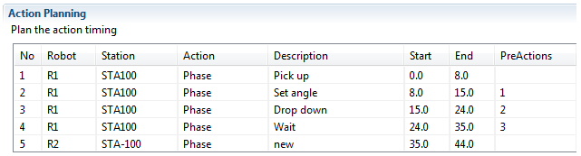
Incorporating Timing Requirements in Models
AutoMax incorporates timing and schedule planning into the initial models

Slide 15
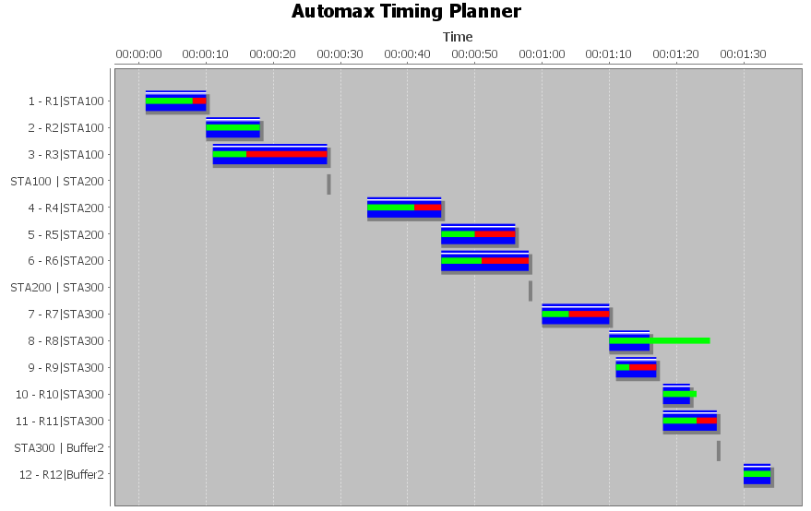
Incorporating Timing Requirements in Models
The actual timing schedule can be visualized anytime to compare the planned schedule so that adjustment can be made

Slide 16
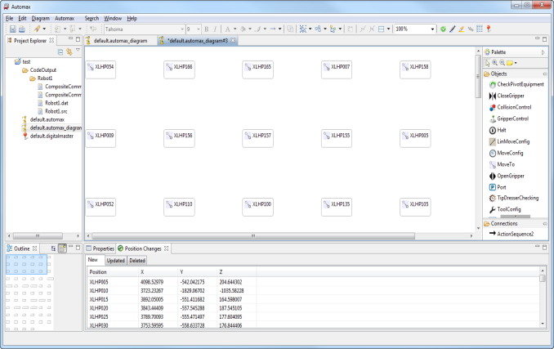
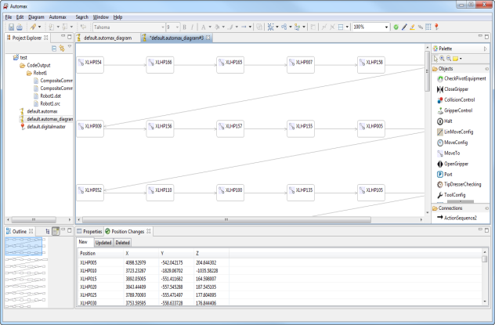
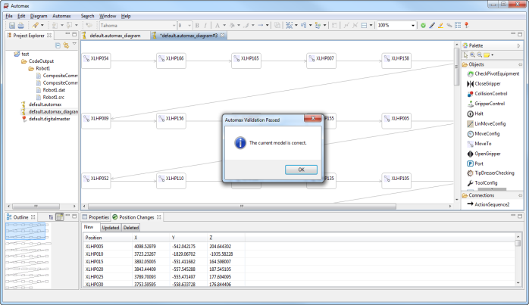
Intelligent Features in AutoMax
Optimize robot actions automatically
Geometric navigation of robots in 3D-space
Model analysis assists in
Understanding correct model configuration and connections
Detection of timing violations

Slide 17
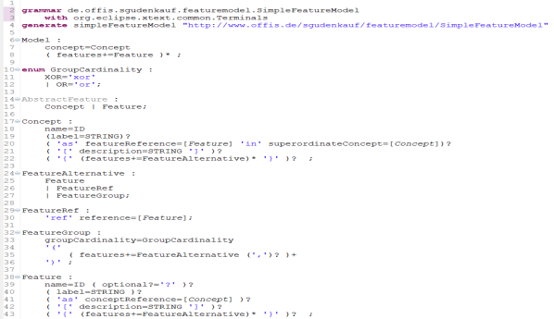
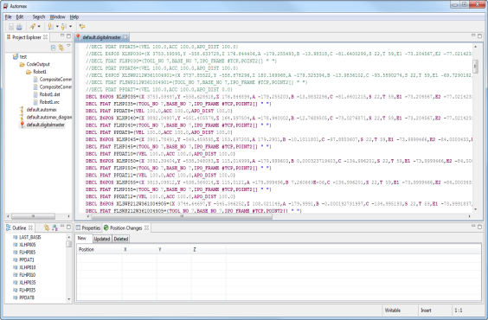
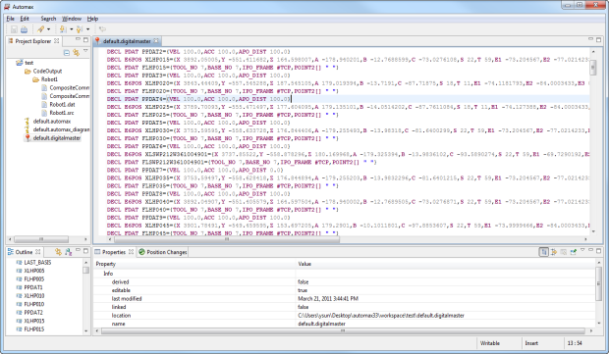
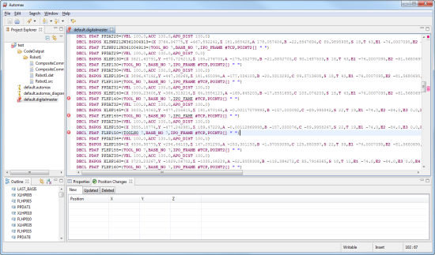
Legacy Code Benefits from AutoMax
AutoMax
Modeling Environment
Digital Master DSL
AutoMax Metamodel
Digital Master DSL Grammar
Sub TDSL
Conforms To
Conforms To
AutoMax Model
Digital Master DSL Input
Input Data
Generates
KUKA Code Framework
KUKA Code
A textual DSL is defined for the legacy configuration so that it can be directly converted into AutoMax models

Slide 18
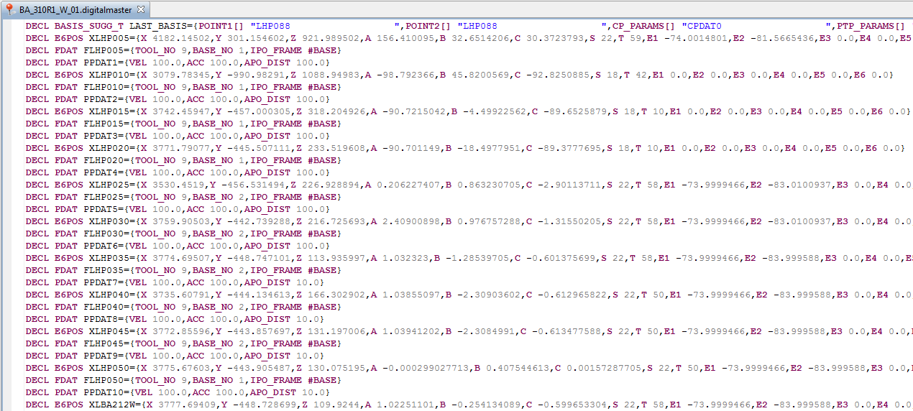
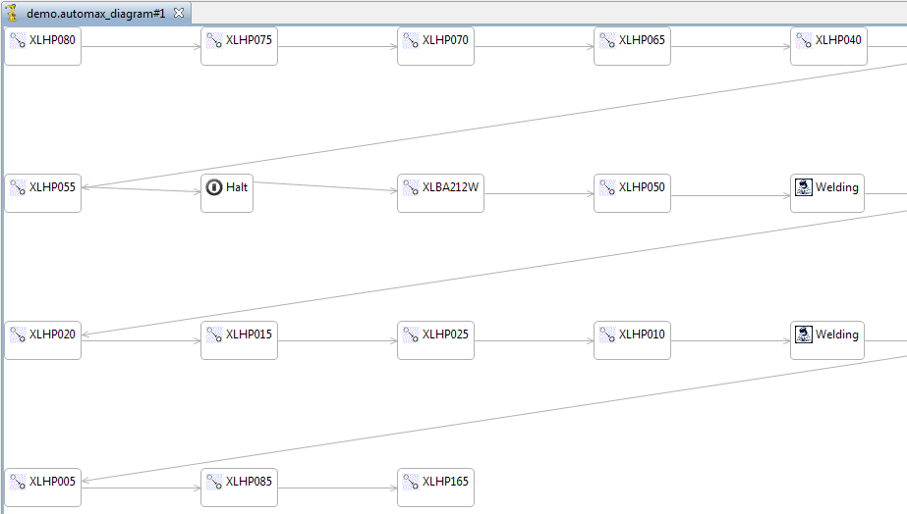
Legacy Code Benefits from AutoMax
The textual DSL is implemented using XText, which is mapped to the metamodel defined in EMF and GMF.

Slide 19
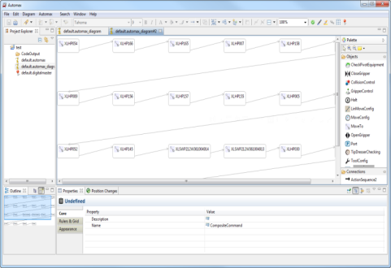
Diverse Code Generators for Multiple Platforms
Platform Independent
The goal of AutoMax is to support multiple platforms by enabling platform-specific code generation from platform-independent models
Automax
Platform Specific
KUKA
ABB
…

Slide 20
Improved Code Architecture / Framework
Legacy Source Code
Optimized Source Code
The code generation framework assists in improving the code architecture / framework by providing an optimization context of digital master code.
Models

Slide 21
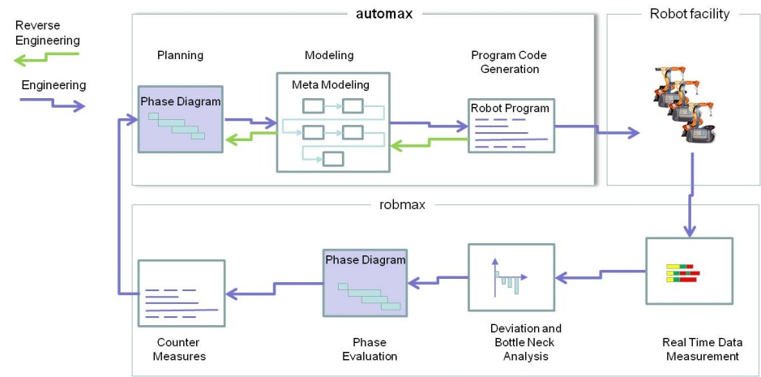
Ongoing AutoMax Integration
AutoMax is being incorporated with a commercial robot pipeline and analysis platform (RobMax)

Slide 22
Conclusion and Future Work
AutoMax Solution: a high-level modeling environment to plan a robot schedule, model the robot control, and generate code automatically
Adapt to evolving engineering changes
Handle timing requirements across multiple robot interactions
Automate the manual planning cycle from digital master input through code generation
Future Work
Extend the generation framework to cover multiple proprietary robot languages
The whole modeling environment implementation is highly dependent on metamodel, so metamodel evolution has a high cost
Extend focus beyond automotive domain (and beyond specific manufacturer needs)
Round-trip interaction with Digital Master

Slide 23
Thank You
Questions?
Comments?
This work is partially supported by
NSF CAREER award CCF-1052616
University of Alabama at Birmingham
University of Alabama

