Slide 1

Contact Profile (1/2)
Yu Sun, University of Alabama at Birmingham
Hyun Cho, University of Alabama
Jeff Gray, University of Alabama
Jules White, Virginia Tech
Model-Driven Engineering, Domain-Specific Modeling, Model Transformation
Feature Model Configuration and Validation
This research is supported by
NSF CAREER award CCF-1052616

Slide 2
Contact Profile (2)
Objectives / Looking for
New ideas in feature model configuration and validation, successful case studies of SPL
Meeting new collaborators interested in SPL & MDE
Learning new ideas and techniques that influence my research interests, meeting people with similar research interests and building collaborative relationships
<Yu Sun, Univ. of Alabama at Birmingham>

Slide 3



Supporting Feature Model Configuration using a Demonstration-based Approach
This research is supported by
NSF CAREER award CCF-1052616

Slide 4
The Problem
<Yu Sun, Univ. of Alabama at Birmingham>
In a feature model editing environment, how can we enable users to easily specify and reuse the knowledge related to feature model configuration and validation?

Slide 5
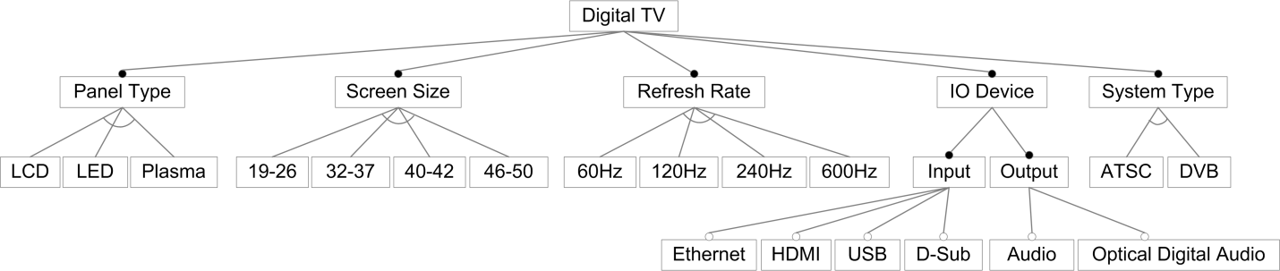
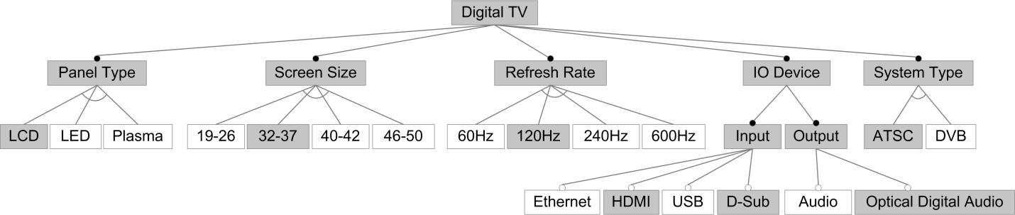
The Problem – Scenario 1
A configuration for LCD32_37
A simplified TV feature model
<Yu Sun, Univ. of Alabama at Birmingham>
Configuration Saving / Loading
Users need to specify and save different configurations, as well as reloading them

Slide 6
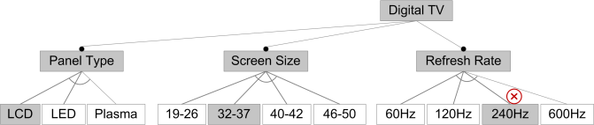
The Problem – Scenario 2
An incorrect TV configuration
<Yu Sun, Univ. of Alabama at Birmingham>
Automatic Constraint Checking
Users need to specify dependency rules and validate them automatically

Slide 7

The Problem – Scenario 3
Fixing the incorrect TV configuration
<Yu Sun, Univ. of Alabama at Birmingham>
Automatic Error Correction
Users need to recover erroneous configurations automatically

Slide 8
Current Solution
<Yu Sun, Univ. of Alabama at Birmingham>
Feature model configuration and validation can be considered as a model transformation process T
T = <P, A>
P: preconditions to satisfy
A: actions to carry out the transformation

Slide 9





Solution: Model Transformation By Demonstration
A complete model transformation framework
Specify and execute model transformations
Users are fully isolated from MTLs and metamodel definitions
Infer and generate model transformation patterns by demonstrating the transformation of models on concrete examples
Add, Remove, Update

Slide 10
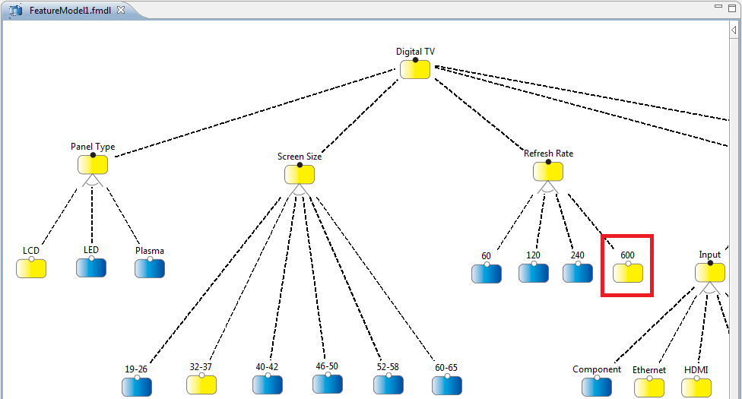
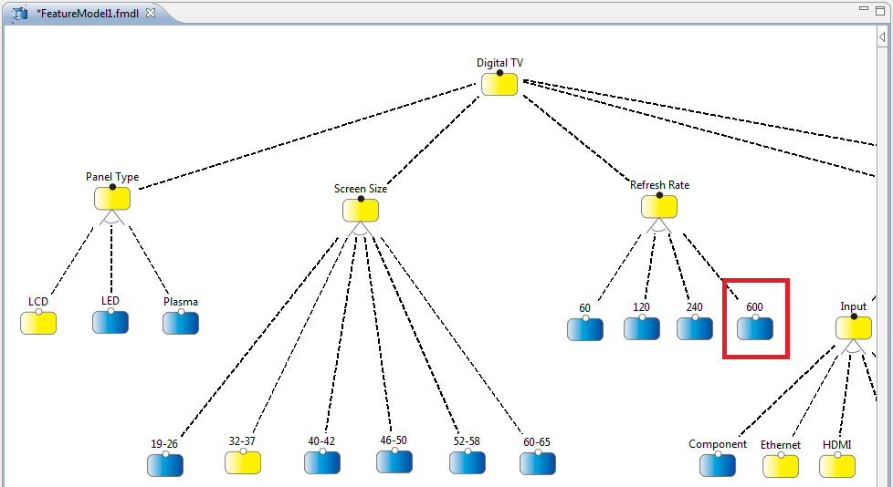
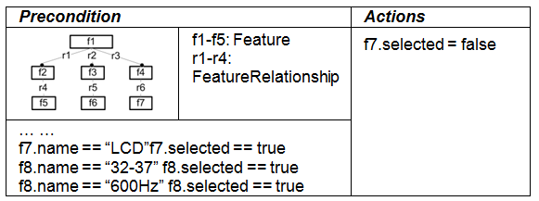
Video Demo

Slide 11
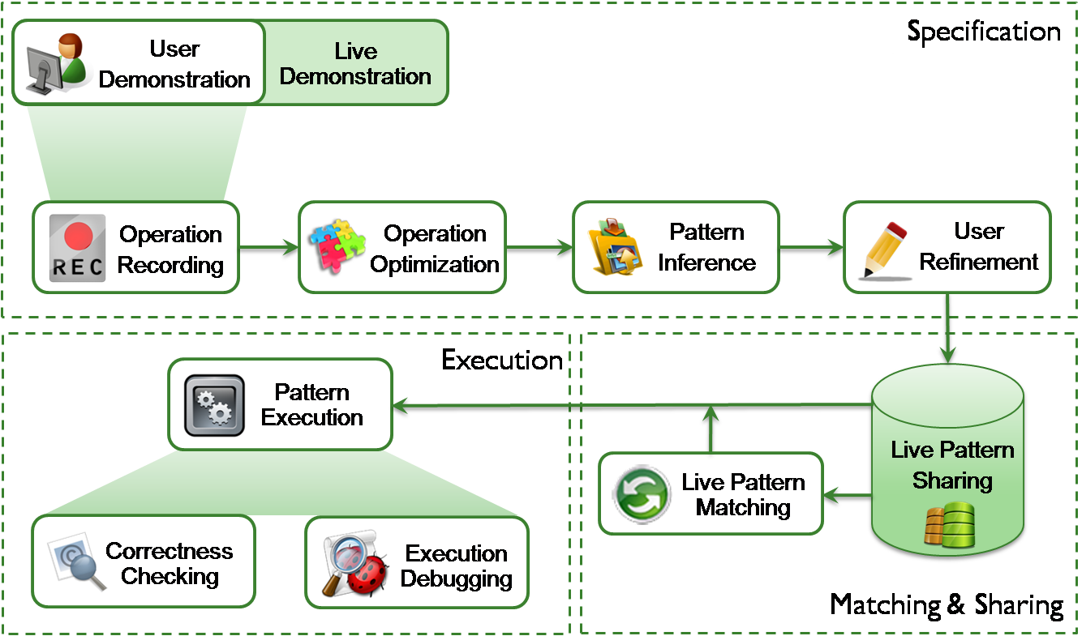
Overview of MTBD

Slide 12
Why is it interesting?
MTBD provides an end-user approach to enable users to specify and reuse the desired configuration and validation, improving knowledge exchange and sharing
Users do not need to know Model Transformation Languages or Metamodels
Users do not need to apply formal specifications such as CSP and SAT
<Yu Sun, Univ. of Alabama at Birmingham>

