Slide 1




Supporting Tool Reuse with Model Transformation
Zekai Demirezen¹, Yu Sun¹,
Frédéric Jouault², Jeff Gray¹
¹ Department of Computer and Information Sciences, University of Alabama at Birmingham
{zekzek, yusun, gray}@cis.uab.edu
² AtlanMod (INRIA & EMN)
frederic.jouault@inria.fr
SEDE2009– June 22 - 24, 2009 -Las Vegas, Nevada
This work funded in part by NSF
CAREER award CCF-0643725.

Slide 2
Outline
Introduction
  Tool Interoperability
  Approaches to Tool Interoperability
  Model Transformation Solution
  AmmA Platform
Case Study: Reusing Graphviz/Dot Layout Algorithm in GMF
  Layout in Graphviz/Dot
  Graphical Modeling Framework
  GMF – Dot Transformation (KM3, ATL, and TCS Specifications)
  Video Demonstration
Lessons Learned & Conclusion
SEDE2009– June 22 - 24, 2009 -Las Vegas, Nevada

Slide 3


Tool Interoperability
HOW???
Reuse functionality
Software A
Software B
tools provide
Binary Data
XML Data (Export-Import Mechanism)
API support
SEDE2009– June 22 - 24, 2009 -Las Vegas, Nevada

Slide 4
Approaches to Tool Interoperability
Software A | Software B | Solution
Supports MetaData Interchange (XMI) | Supports MetaData Interchange (XMI) | Basic and easy solution
Supports Export/Import XML Data | Supports Export/Import XML Data | Requires XML Transformation such as XSLT or MetaModel Transformation
Provide API | Provide API | Programming in general-purpose language
Binary Data | Binary Data | Programming in general-purpose language or MetaModel Transformation
SEDE2009– June 22 - 24, 2009 -Las Vegas, Nevada

Slide 5
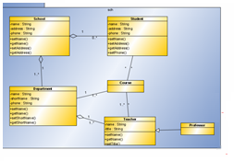
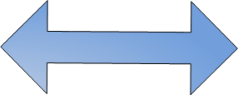
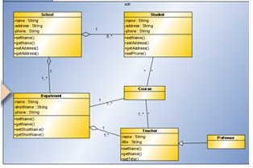
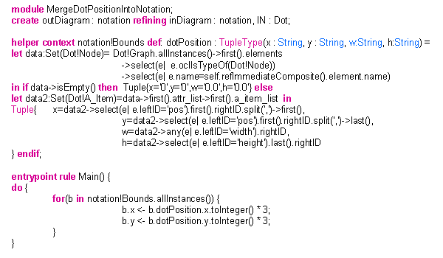
Model Transformation Approach
Software A
Software B
MetaModel Definition
MetaModel Definition
Transformation Definition
Execute Functionality
Based on meta Elements
Reusable and maintainable solution
SEDE2009– June 22 - 24, 2009 -Las Vegas, Nevada

Slide 6
AmmA Platform
AmmA (Atlas Model Management Architecture)
  provides model management and transformation tools.
AmmA offers three core facilities :
  The KM3 (Kernel MetaMetaModel) to define metamodels.
  The TCS (Textual Concrete Syntax) language to define representation syntax.
  The ATL (Atlas Transformation Language) to define transformation rules which map meta-elements.
SEDE2009– June 22 - 24, 2009 -Las Vegas, Nevada

Slide 7
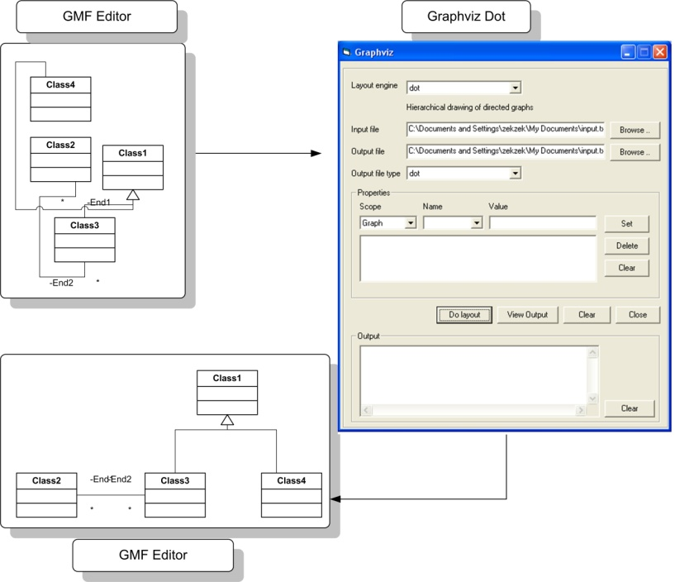
Case Study: Reusing Graphviz/Dot Layout Algorithm in Graphical Modeling Framework
Using the Graphviz/Dot auto-layout algorithm for usage on UML class diagrams in GMF.
SEDE2009– June 22 - 24, 2009 -Las Vegas, Nevada

Slide 8
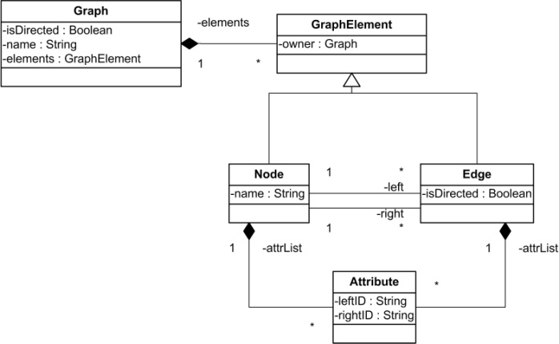
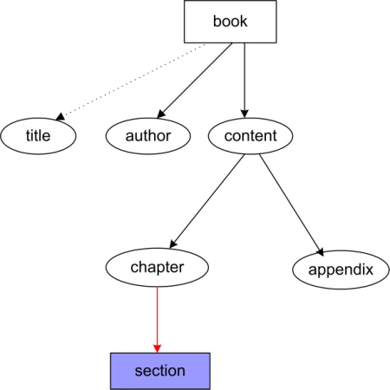
Layout in GraphViz
GraphViz is an open source graph visualization application that has several layout programs for the placement of nodes and edges in graphs.
digraph G {
book [shape=box];
book -> title [style=dotted];
book -> author ;
book -> content [weight=8];
content -> chapter;
content -> appendix;
chapter -> section[color=red];
section [shape=box, style=filled, color=blue];
}
SEDE2009– June 22 - 24, 2009 -Las Vegas, Nevada

Slide 9
Graphical Modeling Framework
The Eclipse Graphical Modeling Framework (GMF) provides a supporting infrastructure for developing graphical editors based on Eclipse Modeling Framework.
Models in GMF are defined by an Ecore metamodel.
  Diagram, (e.g., Class Diagram)
  Node (e.g., Class)
  Edge (e.g,, Association)
SEDE2009– June 22 - 24, 2009 -Las Vegas, Nevada

Slide 10
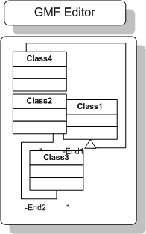
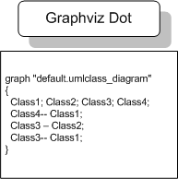
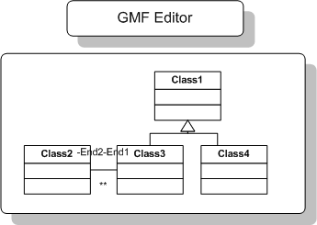
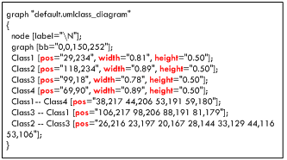
The Dot-GMF Interoperability
graph "default.umlclass_diagram"
{
node [label="\N"];
graph [bb="0,0,150,252"];
Class1 [pos="29,234", width="0.81", height="0.50"];
Class2 [pos="118,234", width="0.89", height="0.50"];
Class3 [pos="99,18", width="0.78", height="0.50"];
Class4 [pos="69,90", width="0.89", height="0.50"];
Class1-- Class4 [pos="38,217 44,206 53,191 59,180"];
Class3 -- Class1 [pos="106,217 98,206 88,191 81,179"];
Class2 -- Class3 [pos="26,216 23,197 20,167 28,144 33,129 44,116 53,106"];
}
graph "default.umlclass_diagram"
{
Class1; Class2; Class3; Class4;
Class4-- Class1;
Class3 -- Class2;
Class3-- Class1;
}
Alignment
SEDE2009– June 22 - 24, 2009 -Las Vegas, Nevada

Slide 11
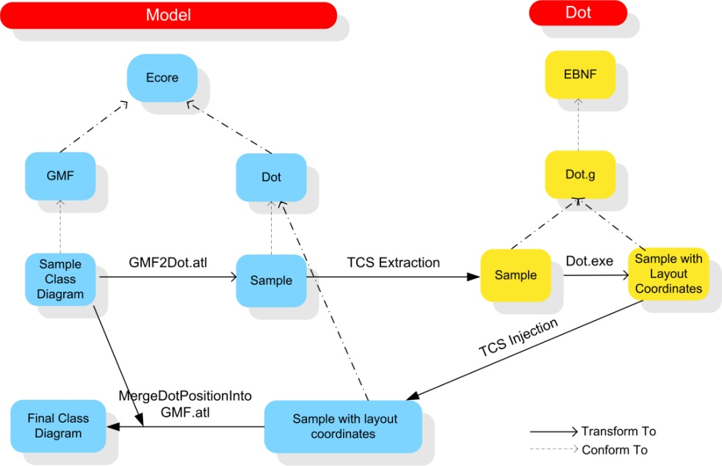
The Dot-GMF Interoperability Implementation
SEDE2009– June 22 - 24, 2009 -Las Vegas, Nevada

Slide 12
The Dot-GMF Interoperability Implementation
Defining Graphviz/Dot Metamodel as Dot.km3 (Note: GMF metamodel already exists)
Defining Dot Concrete Syntax (Dot.tcs) to
  Export GMF models as models in Dot
  Import Dot Models as GMF Models after the execution of auto layout algorithm
Defining Transformation of GMF Models to Dot Models with using ATL (Notation2Dot.atl)
Defining Merge Transformation of source and output models (arranged model) with ATL.(MergeDotPositionIntoNotation.atl)
SEDE2009– June 22 - 24, 2009 -Las Vegas, Nevada

Slide 13
Graphviz/Dot Metamodel (Dot.km3)
--Node statement
class Node extends GraphElement {
attribute name : String;
reference attr_list[*] container: A_Item_List;
}
--Ege statement
class Edge extends GraphElement {
reference left : Node;
reference right : Node;
attribute isDirected : Boolean;
reference attr_list[*] container: A_Item_List;
}
--Attribute statement
class Attribute extends GraphElement {
reference attr_list[*] container: A_Item_List;
}
class Node extends GraphElement {
attribute name : String;
reference attr_list[*] container: A_Item_List;
}
class Edge extends GraphElement {
reference left : Node;
reference right : Node;
attribute isDirected : Boolean;
reference attr_list[*] container: A_Item_List;
}
class Graph extends LocatedElement {
attribute isDirected : Boolean;
attribute name : String;
reference elements[*] container : GraphElement oppositeOf owner;
}
class Graph extends LocatedElement {
attribute isDirected : Boolean;
attribute name : String;
reference elements[*] container : GraphElement oppositeOf owner;
}
abstract class GraphElement extends LocatedElement {
reference owner : Graph oppositeOf elements;
}
abstract class GraphElement extends LocatedElement {
reference owner : Graph oppositeOf elements;
}
SEDE2009– June 22 - 24, 2009 -Las Vegas, Nevada

Slide 14
Dot Concrete Syntax(Dot.tcs)
template Graph main context
:(isDirected ? "digraph" : "graph" ) name "{"
elements {separator = ";"} [[ ";" | ]]
"}"
;
template GraphElement abstract
;
template Attr_Stmt abstract
;
template Node addToContext
:name attr_list
;
template Edge
:left{refersTo = name, autoCreate = ifmissing, createIn = '#context'.elements}
(isDirected ? "->" : "--")
right{refersTo = name, autoCreate = ifmissing, createIn = '#context'.elements} attr_list
;
template Edge_Attr_Stmt context
: "edge" attr_list
;
template Graph_Attr_Stmt context
: "graph" attr_list
;
template Node_Attr_Stmt context
: "node" attr_list
;
template A_Item_List context
: "[" a_item_list {separator = "," } "]"
;
template A_Item context
: leftID
(isDefined(rightID)? "="rightID)
;
digraph G {
book [shape=box];
book -> title [style=dotted];
book -> author ;
book -> content [weight=8];
content -> chapter;
content -> appendix;
chapter -> section[color=red];
section [shape=box, style=filled, color=blue];
}
SEDE2009– June 22 - 24, 2009 -Las Vegas, Nevada

Slide 15
Transformation of GMF Models to Dot Models (Notation2Dot.atl)
module Notation2Dot;
create OUT : Dot from IN : notation;
rule Diagram2Graph{
from
d : notation!Diagram
to
g : Dot!Graph (
name <- d.name,
elements <- d.children->union(d.edges)
)
rule Diagram2Graph{
from
d : notation!Diagram
to
g : Dot!Graph (
name <- d.name,
elements <- d.children->union(d.edges)
)
rule Node2Node{
from
n : notation!Node (
n.type ='2001'
)
to
c : Dot!Node (
name <- n.element.name.debug('Node name')
)
rule Node2Node{
from
n : notation!Node (
n.type ='2001'
)
to
c : Dot!Node (
name <- n.element.name.debug('Node name')
)
rule Edge2Edge{
from
n : notation!Edge (
n.type = '4005'
)
to
c : Dot!Edge (
left <- n.source,
right <- n.target
)
rule Edge2Edge{
from
n : notation!Edge (
n.type = '4005'
)
to
c : Dot!Edge (
left <- n.source,
right <- n.target
)
SEDE2009– June 22 - 24, 2009 -Las Vegas, Nevada

Slide 16
Merge Position Values into GMF Model (Merge.atl)
let data:Set(Dot!Node)= Dot!Graph.allInstances()->first().elements
->select(e| e.oclIsTypeOf(Dot!Node))
->select(e| e.name=self.refImmediateComposite().element.name)
In let data2:Set(Dot!A_Item)=data->first().attr_list->first().a_item_list in
Tuple{
x=data2->select(e| e.leftID='pos').first().rightID.split(',')->first(),
y=data2->select(e| e.leftID='pos').first().rightID.split(',')->last(),
w=data2->any(e| e.leftID='width').rightID,
h=data2->select(e| e.leftID='height').last().rightID
}.debug('tuple');
create outDiagram : notation refining inDiagram : notation, IN : Dot;
helper context notation!Bounds def: dotPosition : TupleType(x : String, y : String, w:String, h:String) =
let data:Set(Dot!Node)= Dot!Graph.allInstances()->first().elements
->select(e| e.oclIsTypeOf(Dot!Node))
->select(e| e.name=self.refImmediateComposite().element.name)
In let data2:Set(Dot!A_Item)=data->first().attr_list->first().a_item_list in
Tuple{ x=data2->select(e| e.leftID='pos').first().rightID.split(',')->first(),
y=data2->select(e| e.leftID='pos').first().rightID.split(',')->last(),
w=data2->any(e| e.leftID='width').rightID,
h=data2->select(e| e.leftID='height').last().rightID
}.debug('tuple');
entrypoint rule Main() {
do {
for(b in notation!Bounds.allInstances()) {
b.x <- b.dotPosition.x.toInteger();
b.y <- b.dotPosition.y.toInteger();
}
for(b in notation!Bounds.allInstances()) {
b.x <- b.dotPosition.x.toInteger();
b.y <- b.dotPosition.y.toInteger();
}
SEDE2009– June 22 - 24, 2009 -Las Vegas, Nevada

Slide 17
Demo
SEDE2009– June 22 - 24, 2009 -Las Vegas, Nevada

Slide 18
Lessons Learned & Conclusion
This study shows software interoperability which is based on Model Transformation technique.
Model Transformation provides a reusable, maintainable solution for interoperability.
Model transformation, enables us to focus on the clear and organized mapping structure between meta-elements of the tools.
AmmA shows good performance. Although it provides most of the basic model activities such as load, edit, build, store, and execution, lack of debugging makes it hard to identify errors.
SEDE2009– June 22 - 24, 2009 -Las Vegas, Nevada

Slide 19
Thanks
Questions & Comments ?
SEDE2009– June 22 - 24, 2009 -Las Vegas, Nevada

