Slide 1

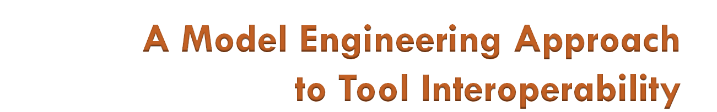
Yu Sun¹, Zekai Demirezen¹, Frédéric Jouault², Robert Tairas¹, Jeff Gray¹
¹ Department of Computer and Information Sciences, University of Alabama at Birmingham
{yusun, zekzek, tairasr, gray}@cis.uab.edu
² AtlanMod (INRIA & EMN)
frederic.jouault@inria.fr

Slide 2




Tool Interoperability is often needed

Slide 3

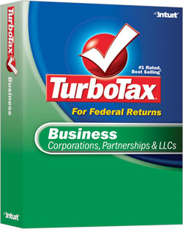
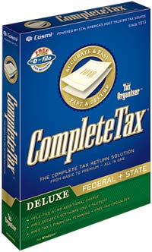
Tool Interoperability is often needed

Slide 4
Approaches to Tool Interoperability
Parsing and interpreting activities implemented with general-purpose programming languages
XML-based interoperability
Model engineering based on model transformation
  different formats are captured as abstract definitions of data structures (i.e., metamodels)
  transformation rules map from one representation to another

Slide 5
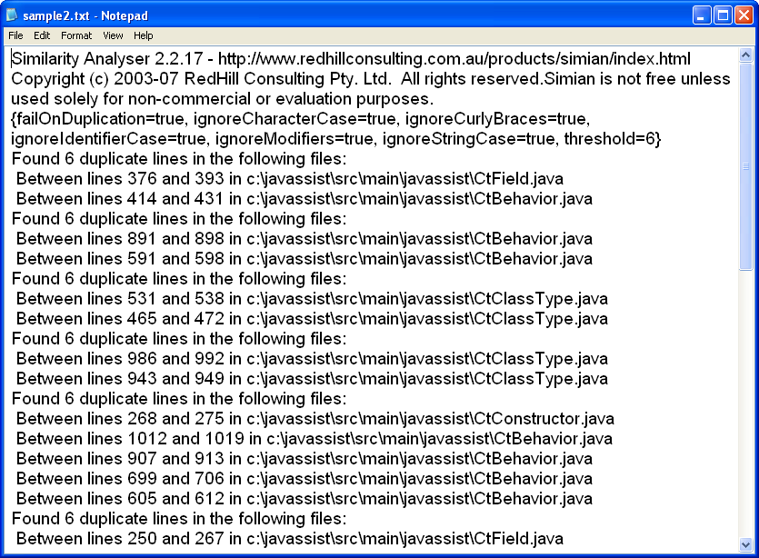
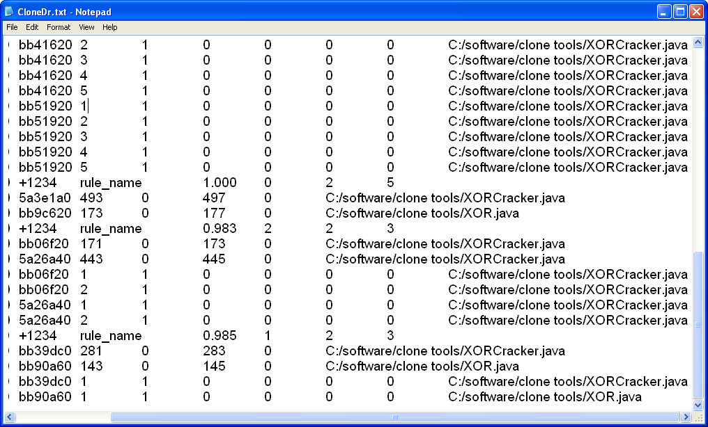
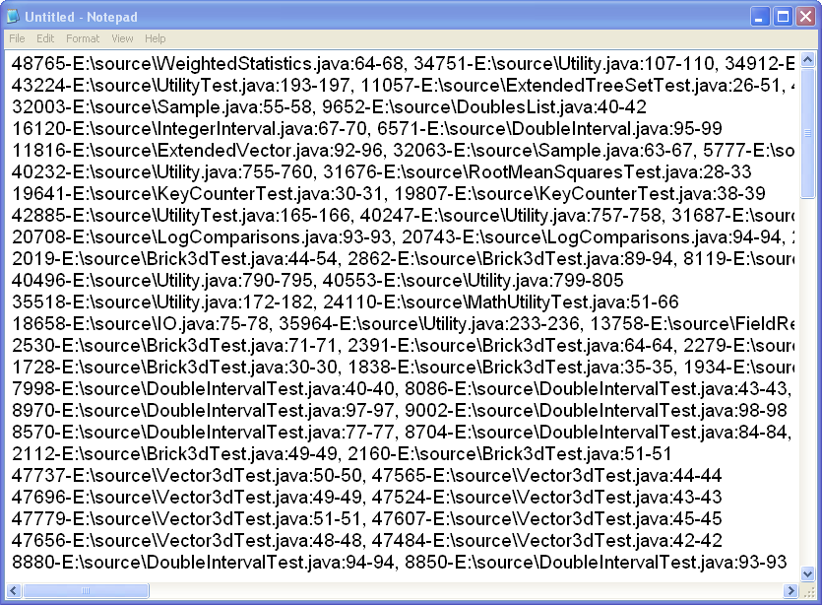
Different Code Clone Detection Tools
Clone Doctor
http://www.semdesigns.com/Products/Clone/
Simian
http://www.redhillconsulting.com.au/products/simian/index.html
SimScan
http://www.blue-edge.bg/simscan/simscan_help_r1.htm

Slide 6
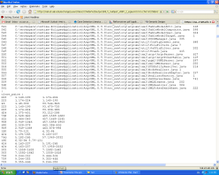
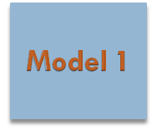

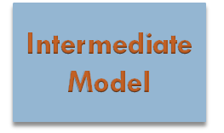
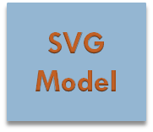
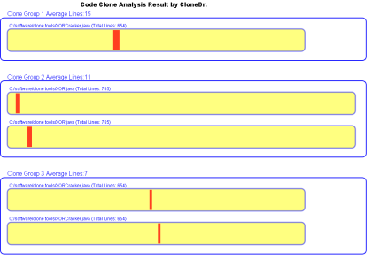
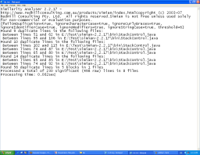
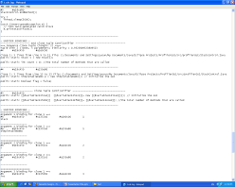

Homogenizing Different Formats
Format 1
Format 2
SVG
Uniform & Visual
Format
Format 3

Slide 7
Step 1: Define of Sub-domains and Injection of Source Reports
Grammarware TS
Model-Driven Engineering (MDE)
Technical Space (TS)
M3
KM3
EBNF
M2
Output.g
Grammar
Clone Tools
Metamodel
M1
CloneTools
Output
Clone Tools
Model
Injection
DSLs | Function
KM3 | A metametamodel compatible with MOF, Ecore
TCS | A technical projector between MDE and EBNF technologies

Slide 8
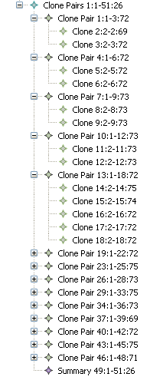
Simian Sample Input & Model
Found 6 duplicate lines in the following files:
Between lines 376 and 393 in E:\Test\simian-2.2.17\bin\CtField.java
Between lines 414 and 431 in E:\Test\simian-2.2.17\bin\CtBehavior.java
Found 6 duplicate lines in the following files:
Between lines 891 and 898 in E:\Test\simian-2.2.17\bin\CtBehavior.java
Between lines 591 and 598 in E:\Test\simian-2.2.17\bin\CtBehavior.java
Found 6 duplicate lines in the following files:
Between lines 531 and 538 in E:\Test\simian-2.2.17\bin\CtClassType.java
Between lines 465 and 472 in E:\Test\simian-2.2.17\bin\CtClassType.java
Found 6 duplicate lines in the following files:
Between lines 986 and 992 in E:\Test\simian-2.2.17\bin\CtClassType.java
Between lines 943 and 949 in E:\Test\simian-2.2.17\bin\CtClassType.java
Found 6 duplicate lines in the following files:
Between lines 268 and 275 in E:\Test\simian-2.2.17\bin\CtConstructor.java
Between lines 1012 and 1019 in E:\Test\simian-2.2.17\bin\CtBehavior.java
Between lines 907 and 913 in E:\Test\simian-2.2.17\bin\CtBehavior.java
EBNF to Model

Slide 9
Step 2: Define Intermediate & Final domains
Grammarware TS
Model-Driven Engineering (MDE)
Technical Space (TS)
M3
KM3
EBNF
M2
Output.g
Grammar
Clone Tools
Metamodel
CodeClone
Metamodel
SVG
Metamodel
XML
Metamodel
M1
CloneTools
Output
Clone Tools
Model
CodeClone
Model
SVG
Model
XML
Model
Injection

Slide 10
Step 3: Define Transformations from Input Model to Final Model
Grammarware TS
Model-Driven Engineering (MDE)
Technical Space (TS)
M3
KM3
EBNF
M2
Output.g
Grammar
Clone Tools
Metamodel
CodeClone
Metamodel
SVG
Metamodel
XML
Metamodel
M1
CloneTools
Output
Clone Tools
Model
CodeClone
Model
SVG
Model
XML
Model
Injection
Output2CodeClone
Transformation
CodeClone2SVG
Transformation
SVG2XML
Transformation
DSLs | Function
ATL | A model-to-model transformation language

Slide 11
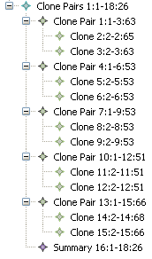
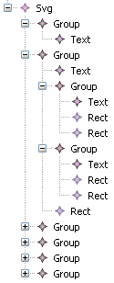
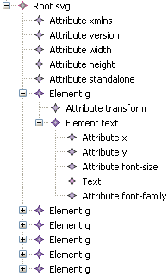
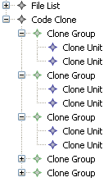
Simian Sample Input Model
Intermediate Model
SVG Model
XML Model

Slide 12
Step 4: Generate the final code from model
Grammarware TS
Model-Driven Engineering (MDE)
Technical Space (TS)
XML TS
M3
KM3
XSD.xsd
EBNF
M2
Output.g
Grammar
Clone Tools
Metamodel
CodeClone
Metamodel
SVG
Metamodel
XML
Metamodel
SVG.xsd
SVG Schema
M1
CloneTools
Output
Clone Tools
Model
CodeClone
Model
SVG
Model
XML
Model
Output.xml
SVG Code
Injection
Output2CodeClone
Transformation
CodeClone2SVG
Transformation
SVG2XML
Transformation
Extraction

Slide 13
Simian Input Sample
Found 6 duplicate lines in the following files:
Between lines 986 and 992 in E:\Test\simian-2.2.17\bin\CtClassType.java
Between lines 943 and 949 in E:\Test\simian-2.2.17\bin\CtClassType.java
Found 6 duplicate lines in the following files:
Between lines 376 and 393 in E:\Test\simian-2.2.17\bin\CtField.java
Between lines 414 and 431 in E:\Test\simian-2.2.17\bin\CtBehavior.java
Found 6 duplicate lines in the following files:
Between lines 891 and 898 in E:\Test\simian-2.2.17\bin\CtBehavior.java
Between lines 591 and 598 in E:\Test\simian-2.2.17\bin\CtBehavior.java
Found 6 duplicate lines in the following files:
Between lines 531 and 538 in E:\Test\simian-2.2.17\bin\CtClassType.java
Between lines 465 and 472 in E:\Test\simian-2.2.17\bin\CtClassType.java
Found 6 duplicate lines in the following files:
Between lines 986 and 992 in E:\Test\simian-2.2.17\bin\CtClassType.java
Between lines 943 and 949 in E:\Test\simian-2.2.17\bin\CtClassType.java
Found 6 duplicate lines in the following files:
Between lines 268 and 275 in E:\Test\simian-2.2.17\bin\CtConstructor.java
Between lines 1012 and 1019 in E:\Test\simian-2.2.17\bin\CtBehavior.java
Between lines 907 and 913 in E:\Test\simian-2.2.17\bin\CtBehavior.java
Between lines 699 and 706 in E:\Test\simian-2.2.17\bin\CtBehavior.java
Between lines 605 and 612 in E:\Test\simian-2.2.17\bin\CtBehavior.java

Slide 14
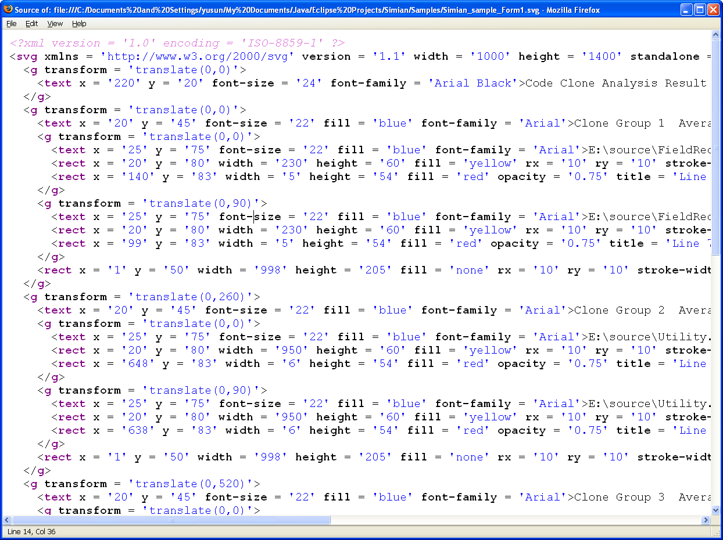
Generated SVG code

Slide 15
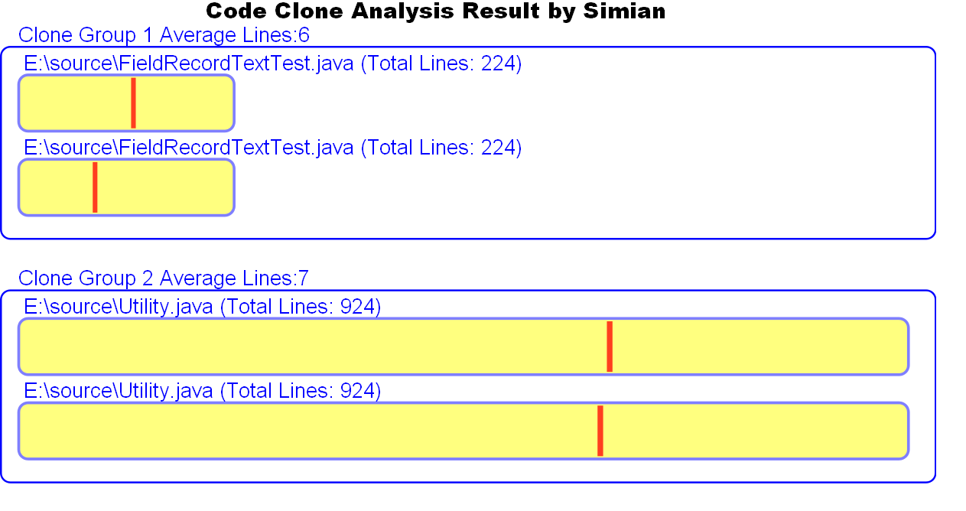

Slide 16
CloneDr Input Sample
#15a7eb90+1234rule_name0.9723215
#25a7eb90bb22a6023302470C:/software/clone tools/XORCracker.java
#35a7eb90bb22a60110000C:/software/clone tools/XORCracker.java
#35a7eb90bb22a60210000C:/software/clone tools/XORCracker.java
#35a7eb90bb22a60310000C:/software/clone tools/XORCracker.java
#35a7eb905a0c460110000C:/software/clone tools/XORCracker.java
#35a7eb905a0c460210000C:/software/clone tools/XORCracker.java
#35a7eb905a0c460310000C:/software/clone tools/XORCracker.java
#15a7e550+1234rule_name0.9702211
#25a7e5503bcb780190290C:/software/clone tools/XOR.java
#25a7e5503bd6560450550C:/software/clone tools/XOR.java
#35a7e5503bcb780110000C:/software/clone tools/XOR.java
#35a7e5503bcb780210000C:/software/clone tools/XOR.java
#35a7e5503bd6560110000C:/software/clone tools/XOR.java
#35a7e5503bd6560210000C:/software/clone tools/XOR.java
#15a8a1d0+1234rule_name0.985527
#25a8a1d0bb4ae8031303190C:/software/clone tools/XORCracker.java
#25a8a1d0bb592a033103370C:/software/clone tools/XORCracker.java
#35a8a1d0bb4ae80110000C:/software/clone tools/XORCracker.java
#35a8a1d0bb4ae80210000C:/software/clone tools/XORCracker.java
#35a8a1d0bb4ae80310000C:/software/clone tools/XORCracker.java
#35a8a1d0bb4ae80410000C:/software/clone tools/XORCracker.java
#35a8a1d0bb4ae80510000C:/software/clone tools/XORCracker.java
#35a8a1d0bb592a0110000C:/software/clone tools/XORCracker.java
#35a8a1d0bb592a0210000C:/software/clone tools/XORCracker.java
#35a8a1d0bb592a0310000C:/software/clone tools/XORCracker.java
#35a8a1d0bb592a0410000C:/software/clone tools/XORCracker.java
#35a8a1d0bb592a0510000C:/software/clone tools/XORCracker.java
#15a8a550+1234rule_name0.986525
#25a8a550bb4162030503090C:/software/clone tools/XORCracker.java
#25a8a550bb5192032303270C:/software/clone tools/XORCracker.java
#35a8a550bb41620110000C:/software/clone tools/XORCracker.java
#35a8a550bb41620210000C:/software/clone tools/XORCracker.java
#35a8a550bb41620310000C:/software/clone tools/XORCracker.java
#35a8a550bb41620410000C:/software/clone tools/XORCracker.java
#2 5a8a550 bb41620 305 0 309 0
C:/software/clone tools/XORCracker.java

Slide 17


Slide 18
SimScan Input Sample
327710-C:\Documents and Settings\yusun\My Documents\Java\Eclipse Projects\NASA\core\FitnessMultiObjective.java:56-69, 324013-C:\Documents and Settings\yusun\My Documents\Java\Eclipse Projects\NASA\core\FitnessDouble.java:33-39, 324071-C:\Documents and Settings\yusun\My Documents\Java\Eclipse Projects\NASA\core\FitnessDouble.java:40-46
312500-C:\Documents and Settings\yusun\My Documents\Java\Eclipse Projects\NASA\core\BreederElitist.java:78-83, 313094-C:\Documents and Settings\yusun\My Documents\Java\Eclipse Projects\NASA\core\BreederSteadyState.java:49-54, 314277-C:\Documents and Settings\yusun\My Documents\Java\Eclipse Projects\NASA\core\BreederWithTeachers.java:91-95, 332176-C:\Documents and Settings\yusun\My Documents\Java\Eclipse Projects\NASA\core\HFC\SubBreeder.java:125-135
348004-C:\Documents and Settings\yusun\My Documents\Java\Eclipse Projects\NASA\core\Weighted0to1.java:44-59, 338634-C:\Documents and Settings\yusun\My Documents\Java\Eclipse Projects\NASA\core\ProductFitnessFunction.java:36-46, 348370-C:\Documents and Settings\yusun\My Documents\Java\Eclipse Projects\NASA\core\WeightedSumFitness.java:32-48
338005-C:\Documents and Settings\yusun\My Documents\Java\Eclipse Projects\NASA\core\PopulationTest.java:48-73
325854-C:\Documents and Settings\yusun\My Documents\Java\Eclipse Projects\NASA\core\FitnessFunctionWorstFitness.java:52-61, 326081-C:\Documents and Settings\yusun\My Documents\Java\Eclipse Projects\NASA\core\FitnessFunctionWorstFitnessManyTries.java:43-62

Slide 19
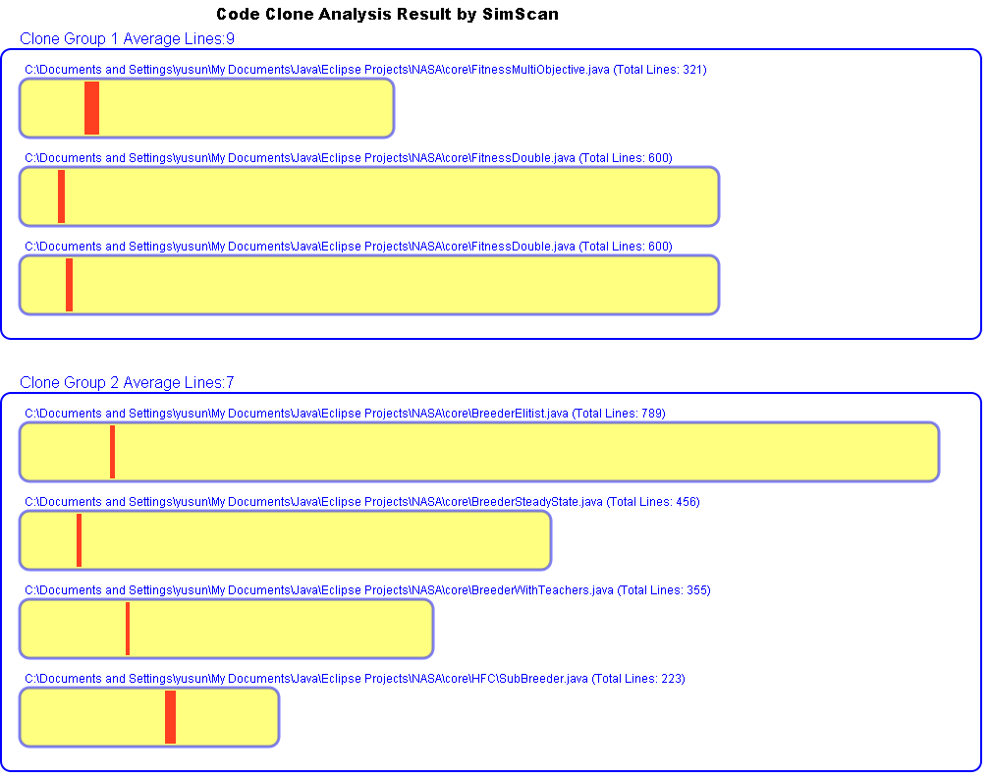

Slide 20
Lessons Learned & Conclusion
Model transformation provides separation of concerns across the integration process
Good adaptability and extensibility in defining new tools
  Defining new tools is efficient
  Complex grammar parsing is still a limit (Future work)
Models are not the primary representation for tools
  Injection / extraction are needed
  Some facilities can aid this process
Maturity of modeling tools
  AMMA shows good performance. The general principles of using software language engineering to solve tool interoperability problem can be applied to other environments.

Slide 21
Thanks
Questions & Comments ?

