Slide 1
WellnessDiary
Team: Three Wheelers
Nur Ul Arafat
Yating Liu
Yutai Ma

Slide 2
Sprint 1
Shomik N Arafat:
Prepare server for web hosting.
Yating Liu
Build the Log-in page,
Integrate Facebook Login API into Log-in page.
Yutai Ma
Build the Home page with menu, summary and list.

Slide 3
Server
Hosting on Heroku
Node.js Web Server

Slide 4
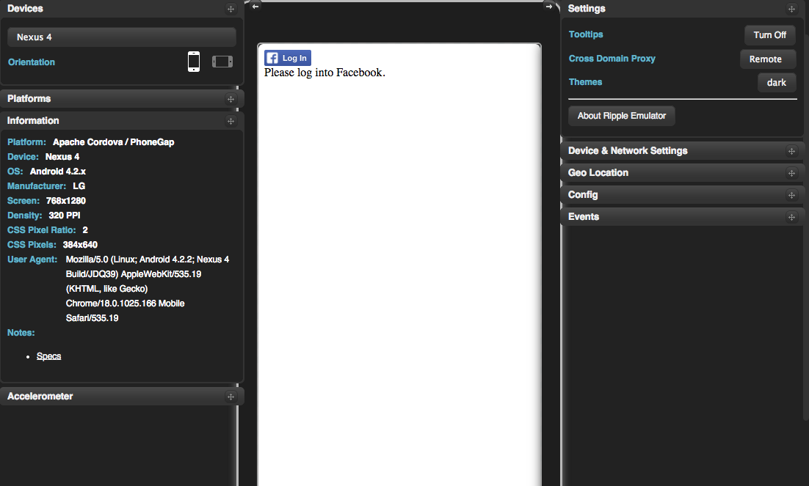
Login in

Slide 5
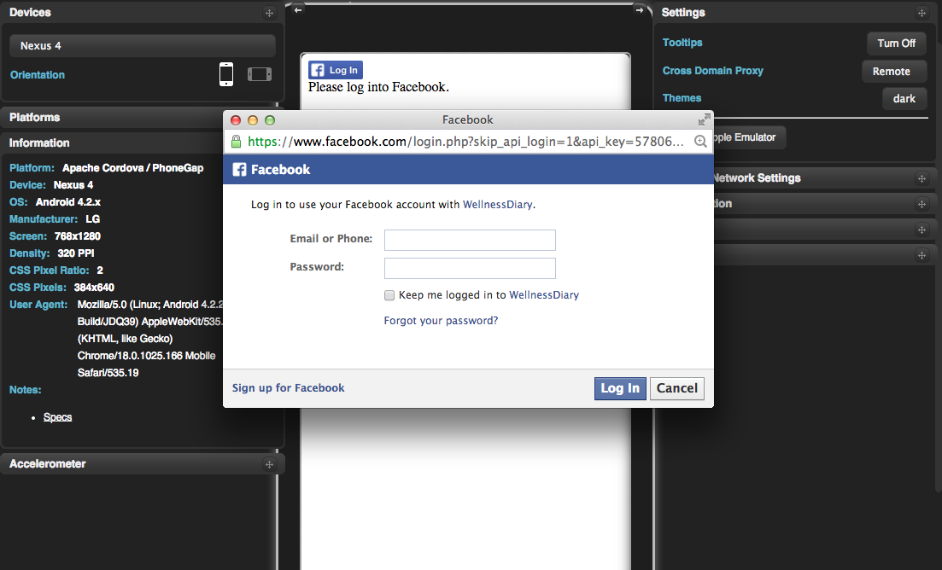
Login in

Slide 6

Login in

Slide 7
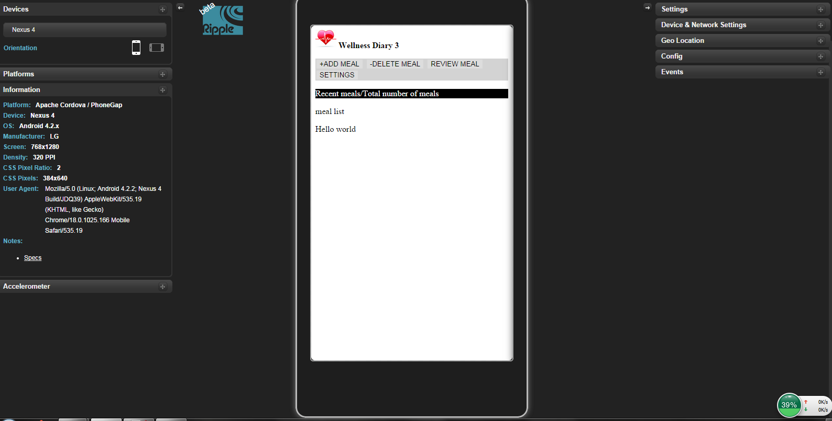
Home Page

