Slide 1
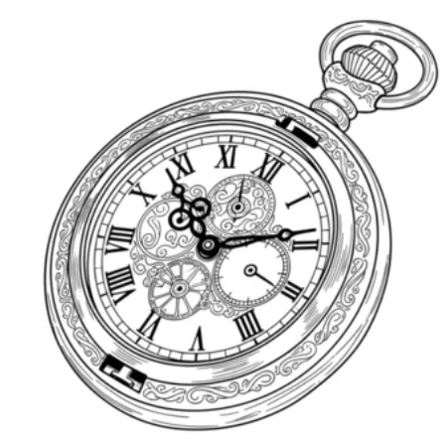
General purpose PLL 2026 May 27
Super Long Wave Yutaka Kotani (team leader) yutaka.kotani.in@gmail.com Ashutosh Chakravarty Cheng Fei Fatima

Slide 2
Agenda
1
Project information
5
Circuit design
2
Team background
6
Layout
3
Specification
7
Evaluation
4
Block diagram
8
Schedule

Slide 3
Project information
Clock multiplier mode
Goal
Creating general purpose PLL
Creating a part of FM Radio component
Design
PLL has two mode
Clock multiplier mode
FM demodulator mode
Application
Digital clock generator & FM Radio
Reference
CMOS CIRCUIT DESIGN,LAYOUT AND SIMULATION, R.JACOB BAKER
CLK:10MHz
PLL
Crystal Oscillator
PFD
Charge pump
Loop Filter
Divider
VCO
Buffer
Center Frequency & KVCO adjust
CLK:80MHz
CPU
2x Current Source
FM demodulator mode
65-80MHz
PLL
FMTuner & LNA
PD
Charge pump
Loop Filter
VCO
Buffer
Center Frequency & KVCO adjust
Audio Signal
2x Current Source
LPF
AMP & Speaker

Slide 4
Team background
 | Yutaka Kotani | Ashutosh Chakravarty | Cheng Fei | Fatima
Discode name | Yutaka KOTANI | Teddy | buttercutter | fa_84
Academic experience | Bachelor of Computer Science | Bachelors in EE | EE | PhD student specializing in Integrated Circuit (IC) Design
Work experience | Field Application engineer in Semiconductor company | Analog Design Engineer with tape out experience | Digital Design Engineer | working with open-source semiconductor technologies, particularly the SG13G2 process.

Slide 5
Specification
Target Spec | Min | Typ | Max
Pin count | 9
Estimated Area | ***um2
Vdd voltage [V] | 3 | 3.3 | 3.6
pll_in voltage [V] | 0.8 | - | 2.5
pll_out voltage [V] | 0 |  | vdd
Pin | Pin name | Notes
1 | VDD | 3.3V
2 | GND
3 | PLL_IN | Reference clk input
4 | PLL_OUT | Clock multiplier output
5 | CEN_FREQ_CUR | Center frequency bias current
6 | KVCO_ADJ_CUR | kvco adjust bias current
7 | MODE_SEL | Hi: Use FM demodulator Low: Use Clock multiplier
8 | LF_IN | External Loop filter input
9 | LF_OUT | External Loop filter output
Clock multiplier mode | Min | Typ | Max
pll_in frequency [MHz] | 9.9 | 10 | 10.1
pll_out frequency [MHz] | 79.9 | 80 | 80.1
Divider ratio |  | 1/8
Cen_freq_cur [uA] | 90 | 100 | 110
FM demodulator mode | Min | Typ | Max
pll_in frequency [MHz] | 76 | - | 90
dmod_out voltage [V] | 0 | - | vdd
Cen_freq_cur [uA] | 10 | - | 110

Slide 6
Block diagram - Clock multiplier mode
lf_in
Charge
pump
External Loop filter
lf_out
PFD
VCO
REF CLK
OUT CLK
Duty -1 to 1
Current
-Ibias to Ibias
Voltage
Vin
Phase
+
1 π
∫
φin
Ibias
R1
+
Kvco
+
φout
-
KVCO_ADJ_CUR
1 C1
∫
Adjust KVCO
CEN_FREQ_CUR
Current
Center Frequency
Phase
Phase
φdiv
φout
1/N
Closed loop: G(s) W(s) = ---------------------- 1 + G(s) H(s) Open loop: G(s) H(s)
Transfer function: Ibias Kvco
G(s) = ------- * (R1+1/C1s) * ------- π s H(s) = 1 / N
Divider

Slide 7
Block diagram – FM demodulator mode
lf_in
Charge
pump
External Loop filter
PD
VCO
FM in
Duty -1 to 1
Current
-Ibias to Ibias
Voltage
Vin
Phase
+
1 π
∫
φin
Ibias
R1
+
Kvco
+
lf_out
-
FM Demodulator out
KVCO_ADJ_CUR
1 C1
∫
Adjust KVCO
CEN_FREQ_CUR
Current
Center Frequency
Phase

Slide 8
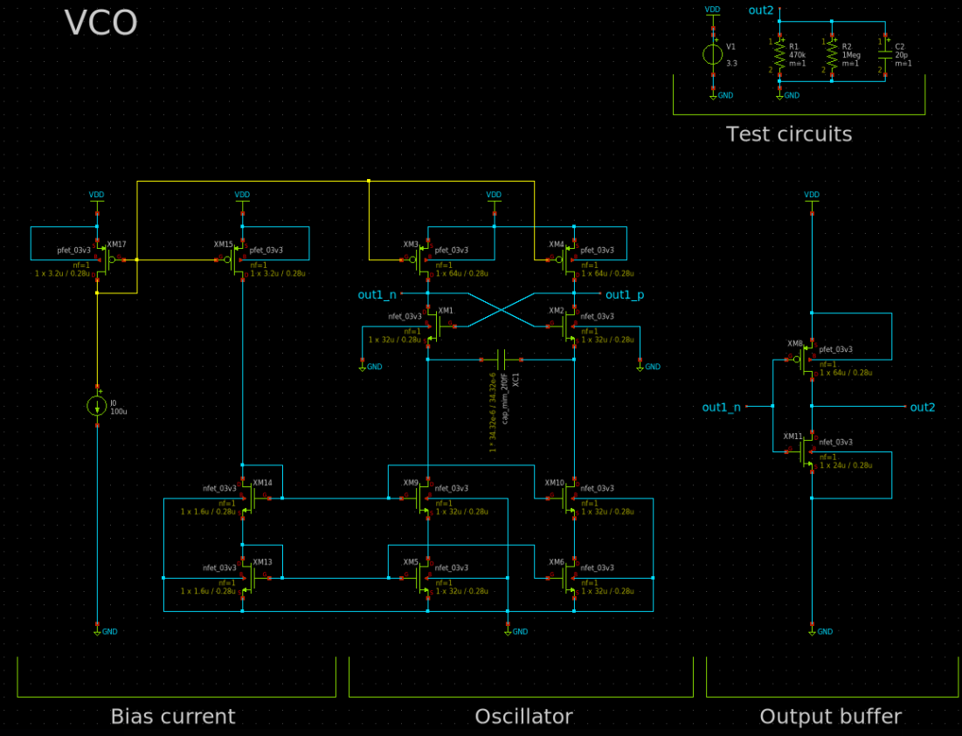
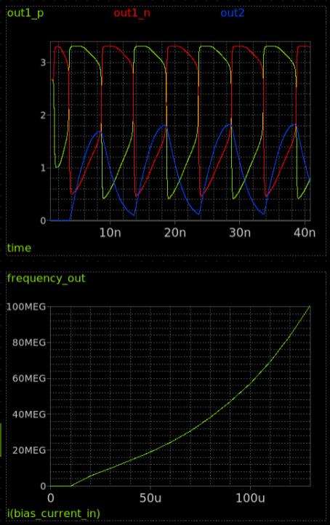
Circuit design - VCO

Slide 9
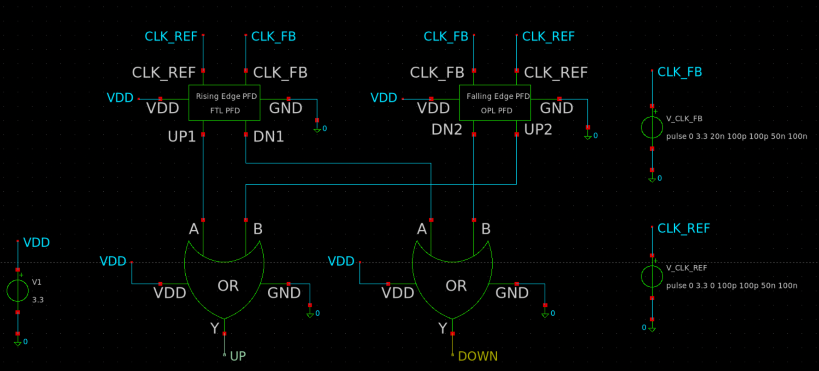
Circuit design – PFD

Slide 10
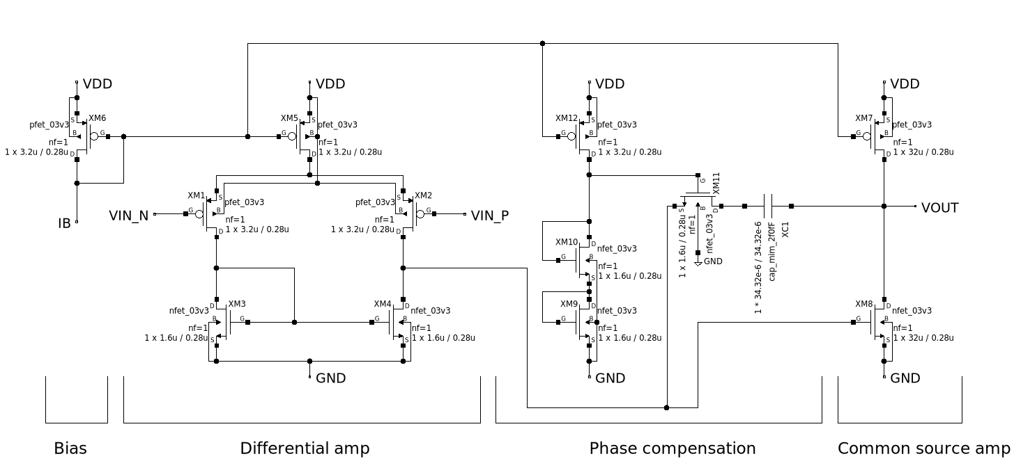
Circuit design - OPAMP

Slide 11
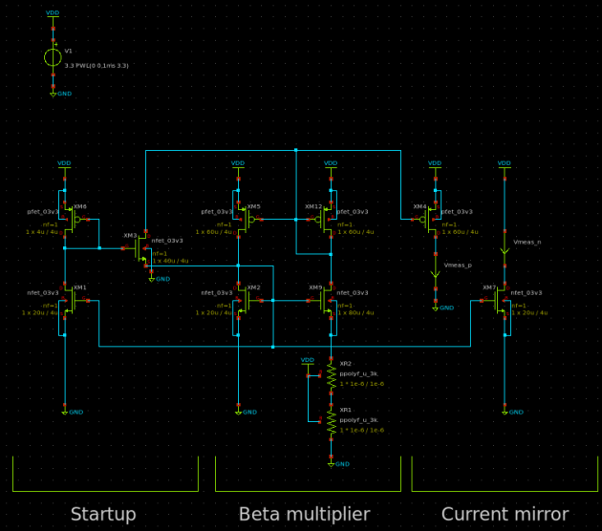
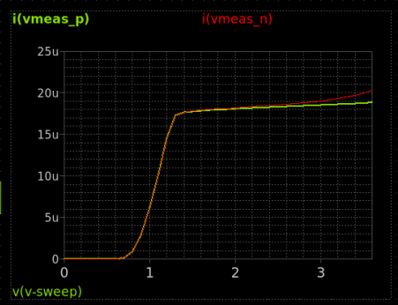
Circuit design – Beta multiplier reference

Slide 12
Layout (T.B.D)

Slide 13
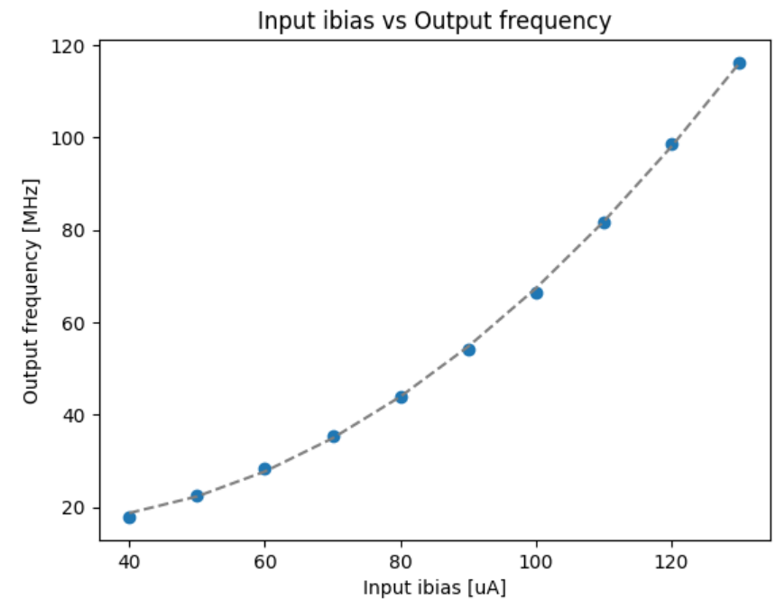
Evaluation - VCO
to left
y = 9.04099539e+15 * x^2-4.55009586e +11 * x + 2.24254037e+07

Slide 14
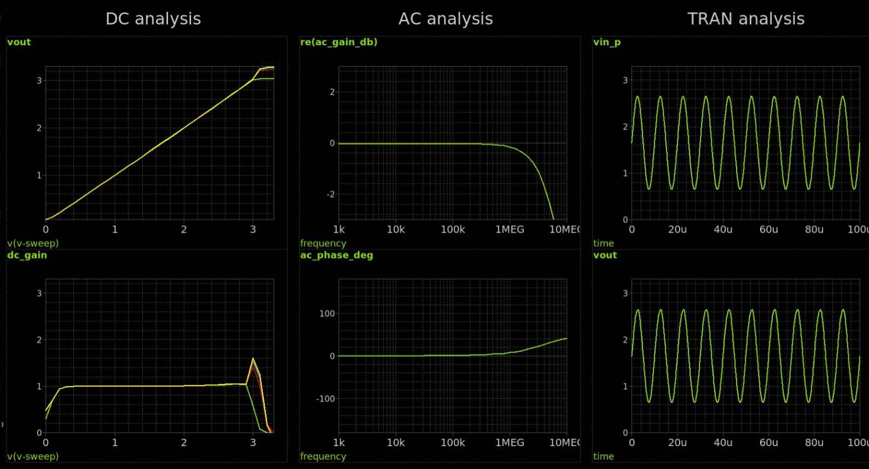
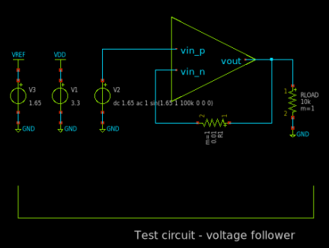
Evaluation - OPAMP
to left

Slide 15
Application block diagram – FM radio
lf_in
Charge
pump
External Loop filter
PD
VCO
Antena in
Duty -1 to 1
Current
-Ibias to Ibias
Voltage
Vin
Phase
+
1 π
φin
Ibias
R1
+
Kvco
+
lf_out
-
FM Demodulator out
KVCO_ADJ_CUR
1 C1
∫
Adjust KVCO
BPF
CEN_FREQ_CUR
Current
Center Frequency
Phase

Slide 16
Schedule
Week | Date | Event | Track Details
Week 23 | June 5 | Team Formation Deadline
Week 24 | June 12 | Project Proposal Review
Week 27 | July 3 | Schematic Review
Week 28 | July 10 | Simulation Review (blocks)
Week 29 | July 17 | Simulation Review (top level)
 |  | READiness Check & Go/No-go Decision
Week 33 | Aug 14 | Layout Review (blocks)
Week 34 | Aug 21 | Layout Review (top level)
Week 35 | Aug. 28 | Verification
 |  | Final Chip Review
 |  | Final Submission
 |  | Upload of Chip Test Results

