Slide 1
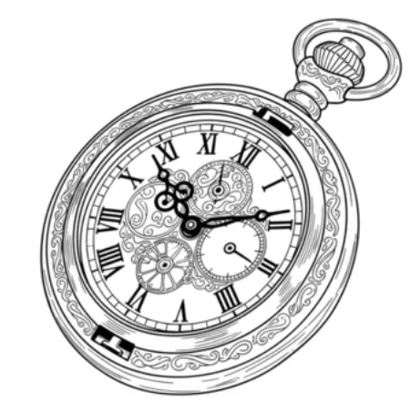
General purpose PLL 2026 July 4
Super Long Wave Yutaka Kotani (team leader) yutaka.kotani.in@gmail.com Ashutosh Chakravarty Cheng Fei Fatima

Slide 2
Agenda
1
Project information
6
Verification status
2
Design objective
7
Design checklist
3
System overview
8
Open issues
4
Schematic summary
9
Questions for reviewers
5
Design assumptions

Slide 3
Design objective
*1
Clock multiplier mode
What problems circuit solves
The PLL extracts the audio signal by performing FM demodulation on the 10.7 MHz intermediate frequency (IF) signal from the preceding radio front-end.
Target specifications
Input FM modulated IF 10.7MHz
Output FM demodulated audio signal
Intended Use
Create FM radio demodulator
Project scope and spec changes Following our mentor's advice, we have reduced the project scope and specifications.
Clock multiplier mode was deleted
Input signal was changed from a direct FM signal to an intermediate frequency of 10.7 MHz
CLK:10MHz
PLL
Crystal Oscillator
PFD
Charge pump
Loop Filter
Divider
VCO
Buffer
Center Frequency & KVCO adjust
CLK:80MHz
CPU
2x Current Source
FM demodulator mode
*2
10.7MHz
PLL
FM radio Frontend
PFD
Charge pump
Loop Filter
VCO
Buffer
Center Frequency adjust
Audio Signal
Current Source
LPF
AMP & Speaker

Slide 4
System overview
PFD * buttercutter write here.
Charge pump * fa_84 write here.
Loop filter (external) * fa_84 write here.
Buffer * Teddy write here.
LPF (external) * Teddy write here.
VCO * Yutaka KOTANI write here.
Current source (external) * Yutaka KOTANI write here.
Mosbius chip internal
10.7MHz
PLL
FM radio Frontend
PFD
Charge pump
Loop Filter
VCO
Buffer
Up to 15KHz
Current Source
LPF
Audio Signal
AMP & Speaker

Slide 5
Specification
Target Spec | Min | Typ | Max
Pin count | 9
Estimated Area | ***um2
Vdd voltage [V] | 3 | 3.3 | 3.6
pll_in voltage [V] | 0.8 | - | 2.5
pll_out voltage [V] | 0 |  | vdd
Pin | Pin name | Notes
1 | VDD | 3.3V
2 | GND
3 | PLL_IN | Reference clk input
4 | PLL_OUT | Clock multiplier output
5 | CEN_FREQ_CUR | Center frequency bias current
6 | KVCO_ADJ_CUR | kvco adjust bias current
7 | MODE_SEL | Hi: Use FM demodulator Low: Use Clock multiplier
8 | LF_IN | External Loop filter input
9 | LF_OUT | External Loop filter output
Clock multiplier mode | Min | Typ | Max
pll_in frequency [MHz] | 9.9 | 10 | 10.1
pll_out frequency [MHz] | 79.9 | 80 | 80.1
Divider ratio |  | 1/8
Cen_freq_cur [uA] | 90 | 100 | 110
FM demodulator mode | Min | Typ | Max
pll_in frequency [MHz] | 76 | - | 90
dmod_out voltage [V] | 0 | - | vdd
Cen_freq_cur [uA] | 10 | - | 110

Slide 6
Block diagram - Clock multiplier mode
lf_in
Charge
pump
External Loop filter
lf_out
PFD
VCO
REF CLK
OUT CLK
Duty -1 to 1
Current
-Ibias to Ibias
Voltage
Vin
Phase
+
1 π
∫
φin
Ibias
R1
+
Kvco
+
φout
-
KVCO_ADJ_CUR
1 C1
∫
Adjust KVCO
CEN_FREQ_CUR
Current
Center Frequency
Phase
Phase
φdiv
φout
1/N
Closed loop: G(s) W(s) = ---------------------- 1 + G(s) H(s) Open loop: G(s) H(s)
Transfer function: Ibias Kvco
G(s) = ------- * (R1+1/C1s) * ------- π s H(s) = 1 / N
Divider

Slide 7
Schematic summary - PFD
Put your schematic diagram here
Purpose
Input and Output
Input
output
Important design decisions
Interface to other blocks

Slide 8
Schematic summary – Charge pump
Put your schematic diagram here
Purpose
Input and Output
Input
output
Important design decisions
Interface to other blocks

Slide 9
Schematic summary – Loop filter
Put your schematic diagram here
Purpose
Input and Output
Input
output
Important design decisions
Interface to other blocks

Slide 10
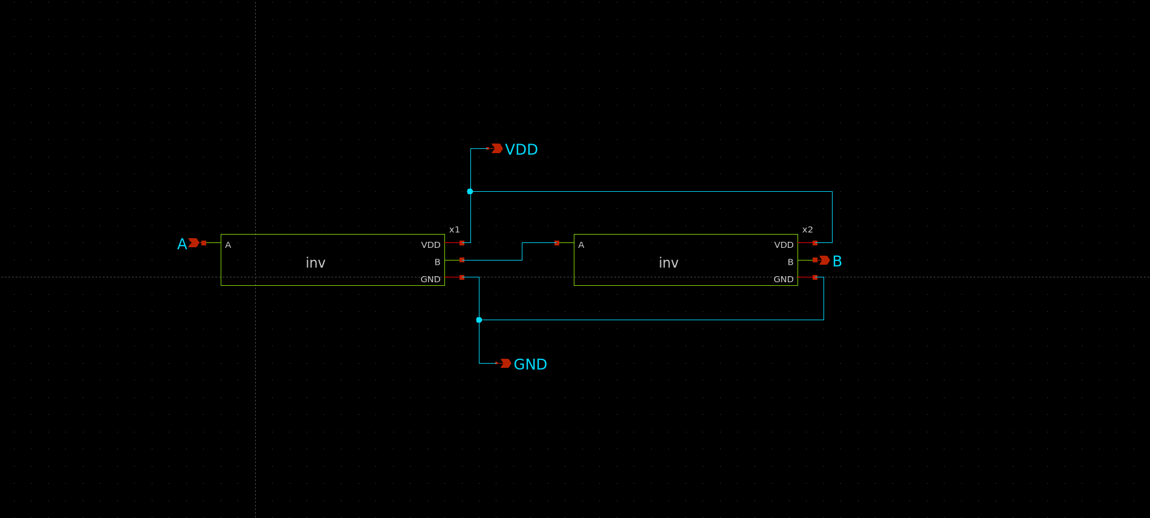
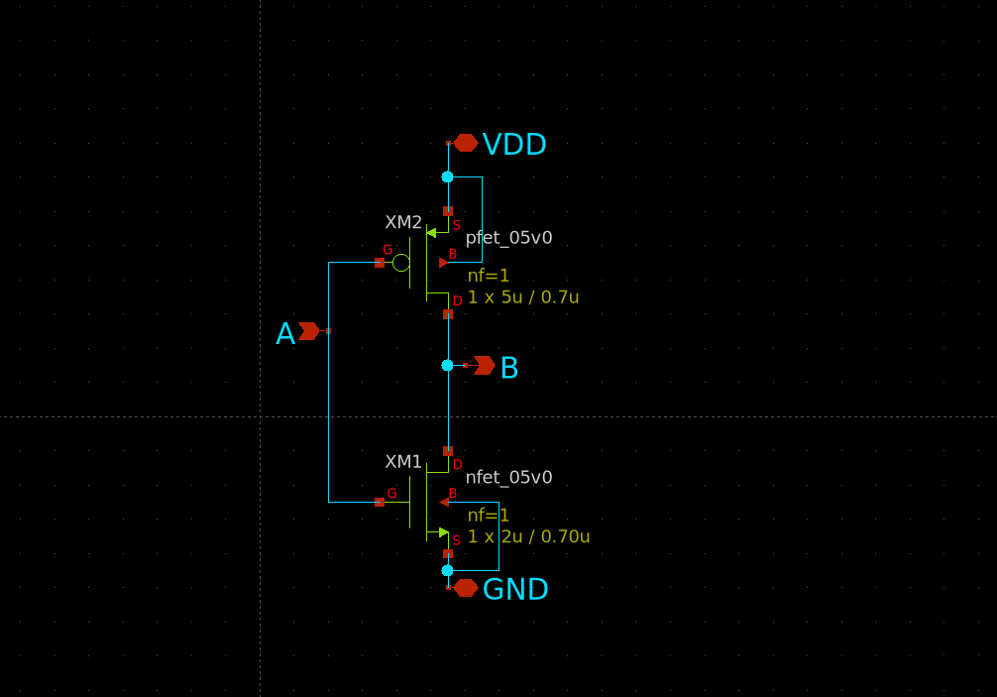
Schematic summary – Buffer
Schematic (Buffer, Inverter respectively)
Purpose
To copy the voltage from the loop filter to the VCO. This ensures a reliable input
Input and Output
Input 3V pulse signal (for simulation)
Output 3V pulse signal identical to input (simulation result)
3V VDD input

Slide 11
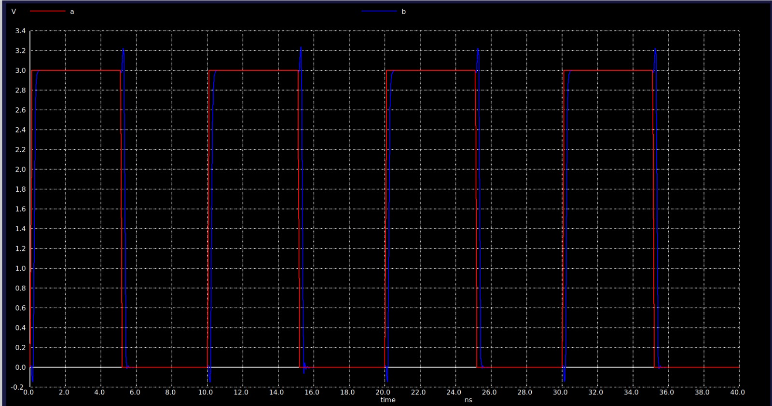
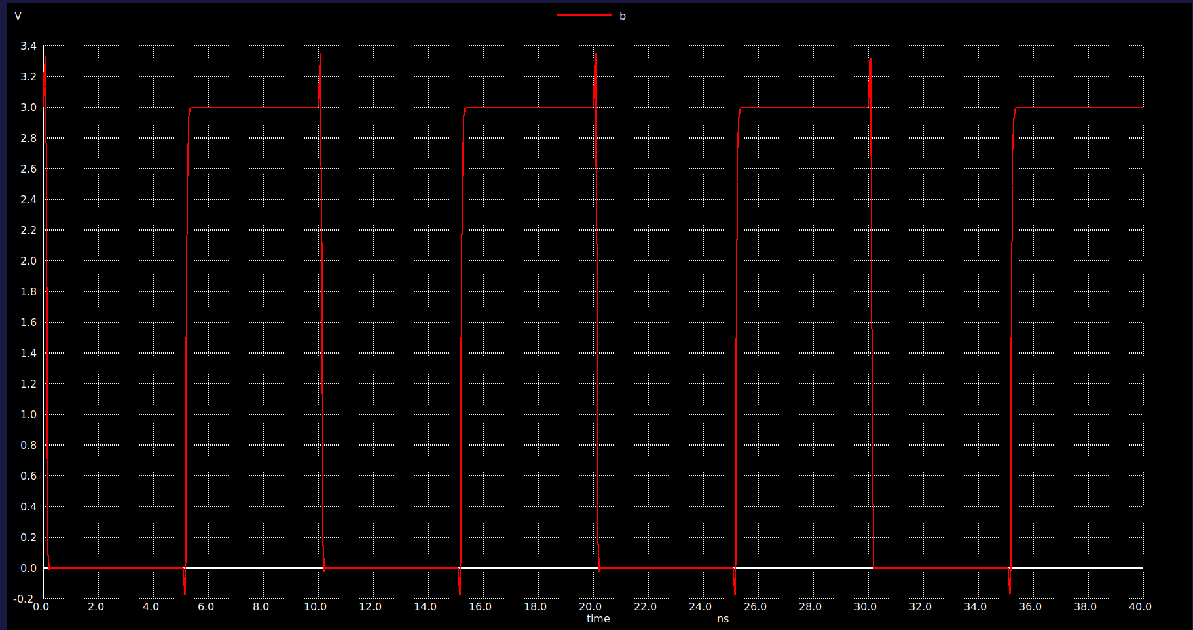
Simulations of Buffer
Output of the Buffer
Output Of Inverter

Slide 12
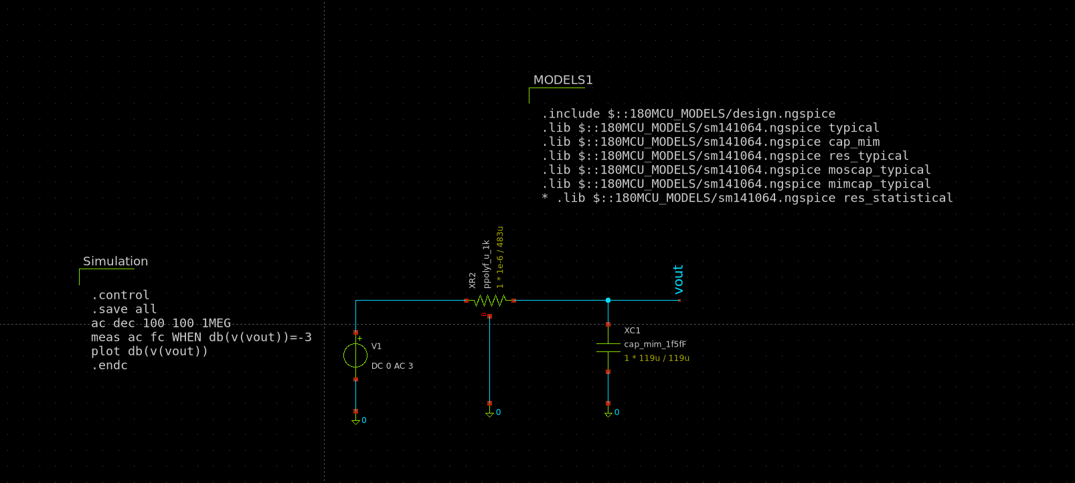
Schematic summary – LPF
Purpose For removing high frequency components from buffer for smoother output
Input and Output
Buffered signal containing high frequency and noise
Clean filtered signal
Important design decisions: Selection of R and C values of reasonable size for filter design
Interface to other blocks Input from buffer
Schematic

Slide 13
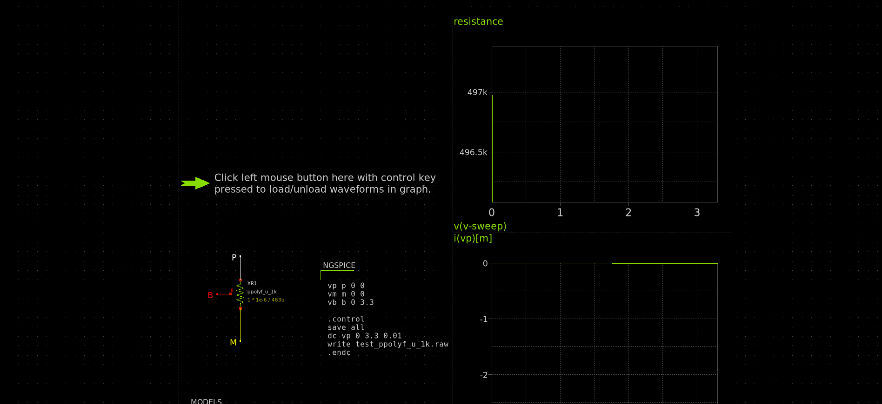
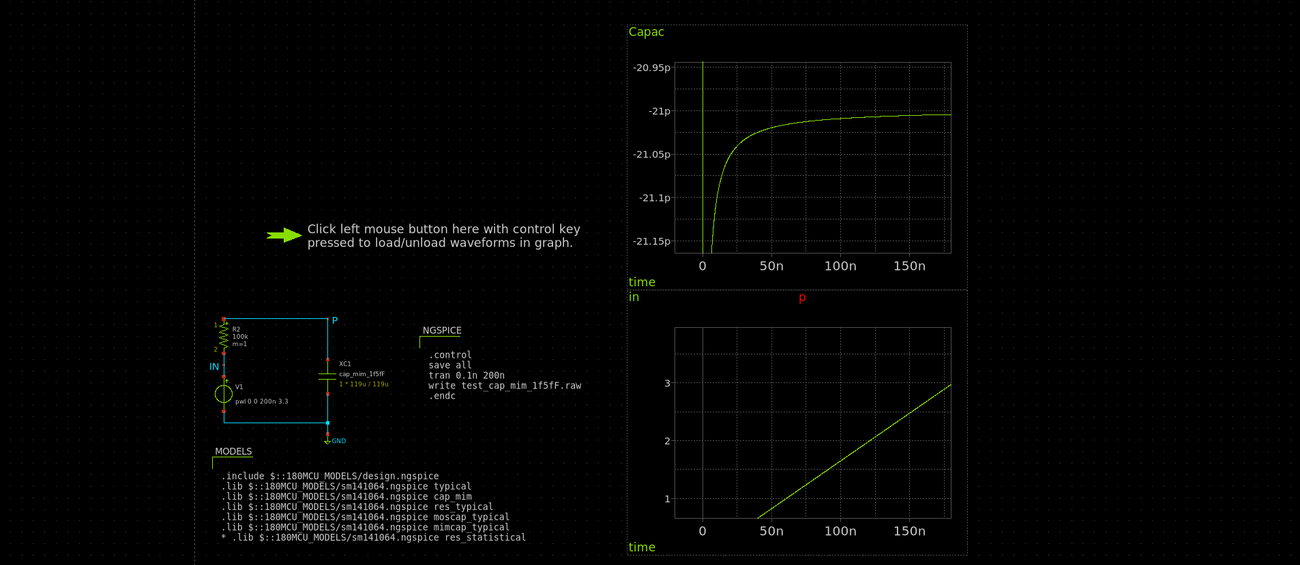
Resistor and Capacitor Value Selection
Resistor Selection
Capacitor Selection

Slide 14
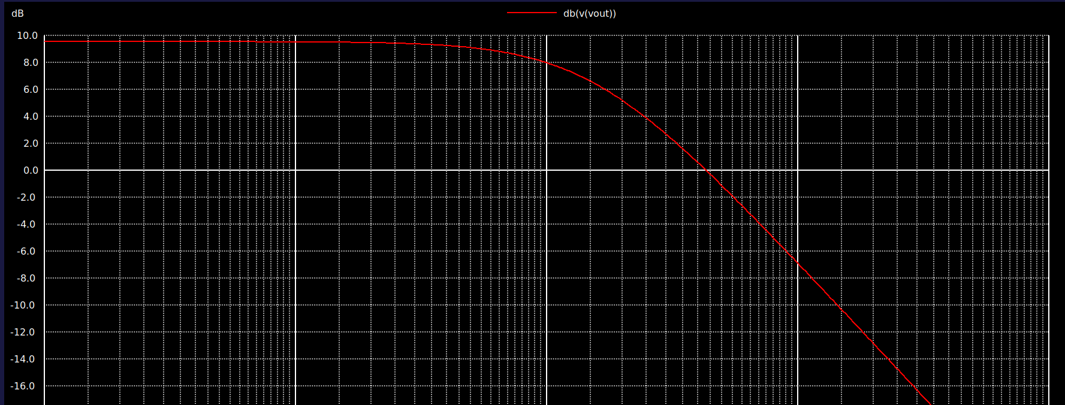
Simulation of LPF

Slide 15
Schematic summary – VCO
Put your schematic diagram here
Purpose
Input and Output
Input
output
Important design decisions
Interface to other blocks

Slide 16
Schematic summary – current source
Put your schematic diagram here
Purpose
Input and Output
Input
output
Important design decisions
Interface to other blocks

Slide 17
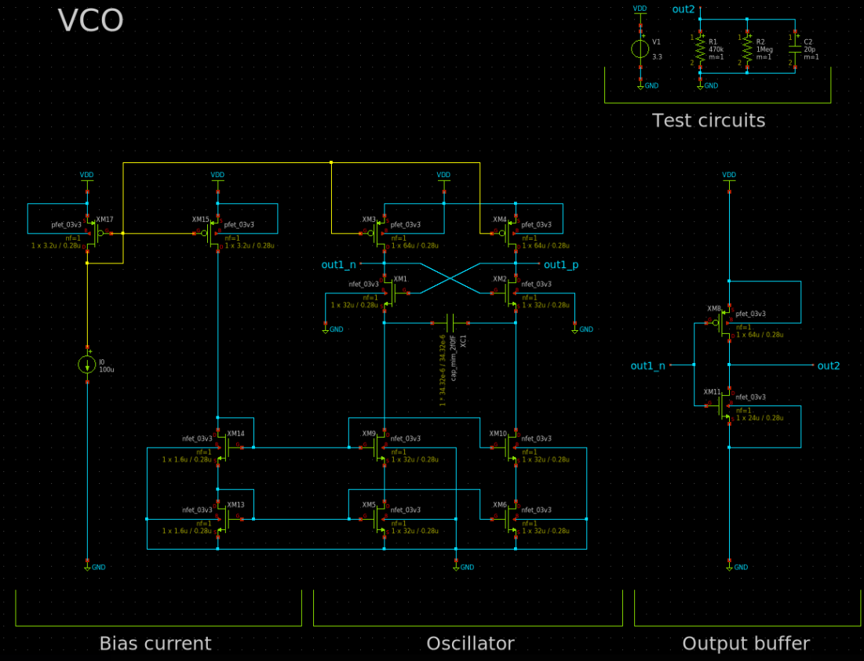
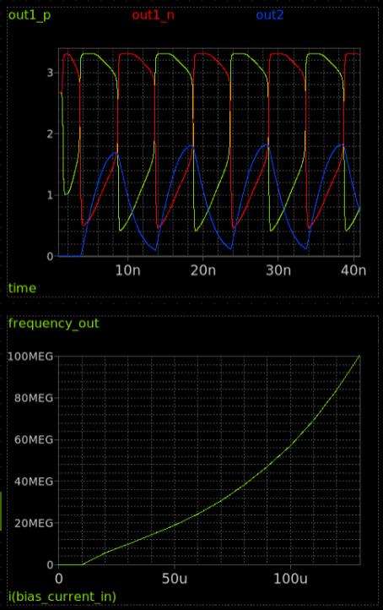
Circuit design - VCO

Slide 18
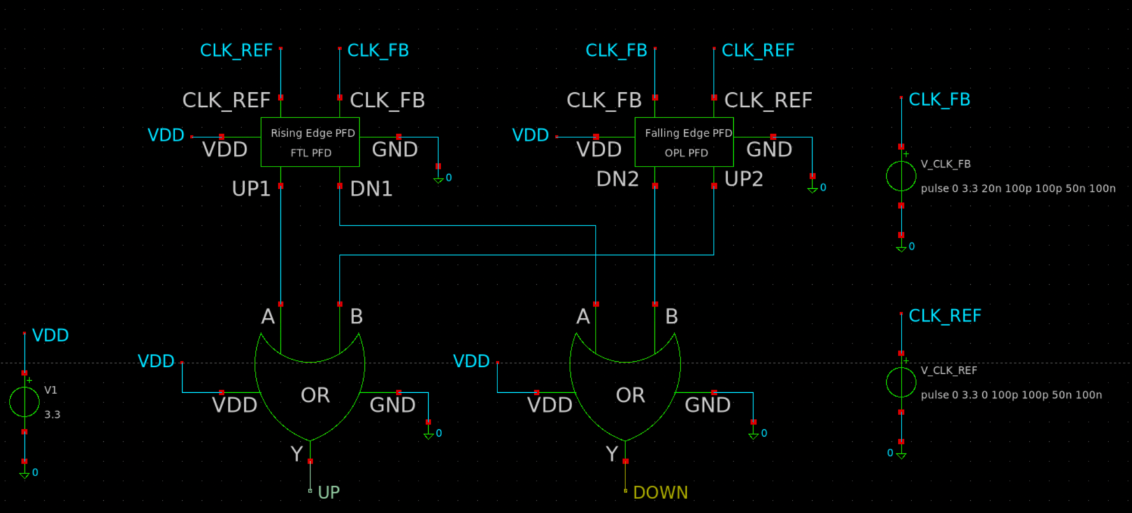
Circuit design – PFD

Slide 19
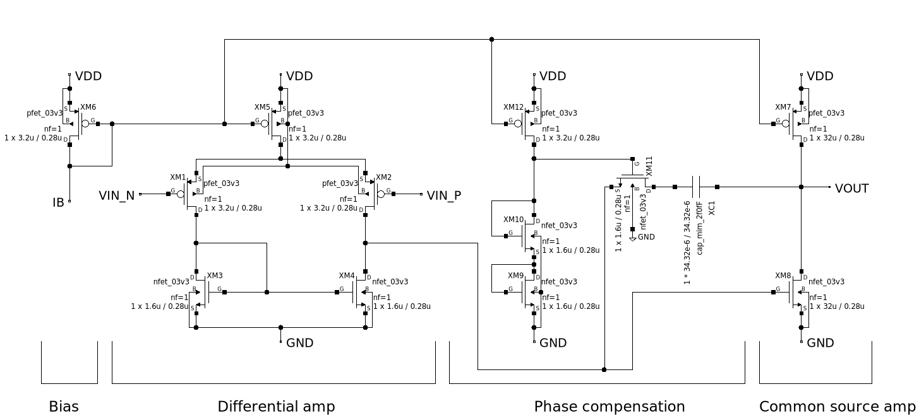
Circuit design - OPAMP

Slide 20
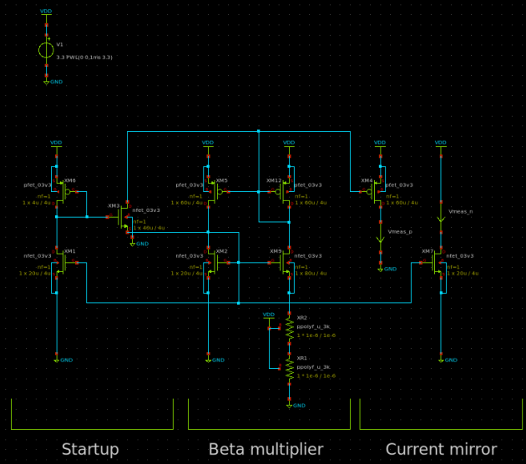
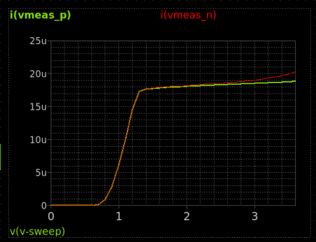
Circuit design – Beta multiplier reference

Slide 21
Layout (T.B.D)

Slide 22
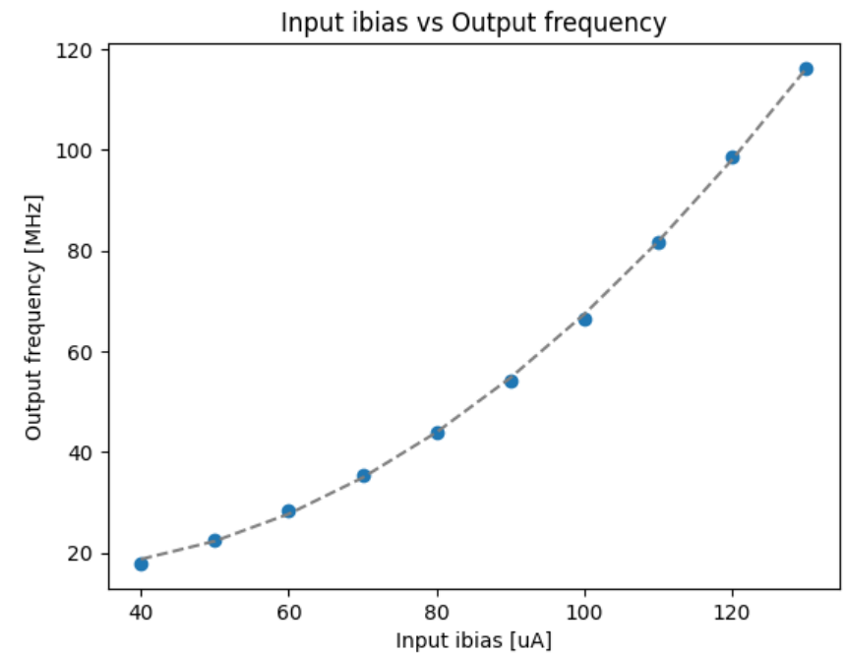
Evaluation - VCO
to left
y = 9.04099539e+15 * x^2-4.55009586e +11 * x + 2.24254037e+07

Slide 23
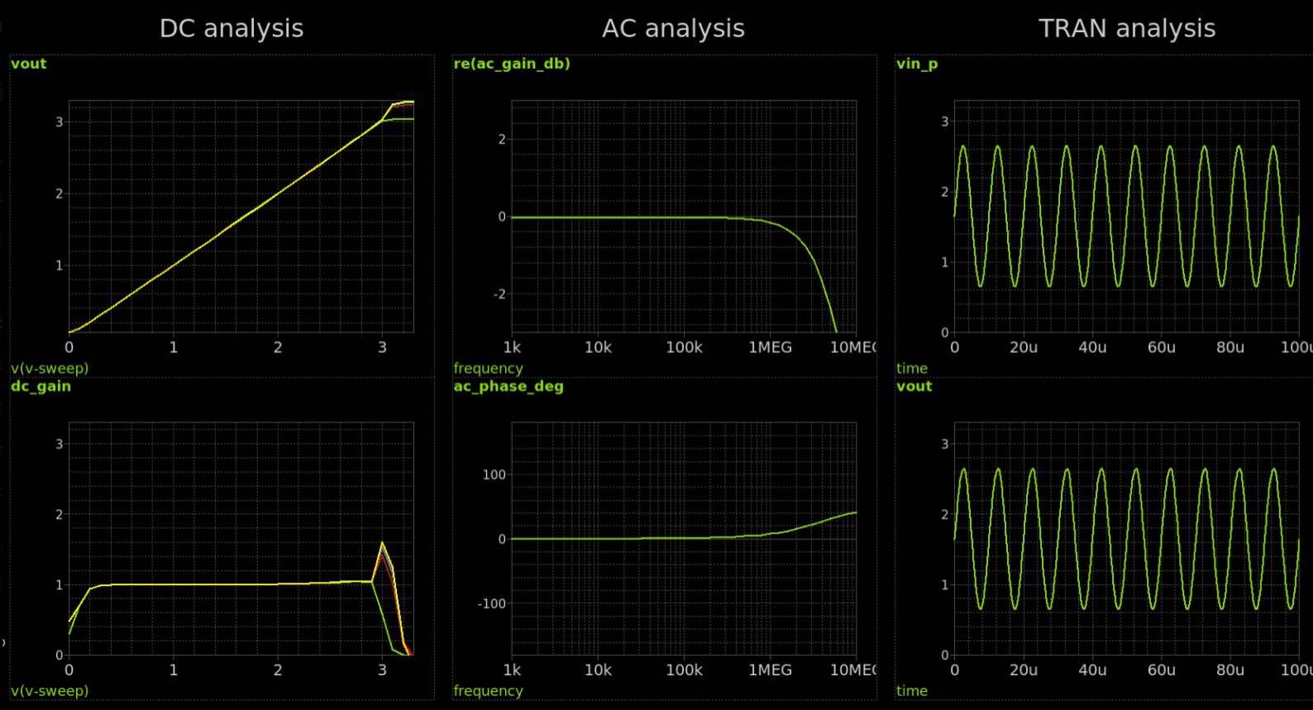
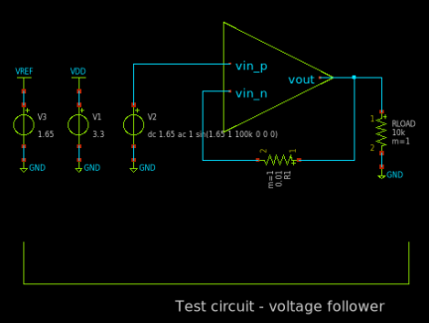
Evaluation - OPAMP
to left

Slide 24
Application block diagram – FM radio
lf_in
Charge
pump
External Loop filter
PD
VCO
Antena in
Duty -1 to 1
Current
-Ibias to Ibias
Voltage
Vin
Phase
+
1 π
φin
Ibias
R1
+
Kvco
+
lf_out
-
FM Demodulator out
KVCO_ADJ_CUR
1 C1
∫
Adjust KVCO
BPF
CEN_FREQ_CUR
Current
Center Frequency
Phase

Slide 25
Schedule
Week | Date | Event | Track Details
Week 23 | June 5 | Team Formation Deadline
Week 24 | June 12 | Project Proposal Review
Week 27 | July 3 | Schematic Review
Week 28 | July 10 | Simulation Review (blocks)
Week 29 | July 17 | Simulation Review (top level)
 |  | READiness Check & Go/No-go Decision
Week 33 | Aug 14 | Layout Review (blocks)
Week 34 | Aug 21 | Layout Review (top level)
Week 35 | Aug. 28 | Verification
 |  | Final Chip Review
 |  | Final Submission
 |  | Upload of Chip Test Results

