Slide 1
Judges’ Comments
Kenjiro Taura (Chief Judge)
University of Tokyo

Slide 2
Thank you all teams!
36 teams / 25 universities
  29 teams / 21 universities from Japan
  7 teams / 4 universities from other countries

Slide 3
Basic statistics
Before showing “real” statistics ...

Slide 4
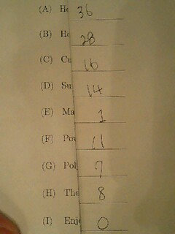
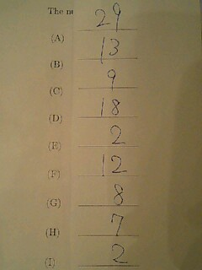
Forecast (1)

Slide 5
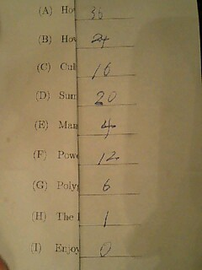
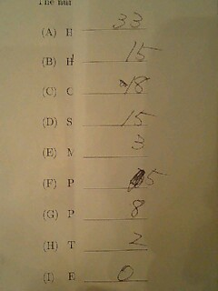
Forecast (2)

Slide 6
My Forecast (made on Nov. 3)
WRONG
☺ All teams solved at least one problem
☺ It was not “speed-race.” The winner solved eight, followed by the second that solved seven
☹ No team solved problem I
☹ Only one team solved problem E
☹ Unusually many timeouts (C, E, F, and G)
TRUE
SEVEN
FIVE
TRUE
NO
TRUE (29)
D, and I

Slide 7
Here real data begins ☺

Slide 8
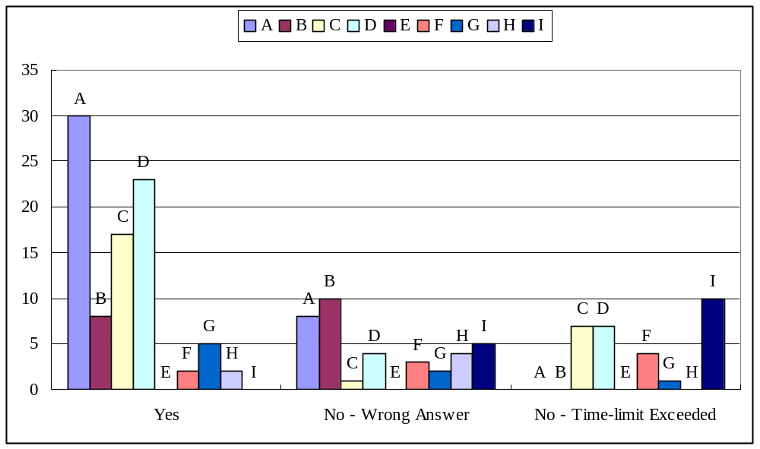
Basic stats

Slide 9
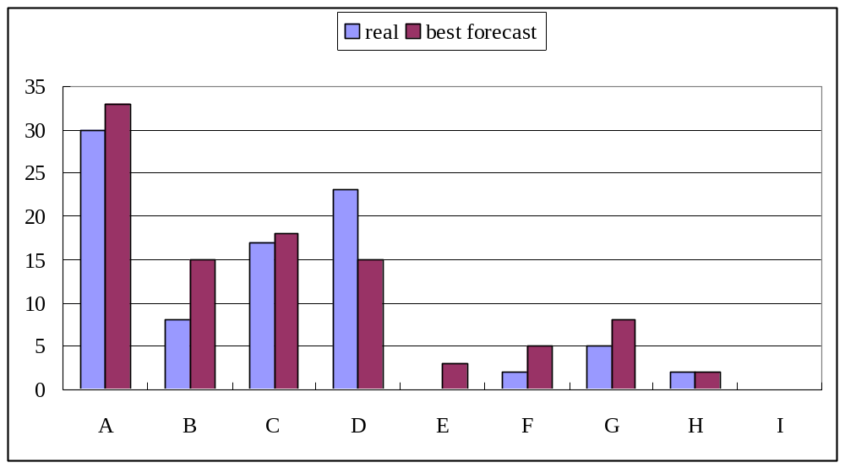
The best forecast vs real data

Slide 10
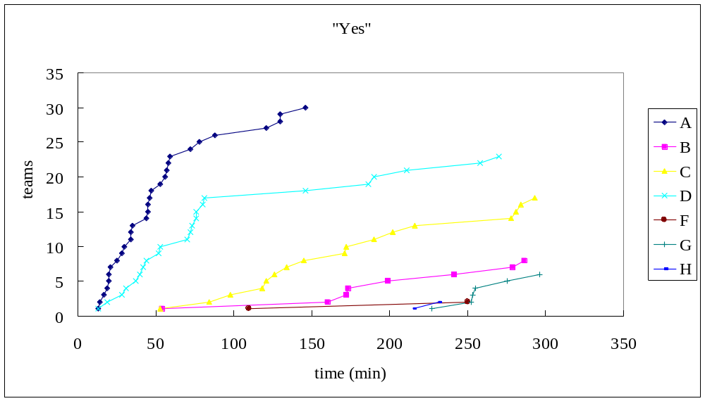
Time series data
“Yes”

Slide 11
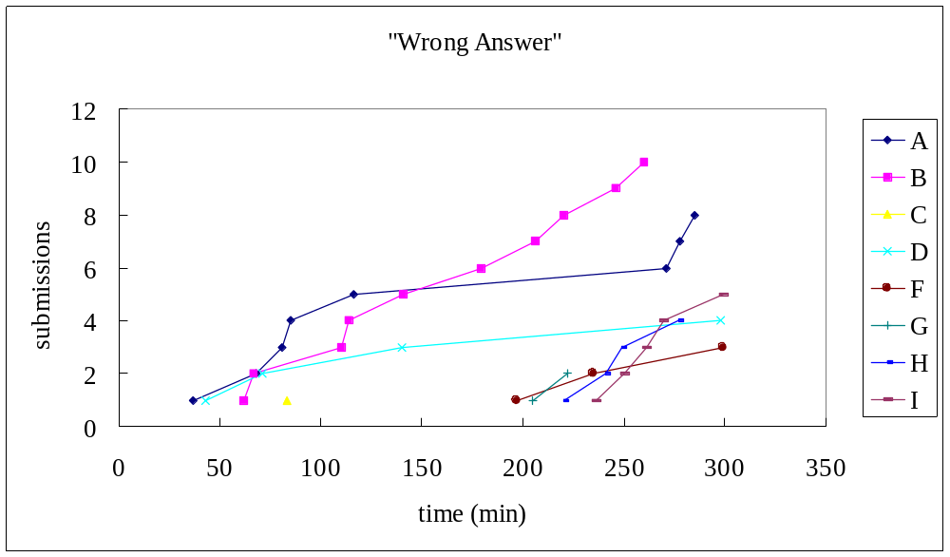
Time series data “Wrong Answer”

Slide 12
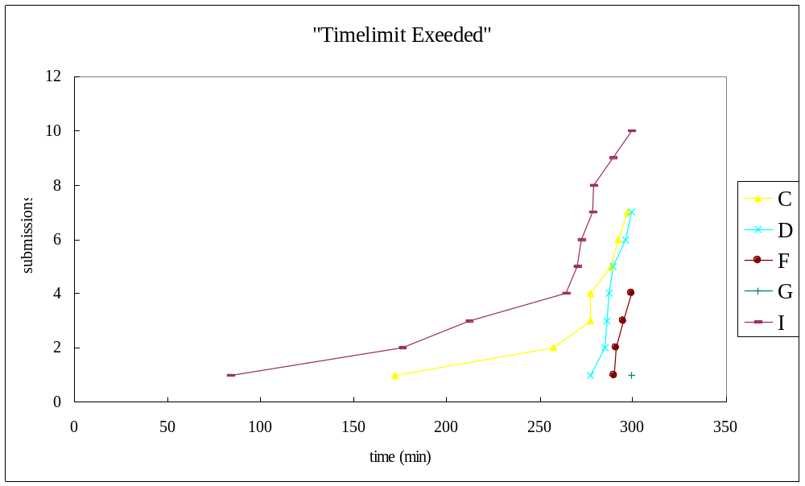
Time series data “Timelimit Exceeded”

Slide 13
Comments on problems

Slide 14
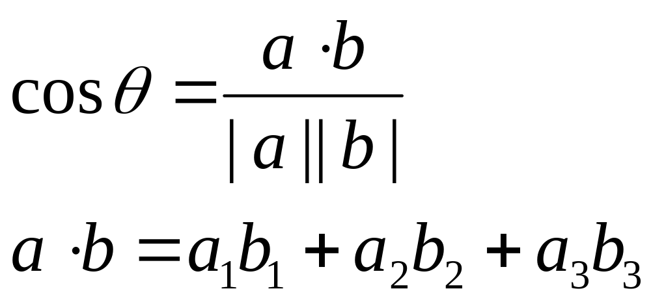
Problem A (30/8/0) : count stars
YES / WRONG / TIMELIMIT
The only high school math you need to know is this
a
b
θ

Slide 15

Problem B (8/10/0) : star shape
YES / WRONG / TIMELIMIT
P
P
P
C
P
P

Slide 16
Problem B: Observation
Centers cannot be on this side
Centers must be on this side
outside
inside
Centers must be here

Slide 17
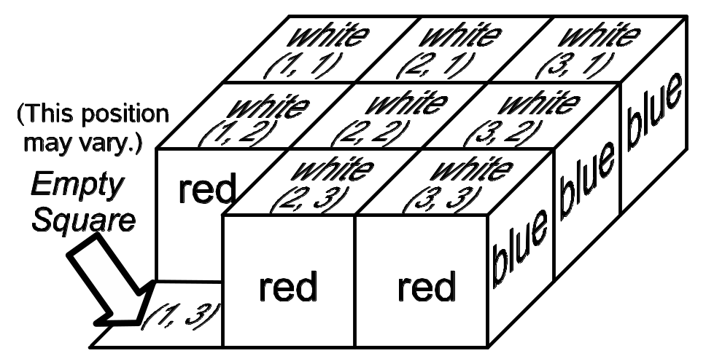
Problem C (17/1/7) : dice puzzle
YES / WRONG / TIMELIMIT
A typical search problem
A typical problem about die ☺
Branching factor ≤ 4
4³⁰ too many
to overcome,
1
4
2
3

Slide 18
Problem C: Observation
One of the possible moves always “goes back”
  branching factor ≤ 3 except for the first move
One move from a position having 4 moves takes you to a position having only 3 moves
≤ 8 ways to move twice (if you don’t go back immediately)
1
1
4
2
2
3
3

Slide 19
Problem D (23/4/7) : sum of primes
YES / WRONG / TIMELIMIT
A typical DP problem

Slide 20
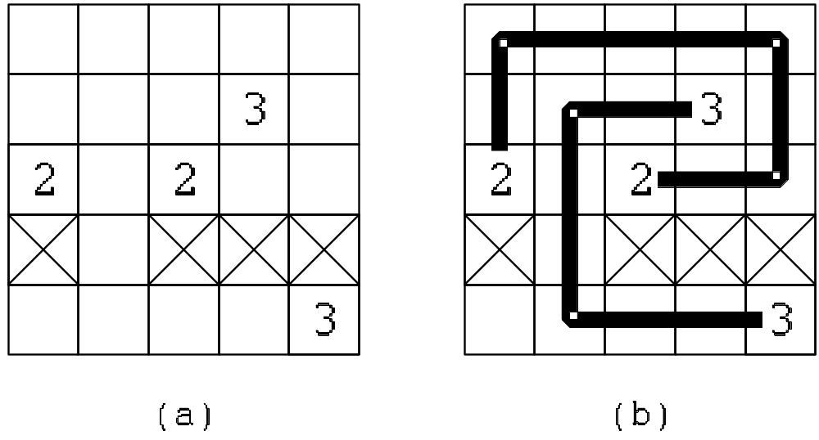
Problem E (0/0/0) : wiring
YES / WRONG / TIMELIMIT
The shortest routes that connect two 2’s and two 3’s
board size ≤ 9 x 9

Slide 21
Problem E: A (false) conjecture
One of the two routes is the shortest path (SP)?
  True in many cases, but not all ...

Slide 22
A counterexample
3-3 SP blocks 2-2
BTW, such an example (slightly larger) was given in the sample
  please remember judges as gentlemen ☺
2-2 SP blocks 3-3
original data

Slide 23
Problem E: You must resort to more extensive search
you must resort to searching algorithm ...
but search space is too big
you need some non-trivial pruning criterion
  ban useless U-turn
  prune hopeless patterns like

Slide 24
Problem F (2/3/4) : make x^{n}
YES / WRONG / TIMELIMIT
A typical search problem that needs relatively simple pruning

Slide 25
Problem G (5/2/1) : make large polygon
YES / WRONG / TIMELIMIT
Basic procedure:
  try many ways to put edges and find a combination whose sum is zero
Points to estimate the size of search space
  ≤ 6 edges
  how many ways to put a single edge?
    a simple experiment tells you it’s ≤ 36
but 36⁶ still too many
O

Slide 26
Problem G: Reducing search space
Level 1
  the last one does not have to be “searched”
    ⇒ 36⁵
  the first one only has to be put in 1 / 4 ways
    ⇒ 9⋅ 36⁴
Level 2
  quit if the current point is too far and the remaining edges are too short, to get back to the origin even if you go straight there
O

Slide 27
Problem H (2/4/0) : baby’s name
YES / WRONG / TIMELIMIT
Good exercise of CFG (how to interpret “Production Rules” of CFG)
  Each symbol represents a set of strings
    terminal symbol (e.g. x) is a singleton set (i.e. { x })
  Production rule specifies inclusions between these sets

Slide 28
Problem H: Basic idea
e.g., A → B C reads:
  assume A, B, and C are set of strings
  “hello” ∈ B ∧ “world” ∈ C then “helloworld” ∈ A
leading to an algorithm that grows these sets, up to a fix point
  if B or C grows, so should A

Slide 29
Problem H: Things to overcome
Literally computing all sets leads to too many useless strings
  keep only a single string for each length
  it is the earliest (in dictionary order) string of that length of that symbol
Efficiently applying production rules of long right hand side needs DP or rewriting grammar
  A → B C D E F ⇔ A → B X
  X → C Y
  Y → D Z
  Z → E F

Slide 30
Problem I (0/5/10) : k-th shortest path
YES / WRONG / TIMELIMIT
k-th shortest acyclic path
number of nodes ≤ 50
still, testing 48! possible paths clearly take too much time

Slide 31
Problem I: Basic procedure
find shortest path except some specified (already found shorter) paths
consider for example how to find the 2nd shortest path...

Slide 32
Problem I: Observation
Let p → q be the edge with which the 2nd shortest path departs from the 1st path
  the rest of the path should take the shortest path from q to the goal
shortest path from q to G
q
G
S
p
1st shortest path

Slide 33
Problem I: Things to keep track of
already found, top X paths
for each of these paths P, the paths that depart from P somewhere and take the shortest path to the goal
...
P

Slide 34
Problem I : Complexity
≤ k paths
≤ n points on each path
run shortest path (O(n²)) on each point
O(k ⋅ n ⋅ n²) = O(k n³)

Slide 35
Thank you!

