Slide 1
Exploratory Data Analysis: Boston Data
A data set containing housing values in 506 suburbs of Boston.
Yutaka 11.5/31

Slide 2
Variable Explanation
crim: per capita crime rate by town.
zn: proportion of residential land zoned for lots over 25,000 sq.ft.
indus: proportion of non-retail business acres per town.
chas: Charles River dummy variable (= 1 if tract bounds river; 0 otherwise).
nox: nitrogen oxides concentration (parts per 10 million).
rm: average number of rooms per dwelling.
age: proportion of owner-occupied units built prior to 1940.
dis: weighted mean of distances to five Boston employment centres.
rad: index of accessibility to radial highways.
tax: full-value property-tax rate per $10,000.
ptratio: pupil-teacher ratio by town.
lstat: lower status of the population (percent).
medv: median value of owner-occupied homes in $1000s.

Slide 3
Dataset
506 rows (total observed suburbs in Boston)
11 columns (variables)
 | crim | zn | indus | chas | nox | rm | age | dis | rad | tax | ptratio | lstat | medv
0 | 0.00632 | 18.0 | 2.31 | 0 | 0.538 | 6.575 | 65.2 | 4.0900 | 1 | 296 | 15.3 | 4.98 | 24.0
1 | 0.02731 | 0.0 | 7.07 | 0 | 0.469 | 6.421 | 78.9 | 4.9671 | 2 | 242 | 17.8 | 9.14 | 21.6
2 | 0.02729 | 0.0 | 7.07 | 0 | 0.469 | 7.185 | 61.1 | 4.9671 | 2 | 242 | 17.8 | 4.03 | 34.7
3 | 0.03237 | 0.0 | 2.18 | 0 | 0.458 | 6.998 | 45.8 | 6.0622 | 3 | 222 | 18.7 | 2.94 | 33.4
4 | 0.06905 | 0.0 | 2.18 | 0 | 0.458 | 7.147 | 54.2 | 6.0622 | 3 | 222 | 18.7 | 5.33 | 36.2
... | ... | ... | ... | ... | ... | ... | ... | ... | ... | ... | ... | ... | ...
501 | 0.06263 | 0.0 | 11.93 | 0 | 0.573 | 6.593 | 69.1 | 2.4786 | 1 | 273 | 21.0 | 9.67 | 22.4
502 | 0.04527 | 0.0 | 11.93 | 0 | 0.573 | 6.120 | 76.7 | 2.2875 | 1 | 273 | 21.0 | 9.08 | 20.6
503 | 0.06076 | 0.0 | 11.93 | 0 | 0.573 | 6.976 | 91.0 | 2.1675 | 1 | 273 | 21.0 | 5.64 | 23.9
504 | 0.10959 | 0.0 | 11.93 | 0 | 0.573 | 6.794 | 89.3 | 2.3889 | 1 | 273 | 21.0 | 6.48 | 22.0
505 | 0.04741 | 0.0 | 11.93 | 0 | 0.573 | 6.030 | 80.8 | 2.5050 | 1 | 273 | 21.0 | 7.88 | 11.9

Slide 4
Data Types
 | Columns | Non-Null Count | Dtype | Uniques
0 | crim | 506 | float64 | 504
1 | zn | 506 | float64 | 26
2 | indus | 506 | float64 | 76
3 | chas | 506 | int64 | 2
4 | nox | 506 | float64 | 81
5 | rm | 506 | float64 | 446
6 | age | 506 | float64 | 356
7 | dis | 506 | float64 | 412
8 | rad | 506 | int64 | 9
9 | tax | 506 | int64 | 66
10 | ptratio | 506 | float64 | 46
11 | lstat | 506 | float64 | 455
12 | medv | 506 | float64 | 229
float64 = Decimal values
int64 = Integer values
Clearly quantitative variables including keywords such as “Per capita”, “Proportion”, “Concentration”, etc.
Clearly categorical variables including “dummy variable”.
Vague variable, which is rad (index of accessibility to radial highways), can be checked for its unique values, returning:
array([ 1, 2, 3, 5, 4, 8, 6, 7, 24], dtype=int64)
Thus, also judging its context, it is an ordinal variable.

Slide 5
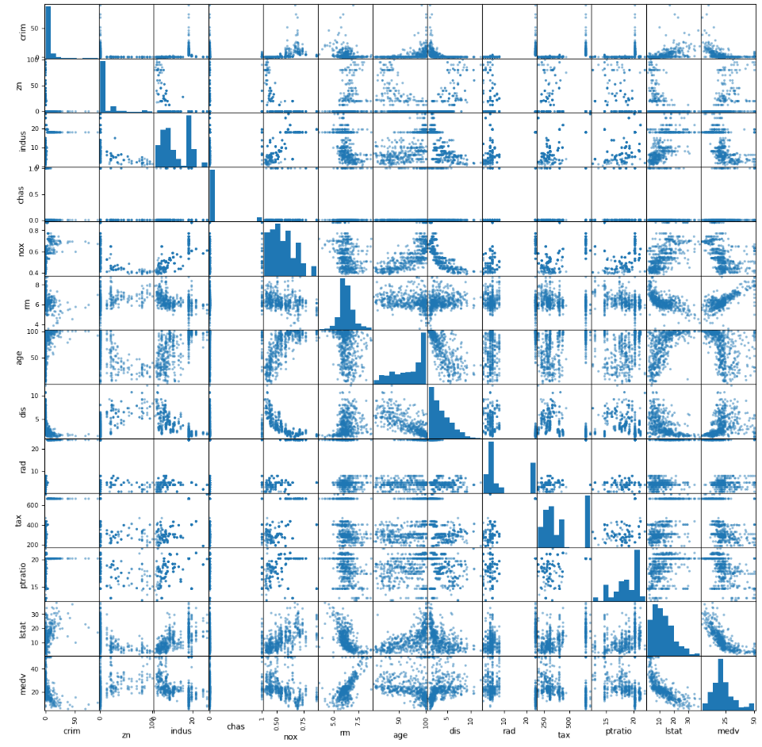
Pairwise Comparison
From the scatter matrix diagram, it can be seen that some relationships:
Can be modeled with linear regression.
Shows clustering
Has ≥ 1 categorical variables, unsuitable for scatter plot.
Pairwise relationships is not discussed further.

Slide 6
Interpretation, Industrial Areas
2 suburbs has the lowest median value of owner-occupied homes, being 5.0.
 | crim | zn | indus | chas | nox | rm | age | dis | rad | tax | ptratio | lstat | medv
398 | 38.3518 | 0.0 | 18.1 | 0 | 0.693 | 5.453 | 100.0 | 1.4896 | 24 | 666 | 20.2 | 30.59 | 5.0
405 | 67.9208 | 0.0 | 18.1 | 0 | 0.693 | 5.683 | 100.0 | 1.4254 | 24 | 666 | 20.2 | 22.98 | 5.0
These are the descriptive statistics of the initial Boston suburbs (unfiltered).
 | crim | zn | indus | chas | nox | rm | age | dis | rad | tax | ptratio | lstat | medv
min | 0.006320 | 0.0 | 0.46 | 0.0 | 0.385 | 3.5610 | 2.900 | 1.129600 | 1.0 | 187.0 | 12.60 | 1.730 | 5.000
25% | 0.082045 | 0.0 | 5.19 | 0.0 | 0.449 | 5.8855 | 45.025 | 2.100175 | 4.0 | 279.0 | 17.40 | 6.950 | 17.025
50% | 0.256510 | 0.0 | 9.69 | 0.0 | 0.538 | 6.2085 | 77.500 | 3.207450 | 5.0 | 330.0 | 19.05 | 11.360 | 21.200
75% | 3.677083 | 12.5 | 18.10 | 0.0 | 0.624 | 6.6235 | 94.075 | 5.188425 | 24.0 | 666.0 | 20.20 | 16.955 | 25.000
max | 88.976200 | 100.0 | 27.74 | 1.0 | 0.871 | 8.7800 | 100.000 | 12.126500 | 24.0 | 711.0 | 22.00 | 37.970 | 50.000

Slide 7
Interpretation, Industrial Areas
These might be industrial areas, as there are:
Zero large/spacious residential areas, suggesting that living areas is scattered.
High non-retail (e.g. industrial, manufacturing) business percentage
Doesn't bound river (to avoid pollution), closely related with the high nitrogen oxides ppm
Very close to employment centres for recruitments and radial highways for employees transportation
High percentage of lower status of the population
Owner-occupied homes is cheap, might be related to the lower status of the population, such as laborers.

Slide 8
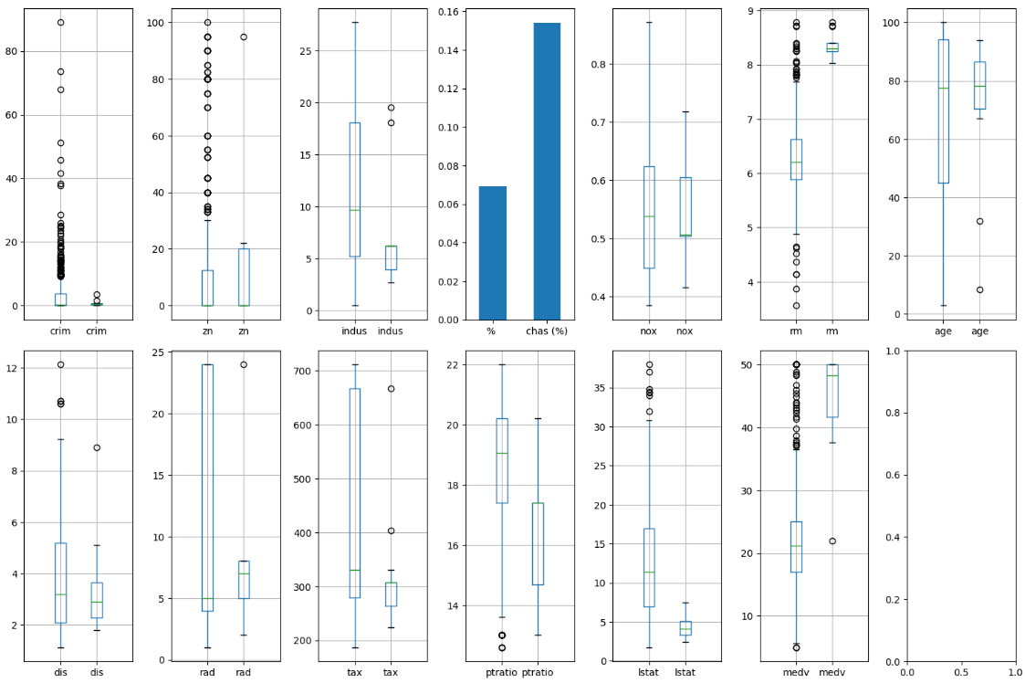
Interpretation, Wealthy Neighborhood
The amount of suburbs averaging >8 rooms per dwelling (13) is considerably less than >7 rooms per dwelling (64).
This suggests that there might be a variable difference between the >8 suburbs and >7 suburbs, or the unfiltered suburbs dataset.

Slide 9
Interpretation, Wealthy Neighborhood
From the data extracted below, there is some important distinction, that suburbs that average more than 8 rooms per dwelling has a:
lower crime rates,
sparser housing placements,
closer to employment centres,
lower percentage of lower status of the population average socioeconomic status is higher), and
more expensive homes.
Another distinction, which is:
Lower proportion of non-retail business,
Larger % of living area bounding Charles River,
Slightly lower mean NO2 conc, with less variance (no extra high NO2),
Average number of rooms per dwelling is high; between 8 and 9,
Large % of old homes,
Mainly less accessible to radial highways, and
Lower property-tax rate.

Slide 10
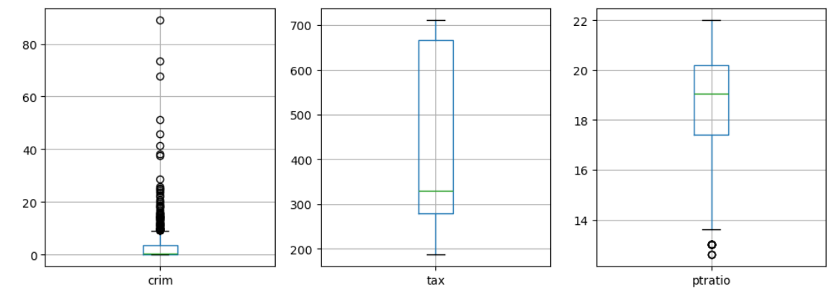
Appendix: Interesting Information
2 clusters on crime rates: range of 0-8 and 8-27.
8 outliers high crime rates.
Tax is positively skewed.
Pupil-teacher ratio is symmetrical (Median = 19.05), with 2 low outliers
Also, only 35 suburbs out of 506 (6.91%) bounds the Charles River.

