Slide 1
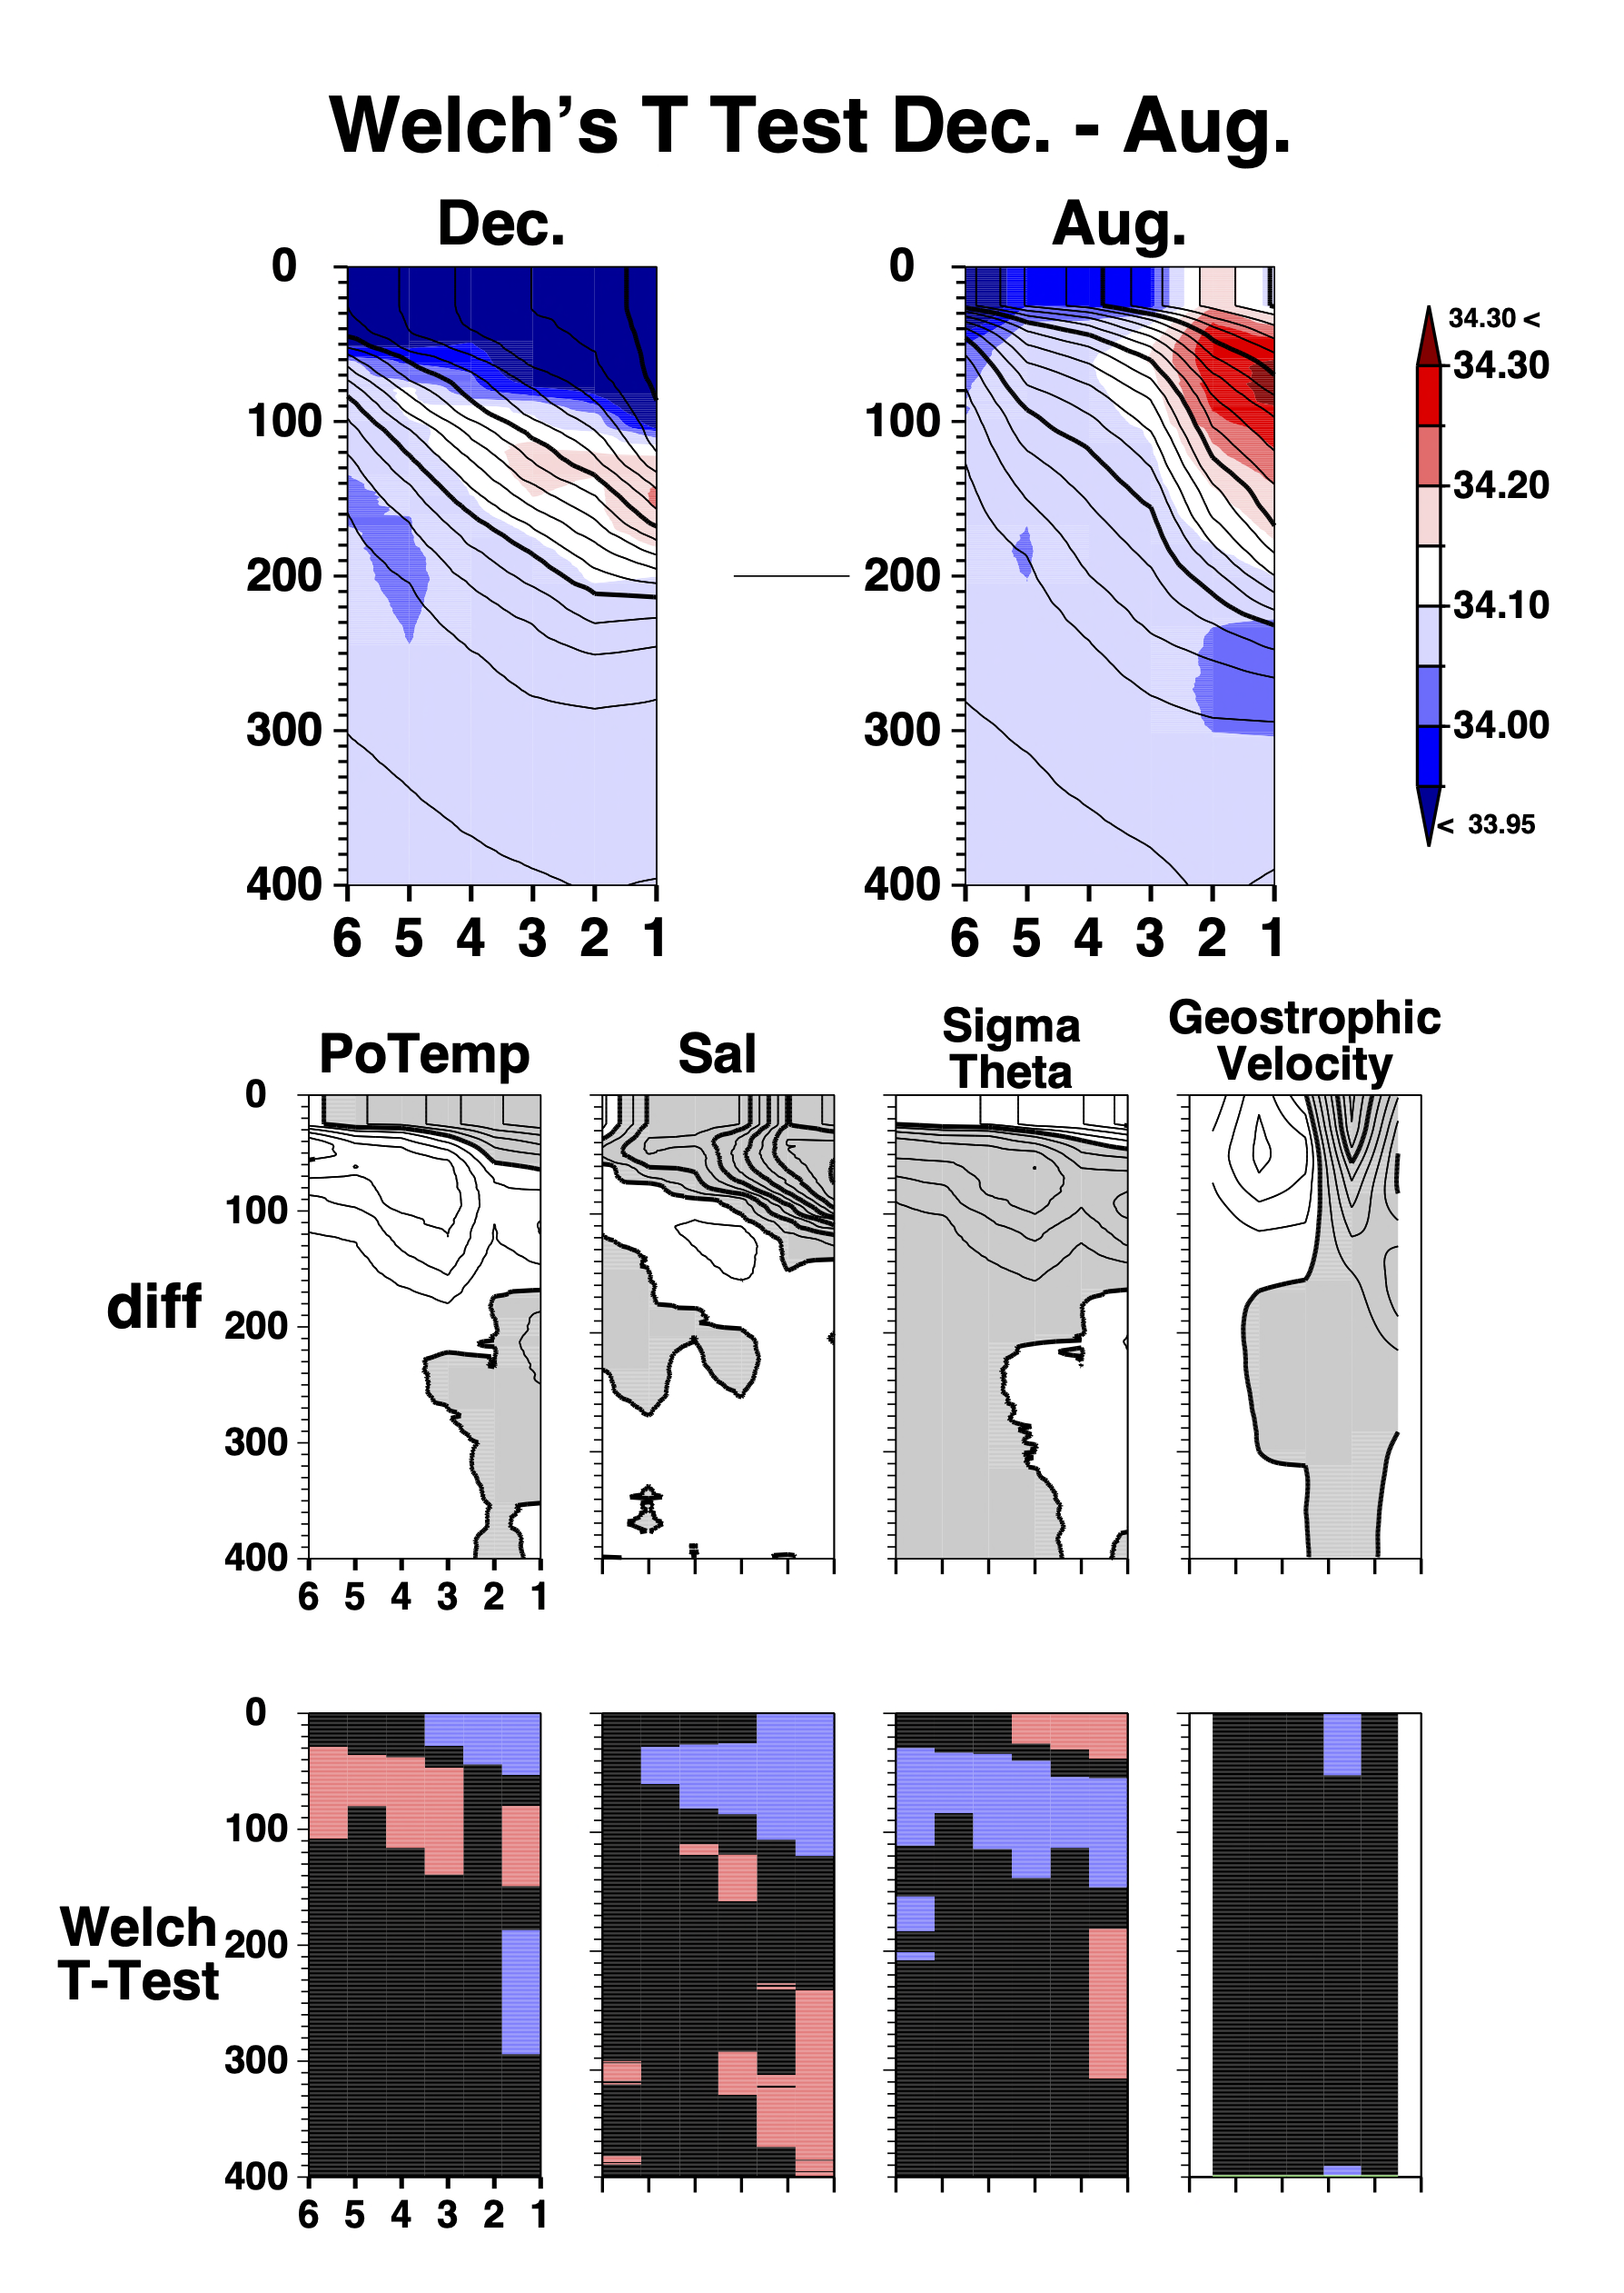
-0.2
5
-0.6
0
-10
-0.1
0
0
0
0

Slide 2
