Slide 1
Invitation to Dry Bulk Market Analysis At Advanced Transportation Planning
July 31, 2020
Koichiro Hayashi

Slide 2
Today’s Contents
Introduction of Tramp Shipping Market
History of Research on Tramp Market
Hands-on #1
Modern Time-Series Analysis
Hands-on #2
Future Studies
Q&A

Slide 3
Self Introduction
Working at NYK Line Research Group
Manager and Chief Analyst of Bulker/Tanker
Cargo (Commodity Production / Demand / Trade)
Fleet (Contract / Delivery / Demolition)
Market (Shipping / Shipbuilding)
M.S. from New York University at 2008
Thesis Subject: Usage of e-Seal for Security
Doctoral Student of TUMSAT from 2020
Doctorate Subject: Cyclical Nature of Drybulk Shipping market.

Slide 4

NYK Annual Shipping Market Report

Slide 5
Today’s Contents
Introduction of Tramp Shipping Market
History of Research on Tramp Market
Hands-on #1
Modern Time-Series Analysis
Hands-on #2
Future Studies
Q&A

Slide 6


Shipping Service : Liner VS. Tramp
 | Liner (mainly Container) | Tramp (incl. Bulker)
Cargo | Container General Cargo | Bulker : Ore, Coal, Grain Tanker : Crude Oil, Gasoline
Schedule | Planned and Published in Advance | Individually decided Based on Shipper’s Convenience
Usage of Ship Space | Partial (Slot of Container) | Basically Ship as a Whole

Slide 7
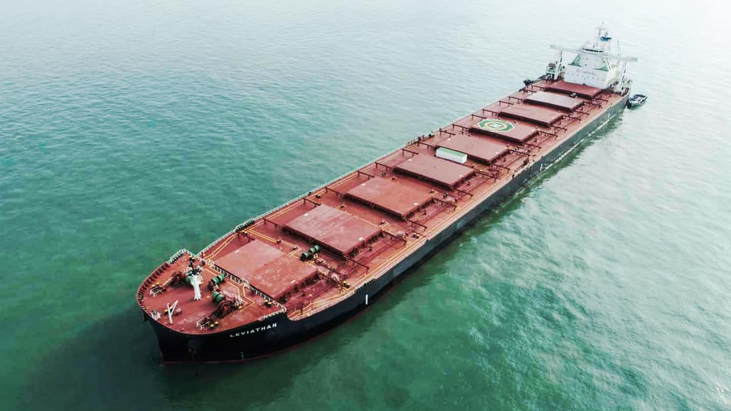
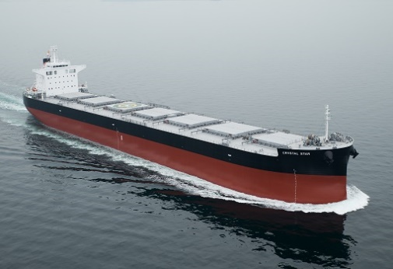
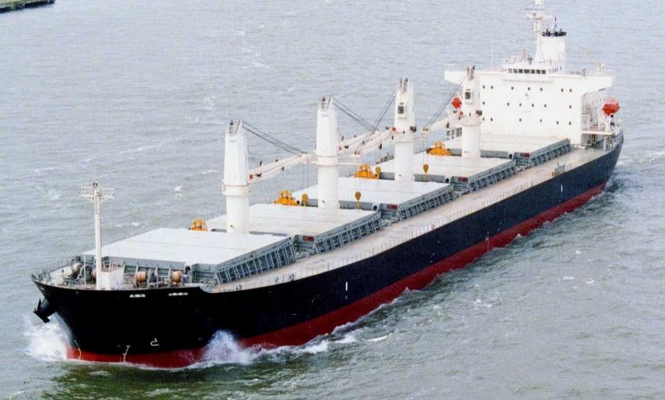
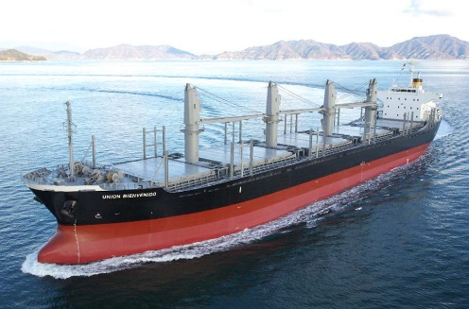
Type of Bulkers (Based on Vessel Size)
Capesize (>100,000DWT)
Gearless
Major Cargo: Iron Ore
Panamax(65,000～99,999DWT)
Gearless
Major Cargo: Coal, Grain
Handymax(40,000～64,999DWT)
Geared
Main Cargo: Grain, Minor Bulk
Handysize(10,000～39,999DWT)
Geared
Main Cargo: Minor Bulk

Slide 8
Characteristics of Bulker Market
Market is separated for each vessel size.
Bulker cargoes are linked to specific vessel size (⬄ container cargoes are not linked to specific vessel size).
Only one or two standard vessel sizes exist for each size group. Spot shipping market exists only for these standard vessel size.
Bulker market is a single global market, not divided by region.
Every shipping contract is different. Standard ships and cargoes exist, but they do not match the actual ones.

Slide 9
Two Kinds of “Freights”
Freight of bulker shipments can be expressed in two ways.
Spot Charter Rate
From the viewpoint of a ship owner.
Pay/receive for ship usage
Freight
From the viewpoint of a cargo owner
Pay/receive for cargo transfer
Relationship between Freight and Spot Charter Rate
Freight (USD/Ton) x Cargo Tonnage
= Spot Charter Rate (USD/Day) x Days of Voyage
+ Fuel Cost + Port/Canal Cost

Slide 10

Fixtures and Baltic Exchange Indices
When an owner and a charterer agreed to disclose their contract (fixture), it will be published to the shipping industry via brokers.
Baltic Exchange publishes market indices based on fixtures and some background information.
These published indices are treated as real freight in most of market analysis, including ones by industry analysts.

Slide 11
Today’s Contents
Introduction of Tramp Shipping Market
History of Research on Tramp Market
Hands-on #1
Modern Time-Seriese Analysis
Hands-on #2
Future Studies
Q&A

Slide 12


Shipping Market Analysis Began with Econometrics
Many of the founders of econometrics, including Nobel laureate Tinbergen and Koopmans, began their carrier with analysis of tramp shipping market in 1930’s.
Since then, tramp shipping market analysis based on demand/supply remained one of the central subjects in maritime economics. Japanese researchers such as Shimojo and Miyashita made significant contribution.

Slide 13
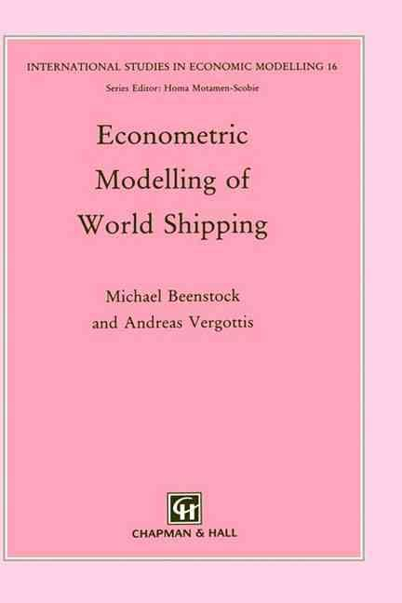
Supply/Demand Approach Suddenly Outdated
This line of study (i.e. time-series analysis of tramp markets based on demand/supply) has been improved and sophisticated, and reached its peak with Beenstock and Vergottis (1993).
However, just after the book was published, this line of study became suddenly outdated.

Slide 14
Reason of Being Outdated
There are some reasons this line of study became outdated.
Soon after the book was published, the shipping market moved into a great bubble. Volatility increased to extreme level and the market became hard to explain. As a result, both industry and academic analysts lose their attention for mathematical analysis.
Indices and maritime/economic indicators became more detailed and with higher frequency. This change invalidated the past know-hows of data.
However, the biggest reason is that the modern time-series analysis concept is introduced.

Slide 15
Today’s Contents
Introduction of Tramp Shipping Market
History of Research on Tramp Market
Hands-on #1
Modern Time-Series Analysis
Hands-on #2
Future Studies
Q&A

Slide 16
Hands-on (1)
> dt <- read.csv("Hayashi_Data1.csv",header=T)
Where dt[,1] is Baltic Panamax 4T/C Average (Monthly, Logarithmic)
dt[,2] is a process created from random numbers. Thus dt[,1] and dt[,2] should not have relationship.
> summary(lm(dt[,1]~dt[,2]))
Call:
lm(formula = dt[, 1] ~ dt[, 2])
Residuals:
Min 1Q Median 3Q Max
-0.51499 -0.14910 -0.00117 0.13960 0.37883
Coefficients:
Estimate Std. Error t value Pr(>|t|)
(Intercept) 3.17214 0.09422 33.67 < 2e-16 ***
dt[, 2] 0.26872 0.03030 8.87 3.42e-14 ***
---
Signif. codes: 0 ‘***’ 0.001 ‘**’ 0.01 ‘*’ 0.05 ‘.’ 0.1 ‘ ’ 1
Residual standard error: 0.1948 on 98 degrees of freedom
Multiple R-squared: 0.4453, Adjusted R-squared: 0.4396
F-statistic: 78.67 on 1 and 98 DF, p-value: 3.424e-14
* High R² Value and very low p-value

Slide 17
Today’s Contents
Introduction of Tramp Shipping Market
History of Research on Tramp Market
Hands-on #1
Modern Time-Series Analysis
Hands-on #2
Future Studies
Q&A

Slide 18
Spurious Regression
Granger and Newbold found that if two independent processes satisfy a specific condition, the regression test with OLS for these processes produces high R² values and high t-ratios. This is called “Spurious Regression”.
Many economic and shipping market indicators used in past tramp market analysis satisfy these condition. Therefore most of past studies based on regression tests were invalidated.

Slide 19
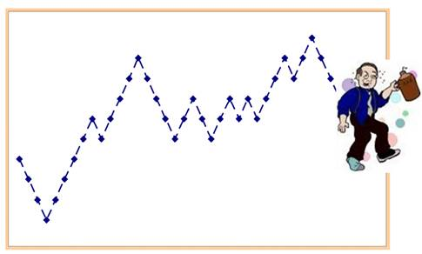
Unit Root / Random Walk Process
A process satisfying the condition notified in the previous slide is called “unit root process”.
A unit root process can be expressed as below:
Y_{t} = Y_{t-1} + c + ε_{t}
Where c is constant and ε_{t} is white noise. When c is zero, the process is called “Random Walk”.

Slide 20

Cointegration
If both X and Y are unit root processes and there exists coefficient α which makes Y+αX not a unit root process, X and Y are cointegrated.
Cointegration is used to determine whether two unit root processes have relationship.
Granger and Engle were awarded the Nobel Memorial Prize in Economic Sciences in 2003 for the developing the concept of cointegration.

Slide 21
Today’s Contents
Introduction of Tramp Shipping Market
History of Research on Tramp Market
Hands-on #1
Modern Time-Seriese Analysis
Hands-on #2
Future Studies
Q&A

Slide 22
Hands-on (2)
> dt <- read.csv("Hayashi_Data2.csv",header=T)
dt[,1] and dt[,2] are the same with Hayashi_Data1.csv
dt[,3] is supply/demand ratio for the Panamax shipping market.
> summary(lm(dt[,1]~dt[,3]))
Call:
lm(formula = dt2[, 1] ~ dt2[, 3])
Residuals:
Min 1Q Median 3Q Max
-0.32032 -0.09910 -0.00183 0.07229 0.32515
Coefficients:
Estimate Std. Error t value Pr(>|t|)
(Intercept) 2.200681 0.102967 21.37 <2e-16 ***
dt2[, 3] 0.090231 0.005152 17.51 <2e-16 ***
---
Signif. codes: 0 ‘***’ 0.001 ‘**’ 0.01 ‘*’ 0.05 ‘.’ 0.1 ‘ ’ 1
Residual standard error: 0.1287 on 98 degrees of freedom
Multiple R-squared: 0.7578, Adjusted R-squared: 0.7554
F-statistic: 306.7 on 1 and 98 DF, p-value: < 2.2e-16
* Also High R² Value and very low p-value

Slide 23
Hands-on (3)
Existence of a unit root can be checked by augmented Dickey-Fuller (ADF) test
> adf.test(dt2[,1])
Augmented Dickey-Fuller Test
data: dt2[, 1]
Dickey-Fuller = -2.496, Lag order = 4, p-value = 0.3712
alternative hypothesis: stationary
> adf.test(dt2[,2])
Augmented Dickey-Fuller Test
data: dt2[, 2]
Dickey-Fuller = -1.9043, Lag order = 4, p-value = 0.6163
alternative hypothesis: stationary
> adf.test(dt2[,3])
Augmented Dickey-Fuller Test
data: dt2[, 3]
Dickey-Fuller = -2.3031, Lag order = 4, p-value = 0.4511
alternative hypothesis: stationary
Existence of a unit root is not rejected for all three processes.

Slide 24
Hands-on (4)
Existence of a cointegration can be checked by augmented Dickey-Fuller test for the residual of regression model
> model1 <- lm(dt2[,1]~dt2[,2])
> adf.test(resid(model1))
data: resid(model1)
Dickey-Fuller = -2.4928, Lag order = 4, p-value = 0.3725
alternative hypothesis: stationary
The residual of regression model between freight process and random walk process has a unit root. As a result, these two processes are not cointegrated.
> model2 <- lm(dt2[,1]~dt2[,3])
> adf.test(resid(model2))
data: resid(model2)
Dickey-Fuller = -3.7226, Lag order = 4, p-value = 0.02578
alternative hypothesis: stationary
The residual of regression model between freight process and supply/demand ratio process does not have a unit root. As a result, these two processes are cointegrated.

Slide 25
Today’s Contents
Introduction of Tramp Shipping Market
History of Research on Tramp Market
Hands-on #1
Modern Time-Series Analysis
Hands-on #2
Future Studies
Q&A

Slide 26
Increasing Attention from Industry
After the bust of the shipping bubble, tramp shipping market returned to be stable. As a result, industry analysts now regard statistical approaches to produce meaningful results.
Also, business people (not limited to the shipping industry) have greater interest in statistical analysis because of a boom in AI and big data.
Maritime database service became more popular and industry analysts can easily download multiple data from the database. They try to investigate them with statistical techniques.

Slide 27
AIS data can be used for analyses.
In recent years, AIS data (real-time report of vessels’ speed and location) are available for both academic and industry analysts.
AIS data can be used as a real-time supply/demand indicator. Also AIS data can be used with other approaches such as geospatial analysis.
Researches on these subjects have not only academic novelty but also business value in the industry.

Slide 28
Wrap Up for This Presentation
Tramp service is a indispensable part of shipping industry, though it is not as well-known as container service.
Because the tramp shipping market is a single global market, time-series analysis should be used.
Past researches on the tramp shipping market was invalidated in the late 1990s because of a new time-series analysis concept introduced by Granger.
Two unit root processes will produce high R² values and t-ratios by regression tests if they are independent.
In order to identify the relationship between two unit root processes, you should test cointegration.

Slide 29
Today’s Contents
Introduction of Tramp Shipping Market
History of Research on Tramp Market
Hands-on #1
Modern Time-Series Analysis
Hands-on #2
Future Studies
Q&A

Slide 30



