Slide 1
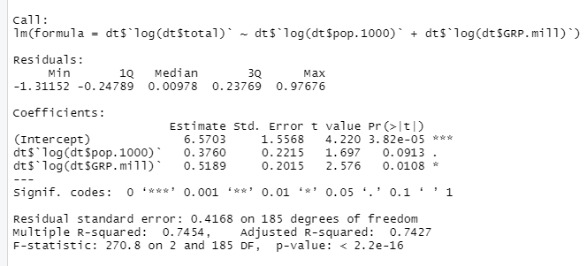
First, Ordinary Least Square (OLS) was tried.
log(total output) ~ log(population) + log(GRP)
Perhaps, satisfactory regression model

Slide 2

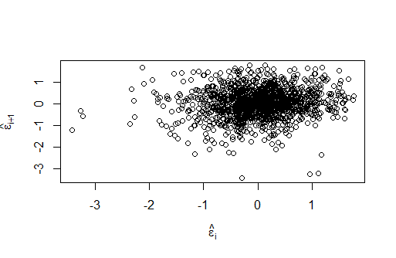
However, the residuals of the normal linear regression model was plotted.
There may be a pattern which might represent the correlation among errors.
The violation of OLS was doubted.
Therefore, Generalized least square (GLS) was opted.

Slide 3
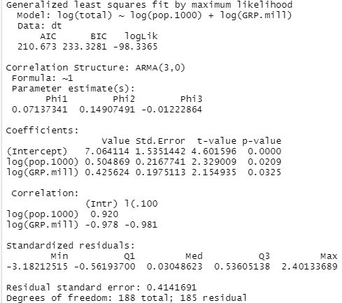

Slide 4



OLS
GLS
GLS
OLS

Slide 5
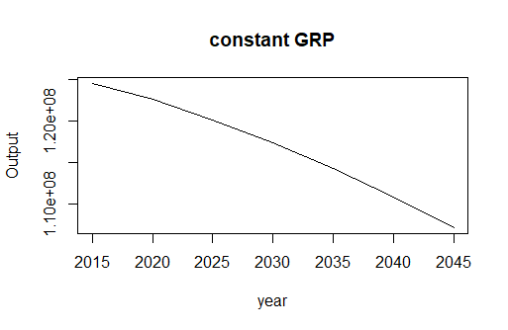
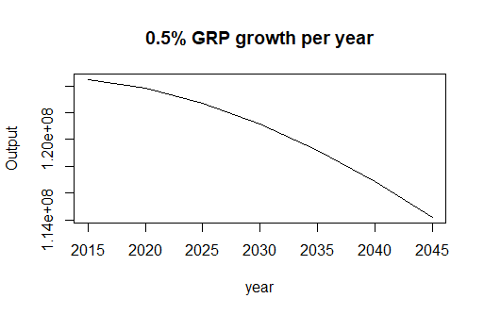
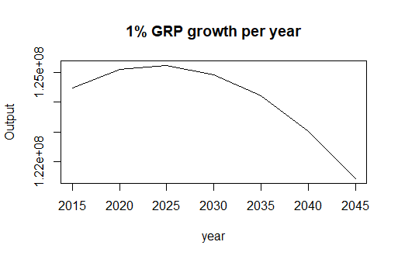
HOKKAIDO

Slide 6
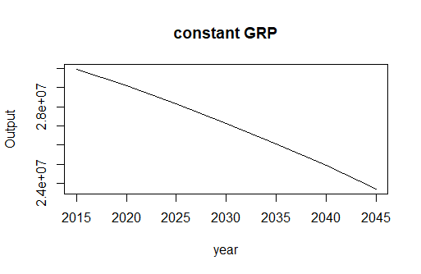
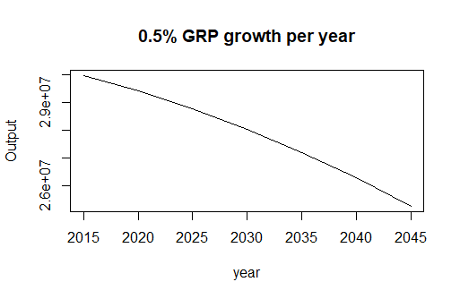

AOMORI

Slide 7
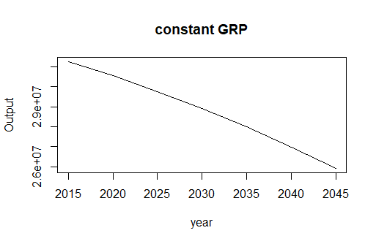
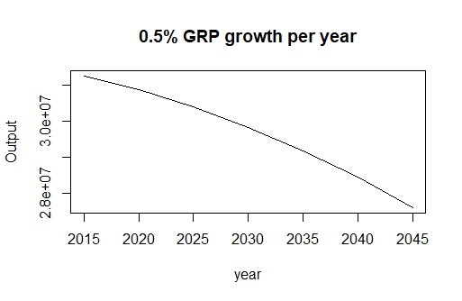
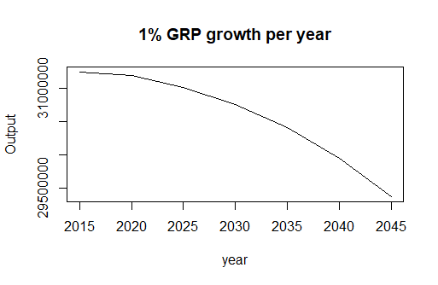
IWATE

Slide 8
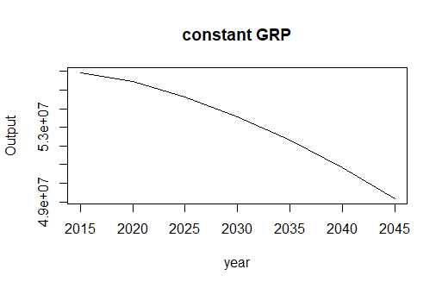
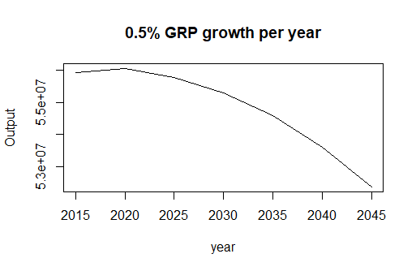
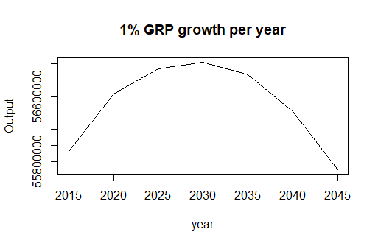
MIYAGI

Slide 9
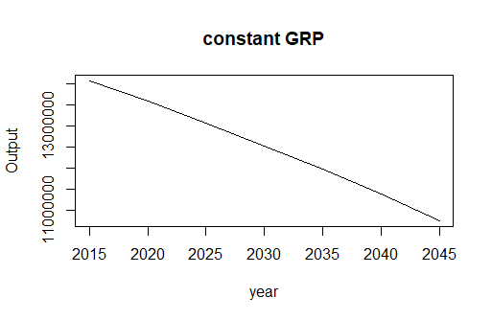
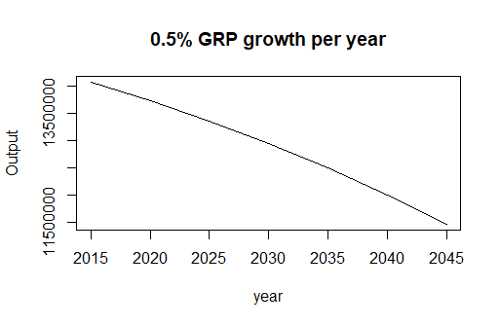
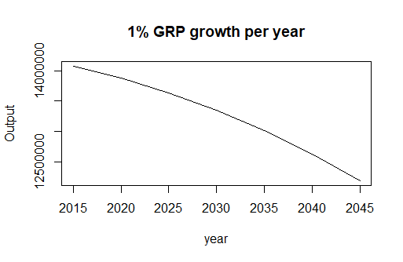
AKITA

Slide 10


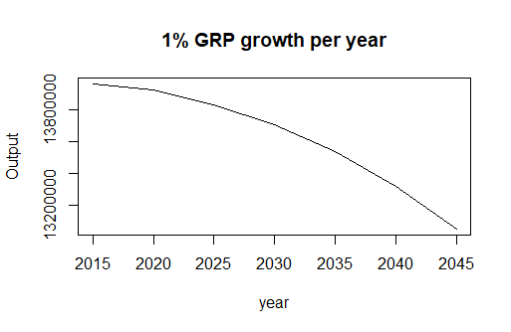
YAMAGATA

Slide 11
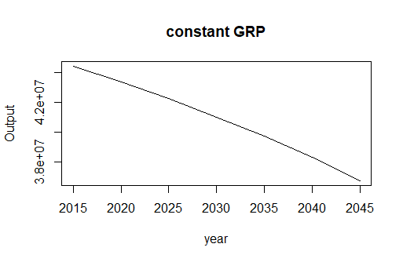
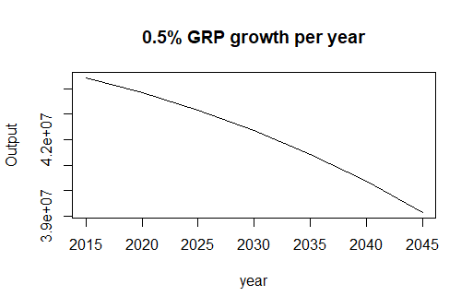
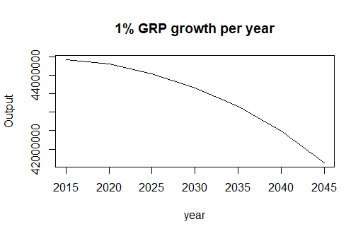
FUKUSHIMA

Slide 12

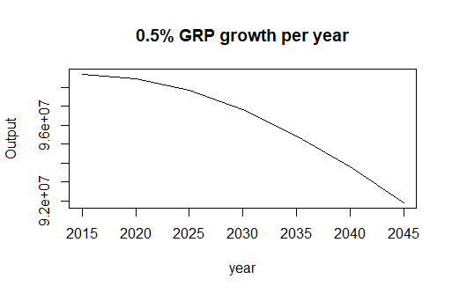
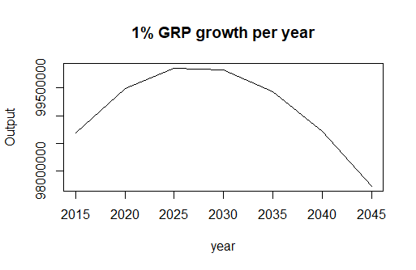
IBARAKI

Slide 13
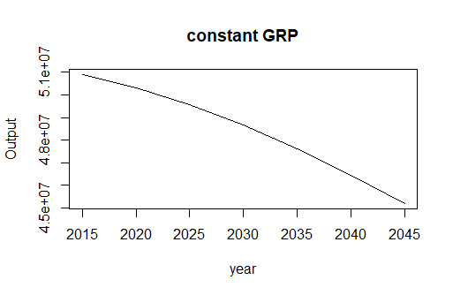
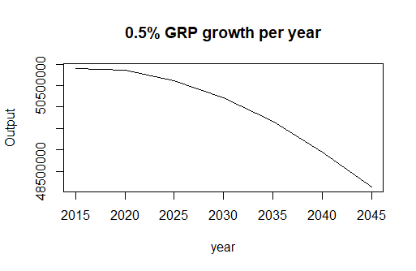
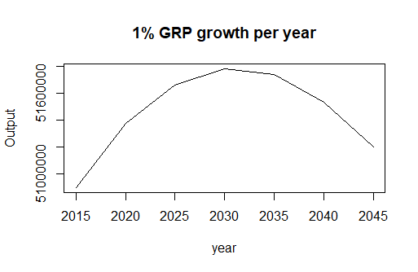
TOCHIGI

Slide 14

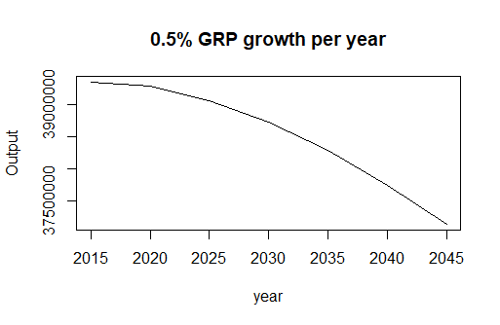
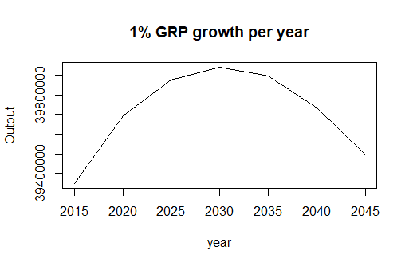
GUNMA

Slide 15
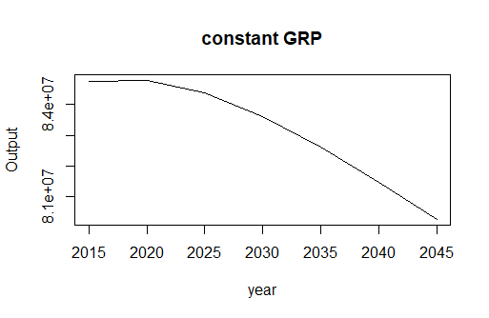
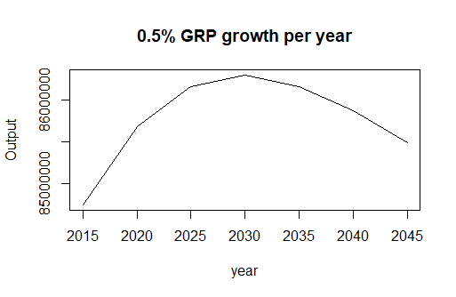
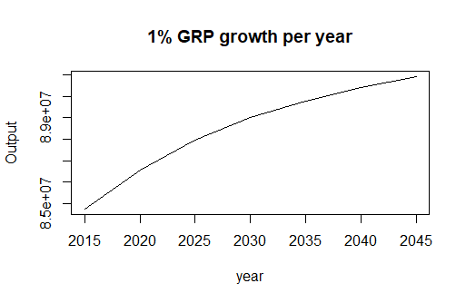
SAITAMA

Slide 16
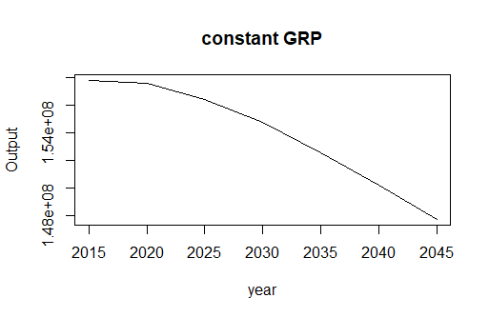
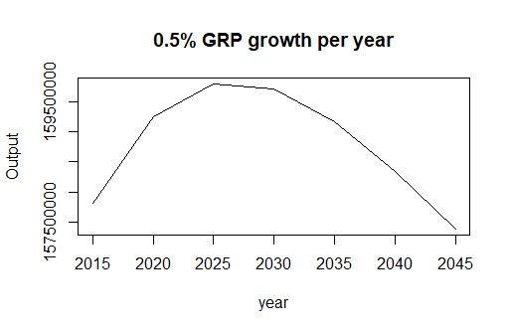
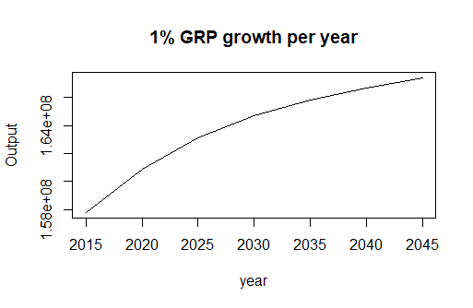
CHIBA

Slide 17
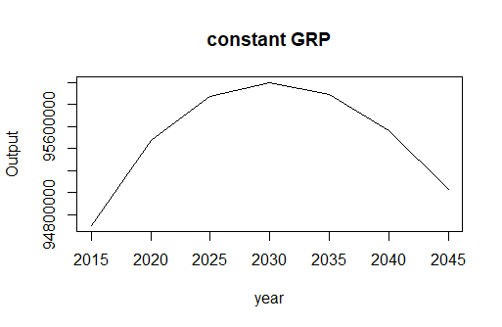
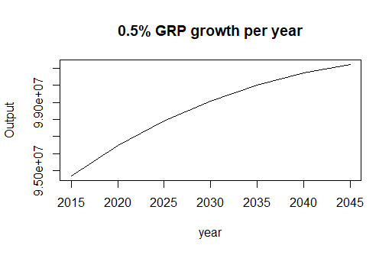
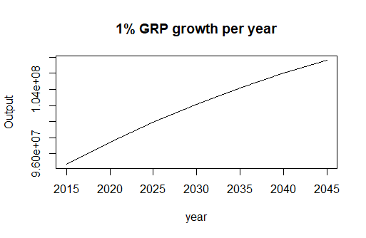
TOKYO

Slide 18
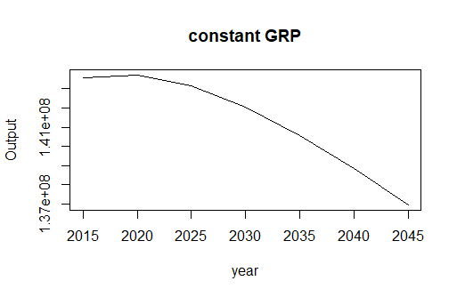
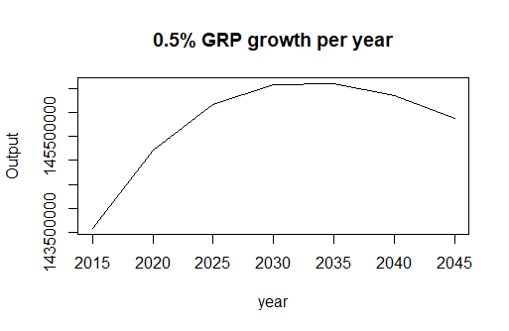
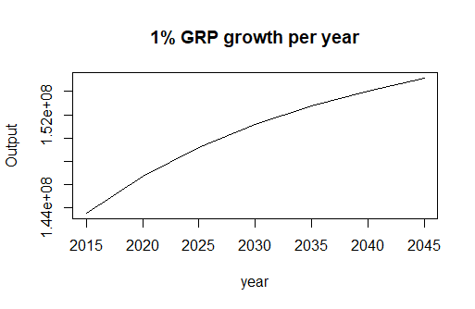
KANAGAWA

Slide 19

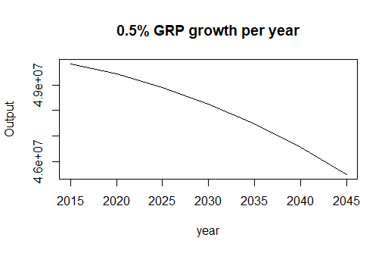
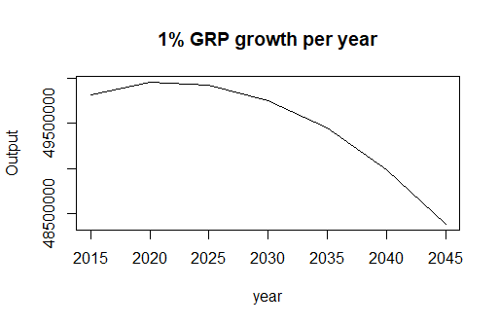
NIIGATA

Slide 20

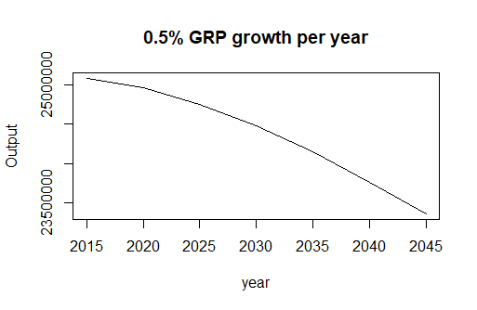
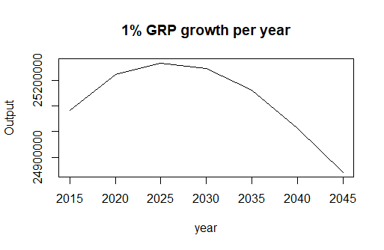
TOYAMA

Slide 21
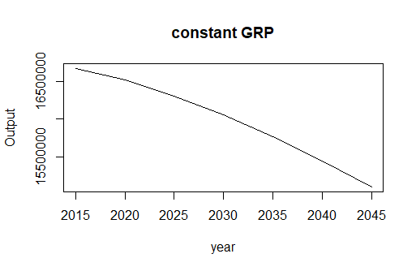
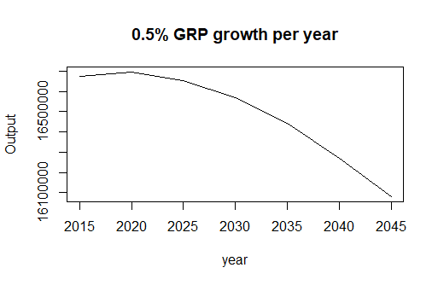
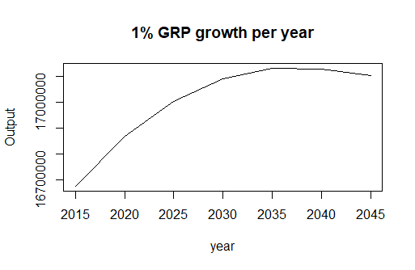
ISHIKAWA

Slide 22

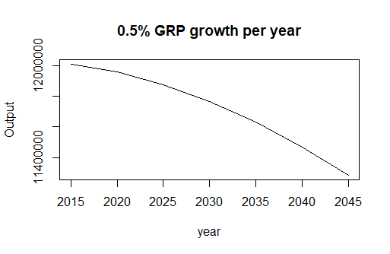
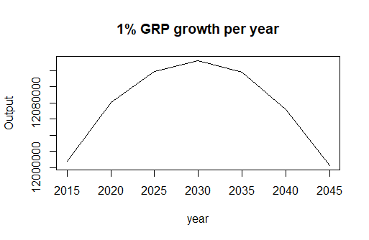
FUKUI

Slide 23
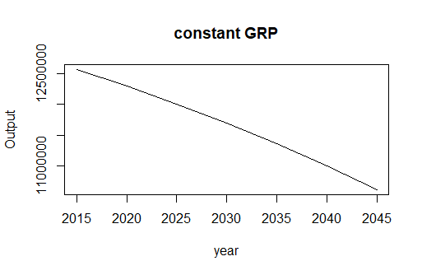


YAMANASHI

Slide 24



NAGANO

Slide 25



GIFU

Slide 26



SHIZUOKA

Slide 27



AICHI

Slide 28



MIE

Slide 29



SHIGA

Slide 30



KYOTO

Slide 31



OSAKA

Slide 32



HYOUGO

Slide 33



NARA

Slide 34



WAKAYAMA

Slide 35



TOTTORI

Slide 36



SHIMANE

Slide 37



OKAYAMA

Slide 38



HIROSHIMA

Slide 39



YAMAGUCHI

Slide 40



TOKUSHIMA

Slide 41



KAGAWA

Slide 42



EHIME

Slide 43



KOUCHI

Slide 44



FUKUOKA

Slide 45



SAGA

Slide 46



NAGASAKI

Slide 47



KUMAMOTO

Slide 48



OOITA

Slide 49



MIYAZAKI

Slide 50



KAGOSHIMA

Slide 51



OKINAWA

