Slide 1
Lecture note for Discrete Choice Models
#4
At
Advanced Transportation Planning
Tetsuro HYODO

Slide 2
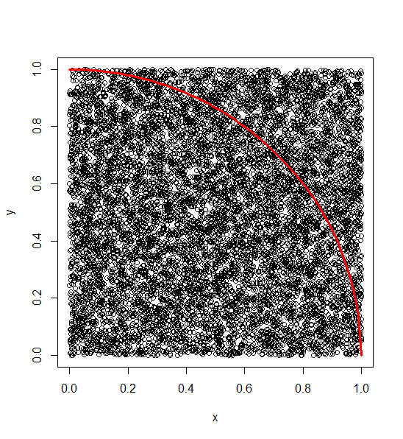
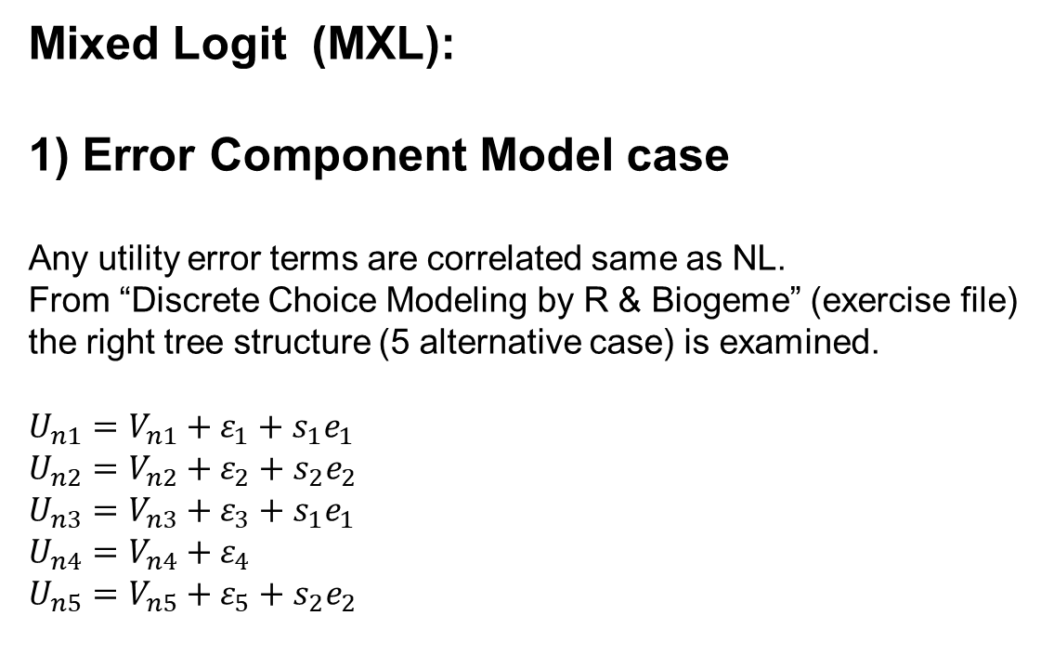
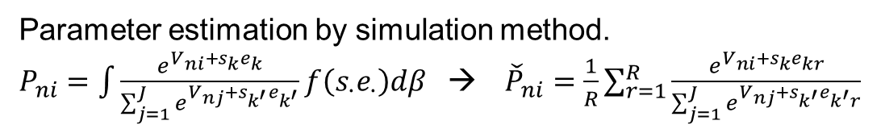

Mixed Logit (MXL):
1) Error Component Model case
Any utility error terms are correlated same as NL.
From “Discrete Choice Modeling by R & Biogeme” (exercise file) the right tree structure (5 alternative case) is examined.
$$U_{n1}=V_{n1}+{ε_{1}+s}_{1}e_{1} \\ U_{n2}=V_{n2}+ε_{2}+s_{2}e_{2} \\ U_{n3}=V_{n3}+ε_{3}+s_{1}e_{1} \\ U_{n4}=V_{n4}+ε_{4} \\ U_{n5}=V_{n5}+ε_{5}+s_{2}e_{2}$$
n <- 10000; x <- runif(n); y <- runif(n)
pi <- sum(x^2+y^2 < 1)/n*4; print(pi); plot(x,y)
curve( sqrt(1-x^2), xlim=c(0,1), ylim=c(0,1), add=T, col="red", lwd=3)
$$ε_{j}\sim G\left(0,λ\right) \\ e_{k}\sim N\left(0,1\right)$$
Parameter estimation by simulation method.
$P_{ni}=\int{\frac{e^{V_{ni}+s_{k}e_{k}}}{\sum_{j=1}^{J}{e^{V_{nj}+s_{k^{′}}e_{k^{′}}}}}f\left(s_{∙}e_{∙}\right)dβ}$ → ${\check{P}}_{ni}=\frac{1}{R}\sum_{r=1}^{R}{\frac{e^{V_{ni}+s_{k}e_{kr}}}{\sum_{j=1}^{J}{e^{V_{nj}+s_{k^{′}}e_{k^{′}r}}}}}$

Slide 3
The core of MXL code by R
np <- 2 #number of error term as MXL
nr <- 300 #number of draws
## making normal random
hm <- array(0,c(np,ns,nr))
for(i in 1:np) hm[i,,] <- matrix(rnorm(ns*nr,0,1),ns*nr,T)
## calculating choice probability
fr <-function(b) {
u <- matrix(0, nr=ns, nc=n.alt) ## utility function
p <- matrix(0, nr=ns, nc=n.alt) ## probability
pp <- matrix(0, nr=ns, nc=n.alt) ## probability
for(i in 1:n.alt) u[,i] <- x[,i,] %*% b[1:n.var]
for(n in 1:nr){
eu <- matrix(0, nr=ns, nc=n.alt)
eu[,1] <- exp(u[,1]+b[n.var+1]*hm[1,,n])
eu[,2] <- exp(u[,2]+b[n.var+2]*hm[2,,n])
eu[,3] <- exp(u[,3]+b[n.var+1]*hm[1,,n])
eu[,4] <- exp(u[,4] )
eu[,5] <- exp(u[,5]+b[n.var+2]*hm[2,,n])
for(i in 1:n.alt) p[,i] <- eu[,i]/rowSums(eu)
pp <- pp + p
}
return(pp/nr)
}

Slide 4
The result of estimation
Maximum Likelihood estimation
Newton-Raphson maximisation, 11 iterations
Return code 2: successive function values within tolerance limit
Log-Likelihood: -1110.832
12 free parameters
Estimates:
Estimate Std. error t value Pr(> t)
[1,] -0.025049 0.013385 -1.871 0.06128 .
[2,] -0.019835 0.003911 -5.071 3.95e-07 ***
[3,] 0.151463 0.274250 0.552 0.58076
[4,] -0.028803 0.122327 -0.235 0.81385
[5,] -1.213324 0.303061 -4.004 6.24e-05 ***
[6,] 0.513281 0.189933 2.702 0.00688 **
[7,] -0.840916 1.094945 -0.768 0.44249
[8,] 2.708272 0.290301 9.329 < 2e-16 ***
[9,] -4.621670 1.661289 -2.782 0.00540 **
[10,] -1.410881 1.279890 -1.102 0.27031
[11,] 1.164329 1.370257 0.850 0.39548
[12,] 2.547433 1.108628 2.298 0.02157 *

Slide 5
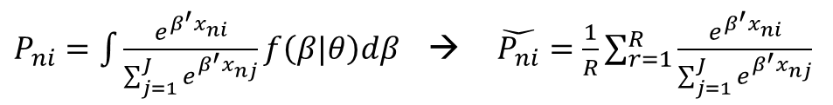
Estimation of Mixed Logit Model
$P_{ni}=\int{\frac{e^{β^{′}x_{ni}}}{\sum_{j=1}^{J}{e^{β^{′}x_{nj}}}}f\left(β|θ\right)dβ}$ → $\check{P_{ni}}=\frac{1}{R}\sum_{r=1}^{R}{\frac{e^{β^{′}x_{ni}}}{\sum_{j=1}^{J}{e^{β^{′}x_{nj}}}}}$
MXL_4_13_25.r
rm(list=ls())
setwd("c:/usr/doc/dropbox/daigakuin/forComp/")
library(maxLik)
library(randtoolbox)
dt <-read.csv("d1000.csv",header=T)
ns <- nrow(dt) ## ns is number of samples
n.alt <- 5 ## number of alternatives
n.var <- 10 ## number of parameters
b0 <- rep(0,n.var) ## set initial parameters
x <- array(0,c(ns,n.alt,n.var)) ## make independent variable matrix
y <- array(0,c(ns,n.alt)) ## make choice result matrix
m.av <- array(1,c(ns,n.alt)) ## mode availability
np <- 2 #number of error term as MXL
nr <- 100

Slide 6
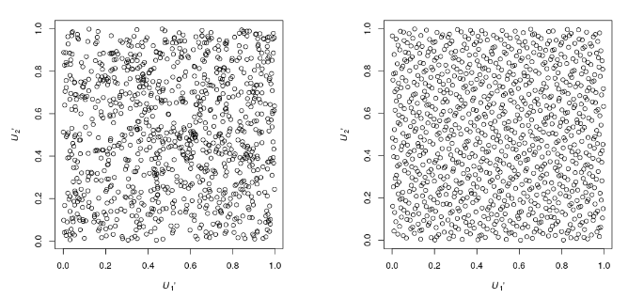
## making Halton sequence
hm <- array(0,c(np,ns,nr))
h <- array(0,c(ns*np*nr,2))
h[,1] <- halton(ns*np*nr,dim=1,init=T,normal=F,usetime=F)
h[,2] <- runif(ns*np*nr) # randoms for scramble
hn <- h[order(h[,2]),1] # scrambling by sorting uniformR
hn <- qnorm(hn) # qnorm: to normalD, qlnorm: to log-normalD
for (i in 1:np){
a <- hn[( (i-1)*ns*nr+1 ):( i*ns*nr ) ]
hm[i,,] <- matrix(a,ns*nr,T)
}
b0 <- c(-0.01726, -0.01694, 0.4128, 0.07561, -0.8467, 0.6351, 0.5342, 2.652, -3.677, 0.4521, 0.5, 0.5)
## calculating choice probability
fr <-function(b) {
u <- matrix(0, nr=ns, nc=n.alt) ## utility function
p <- matrix(0, nr=ns, nc=n.alt) ## probability
pp <- matrix(0, nr=ns, nc=n.alt) ## probability
for(i in 1:n.alt) u[,i] <- x[,i,] %*% b[1:n.var]
for(n in 1:nr){
eu <- matrix(0, nr=ns, nc=n.alt)
eu[,1] <- exp(u[,1]+b[n.var+1]*hm[1,,n])
eu[,2] <- exp(u[,2]+b[n.var+2]*hm[2,,n])
eu[,3] <- exp(u[,3]+b[n.var+1]*hm[1,,n])
eu[,4] <- exp(u[,4] )
eu[,5] <- exp(u[,5]+b[n.var+2]*hm[2,,n])
for(i in 1:n.alt) p[,i] <- eu[,i]/rowSums(eu)
pp <- pp + p
}
return(pp/nr)
}

Slide 7
## log likelihood function
sumfr <- function (x) {
a <- sum( log( rowSums(fr(x)*y) ) ) ; print(a) #; print(Sys.time())
return(a)
}
## set matrix of variables: x[, mode, parameter.num]
x[,1,1] <- dt[, 2]; x[,2,1] <- dt[, 3]; x[,3,1] <- dt[, 4]; x[,4,1] <- dt[, 5]; x[,5,1] <- dt[, 6]
x[,1,2] <- dt[, 7]; x[,2,2] <- dt[, 8]; x[,3,2] <- dt[, 9]; x[,4,2] <- dt[,10]; x[,5,2] <- dt[,11]
x[,1,3] <- dt[,12]; x[,2,3] <- dt[,13]; x[,3,3] <- dt[,14]; x[,4,3] <- dt[,15]; x[,5,3] <- dt[,16]
x[,1,4] <- dt[,17]; x[,2,4] <- dt[,18]; x[,3,4] <- dt[,19]; x[,4,4] <- dt[,20]; x[,5,4] <- dt[,21]
x[,1,5] <- dt[,22]; x[,2,5] <- dt[,23]; x[,3,5] <- dt[,24]; x[,4,5] <- dt[,25]; x[,5,5] <- dt[,26]
x[,1,6] <- dt[,27]; x[,2,6] <- dt[,28]; x[,3,6] <- dt[,29]; x[,4,6] <- dt[,30]; x[,5,6] <- dt[,31]
x[,2,7] <- 1; x[,3,8] <- 1; x[,4,9] <- 1; x[,5,10] <- 1
y <- array(0,c(ns,5))
for(n in 1:ns) y[n,dt[n,1]] <- 1
system.time( res <- maxLik(sumfr,start=b0) )
print(res)
summary(res)

Slide 8
Estimation of Mixed Logit Model by Biogeme
from biogeme import *
from headers import *
from loglikelihood import *
from statistics import *
from nested import *
ASC_1ibaraki = Beta('ASC_1ibaraki', 0 , -100, 100, 1,'1ibaraki cte.')
ASC_2tokyo = Beta('ASC_2tokyo' ,-2.19 , -100, 100, 0,'2tokyo cte.')
ASC_3hachi = Beta('ASC_3hachi' , 2.95 , -100, 100, 0,'3hachi cte.')
ASC_4rail = Beta('ASC_4rail' ,-3.78 , -100, 100, 0,'4rail cte.')
ASC_5seikan = Beta('ASC_5seikan' ,-0.978, -100, 100, 0,'5seikan cte.')
B_TIME = Beta('B_TIME' ,-0.00284, -100, 100, 0,'Travel time')
B_COST = Beta('B_COST' ,-0.107 , -100, 100, 0,'Travel cost')
D_1weight = Beta('D_1weight' , 0.577 , -100, 100, 0,'Weight 1')
D_2weight = Beta('D_2weight' , 1.11 , -100, 100, 0,'Weight 2')
D_3weight = Beta('D_3weight' ,-0.978, -100, 100, 0,'Weight 3')
D_4weight = Beta('D_4weight' , 1.04 , -100, 100, 0,'Weight 4')
D_5weight = Beta('D_5weight' , 0 , -100, 100, 1,'Weight 5')
S_n13 = Beta('S_n13' , 0.1, 0, 100, 0)
ES_n13 = S_n13 * bioDraws('ES_n13')
S_n25 = Beta('S_n25' , 0.1, 0, 100, 0)
ES_n25 = S_n25 * bioDraws('ES_n25')
MXL_bio_4_13_25.py

Slide 9
V1 = ASC_1ibaraki + B_TIME*time_1ibaraki + B_COST * cost_1ibaraki + D_1weight * weight_log10 + ES_n13
V2 = ASC_2tokyo + B_TIME*time_2tokyo + B_COST * cost_2tokyo + D_2weight * weight_log10 + ES_n25
V3 = ASC_3hachi + B_TIME*time_3hachi + B_COST * cost_3hachi + D_3weight * weight_log10 + ES_n13
V4 = ASC_4rail + B_TIME*time_4rail + B_COST * cost_4rail + D_4weight * weight_log10
V5 = ASC_5seikan + B_TIME*time_5seikan + B_COST * cost_5seikan + D_5weight * weight_log10 + ES_n25
V = {1: V1, 2: V2, 3: V3, 4: V4, 5: V5 }
av = {1: 1, 2: 1, 3: 1, 4: 1, 5: 1 }
logprob = bioLogit(V,av,mode)
l = mixedloglikelihood(logprob)
rowIterator('obsIter')
BIOGEME_OBJECT.ESTIMATE = Sum(l, 'obsIter')
nullLoglikelihood(av,'obsIter')
choiceSet = [1,2,3,4,5]
cteLoglikelihood(choiceSet,mode,'obsIter')
availabilityStatistics(av,'obsIter')
BIOGEME_OBJECT.PARAMETERS['NbrOfDraws'] = "300"
BIOGEME_OBJECT.PARAMETERS['RandomDistribution'] = "HALTON"
BIOGEME_OBJECT.PARAMETERS['optimizationAlgorithm'] = "BIO"
BIOGEME_OBJECT.DRAWS = { 'ES_n13':'NORMAL’, 'ES_n25':'NORMAL' }
BIOGEME_OBJECT.FORMULAS['1ibaraki utility'] = V1
BIOGEME_OBJECT.FORMULAS['2tokyo utility'] = V2
BIOGEME_OBJECT.FORMULAS['3hachi utility'] = V3
BIOGEME_OBJECT.FORMULAS['4rail utility'] = V4
BIOGEME_OBJECT.FORMULAS['5seikan utility'] = V5

Slide 10
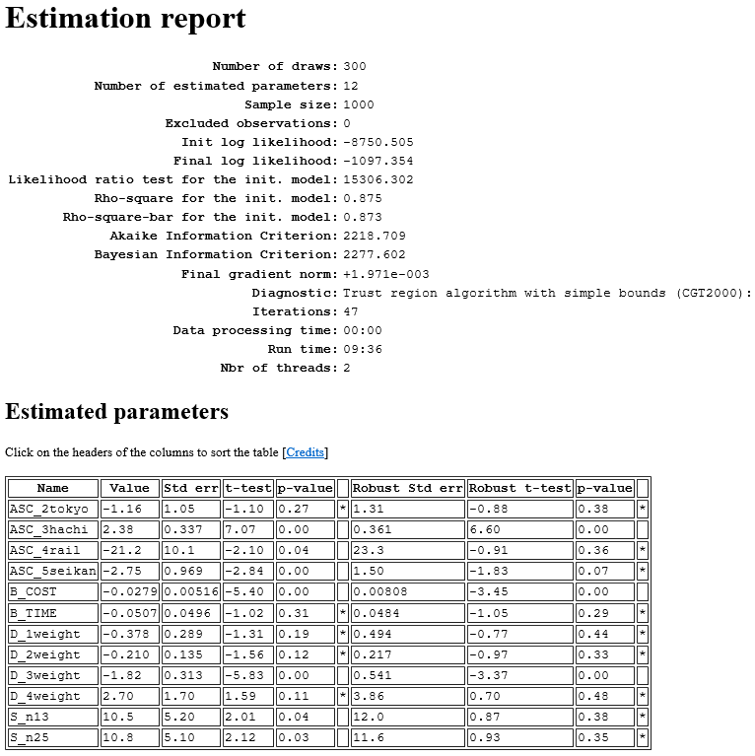

Slide 11
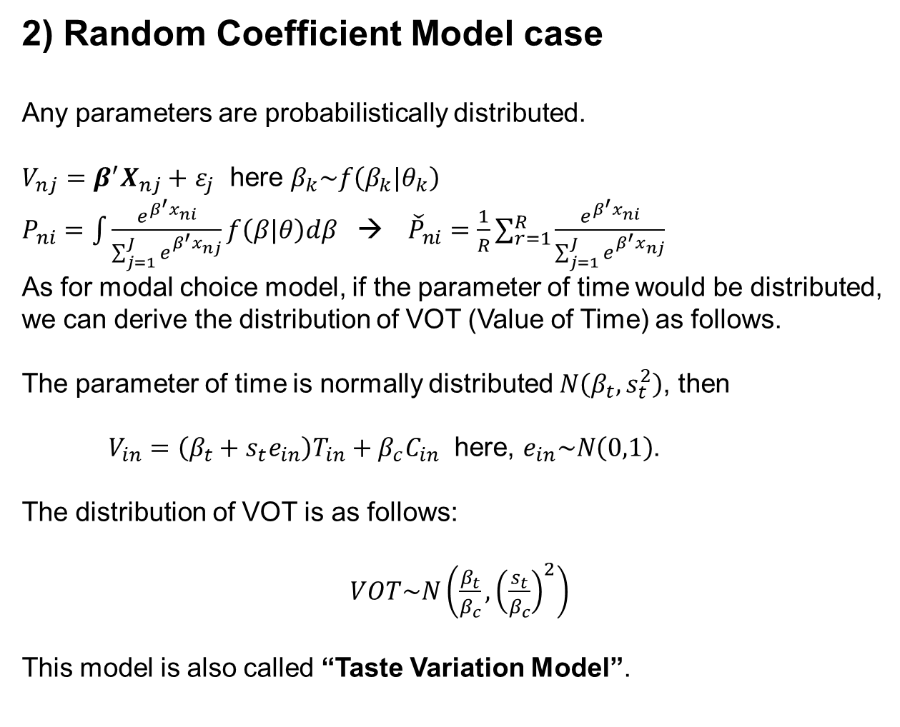
2) Random Coefficient Model case
Any parameters are probabilistically distributed.
$V_{nj}=β^{′}X_{nj}+$ $ε_{j}$ here $β_{k}\sim f\left(β_{k}|θ_{k}\right)$
$P_{ni}=\int{\frac{e^{β^{′}x_{ni}}}{\sum_{j=1}^{J}{e^{β^{′}x_{nj}}}}f\left(β|θ\right)dβ}$ → ${\check{P}}_{ni}=\frac{1}{R}\sum_{r=1}^{R}{\frac{e^{β^{′}x_{ni}}}{\sum_{j=1}^{J}{e^{β^{′}x_{nj}}}}}$
As for modal choice model, if the parameter of time would be distributed, we can derive the distribution of VOT (Value of Time) as follows.
The parameter of time is normally distributed $N\left(β_{t},s_{t}^{2}\right)$, then
$V_{in}=\left(β_{t}+s_{t}e_{in}\right)T_{in}+β_{c}C_{in}$ here, $e_{in}\sim N\left(0,1\right)$.
The distribution of VOT is as follows:
$VOT\sim N\left(\frac{β_{t}}{β_{c}}, {\left(\frac{s_{t}}{β_{c}}\right)}^{2}\right)$
This model is also called “Taste Variation Model”.

Slide 12
The core of MXL code by R
np <- 1 #number of error term as MXL
nr <- 300
hm <- array(0,c(np,ns,nr))
for(i in 1:np) hm[i,,] <- matrix(rnorm(ns*nr,0,1),ns*nr,T)
## calculating choice probability
fr <-function(b) {
u <- matrix(0, nr=ns, nc=n.alt) ## utility function
p <- matrix(0, nr=ns, nc=n.alt) ## probability
pp <- matrix(0, nr=ns, nc=n.alt) ## probability
for(i in 1:n.alt) u[,i] <- x[,i,] %*% b[1:n.var]
for(n in 1:nr){
eu <- matrix(0, nr=ns, nc=n.alt)
eu[,1] <- exp(u[,1] + b[n.var+1]*hm[1,,n]*x[,1,1] )
eu[,2] <- exp(u[,2] + b[n.var+1]*hm[1,,n]*x[,2,1] )
eu[,3] <- exp(u[,3] + b[n.var+1]*hm[1,,n]*x[,3,1] )
eu[,4] <- exp(u[,4] + b[n.var+1]*hm[1,,n]*x[,4,1] )
eu[,5] <- exp(u[,5] + b[n.var+1]*hm[1,,n]*x[,5,1] )
for(i in 1:n.alt) p[,i] <- eu[,i]/rowSums(eu)
pp <- pp + p
}
return(pp/nr)
}

Slide 13
The result of estimation
Maximum Likelihood estimation
Newton-Raphson maximisation, 9 iterations
Return code 2: successive function values within tolerance limit
Log-Likelihood: -1091.708
11 free parameters
Estimates:
Estimate Std. error t value Pr(> t)
[1,] -0.123468 0.027260 -4.529 5.92e-06 ***
[2,] -0.014950 0.002803 -5.334 9.59e-08 ***
[3,] 0.570301 0.123413 4.621 3.82e-06 ***
[4,] 0.879492 0.236993 3.711 0.000206 ***
[5,] -0.963296 0.118792 -8.109 5.10e-16 ***
[6,] 0.997711 0.173028 5.766 8.11e-09 ***
[7,] -1.671947 0.655140 -2.552 0.010709 *
[8,] 2.637376 0.267775 9.849 < 2e-16 ***
[9,] -4.022165 0.613392 -6.557 5.48e-11 ***
[10,] -0.010181 0.333908 -0.030 0.975677
[11,] -0.200743 0.030120 -6.665 2.65e-11 ***

Slide 14
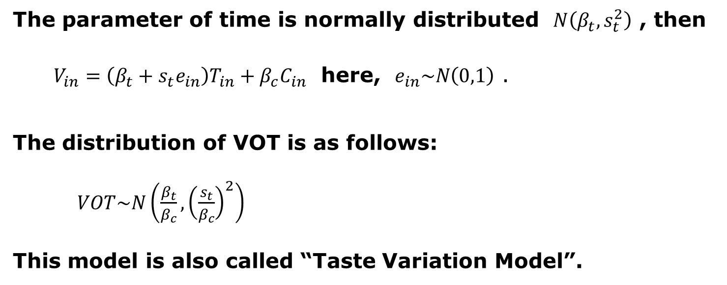
Random Coefficient Model by Mixed Logit
For example, probabilistically distributed value of time (VOT) can be estimated by random coefficient model.
The parameter of time is normally distributed $N\left(β_{t},s_{t}^{2}\right)$ , then
$V_{in}=\left(β_{t}+s_{t}e_{in}\right)T_{in}+β_{c}C_{in}$ here, $e_{in}\sim N\left(0,1\right)$ .
The distribution of VOT is as follows:
$VOT\sim N\left(\frac{β_{t}}{β_{c}}, {\left(\frac{s_{t}}{β_{c}}\right)}^{2}\right)$
This model is also called “Taste Variation Model”.
MXL_TV.r
MXL_bio_TV.py
Taste variation by homemade (R)
Taste variation by Biogeme

Slide 15
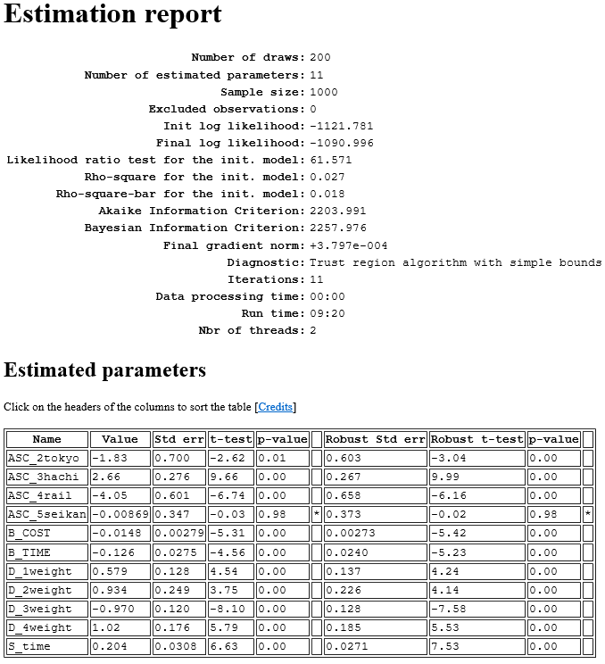
“mlogit” also can estimate MXL such as:
mxl <- mlogit(mode~time+cost+wei1+wei2+wei3+wei4, m_dt,
rpar=c(time='n'), R = 1000, print.level=1)
summary(mxl)

Slide 16
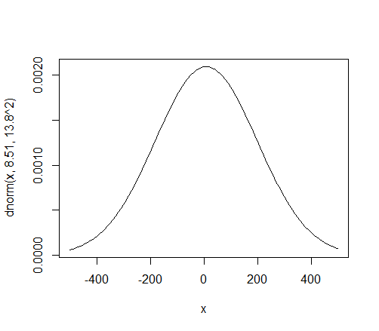
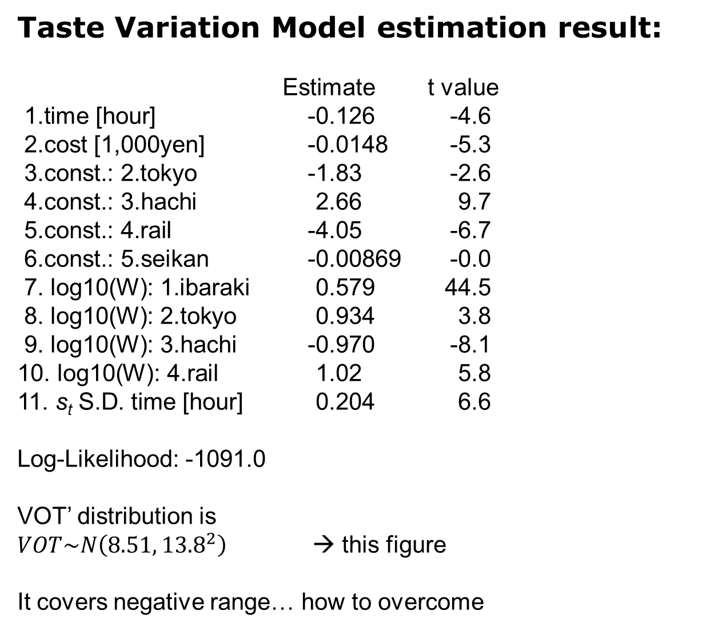
Taste Variation Model estimation result:
Estimate t value
1.time [hour] -0.126 -4.6
2.cost [1,000yen] -0.0148 -5.3
3.const.: 2.tokyo -1.83 -2.6
4.const.: 3.hachi 2.66 9.7
5.const.: 4.rail -4.05 -6.7
6.const.: 5.seikan -0.00869 -0.0
7. log10(W): 1.ibaraki 0.579 44.5
8. log10(W): 2.tokyo 0.934 3.8
9. log10(W): 3.hachi -0.970 -8.1
10. log10(W): 4.rail 1.02 5.8
11. s_{t} S.D. time [hour] 0.204 6.6
Log-Likelihood: -1091.0
VOT’ distribution is
$VOT\sim N\left(8.51, {13.8}^{2}\right)$ → this figure
It covers negative range… how to overcome
curve(dnorm(x,8.51,13.8^2),-500,500)

Slide 17
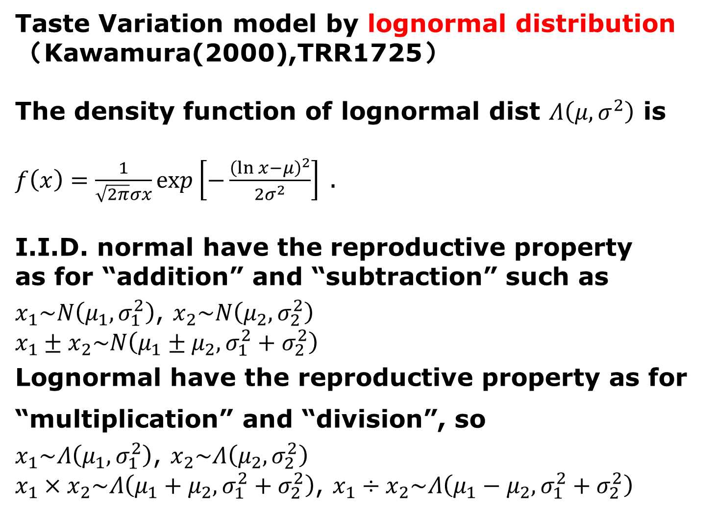
Taste Variation model by lognormal distribution
（Kawamura(2000),TRR1725）
The density function of lognormal dist $Λ\left(μ, σ^{2}\right)$ is
$f\left(x\right)=\frac{1}{\sqrt{2π}σx}exp\left[−\frac{{\left(\ln{x}−μ\right)}^{2}}{2σ^{2}}\right]$ .
I.I.D. normal have the reproductive property as for “addition” and “subtraction” such as
$x_{1}\sim N\left(μ_{1}, σ_{1}^{2}\right)$, $x_{2}\sim N\left(μ_{2}, σ_{2}^{2}\right)$
$$x_{1}±x_{2}\sim N\left(μ_{1}±μ_{2}, σ_{1}^{2}+σ_{2}^{2}\right)$$
Lognormal have the reproductive property as for
“multiplication” and “division”, so
$x_{1}\sim Λ\left(μ_{1}, σ_{1}^{2}\right)$, $x_{2}\sim Λ\left(μ_{2}, σ_{2}^{2}\right)$
$x_{1}×x_{2}\sim Λ\left(μ_{1}+μ_{2}, σ_{1}^{2}+σ_{2}^{2}\right)$, $x_{1}÷x_{2}\sim Λ\left(μ_{1}−μ_{2}, σ_{1}^{2}+σ_{2}^{2}\right)$

Slide 18
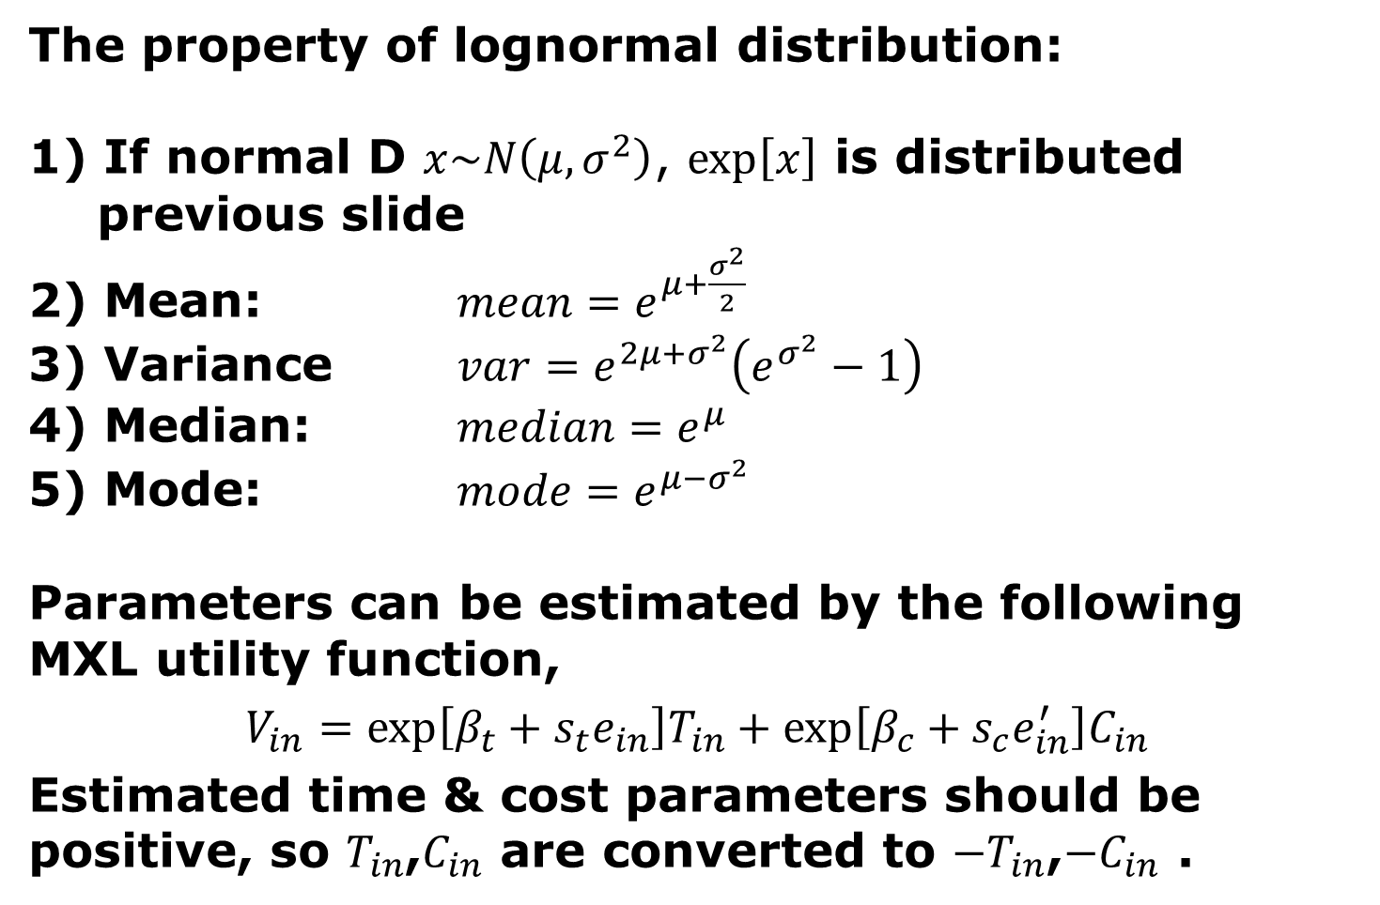
The property of lognormal distribution:
1) If normal D $x\sim N\left(μ, σ^{2}\right)$, $\exp\left[x\right]$ is distributed previous slide
2) Mean: $mean=e^{μ+\frac{σ^{2}}{2}}$
3) Variance $var=e^{2μ+σ^{2}}\left(e^{σ^{2}}−1\right)$
4) Median: $median=e^{μ}$
5) Mode: $mode=e^{μ−σ^{2}}$
Parameters can be estimated by the following MXL utility function,
$$V_{in}=\exp\left[β_{t}+s_{t}e_{in}\right]T_{in}+\exp\left[β_{c}+s_{c}e_{in}^{′}\right]C_{in}$$
Estimated time & cost parameters should be positive, so $T_{in}$,$C_{in}$ are converted to $−T_{in}$,$−C_{in}$ .
MXL_TV_logN.r
MXL_logN_bio.py
Lognormal TV by homemade (R)
Lognormal TV by Biogeme

Slide 19
Homemade R code :
for(i in 1:n.alt) u[,i] <- x[,i,] %*% b[1:n.var]
for(n in 1:nr){
eu <- matrix(0, nr=ns, nc=n.alt)
eu[,1] <- exp(u[,1] - exp(b[n.var+1]+b[n.var+2]*hm[1,,n])*TC[,1,1]
- exp(b[n.var+3]+b[n.var+4]*hm[2,,n])*TC[,1,2])
eu[,2] <- exp(u[,2] - exp(b[n.var+1]+b[n.var+2]*hm[1,,n])*TC[,2,1]
- exp(b[n.var+3]+b[n.var+4]*hm[2,,n])*TC[,2,2])
eu[,3] <- exp(u[,3] - exp(b[n.var+1]+b[n.var+2]*hm[1,,n])*TC[,3,1]
- exp(b[n.var+3]+b[n.var+4]*hm[2,,n])*TC[,3,2])
eu[,4] <- exp(u[,4] - exp(b[n.var+1]+b[n.var+2]*hm[1,,n])*TC[,4,1]
- exp(b[n.var+3]+b[n.var+4]*hm[2,,n])*TC[,4,2])
eu[,5] <- exp(u[,5] - exp(b[n.var+1]+b[n.var+2]*hm[1,,n])*TC[,5,1]
- exp(b[n.var+3]+b[n.var+4]*hm[2,,n])*TC[,5,2])
for(i in 1:n.alt) p[,i] <- eu[,i]/rowSums(eu)
pp <- pp + p
}
return(pp/nr)
time
cost

Slide 20
Biogeme code :
S_TIME = Beta('S_TIME' , 0.8, 0, 10, 0)
ES_TIME = S_TIME * bioDraws('ES_TIME')
S_COST = Beta('S_COST' , 0.8, 0, 10, 0)
ES_COST = S_COST * bioDraws('ES_COST')
n_time_1ibaraki = DefineVariable('time_1ibaraki_neg', time_1ibaraki * -1 )
n_time_2tokyo = DefineVariable('time_2tokyo_neg' , time_2tokyo * -1 )
n_time_3hachi = DefineVariable('time_3hachi_neg' , time_3hachi * -1 )
n_time_4rail = DefineVariable('time_4rail_neg' , time_4rail * -1 )
n_time_5seikan = DefineVariable('time_5seikan_neg' , time_5seikan * -1 )
n_cost_1ibaraki = DefineVariable('cost_1ibaraki_neg', cost_1ibaraki * -1 )
n_cost_2tokyo = DefineVariable('cost_2tokyo_neg' , cost_2tokyo * -1 )
n_cost_3hachi = DefineVariable('cost_3hachi_neg' , cost_3hachi * -1 )
n_cost_4rail = DefineVariable('cost_4rail_neg' , cost_4rail * -1 )
n_cost_5seikan = DefineVariable('cost_5seikan_neg' , cost_5seikan * -1 )
V1 = ASC_1ibaraki + exp(B_TIME + ES_TIME) * n_time_1ibaraki
+ exp(B_COST + ES_COST) * n_cost_1ibaraki + D_1weight * weight_log10
V2 = ASC_2tokyo + exp(B_TIME + ES_TIME) * n_time_2tokyo
+ exp(B_COST + ES_COST) * n_cost_2tokyo + D_2weight * weight_log10
V3 = ASC_3hachi + exp(B_TIME + ES_TIME) * n_time_3hachi
+ exp(B_COST + ES_COST) * n_cost_3hachi + D_3weight * weight_log10
V4 = ASC_4rail + exp(B_TIME + ES_TIME) * n_time_4rail
+ exp(B_COST + ES_COST) * n_cost_4rail + D_4weight * weight_log10
V5 = ASC_5seikan + exp(B_TIME + ES_TIME) * n_time_5seikan
+ exp(B_COST + ES_COST) * n_cost_5seikan + D_5weight * weight_log10

Slide 21
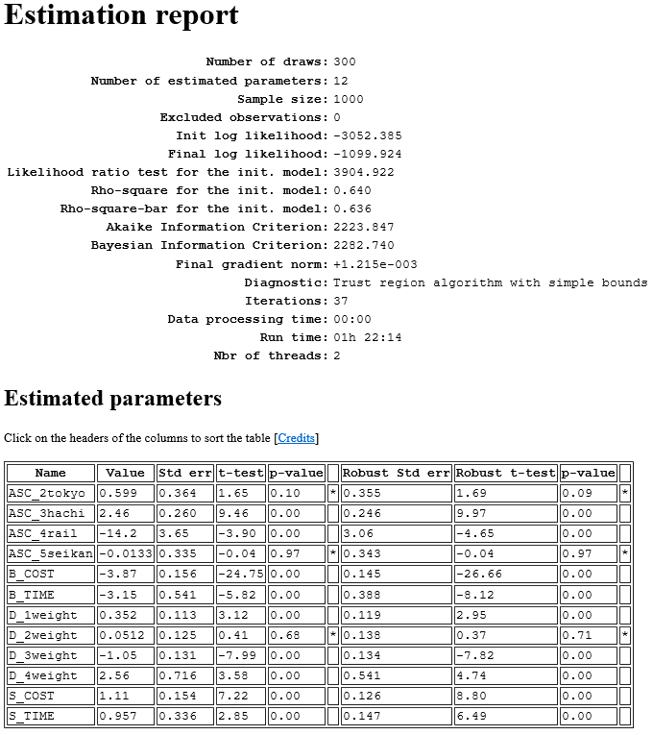

Slide 22
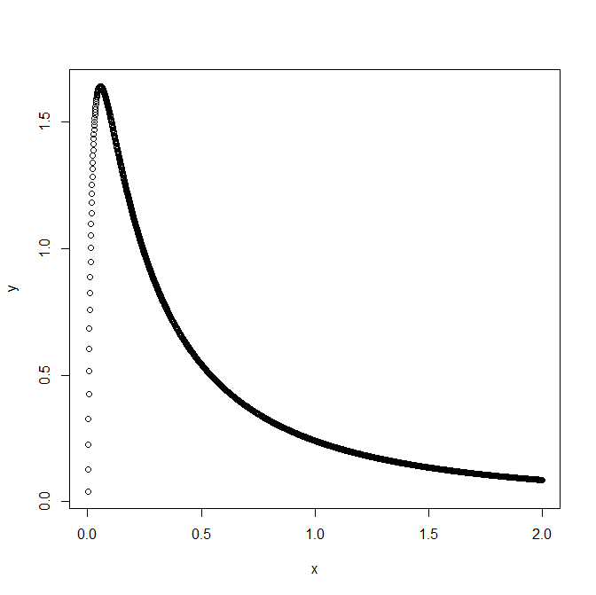
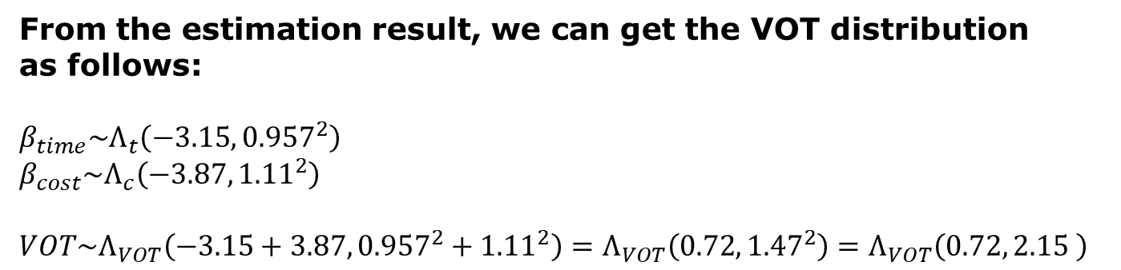
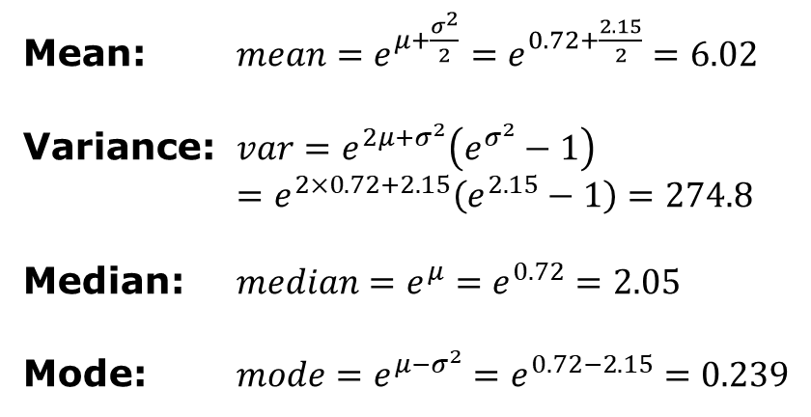
From the estimation result, we can get the VOT distribution as follows:
$$β_{time}\sim Λ_{t}\left(−3.15, {0.957}^{2}\right)$$
$β_{cost}\sim Λ_{c}\left(−3.87, {1.11}^{2}\right)$
$$VOT\sim Λ_{VOT}\left(−3.15+3.87,{0.957}^{2}+{1.11}^{2}\right)=Λ_{VOT}\left(0.72,{1.47}^{2}\right)=Λ_{VOT}\left(0.72, 2.15 \right)$$
Mean: $mean=e^{μ+\frac{σ^{2}}{2}}=e^{0.72+\frac{2.15}{2}}=6.02$
Variance: $var=e^{2μ+σ^{2}}\left(e^{σ^{2}}−1\right)$
$=e^{2×0.72+2.15}\left(e^{2.15}−1\right)=274.8$
Median: $median=e^{μ}=e^{0.72}=2.05$
Mode: $mode=e^{μ−σ^{2}}=e^{0.72−2.15}=0.239$
m <- -0.72; s <- 1.47; x <- seq(0.001,2,0.001)
y <- 1/(sqrt(2*pi)*x*s)*exp(-((log(x)-m)^2)/(2*(s^2))); plot(x,y)

Slide 23

Have you become able to make models freely?

