Slide 1
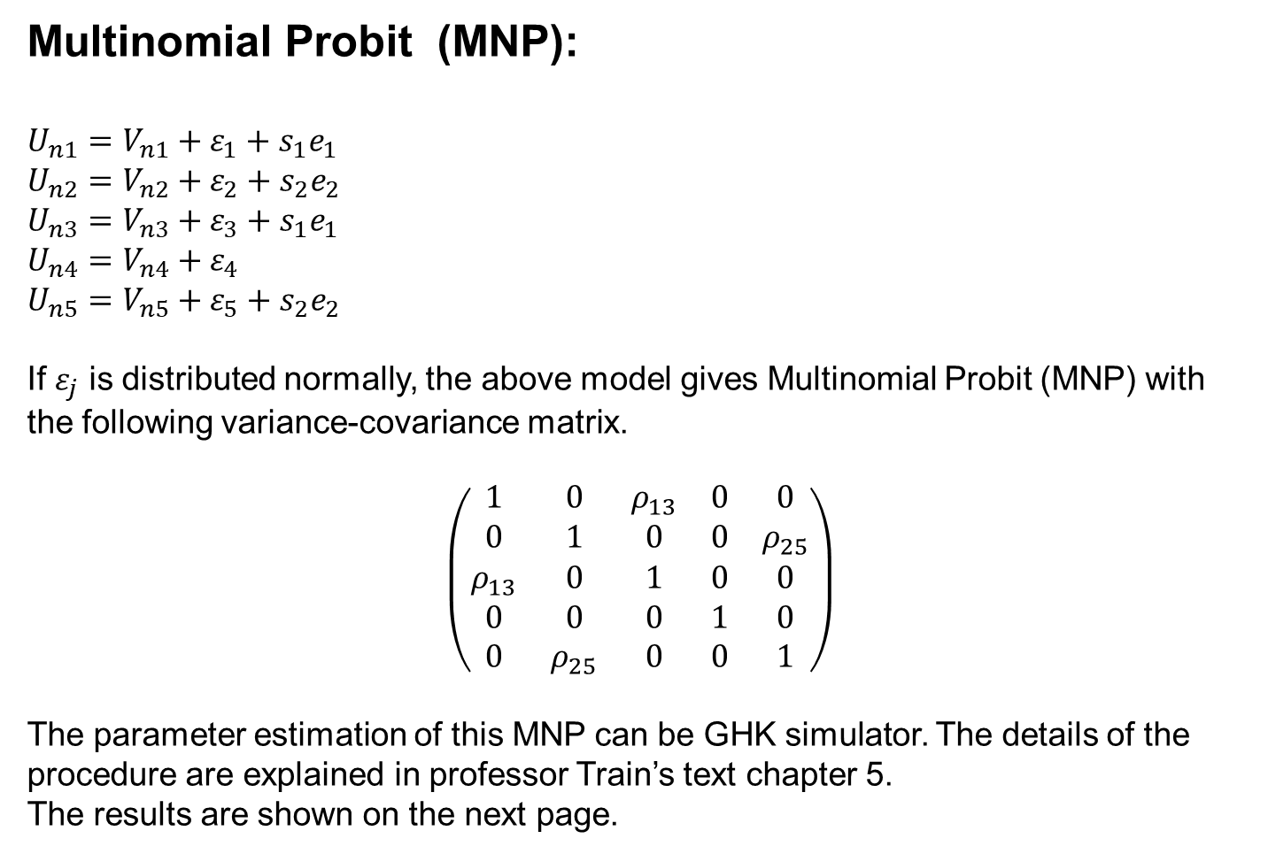

Multinomial Probit (MNP):
$$U_{n1}=V_{n1}+{ε_{1}+s}_{1}e_{1} \\ U_{n2}=V_{n2}+ε_{2}+s_{2}e_{2} \\ U_{n3}=V_{n3}+ε_{3}+s_{1}e_{1} \\ U_{n4}=V_{n4}+ε_{4} \\ U_{n5}=V_{n5}+ε_{5}+s_{2}e_{2}$$
If $ε_{j}$ is distributed normally, the above model gives Multinomial Probit (MNP) with the following variance-covariance matrix.
$\left(\begin{matrix}1 & 0 & ρ_{13} & 0 & 0 \\ 0 & 1 & 0 & 0 & ρ_{25} \\ ρ_{13} & 0 & 1 & 0 & 0 \\ 0 & 0 & 0 & 1 & 0 \\ 0 & ρ_{25} & 0 & 0 & 1\end{matrix}\right)$
The parameter estimation of this MNP can be GHK simulator. The details of the procedure are explained in professor Train’s text chapter 5.
The results are shown on the next page.
$$ε_{j}\sim N\left(0,λ\right) \\ e_{k}\sim N\left(0,1\right)$$

Slide 2
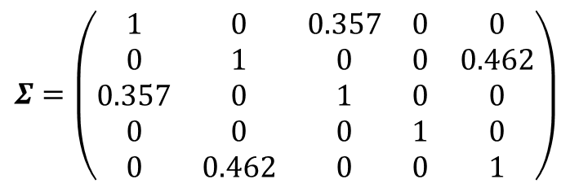
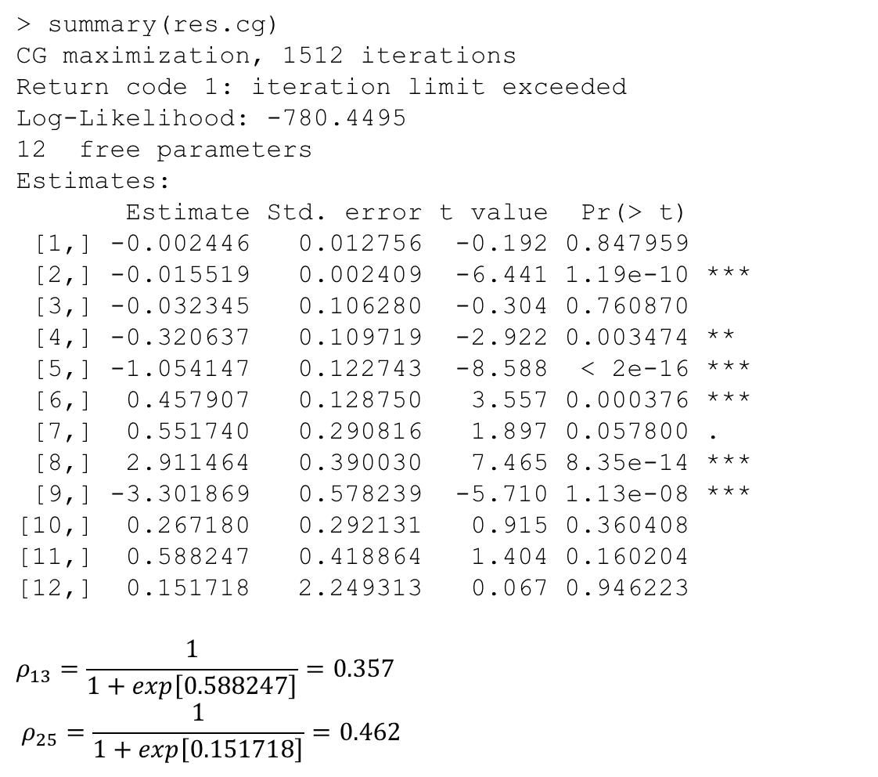
> summary(res.cg)
CG maximization, 1512 iterations
Return code 1: iteration limit exceeded
Log-Likelihood: -780.4495
12 free parameters
Estimates:
Estimate Std. error t value Pr(> t)
[1,] -0.002446 0.012756 -0.192 0.847959
[2,] -0.015519 0.002409 -6.441 1.19e-10 ***
[3,] -0.032345 0.106280 -0.304 0.760870
[4,] -0.320637 0.109719 -2.922 0.003474 **
[5,] -1.054147 0.122743 -8.588 < 2e-16 ***
[6,] 0.457907 0.128750 3.557 0.000376 ***
[7,] 0.551740 0.290816 1.897 0.057800 .
[8,] 2.911464 0.390030 7.465 8.35e-14 ***
[9,] -3.301869 0.578239 -5.710 1.13e-08 ***
[10,] 0.267180 0.292131 0.915 0.360408
[11,] 0.588247 0.418864 1.404 0.160204
[12,] 0.151718 2.249313 0.067 0.946223
$$ρ_{13}=\frac{1}{1+exp\left[0.588247\right]}=0.357 \\ ρ_{25}=\frac{1}{1+exp\left[0.151718\right]}=0.462$$
$Σ=\left(\begin{matrix}1 & 0 & 0.357 & 0 & 0 \\ 0 & 1 & 0 & 0 & 0.462 \\ 0.357 & 0 & 1 & 0 & 0 \\ 0 & 0 & 0 & 1 & 0 \\ 0 & 0.462 & 0 & 0 & 1\end{matrix}\right)$

