Slide 1
Lecture note for Discrete Choice Models
#1
At
Advanced Transportation Planning
Tetsuro HYODO

Slide 2
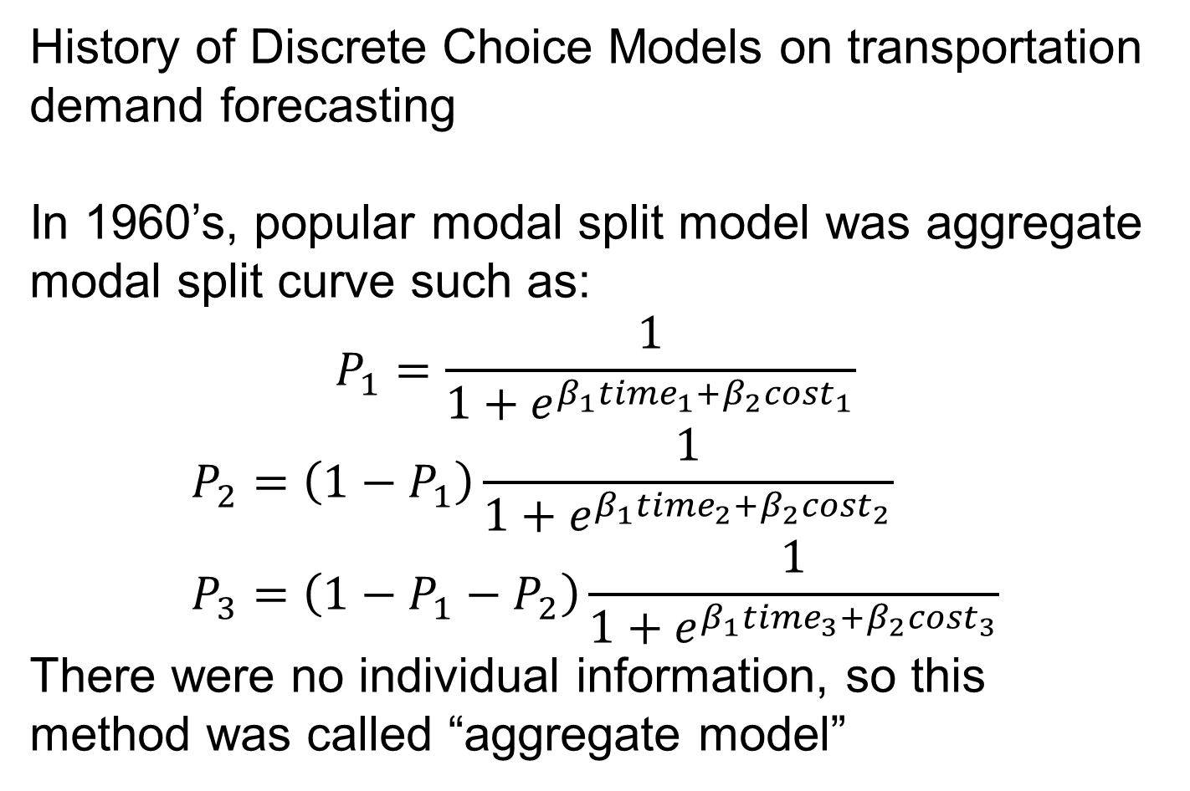
History of Discrete Choice Models on transportation demand forecasting
In 1960’s, popular modal split model was aggregate modal split curve such as:
$$P_{1}=\frac{1}{1+e^{β_{1}{time}_{1}+β_{2}{cost}_{1}}}$$
$$P_{2}=\left(1−P_{1}\right)\frac{1}{1+e^{β_{1}{time}_{2}+β_{2}{cost}_{2}}} \\ P_{3}=\left(1−P_{1}−P_{2}\right)\frac{1}{1+e^{β_{1}{time}_{3}+β_{2}{cost}_{3}}}$$
There were no individual information, so this method was called “aggregate model”

Slide 3
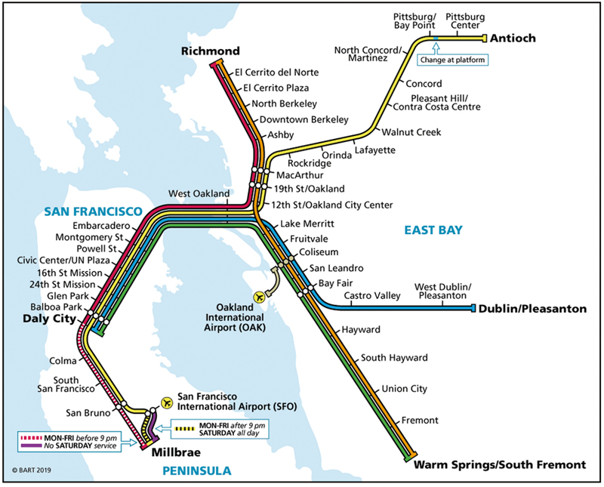
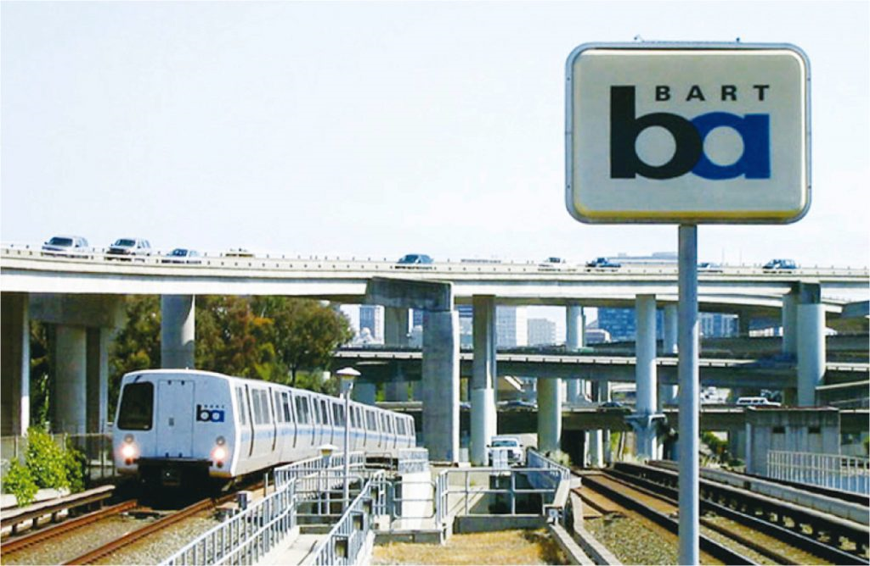
In early 1970’s, the demand forecasting for BART (Bay Area Rapid Transit) applied discrete choice model, Logit Model.
Professor at UC Berkeley, department of ecomomics, Dr.Daniel McFadden developed this model.

Slide 4
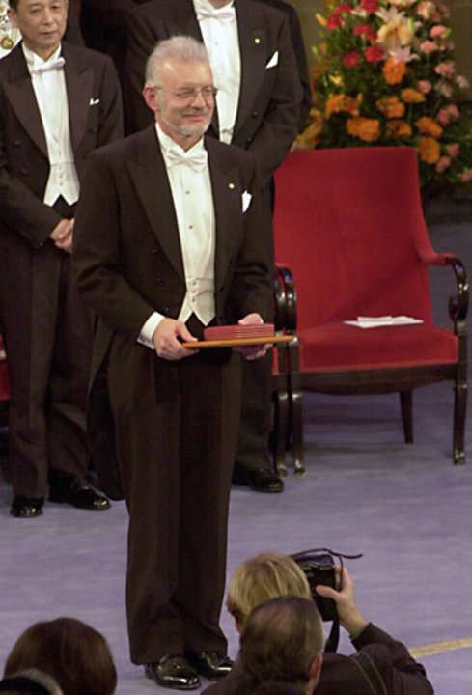
The discrete choice model was successful to improve the accuracy of demand forecasting model. The error was under 5%, quite high predictability.
Because of the achievement of developing discrete choice models, Professor Daniel McFadden won the Nobel Prize in 2000.
NW
NW
NW

Slide 5


This transportation demand forecasting “System” was sophisticated by professor Moshe Ben-Akiva, MIT with other professors.
They established “Cambridge Systematics”, private company specialized for transportation demand forecasting.
Now Cambridge Systematics is one of the major consultant companies, and many graduates from MIT are working at this company.

Slide 6
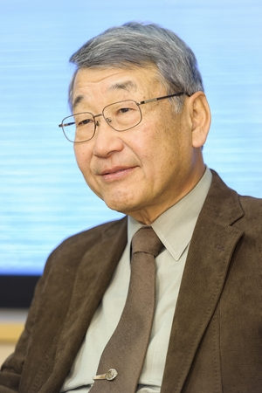
Discrete choice model in Japan:
Professor Shigeru Morichi, my supervisor, stayed at MIT in 1979 when he was 36 years old. He studied not only theoretical mattes but also “Model System” developed by MIT team.
He returned to Japan and held a seminar on “Travel Demand Modelling by disaggregate model” by inviting three major MIT professors.
It gained popularity and became popular in Japanese academic people.

Slide 7
Disaggregate Logit model was applied demand forecasting for Tokyo Metropolitan Railway network. The first case was “Future master plan for 2000” which was conducted in 1985.
In Tokyo Area, every 15 years, the railway master plan was updated.
The 1985 plan involved “No.12 subway line”. This line is current “OHEDO line” which is the first ring subway line in Japan.
The opening day was December 12th in 2000 (Heisei 12th year) → 12/12/12.

Slide 8
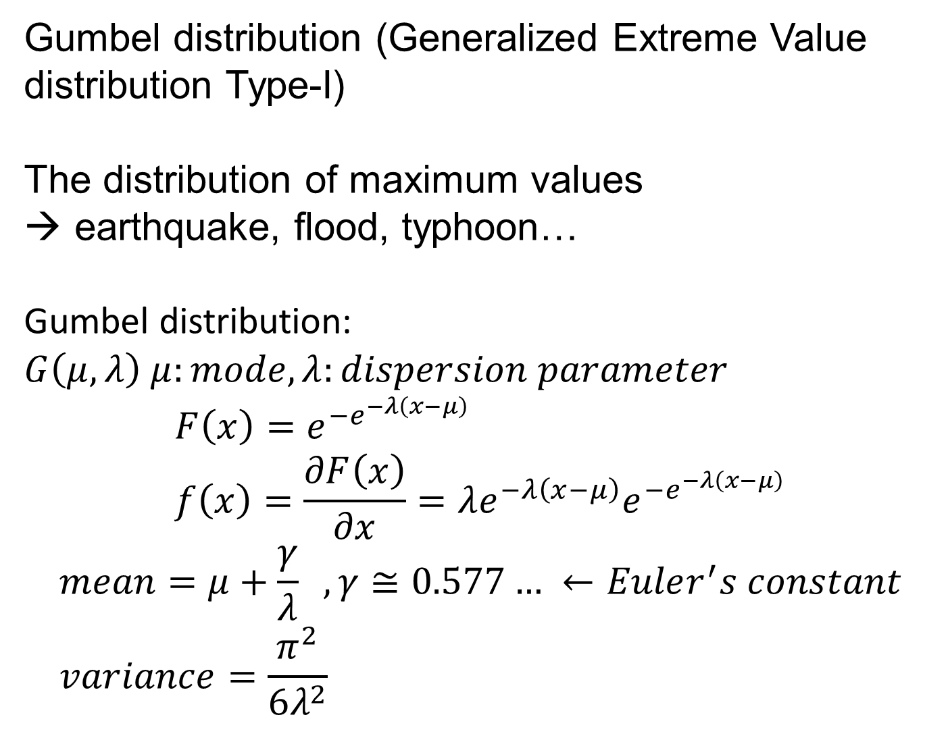
Gumbel distribution (Generalized Extreme Value distribution Type-I)
The distribution of maximum values
earthquake, flood, typhoon…
Gumbel distribution: $G\left(μ,λ\right) μ:mode, λ:dispersion parameter$
$$F\left(x\right)=e^{−e^{−λ\left(x−μ\right)}} \\ f\left(x\right)=\frac{∂F\left(x\right)}{∂x}=λe^{−λ\left(x−μ\right)}e^{−e^{−λ\left(x−μ\right)}}$$
$$mean=μ+\frac{γ}{λ} , γ≅0.577… ←Euler^{′}s constant \\ variance=\frac{π^{2}}{6λ^{2}}$$

Slide 9
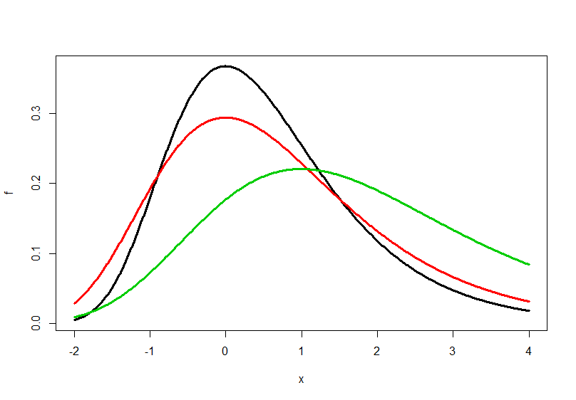



$$G\left(0,1\right)$$
$$G\left(0,0.8\right)$$
$$G\left(1,0.6\right)$$
mu <- 0; lam <- 1; x <- seq(-2,4,0.01)
f <- lam*exp(-lam*(x-mu))*exp(-exp(-lam*(x-mu)))
plot(x,f,type='l',lwd=3)
mu <- 0; lam <- 0.8; x <- seq(-2,4,0.01)
f <- lam*exp(-lam*(x-mu))*exp(-exp(-lam*(x-mu)))
lines(x,f,lwd=3,col=2)
mu <- 1; lam <- 0.6; x <- seq(-2,4,0.01)
f <- lam*exp(-lam*(x-mu))*exp(-exp(-lam*(x-mu)))
lines(x,f,lwd=3,col=3)

Slide 10
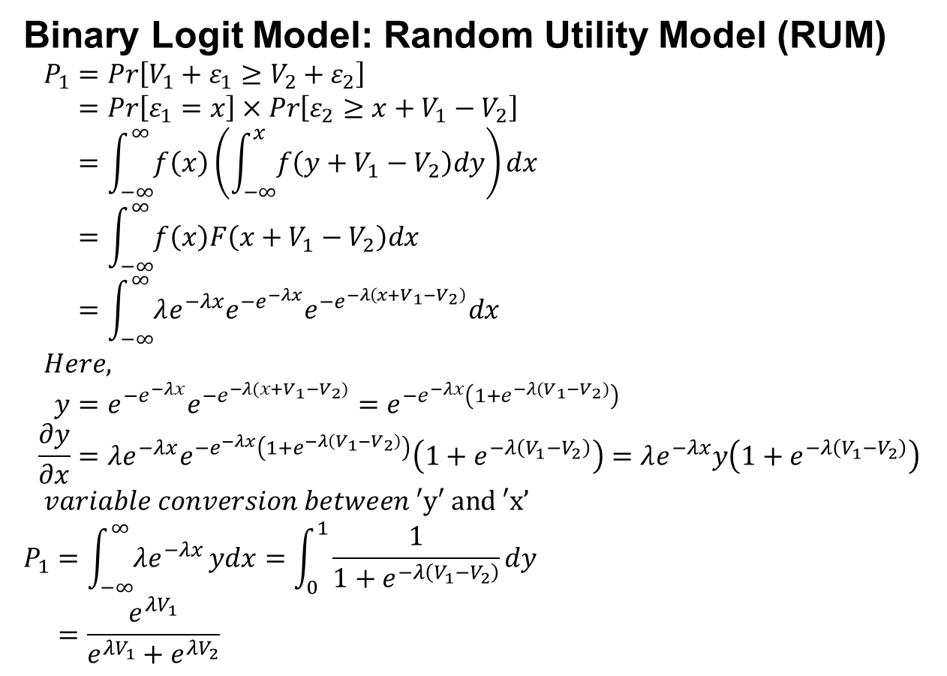
Binary Logit Model: Random Utility Model (RUM)
$$P_{1}=Pr\left[V_{1}+ε_{1}≥V_{2}+ε_{2}\right] \\ =Pr\left[ε_{1}=x\right]×Pr\left[ε_{2}≥x+V_{1}−V_{2}\right] \\ =\int_{−∞}^{∞}{f\left(x\right)}\left(\int_{−∞}^{x}{f\left(y+V_{1}−V_{2}\right)dy}\right)dx \\ =\int_{−∞}^{∞}{f\left(x\right)F\left(x+V_{1}−V_{2}\right)dx} \\ =\int_{−∞}^{∞}{λe^{−λx}e^{−e^{−λx}}e^{−e^{−λ\left(x+V_{1}−V_{2}\right)}}dx} \\ Here, \\ y=e^{−e^{−λx}}e^{−e^{−λ\left(x+V_{1}−V_{2}\right)}}=e^{−e^{−λx}\left(1+e^{−λ\left(V_{1}−V_{2}\right)}\right)} \\ \frac{∂y}{∂x}={λe^{−λx}e}^{−e^{−λx}\left(1+e^{−λ\left(V_{1}−V_{2}\right)}\right)}\left(1+e^{−λ\left(V_{1}−V_{2}\right)}\right)=λe^{−λx}y\left(1+e^{−λ\left(V_{1}−V_{2}\right)}\right) \\ variable conversion between \text{′}\text{y}\text{′ }\text{and}\text{ ′}\text{x}’$$
$$P_{1}=\int_{−∞}^{∞}{λe^{−λx}}ydx=\int_{0}^{1}{\frac{1}{1+e^{−λ\left(V_{1}−V_{2}\right)}}}dy \\ =\frac{e^{{λV}_{1}}}{e^{{λV}_{1}}+e^{{λV}_{2}}}$$
Utility:
1) Weight of different goods
2) Diminishing marginal utility
（限界効用逓減）
> y <- expression( exp(- exp(-lam*x) ) * exp( -exp(-lam*(x+V1-V2))) )
> D(y, "x")
> exp(-exp(-lam*x)) * exp(-lam*x)*lam * exp(-exp(-lam*(x + V1 - V2))) + exp(-exp(-lam*x)) * (exp(-exp(-lam*(x + V1 - V2))) * (exp(-lam * (x+V1-V2))*lam))

Slide 11
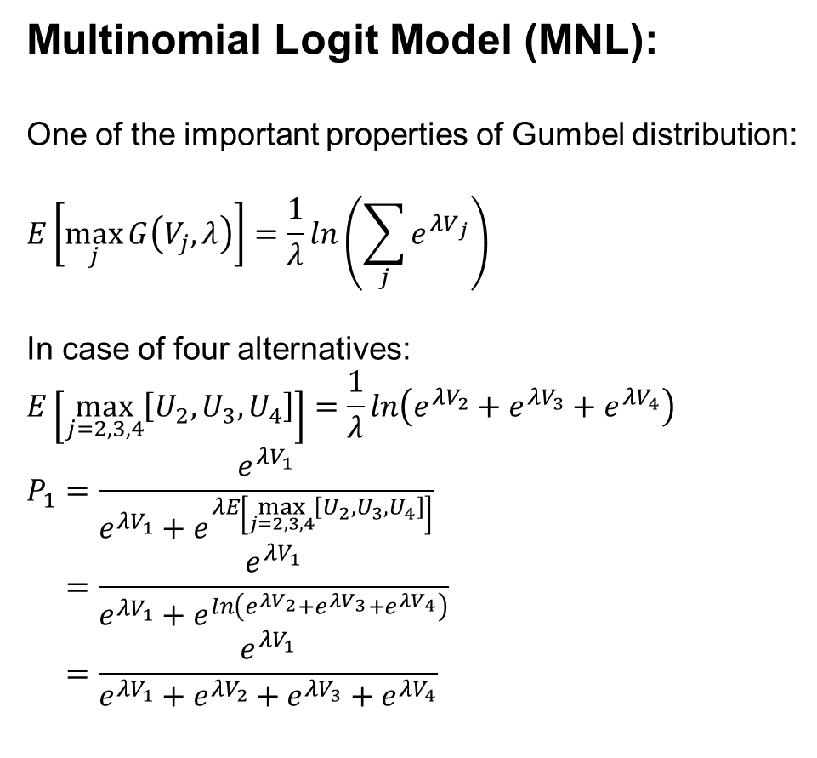
Multinomial Logit Model (MNL):
One of the important properties of Gumbel distribution:
$$E\left[\max_{j}{G\left(V_{j},λ\right)}\right]=\frac{1}{λ}ln\left(\sum_{j}{e^{{λV}_{j}}}\right)$$
In case of four alternatives:
$$E\left[\max_{j=2,3,4}\left[U_{2},U_{3},U_{4}\right]\right]=\frac{1}{λ}ln\left(e^{{λV}_{2}}+e^{{λV}_{3}}+e^{{λV}_{4}}\right)$$
$$P_{1}=\frac{e^{{λV}_{1}}}{e^{{λV}_{1}}+e^{λE\left[\max_{j=2,3,4}\left[U_{2},U_{3},U_{4}\right]\right]}} \\ =\frac{e^{{λV}_{1}}}{e^{{λV}_{1}}+e^{ln\left(e^{{λV}_{2}}+e^{{λV}_{3}}+e^{{λV}_{4}}\right)}} \\ =\frac{e^{{λV}_{1}}}{e^{{λV}_{1}}+e^{{λV}_{2}}+e^{{λV}_{3}}+e^{{λV}_{4}}}$$

Slide 12
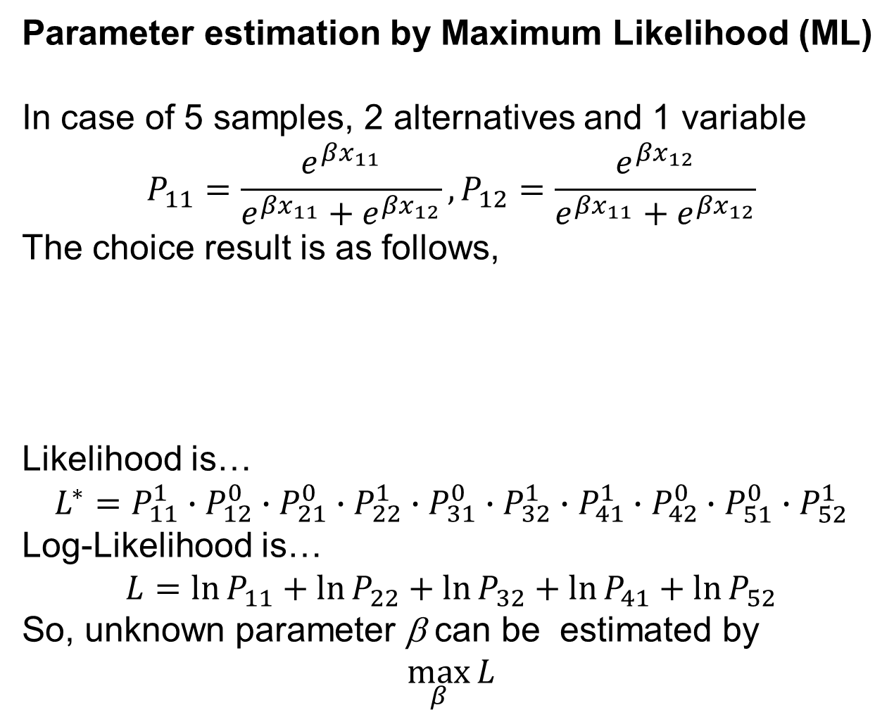
Parameter estimation by Maximum Likelihood (ML)
In case of 5 samples, 2 alternatives and 1 variable
$$P_{11}=\frac{e^{βx_{11}}}{e^{βx_{11}}+e^{βx_{12}}},P_{12}=\frac{e^{βx_{12}}}{e^{βx_{11}}+e^{βx_{12}}}$$
The choice result is as follows,
Likelihood is…
$$L^{∗}=P_{11}^{1}∙P_{12}^{0}∙P_{21}^{0}∙P_{22}^{1}∙P_{31}^{0}∙P_{32}^{1}∙P_{41}^{1}∙P_{42}^{0}∙P_{51}^{0}∙P_{52}^{1}$$
Log-Likelihood is…
$$L=\ln{P_{11}+\ln{P_{22}}+\ln{P_{32}}+\ln{P_{41}}+\ln{P_{52}}}$$
So, unknown parameter β can be estimated by
$$\max_{β}{L}$$
sample | 1 | 2 | 3 | 4 | 5
Alt.1 | 1 | 0 | 0 | 1 | 0
Alt.2 | 0 | 1 | 1 | 0 | 1

Slide 13
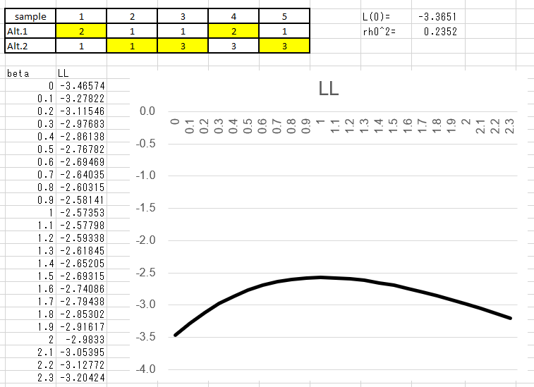
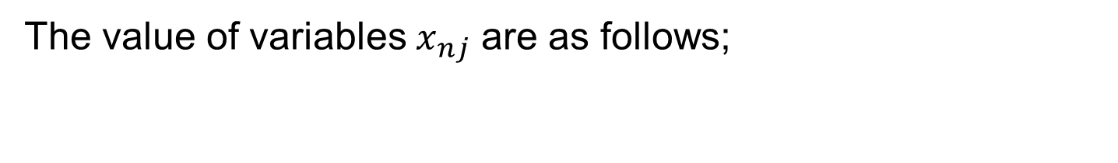
The value of variables $x_{nj}$ are as follows;
sample | 1 | 2 | 3 | 4 | 5
Alt.1 | 2 | 1 | 1 | 2 | 1
Alt.2 | 1 | 1 | 3 | 3 | 3

Slide 14


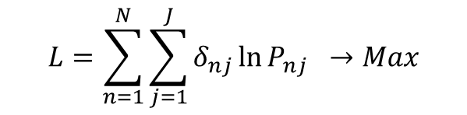

Actually, Newton-Raphson method is applied.
$$\frac{∂L}{∂β}$$
$$\frac{∂^{2}L}{∂β^{2}}$$
$$β$$
$$L=\sum_{n=1}^{N}{\sum_{j=1}^{J}{δ_{nj}\ln{P_{nj}}}} →Max$$

Slide 15
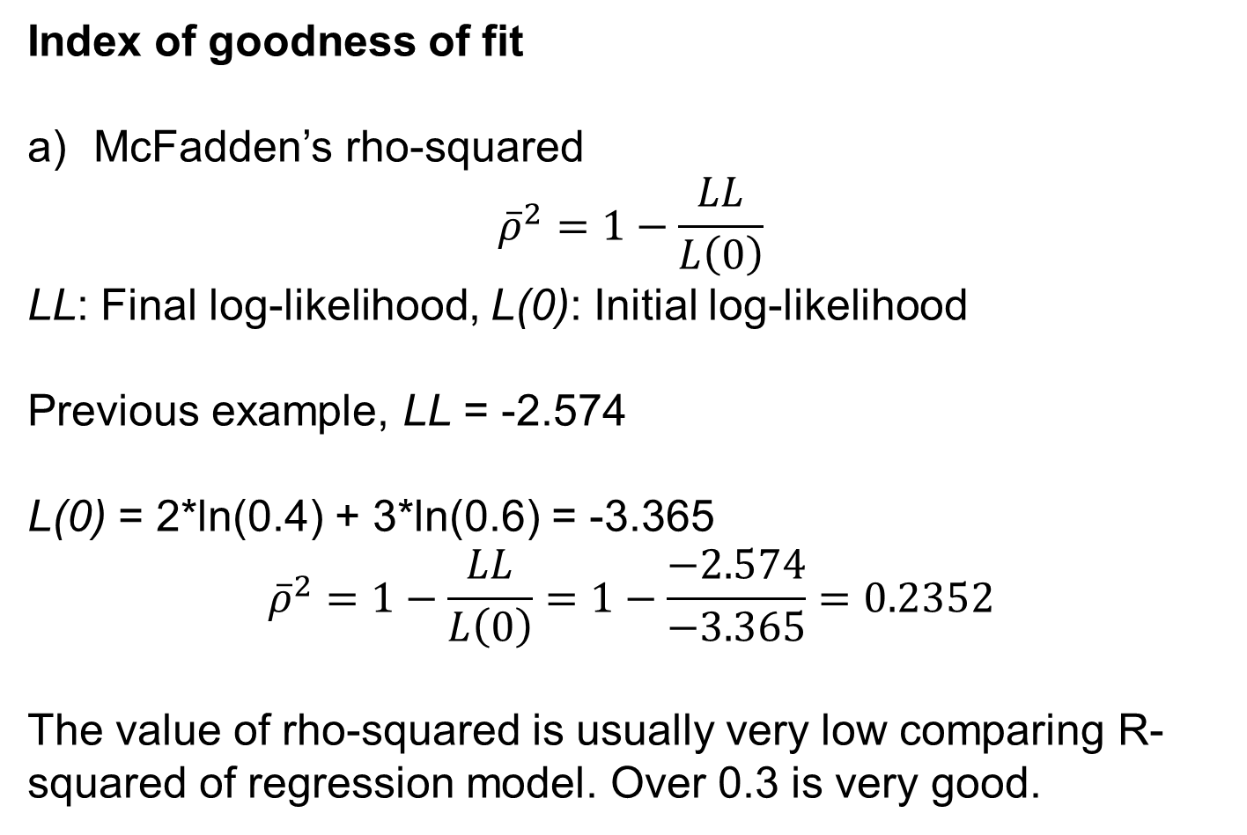
Index of goodness of fit
McFadden’s rho-squared
$${\overline{ρ}}^{2}=1−\frac{LL}{L\left(0\right)}$$
LL: Final log-likelihood, L(0): Initial log-likelihood
Previous example, LL = -2.574
L(0) = 2*ln(0.4) + 3*ln(0.6) = -3.365
$${\overline{ρ}}^{2}=1−\frac{LL}{L\left(0\right)}=1−\frac{−2.574}{−3.365}=0.2352$$
The value of rho-squared is usually very low comparing R-squared of regression model. Over 0.3 is very good.

Slide 16
Index of goodness of fit
b) Hit ratio
Choice result of n-th sample is the maximum choice probability alternative. If the alternative equals observed alternative, “hit” otherwise “miss”.
Previous case…
Hit table
Hit ratio=4/5=80%

Slide 17
- Not only modal choice, destination choice, car own…
Destination choice model
Housing type choice model
Japan
USA
UK
Own home
Rented home
Departure time choice model
Trip generation choice model
Mackerel choice model !
6:30
6:45
7:00
7:15
0
1+
Car ownership choice model
Norway
mackerel
Japan
mackerel
1
2+
0
1
2
3+
2
3+

