Slide 1
Lecture note for Discrete Choice Models
#2
At
Advanced Transportation Planning
Tetsuro HYODO

Slide 2
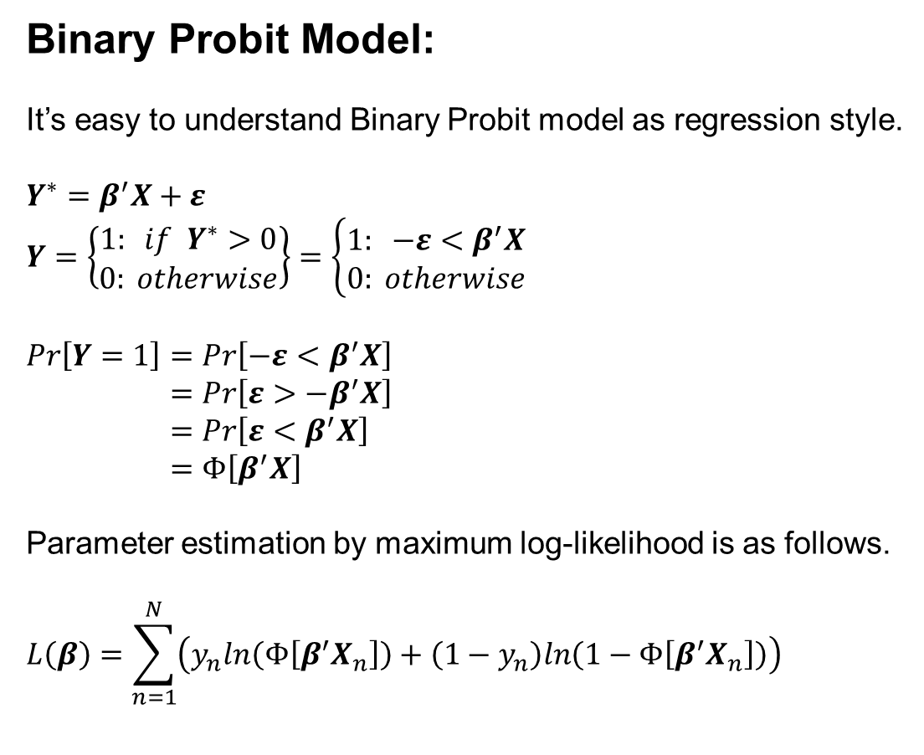
Binary Probit Model:
It’s easy to understand Binary Probit model as regression style.
$$Y^{∗}=β^{′}X+ε \\ Y=\left\{\begin{matrix}1: if{ Y}^{∗}>0 \\ 0: otherwise\end{matrix}\right\}=\left\{\begin{matrix}1: −ε<β^{′}X \\ 0: otherwise\end{matrix}\right.$$
$$Pr\left[Y=1\right]=Pr\left[−ε<β^{′}X\right] \\ =Pr\left[ε>{−β}^{′}X\right] \\ =Pr\left[ε<β^{′}X\right] \\ =Φ\left[β^{′}X\right]$$
Parameter estimation by maximum log-likelihood is as follows.
$$L\left(β\right)=\sum_{n=1}^{N}{\left(y_{n}ln\left(Φ\left[β^{′}X_{n}\right]\right)+\left(1−y_{n}\right)ln\left(1−Φ\left[β^{′}X_{n}\right]\right)\right)}$$
→ by symmetry of the normal distribution

Slide 3
Parameter estimation code for Logit & Binary Probit model by R
Data for models: “IZAKAYA happy hour set choice data”
- There are 36 questionnaire sheets, all combination of values are different based on “design of experiments method” (TAGUCHI-method).
Revealed Preference (RP) vs.
Stated Preference (SP)
Q1. After finishing your work, you go to favorite bar. You find the following “happy hour set”. Which one do you prefer ?
Q2. Do you like alcohol drinking ?
1. Yes 2. No
Set-A
Beer 1 glass
Yakitori 2 pieces
Price 300 yen
Set-B
Beer 2 glasses
Yakitori 4 pieces
Price 700 yen

Slide 4
Students’ answers at the class in 2008 was as follows (CSV file).
0,1,1,2,2,6,300,300,0,1
1,0,2,3,2,2,500,700,1,0
0,1,1,3,2,4,300,300,0,1
1,0,1,3,6,2,700,700,0,1
0,1,2,2,4,6,700,300,1,0
0,1,1,3,4,2,500,700,1,0
0,1,2,3,4,4,700,300,1,0
0,1,2,3,4,2,700,700,1,0
1,0,1,2,2,4,300,700,1,0
0,1,2,2,2,6,500,300,1,0
1,0,1,1,2,6,300,700,1,0
0,1,2,3,2,4,500,300,1,0
0,1,1,3,4,4,500,300,1,0
0,1,1,3,6,4,700,300,0,1
1,0,1,3,2,2,300,700,0,1
1,0,2,2,2,4,500,700,0,1
0,1,1,3,4,6,500,500,0,1
0,1,1,2,4,6,500,300,0,1
1,0,1,1,4,6,500,700,0,1
1,0,1,2,6,2,700,500,0,1
0,1,2,3,2,6,500,500,0,1
1,0,1,2,4,2,500,500,0,1
1,0,2,3,6,4,300,300,0,1
0,1,3,3,2,6,700,500,0,1
0,1,1,2,6,6,700,300,1,0
0,1,2,3,4,6,700,500,1,0
1,0,3,3,4,6,300,500,1,0
1,0,1,2,2,2,300,500,0,1
1,0,1,3,2,6,300,500,0,1
1,0,2,3,6,2,300,700,0,1
1,0,2,3,6,6,300,500,0,1
0,1,3,3,2,4,700,300,0,1
1,0,1,2,4,4,500,700,0,1
0,1,1,1,2,4,300,500,0,1
0,1,1,3,6,6,700,500,0,1
1,0,1,2,6,4,700,700,0,1

Slide 5
rm(list=ls())
library(maxLik)
setwd("c:/usr/doc/dropbox/daigakuin/beer/")
data <-read.csv("beer2008.csv",header=F)
ns <- nrow(data) ## ns is number of samples
n.alt <- 2 ## number of alternatives
n.var <- 4 ## number of parameters
b0 <- rep(0,n.var) ## set initial parameters
x <- array(0,c(ns,n.alt,n.var)) ## make independent variable matrix
y <- array(0,c(ns,n.alt)) ## make choice result matrix
## set matrix of variables
x[,1,1] <- data[,3]; x[,2,1] <- data[,4]
x[,1,2] <- data[,5]; x[,2,2] <- data[,6]
x[,1,3] <- data[,7]; x[,2,3] <- data[,8]
x[,1,4] <- 1
y <- data[,1:2]
R code: Logit_maxLik.r

Slide 6
## Log-Likelihood function of Logit Model
logit <- function(b) {
u <- matrix(0, nr=ns, nc=n.alt) ## utility function
p <- matrix(0, nr=ns, nc=n.alt) ## probability
for(i in 1:n.alt) u[,i] <- exp(x[,i,] %*% b)
for(i in 1:n.alt) p[,i] <- u[,i]/rowSums(u)
a <- p*y; prb <- rowSums(a)
LL <- sum(log(prb))
return(LL)
}
## Log-Likelihood function of BinaryProbit Model
probit <- function(b) {
u <- matrix(0, nr=ns, nc=n.alt)
p <- matrix(0, nr=ns, nc=n.alt)
for(i in 1:n.alt) u[,i] <- x[,i,] %*% b
p[,1] <- pnorm((u[,1]-u[,2]), mean=0, sd=1)
p[,2] <- 1-p[,1]
a <- p*y; prb <- rowSums(a)
LL <- sum(log(prb))
return(LL)
}

Slide 7
## Maximization of Log-Likelihood by “maxLik"
res <- maxLik(logit,start=rep(0,n.var))
# res <- maxLik(probit,start=rep(0,n.var))
## estimated parameter & Hessian
b <- res$estimate; hhh<-res$hessian
## estimating t-value
tval <- b/sqrt(-diag(solve(hhh)))
## Initial Log-likelihood
L0 <- ns*log(1/n.alt)
## Final Log-Likelihood
LL <- res$maximum
## Goodness of Fit
## rho-square
print((L0-LL)/L0)
## rho-square adjusted by degree of freedom
print((L0-(LL-length(b)))/L0)
print(b); print(tval)

Slide 8
The estimated parameters by Logit model:
rho: 0.5718, rho-bar: 0.4115
parameters:
0.717 0.573 -0.0109 0.632
t-values:
0.827 2.34 -2.87 0.567
V_{set-A}= 0.717Beer_{set-A} +0.573YAKITORI_{set-A} -0.0109price_{set-A} +0.632
V_{set-B}= 0.717Beer_{set-B} +0.573YAKITORI_{set-B} -0.0109price_{set-B}
The estimated parameters by Probit model:
rho: 0.5768, rho-bar: 0.4165
parameters:
0.506 0.333 -0.00625 0.442
t-values:
1.13 2.51 -3.28 0.742

Slide 9
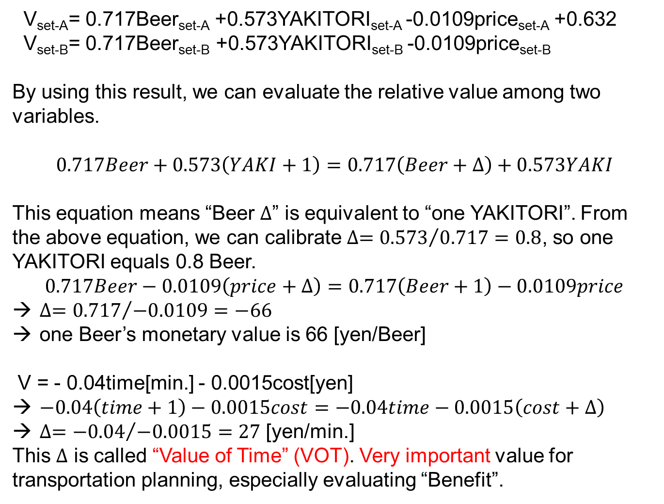
V_{set-A}= 0.717Beer_{set-A} +0.573YAKITORI_{set-A} -0.0109price_{set-A} +0.632
V_{set-B}= 0.717Beer_{set-B} +0.573YAKITORI_{set-B} -0.0109price_{set-B}
By using this result, we can evaluate the relative value among two variables.
$$0.717Beer+0.573\left(YAKI+1\right)=0.717\left(Beer+∆\right)+0.573YAKI$$
This equation means “Beer $∆$” is equivalent to “one YAKITORI”. From the above equation, we can calibrate $∆={0.573}/{0.717}=0.8$, so one YAKITORI equals 0.8 Beer.
$$0.717Beer−0.0109\left(price+∆\right)=0.717\left(Beer+1\right)−0.0109price$$
$∆={0.717}/{−0.0109}=−66$
one Beer’s monetary value is 66 [yen/Beer]
V = - 0.04time[min.] - 0.0015cost[yen]
$−0.04\left(time+1\right)−0.0015cost=−0.04time−0.0015\left(cost+∆\right)$
$∆={−0.04}/{−0.0015}=27$ [yen/min.]
This $∆$ is called “Value of Time” (VOT). Very important value for transportation planning, especially evaluating “Benefit”.

Slide 10
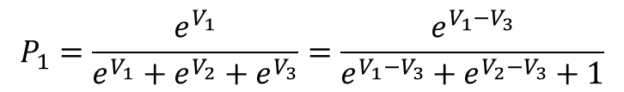
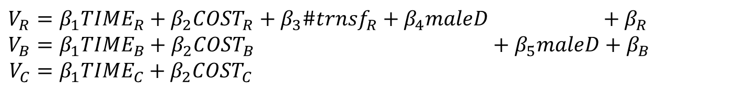
Several type of variables:
Typical example of urban modal choice
R:rail, B:bus, C:car
$$V_{R}=β_{1}{TIME}_{R}+β_{2}{COST}_{R}+β_{3}{\#trnsf}_{R}+β_{4}maleD +β_{R} \\ V_{B}=β_{1}{TIME}_{B}+β_{2}{COST}_{B} +β_{5}maleD+β_{B} \\ V_{C}=β_{1}{TIME}_{C}+β_{2}{COST}_{C}$$
$$P_{1}=\frac{e^{V_{1}}}{e^{V_{1}}+e^{V_{2}}+e^{V_{3}}}=\frac{e^{V_{1}−V_{3}}}{e^{V_{1}−V_{3}}+e^{V_{2}−V_{3}}+1}$$
-Common variable: time, cost…
-Alternative specific variable: # of transfer, # of cars, driving license dummy…
-Social Economics variable: age, gender, income…
-Intercept: maximum number is “# of alternatives – 1” why ?

Slide 11
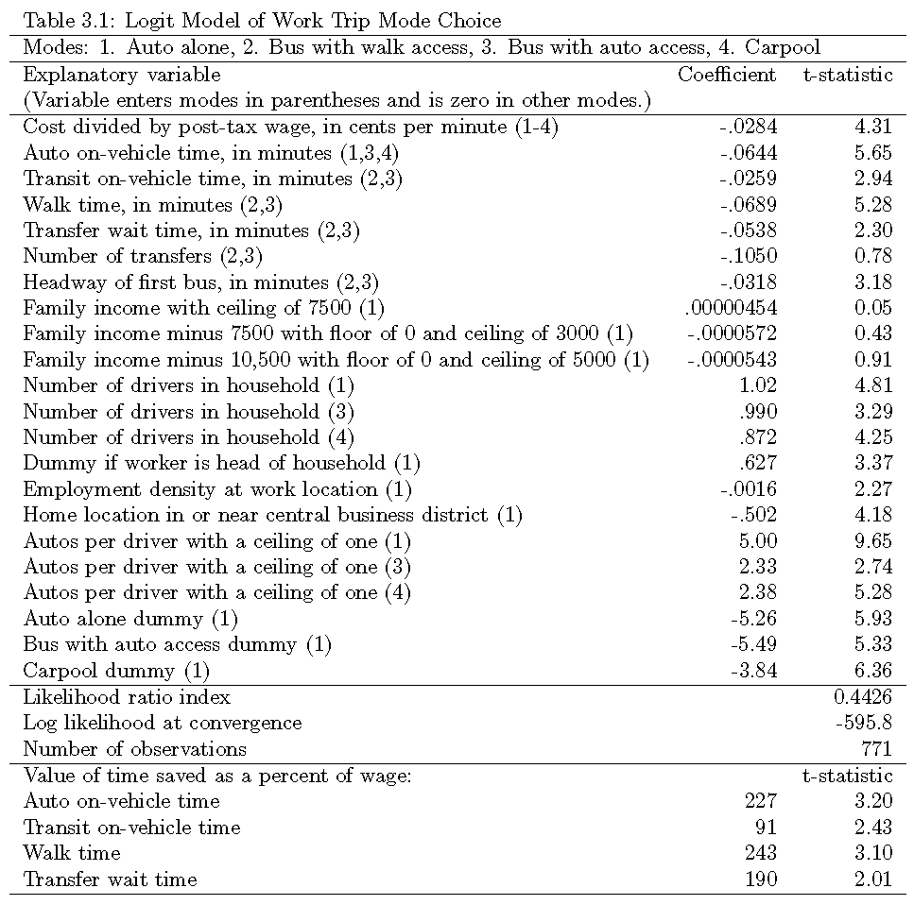
An example shown in “Discrete Choice Methods with Simulation” by K.Train (2009)

Slide 12
Discrete Choice Modeling by R & Biogeme
R: homemade (MNL, NL, MXL), mlogit, MNP
Biogeme: MNL, NL, MXL, Taste Variation, CNL
using 5 alternatives & 1,000 samples
Intercity freight data
May, 2018
Tetsuro HYODO
hyodo@kaiyodai.ac.jp

Slide 13
日本語による前文
2009年1月に，自身のHP上で，「Rによる離散選択モデルの推定方法メモ」
http://www2.kaiyodai.ac.jp/~hyodo/Logit_by_R.pdf
を公開し，ありがたくも何名かの方から，「役に立っています」とのお言葉を頂いた．
しかし，さすがに9年が経過し，色々と不具合も目立ってきた．申し訳ないのだが，最大の問題は，最尤推定に “optim” を使用していたことで，これは特に選択肢の利用可能性がマチマチな時に正しいパラメータを導いてくれないことが判明していた．maxLikを用いれば，現時点では問題がないことが分かっている．あとはNLの記述が，現在GEV由来が主流であることか．GEV式の方が自家製コードも楽に作ることができる．
さて，2017年度の卒論で，本州－北海道間の物流センサスを用いた5経路の輸送手段選択モデルに取り組んでいた．実はこのデータが，様々な離散選択モデルのテストデータとして優れており，担当卒論生や博士課程の留学生も交えて，バリエーション多彩なモデル群を試すことになった．
そして，2018年度前期，大学院の授業で非漢字圏の修士学生を対象に，3年ぶりに英語授業をすることになった．そこで，この際，卒論で手がけた一連のモデルを，ある一つのデータ（卒論データから抽出した1,000サンプルデータ）への適用コードとして（怪しい）英語で整理することを試みた．Rによる自家製コード，mlogit，Biogeme，MNP がその構成要素である．自習可能なように，コードやデータも同梱しました．適宜，試してみて下さい．
種々のコード作成にご協力頂いた，佐々木葵さん（修士1年），Seiji LIDASAN君（博士2年）に感謝申し上げます．

Slide 14
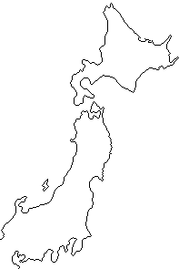
Data is freight modal choice between Kanto & Hokkaido
Hokkaido
Tomakomai
Hakodate
1.Ibaraki→Tomakomai
Aomori
Hachinohe
2.Tokyo→Tomakomai
3.Kanto→Hachinohe→Tomakomai
4.Kanto→Hokkaido (rail)
5.Kanto→Aomori→Hakodate
Kanto
Ibaraki
Tokyo

Slide 15
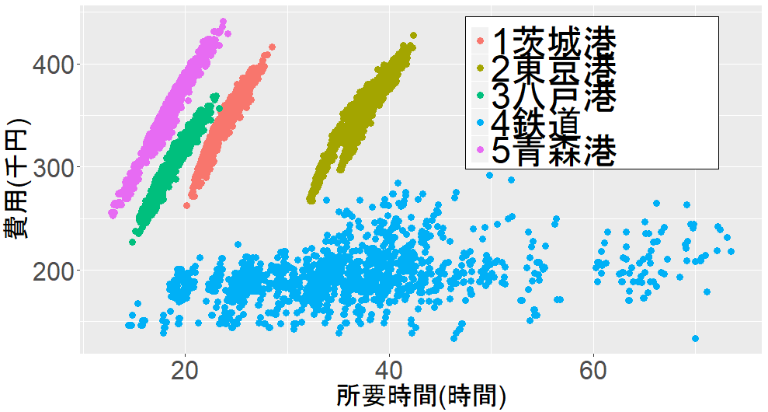
Time & cost relationship
(10ton cargo is assumed)
1.ibaraki
2.tokyo
3.hachinohe
4.rail
5.seikan
Cost [1,000yen]
Time [hour]
By NITAS ver. 2.4

Slide 16
Data structure:
One sample (1 row)
from the data is transposed
for easy viewing.
2 common variables (time and cost), 1 socioeconomic(SE) variable (log10(weight)).
Another variable type is “alternative specific”,
what is this variable?
“goods” is goods type, but is not used in this case.
d1000.csv

Slide 17
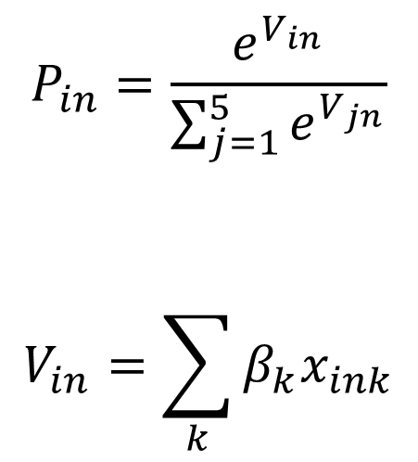
Estimation of Multinomial Logit (MNL):
$$P_{in}=\frac{e^{V_{in}}}{\sum_{j=1}^{5}{e^{V_{jn}}}}$$
$$V_{in}=\sum_{k}{β_{k}x_{ink}}$$
-Don’t use “optim”
-”maxLik” is better
-”with gradient function”,
it is faster
-”rowSums” is 40% faster than “apply(x,1,sum)” → why ?
MNL.r

Slide 18
L(0)= -1359.237 initial log-likelihood
L(*)= -1112.049 final log-likelihood
rho= 0.1818578 rho-bar= 0.1745007 log-likelihood ratio
1 , -0.017264 , -1.64 time [hour], t-value
2 , -0.01694384 , -8.19 cost[1000yen]
3 , 0.4128331 , 3.94 log(weight.ton)-1.ibaraki
4 , 0.0756141 , 0.65 log(weight.ton)-2.tokyo
5 , -0.8467355 , -8.27 log(weight.ton)-3.hachinohe
6 , 0.6351293 , 5.13 log(weight.ton)-4.rail
7 , 0.5342334 , 1.63 intercept-2.tokyo
8 , 2.652349 , 11.08 intercept-3.hachinohe
9 , -3.677233 , -7.52 intercept-4.rail
10 , 0.4521059 , 1.53 intercept-5.seikan
Hit ratio(%): 40.575
1 2 3 4 5 total
1 122 2 72 3 1 200
2 48 0 52 0 0 100
3 26 3 463 0 8 500
4 70 0 26 4 0 100
5 19 0 42 5 34 100
Total 285 5 655 12 43 1000

