Slide 1
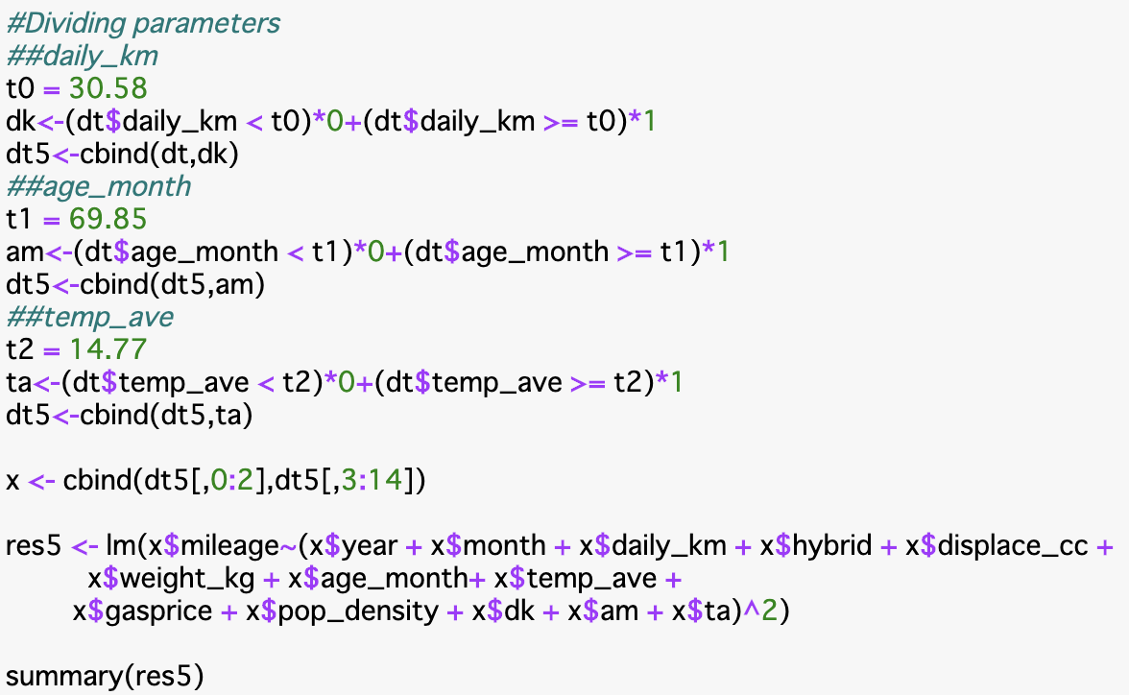
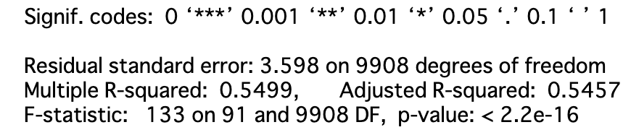
Select the mean value as each threshold value.
These 3 variables was effective.
The combinations of 2 variables were also effective.

