Slide 1
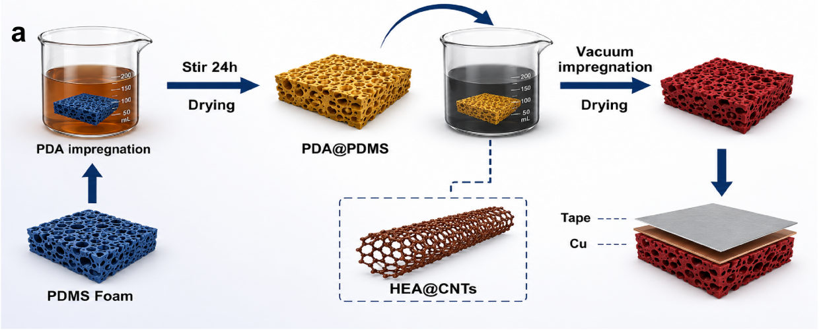
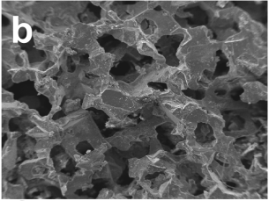
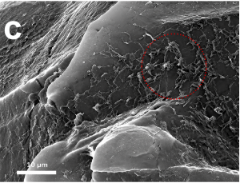
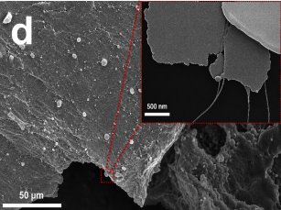
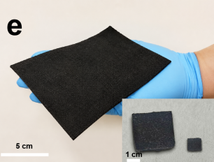
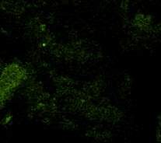
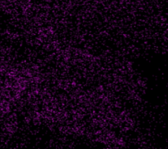
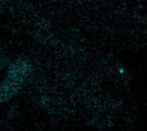
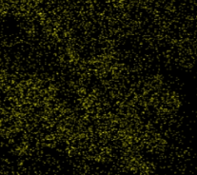
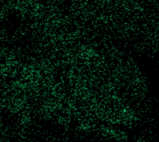
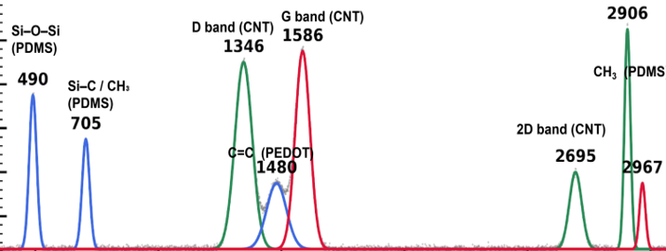
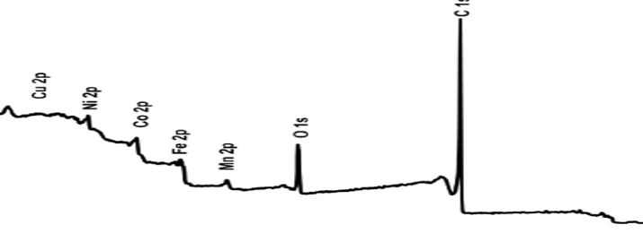
Figure 1
f
Al
Co
Fe
Ni
Mn
100 μm
100 μm
100 μm
100 μm
100 μm
g
h
Intensity (a.u.)
Intensity (a.u.)
500
1000
1500
2000
2500
3000
1000
800
600
400
200
0
Raman shift (cm⁻¹)
Binding energy (eV)
Notes:
Source: uploaded Manuscript1.docx, Figure 1. Layout and external panel labels are editable. Original traces remain raster evidence; no raw experimental data have been reconstructed. Figure 3 excludes the unreconciled comparison panel.

Slide 2
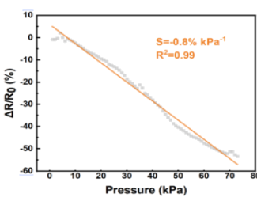
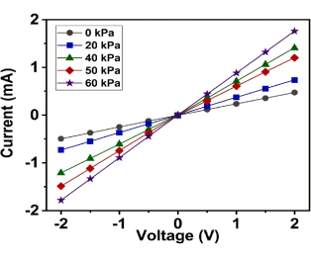
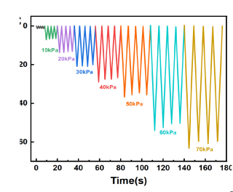
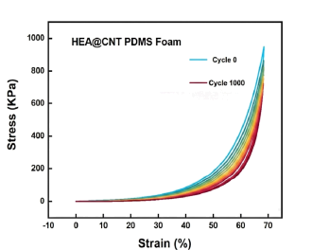
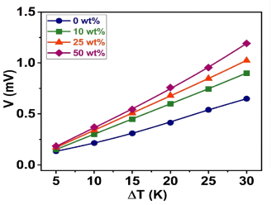
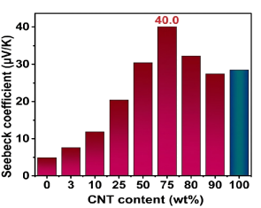
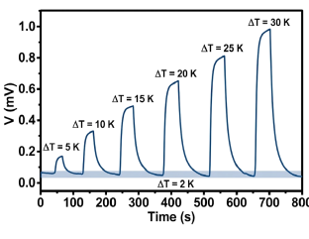
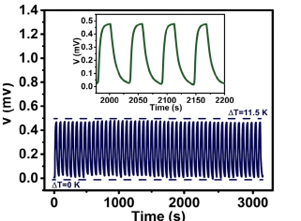
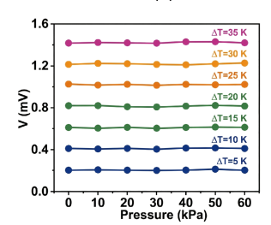
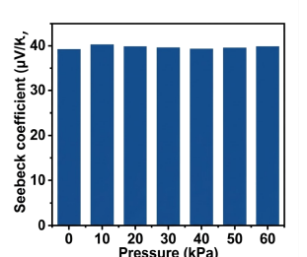
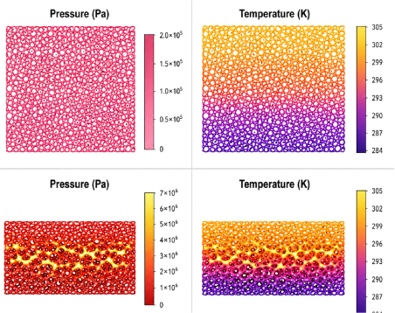
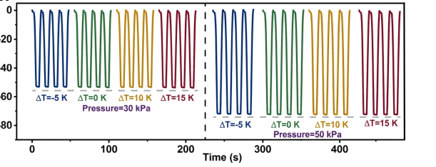
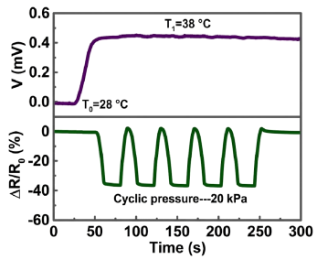
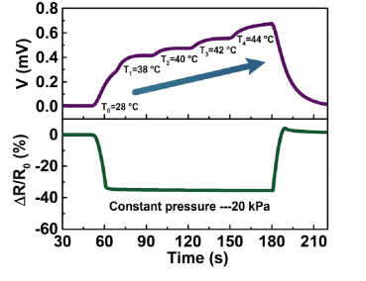
Figure 2
a
b
c
d
e
f
g
h
i
j
k
l
m
n
Notes:
Source: uploaded Manuscript1.docx, Figure 2. Layout and external panel labels are editable. Original traces remain raster evidence; no raw experimental data have been reconstructed. Figure 3 excludes the unreconciled comparison panel.

Slide 3
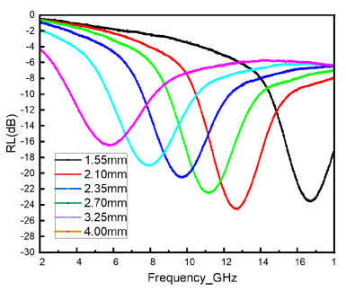
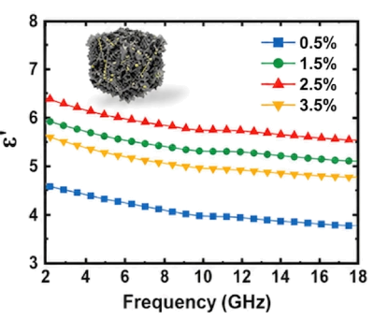
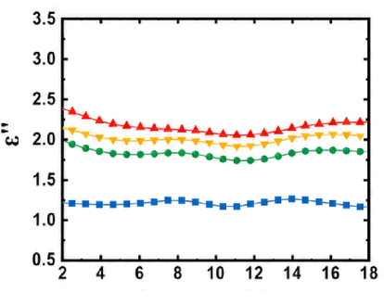
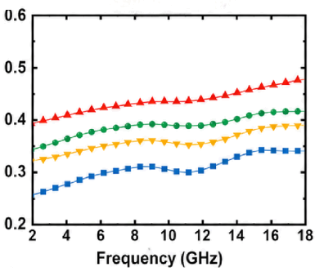
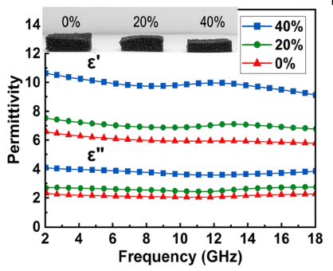
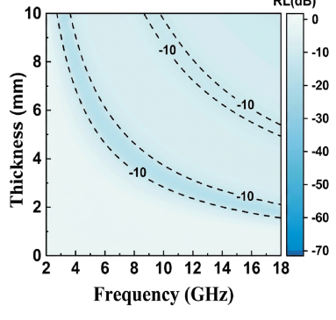
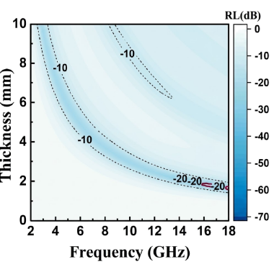
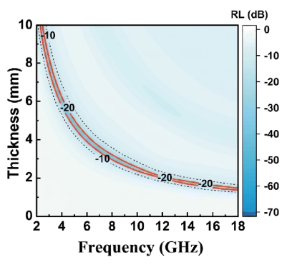
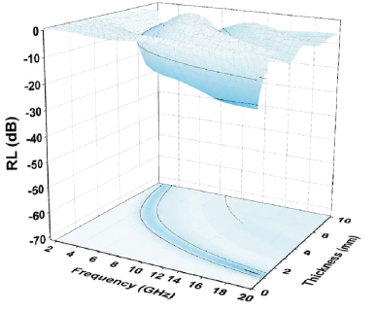
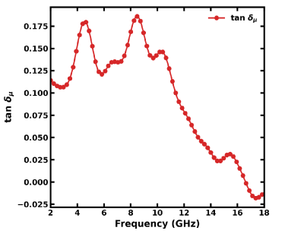
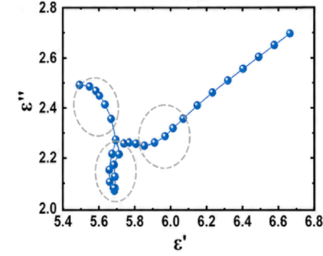
Figure 3
a
b
c
d
e
f
g
h
i
j
k
Notes:
Source: uploaded Manuscript1.docx, Figure 3. Layout and external panel labels are editable. Original traces remain raster evidence; no raw experimental data have been reconstructed. Figure 3 excludes the unreconciled comparison panel.

Slide 4
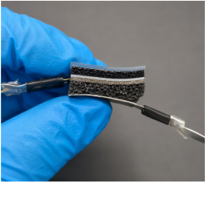
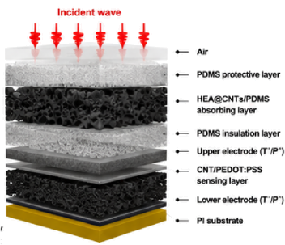
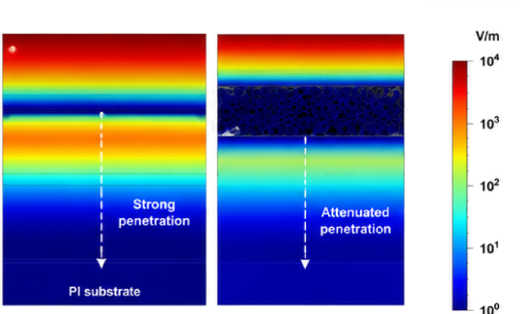
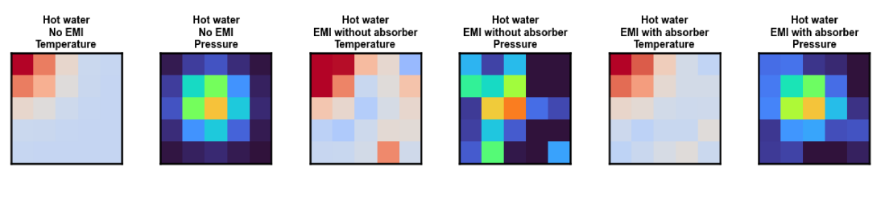

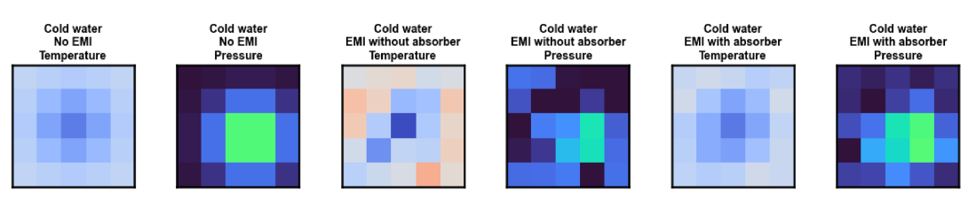

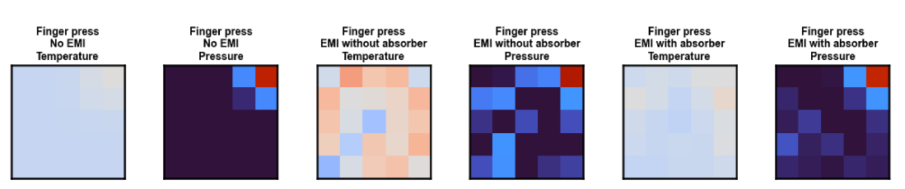
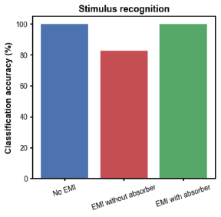
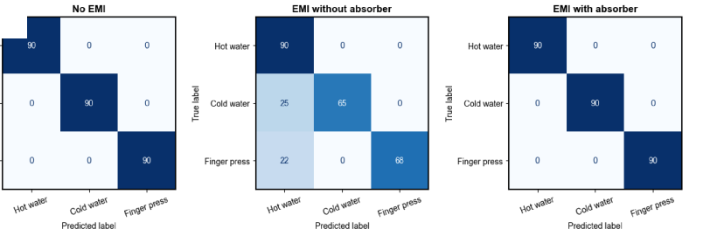
Figure 4
a
b
c
d
e
f
g
h
Notes:
Source: uploaded Manuscript1.docx, Figure 4. Layout and external panel labels are editable. Original traces remain raster evidence; no raw experimental data have been reconstructed. Figure 3 excludes the unreconciled comparison panel.

Slide 5
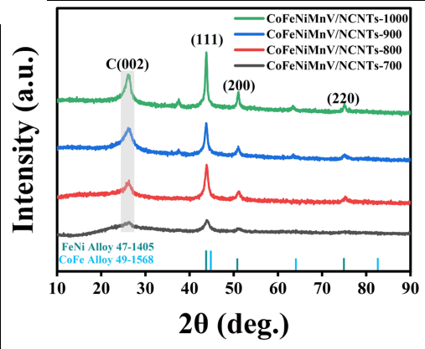
Figure S01
Notes:
XRD patterns of CoFeNiMnV/NCNTs prepared at 700, 800, 900 and 1000 °C. Reference characterization, not a new measurement of the PDMS composite.
Source: Hassan thesis, Figure 6-1a, printed p. 131, PDF p. 142.
The layout and external text are editable. Embedded traces and microscopy remain source raster data. Reference CoFeNiMnV figures are not measurements of the actual Al–Co–Fe–Ni–Mn material.

Slide 6
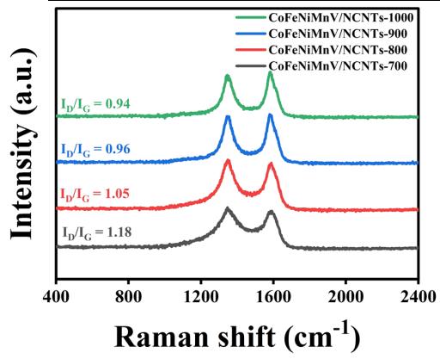
Figure S02
Notes:
Raman spectra of the same reference series. The source reports I_D/I_G values of 1.18, 1.05, 0.96 and 0.94 for 700, 800, 900 and 1000 °C, respectively.
Source: Hassan thesis, Figure 6-1b, printed p. 131, PDF p. 142.
The layout and external text are editable. Embedded traces and microscopy remain source raster data. Reference CoFeNiMnV figures are not measurements of the actual Al–Co–Fe–Ni–Mn material.

Slide 7
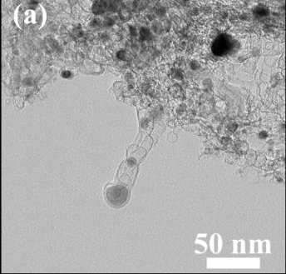
Figure S03
Notes:
Reference CoFeNiMnV/NCNTs-800 nanocomposite. TEM overview with the original 50 nm scale bar. This is cited precursor characterization.
Source: Hassan thesis, Figure 6-3a, printed p. 133, PDF p. 144.
The layout and external text are editable. Embedded traces and microscopy remain source raster data. Reference CoFeNiMnV figures are not measurements of the actual Al–Co–Fe–Ni–Mn material.

Slide 8
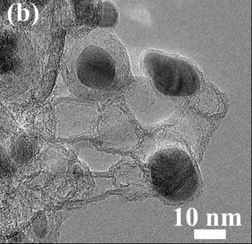
Figure S04
Notes:
Reference CoFeNiMnV/NCNTs-800 nanocomposite. Higher-magnification TEM image with the original 10 nm scale bar. This is cited precursor characterization.
Source: Hassan thesis, Figure 6-3b, printed p. 133, PDF p. 144.
The layout and external text are editable. Embedded traces and microscopy remain source raster data. Reference CoFeNiMnV figures are not measurements of the actual Al–Co–Fe–Ni–Mn material.

Slide 9
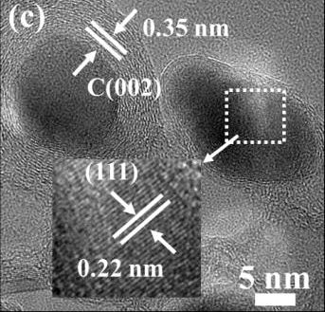
Figure S05
Notes:
Reference CoFeNiMnV/NCNTs-800 nanocomposite. HRTEM image with source annotations of approximately 0.35 nm carbon-layer spacing and 0.22 nm alloy-lattice spacing. The original 5 nm inset scale bar is retained. This is cited precursor characterization.
Source: Hassan thesis, Figure 6-3c, printed p. 133, PDF p. 144.
The layout and external text are editable. Embedded traces and microscopy remain source raster data. Reference CoFeNiMnV figures are not measurements of the actual Al–Co–Fe–Ni–Mn material.

Slide 10

Figure S06
Notes:
Reference CoFeNiMnV/NCNTs-800 nanocomposite. HAADF-STEM and elemental maps of Co, Fe, Ni, Mn, V and C. The original 50 nm HAADF scale bar is retained; no new scale is assigned to the individual maps. This is cited precursor characterization.
Source: Hassan thesis, Figure 6-3d, printed p. 133, PDF p. 144.
The layout and external text are editable. Embedded traces and microscopy remain source raster data. Reference CoFeNiMnV figures are not measurements of the actual Al–Co–Fe–Ni–Mn material.

Slide 11

Figure S07
Notes:
Reference Survey XPS spectrum of CoFeNiMnV/NCNTs-800. Original traces, fits and peak labels are retained; this spectrum is not assigned to the present PDMS foam.
Source: Hassan thesis, Figure 6-4a, printed p. 134, PDF p. 145.
The layout and external text are editable. Embedded traces and microscopy remain source raster data. Reference CoFeNiMnV figures are not measurements of the actual Al–Co–Fe–Ni–Mn material.

Slide 12

Figure S08
Notes:
Reference Co 2p XPS spectrum of CoFeNiMnV/NCNTs-800. Original traces, fits and peak labels are retained; this spectrum is not assigned to the present PDMS foam.
Source: Hassan thesis, Figure 6-4b, printed p. 134, PDF p. 145.
The layout and external text are editable. Embedded traces and microscopy remain source raster data. Reference CoFeNiMnV figures are not measurements of the actual Al–Co–Fe–Ni–Mn material.

Slide 13

Figure S09
Notes:
Reference Fe 2p XPS spectrum of CoFeNiMnV/NCNTs-800. Original traces, fits and peak labels are retained; this spectrum is not assigned to the present PDMS foam.
Source: Hassan thesis, Figure 6-4c, printed p. 134, PDF p. 145.
The layout and external text are editable. Embedded traces and microscopy remain source raster data. Reference CoFeNiMnV figures are not measurements of the actual Al–Co–Fe–Ni–Mn material.

Slide 14

Figure S10
Notes:
Reference Ni 2p XPS spectrum of CoFeNiMnV/NCNTs-800. Original traces, fits and peak labels are retained; this spectrum is not assigned to the present PDMS foam.
Source: Hassan thesis, Figure 6-4d, printed p. 134, PDF p. 145.
The layout and external text are editable. Embedded traces and microscopy remain source raster data. Reference CoFeNiMnV figures are not measurements of the actual Al–Co–Fe–Ni–Mn material.

Slide 15

Figure S11
Notes:
Reference Mn 2p XPS spectrum of CoFeNiMnV/NCNTs-800. Original traces, fits and peak labels are retained; this spectrum is not assigned to the present PDMS foam.
Source: Hassan thesis, Figure 6-4e, printed p. 134, PDF p. 145.
The layout and external text are editable. Embedded traces and microscopy remain source raster data. Reference CoFeNiMnV figures are not measurements of the actual Al–Co–Fe–Ni–Mn material.

Slide 16

Figure S12
Notes:
Reference V 2p XPS spectrum of CoFeNiMnV/NCNTs-800. Original traces, fits and peak labels are retained; this spectrum is not assigned to the present PDMS foam.
Source: Hassan thesis, Figure 6-4f, printed p. 134, PDF p. 145.
The layout and external text are editable. Embedded traces and microscopy remain source raster data. Reference CoFeNiMnV figures are not measurements of the actual Al–Co–Fe–Ni–Mn material.

Slide 17

Figure S13
Notes:
Reference N 1s XPS spectrum of CoFeNiMnV/NCNTs-800. Original traces, fits and peak labels are retained; this spectrum is not assigned to the present PDMS foam.
Source: Hassan thesis, Figure 6-4g, printed p. 134, PDF p. 145.
The layout and external text are editable. Embedded traces and microscopy remain source raster data. Reference CoFeNiMnV figures are not measurements of the actual Al–Co–Fe–Ni–Mn material.

Slide 18

Figure S14
Notes:
Reference C 1s XPS spectrum of CoFeNiMnV/NCNTs-800. Original traces, fits and peak labels are retained; this spectrum is not assigned to the present PDMS foam.
Source: Hassan thesis, Figure 6-4h, printed p. 134, PDF p. 145.
The layout and external text are editable. Embedded traces and microscopy remain source raster data. Reference CoFeNiMnV figures are not measurements of the actual Al–Co–Fe–Ni–Mn material.

Slide 19

Figure S15
Notes:
Reference O 1s XPS spectrum of CoFeNiMnV/NCNTs-800. Original traces, fits and peak labels are retained; this spectrum is not assigned to the present PDMS foam.
Source: Hassan thesis, Figure 6-4i, printed p. 134, PDF p. 145.
The layout and external text are editable. Embedded traces and microscopy remain source raster data. Reference CoFeNiMnV figures are not measurements of the actual Al–Co–Fe–Ni–Mn material.

Slide 20

Figure S16
Notes:
Compressive stress-strain curves of PDMS and functionalized foams. The source labels 5% and 20% HEA@CNTs loading, defined by the author as the mass percentage of HEA@CNTs in HEA@CNTs plus unmodified CNTs.
Source: Original Supporting Information, S1 panel a.
The layout and external text are editable. Embedded traces and microscopy remain source raster data. Reference CoFeNiMnV figures are not measurements of the actual Al–Co–Fe–Ni–Mn material.

Slide 21

Figure S17
Notes:
Cyclic compressive stress-strain response including the trace labelled Cycle 1000. The abscissa must be confirmed from the original dataset.
Source: Original Supporting Information, S1 panel b.
The layout and external text are editable. Embedded traces and microscopy remain source raster data. Reference CoFeNiMnV figures are not measurements of the actual Al–Co–Fe–Ni–Mn material.

Slide 22

Figure S18
Notes:
Seebeck coefficients at foam thicknesses of 3, 4, 5 and 6 mm. Error bars are retained as supplied; their definition and number of replicates need confirmation.
Source: Original Supporting Information, S2 panel a.
The layout and external text are editable. Embedded traces and microscopy remain source raster data. Reference CoFeNiMnV figures are not measurements of the actual Al–Co–Fe–Ni–Mn material.

Slide 23

Figure S19
Notes:
Resistance response under a periodic pressure of 200 Pa. This demonstrates detection at 200 Pa and does not establish a statistical detection limit.
Source: Original Supporting Information, S3 panel a.
The layout and external text are editable. Embedded traces and microscopy remain source raster data. Reference CoFeNiMnV figures are not measurements of the actual Al–Co–Fe–Ni–Mn material.

Slide 24

Figure S20
Notes:
Transient loading and unloading response with source-labelled response and recovery times of approximately 200 and 110 ms. The response-time convention needs confirmation.
Source: Original Supporting Information, S3 panel b.
The layout and external text are editable. Embedded traces and microscopy remain source raster data. Reference CoFeNiMnV figures are not measurements of the actual Al–Co–Fe–Ni–Mn material.

Slide 25

Figure S21
Notes:
Pressure-response waveform near the beginning of the long-cycle test. Original cycle labels are retained; repeated tick labels require correction from the underlying data.
Source: Original Supporting Information, S4 panel a.
The layout and external text are editable. Embedded traces and microscopy remain source raster data. Reference CoFeNiMnV figures are not measurements of the actual Al–Co–Fe–Ni–Mn material.

Slide 26

Figure S22
Notes:
Pressure-response waveform around cycle 2500. Original cycle labels are retained; repeated tick labels require correction from the underlying data.
Source: Original Supporting Information, S4 panel b.
The layout and external text are editable. Embedded traces and microscopy remain source raster data. Reference CoFeNiMnV figures are not measurements of the actual Al–Co–Fe–Ni–Mn material.

Slide 27

Figure S23
Notes:
Real and imaginary permittivity at nominal compressive strains of 50% and 60%.
Source: Original Supporting Information, S5 panel a.
The layout and external text are editable. Embedded traces and microscopy remain source raster data. Reference CoFeNiMnV figures are not measurements of the actual Al–Co–Fe–Ni–Mn material.

Slide 28

Figure S24
Notes:
Representative real and imaginary permittivity. The specimen identity and compressive state need author confirmation.
Source: Original Supporting Information, S5 panel b.
The layout and external text are editable. Embedded traces and microscopy remain source raster data. Reference CoFeNiMnV figures are not measurements of the actual Al–Co–Fe–Ni–Mn material.

Slide 29

Figure S25
Notes:
Representative real and imaginary permeability from 2 to 18 GHz. The specimen identity and compressive state need author confirmation.
Source: Original Supporting Information, S5 panel c.
The layout and external text are editable. Embedded traces and microscopy remain source raster data. Reference CoFeNiMnV figures are not measurements of the actual Al–Co–Fe–Ni–Mn material.

Slide 30

Figure S26
Notes:
Magnitude of normalized input impedance for thicknesses labelled 1.55, 2.10, 2.35, 2.70, 3.25 and 4.00 mm. These curves compare thicknesses, not compressive strains.
Source: Original Supporting Information, S5 panel d.
The layout and external text are editable. Embedded traces and microscopy remain source raster data. Reference CoFeNiMnV figures are not measurements of the actual Al–Co–Fe–Ni–Mn material.

Slide 31


Figure S27
With absorber
Without absorber
Notes:
HFSS electric-field maps at 2 GHz with and without the absorbing layer. The original legends are retained. Their color-scale maxima differ, so color alone cannot quantify attenuation.
Source: Original Supporting Information Figure S6.
The layout and external text are editable. Embedded traces and microscopy remain source raster data. Reference CoFeNiMnV figures are not measurements of the actual Al–Co–Fe–Ni–Mn material.

Slide 32


Figure S28
With absorber
Without absorber
Notes:
HFSS electric-field maps at 6 GHz with and without the absorbing layer. The original legends are retained. Their color-scale maxima differ, so color alone cannot quantify attenuation.
Source: Original Supporting Information Figure S6.
The layout and external text are editable. Embedded traces and microscopy remain source raster data. Reference CoFeNiMnV figures are not measurements of the actual Al–Co–Fe–Ni–Mn material.

Slide 33


Figure S29
With absorber
Without absorber
Notes:
HFSS electric-field maps at 10 GHz with and without the absorbing layer. The original legends are retained. Their color-scale maxima differ, so color alone cannot quantify attenuation.
Source: Original Supporting Information Figure S6.
The layout and external text are editable. Embedded traces and microscopy remain source raster data. Reference CoFeNiMnV figures are not measurements of the actual Al–Co–Fe–Ni–Mn material.

Slide 34


Figure S30
With absorber
Without absorber
Notes:
HFSS electric-field maps at 14 GHz with and without the absorbing layer. The original legends are retained. Their color-scale maxima differ, so color alone cannot quantify attenuation.
Source: Original Supporting Information Figure S6.
The layout and external text are editable. Embedded traces and microscopy remain source raster data. Reference CoFeNiMnV figures are not measurements of the actual Al–Co–Fe–Ni–Mn material.

Slide 35


Figure S31
With absorber
Without absorber
Notes:
HFSS electric-field maps at 18 GHz with and without the absorbing layer. The original legends are retained. Their color-scale maxima differ, so color alone cannot quantify attenuation.
Source: Original Supporting Information Figure S6.
The layout and external text are editable. Embedded traces and microscopy remain source raster data. Reference CoFeNiMnV figures are not measurements of the actual Al–Co–Fe–Ni–Mn material.

Slide 36

Figure S32
Notes:
HFSS volumetric electromagnetic-loss-density map at 2 GHz. Original spatial field and legend are retained.
Source: Original Supporting Information Figure S7.
The layout and external text are editable. Embedded traces and microscopy remain source raster data. Reference CoFeNiMnV figures are not measurements of the actual Al–Co–Fe–Ni–Mn material.

Slide 37

Figure S33
Notes:
HFSS volumetric electromagnetic-loss-density map at 6 GHz. Original spatial field and legend are retained.
Source: Original Supporting Information Figure S7.
The layout and external text are editable. Embedded traces and microscopy remain source raster data. Reference CoFeNiMnV figures are not measurements of the actual Al–Co–Fe–Ni–Mn material.

Slide 38

Figure S34
Notes:
HFSS volumetric electromagnetic-loss-density map at 10 GHz. Original spatial field and legend are retained.
Source: Original Supporting Information Figure S7.
The layout and external text are editable. Embedded traces and microscopy remain source raster data. Reference CoFeNiMnV figures are not measurements of the actual Al–Co–Fe–Ni–Mn material.

Slide 39

Figure S35
Notes:
HFSS volumetric electromagnetic-loss-density map at 14 GHz. Original spatial field and legend are retained.
Source: Original Supporting Information Figure S7.
The layout and external text are editable. Embedded traces and microscopy remain source raster data. Reference CoFeNiMnV figures are not measurements of the actual Al–Co–Fe–Ni–Mn material.

Slide 40

Figure S36
Notes:
HFSS volumetric electromagnetic-loss-density map at 18 GHz. Original spatial field and legend are retained.
Source: Original Supporting Information Figure S7.
The layout and external text are editable. Embedded traces and microscopy remain source raster data. Reference CoFeNiMnV figures are not measurements of the actual Al–Co–Fe–Ni–Mn material.

Slide 41

Figure S37
Notes:
HFSS line profile at 2 GHz. Original quantity, distance axis and trace are retained. The path coordinates and normalization need author confirmation.
Source: Original Supporting Information Figure S8.
The layout and external text are editable. Embedded traces and microscopy remain source raster data. Reference CoFeNiMnV figures are not measurements of the actual Al–Co–Fe–Ni–Mn material.

Slide 42

Figure S38
Notes:
HFSS line profile at 6 GHz. Original quantity, distance axis and trace are retained. The path coordinates and normalization need author confirmation.
Source: Original Supporting Information Figure S8.
The layout and external text are editable. Embedded traces and microscopy remain source raster data. Reference CoFeNiMnV figures are not measurements of the actual Al–Co–Fe–Ni–Mn material.

Slide 43

Figure S39
Notes:
HFSS line profile at 10 GHz. Original quantity, distance axis and trace are retained. The path coordinates and normalization need author confirmation.
Source: Original Supporting Information Figure S8.
The layout and external text are editable. Embedded traces and microscopy remain source raster data. Reference CoFeNiMnV figures are not measurements of the actual Al–Co–Fe–Ni–Mn material.

Slide 44

Figure S40
Notes:
HFSS line profile at 14 GHz. Original quantity, distance axis and trace are retained. The path coordinates and normalization need author confirmation.
Source: Original Supporting Information Figure S8.
The layout and external text are editable. Embedded traces and microscopy remain source raster data. Reference CoFeNiMnV figures are not measurements of the actual Al–Co–Fe–Ni–Mn material.

Slide 45

Figure S41
Notes:
HFSS line profile at 18 GHz. Original quantity, distance axis and trace are retained. The path coordinates and normalization need author confirmation.
Source: Original Supporting Information Figure S8.
The layout and external text are editable. Embedded traces and microscopy remain source raster data. Reference CoFeNiMnV figures are not measurements of the actual Al–Co–Fe–Ni–Mn material.

