Slide 1
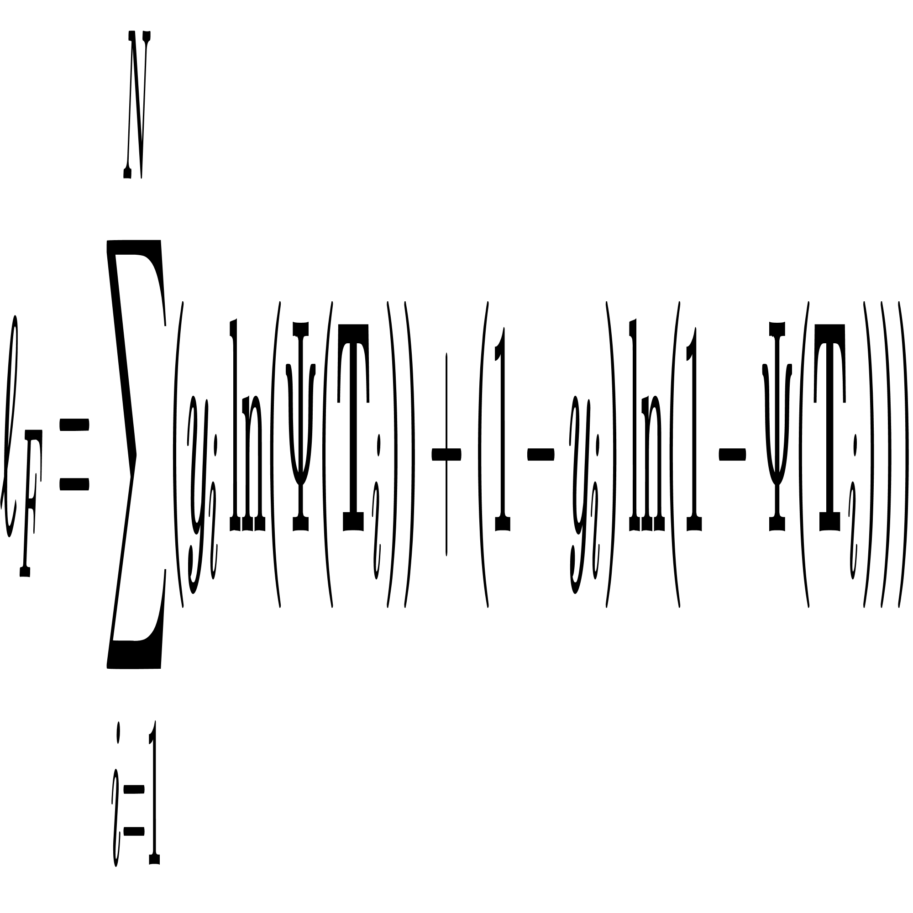
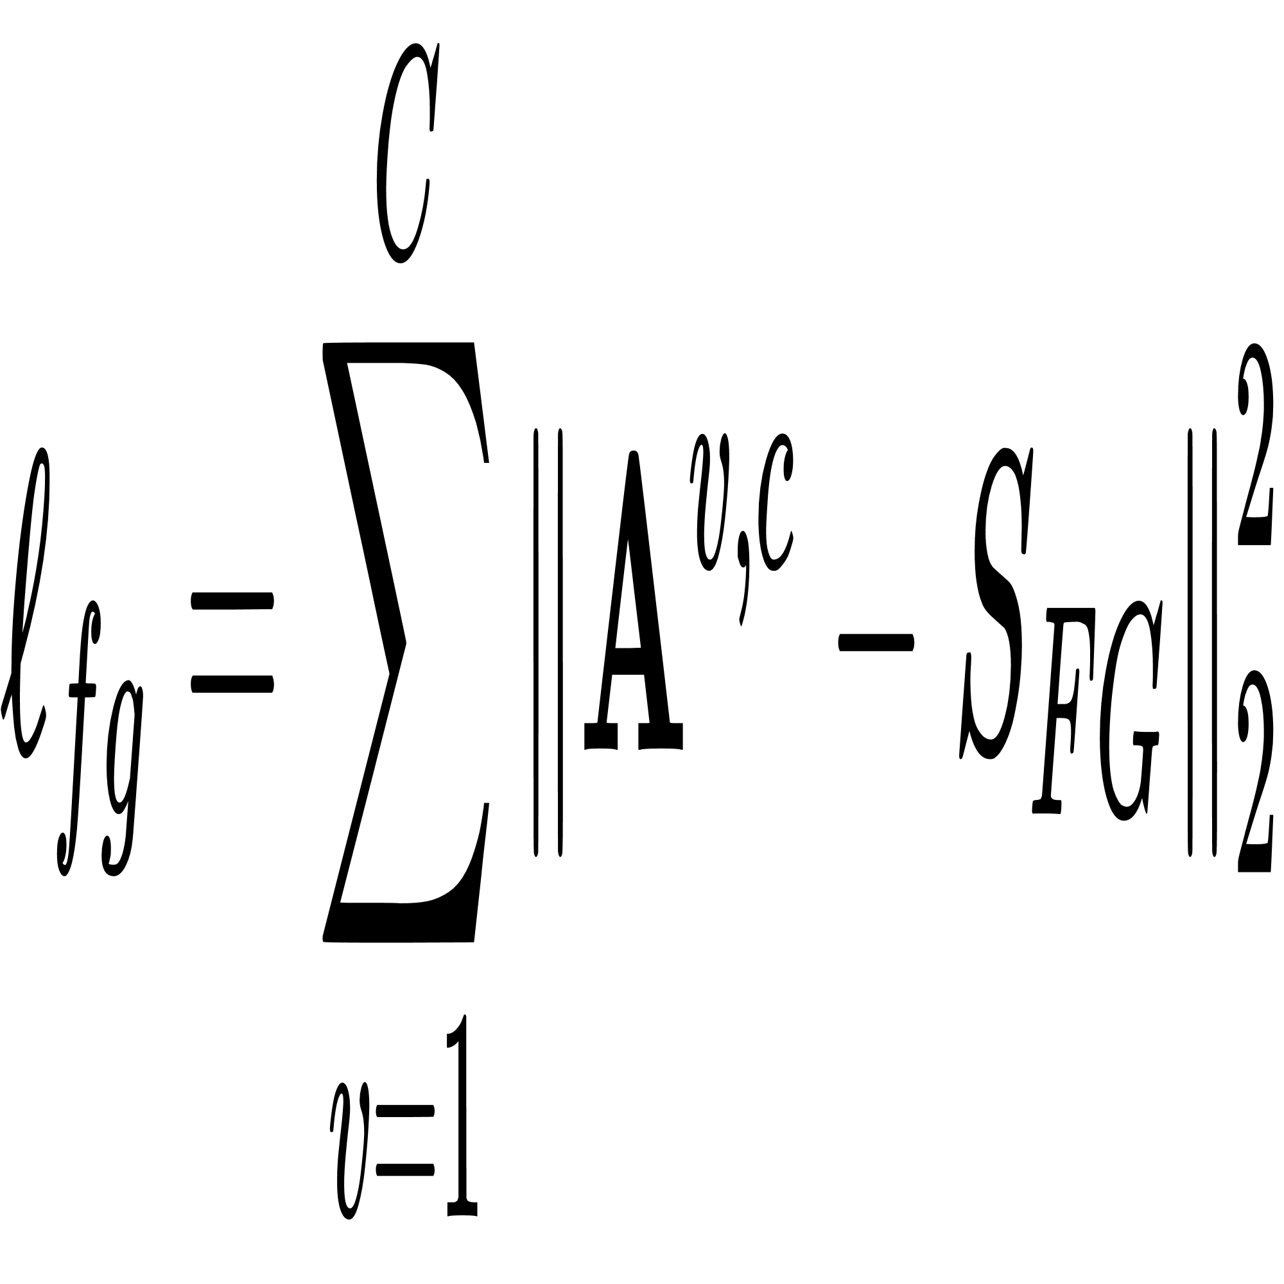
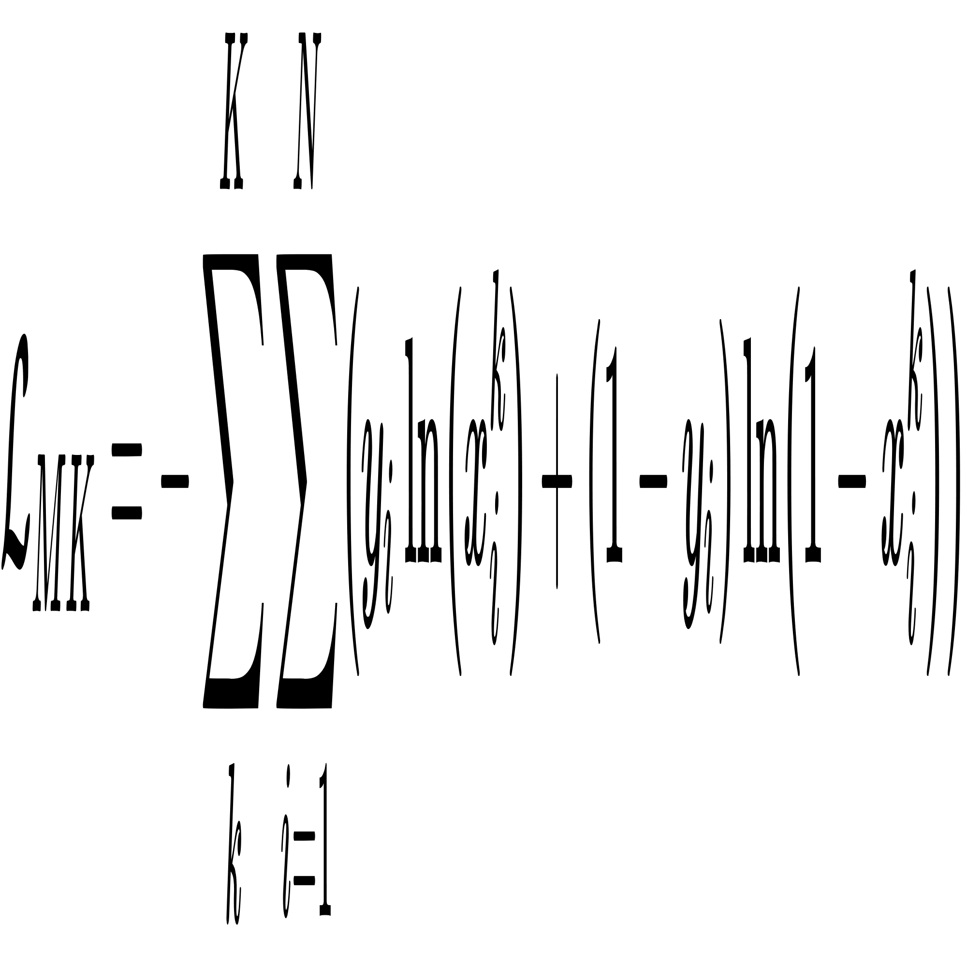
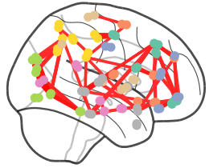






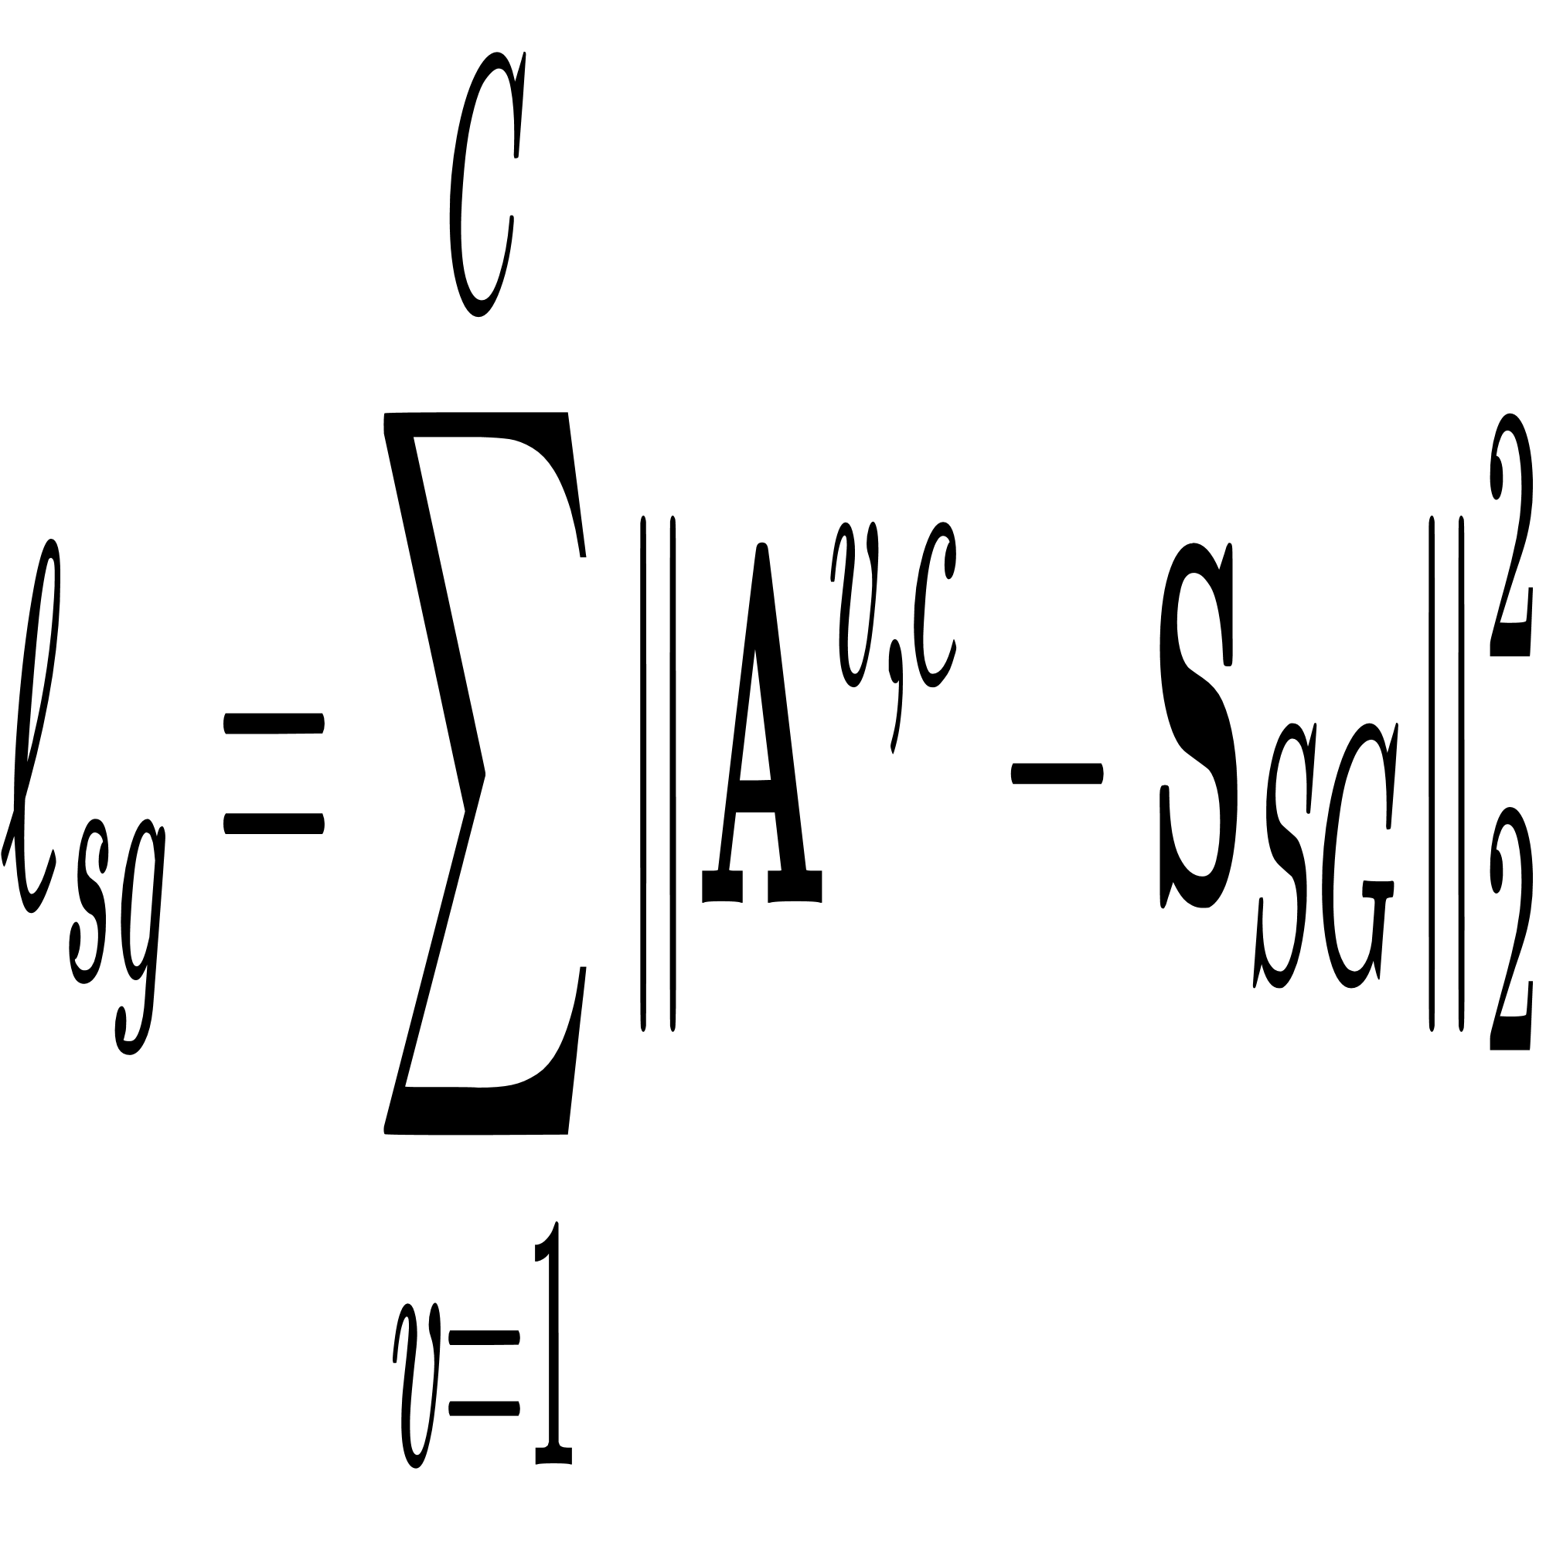

Multi-modal Graph Embedding(MMGE)
Multi-Kernel Graph Learning(MKGL)
Function Graph
Multi-modal Graph
RAM
GC
RAM
GC
RAM
GC
Functional connectivity
$$V_{1}$$
$$V_{6}$$
$$V_{4}$$
ASD
$$V_{2}$$
$$V_{5}$$
?
RAM
GC
RAM
GC
RAM
GC
Anat
$$V_{3}$$
?
Cross-kernel Discovery Tensor
TC
Trainset Label
RAM
GC
RAM
GC
RAM
GC
...
...
Func
Supervision Graph
Hadamard Product
Graph convolution layers of different sizes of convolution kernels
GC
GC
GC
Matrix Addition
Adaptive Graph Construction
RAM
Relationship Attention Mechanism
Phenotypic
information
Loss function supervision
Relational Attention Operator

