Slide 1
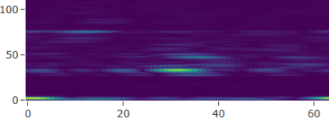

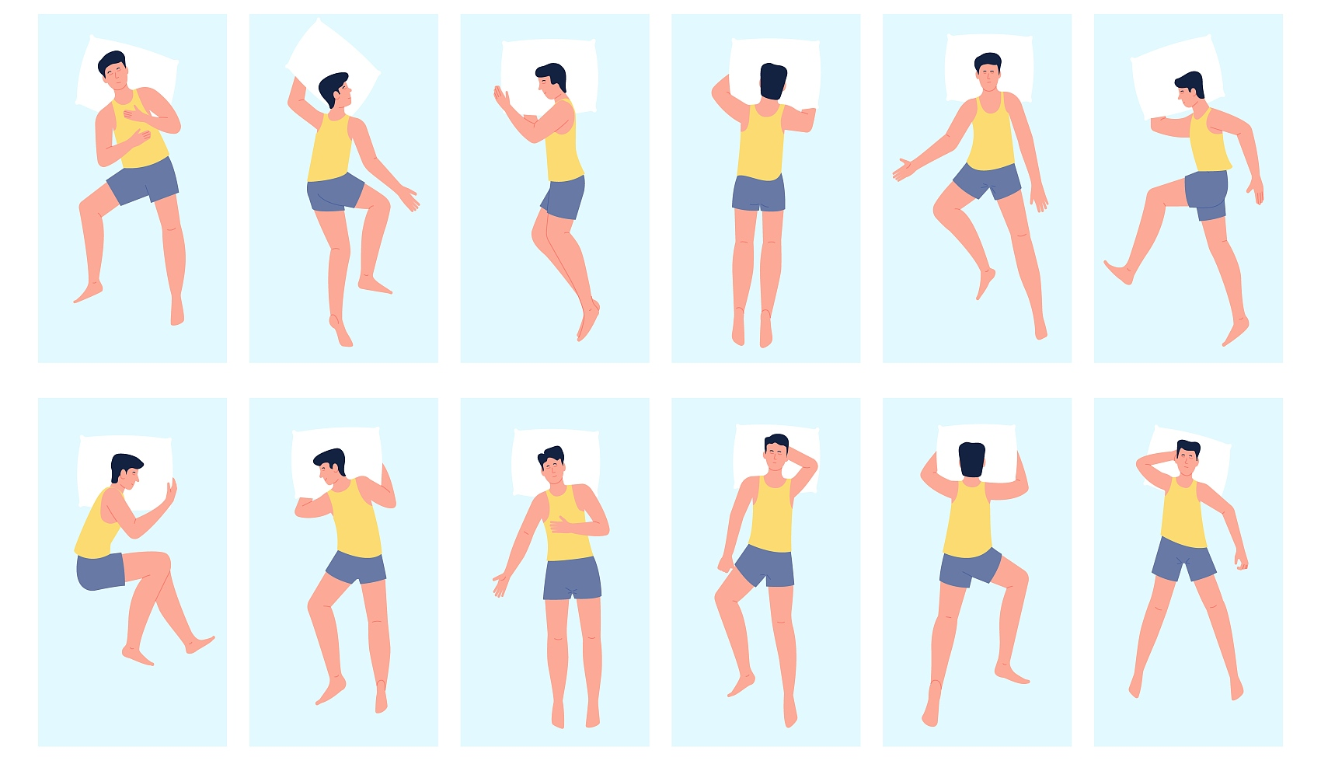
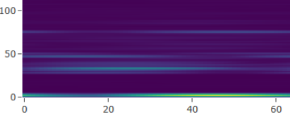
Angle-Depression Range Spectrum
4X
Auxiliary Task classifier
(128 x individual counts)
Features J1
Sigmoid
Fully Connected Layer
（64 x 32）
Conv1d
(256 x 64)
DenseBlock
（64 x 32）
Individual
TransitionBlock（96 x 64）
Concat(J1, J2)
Angle-Elevation Range Spectrum
4X
Main Task classifier
(128 x 4)
Features J2
Sleep posture
Fully Connected Layer
（64 x 32）
Sigmoid
Conv1d
(256 x 64)
DenseBlock
（64 x 32）
TransitionBlock（96 x 64）
Input
Feature Extractor Block
Global Multi-View Fusion Network
Multi-Task Output

