Slide 1
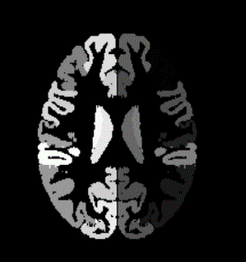
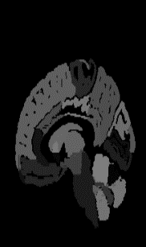
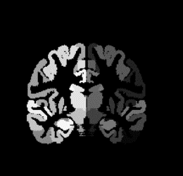
I
I
I
D
D
D
NC/AD
…
…
S
S
S
3D MR Image
D
D
MMSE
Score
D
…
…
Convolution with max-pooling layer
Fully connected layer
Feature input/output
I
Feature interaction layer (I)
S
Feature sharing module (S)
D
D
Feature decoupling module (D)

