Slide 1


Mininet Tutorial
CS352-Summer 2021
Summer 2021
Used with permission from D. Raychaudhuri (ECE, RUTGERS UNIVERSITY).

Slide 2
Requirements
Just a few requirements
Python programming
Language syntax
Few basic commands and scripting
Linux command line
Basic knowledge (e.g., run programs)
Basic networking tools (e.g., ifconfig)

Slide 3
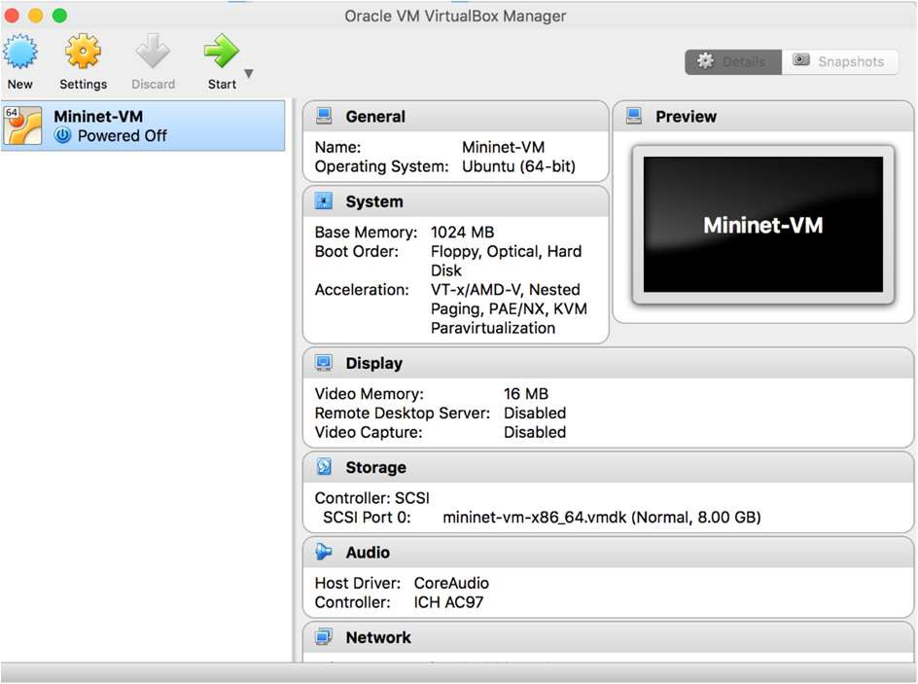
Virtual Machine Set-up
Download mininet VM from:
https://github.com/mininet/mininet/releases
VM OVS format is compatible with most virtual environments
Suggestion: Virtual Box from Oracle. It is free, multiplatform
https://www.virtualbox.org/wiki/Downloads
Start the virtual box application and import the mininet VM image in virtual box. You can either click on the VM image or import via the menu in virtual box window

Slide 4
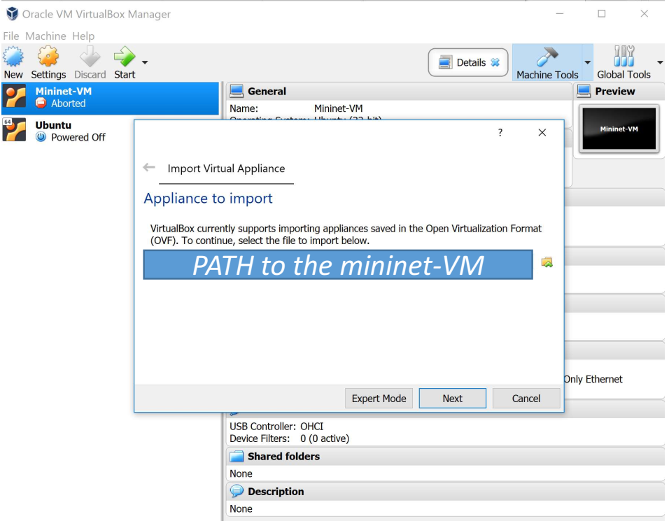
How to load the VM into VBox
File -> Import Appliance

Slide 5
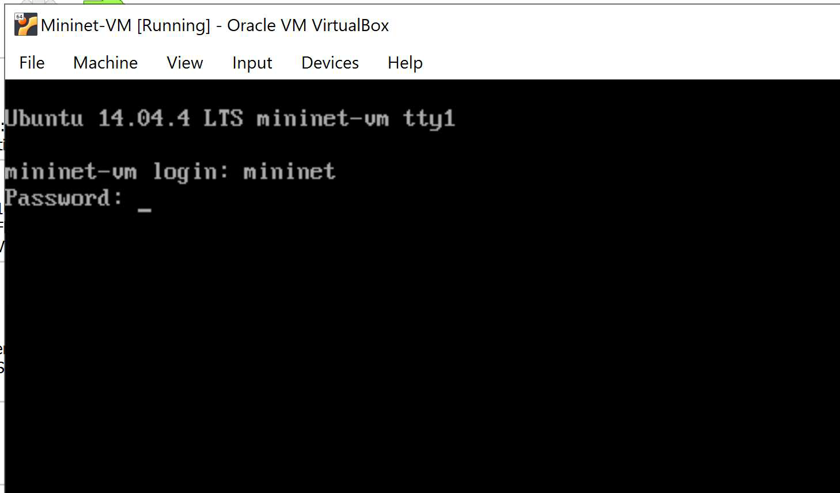
SSH into the VM
Start the VM
Login
Username: mininet
Password: mininet
Explore:
/home/mininet/mininet/examples
5

Slide 6
SSH into the VM
Activate interface eth1 at the mininet-VM permanently by editing the interfaces configuration:
$sudo vi /etc/network/interfaces
Add following lines in this file: auto eth1
iface eth1 inet dhcp
Now restart the mininet-VM: sudo reboot
Check that both eth0 and eth1 are up and are assigned the IP addresses using: Ifconfig -a
You can now ssh into the VM (while it is running), from your host OS
On Unix machines:
$ssh mininet@IPAddress_of_host_only_adapter
On windows:
Use tools such as Mobaxterm or Putty and then ssh
(if you are unable to login, please see the next slide)

Slide 7
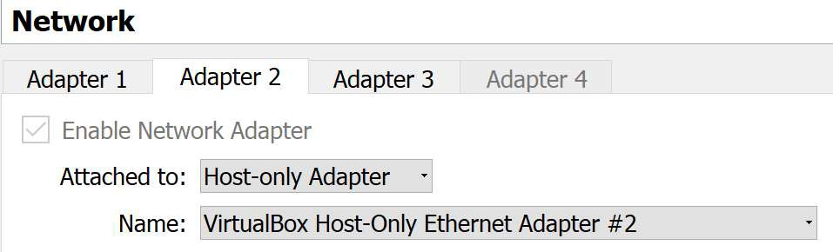
Unable to SSH into the VM
1. Check the Adaptor2 of mininet VM and change it to host-only adaptor
2. Follow the instructions available here to enable the port forwarding.

Slide 8

Let us start with a simple topology
Internet Browser
Controller
Internet Browser
Host1
Host2
Switch
Host2
Creation using Linux
Create host namespaces: e.g., ip netns add h1
Create switch: e.g., ovs-vsctl add-br s1
Create links: e.g., ip link add h1-eth0 type veth peer name s1-eth1
Move host ports into the namespaces: e.g., ip link set h1-eth0 netns h1
Connect switch ports to OVS: e.g., ovs-vsctl add-port s1 s1-eth1
Set-up a controller: e.g., ovs-vsctl set-controller s1 tcp:127.0.0.1
Configure network: e.g., ip netns exec h1 ifconfig h1-eth0 10.0.0.1
Test network: ip netns exec h1 ping -c1 10.0.0.2

Slide 9
What is the alternative?
A simple command-line tool or APIs for the automatic:
Topology creation
Network configuration
Protocols and algorithms test
…
Mininet:
Mininet creates a realistic virtual network, running real kernel, switch and application code, on a single machine (VM, cloud or native), in seconds, with a single command: sudo mn

Slide 10
Mininet Commands
Enter the mininet world:
$sudo mn
Display command line interface (CLI) commands:
mininet> help
Display nodes:
mininet> nodes
Show interface of host h1:
mininet> h1 ifconfig
Test connectivity between two hosts:
mininet> h1 ping h2
Test complete connectivity:
mininet> pingall
Exit mininet:
mininet> exit
Cleanup:
mininet> sudo mn -c
10

Slide 11
Sources
Modified from previous slide deck: http://www.winlab.rutgers.edu/comnet2/Projects/documents/intro_proto.pdf

