Slide 1
WELCOME TO DATA SCIENCE
CS 418 Introduction to Data Science
Prof. Sathya Ravi
August 27, 2024

Slide 2
What is Data Science?

Slide 3
WHAT IS DATA SCIENCE? From syllabus
“Our ability to collect, manipulate, analyze, and act on vast amounts of data is having a profound impact on all aspects of society. This transformation has led to the emergence of data science as a new discipline. The explosive growth of interest in this area has been driven by research in social, natural, and physical sciences with access to data at an unprecedented scale and variety, by industry assembling huge amounts of operational and behavioral information to create new services and sources of revenue, and by government, social services and non-profits leveraging data for social good. This emerging discipline relies on a novel mix of mathematical and statistical modeling, computational thinking and methods, data representation and management, and domain expertise.”
Computing Research Association’s Committee on Data Science, 2016
“Data science is a data-based approach to problem solving by analyzing and exploring large volumes of possibly multi-modal data, extracting knowledge and insight from it, and using information for better decision-making. It involves the process of collecting, preparing, managing, analyzing, explaining, and disseminating the data and analysis results.” from Data Science -- A Systematic Treatment, CACM, 2023

Slide 4
WHAT IS DATA SCIENCE? Informal but useful definition
The application of data-centric, computational, and inferential thinking to:
1) understand the world (science)
2) solve problems (engineering)
Data science = statistics
+ data collection
+ data preprocessing
+ machine learning
+ visualization
+ business insights
+ scientific hypotheses
+ big data
+ (etc)
--Joey Gonzalez (UC Berkeley)
-- Zico Kolter (CMU)

Slide 5
What Data Science is not
(at least not by itself)

Slide 6
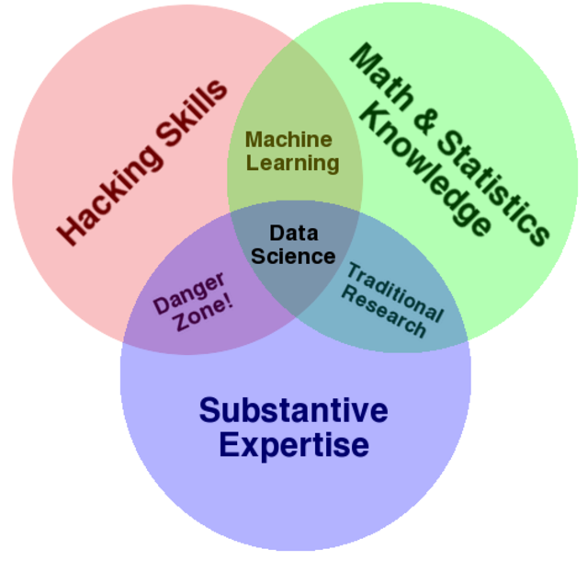
DATA SCIENCE IS NOT MACHINE LEARNING
Machine learning involves computation and statistics, but has not traditionally been very concerned about answering scientific questions
Machine learning has a heavy focus on fancy algorithms…
... but sometimes the best way to solve a problem is just by visualizing the data, for instance
Drew Conway’s Venn Diagram
See Battle of the Data Science Venn Diagrams: http://www.prooffreader.com/2016/09/battle-of-data-science-venn-diagrams.html

Slide 7

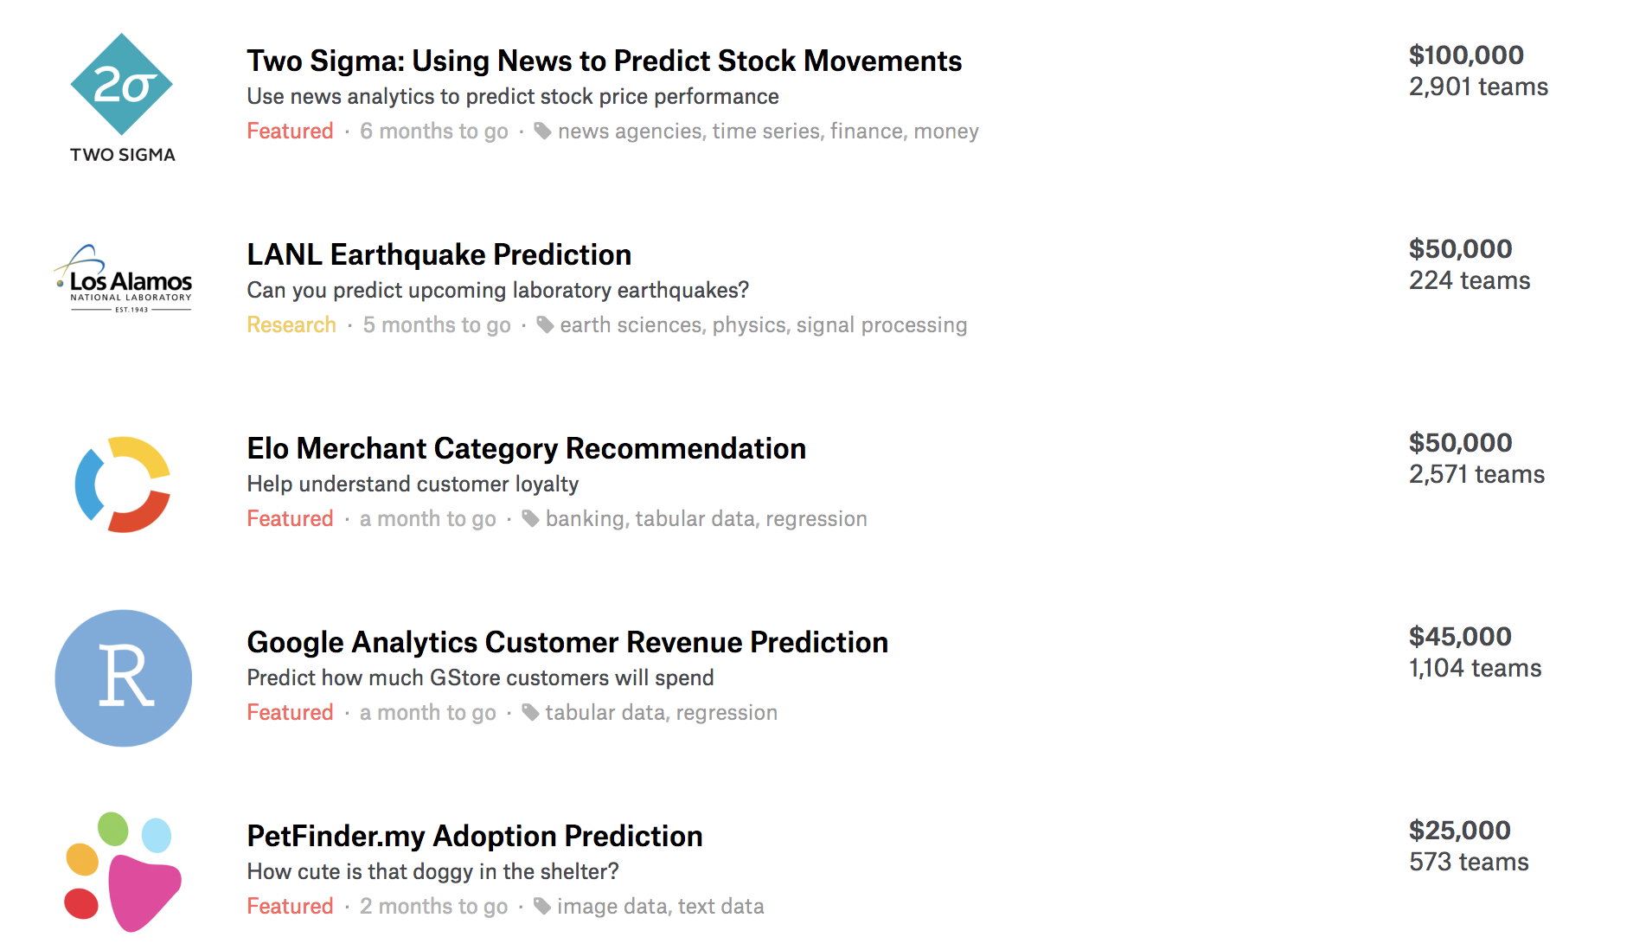
DATA SCIENCE IS NOT MACHINE LEARNING COMPETITIONS
Data science competitions like Kaggle ask you to optimize a metric on a fixed data set
This may or may not ultimately solve the desired business/scientific problem
Data science is the iterative cycle of designing a concrete problem, finding the right data for it, building an algorithm to solve it (or determining that this is not possible), and evaluating what insights this provides for the real underlying question

Slide 8
DATA SCIENCE IS NOT STATISTICS
“Analyzing data computationally, to understand some phenomenon in the real world, you say? … that sounds an awful lot like statistics”
Statistics (at least the academic type) has evolved a lot more along the theoretical frontier. For example: under what technical conditions are the results from data analysis valid?
We will see and use some basic definitions and notions such as hypothesis testing, confidence interval etc. in this class
Statistics courses usually do not have lectures on e.g. web scraping, data processing, databases, cloud computing, algorithms. These are key entry points in Data Science

Slide 9
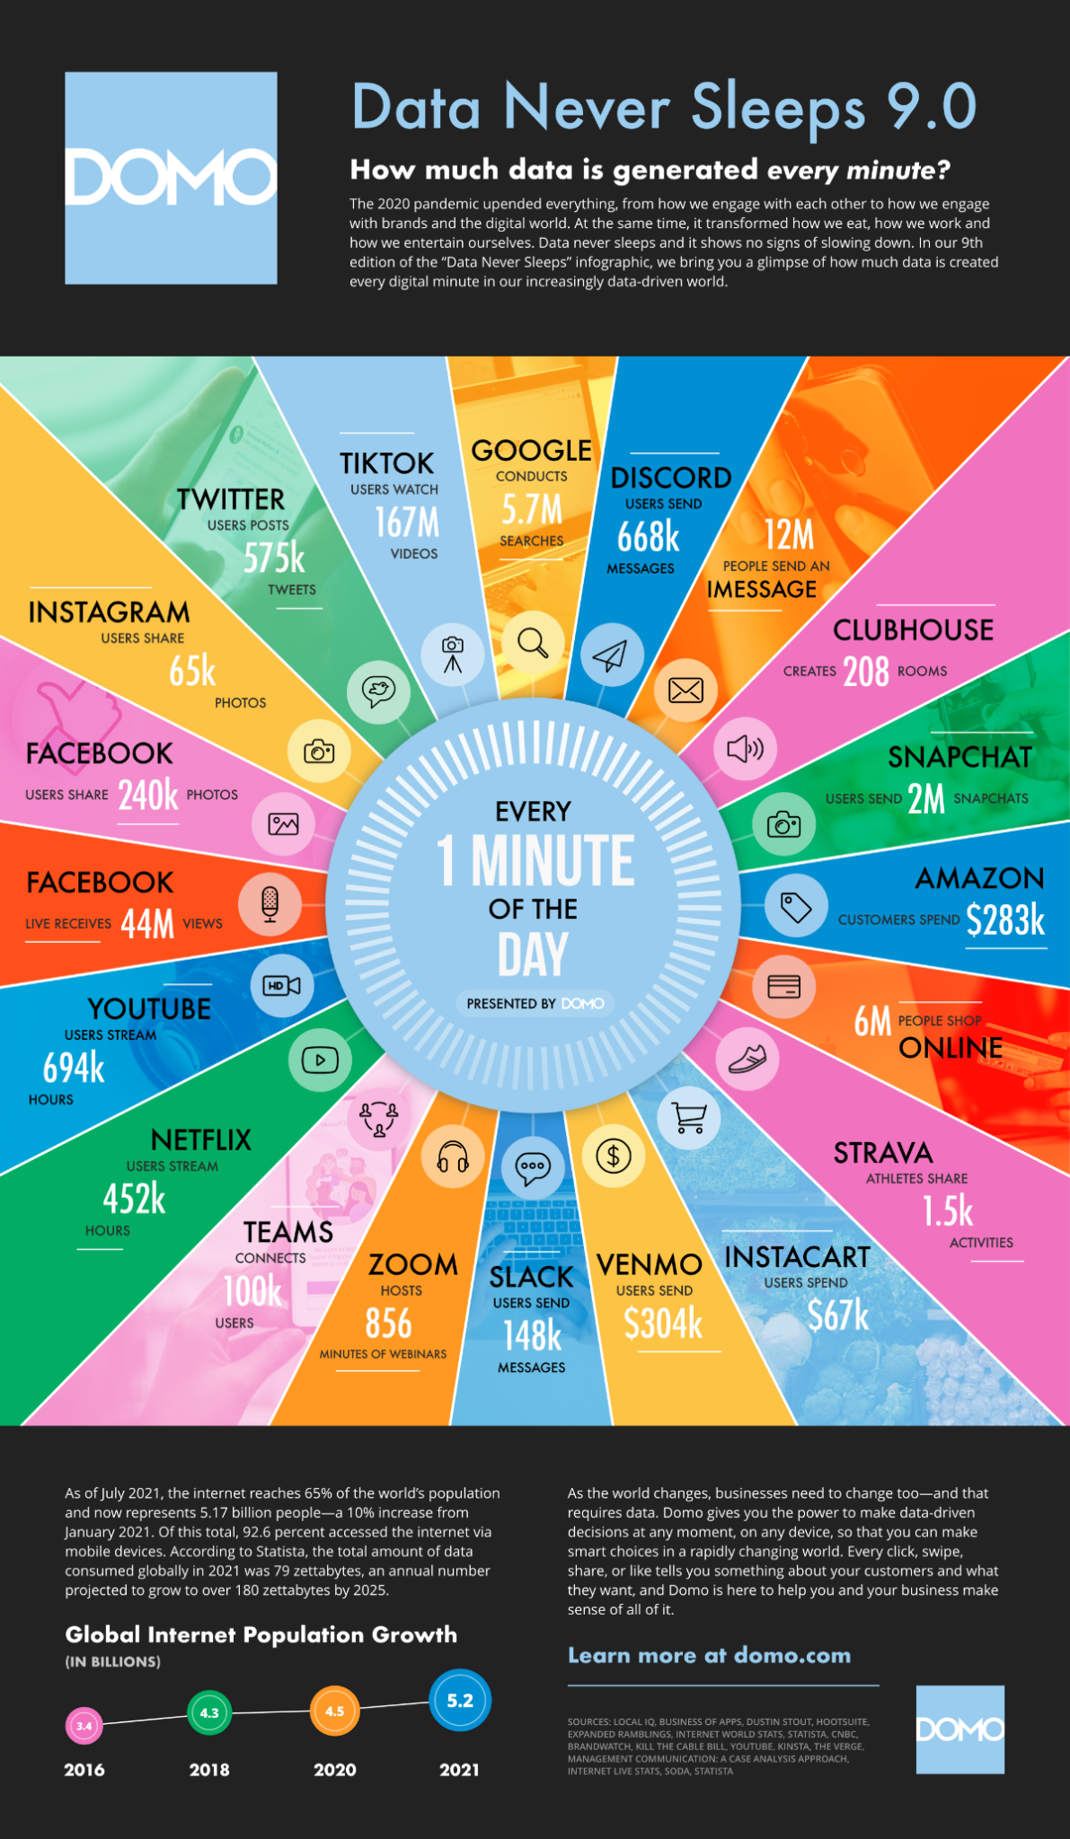
DATA SCIENCE IS NOT BIG DATA
Sometimes, in order to truly understand and answer your question, you need massive amounts of data
But often you don’t
Don’t create more work for yourself than you need to
“Big data is not about the data”
–- Gary King (Harvard)

Slide 10
Textbook definition of Data science – Fig 1-1
Note the two distinct entry points!
Formulate Question or Problem (node 1)
Acquire and Clean Data
(node 2)
Draw Conclusions from Predictions and Inference
(node 4)
Exploratory Data Analysis
(node 3)
Reports, Decisions, and Solutions

Slide 11
IN SIMPLER TERMS
Note the two distinct entry points!
Ask a Question
Obtain Data
Understand the World
Understand the Data
Reports, Decisions, and Solutions

Slide 12
Data Science examples

Slide 13
The greatest value of a picture is when it forces us to notice what we never expected to see.
-John Tukey

Slide 14
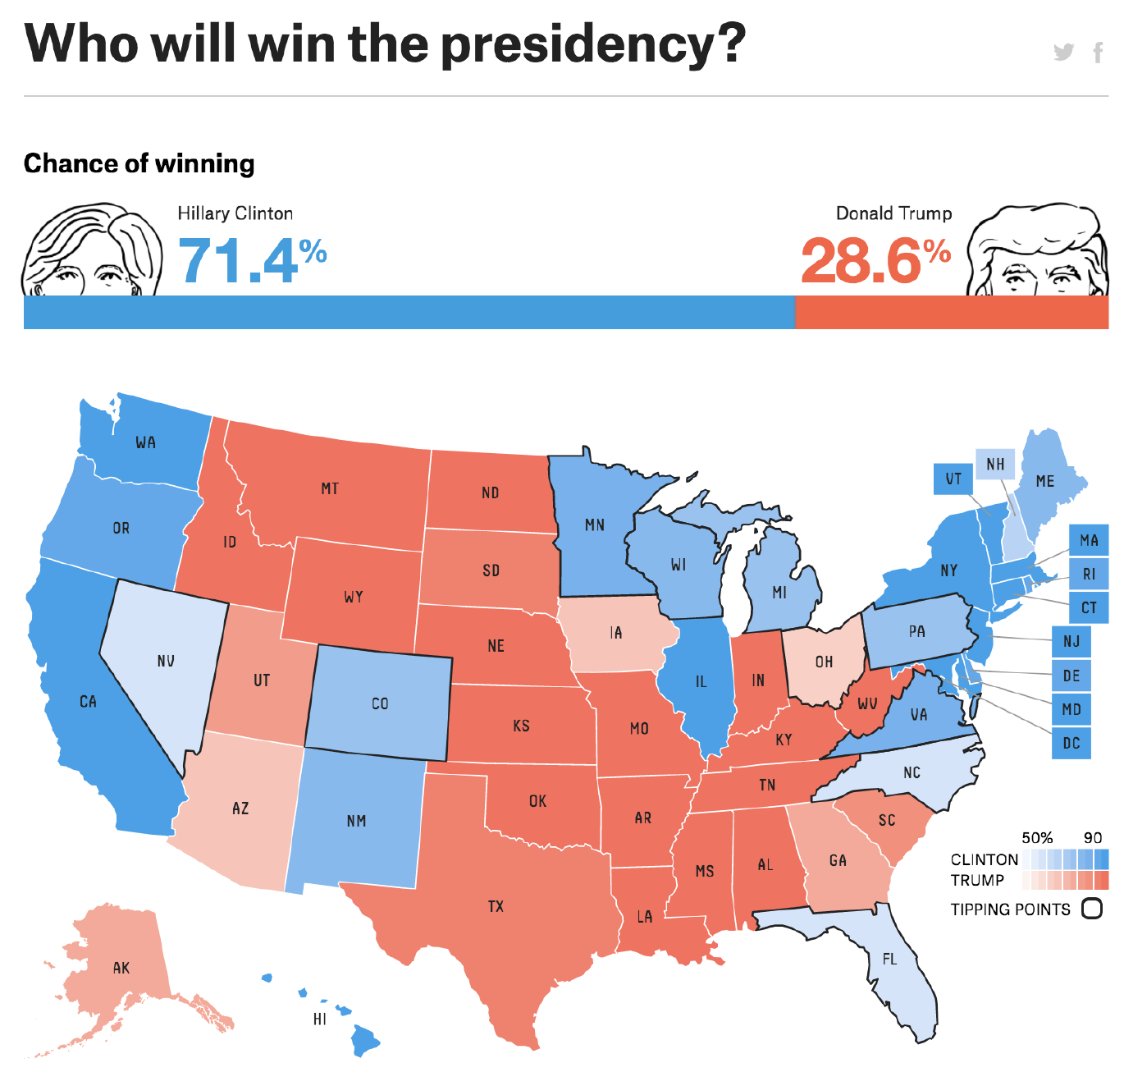
FIVETHIRTYEIGHT
https://projects.fivethirtyeight.com/2016-election-forecast/

Slide 15
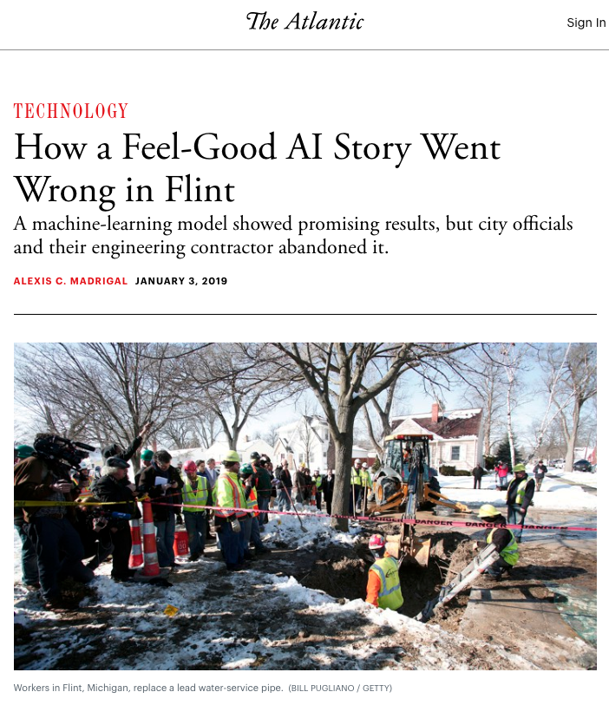
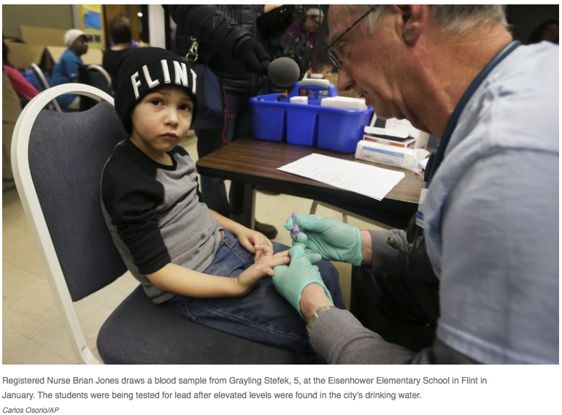
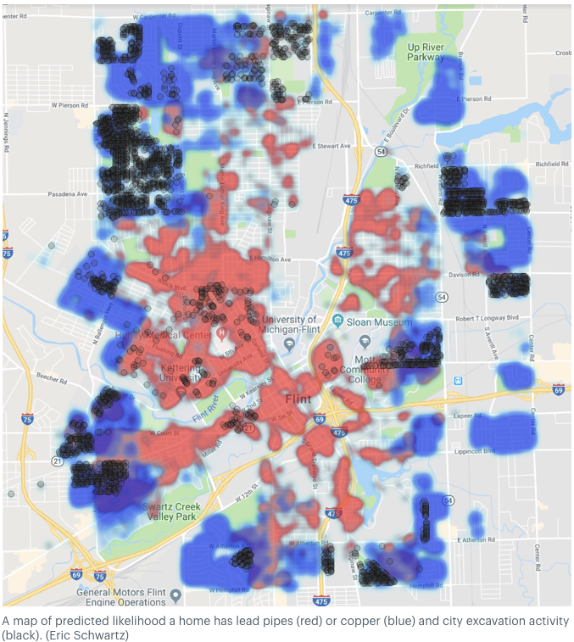
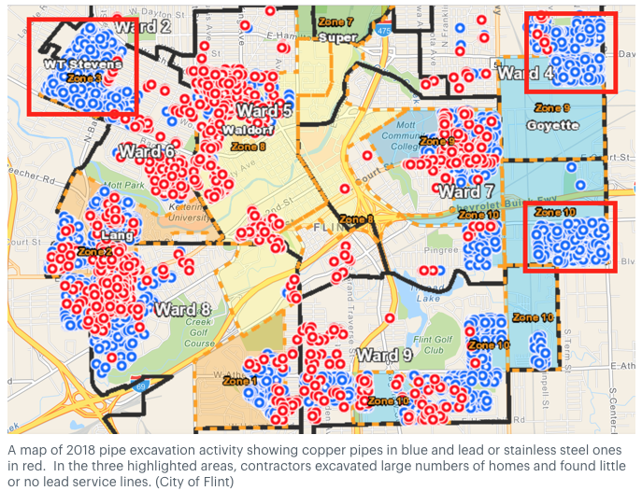
LEAD WATER PIPES
Source:https://www.npr.org/sections/thetwo-way/2016/04/20/465545378/lead-laced-water-in-flint-a-step-by-step-look-at-the-makings-of-a-crisis
Source:https://www.theatlantic.com/technology/archive/2019/01/how-machine-learning-found-flints-lead-pipes/578692/

Slide 16
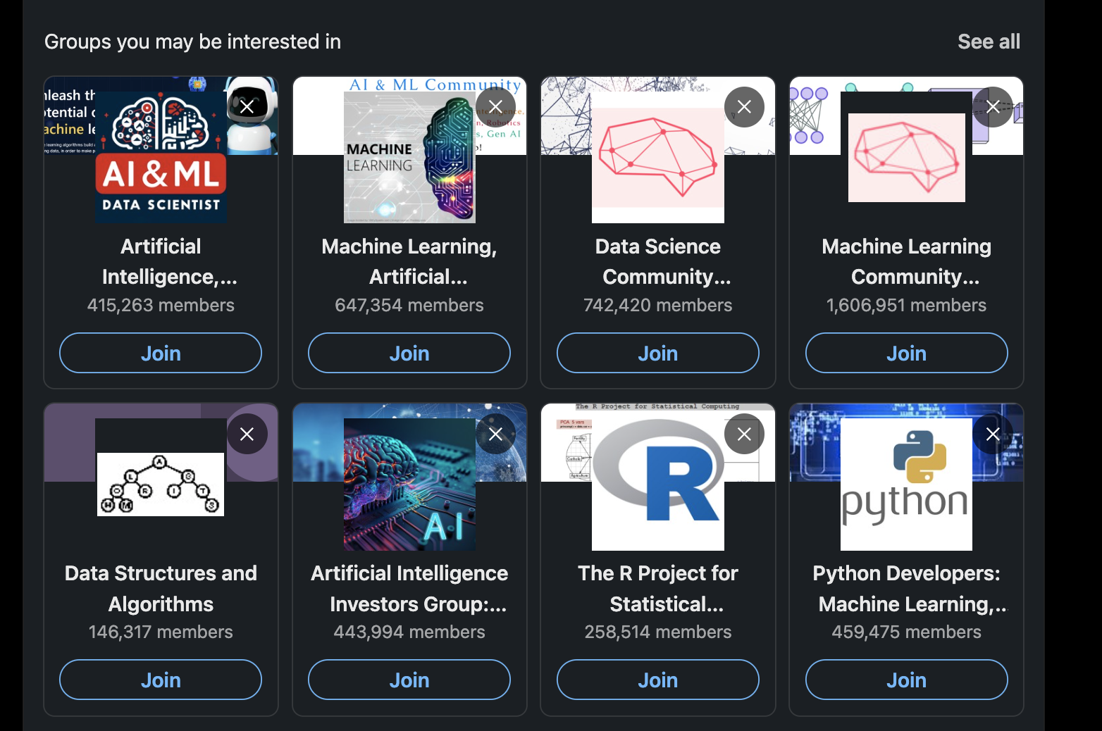
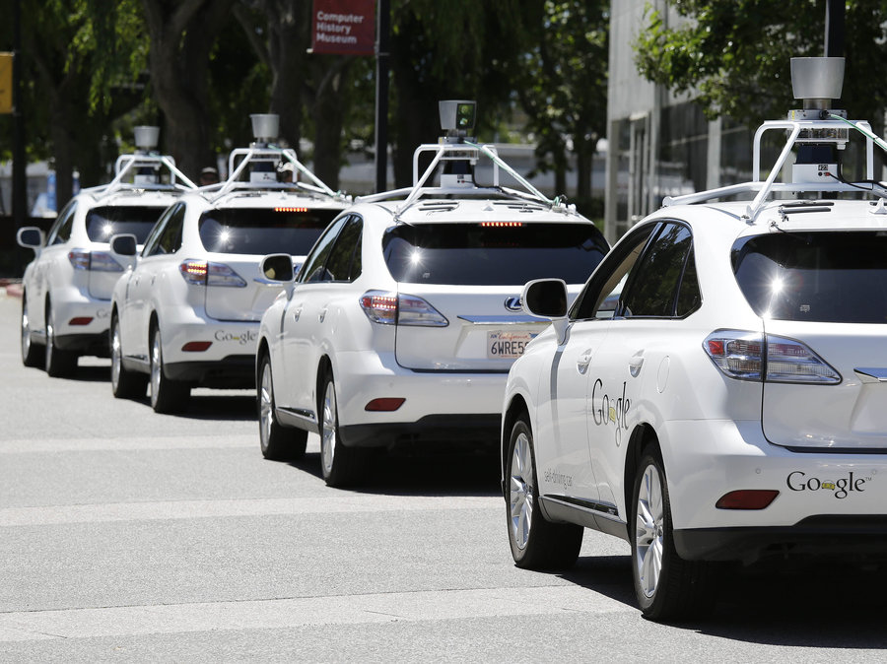
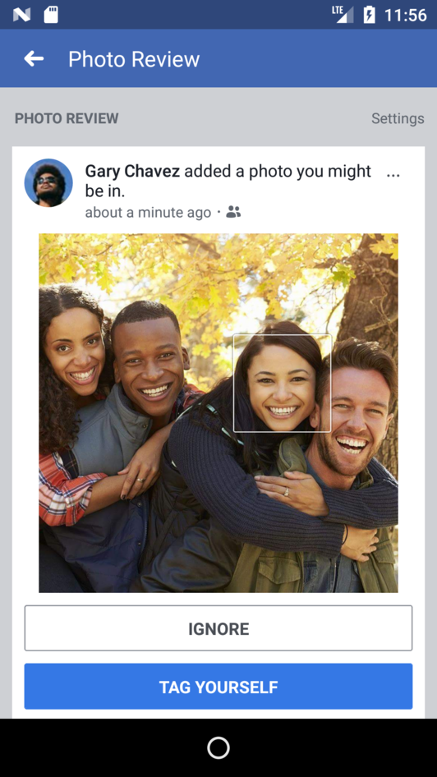
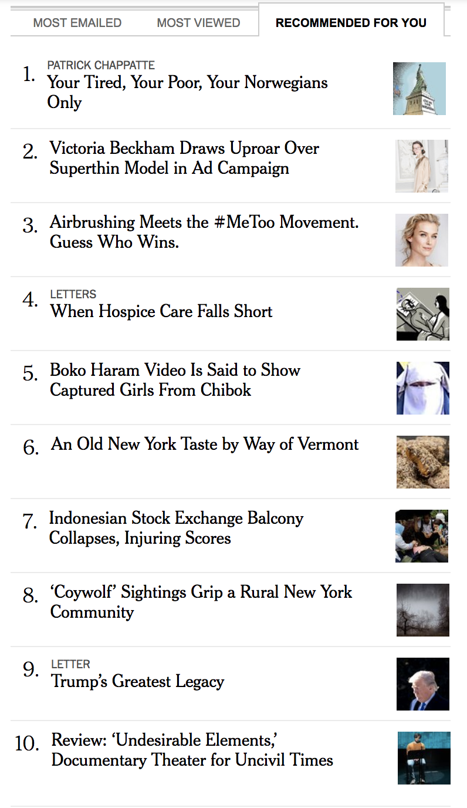
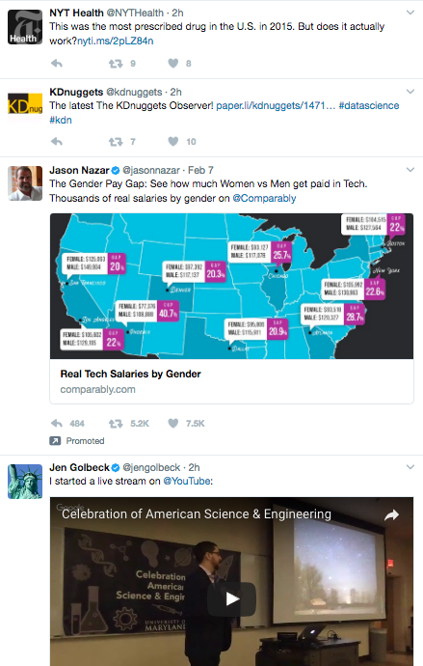
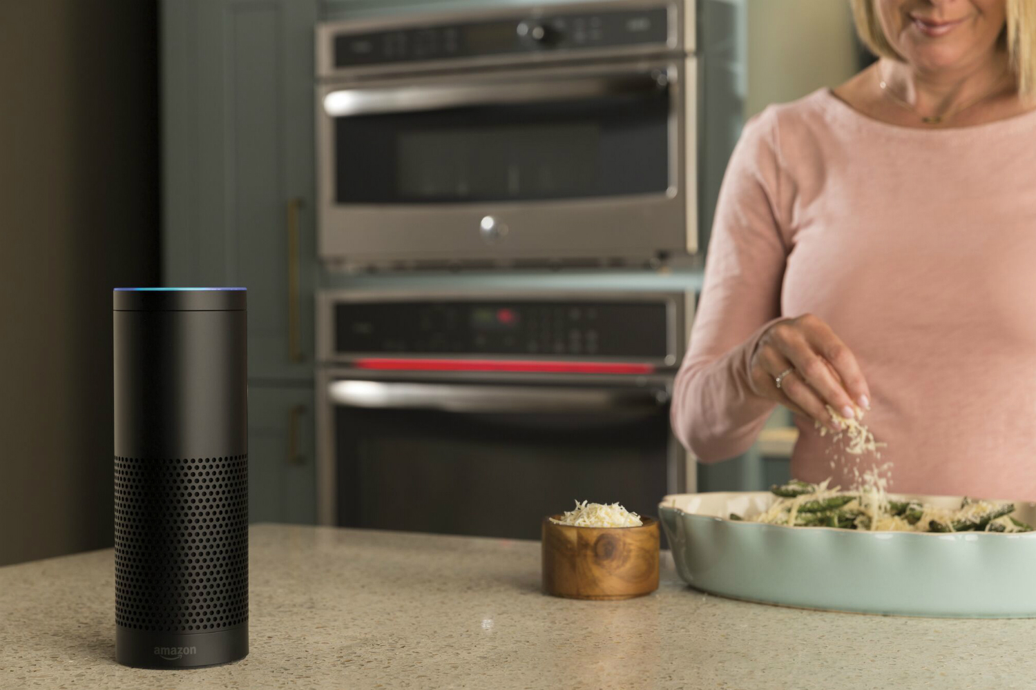
DATA (SCIENCE) PRODUCTS

Slide 17
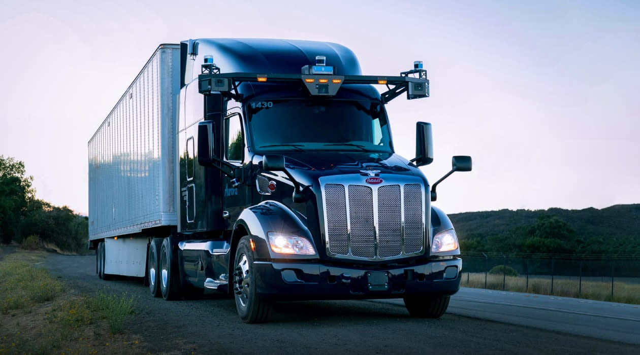
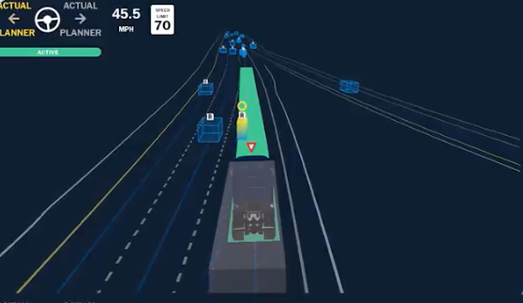
AUTONOMOUS VEHICLES
Use mapping data, on-road data, and simulation data to safely drive
Challenge: fat tail of corner cases
Extremely data-driven! How can you ensure changes improve driving?
Source: https://aurora.tech

Slide 18
TYPES OF DATA SCIENTISTS
Decision scientists (data science for humans)
Output: data summaries, metrics, visualizations, experiments
Consumers of the output: decision makers
Products: dashboards
Modeling scientists (data science for machines)
Output: training data, models and algorithms
Consumers of the output: computers
Products: recommender systems
Products either deployed directly to production systems or prototypes are handed off to software engineers
Source: https://hbr.org/2018/11/the-kinds-of-data-scientist

Slide 19
HOW DO I BECOME A DATA SCIENTIST
Claudia Perlich (Two Sigma): “Learning how to do data science is like learning to ski. You have to do it.”
DJ Patil (Former US Chief Data Scientist): “The No. 1 thing is you’ve got to have passion. This rich passion for going ruthlessly after the problem and being deeply intellectually honest with yourself about whether this is a reasonable answer…. The second part is having the ability to be extremely clever with the data. And what I mean by that is: You’re working with ambiguity. And very often you can’t approach the problem with the rigor you would a homework assignment. The only way to survive through that is by being clever—to think of a different question that gets at the answer.”
https://www.kdnuggets.com/2017/05/42-essential-quotes-data-science-thought-leaders.html

Slide 20
MOST DESIRED DATA SCIENTIST TRAITS
In addition to technical skills:
Ability to collaborate
In love with solving problems, not specific solutions or methods
High integrity
Source: https://hbr.org/2018/11/the-kinds-of-data-scientist

Slide 21
What is this course about?

Slide 22
WHAT IS THIS COURSE ABOUT?
Exploring key areas of data science
Question formulation, data collection and cleaning, visualization, statistical inference, predictive modeling, decision making
Covering key principles and techniques of data science
Techniques for transforming, querying and analyzing data
Principles behind creating informative data visualizations
Statistical concepts of measurement error and prediction
Algorithms for machine learning and their evaluation
Techniques for scalable data processing

Slide 23
LEARNING OBJECTIVES FOR THE COURSE
Empower students to apply computational and statistical thinking to tackle real-world problems with data
understand the full data science pipeline, and be familiar with programming tools to accomplish the different portions
be able to collect data from unstructured sources and store it using appropriate structure such as relational databases, graphs, matrices, etc.
know to explore and visualize your data
be able to analyze your data rigorously using a variety of statistical and machine learning approaches
This is an introductory Data Science course and by no means comprehensive!
A lot of emphasis on practice and hands-on programming
You are strongly encouraged to go beyond what you learn in class

Slide 24
COURSE PREREQUISITES
This course requires working knowledge of probability, data structures, programming
Otherwise, it will be hard for you to complete class assignments
Probability and statistics
Random variables, continuous and discrete distributions, expectations, variance
Conditional probability, marginalization, Bayes rule
Refreshers: https://see.stanford.edu/materials/aimlcs229/cs229-prob.pdf http://www.cs.princeton.edu/courses/archive/spring07/cos424/scribe_notes/0208.pdf
Ability to (learn to) program in Python

Slide 25
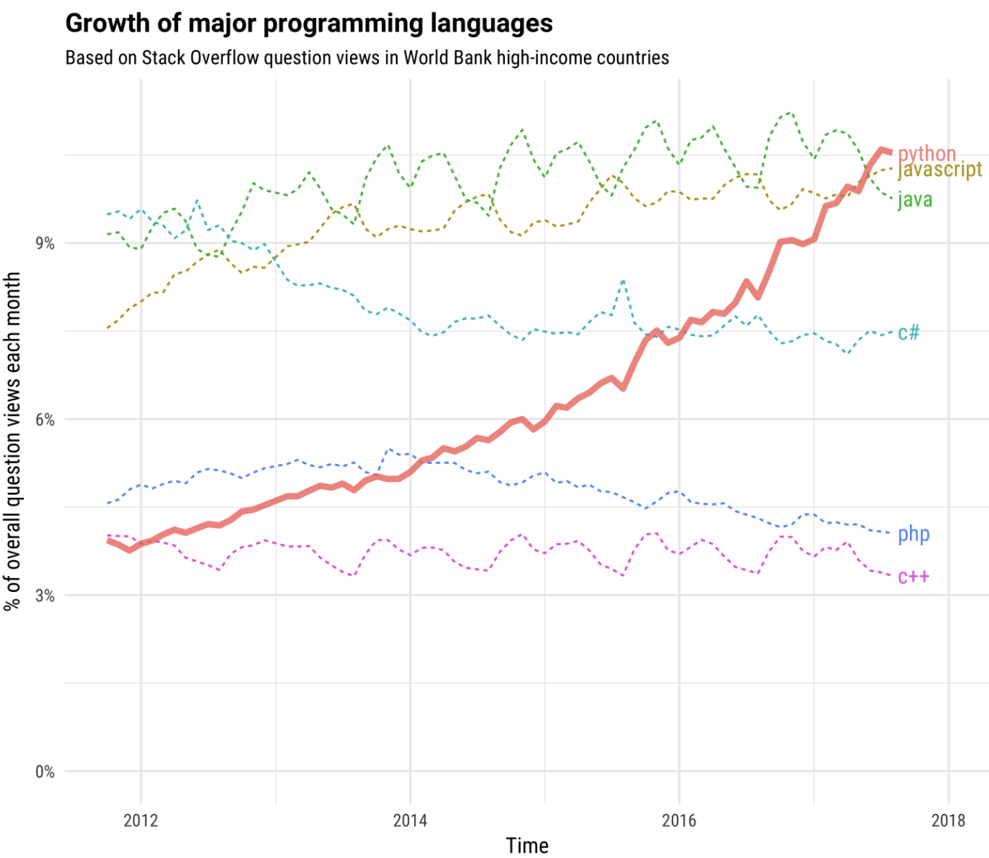
MAIN PROGRAMMING LANGUAGE: PYTHON
Source: https://stackoverflow.blog/2017/09/06/incredible-growth-python/

Slide 26
DELIVERABLES AND GRADING
Homework assignments including programming/implementation (3*10%=30%)
Group class project (30%)
In-class quizzes (2*10%=20%)
No make-up, beginning of the lectures for 30 minutes.
One midterm exam (20%)
No make-up, full lecture.
Extra credit for extraordinary Piazza contributions and project presentation feedback (up to 5%)
Online textbooks, including:
Learning Data Science. Lau, Gonzalez, Nolan (will be denoted as LDS)
Mining of Massive Datasets. Leskovec, Rajaraman, Ullman (MMD)

Slide 27
THREE HOMEWORK ASSIGNMENTS (30%)
Homework reinforces the material through programming assignments
Typically released on Tuesday and due two weeks later on Thursday
Starting early on each assignment is very important for successful completion
Late work policy
You have 3 late day credits, can be used on one homework assignment or spread across 2 or 3
If 3 late days have been used, then 20% grade penalty per day for submitting up to 3 days late
No homework assignment will be accepted beyond 3 days late
Do not expect office hours/Piazza assistance after the HW deadline if using late days!
Statute of limitations
We can address grading questions only within 2 weeks after an item is returned – no exceptions!
Blackboard and/or Gradescope for grading assignments (please read instructions before starting)

Slide 28
GROUP PROJECT (30%)
Detailed project specifications will be released 2nd week of the semester
Groups will have five/six members each
There is an individual and group component of the grade
Group Deliverables
Check-in with professor
Progress report
Project presentation
Final report
Individual Assessment
Project proposal
Peer assessment
Code contributions

Slide 29
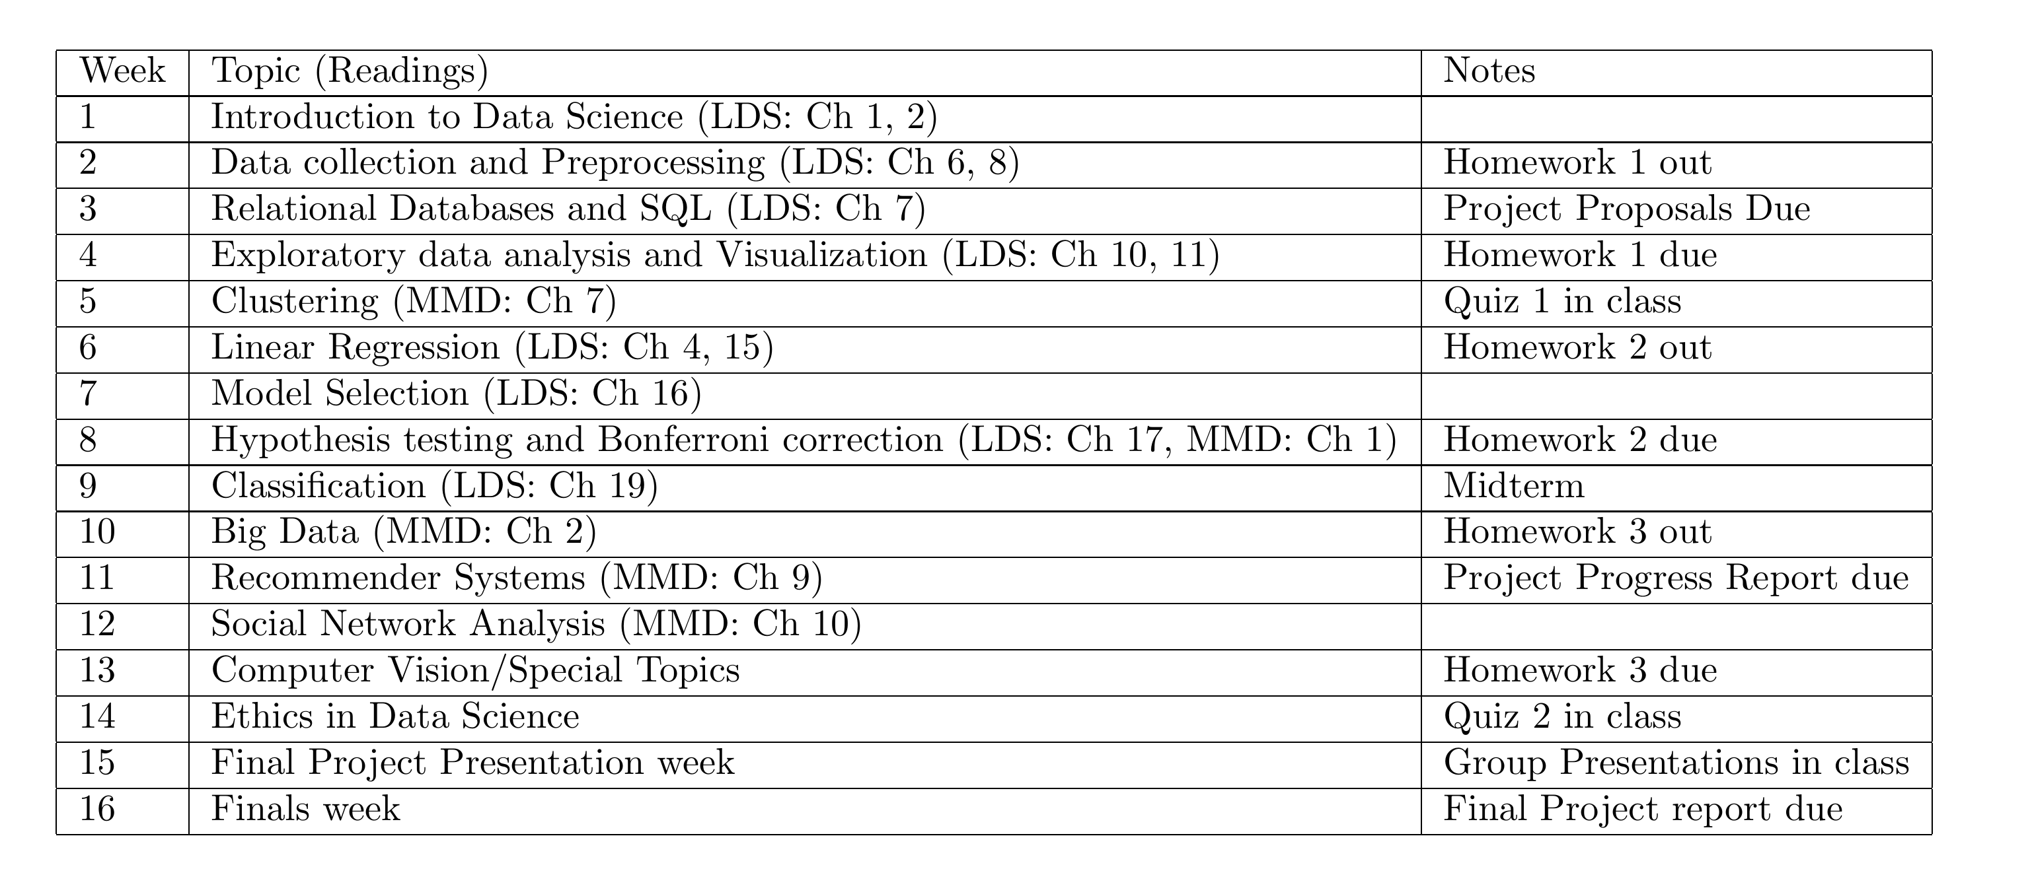
TENTATIVE SCHEDULE as in syllabus
Check Piazza for most up-to-date
Data Preparation
Data Analytics

Slide 30

ANNOUNCEMENTS
In a typical lecture you will see a slide like this to help you stay on top of deliverables
Before next lecture, log in to Piazza using your UIC email
Setup python on a computer
Read the syllabus
Read the assigned reading (chapter 1, 2)
Sign up for Gradescope using your UIC email
Let me know dates of religious holidays you observe, if you need disability accommodation
Attend class on time, in order not to miss the quizzes (in the beginning)

Slide 31
WHAT WE WILL USE PIAZZA FOR
Main hub for course schedule, materials, assigned readings, lecture slides
You should have received an email to register for Piazza
Discussion of class materials and requirements
Piazza should be your go-to place for questions
Questions should be posted as public notes
We encourage you to ask any question, but recognize that sometimes this is embarrassing, which is why your posts can be anonymous to other students
Private notes to the Instructors can be posted only if you need to share part of your homework solution
Students are encouraged to answer other student questions (see Extra Credit policy)
TA’s will be available to answer questions through Piazza
Under no circumstances should you post homework solutions on Piazza or anywhere else (see Academic Integrity policy)
Means of communication with the Instructors (not email!)
We will not respond to emails unless they are of sensitive personal nature

Slide 32
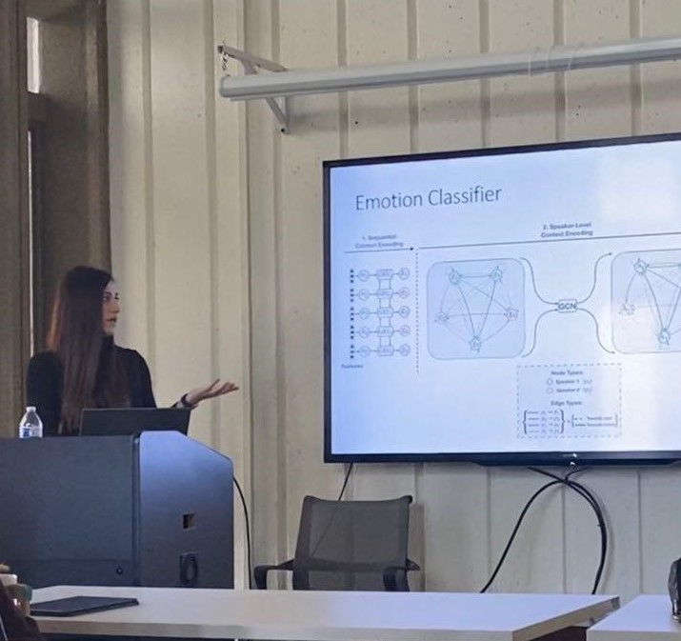
WHAT YOU CAN EXPECT FROM INSTRUCTORS
TA: Zhu (Ellen) Wang zwang260@uic.edu
We are here to help you learn by
Introducing concepts from both theory and practice perspective
Assigning appropriate readings
Keeping you on track through homework
Guiding your project
Providing help during office hours*
Addressing your questions on Piazza within a reasonable amount of time (typically 24 hours or less during the week)
*Office hours start next week: for time/location, check Piazza -> Resources -> Staff

Slide 33
WHAT I EXPECT FROM YOU
Read assigned readings before class - see syllabus
Start homework assignments and project early
Be proactive
The class project is your opportunity to do real data science!
Attend and participate in lectures
Participation is a component of the course grade and essential for success in the course
The instructor and TA’s will not be able to go over missed lecture material with you
Material covered in lectures can be a part of the exams even if it’s not in the assigned readings and slides

Slide 34

1. QUESTION / PROBLEM FORMULATION
What do we want to know?
What problems are we trying to solve?
What are the hypotheses we want to test?
What are our metrics for success?
Formulate Question or Problem

Slide 35
2. DATA ACQUISITION AND CLEANING
What data do we have and what data do we need?
How will we collect more data?
How do we organize the data for analysis?
You will typically acquire data in one of four ways:
Directly download a data file (or files)
Query data from a database – later in the course
Query an API (usually web-based, these days)
Scrape data from a webpage
The last two will be part of HW1
Acquire and Clean Data

Slide 36
3. EXPLORATORY DATA ANALYSIS AND VISUALIZATION
Do we already have relevant data?
What are the biases, anomalies, or other issues with our data?
How do we transform the data to enable effective analysis?
Exploratory Data Analysis
Exploratory data analysis (EDA): the process of discovering traits about our data that inform future analysis.

Slide 37
4. PREDICTIONS AND INFERENCE
What does the data say about the world?
Does it answer our questions or accurately solve the problem?
How robust are our conclusions and can we trust the predictions?
Draw Conclusions from Predictions and Inference
Reports, Decisions, and Solutions

