Slide 1
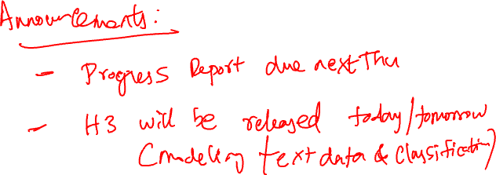
BIAS VARIANCE TRADEOFF
Chapter 17.6

Slide 2
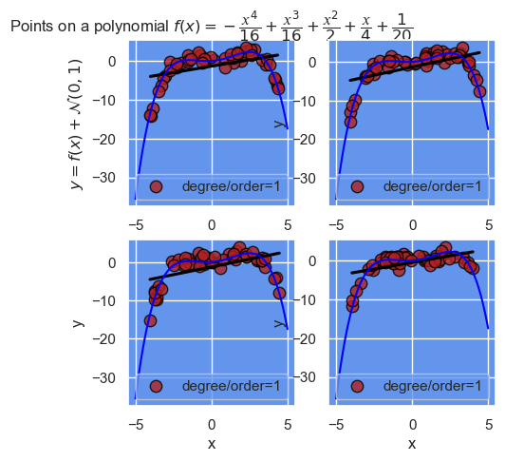
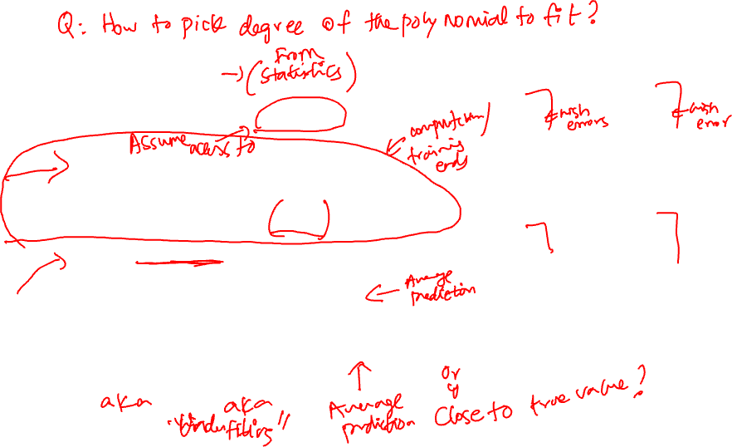
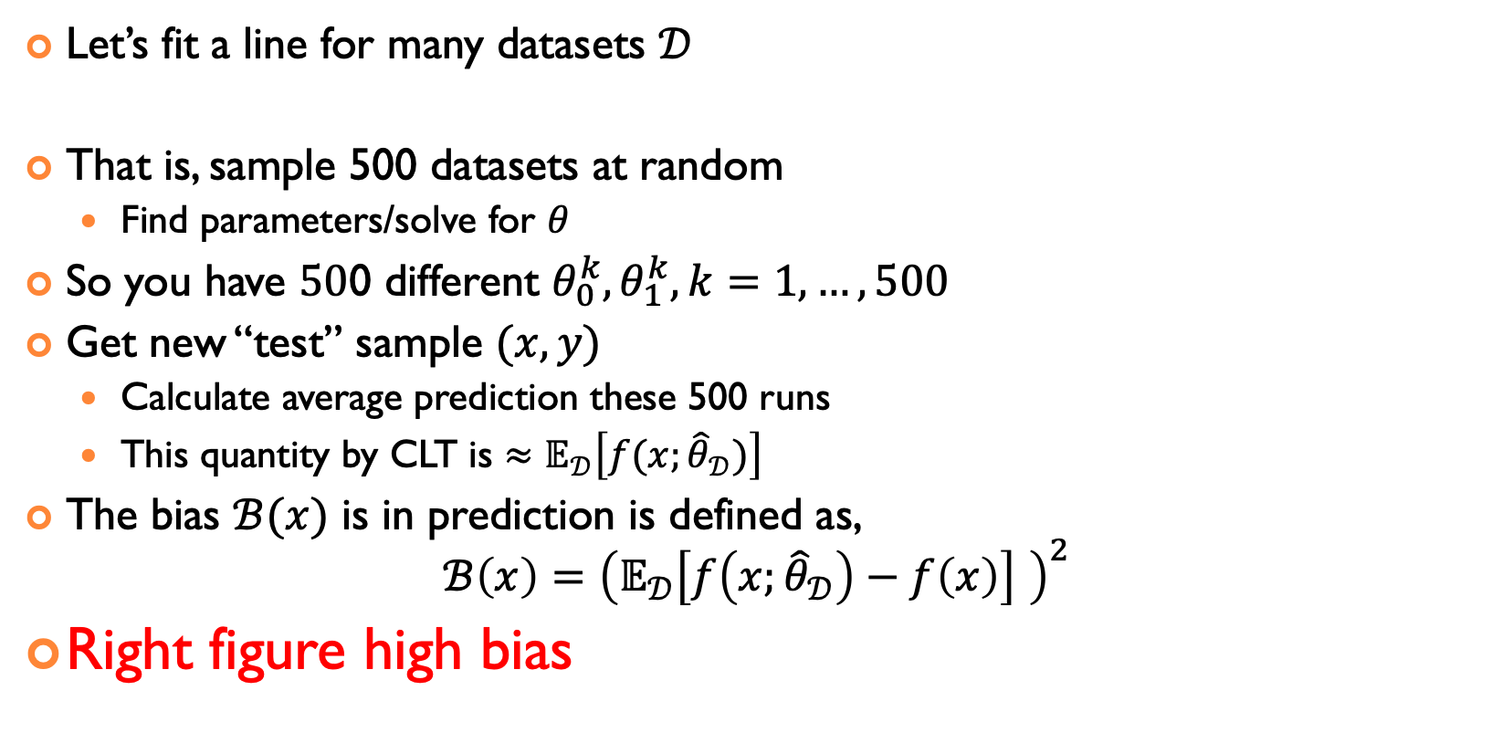
DEFINING BIAS
Let’s fit a line for many datasets $𝒟$
That is, sample 500 datasets at random
Find parameters/solve for $θ$
So you have $50$0 different $θ_{0}^{k},θ_{1}^{k}, k=1,…,500$
Get new “test” sample $(x,y)$
Calculate average prediction these 500 runs
This quantity by CLT is $≈𝔼_{𝒟}\left[f(x;{\hat{θ}}_{𝒟})\right]$
The bias $ℬ(x)$ is in prediction is defined as, $ℬ\left(x\right)={\left(𝔼_{𝒟}\left[f\left(x;{\hat{θ}}_{𝒟}\right)−f\left(x\right)\right] \right)}^{2}$
Right figure high bias

Slide 3
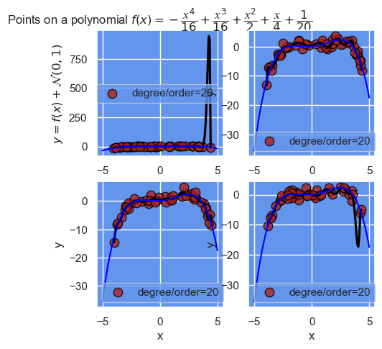
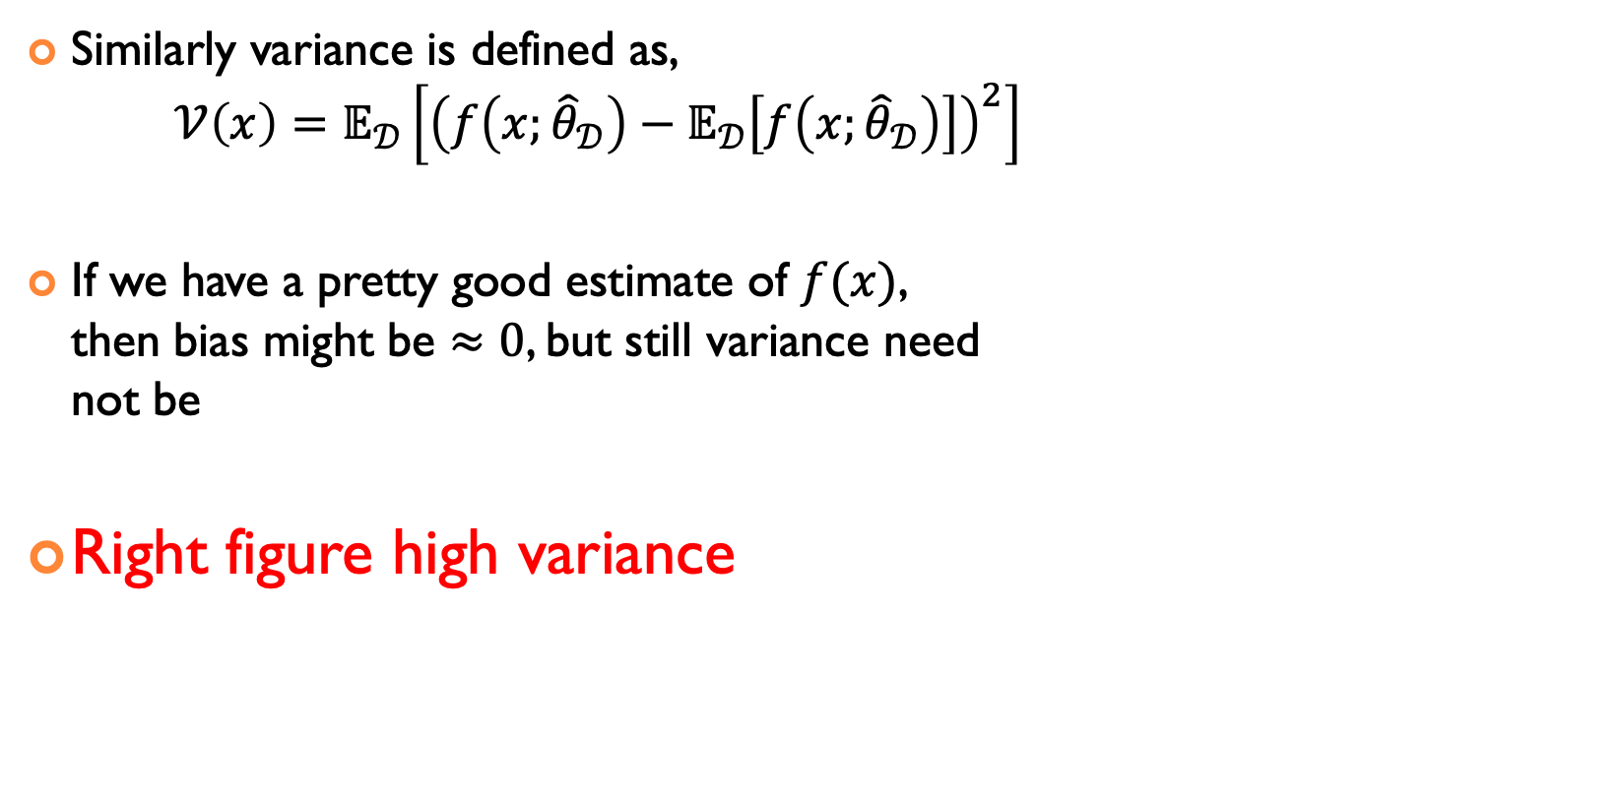
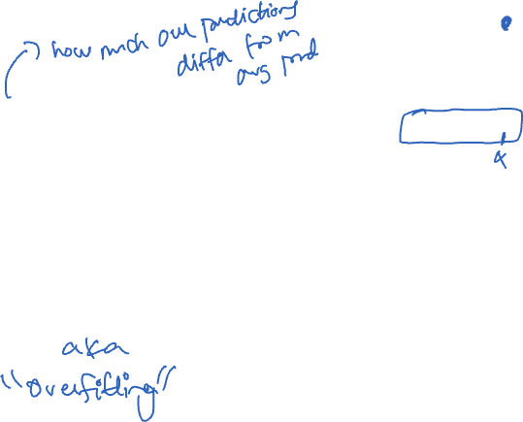
DEFINING VARIANCE
Similarly variance is defined as, ${𝒱\left(x\right)=𝔼}_{𝒟}\left[{\left(f\left(x;{\hat{θ}}_{𝒟}\right)−𝔼_{𝒟}\left[f\left(x;{\hat{θ}}_{𝒟}\right)\right]\right)}^{2}\right]$
If we have a pretty good estimate of $f(x)$, then bias might be $≈0$, but still variance need not be
Right figure high variance

Slide 4
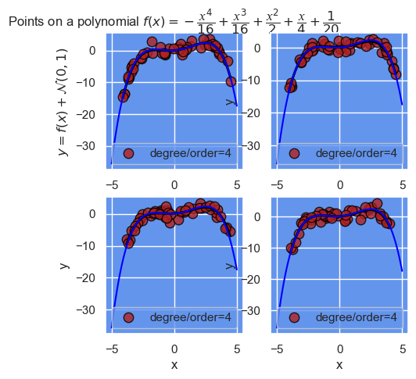
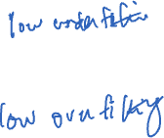
GOOD FIT
Q: Right figure low bias
Q: Right figure low variance

Slide 5
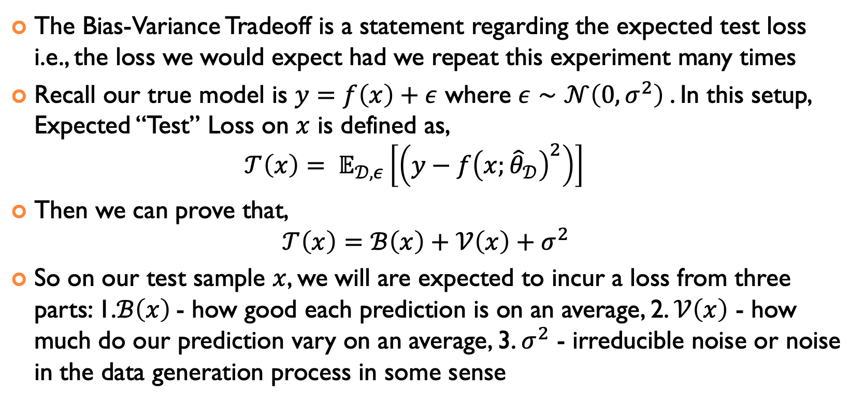
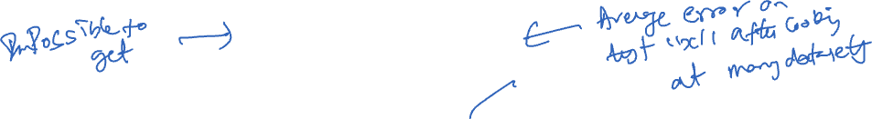
WHAT CAN WE SAY IF WE REPEAT THE EXPERIMENT
The Bias-Variance Tradeoff is a statement regarding the expected test loss i.e., the loss we would expect had we repeat this experiment many times
Recall our true model is $y=f\left(x\right)+ε$ where $ε∼𝒩\left(0,σ^{2}\right)$. In this setup, Expected “Test” Loss on $x$ is defined as, $𝒯\left(x\right)= 𝔼_{𝒟,ε}\left[\left(y−f{\left(x;{\hat{θ}}_{𝒟}\right)}^{2}\right)\right]$
Then we can prove that, $𝒯\left(x\right)=ℬ\left(x\right)+𝒱\left(x\right)+σ^{2}$
So on our test sample $x$, we will are expected to incur a loss from three parts: 1.$ℬ\left(x\right)$- how good each prediction is on an average, 2. $𝒱\left(x\right)$ - how much do our prediction vary on an average, 3. $σ^{2}$ - irreducible noise or noise in the data generation process in some sense

Slide 6
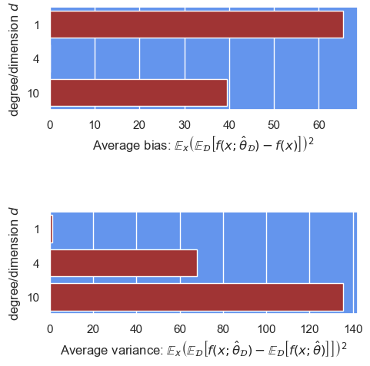

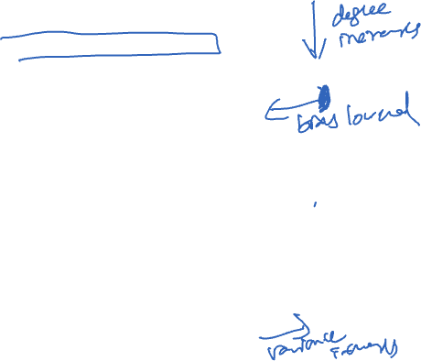
BIAS – VARIANCE TRADEOFF ILLUSTRATION
For each degree/order:
Collect many datasets for the same prediction
Find parameters for each dataset
Choose new/test set of points of independent variables $x$
For each test $x$, calculate bias, variance
Calculate average bias, average variance over all test points

Slide 7
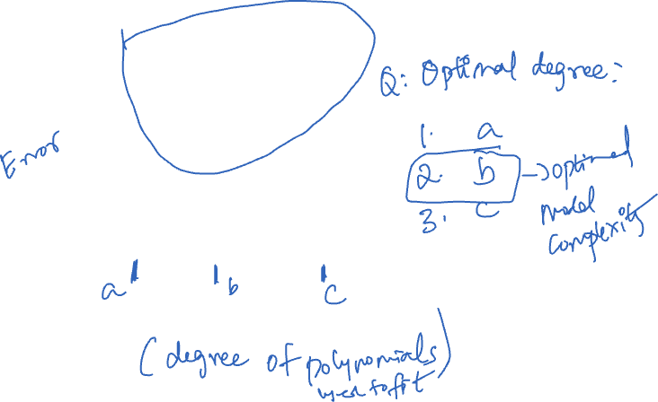
BIAS VARIANCE IN ONE FIGURE FOR FIXED DATASET SIZE
Average Test Error
Bias
Variance
Model Complexity

Slide 8
HOW TO DO THIS IN PRACTICE?

Slide 9

BV TRADEOFF IN PRACTICE
Question: Why to use/study bias-variance tradeoff?
Answer: To pick the right degree d, or more generally model “complexity”
How? Calculate the bias and variance of each degree and choose d with the lower sum of bias and variance, or more generally ”test” error
What is the issue with this approach?

Slide 10
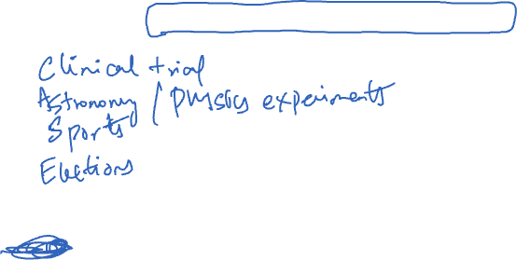
SOME PRACTICAL ISSUES IN BV TRADEOFF EXAMPLE
Issue: To calculate the bias and variance of our linear regression “algorithm” that estimates the parameters, we need access to a collection of datasets.
At the very least, have to get the “test” points separately. Both are impractical for many applications (if not impossible). For ex:
Statistics/Machine Learning literature offers a viable solution to decide model complexity
Notes:
Health care, physics experiments, sports,

Slide 11
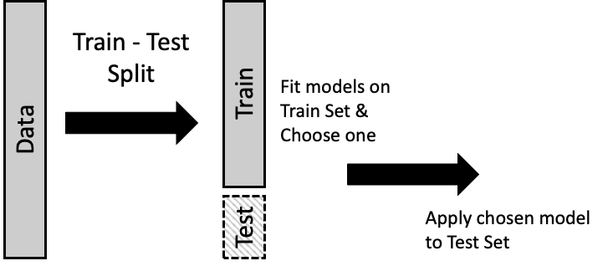
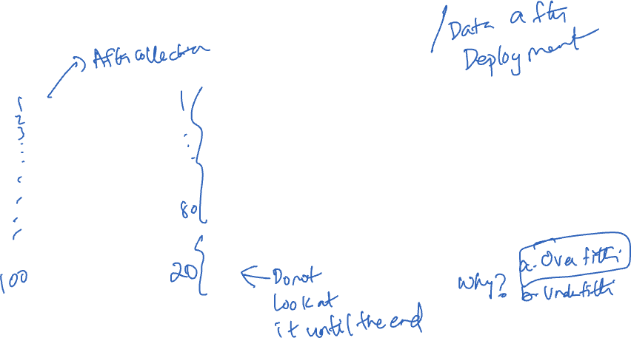
USE A PART OF THE DATASET AS “TEST” SET

Slide 12
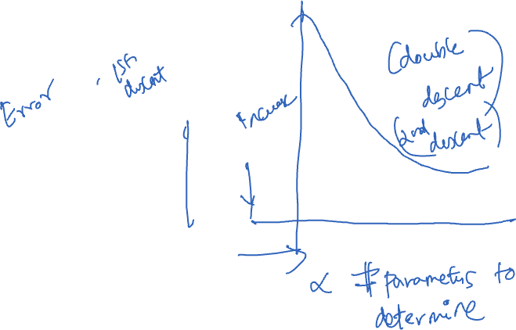
WITH THIS CHANGE THE BV FIGURE BECOMES
Average Test Error
Average Train error
Model Complexity

Slide 13
LET’S APPLY THIS IDEA

Slide 14
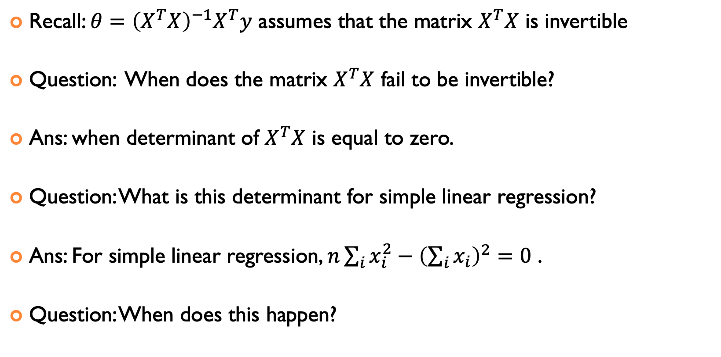
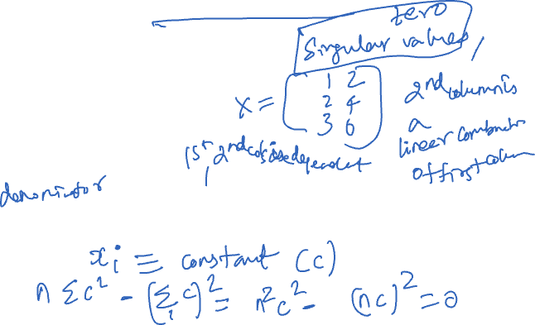
FRIENDS OF LINEAR REGRESSION: RIDGE REGRESSION
Recall: $θ={\left(X^{T}X\right)}^{−1}X^{T}y$ assumes that the matrix $X^{T}X$ is invertible
Question: When does the matrix $X^{T}X$ fail to be invertible?
Ans: when determinant of $X^{T}X$ is equal to zero.
Question: What is this determinant for simple linear regression?
Ans: For simple linear regression, $n\sum_{i}{x_{i}^{2}}−{\left(\sum_{i}{x_{i}}\right)}^{2}=0$ .
Question: When does this happen?

Slide 15
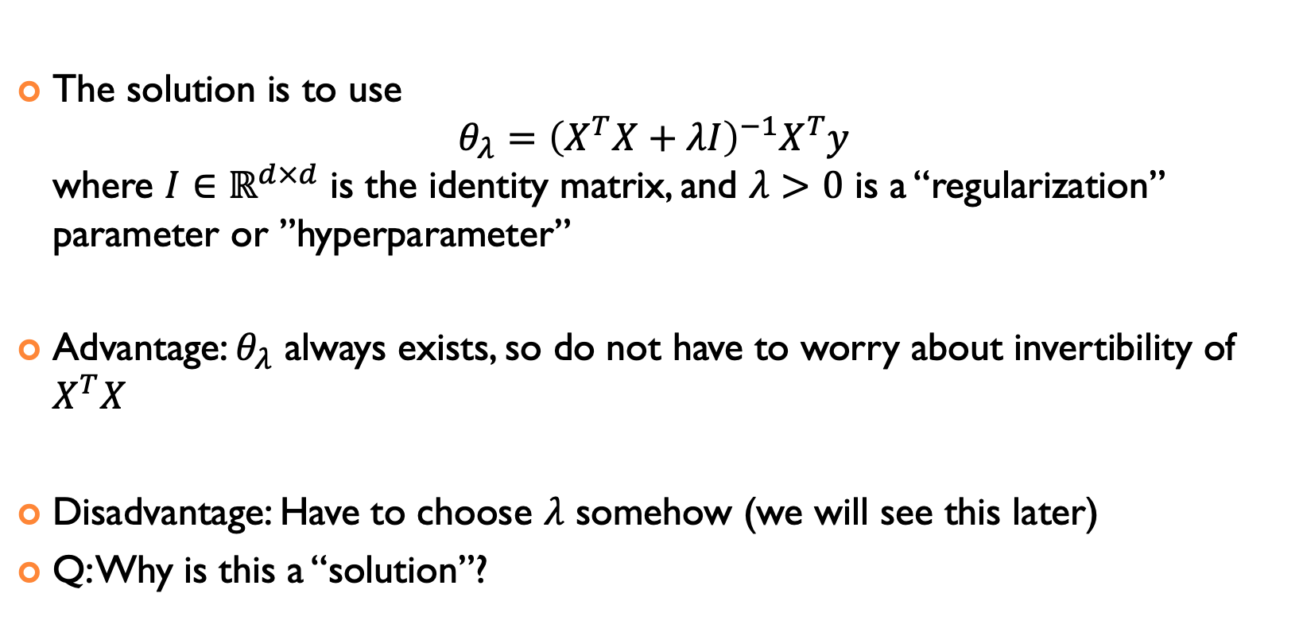
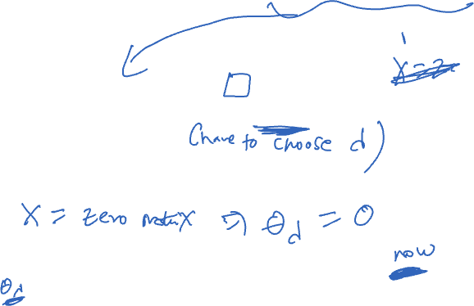
FRIENDS OF LINEAR REGRESSION: RIDGE REGRESSION
The solution is to use $θ_{λ}={\left(X^{T}X+λI\right)}^{−1}X^{T}y$ where $I∈ℝ^{d×d}$ is the identity matrix, and $λ>0$ is a “regularization” parameter or ”hyperparameter”
Advantage: $θ_{λ}$ always exists, so do not have to worry about invertibility of $X^{T}X$
Disadvantage: Have to choose $λ$ somehow (we will see this later)
Q: Why is this a “solution”?

Slide 16
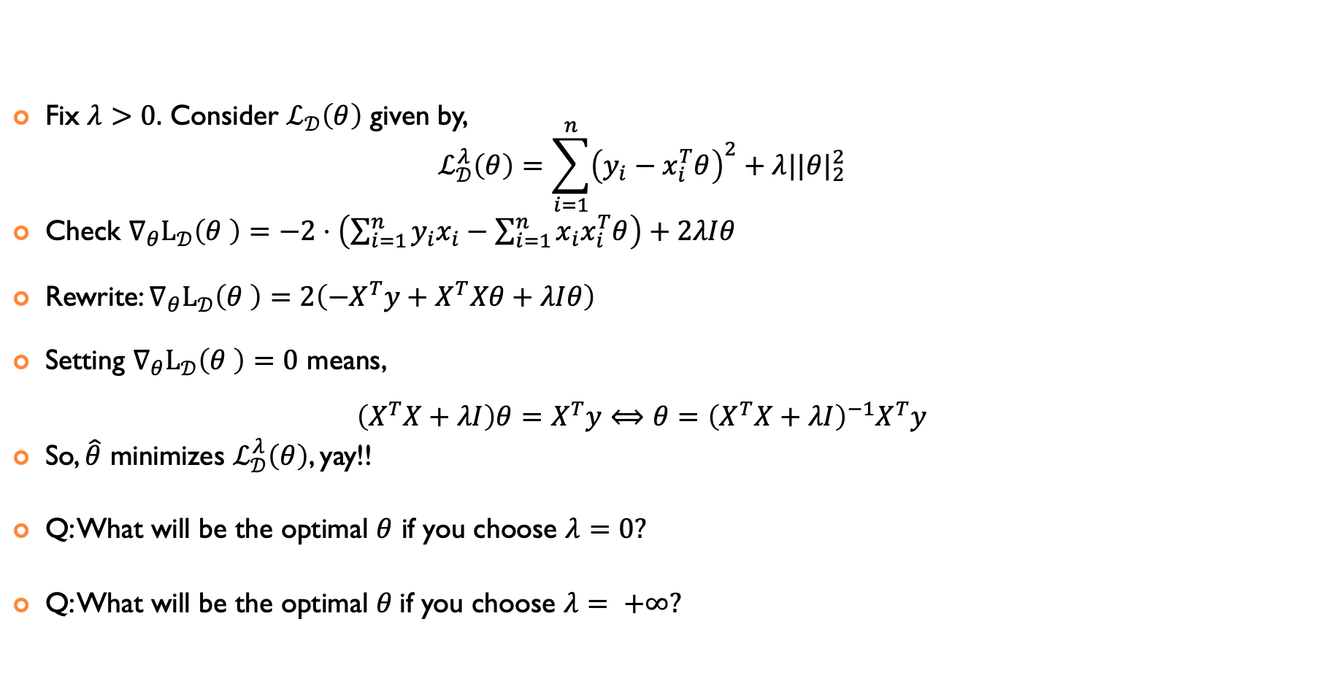
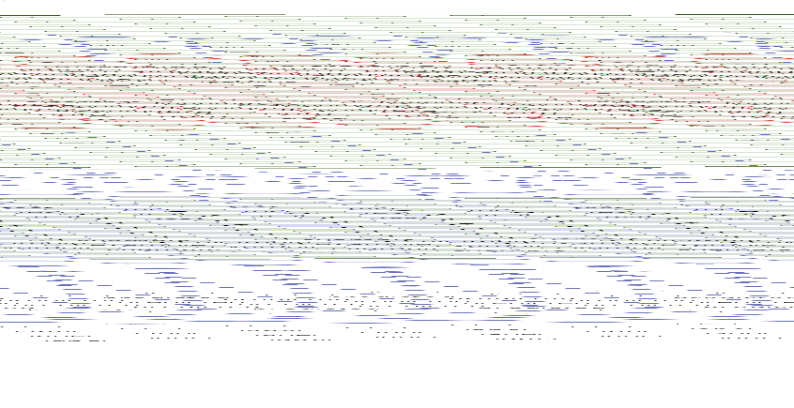
FRIENDS OF LINEAR REGRESSION: RIDGE REGRESSION
Fix $λ>0.$ Consider $ℒ_{𝒟}\left(θ\right)$ given by, $ℒ_{𝒟}^{λ}\left(θ\right)=\sum_{i=1}^{n}{{\left(y_{i}−x_{i}^{T}θ\right)}^{2}}+λ||θ|_{2}^{2}$
Check $∇_{θ}L_{𝒟}\left(θ \right)=−2⋅\left(\sum_{i=1}^{n}{y_{i}x_{i}−\sum_{i=1}^{n}{x_{i}x_{i}^{T}θ}}\right)+2λIθ$
Rewrite: $∇_{θ}L_{𝒟}\left(θ \right)=2\left({−X}^{T}y+X^{T}Xθ+λIθ\right)$
Setting $∇_{θ}L_{𝒟}\left(θ \right)=0$ means, $\left(X^{T}X+λI\right)θ=X^{T}y⟺θ={\left(X^{T}X+λI\right)}^{−1}X^{T}y$
So, $\hat{θ}$ minimizes $ℒ_{𝒟}^{λ}\left(θ\right)$, yay!!
Q: What will be the optimal $θ$ if you choose $λ=0?$
Q: What will be the optimal $θ$if you choose $λ= +∞?$

Slide 17









Slide 18
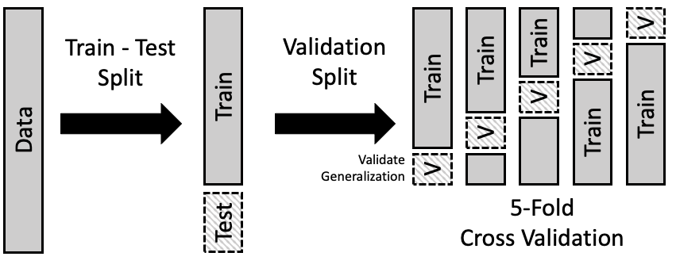
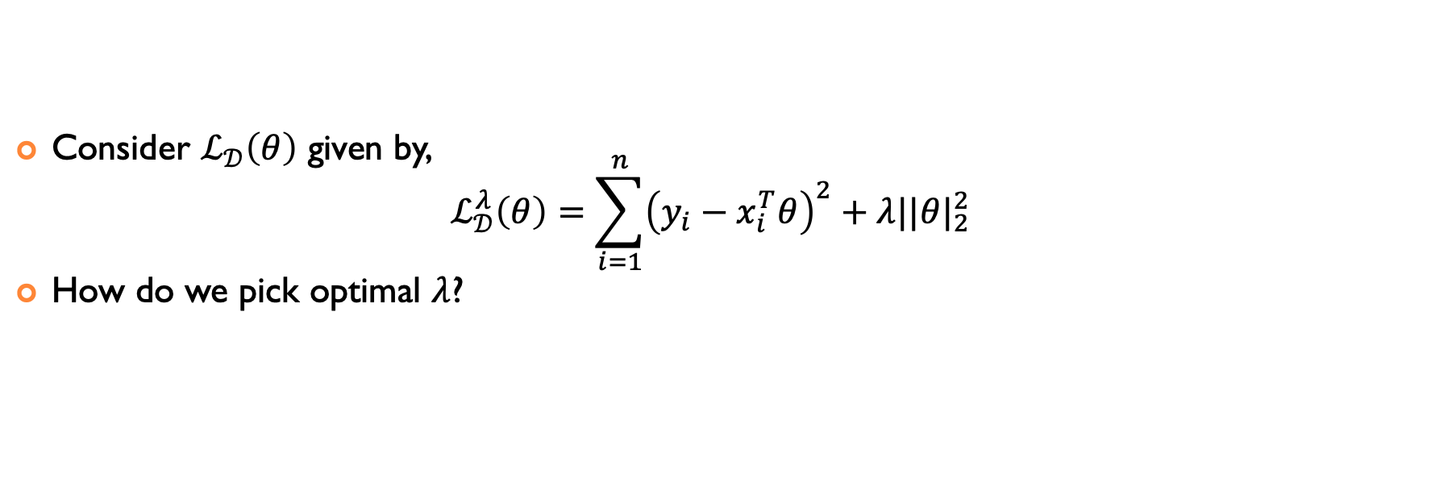
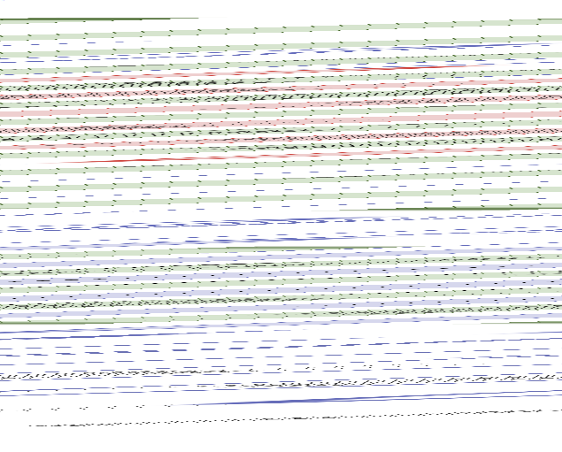
HOW TO CHOOSE LAMBDA?
Consider $ℒ_{𝒟}\left(θ\right)$ given by, $ℒ_{𝒟}^{λ}\left(θ\right)=\sum_{i=1}^{n}{{\left(y_{i}−x_{i}^{T}θ\right)}^{2}}+λ||θ|_{2}^{2}$
How do we pick optimal $λ$?

Slide 19
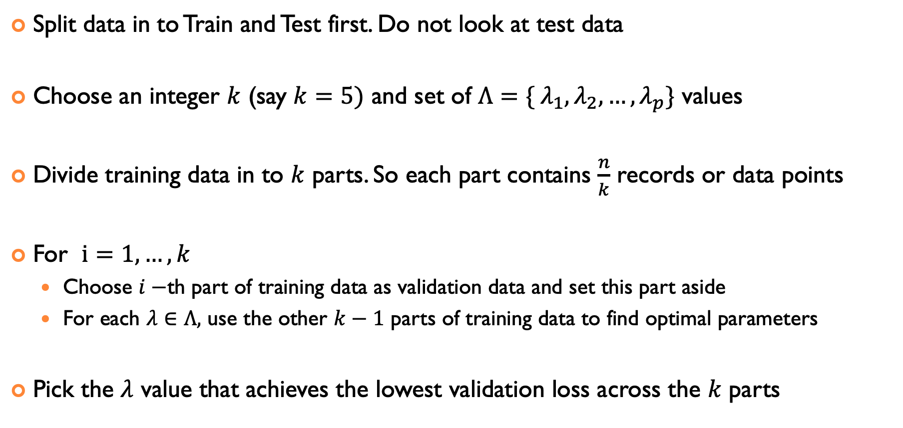

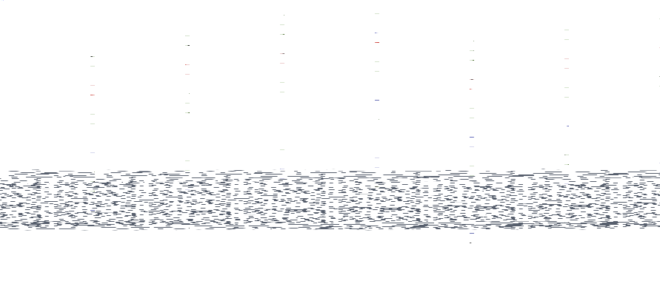
Choosing $λ$ using $k$-FOLD CROSS-VALIDATION
Split data in to Train and Test first. Do not look at test data
Choose an integer $k$ (say $k=5)$ and set of $Λ=\{ λ_{1},λ_{2},…,λ_{p}\}$ values
Divide training data in to $k$ parts. So each part contains $\frac{n}{k}$ records or data points
For $i=1,…,k$
Choose $i−$th part of training data as validation data and set this part aside
For each $λ∈Λ,$ use the other $k−1$ parts of training data to find optimal parameters
Pick the $λ$ value that achieves the lowest validation loss across the $k$ parts

Slide 20
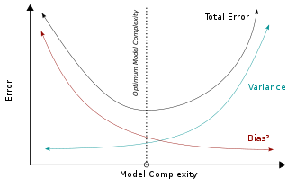
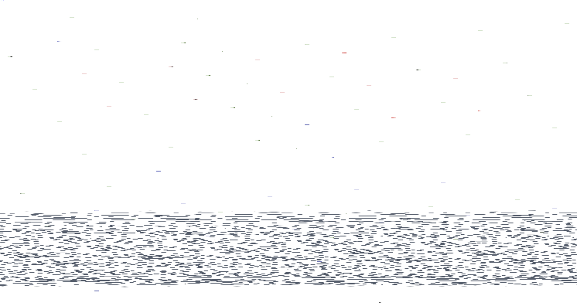
STATISTICS vs. MACHINE LEARNING
Machine learning: Find appropriate model complexity to minimize prediction loss.
Statistics: Find appropriate model complexity to infer statistically meaningful conclusions about relationships/parameters.
…but the boundaries are fuzzy
…and machine learning “borrowed” and scaled many ideas from statistics
Notes:
the square of the bias of the learning method, which can be thought of as the error caused by the simplifying assumptions built into the method.
the variance of the learning method, or, intuitively, how much the learning method will move around its mean;
the irreducible error

Slide 21
ACKNOWLEDGMENTS
These slides use materials by the Brian Ziebart

