Slide 1
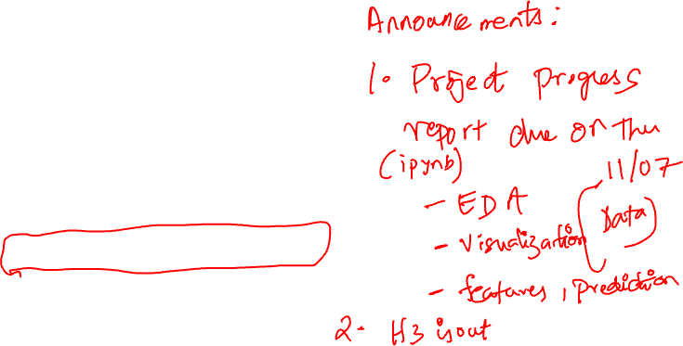
MACHINE LEARNING
LDS Ch 19: LOGISTIC REGRESSION

Slide 2
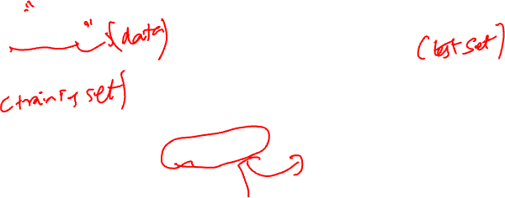
WHAT IS MACHINE LEARNING?
Tom Mitchell: “the field of machine learning is concerned with the question how to construct computer programs that automatically improve with experience”
Hal Daume: “machine learning is about predicting the future based on the past”
Goodfellow, Bengio, Courville: “a technique that enables computer systems to improve with experience and data”

Slide 3
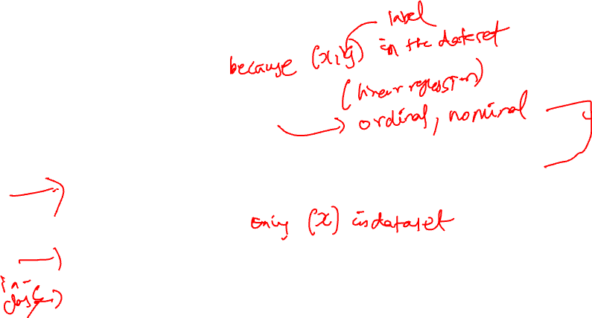
TYPES OF MACHINE LEARNING
Supervised learning
Regression: predict a real value (e.g., % tip)
Classification: predict a categorical value
Binary: Predict a yes/no response (e.g., cat or dog)
Multiclass: Placing an item into one of multiple classes (e.g., predicting country of origin)
Ranking: predicting relevance for a set of items and ordering them by relevance
e.g., NYT’s ”Recommended for You”
Unsupervised learning
Clustering: identify sets of items that are similar to each other (e.g., types of dogs)
Dimensionality reduction: represent each example using a small number of variables
Density estimation: estimating the probability distribution over the data space

Slide 4
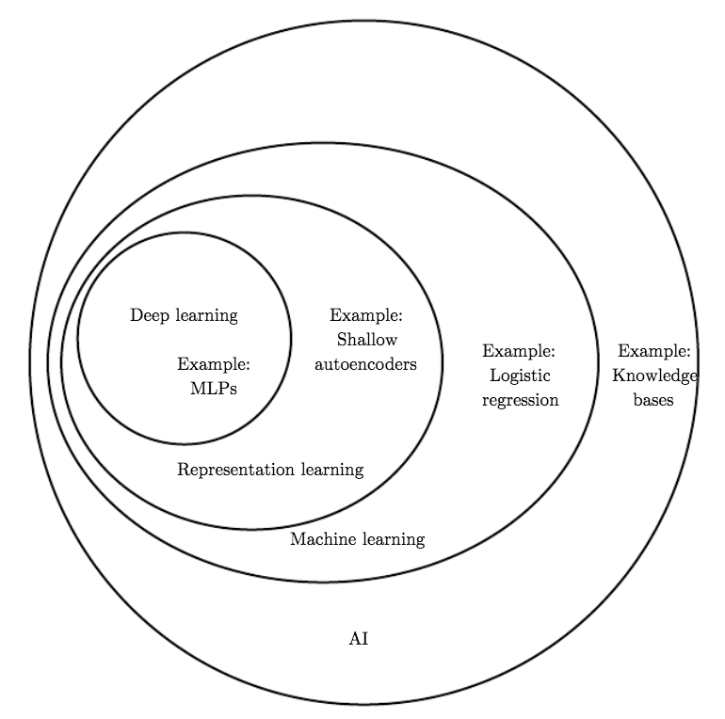
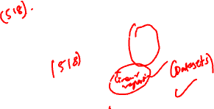
RELATIONSHIP TO AI AND DEEP LEARNING
Source: Deep Learning book by Goodfellow, Bengio, Courville. 2016.
Notes:
multilayer perceptron

Slide 5
CLASSIFICATION

Slide 6
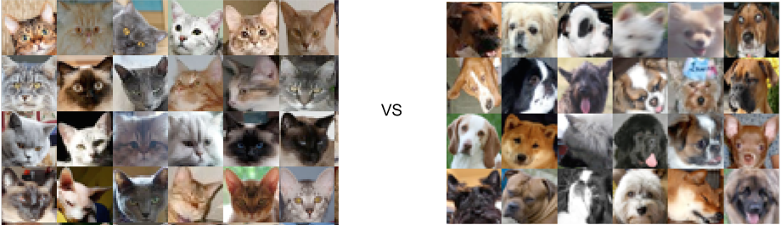
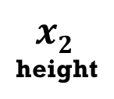
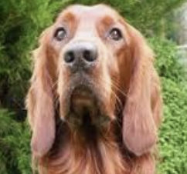
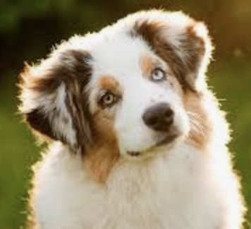







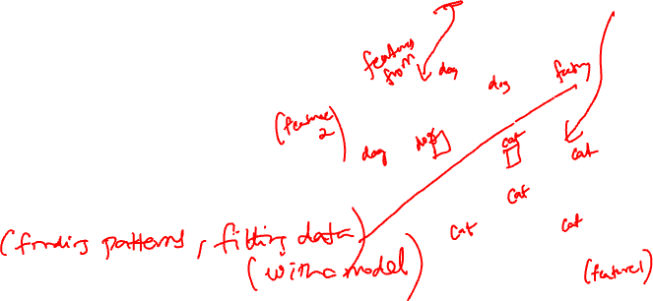
CLASSIFICATION
Goal: build a model that can predict the categorical value of an unseen object
Our focus for the next couple of lectures
What does it mean for a machine/computer to learn from data?
And act without being explicitly programmed
Let’s look at some classification tasks first…
w
fluffiness
?
Notes:
ML is a sub-field of AI, its goal is to get computers to act without being explicitly programmed, typically by learning from past experience and data
Inductive bias
Formalizing learning

Slide 7




EXAMPLE 1: EMAIL SPAM CLASSIFICATION
Can you write a program that
distinguishes between spam
and non-spam messages given
the words in each message?
?
Notes:
Given some email examples of spam and not spam, can you write a program that will be able to distinguish between them?

Slide 8








EXAMPLE 2: VOTER DATA CLASSIFICATION
Can you write a program that
distinguishes between Republican
and Democrat users given their
social media posts and profile attributes?
?

Slide 9
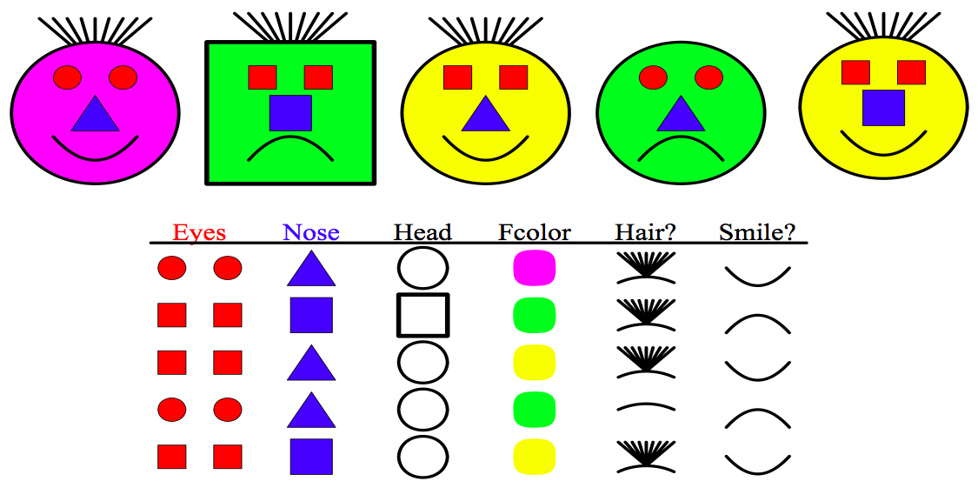
EXAMPLE 3: TOY IMAGE CLASSIFICATION
Can you write a program that
distinguishes between smiling
and frowny faces?

Slide 10
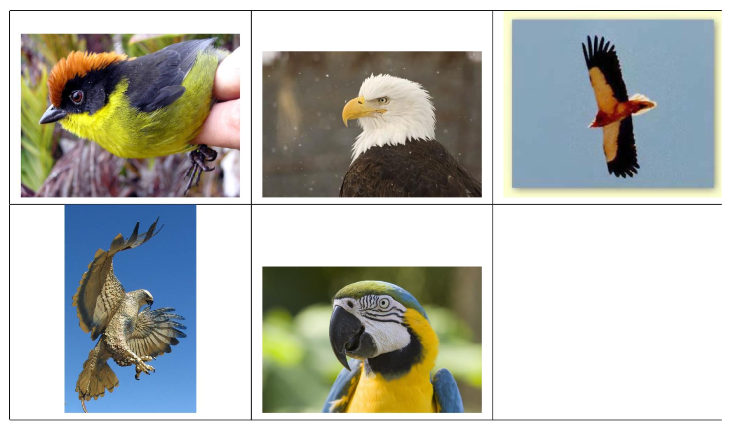
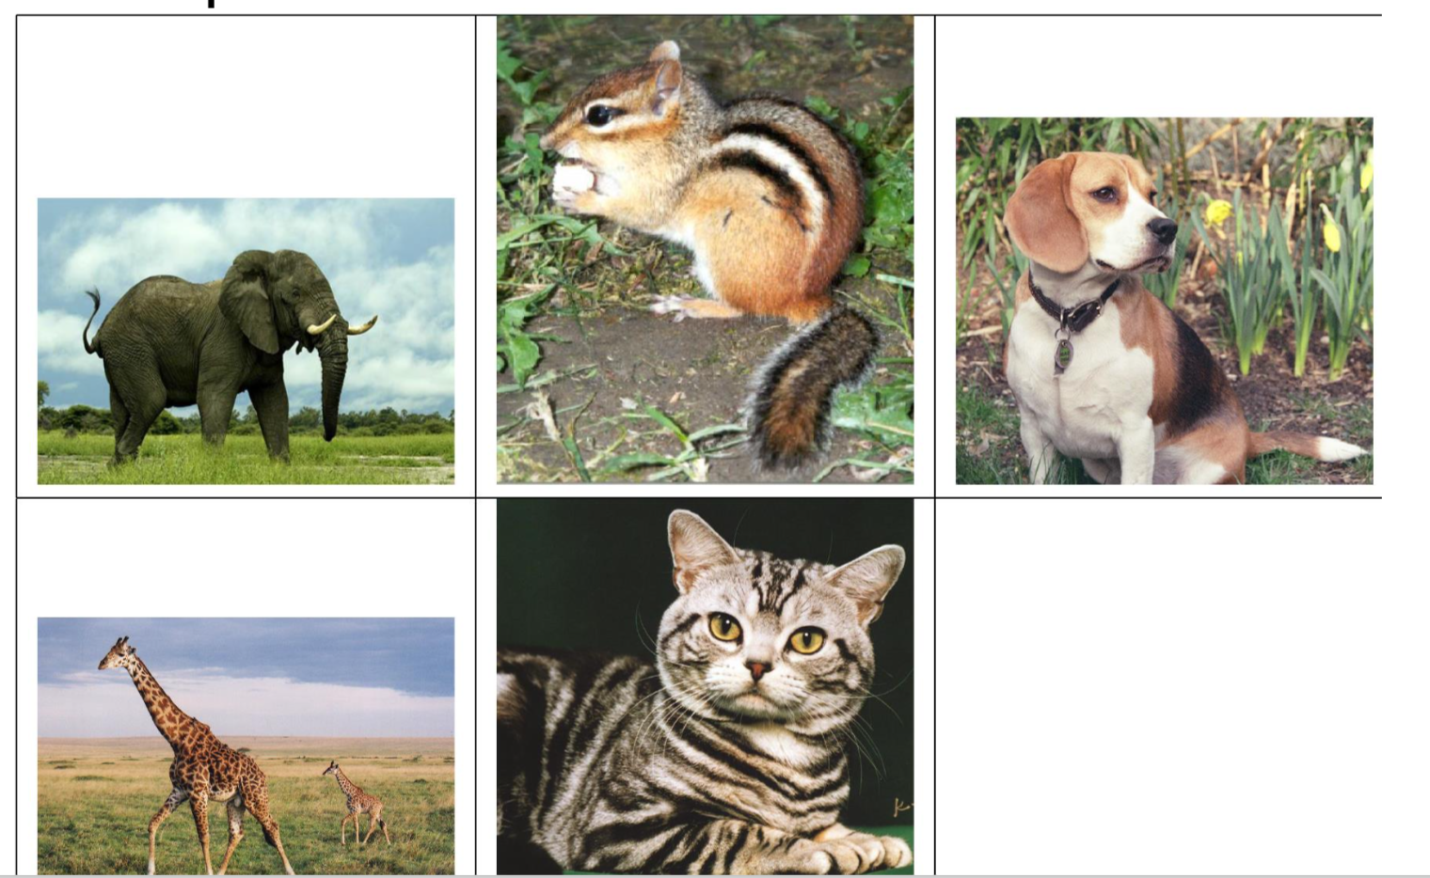

LET’S TRY IT OUT
Your task: learn a classifier to distinguish class A from class B from these examples
Class A
Class B
Example credit: Marine Carpuat

Slide 11
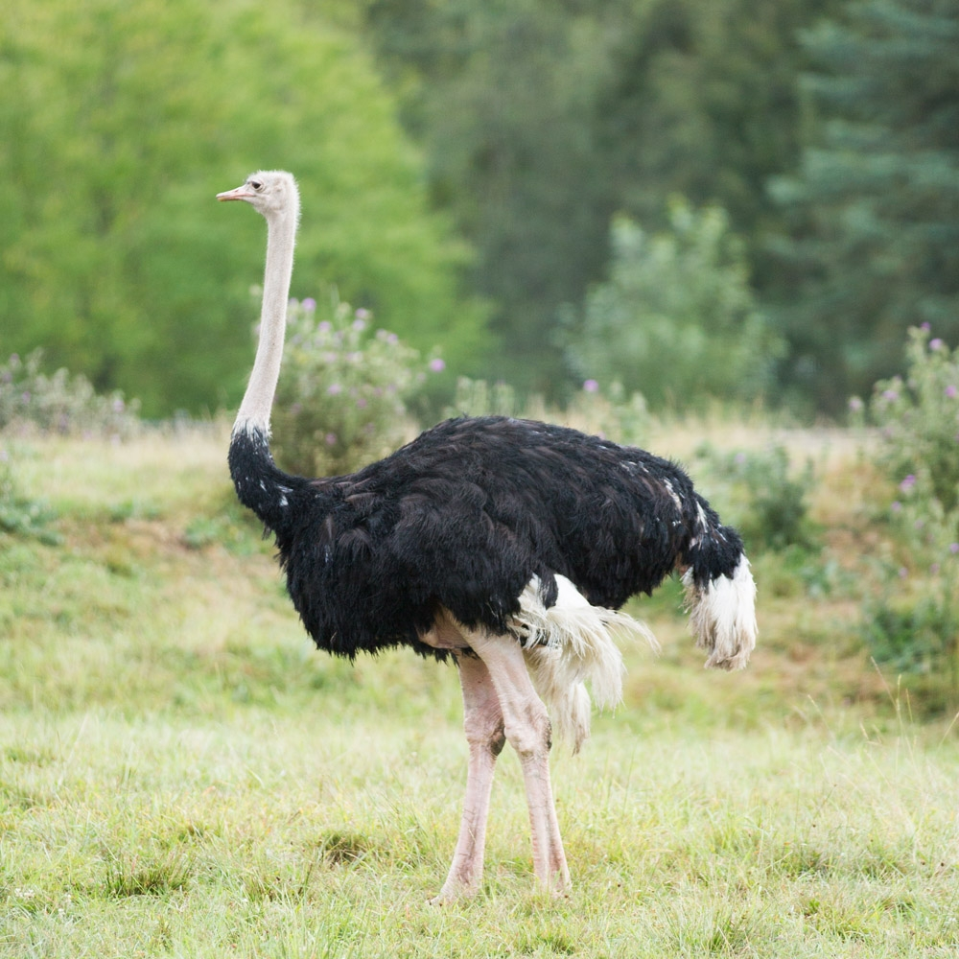
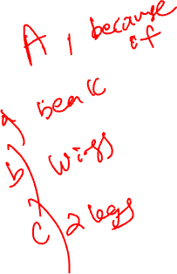

Slide 12
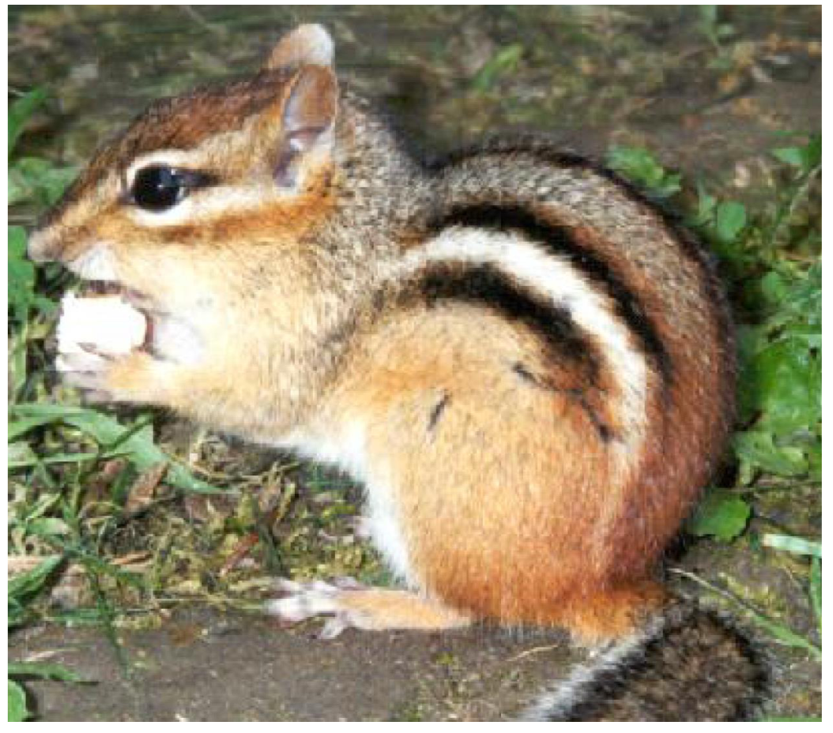
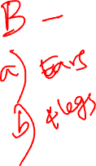

Slide 13
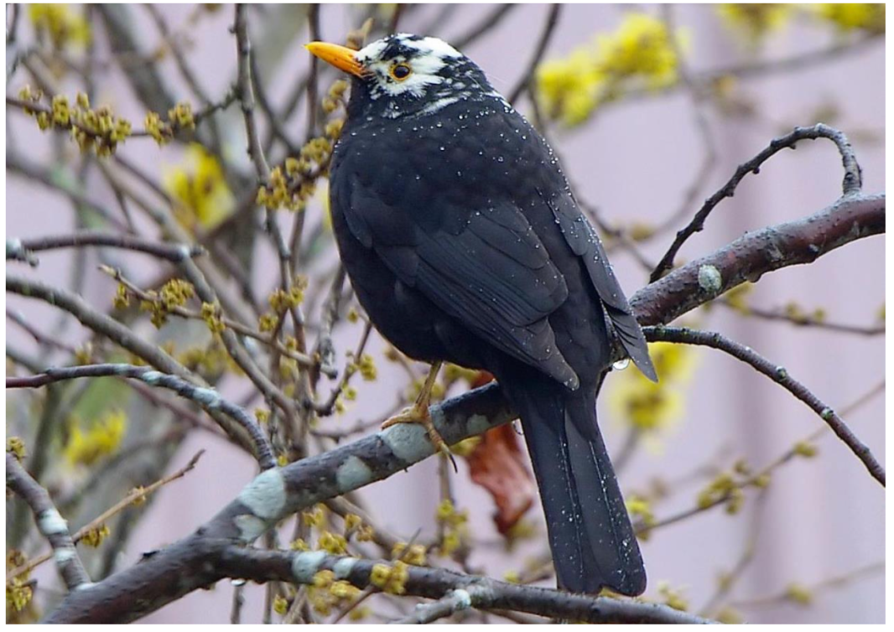


Slide 14
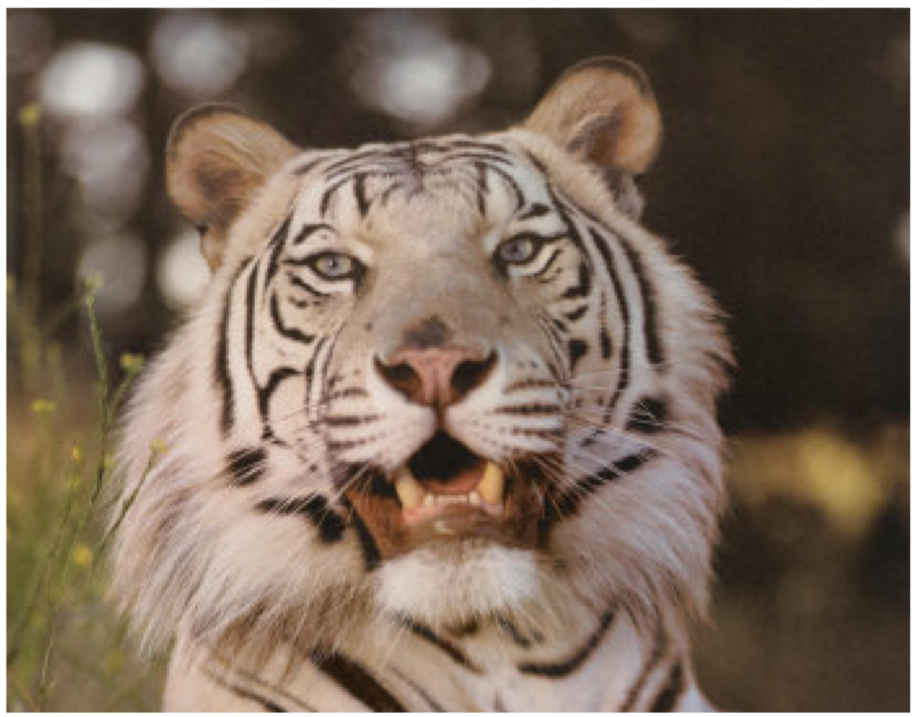


Slide 15
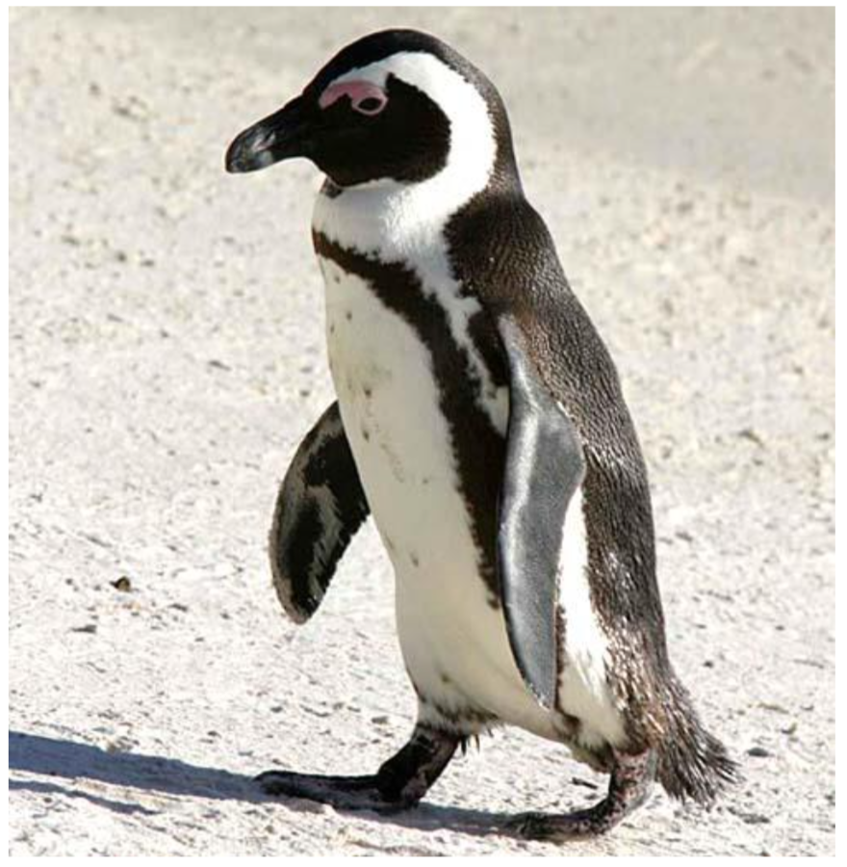

Notes:
bird

Slide 16
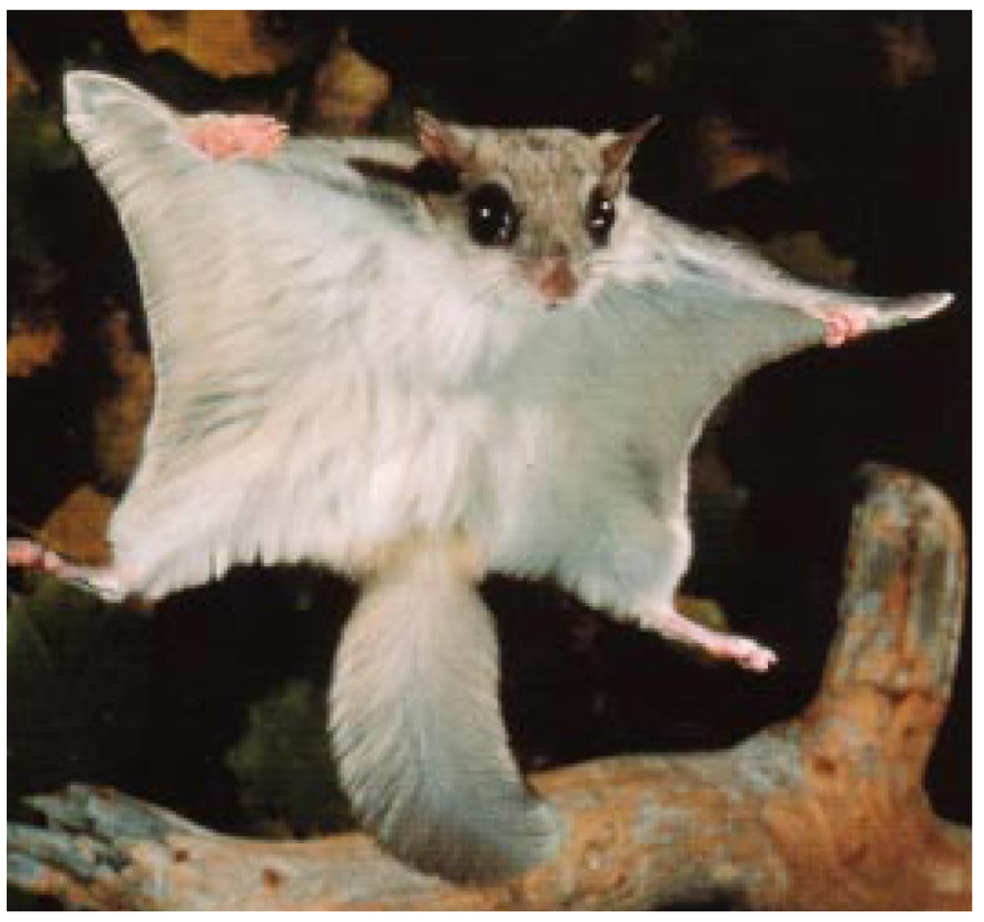


Slide 17
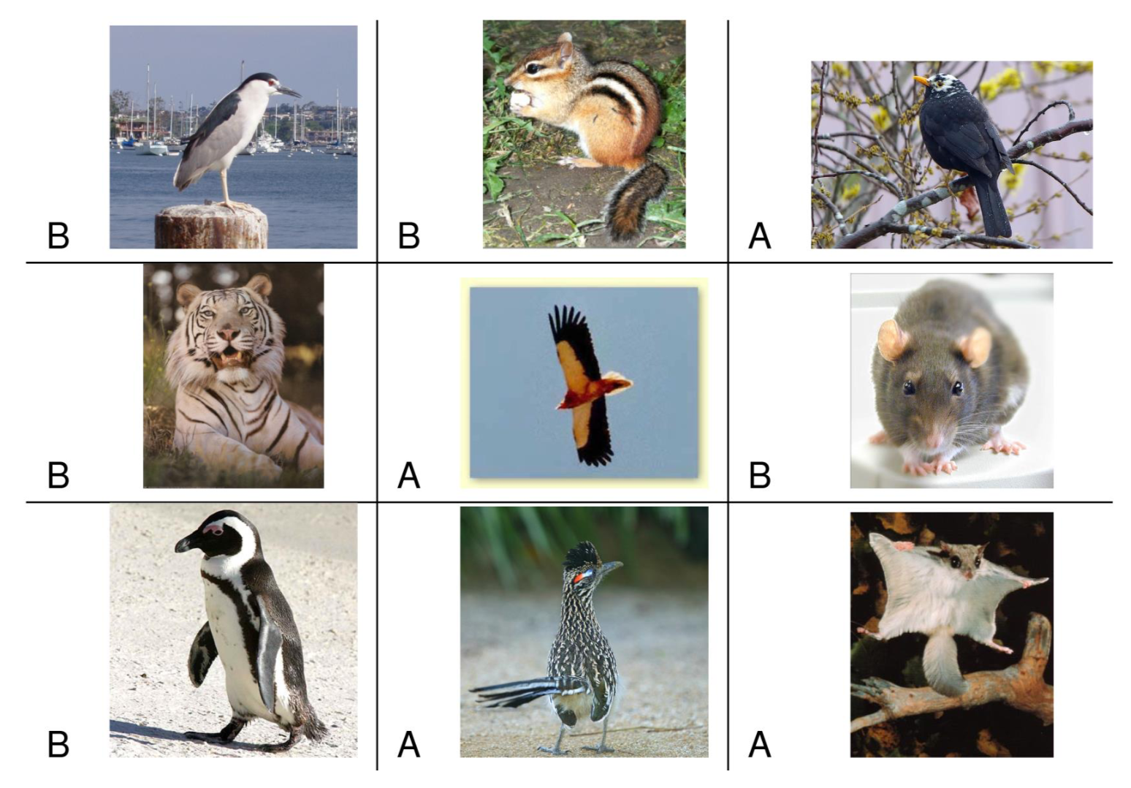
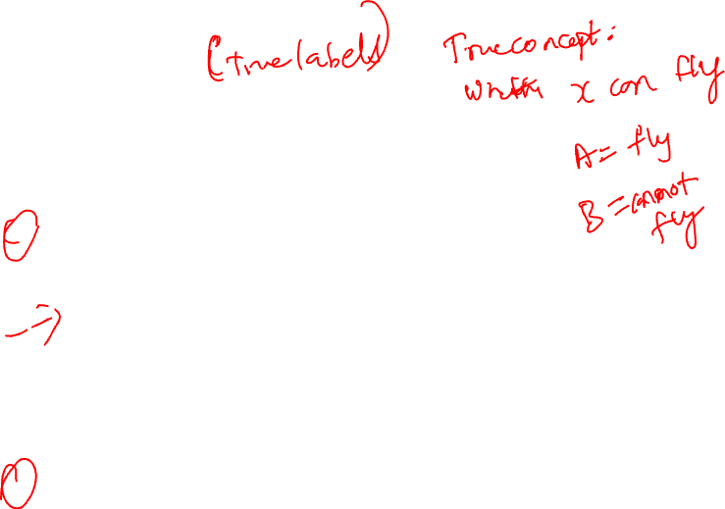
WHAT IF I TOLD YOU
Classification is highly dependent on
having good data and features

Slide 18
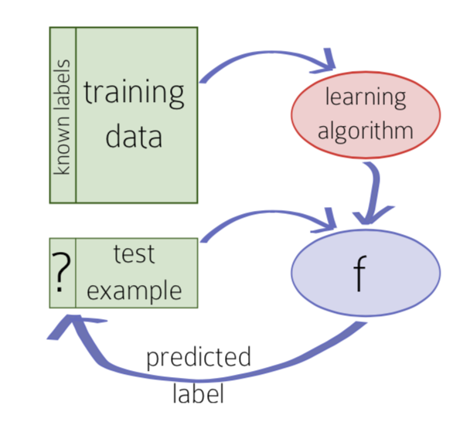
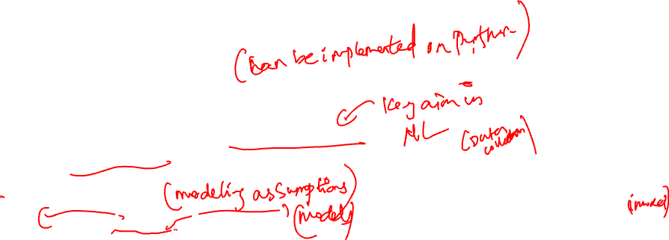
KEY LEARNING INGREDIENTS
Training vs. testing data
Memorizing the training examples is not good enough
Need to generalize to make good predictions on test examples
Inductive bias
Many hypotheses are plausible
Need assumptions about the nature of the relation between examples and classes
How do we go about learning formally?

Slide 19
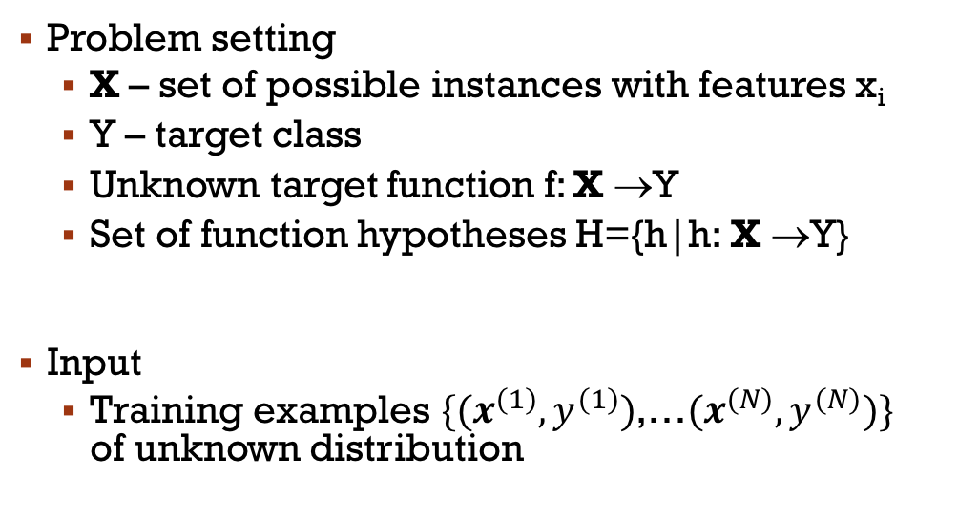
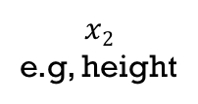
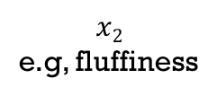
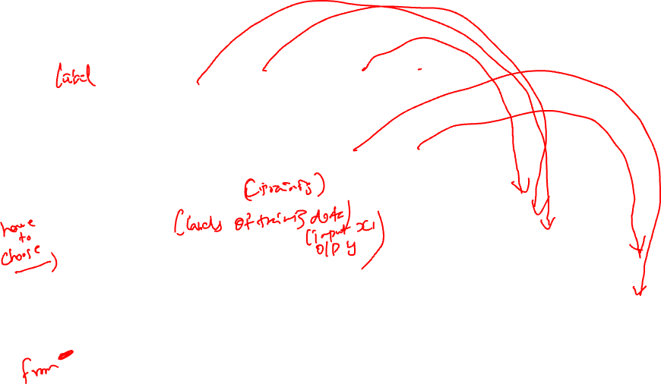
CLASSIFICATION SETTING
Y=1
Y=0
h₃
1
1
1
h₂
h₁
1
1
1
1
0
0
0
0
0
0
0
Notes:
A classifier can be viewed as partitioning the input space or feature space X into decision regions → often halfspaces

Slide 20
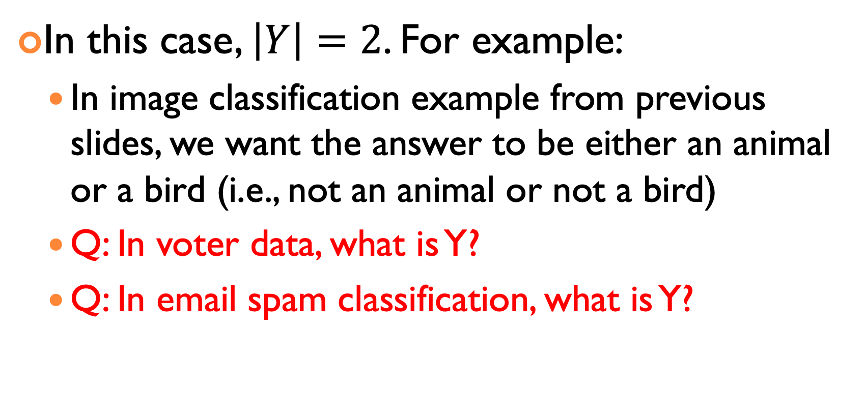
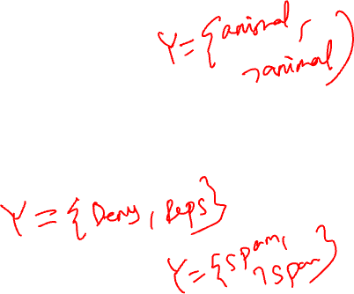
A SPECIAL CASE: BINARY CLASSICATION
In this case, $\left|Y\right|=2$. For example:
In image classification example from previous slides, we want the answer to be either an animal or a bird (i.e., not an animal or not a bird)
Q: In voter data, what is Y?
Q: In email spam classification, what is Y?

Slide 21
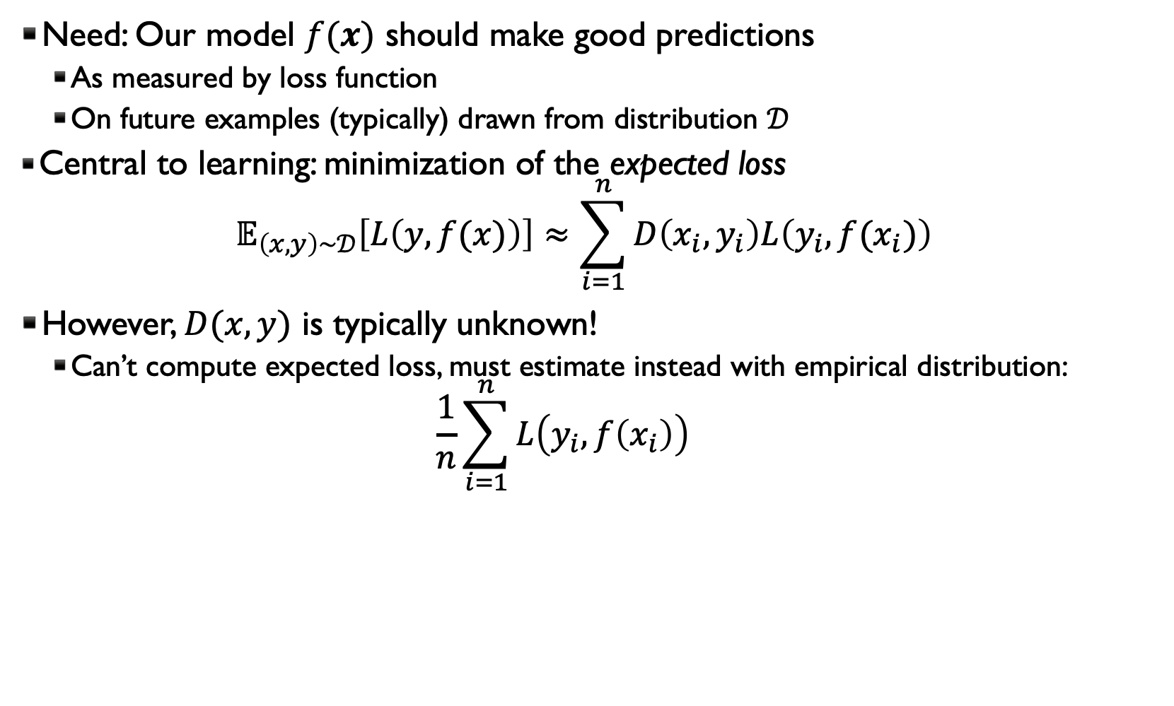
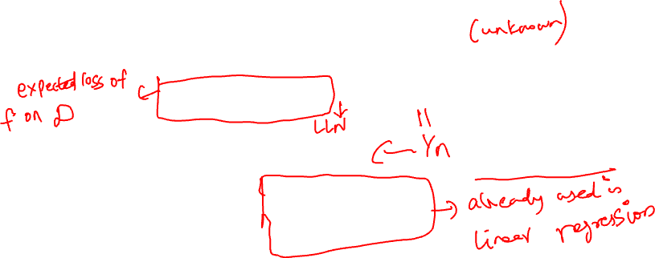
FORMALIZING INDUCTION
Need: Our model $f(x)$ should make good predictions
As measured by loss function
On future examples (typically) drawn from distribution $𝒟$
Central to learning: minimization of the expected loss $𝔼_{\left(x,y\right)∼𝒟}\left[L\left(y,f(x)\right)\right]≈\sum_{i=1}^{n}{D\left(x_{i},y_{i}\right)L\left(y_{i},f(x_{i})\right)}$
However, $D(x,y)$ is typically unknown!
Can’t compute expected loss, must estimate instead with empirical distribution: $\frac{1}{n}\sum_{i=1}^{n}{L\left(y_{i},f\left(x_{i}\right)\right)}$

Slide 22

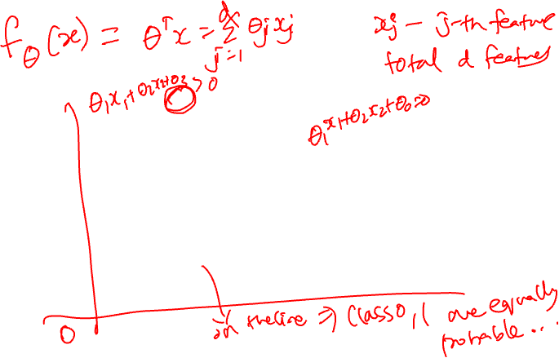
EVEN MORE SPECIAL: LINEAR BINARY CLASSIFICATION
Class 1
Class 0

Slide 23
REGRESSION METHODS FOR CLASSIFICATION?

Slide 24
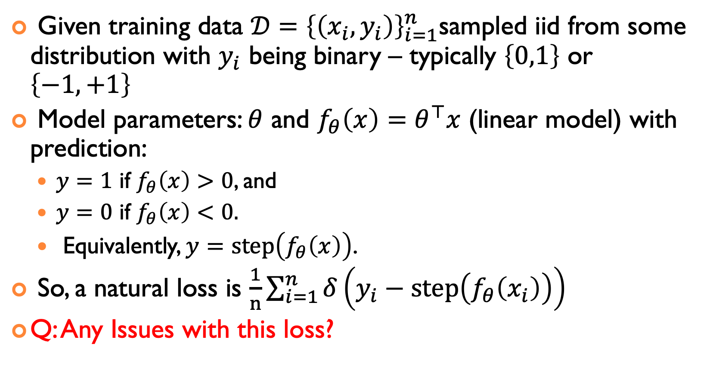
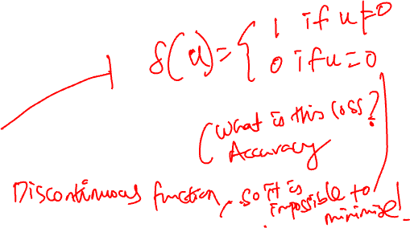
PROBLEM SETUP
Given training data $𝒟{=\left\{\left(x_{i},y_{i}\right)\right\}}_{i=1}^{n}$sampled iid from some distribution with $y_{i}$ being binary – typically $\left\{0,1\right\}$ or $\left\{−1,+1\right\}$
Model parameters: $θ$ and $f_{θ}\left(x\right)=θ^{⊤}x$ (linear model) with prediction:
$y=1$ if $f_{θ}\left(x\right)>0$, and
$y=0$ if $f_{θ}\left(x\right)<0.$
Equivalently, $y=\text{step}\left(f_{θ}\left(x\right)\right)$.
So, a natural loss is $\frac{1}{n}\sum_{i=1}^{n}{δ\left(y_{i}\text{ − }\text{step}\left(f_{θ}\left(x_{i}\right)\right)\right)}$
Q: Any Issues with this loss?

Slide 25
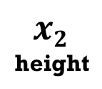

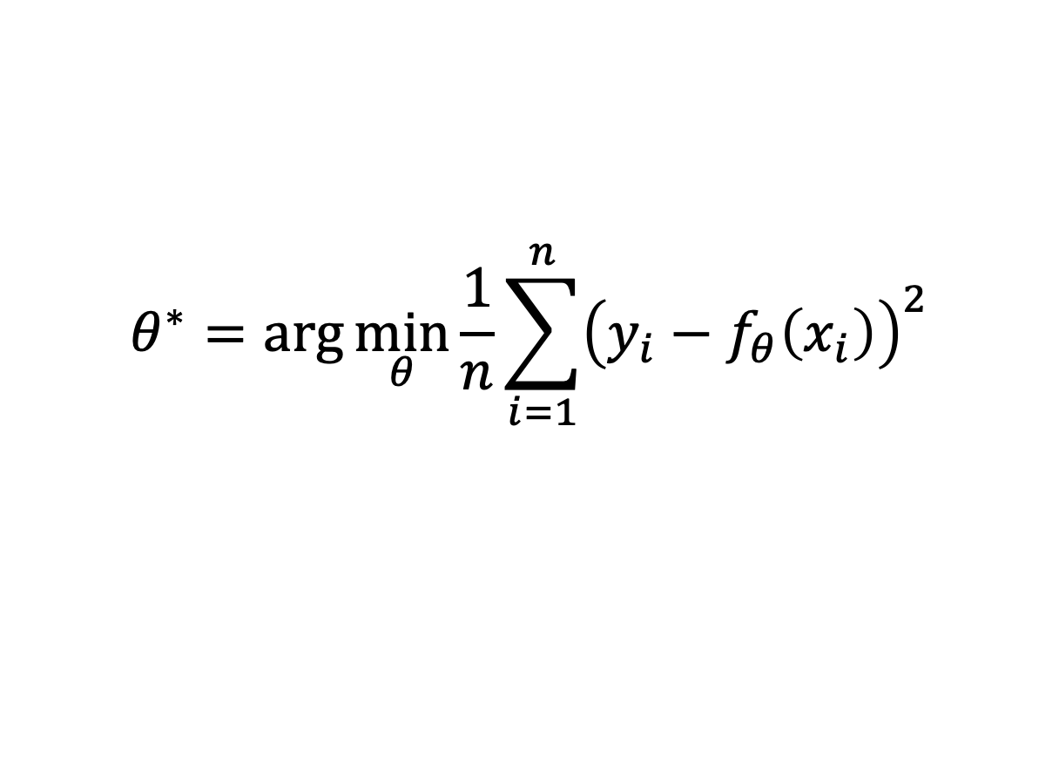
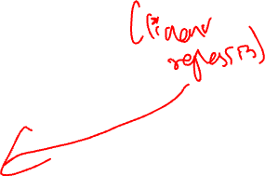
TREAT CLASSIFICATION AS REGRESSION with SQUARED LOSS?
Binary label:
y_{i} ∈ {0,1}
Linear model:
f_{θ}(x) ∈ R
$$θ^{∗}=\arg{\min_{θ}{\frac{1}{n}\sum_{i=1}^{n}{{\left(y_{i}−f_{θ}\left(x_{i}\right)\right)}^{2}}}}$$
w
fluffiness

Slide 26
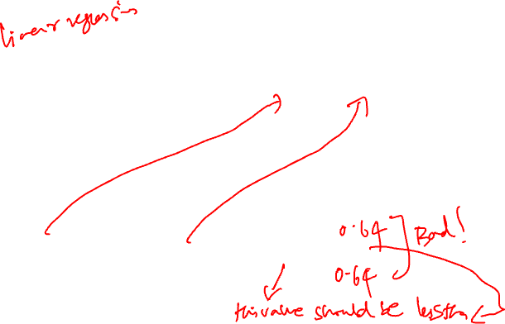
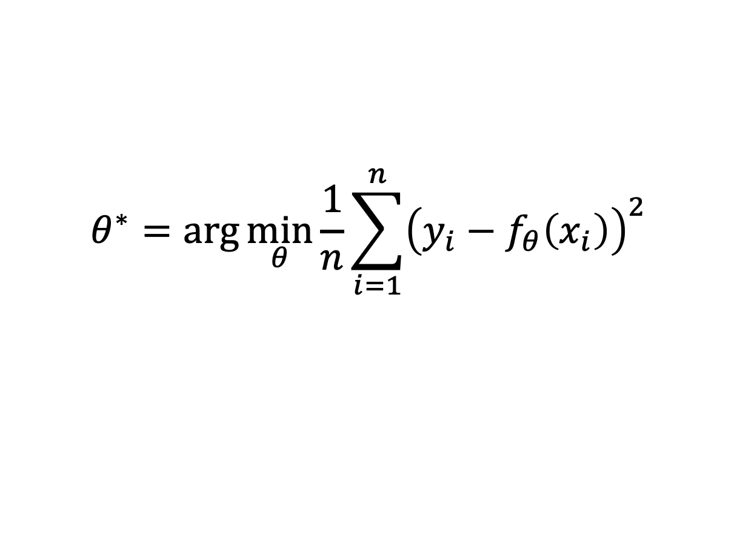
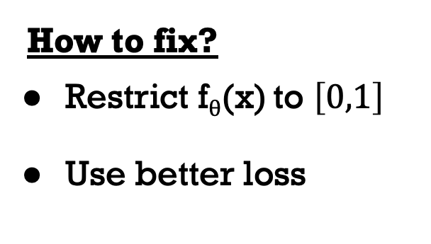
TREAT CLASSIFICATION AS REGRESSION?
Binary label:
y_{i} ∈ {0,1}
Linear model:
f_{θ}(x) ∈ R
$$θ^{∗}=\arg{\min_{θ}{\frac{1}{n}\sum_{i=1}^{n}{{\left(y_{i}−f_{θ}\left(x_{i}\right)\right)}^{2}}}}$$
y_{i} | f_{θ}(x_{i}) | Squared loss
1 | 0.2 | ?
1 | 1.8 | ?
How to fix?
Restrict f_{θ}(x) to $\left[0,1\right]$
Use better loss

Slide 27
LOGISTIC REGRESSION

Slide 28
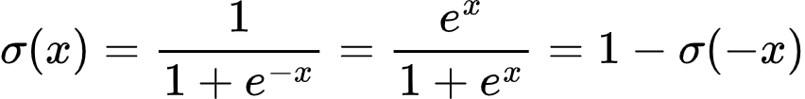
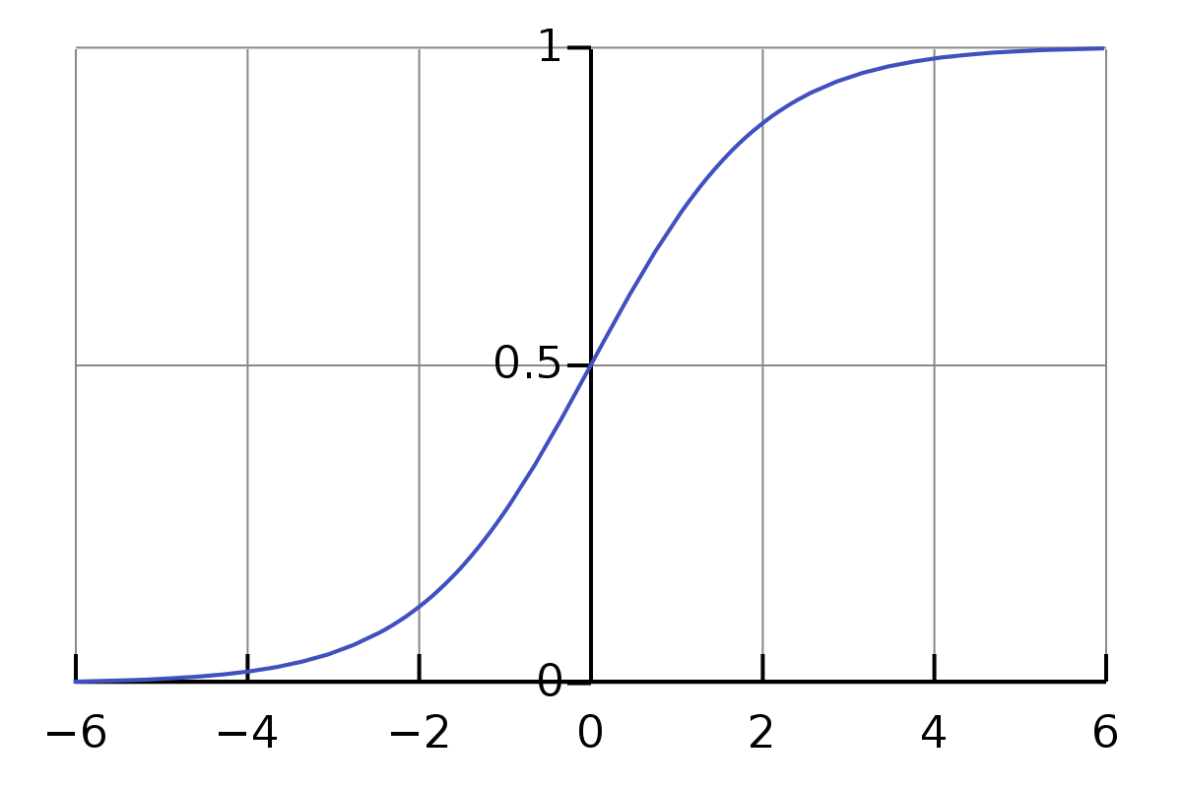
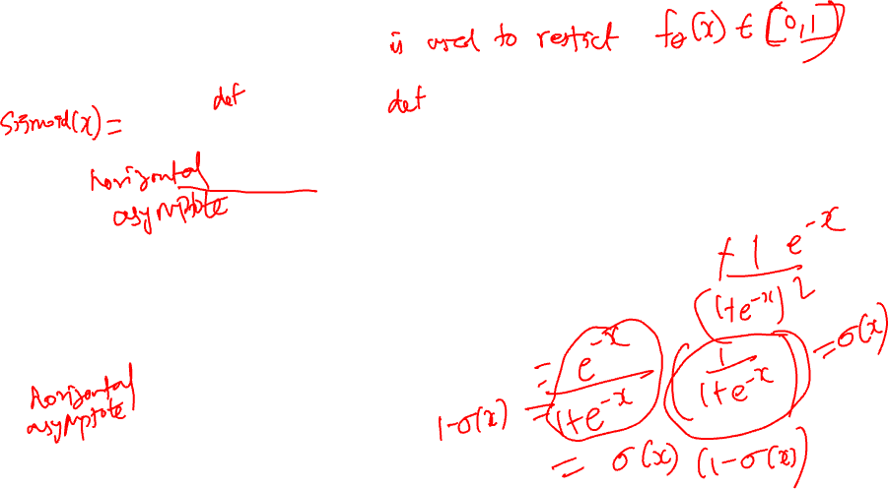
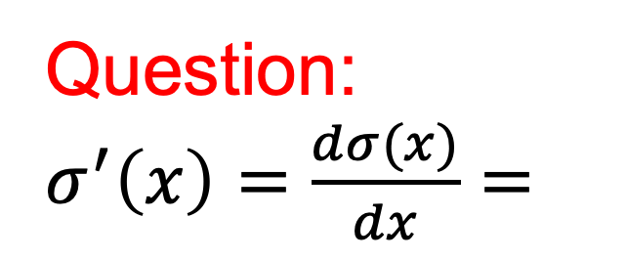
SIGMOID FUNCTION
Question: $σ^{′}\left(x\right)=\frac{dσ(x)}{dx}=$

Slide 29
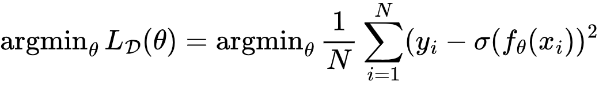
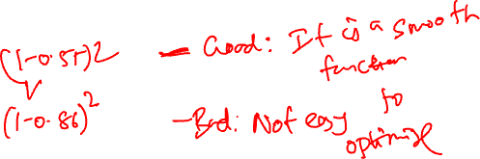
TREAT CLASSIFICATION AS REGRESSION?
Binary label:
y_{i} ∈ {0,1}
Linear model:
f_{θ}(x) ∈ R
Sigmoid
y_{i} | f_{θ}(x_{i}) | σ(f_{θ}(x_{i})) | Squared loss
1 | 0.2 | 0.55 | ?
1 | 1.8 | 0.86 | ?
Any issues?
Notes:
0.2025, 0.0196

Slide 30
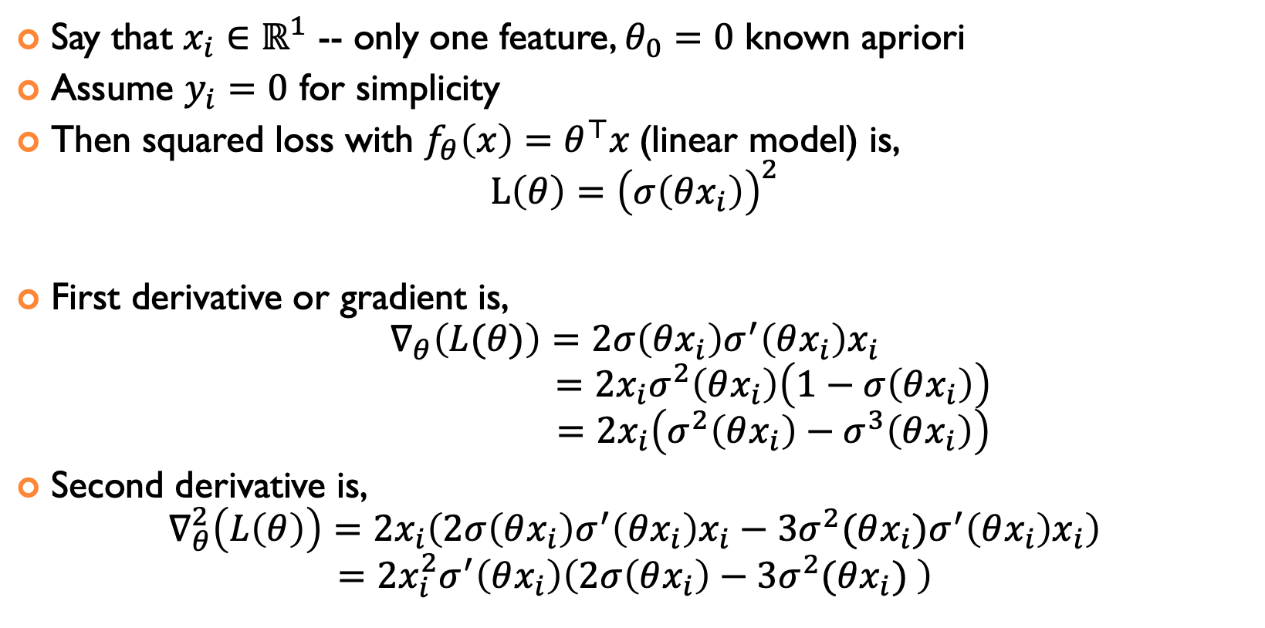
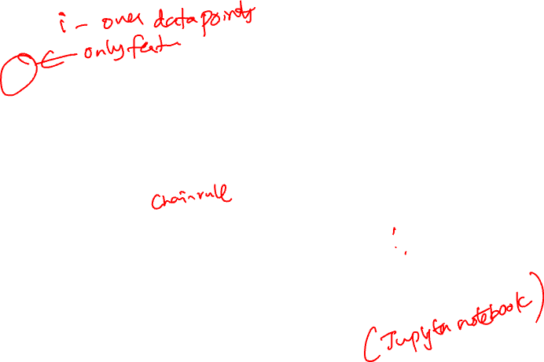
DERIVATIVES
Say that $x_{i}∈ℝ^{1}$ -- only one feature, $θ_{0}=0$ known apriori
Assume $y_{i}=0$ for simplicity
Then squared loss with $f_{θ}\left(x\right)=θ^{⊤}x$(linear model) is, $L\left(θ\right)={\left(σ\left(θx_{i}\right)\right)}^{2}$
First derivative or gradient is, $∇_{θ}\left(L(θ)\right)=2σ\left(θx_{i}\right)σ^{′}\left(θx_{i}\right)x_{i}$ $=2x_{i}σ^{2}\left(θx_{i}\right)\left(1−σ\left(θx_{i}\right)\right)$ $=2x_{i}\left(σ^{2}\left(θx_{i}\right)−σ^{3}\left(θx_{i}\right)\right)$
Second derivative is, $∇_{θ}^{2}\left(L\left(θ\right)\right)=2x_{i}\left(2σ\left(θx_{i}\right)σ^{′}\left(θx_{i}\right)x_{i}−3σ^{2}(θx_{i})σ^{′}\left(θx_{i}\right)x_{i}\right)$ $=2x_{i}^{2}σ^{′}\left(θx_{i}\right)\left(2σ\left(θx_{i}\right)−3σ^{2}(θx_{i}) \right)$

Slide 31



CONVEXITY: IS THE SECOND DERIVATIVE POSITIVE ALWAYS?
Assume more that $x_{i}=1$
Second derivative is, $∇_{θ}^{2}\left(L\left(θ\right)\right) =2x_{i}^{2}σ^{′}\left(θx_{i}\right)\left(2σ\left(θx_{i}\right)−3σ^{2}(θx_{i}) \right)$ $=2σ^{′}\left(θ\right)\left(2σ\left(θ\right)−3σ^{2}\left(θ\right)\right)$ $=2σ\left(θ\right)\left(1−σ(θ)\right)\left(2σ\left(θ\right)−3σ^{2}\left(θ\right)\right)$
When $θ=0$, we have that $σ\left(0\right)=\frac{1}{2},σ^{2}\left(1\right)=\frac{1}{4}$. So the second derivative is, $∇_{θ=0}^{2}\left(L\left(θ\right)\right)=2σ\left(0\right)\left(1−σ(0)\right)\left(2σ\left(0\right)−3σ^{2}\left(0\right)\right)=\frac{1}{2}\left(1−\frac{3}{4}\right)>0$
However, when $θ=1$, we have that $\left(σ\left(1\right)≈0.73,σ^{2}\left(1\right)≈0.53\right).$ So the second derivative is, $∇_{θ=1}^{2}\left(L\left(θ\right)\right)=2σ\left(1\right)\left(1−σ(1)\right)\left(2σ\left(1\right)−3σ^{2}\left(1\right)\right)=−0.0555<0$

Slide 32


CLASSIFICATION WITH SQUARED LOSS IS NOT CONVEX
Is there a better loss?

Slide 33





LOGISTIC REGRESSION: MODEL CONDITIONAL PROBABILITY
Sigmoid:
Transform the linear model’s real-valued outputs to [0,1] using Sigmoid function.
This implies:
Which implies:
and
Linear classification rule!

Slide 34

LOGISTIC REGRESSION: DECISION BOUNDARY
θ
fluffiness

Slide 35



MULTI-CLASS LOGISTIC REGRESSION
Each class label has its own linear potential function: $${\hat{P}}_{θ}\left(Y=c|x\right)=\frac{\exp\left(f_{θ^{c}}\left(x\right)\right)}{\sum_{c′}{\exp\left(f_{θ^{c′}}\left(x\right)\right)}}=\text{softmax}\left(\exp\left(f_{θ^{c}}\left(x\right)\right)\right)$$
One set of weights is redundant due to normalization.
For binary, we just fixed $f_{θ^{0}}\left(x\right)=0$ to eliminate redundancy.

Slide 36


FINALLY, LOGISTIC REGRESSION USING LIKELIHOOD
Since we are modeling ${\hat{P}}_{θ}\left(Y=y|x\right)$, the conditional distribution of $y$ given $x$, perhaps better to use it directly
Recall ${\hat{P}}_{θ}\left(Y=y|x\right)=\text{softmax}\left(\exp\left(f_{θ^{y}}\left(x\right)\right)\right)∈\left[0,1\right]$
Then, for a single data point $(x_{i},y_{i})$, ${\hat{P}}_{θ}\left(Y=y_{i}|x_{i}\right)$ is the probability or “belief” that $x_{i}$ is classified as $y_{i}$ according to the model parameters $θ$
Q: Should we maximize or minimize ${\hat{P}}_{θ}\left(Y=y_{i}|x_{i}\right)$?

Slide 37



Log Reg FOR BINARY PREDICTION VARIABLES $y$
$\text{Q}\text{: }\text{For} \text{the} \text{dataset} {\left\{\left(x_{i},y_{i}\right)\right\}}_{i=1}^{n}\text{, }\text{which} \text{of} \text{the} \text{following} \text{two} \text{likelihoods} \text{should} \text{be} \text{maximized}\text{?}$
$\prod_{i=1}^{n}{{\hat{P}}_{θ}\left(Y=y_{i}|x_{i}\right) }$
$\sum_{i=1}^{n}{{\hat{P}}_{θ}\left(Y=y_{i}|x_{i}\right) }$
In Binary log reg, the function to be maximized wrt $θ$ for is given by, $l\left(θ\right)=\prod_{i=1}^{n}{{\hat{P}}_{θ}\left(Y=y_{i}|x_{i}\right) }$ $=\prod_{i=1:y_{i}=1}^{n}{\frac{\exp\left(f_{θ}\left(x_{i}\right)\right)}{1+\exp\left(f_{θ}\left(x_{i}\right)\right)} ⋅\prod_{i=1:y_{i}=0}^{n}{\frac{1}{1+\exp\left(f_{θ}\left(x_{i}\right)\right)}}}$
Q: What do we want to do with this: a. Maximize or b. Minimize wrt $θ?$
Fact: $\max_{θ}{l\left(θ\right)}=\underset{θ}{− min}{(−l\left(θ\right))}$, so we can minimize $−l\left(θ\right)$ also, they are both equivalent

Slide 38
ACKNOWLEDGMENTS
These slides use materials by the Brian Ziebart

