Slide 1
MACHINE LEARNING
LDS Ch 19: LOGISTIC REGRESSION

Slide 2

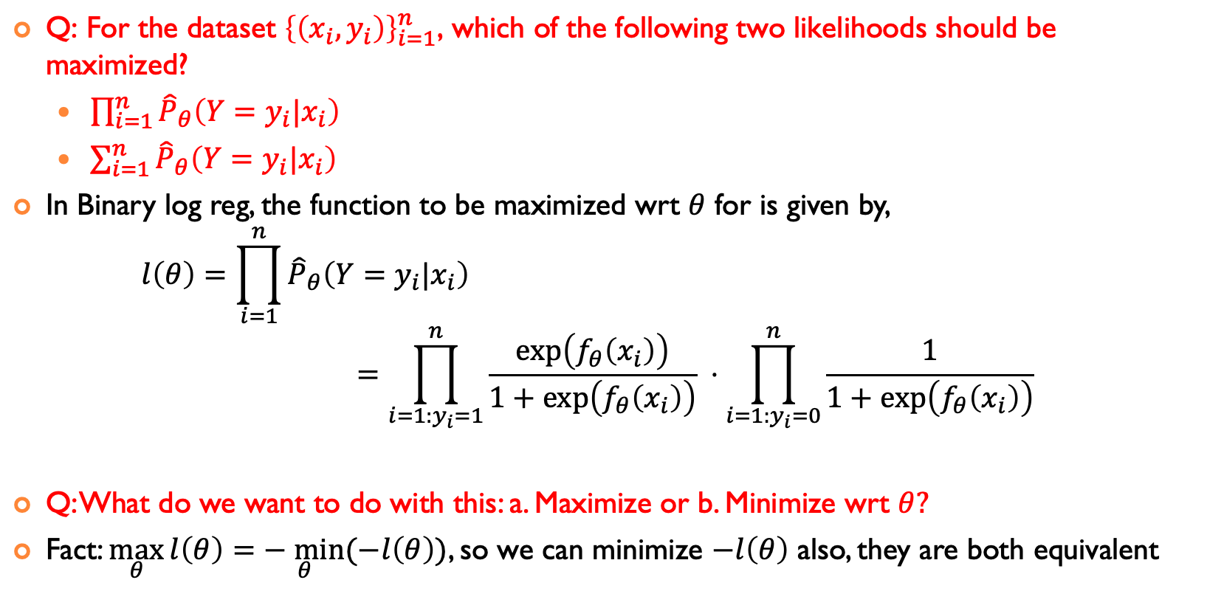
Log Reg FOR BINARY PREDICTION VARIABLES $y$
$\text{Q}\text{: }\text{For} \text{the} \text{dataset} {\left\{\left(x_{i},y_{i}\right)\right\}}_{i=1}^{n}\text{, }\text{which} \text{of} \text{the} \text{following} \text{two} \text{likelihoods} \text{should} \text{be} \text{maximized}\text{?}$
$\prod_{i=1}^{n}{{\hat{P}}_{θ}\left(Y=y_{i}|x_{i}\right) }$
$\sum_{i=1}^{n}{{\hat{P}}_{θ}\left(Y=y_{i}|x_{i}\right) }$
In Binary log reg, the function to be maximized wrt $θ$ for is given by, $l\left(θ\right)=\prod_{i=1}^{n}{{\hat{P}}_{θ}\left(Y=y_{i}|x_{i}\right) }$ $=\prod_{i=1:y_{i}=1}^{n}{\frac{\exp\left(f_{θ}\left(x_{i}\right)\right)}{1+\exp\left(f_{θ}\left(x_{i}\right)\right)} ⋅\prod_{i=1:y_{i}=0}^{n}{\frac{1}{1+\exp\left(f_{θ}\left(x_{i}\right)\right)}}}$
Q: What do we want to do with this: a. Maximize or b. Minimize wrt $θ?$
Fact: $\max_{θ}{l\left(θ\right)}=\underset{θ}{− min}{(−l\left(θ\right))}$, so we can minimize $−l\left(θ\right)$ also, they are both equivalent

Slide 3
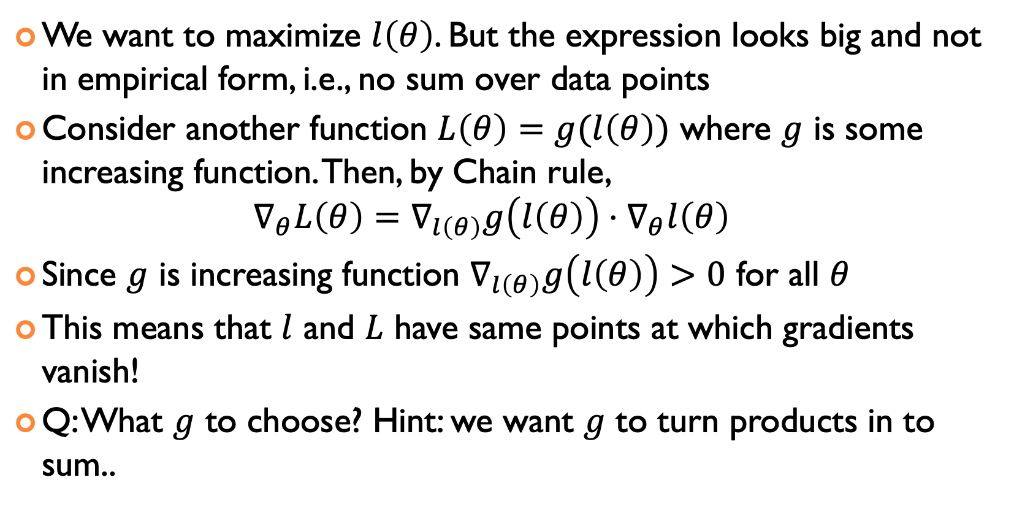
INCREASING FUNCTIONS DO NOT CHANGE MAXIMIZERS
We want to maximize $l\left(θ\right)$. But the expression looks big and not in empirical form, i.e., no sum over data points
Consider another function $L\left(θ\right)=g(l\left(θ\right))$ where $g$ is some increasing function. Then, by Chain rule, $∇_{θ}L\left(θ\right)=∇_{l\left(θ\right)}g\left(l\left(θ\right)\right)⋅∇_{θ}l\left(θ\right)$
Since $g$ is increasing function $∇_{l\left(θ\right)}g\left(l\left(θ\right)\right)>0$ for all $θ$
This means that $l$ and $L$ have same points at which gradients vanish!
Q: What $g$ to choose? Hint: we want $g$ to turn products in to sum..

Slide 4
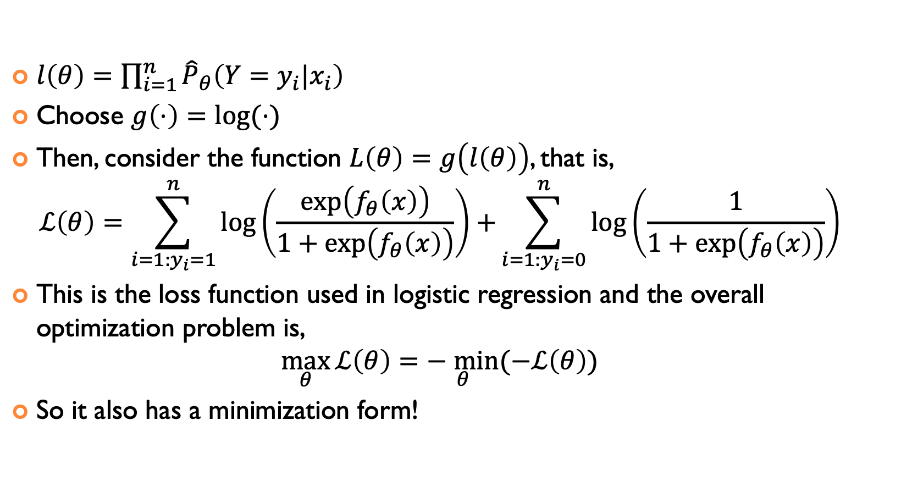
LOGISTIC REGRESSION LOSS FUNCTION
$l\left(θ\right)=\prod_{i=1}^{n}{{\hat{P}}_{θ}\left(Y=y_{i}|x_{i}\right) }$
Choose $g\left(⋅\right)=\log{(⋅)}$
Then, consider the function $L\left(θ\right)=g\left(l\left(θ\right)\right)$, that is, $ℒ\left(θ\right)=\sum_{i=1:y_{i}=1}^{n}{\log\left(\frac{\exp\left(f_{θ}\left(x\right)\right)}{1+\exp\left(f_{θ}\left(x\right)\right)}\right)+}\sum_{i=1:y_{i}=0}^{n}{\log\left(\frac{1}{1+\exp\left(f_{θ}\left(x\right)\right)}\right)}$
This is the loss function used in logistic regression and the overall optimization problem is, $\max_{θ}{ℒ\left(θ\right)}=\underset{θ}{− min}{(−ℒ\left(θ\right))}$
So it also has a minimization form!

Slide 5
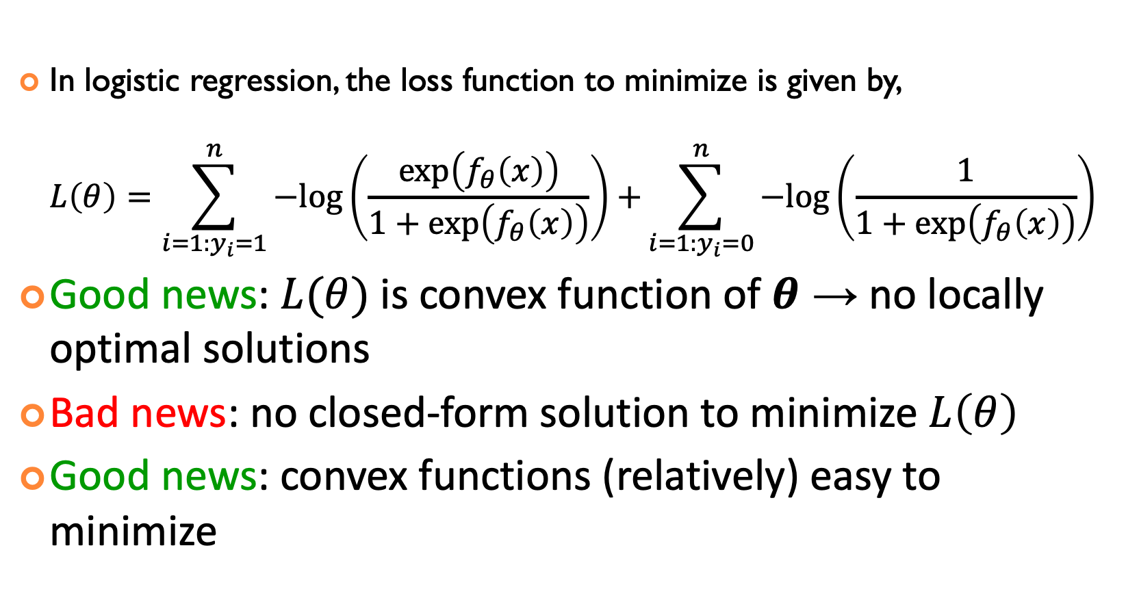
Summary OF BINARY LOGISTIC REGRESSION
In logistic regression, the loss function to minimize is given by, $L\left(θ\right)=\sum_{i=1:y_{i}=1}^{n}{−log\left(\frac{\exp\left(f_{θ}\left(x\right)\right)}{1+\exp\left(f_{θ}\left(x\right)\right)}\right)+}\sum_{i=1:y_{i}=0}^{n}{−log\left(\frac{1}{1+\exp\left(f_{θ}\left(x\right)\right)}\right)}$
Good news: $L(θ)$ is convex function of $θ$ → no locally optimal solutions
Bad news: no closed-form solution to minimize $L\left(θ\right)$
Good news: convex functions (relatively) easy to minimize

Slide 6
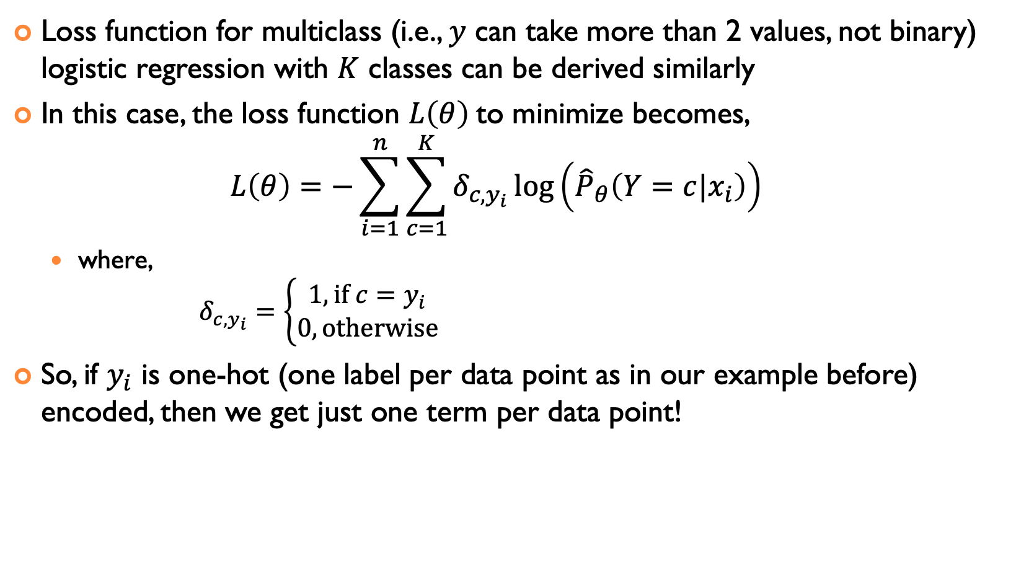
MULTICLASS LOGISTIC REGRESSION
Loss function for multiclass (i.e., $y$ can take more than 2 values, not binary) logistic regression with $K$ classes can be derived similarly
In this case, the loss function $L\left(θ\right)$to minimize becomes, $L\left(θ\right)=−\sum_{i=1}^{n}{\sum_{c=1}^{K}{δ_{c,y_{i}}\log\left({\hat{P}}_{θ}\left(Y=c|x_{i}\right)\right)}}$
where, $δ_{c,y_{i}}=\left\{\begin{aligned}1, \text{if} c=y_{i} \\ 0, \text{otherwise}\end{aligned}\right.$
So, if $y_{i}$ is one-hot (one label per data point as in our example before) encoded, then we get just one term per data point!

Slide 7
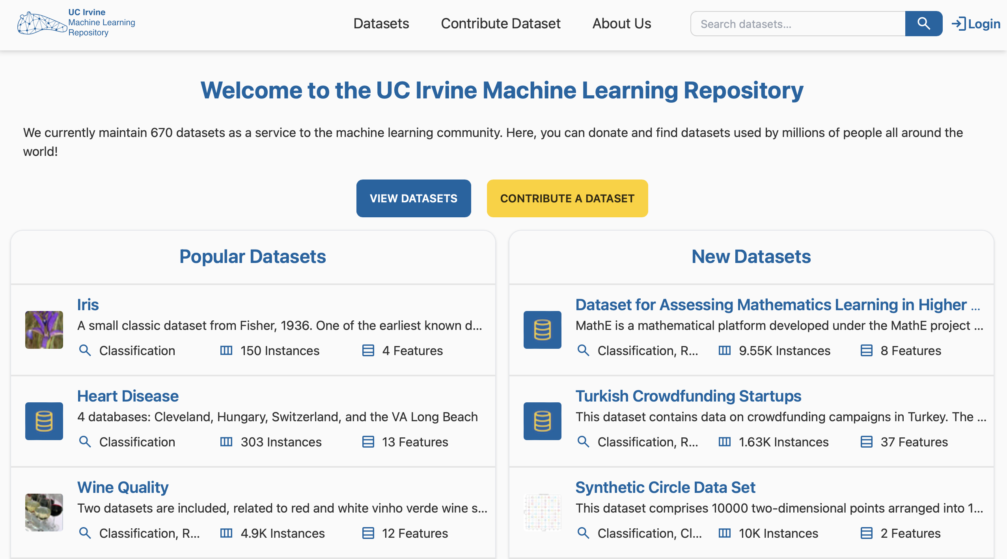
Logistic regression practice

Slide 8
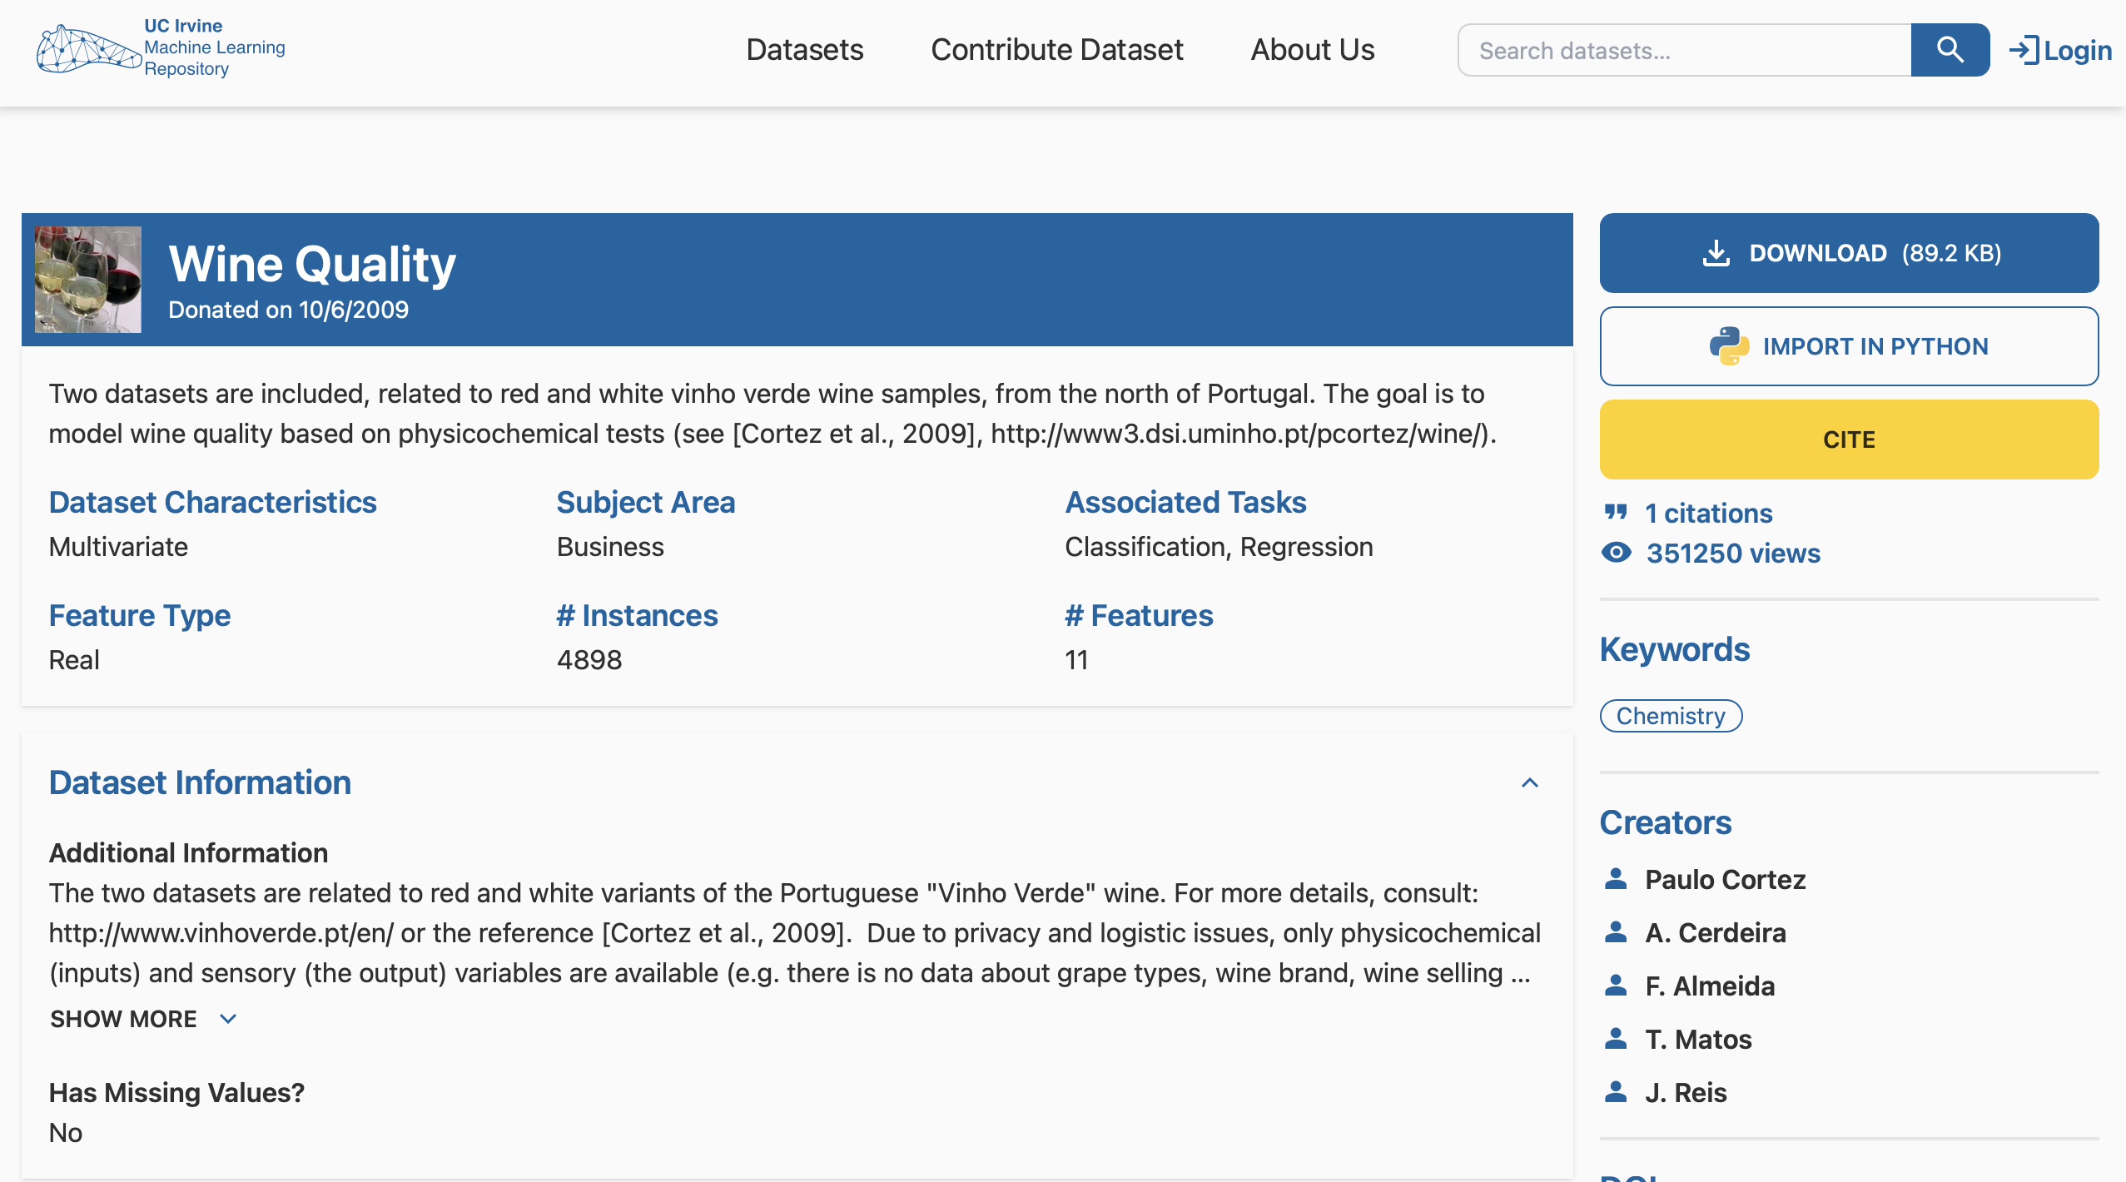
Logistic regression practice

Slide 9
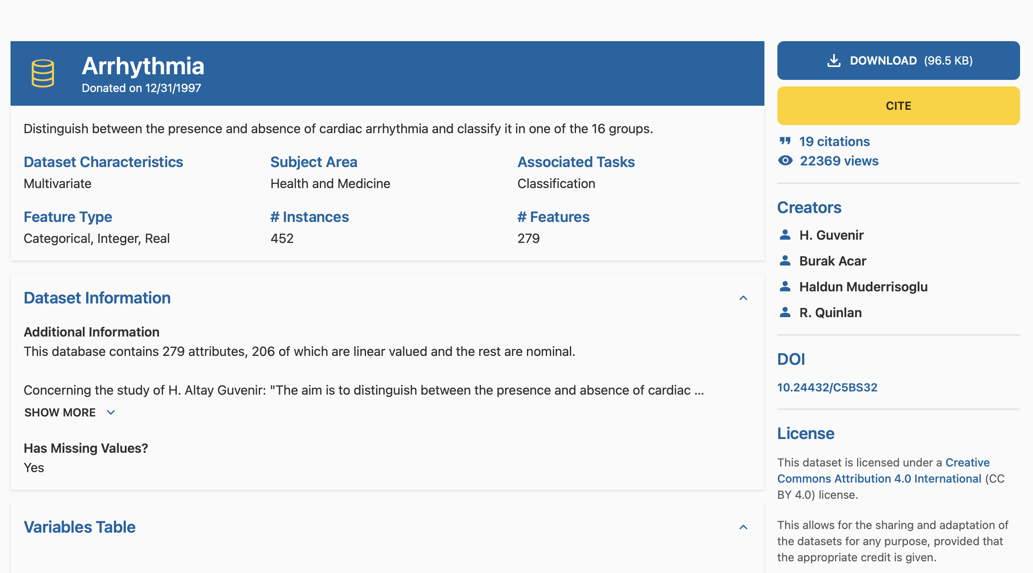
Logistic regression practice
Multi-class dataset

Slide 10
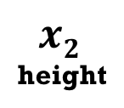
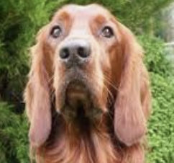
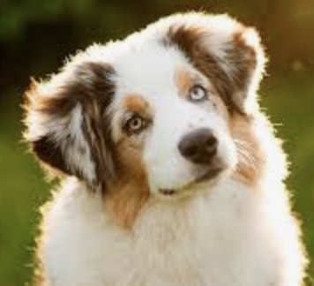
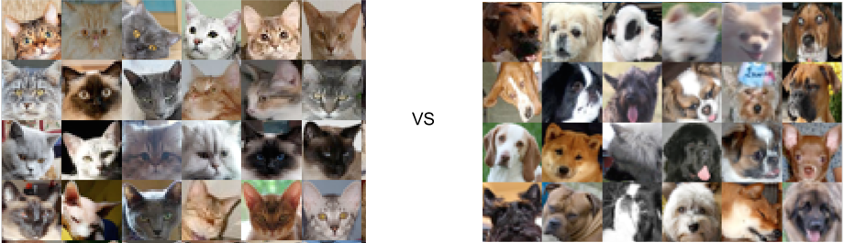
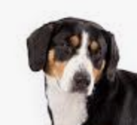







LINEAR ALGEBRA AND MACHINE LEARNING
AI and machine learning rely on algorithms that learn to distinguish between classes of objects by using data examples
Linear algebra concept: hyperplanes separate a D-dimensional space into two half-spaces
Machine learning algorithm: find the hyperplane that separates positive from negative examples the best
Allows predicting the class of new examples
w
fluffiness
?
Notes:
线性代数概念：超平面将一个 D 维空间分成两个半空间。 机器学习算法：寻找最能将正例和负例分开的超平面。 用于预测新样本的类别。

Slide 11
ACKNOWLEDGMENTS
These slides use materials by the Brian Ziebart

