Slide 1
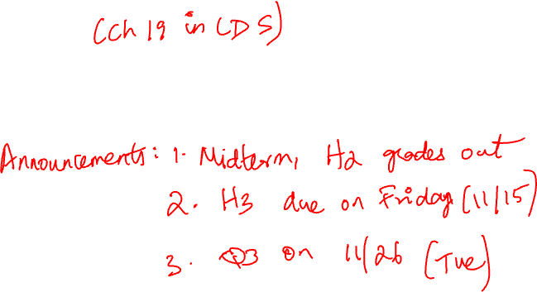
LOGISTIC REGRESSION

Slide 2
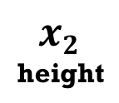









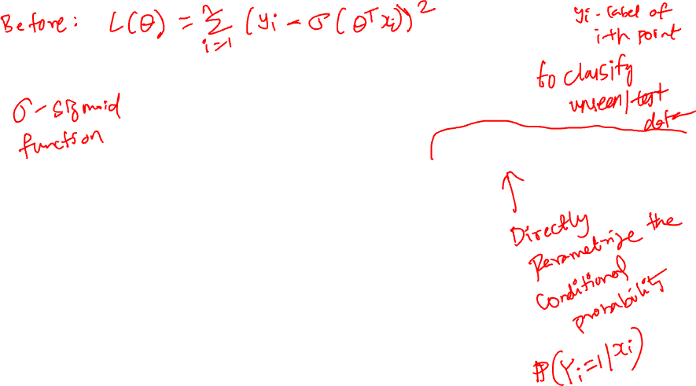
LOGISTIC REGRESSION: DECISION BOUNDARY
θ
fluffiness

Slide 3
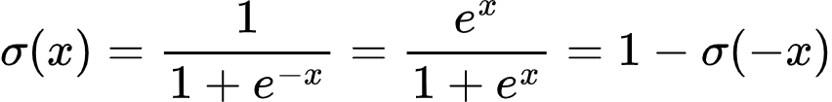
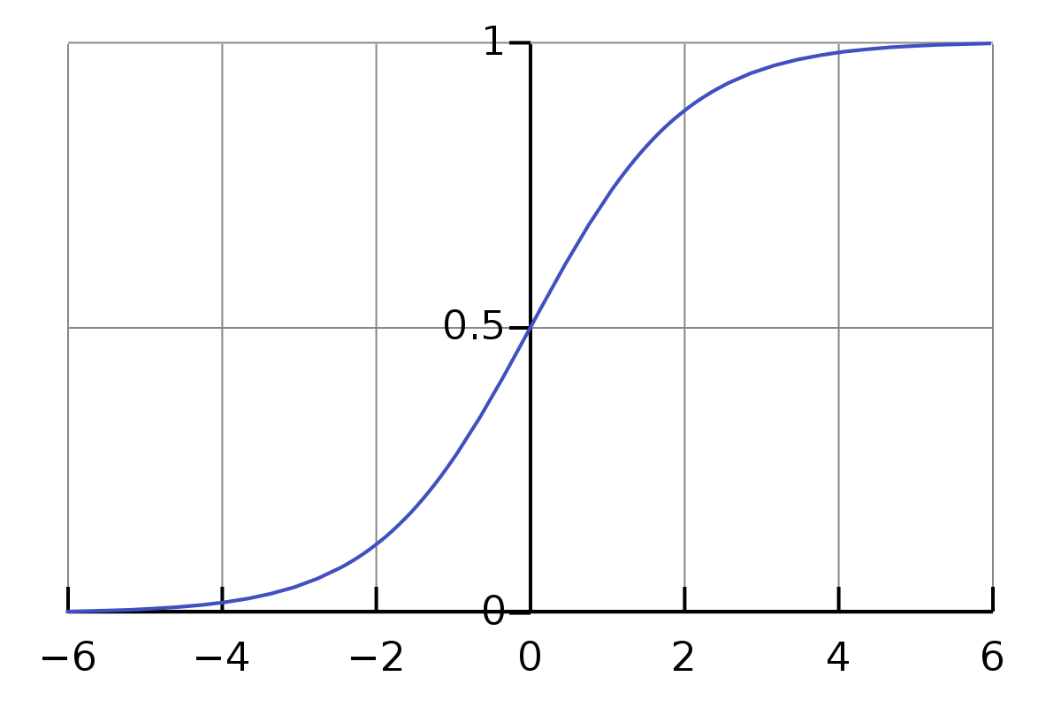

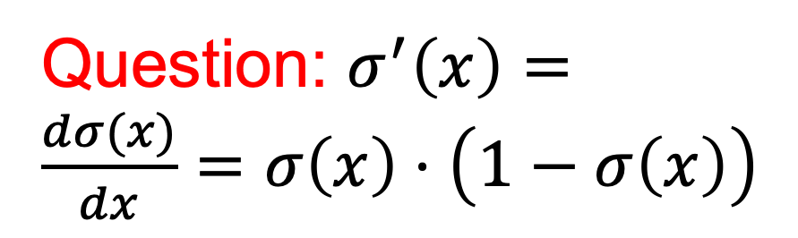
SIGMOID FUNCTION
Question: $σ^{′}\left(x\right)=\frac{dσ(x)}{dx}=σ\left(x\right)⋅\left(1−σ\left(x\right)\right)$

Slide 4
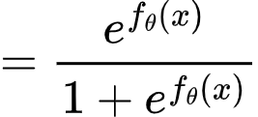
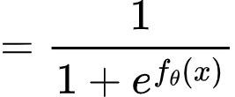
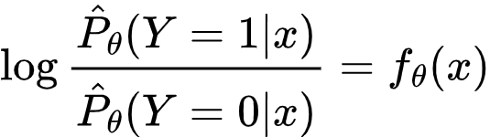
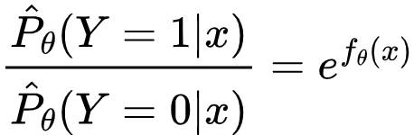
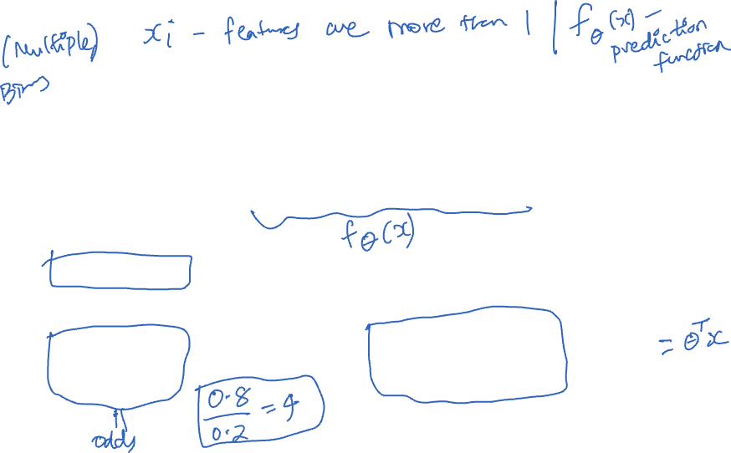
LOGISTIC REGRESSION: MODEL CONDITIONAL PROBABILITY
Sigmoid:
Transform the linear model’s real-valued outputs to [0,1] using Sigmoid function.
This implies:
Which implies:
and
Linear classification rule!

Slide 5
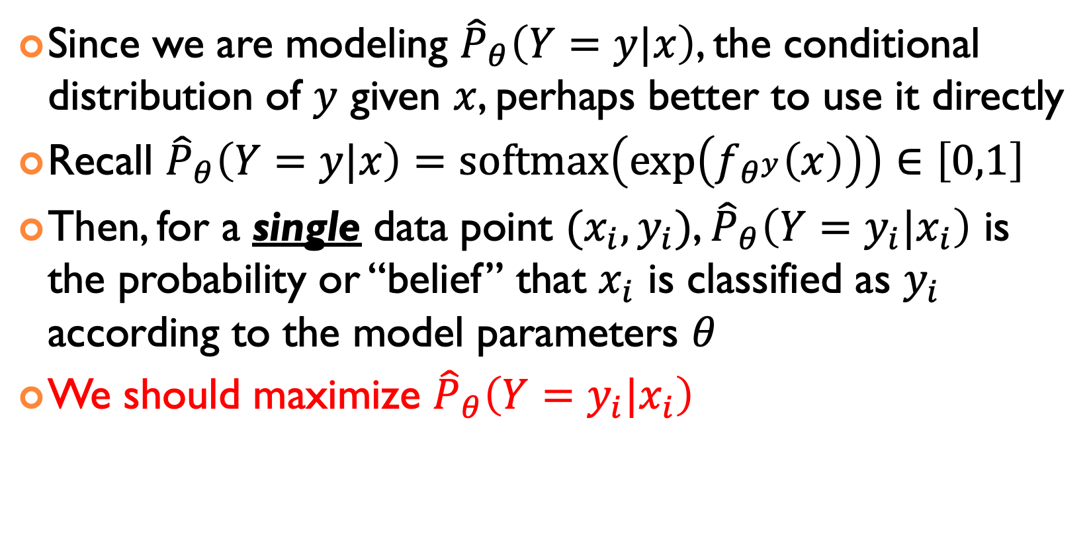
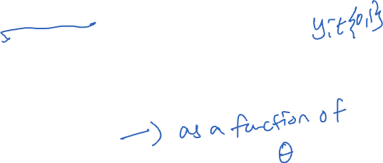
FINALLY, LOGISTIC REGRESSION USING LIKELIHOOD
Since we are modeling ${\hat{P}}_{θ}\left(Y=y|x\right)$, the conditional distribution of $y$ given $x$, perhaps better to use it directly
Recall ${\hat{P}}_{θ}\left(Y=y|x\right)=\text{softmax}\left(\exp\left(f_{θ^{y}}\left(x\right)\right)\right)∈\left[0,1\right]$
Then, for a single data point $(x_{i},y_{i})$, ${\hat{P}}_{θ}\left(Y=y_{i}|x_{i}\right)$ is the probability or “belief” that $x_{i}$ is classified as $y_{i}$ according to the model parameters $θ$
We should maximize ${\hat{P}}_{θ}\left(Y=y_{i}|x_{i}\right)$

Slide 6
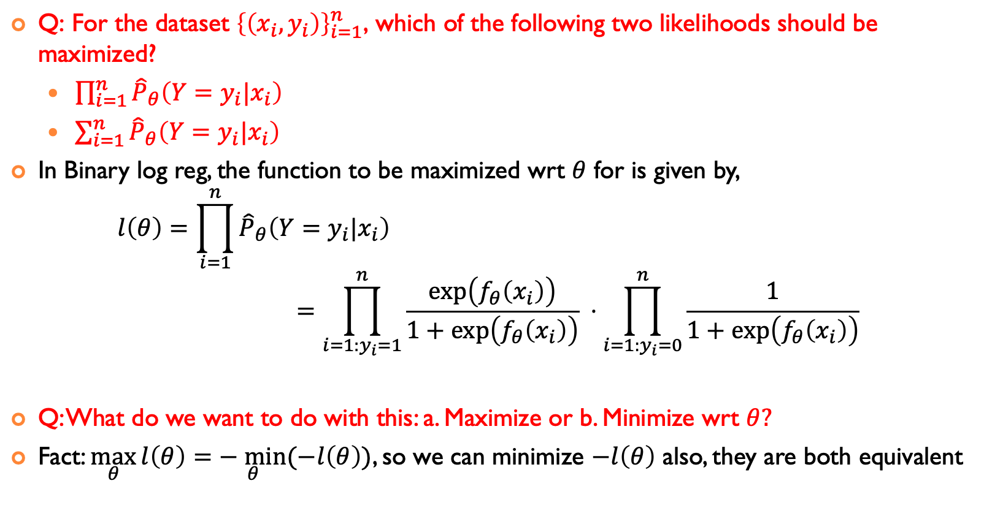

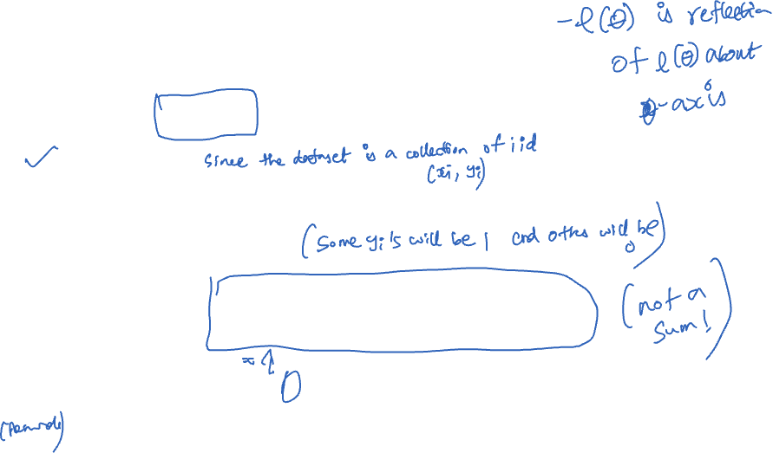
Log Reg FOR BINARY PREDICTION VARIABLES $y$
$\text{Q}\text{: }\text{For} \text{the} \text{dataset} {\left\{\left(x_{i},y_{i}\right)\right\}}_{i=1}^{n}\text{, }\text{which} \text{of} \text{the} \text{following} \text{two} \text{likelihoods} \text{should} \text{be} \text{maximized}\text{?}$
$\prod_{i=1}^{n}{{\hat{P}}_{θ}\left(Y=y_{i}|x_{i}\right) }$
$\sum_{i=1}^{n}{{\hat{P}}_{θ}\left(Y=y_{i}|x_{i}\right) }$
In Binary log reg, the function to be maximized wrt $θ$ for is given by, $l\left(θ\right)=\prod_{i=1}^{n}{{\hat{P}}_{θ}\left(Y=y_{i}|x_{i}\right) }$ $=\prod_{i=1:y_{i}=1}^{n}{\frac{\exp\left(f_{θ}\left(x_{i}\right)\right)}{1+\exp\left(f_{θ}\left(x_{i}\right)\right)} ⋅\prod_{i=1:y_{i}=0}^{n}{\frac{1}{1+\exp\left(f_{θ}\left(x_{i}\right)\right)}}}$
Q: What do we want to do with this: a. Maximize or b. Minimize wrt $θ?$
Fact: $\max_{θ}{l\left(θ\right)}=\underset{θ}{− min}{(−l\left(θ\right))}$, so we can minimize $−l\left(θ\right)$ also, they are both equivalent

Slide 7
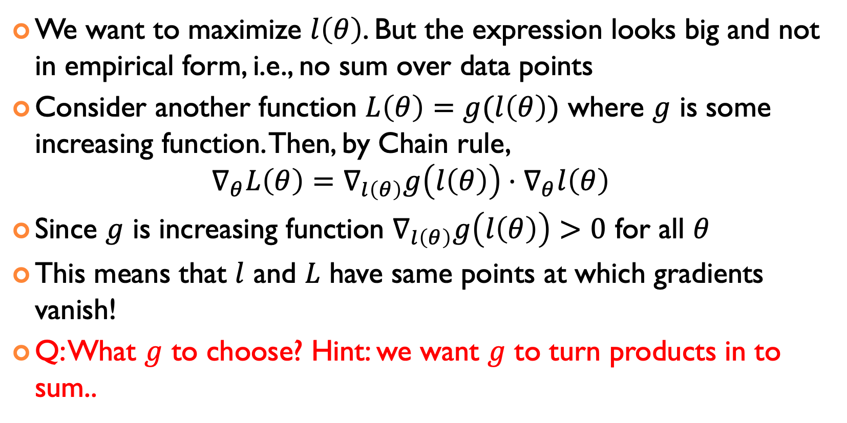
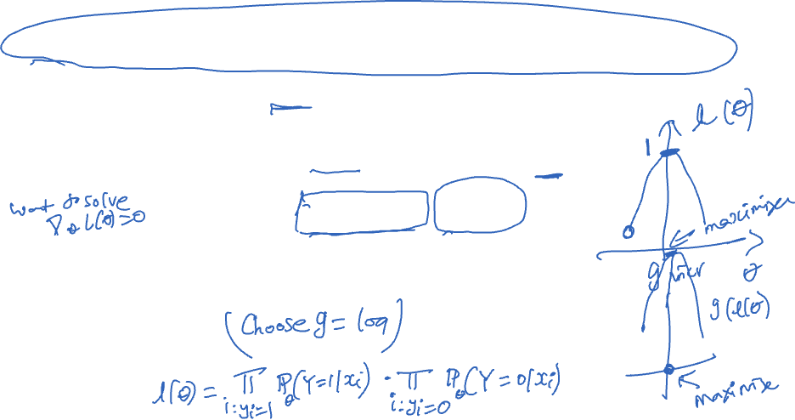
INCREASING FUNCTIONS DO NOT CHANGE MAXIMIZERS
We want to maximize $l\left(θ\right)$. But the expression looks big and not in empirical form, i.e., no sum over data points
Consider another function $L\left(θ\right)=g(l\left(θ\right))$ where $g$ is some increasing function. Then, by Chain rule, $∇_{θ}L\left(θ\right)=∇_{l\left(θ\right)}g\left(l\left(θ\right)\right)⋅∇_{θ}l\left(θ\right)$
Since $g$ is increasing function $∇_{l\left(θ\right)}g\left(l\left(θ\right)\right)>0$ for all $θ$
This means that $l$ and $L$ have same points at which gradients vanish!
Q: What $g$ to choose? Hint: we want $g$ to turn products in to sum..

Slide 8
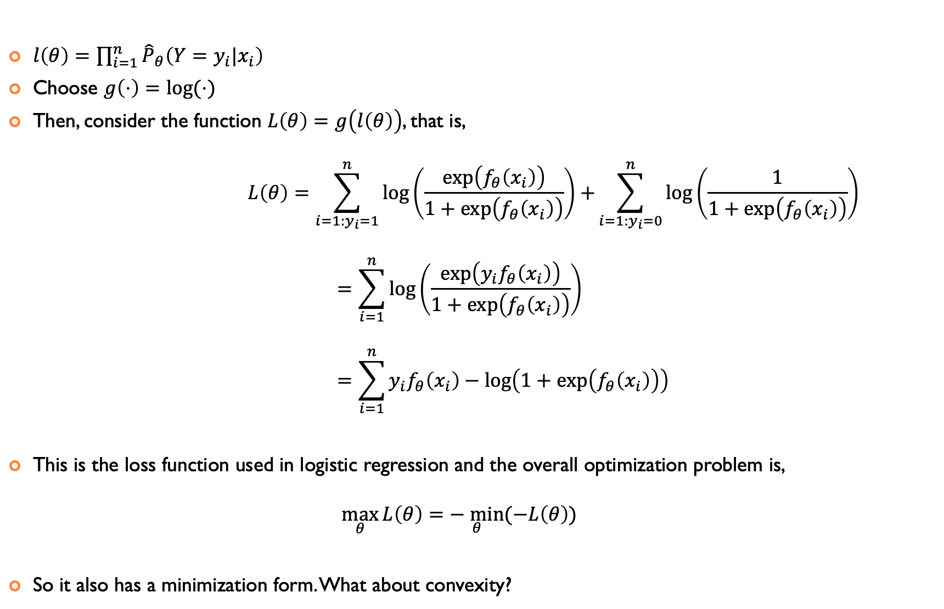
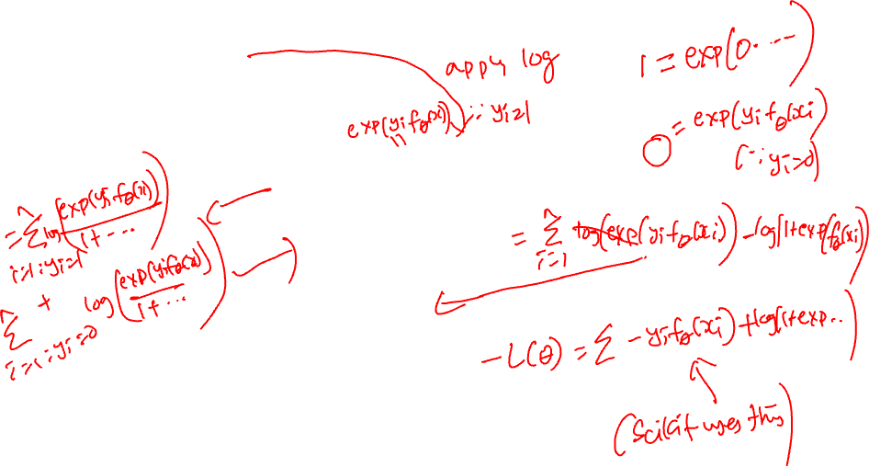
LOGISTIC REGRESSION LOSS FUNCTION
$l\left(θ\right)=\prod_{i=1}^{n}{{\hat{P}}_{θ}\left(Y=y_{i}|x_{i}\right) }$
Choose $g\left(⋅\right)=\log{(⋅)}$
Then, consider the function $L\left(θ\right)=g\left(l\left(θ\right)\right)$, that is, $L\left(θ\right)=\sum_{i=1:y_{i}=1}^{n}{\log\left(\frac{\exp\left(f_{θ}\left(x_{i}\right)\right)}{1+\exp\left(f_{θ}\left(x_{i}\right)\right)}\right)+}\sum_{i=1:y_{i}=0}^{n}{\log\left(\frac{1}{1+\exp\left(f_{θ}\left(x_{i}\right)\right)}\right)}$ $=\sum_{i=1}^{n}{\log\left(\frac{\exp\left(y_{i}f_{θ}\left(x_{i}\right)\right)}{1+\exp\left(f_{θ}\left(x_{i}\right)\right)}\right)}$ $=\sum_{i=1}^{n}{y_{i}f_{θ}\left(x_{i}\right)}−\log\left(1+\exp\left(f_{θ}\left(x_{i}\right)\right)\right)$
This is the loss function used in logistic regression and the overall optimization problem is, $\max_{θ}{L\left(θ\right)}=\underset{θ}{− min}{(−L\left(θ\right))}$
So it also has a minimization form. What about convexity?

Slide 9
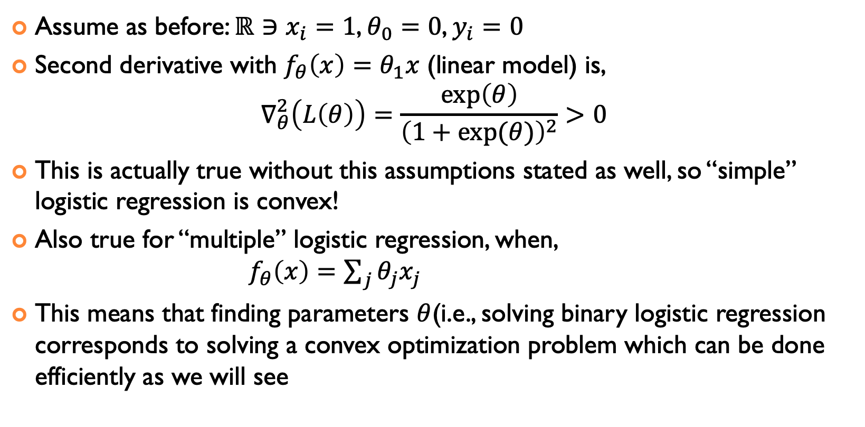
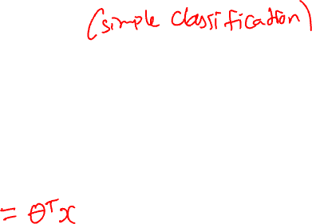
CONVEXITY: IS THE SECOND DERIVATIVE POSITIVE ALWAYS?
Assume as before: $ℝ∋x_{i}=1$, $θ_{0}=0$, $y_{i}=0$
Second derivative with $f_{θ}\left(x\right)=θ_{1}x$ (linear model) is, $∇_{θ}^{2}\left(L\left(θ\right)\right)=\frac{\exp\left(θ\right)}{{\left(1+\exp{(θ)}\right)}^{2}}>0$
This is actually true without this assumptions stated as well, so “simple” logistic regression is convex!
Also true for “multiple” logistic regression, when, $f_{θ}\left(x\right)=\sum_{j}{θ_{j}x_{j}}$
This means that finding parameters $θ$(i.e., solving binary logistic regression corresponds to solving a convex optimization problem which can be done efficiently as we will see

Slide 10
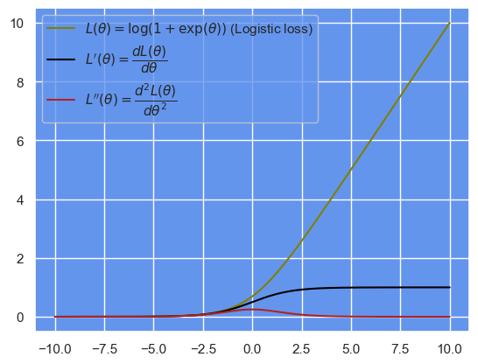
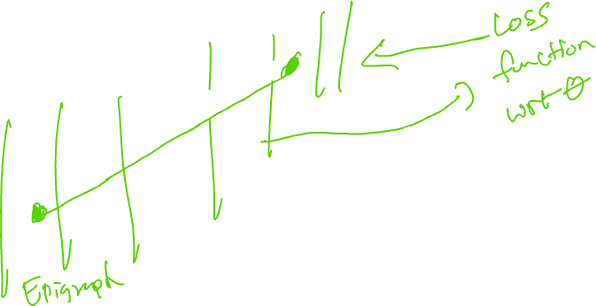
CLASSIFICATION WITH LOGISTIC LOSS IS CONVEX
This is a much better loss compared to the squared sigmoid function before!

Slide 11
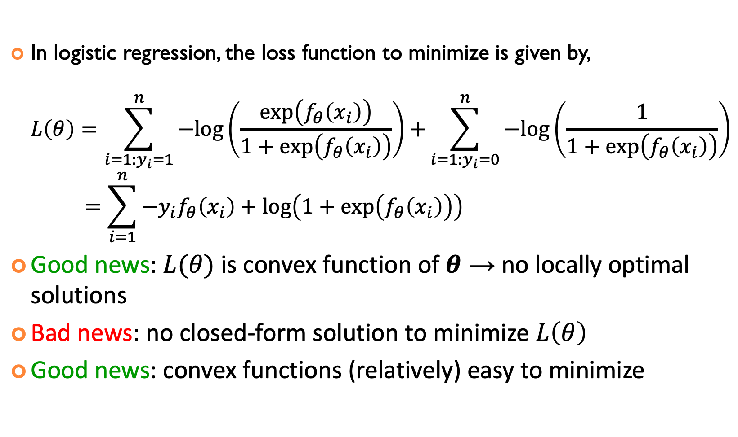
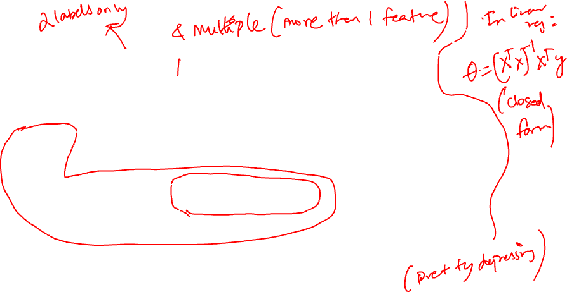
Summary OF BINARY LOGISTIC REGRESSION
In logistic regression, the loss function to minimize is given by, $L\left(θ\right)=\sum_{i=1:y_{i}=1}^{n}{−log\left(\frac{\exp\left(f_{θ}\left(x_{i}\right)\right)}{1+\exp\left(f_{θ}\left(x_{i}\right)\right)}\right)+}\sum_{i=1:y_{i}=0}^{n}{−log\left(\frac{1}{1+\exp\left(f_{θ}\left(x_{i}\right)\right)}\right)}$ $=\sum_{i=1}^{n}{−y_{i}f_{θ}\left(x_{i}\right)}+\log\left(1+\exp\left(f_{θ}\left(x_{i}\right)\right)\right)$
Good news: $L(θ)$ is convex function of $θ$ → no locally optimal solutions
Bad news: no closed-form solution to minimize $L\left(θ\right)$
Good news: convex functions (relatively) easy to minimize

Slide 12
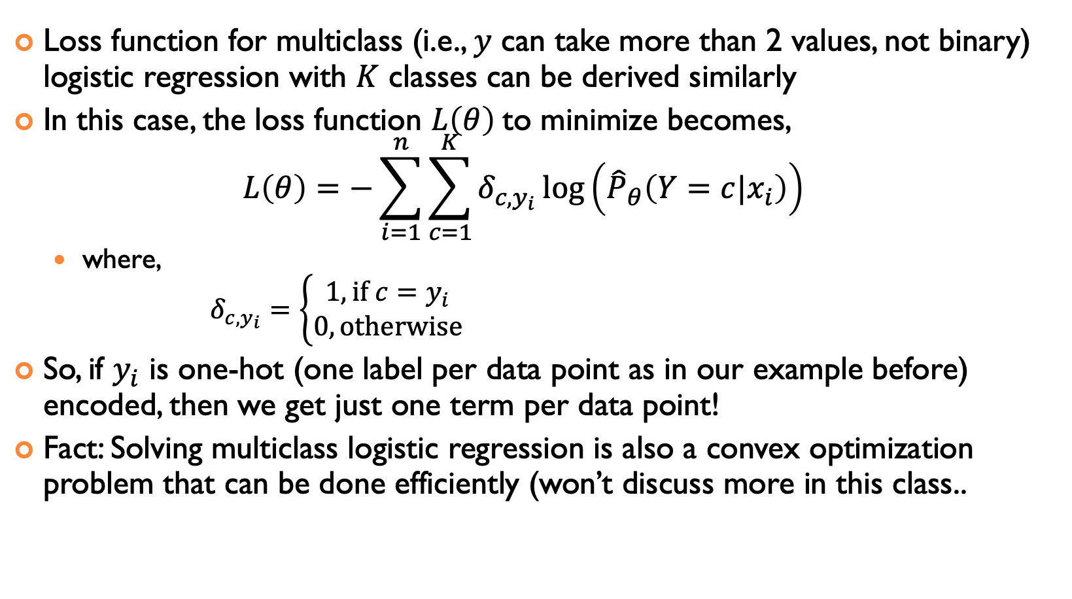
MULTICLASS LOGISTIC REGRESSION
Loss function for multiclass (i.e., $y$ can take more than 2 values, not binary) logistic regression with $K$ classes can be derived similarly
In this case, the loss function $L\left(θ\right)$to minimize becomes, $L\left(θ\right)=−\sum_{i=1}^{n}{\sum_{c=1}^{K}{δ_{c,y_{i}}\log\left({\hat{P}}_{θ}\left(Y=c|x_{i}\right)\right)}}$
where, $δ_{c,y_{i}}=\left\{\begin{aligned}1, \text{if} c=y_{i} \\ 0, \text{otherwise}\end{aligned}\right.$
So, if $y_{i}$ is one-hot (one label per data point as in our example before) encoded, then we get just one term per data point!
Fact: Solving multiclass logistic regression is also a convex optimization problem that can be done efficiently (won’t discuss more in this class..

Slide 13
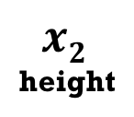
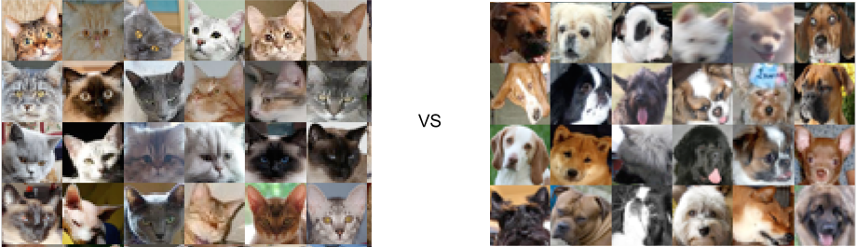



LINEAR ALGEBRA AND MACHINE LEARNING
AI and machine learning rely on algorithms that learn to distinguish between classes of objects by using data examples
Linear algebra concept: hyperplanes separate a D-dimensional space into two half-spaces
Machine learning algorithm: find the hyperplane that separates positive from negative examples the best
Allows predicting the class of new examples
w
fluffiness
?

Slide 14

NUMERICAL OPTIMIZATION
LDS Ch 20

Slide 15
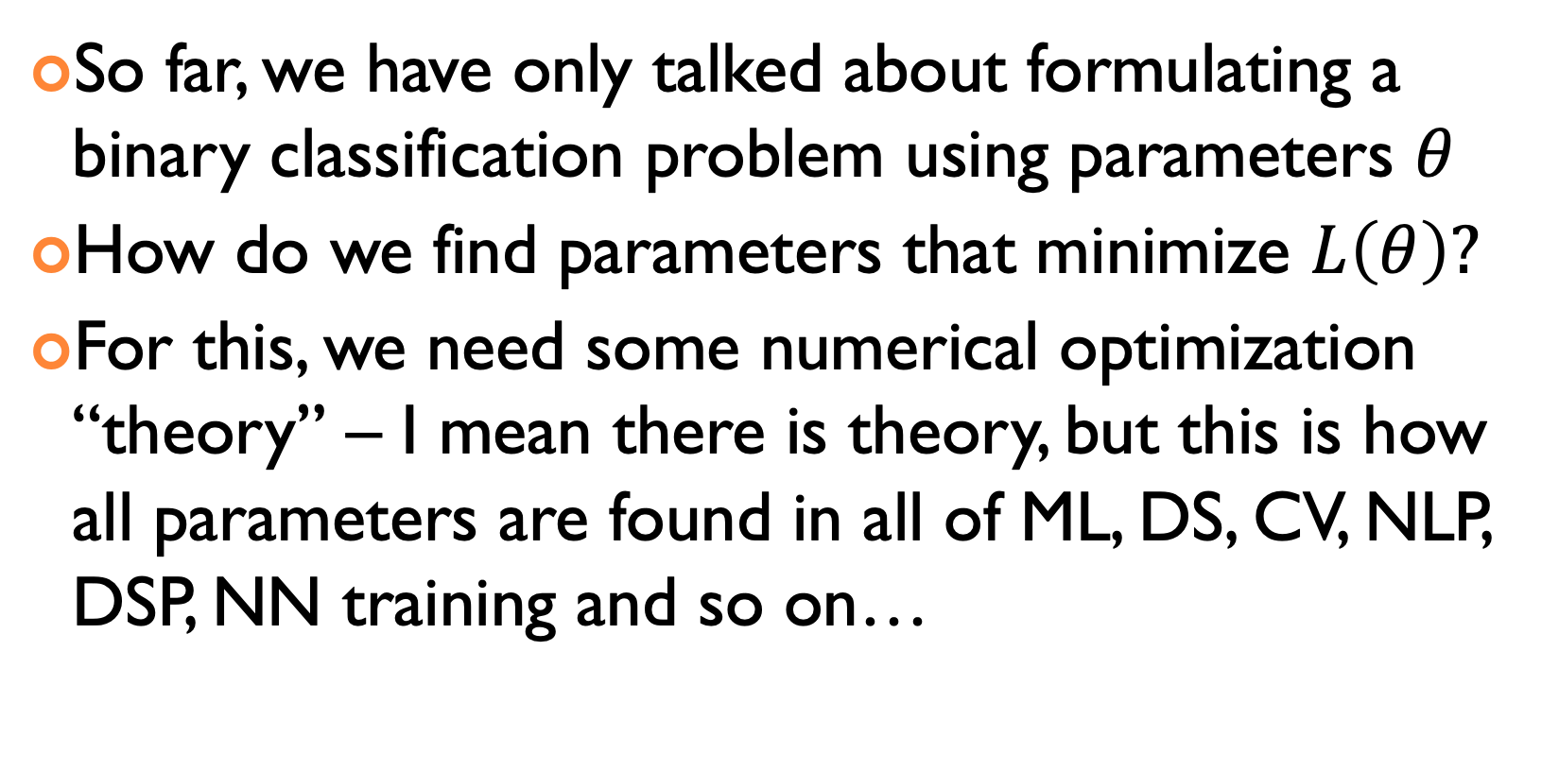

HOW TO FIND PARAMETERS OF LOGISTIC REGRESSION?
So far, we have only talked about formulating a binary classification problem using parameters $θ$
How do we find parameters that minimize $L\left(θ\right)?$
For this, we need some numerical optimization “theory” – I mean there is theory, but this is how all parameters are found in all of ML, DS, CV, NLP, DSP, NN training and so on…

Slide 16
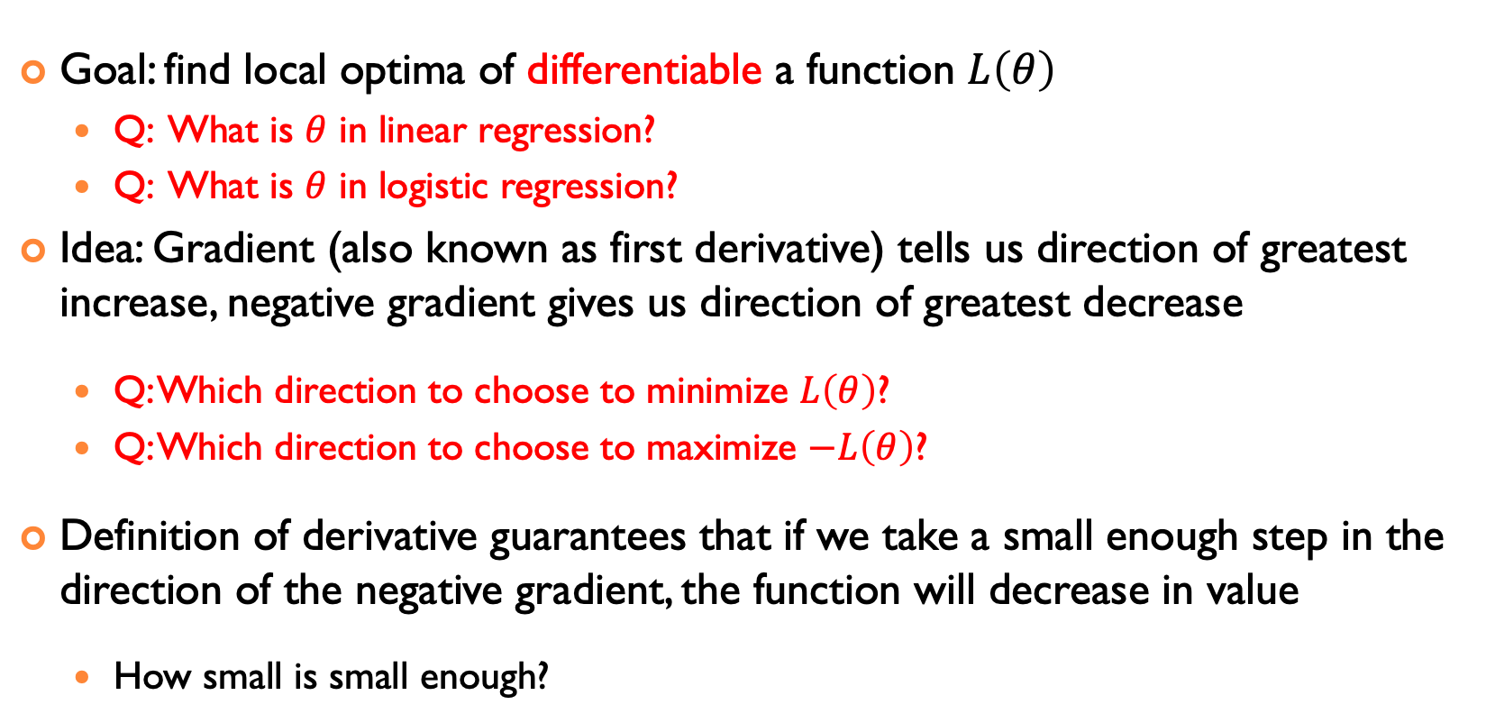
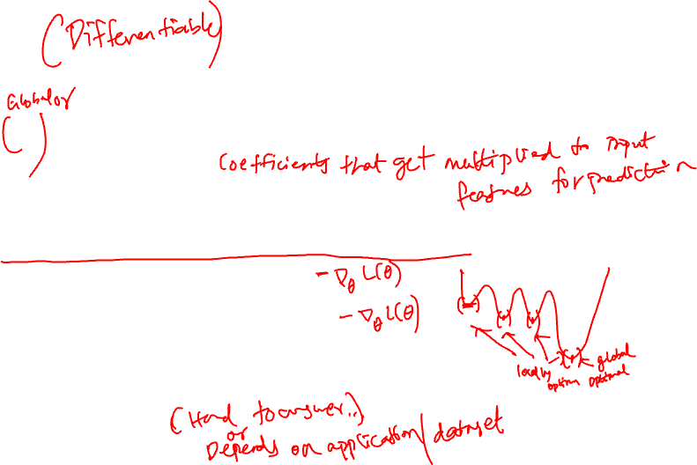
SMOOTH OPTIMIZATION
Goal: find local optima of differentiable a function $L\left(θ\right)$
Q: What is $θ$ in linear regression?
Q: What is $θ$ in logistic regression?
Idea: Gradient (also known as first derivative) tells us direction of greatest increase, negative gradient gives us direction of greatest decrease
Q: Which direction to choose to minimize $L\left(θ\right)$?
Q: Which direction to choose to maximize $−L\left(θ\right)$?
Definition of derivative guarantees that if we take a small enough step in the direction of the negative gradient, the function will decrease in value
How small is small enough?

Slide 17
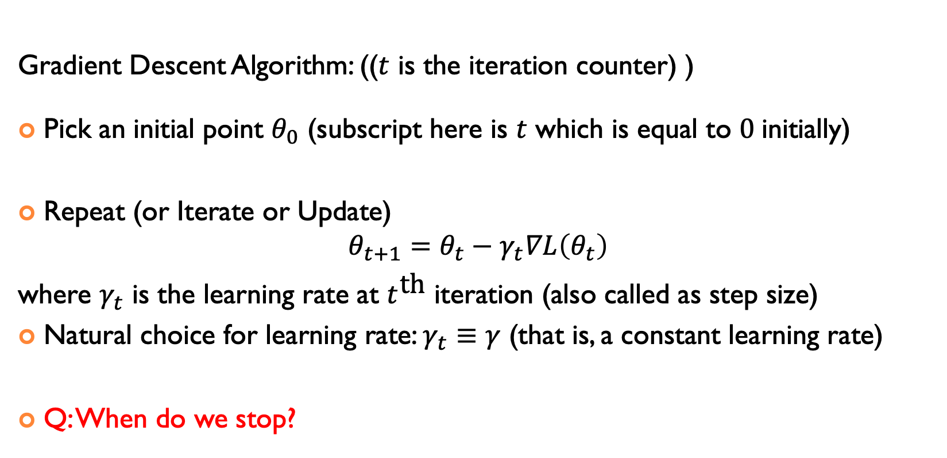
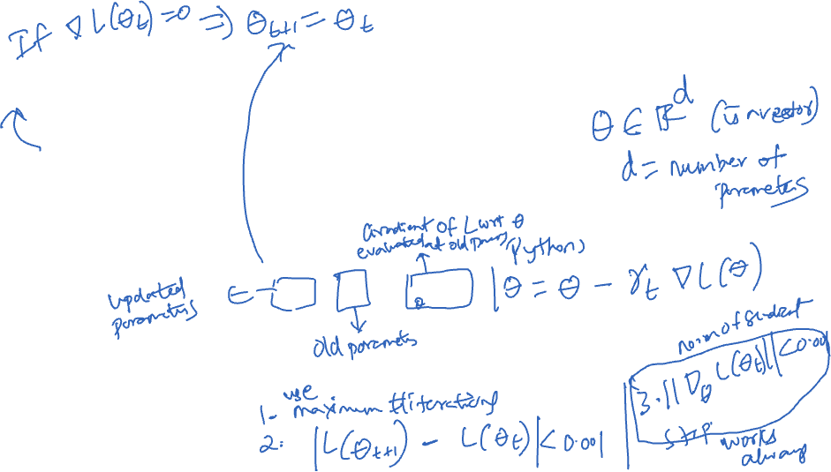
Gradient Descent: Basic Iterative Algorithm
Gradient Descent Algorithm: (($t$ is the iteration counter) )
Pick an initial point $θ_{0}$ (subscript here is $t$ which is equal to $0$initially)
Repeat (or Iterate or Update) $θ_{t+1}=θ_{t}−γ_{t}∇L\left(θ_{t}\right)$
where $γ_{t}$ is the learning rate at $t^{\text{th}}$ iteration (also called as step size)
Natural choice for learning rate: $γ_{t}≡γ$ (that is, a constant learning rate)
Q: When do we stop?

Slide 18
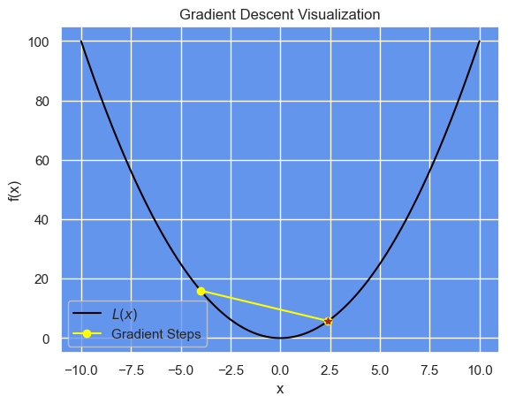
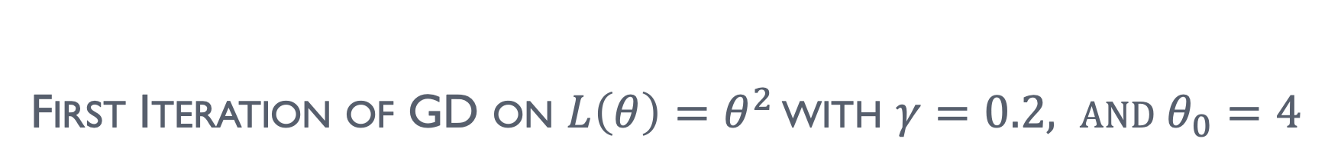
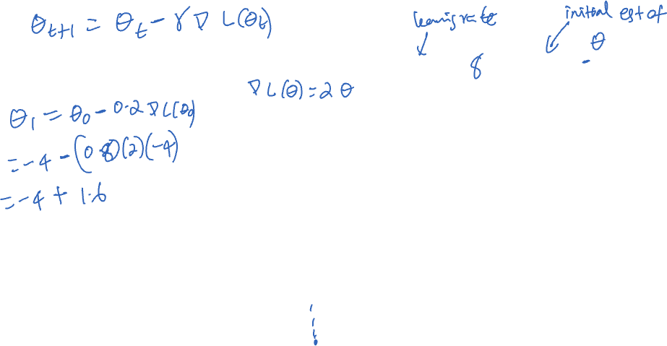
First Iteration of GD on $L\left(θ\right)=θ^{2}$ with $γ=0.2, \text{and} θ_{0}=4$

Slide 19
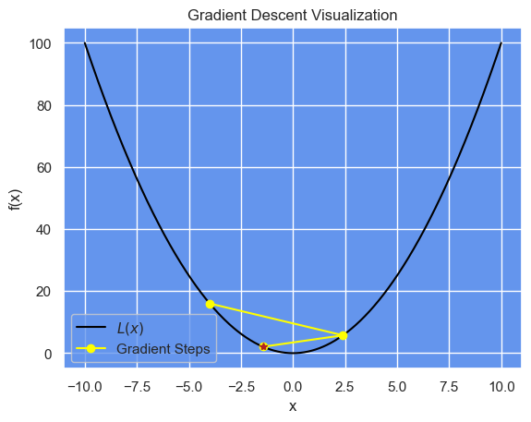
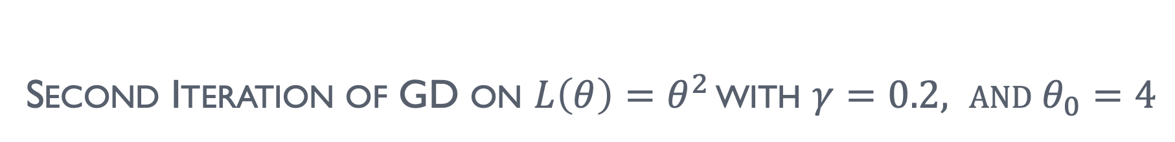
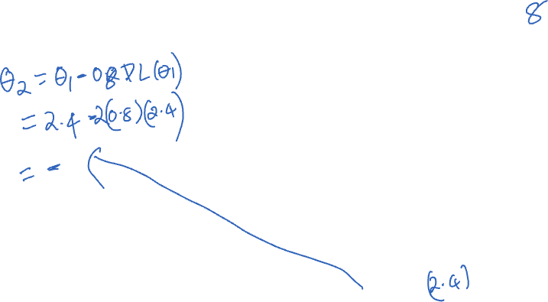
Second Iteration of GD on $L\left(θ\right)=θ^{2}$ with $γ=0.2, \text{and} θ_{0}=4$

Slide 20
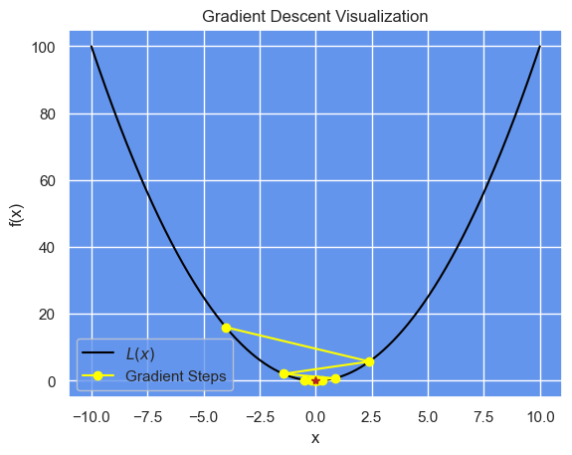

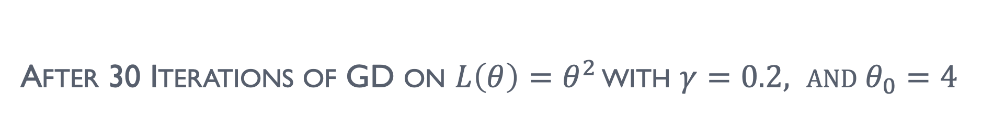
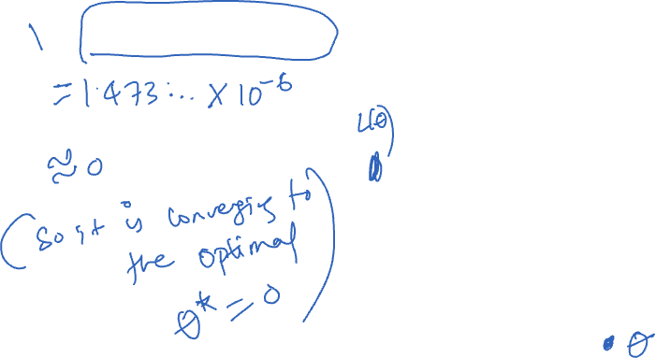
After 30 Iterations of GD on $L\left(θ\right)=θ^{2}$ with $γ=0.2, \text{and} θ_{0}=4$
$θ_{30}≈\text{1.473826131471562}\text{e}\text{−06}$

Slide 21
IMPACT OF LEARNING RATE
Big vs small learning rate can affect the procedure significantly

Slide 22

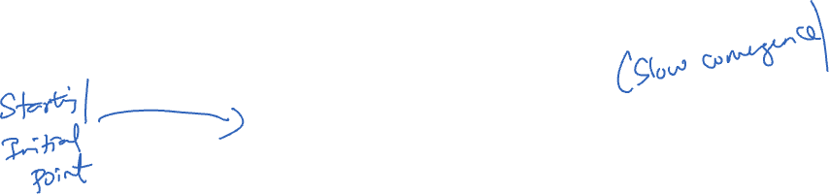
Can View as an Animation in MATPLOTLIB with $γ=0.9$

Slide 23


Can View as an Animation in MATPLOTLIB with $γ=0.2$

Slide 24

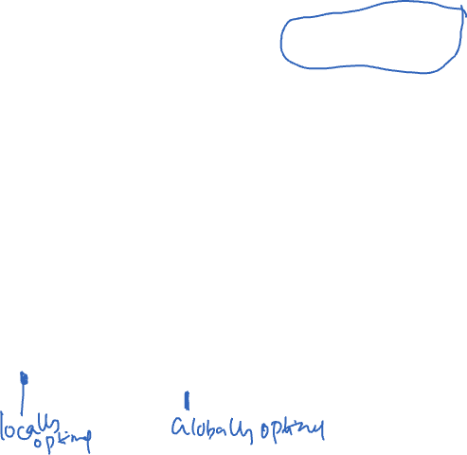
NONCONVEX LOSS: $L\left(θ\right)=\frac{θ^{4}}{16}−\frac{θ^{3}}{16}−\frac{θ^{2}}{2}−\frac{θ}{4}−\frac{1}{20}$ with $γ=0.2, θ_{0}=4$

Slide 25


NONCONVEX LOSS: $L\left(θ\right)=\frac{θ^{4}}{16}−\frac{θ^{3}}{16}−\frac{θ^{2}}{2}−\frac{θ}{4}−\frac{1}{20}$ with $γ=0.72, θ_{0}=4$

Slide 26

HOW TO KNOW IF WE ARE SOLVING?
Or what it does it mean for an algorithm to “converge”?

Slide 27
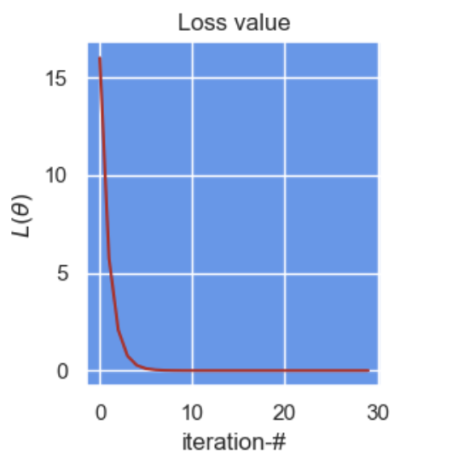
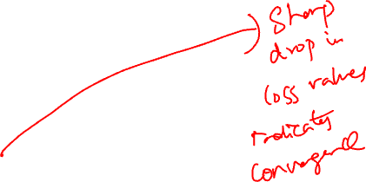
NOT ALWAYS POSSIBLE TO ANIMATE! So, plot loss value

Slide 28
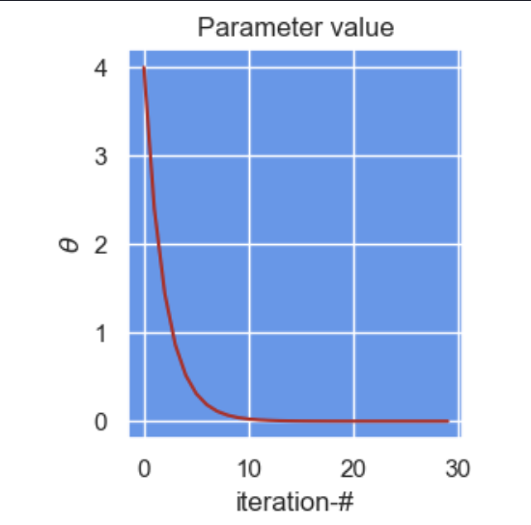
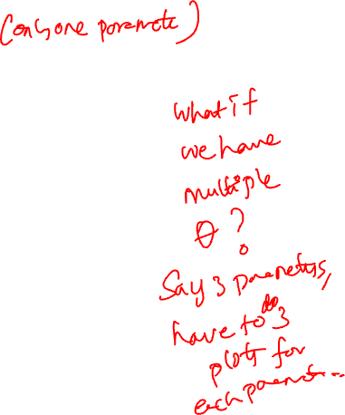
NOT ALWAYS POSSIBLE TO ANIMATE! So, plot parameter value

Slide 29
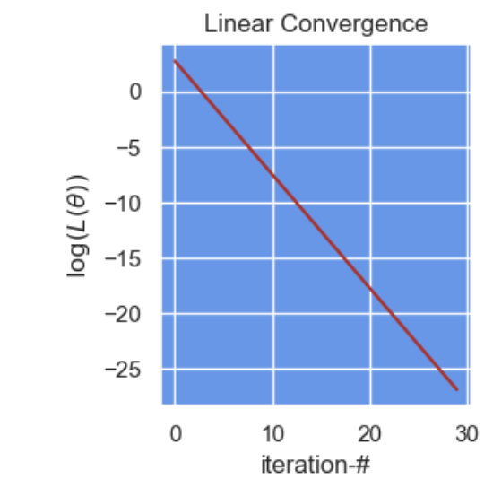

LINEAR CONVERGENCE WITH LOG-LOSS value

Slide 30



TOGETHER for $L\left(θ\right)=θ^{2}$

Slide 31
SOLVING LOGISTIC REGRESSION
Gradient Descent algorithm remains the same, we just have to calculate gradient

Slide 32



BINARY LOGISTIC REGRESSION with $f_{θ}\left(x_{i}\right)=θ^{⊤}x_{i}$
In logistic regression, the loss function to minimize is given by, $L\left(θ\right)=\sum_{i=1:y_{i}=1}^{n}{−log\left(\frac{\exp\left(f_{θ}\left(x_{i}\right)\right)}{1+\exp\left(f_{θ}\left(x_{i}\right)\right)}\right)+}\sum_{i=1:y_{i}=0}^{n}{−log\left(\frac{1}{1+\exp\left(f_{θ}\left(x_{i}\right)\right)}\right)}$ $=\sum_{i=1}^{n}{−y_{i}f_{θ}\left(x_{i}\right)}+\log\left(1+\exp\left(f_{θ}\left(x_{i}\right)\right)\right)$
So gradient of $L\left(θ\right)$wrt $θ$ is given by, $∇_{θ}L\left(θ\right)=\sum_{i=1}^{n}{\left[−y_{i}∇_{θ}f_{θ}\left(x_{i}\right)+\frac{\exp\left(f_{θ}\left(x_{i}\right)\right)}{1+\exp\left(f_{θ}\left(x_{i}\right)\right)}⋅∇_{θ}f_{θ}\left(x_{i}\right)\right]}$ $=$

Slide 33


Gradient Descent For Logistic Regression
Gradient Descent Algorithm: (($t$ is the iteration counter) )
Pick an initial point $θ_{0}$ (subscript here is $t$ which is equal to $0$initially)
Repeat (or Iterate or Update) $θ_{t+1}=θ_{t}−γ_{t}∇L\left(θ_{t}\right)$
where $γ_{t}$ is the learning rate at $t^{\text{th}}$ iteration (also called as step size)
Natural choice for learning rate: $γ_{t}≡γ$ (that is, a constant learning rate)
Constant learning rate will work, but have to be sufficiently small!

Slide 34

MULTICLASS LOGISTIC REGRESSION
Loss function for multiclass (i.e., $y$ can take more than 2 values, not binary) logistic regression with $K$ classes can be derived similarly
In this case, the loss function $L\left(θ\right)$to minimize becomes, $L\left(θ\right)=−\sum_{i=1}^{n}{\sum_{c=1}^{K}{δ_{c,y_{i}}\log\left({\hat{P}}_{θ}\left(Y=c|x_{i}\right)\right)}}$
where, $δ_{c,y_{i}}=\left\{\begin{aligned}1, \text{if} c=y_{i} \\ 0, \text{otherwise}\end{aligned}\right.$
So, if $y_{i}$ is one-hot (one label per data point as in our example before) encoded, then we get just one term per data point!

Slide 35
ACKNOWLEDGMENTS
These slides use materials by the Brian Ziebart

