Slide 1
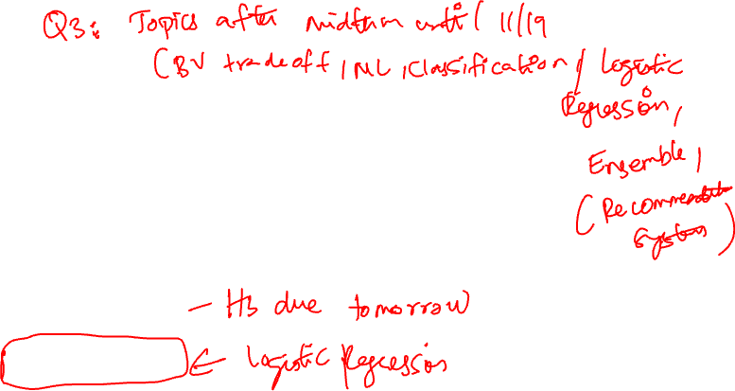
SOLVING LOGISTIC REGRESSION
See Jupyter notebook

Slide 2
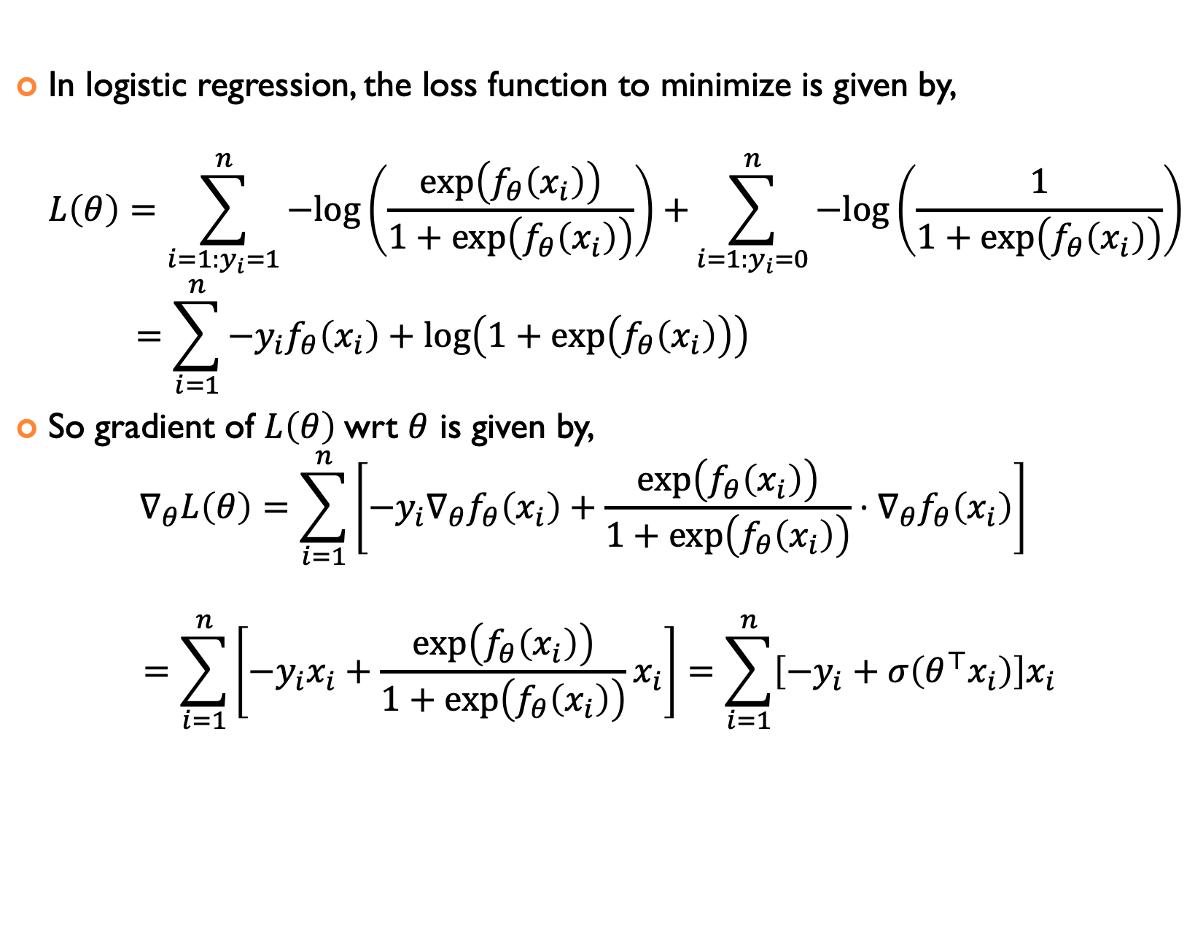

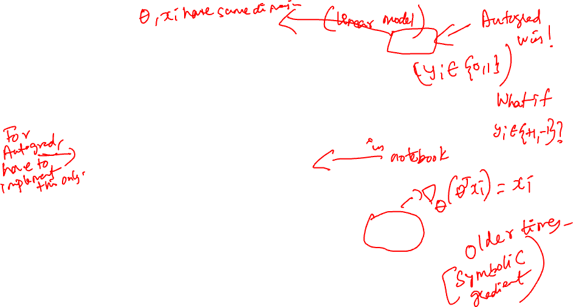
BINARY LOGISTIC REGRESSION with $f_{θ}\left(x_{i}\right)=θ^{⊤}x_{i}$
In logistic regression, the loss function to minimize is given by, $L\left(θ\right)=\sum_{i=1:y_{i}=1}^{n}{−log\left(\frac{\exp\left(f_{θ}\left(x_{i}\right)\right)}{1+\exp\left(f_{θ}\left(x_{i}\right)\right)}\right)+}\sum_{i=1:y_{i}=0}^{n}{−log\left(\frac{1}{1+\exp\left(f_{θ}\left(x_{i}\right)\right)}\right)}$ $=\sum_{i=1}^{n}{−y_{i}f_{θ}\left(x_{i}\right)}+\log\left(1+\exp\left(f_{θ}\left(x_{i}\right)\right)\right)$
So gradient of $L\left(θ\right)$wrt $θ$ is given by, $∇_{θ}L\left(θ\right)=\sum_{i=1}^{n}{\left[−y_{i}∇_{θ}f_{θ}\left(x_{i}\right)+\frac{\exp\left(f_{θ}\left(x_{i}\right)\right)}{1+\exp\left(f_{θ}\left(x_{i}\right)\right)}⋅∇_{θ}f_{θ}\left(x_{i}\right)\right]}$
$$=\sum_{i=1}^{n}{\left[−y_{i}x_{i}+\frac{\exp\left(f_{θ}\left(x_{i}\right)\right)}{1+\exp\left(f_{θ}\left(x_{i}\right)\right)}x_{i}\right]}=\sum_{i=1}^{n}{\left[−y_{i}+σ\left(θ^{⊤}x_{i}\right)\right]x_{i}}$$

Slide 3
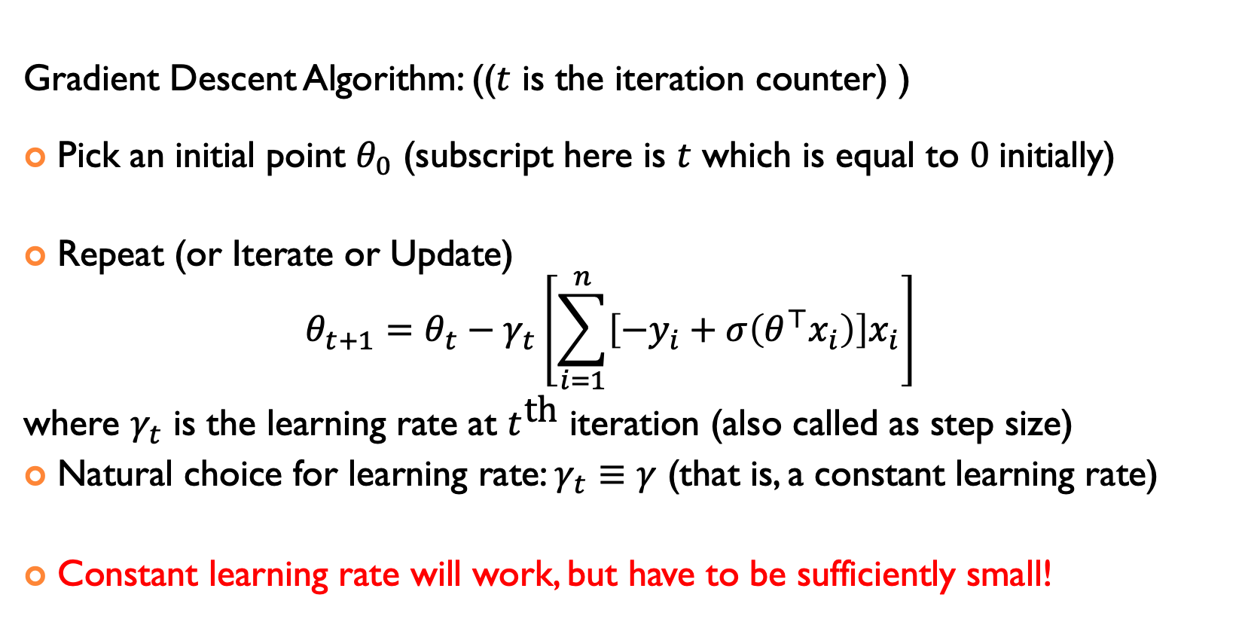
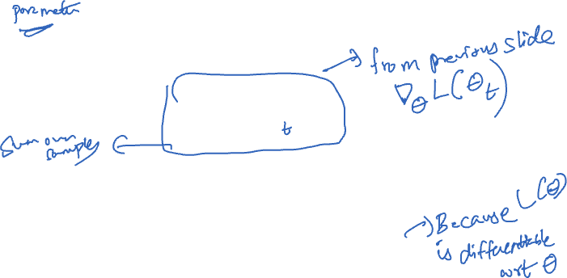
Gradient Descent For Logistic Regression
Gradient Descent Algorithm: (($t$ is the iteration counter) )
Pick an initial point $θ_{0}$ (subscript here is $t$ which is equal to $0$initially)
Repeat (or Iterate or Update) $θ_{t+1}=θ_{t}−γ_{t}\left[\sum_{i=1}^{n}{\left[−y_{i}+σ\left(θ^{⊤}x_{i}\right)\right]x_{i}}\right]$
where $γ_{t}$ is the learning rate at $t^{\text{th}}$ iteration (also called as step size)
Natural choice for learning rate: $γ_{t}≡γ$ (that is, a constant learning rate)
Constant learning rate will work, but have to be sufficiently small!

Slide 4
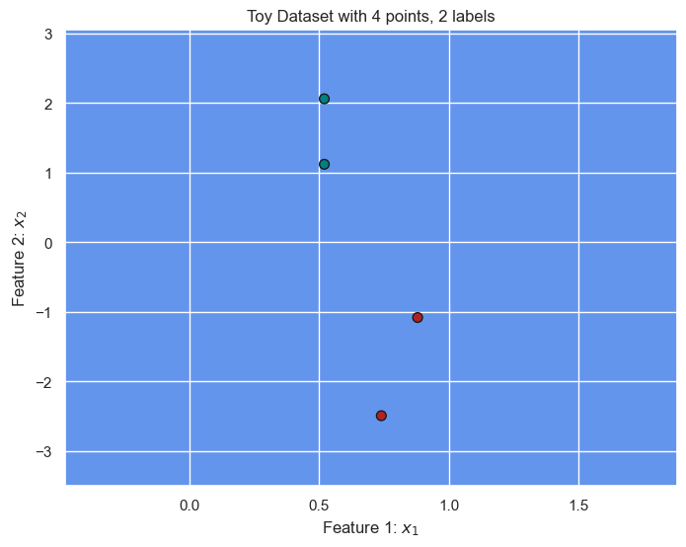


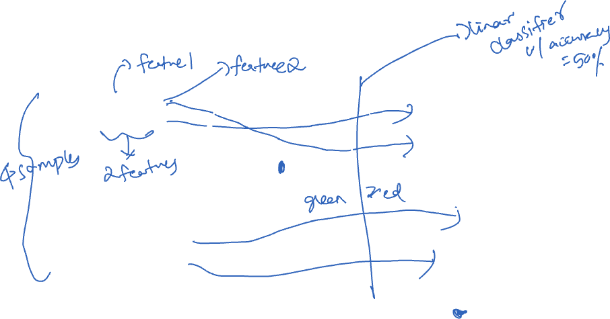
LET’S GO OVER AN EXAMPLE: $θ_{0}=[−1.0, 1.0]$
Green points are labeled as 0: $x_{1} = [0.52, 1.12]$, $x_{2} = [0.52, 2.06]$
Red points are labeled as 1: $x_{3} = [0.88, −1.08],$ $x_{4} = [0.74, −2.49]$

Slide 5
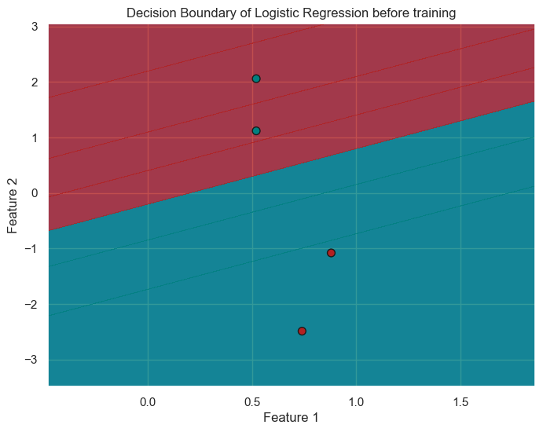

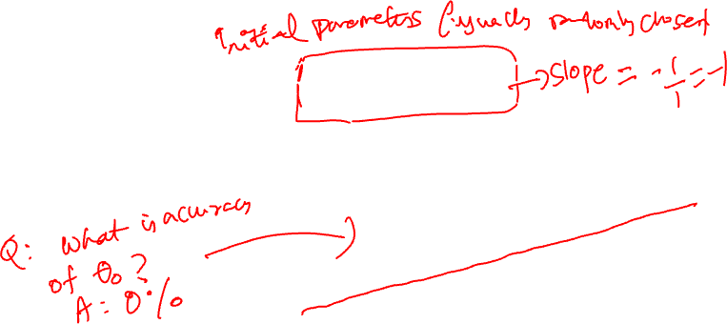
LET’S GO OVER AN EXAMPLE: $θ_{0}=[−1.0, 1.0]$
Green points are labeled as 0: $x_{1} = [0.52, 1.12]$, $x_{2} = [0.52, 2.06]$
Red points are labeled as 1: $x_{3} = [0.88, −1.08],$ $x_{4} = [0.74, −2.49]$

Slide 6
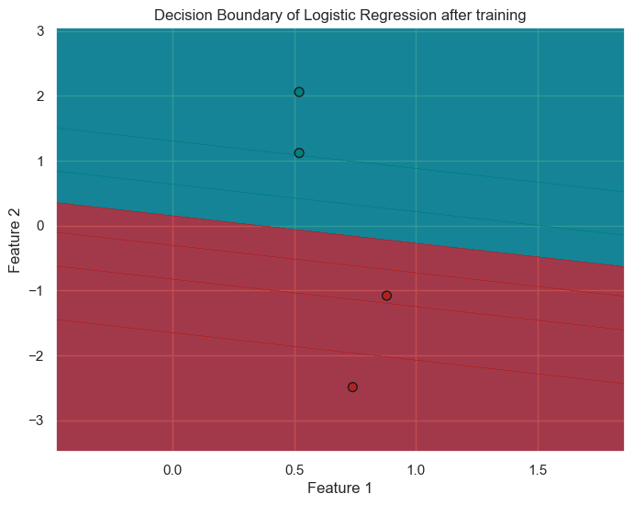

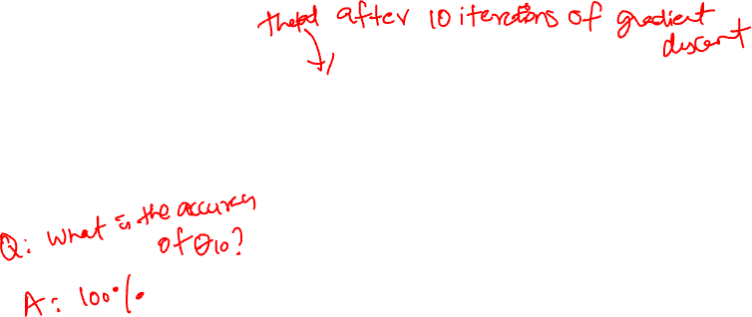
LET’S GO OVER AN EXAMPLE: $θ_{10}≈\text{[−0.56}\text{2, }\text{−1.330]}$
Green points are labeled as 0: $x_{1} = [0.52, 1.12]$, $x_{2} = [0.52, 2.06]$
Red points are labeled as 1: $x_{3} = [0.88, −1.08],$ $x_{4} = [0.74, −2.49]$

Slide 7
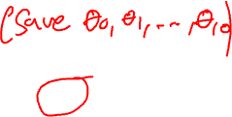
LET’S GO OVER AN EXAMPLE: Final Animation
Green points are labeled as 0: $x_{1} = [0.52, 1.12]$, $x_{2} = [0.52, 2.06]$
Red points are labeled as 1: $x_{3} = [0.88, −1.08],$ $x_{4} = [0.74, −2.49]$

Slide 8
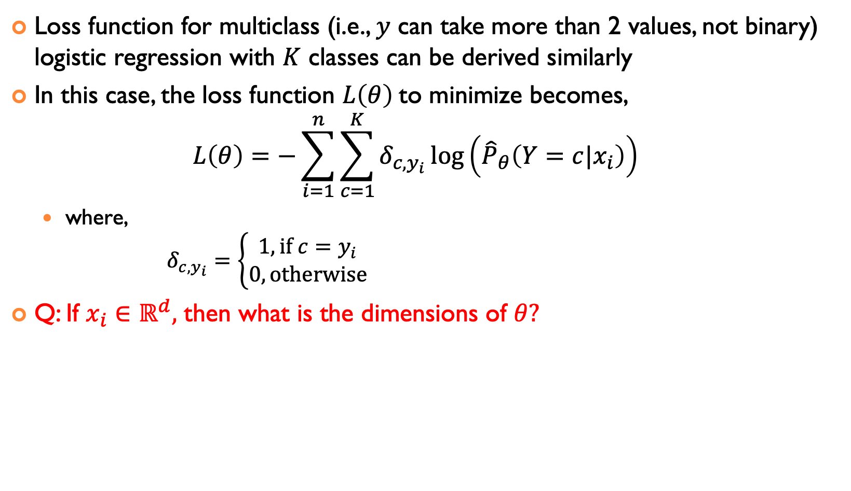
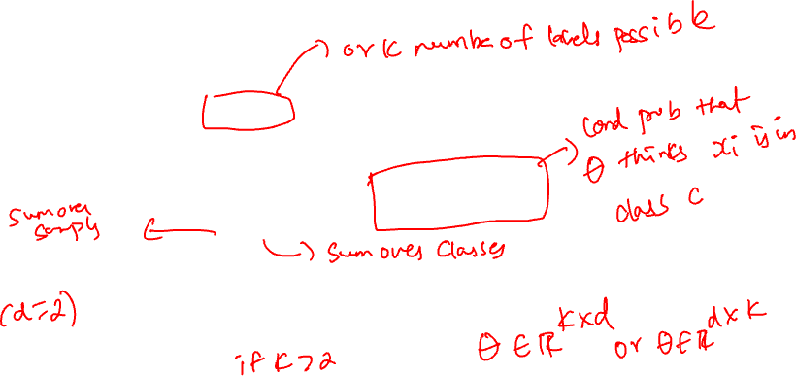
MULTICLASS LOGISTIC REGRESSION
Loss function for multiclass (i.e., $y$ can take more than 2 values, not binary) logistic regression with $K$ classes can be derived similarly
In this case, the loss function $L\left(θ\right)$to minimize becomes, $L\left(θ\right)=−\sum_{i=1}^{n}{\sum_{c=1}^{K}{δ_{c,y_{i}}\log\left({\hat{P}}_{θ}\left(Y=c|x_{i}\right)\right)}}$
where, $δ_{c,y_{i}}=\left\{\begin{aligned}1, \text{if} c=y_{i} \\ 0, \text{otherwise}\end{aligned}\right.$
Q: If $x_{i}∈ℝ^{d},$ then what is the dimensions of $θ?$

Slide 9
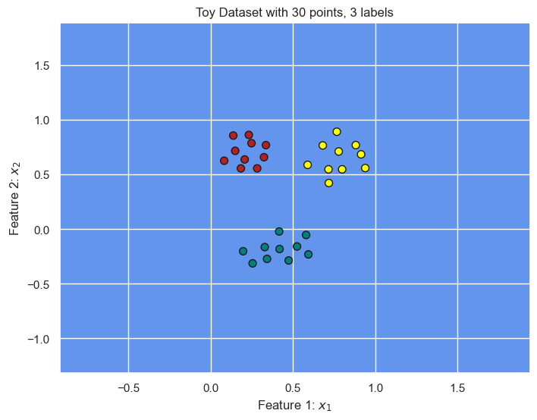


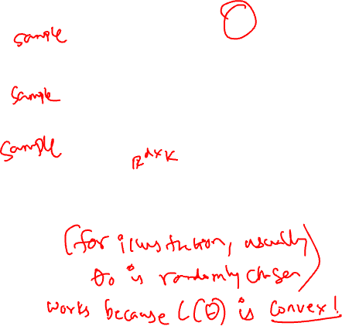
LET’S GO OVER AN EXAMPLE with $d=2, K=3$ (see jupyter notebook)
Red points are labeled as 0: $x_{1}= [0.1486, 0.7157]$
Yellow points are labeled as 1: $x_{2}= [0.7661, 0.8906]$
Green points are labeled as 2: $x_{3}= [0.4182, −0.1822]$
Then, $θ∈ℝ^{2×3}$ matrix
So say, $θ_{0}=\left[\begin{matrix}1 & 0.1 & 0.1 \\ 0 & 0.5 & 0.1\end{matrix}\right]$

Slide 10
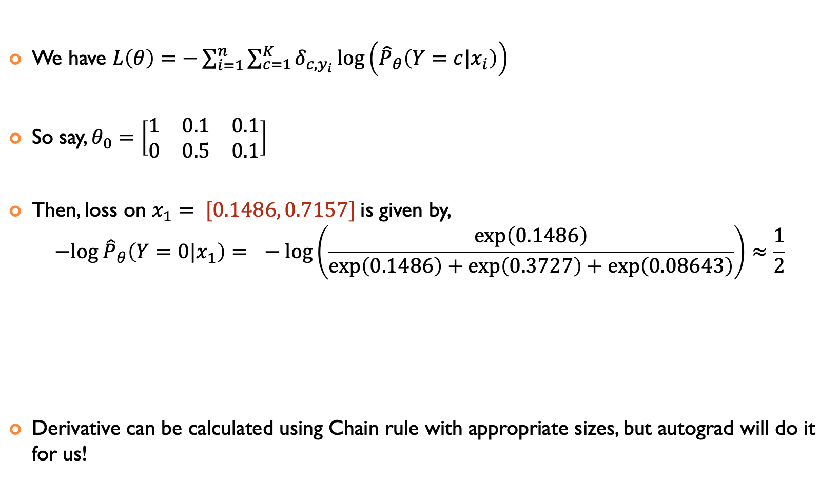

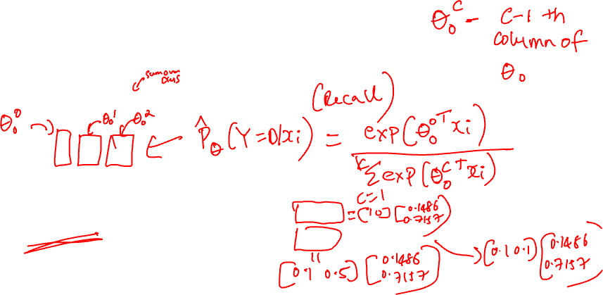
LET’S GO OVER AN EXAMPLE with $d=2, K=3$
We have $L\left(θ\right)=−\sum_{i=1}^{n}{\sum_{c=1}^{K}{δ_{c,y_{i}}\log\left({\hat{P}}_{θ}\left(Y=c|x_{i}\right)\right)}}$
So say, $θ_{0}=\left[\begin{matrix}1 & 0.1 & 0.1 \\ 0 & 0.5 & 0.1\end{matrix}\right]$
Then, loss on $x_{1}= [0.1486, 0.7157]$ is given by, $−log {\hat{P}}_{θ}\left(Y=0|x_{1}\right)= −log\left(\frac{\exp\left(0.1486\right)}{\exp\left(0.1486\right)+\exp\left(0.3727\right)+\exp\left(0.08643\right)}\right)≈\frac{1}{2}$
Derivative can be calculated using Chain rule with appropriate sizes, but autograd will do it for us!

Slide 11
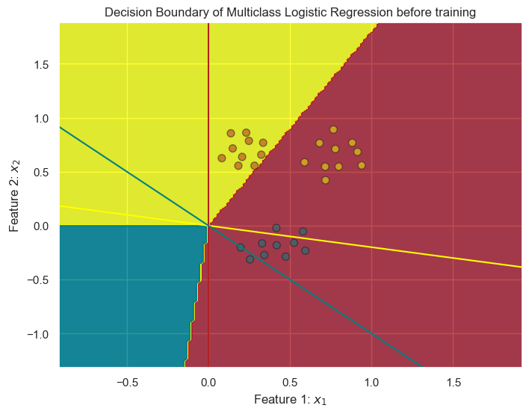

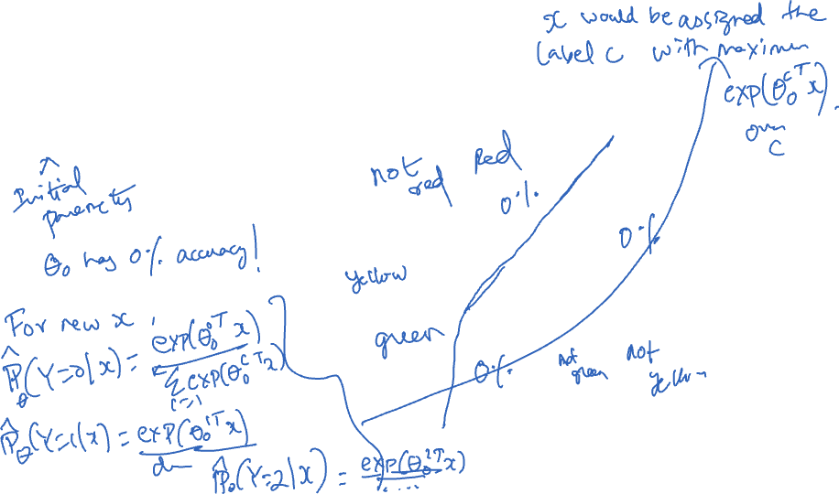
Decision Boundary in Multiclass Logistic Regression
$θ_{0}=\left[\begin{matrix}1 & 0.1 & 0.1 \\ 0 & 0.5 & 0.1\end{matrix}\right]$

Slide 12
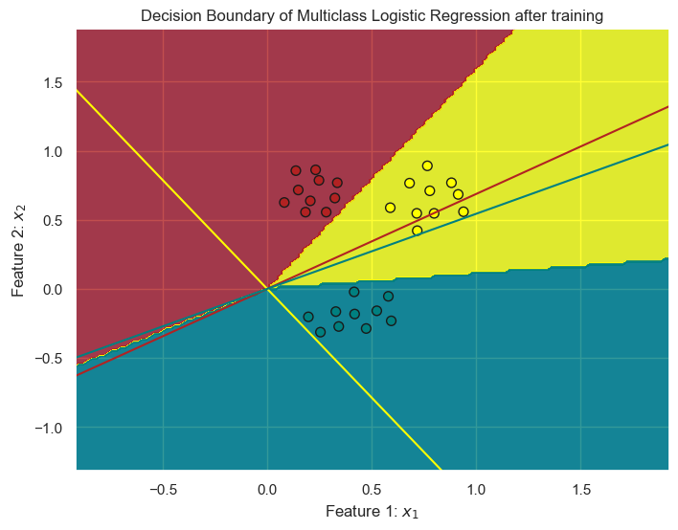

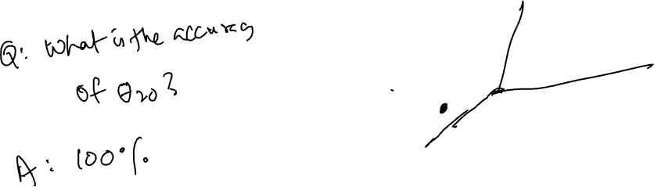
Decision Boundary in Multiclass Logistic Regression
$θ_{20}≈\left[\begin{matrix}−2.27 & 1.48 & 1.99 \\ 3.31 & 0.94 & −3.66\end{matrix}\right]$

Slide 13


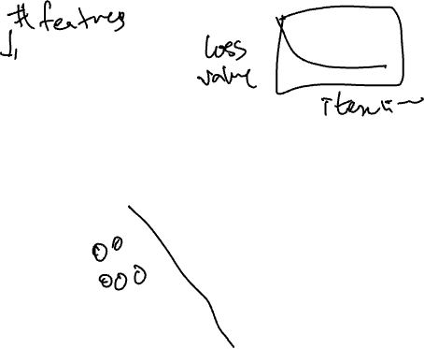
FINAL ANIMATION with $d=2, K=3$
Red points are labeled as 0: $x_{1}= [0.1486, 0.7157]$
Yellow points are labeled as 1: $x_{2} = [0.7661, 0.8906]$
Green points are labeled as 2: $x_{3}= [0.4182, −0.1822]$
Then, $θ∈ℝ^{2×3}$ matrix
$θ_{0}=\left[\begin{matrix}1 & 0.1 & 0.1 \\ 0 & 0.5 & 0.1\end{matrix}\right]$
$θ_{20}≈\left[\begin{matrix}−2.27 & 1.48 & 1.99 \\ 3.31 & 0.94 & −3.66\end{matrix}\right]$

Slide 14
PRACTICAL ISSUES: IMBALANCED DISTRIBUTIONS

Slide 15
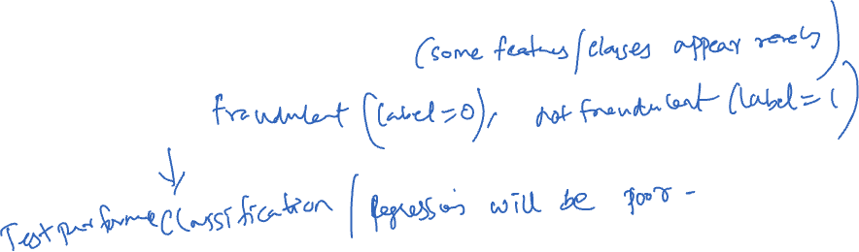
IMBALANCED DATA DISTRIBUTION
Sometimes training examples are drawn from an imbalanced distribution
This results in an imbalanced training set
“needle in a haystack” problem
E.g., find fraudulent transactions in credit card histories
Why is this a big problem for the ML algorithms we know?
Notes:
For 99% negative, predict always negative!不平衡分布
分类器：对少数类的分类效果非常差。
回归器：可能无法准确捕捉少数类别的特征。

Slide 16
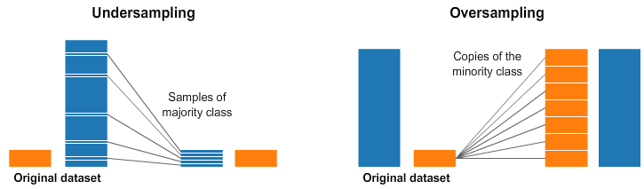
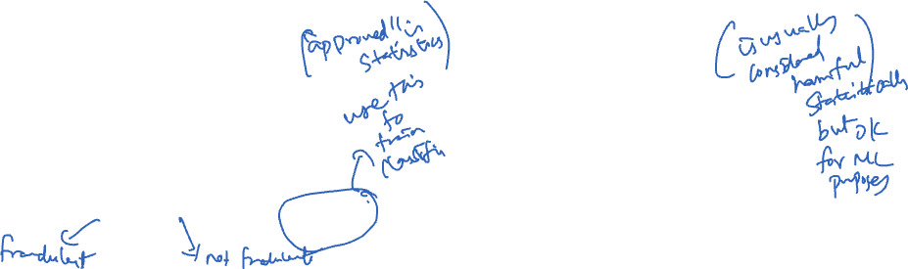
STRATEGIES FOR INDUCING A NEW BINARY DISTRIBUTION
Undersample the majority (overrepresented) class in the training data
Oversample the minority (underrepresented) class in the training data

Slide 17
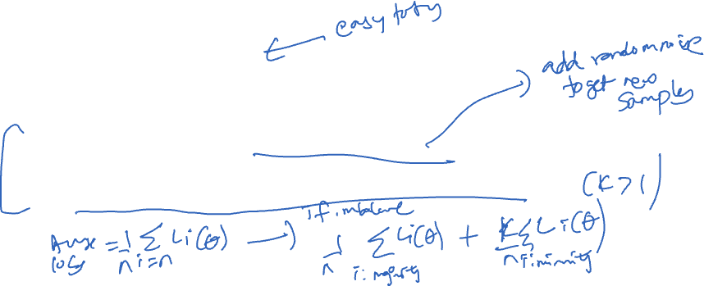
STRATEGIES FOR INDUCING A NEW BINARY DISTRIBUTION
Undersample the majority class
More computationally efficient
Oversample the minority class
Base binary classifier might do better with more training examples
Efficient implementations incorporate weight in algorithm, instead of explicitly duplicating data
By giving more weight to misclassifying the underrepresented class

Slide 18
PRACTICAL ISSUES: CLASS IMBALANCE
Notes:
Could present with ranking

Slide 19
PRACTICAL ISSUES: EVALUATION
So far we’ve measured classification performance using accuracy
But this is not a good metric when some errors matter more than others
Given medical record, predict whether patient has cancer or not
Given a document collection and a query, find documents in collection that are relevant to query
What to do if one class is more important than the other?

Slide 20
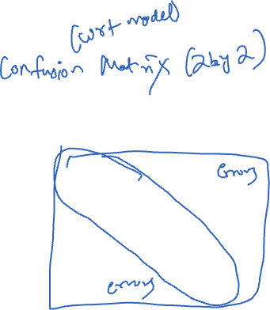
WHEN ONE CLASS IS MORE IMPORTANT
Imagine we are addressing a document retrieval task for a given query where +1 means that the document is relevant and -1 means that the document is not relevant
For any classifier results, we can categorize each document as
True/False Positive
True/False Negative
 | True label = +1 | True label = -1
Predicted label = +1 | True positives (TP) | False positives (FP)
Predicted label = -1 | False negatives (FN) | True negatives (TN)

Slide 21
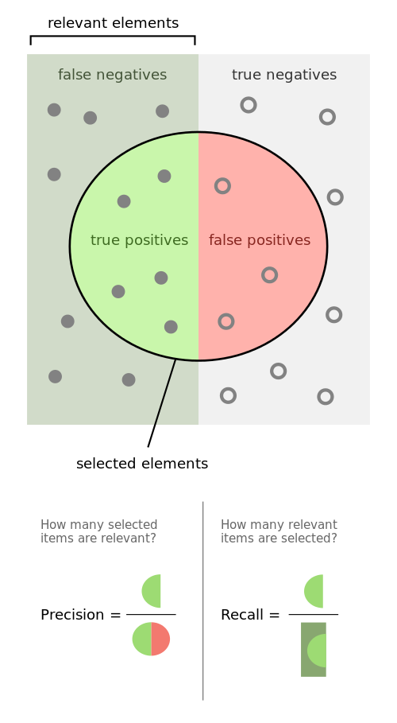
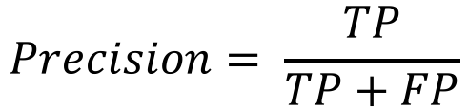
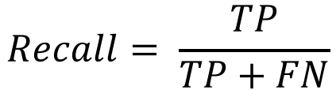
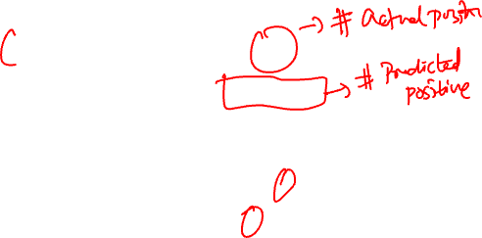
PRECISION/ RECALL
Precision: % positive predictions that are correct
Recall: % positive true labels that are predicted
Source: https://commons.wikimedia.org/wiki/File:Precisionrecall.svg
Notes:
FPR=FP/(FP+TN)
FNR=FN/(TP+FN)
Sensitivity = recall
Specificity = true negative rate = TN/(TN+FP)
False positive rate = 1-specificity

Slide 22
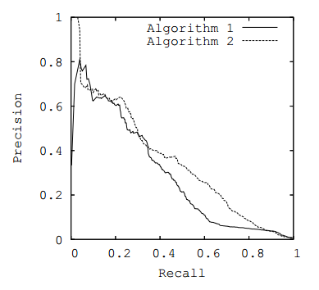
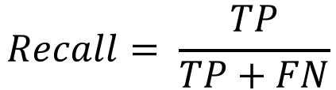
PRECISION/RECALL CURVE
Precision: % positive predictions that are correct
Recall: % positive true labels that are predicted
Different ranking cutoff thresholds lead to different precision-recall tradeoff

Slide 23
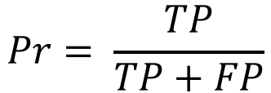
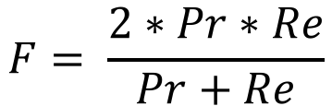
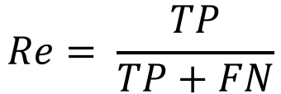
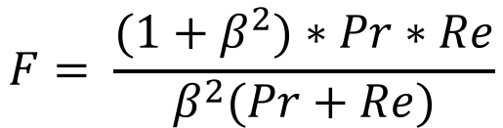
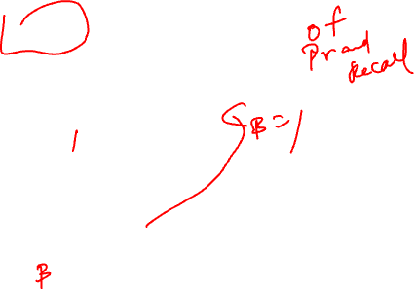
F-SCORE
Precision: % positive predictions that are correct
Recall: % positive true labels that are predicted
F-score: harmonic mean
Weighted f-score: if precision is more important than recall

Slide 24
ACKNOWLEDGMENTS
These slides use materials by the Brian Ziebart

