Slide 1
Data lifecycle
CS 418 Introduction to Data Science
Prof. Sathya Ravi
August 29, 2024

Slide 2


ANNOUNCEMENTS
Quiz 0 background survey out, please fill by the weekend so that it is easy to make necessary modifications in the course
Python tutorial is out. To open the ipynb file (Jupyter notebook), follow these instructions:
Install Anaconda package manager (using terminal)
Create an environment for CS 418 course
In terminal: Activate the environment, install jupyter notebook using “conda install jupyter”
In terminal: Launch jupyter GUI by executing “jupyter notebook”, this will open in a browser. Then find the notebook to open. If needed, cd to the folder containing the notebook and then launch jupyter.
In terminal: Install other python packages such as numpy by using “conda install numpy”
Optional: Install VS Code, and extensions to open Jupyter notebook. If you simply open the notebook with VS Code, it will prompt you to install. You can select the environment you created by clicking “Select Kernel” on top right. VS Code also can open terminal so you wouldn’t need a browser

Slide 3

IN SIMPLER TERMS
Note the two distinct entry points!
Ask a Question
Obtain Data
Understand the World
Understand the Data
Reports, Decisions, and Solutions

Slide 4

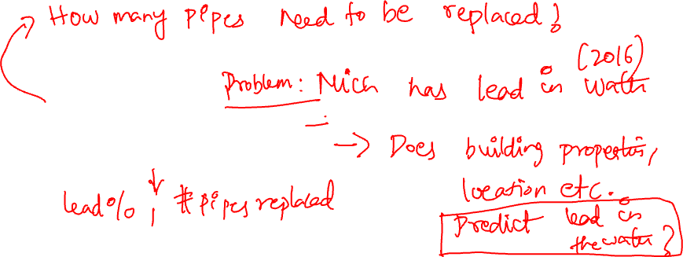
1. QUESTION / PROBLEM FORMULATION
What do we want to know?
What problems are we trying to solve?
What are the hypotheses we want to test?
What are our metrics for success?
Formulate Question or Problem

Slide 5
2. DATA ACQUISITION AND CLEANING
What data do we have and what data do we need?
How will we collect more data?
How do we organize the data for analysis?
You will typically acquire data in one of four ways:
Directly download a data file (or files)
Query data from a database – later in the course
Query an API (usually web-based, these days)
Scrape data from a webpage
The last two will be part of HW1
Acquire and Clean Data

Slide 6
3. EXPLORATORY DATA ANALYSIS AND VISUALIZATION
Do we already have relevant data?
What are the biases, anomalies, or other issues with our data?
How do we transform the data to enable effective analysis?
Exploratory Data Analysis
Exploratory data analysis (EDA): the process of discovering traits about our data that inform future analysis.

Slide 7

4. PREDICTIONS AND INFERENCE
What does the data say about the world?
Does it answer our questions or accurately solve the problem?
How robust are our conclusions and can we trust the predictions?
Draw Conclusions from Predictions and Inference
Reports, Decisions, and Solutions

Slide 8
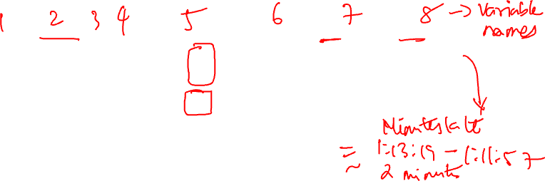
Case study: Why is my bus always late? (Chapter 5 in LDS)
Step 1 (Question formulation): Do bus arrival times give us additional information about the transit system?
Vague is OK at first!
Step 2 (Data acquisition and cleaning): Bus arrival times
The LDS book Chapter 5 contains the Python code to do this bus experience analysis
 | OPD_DATE | VEHICLE_ID | RTE | DIR | ... | STOP_ID | STOP_NAME | SCH_STOP_TM | ACT_STOP_TM
0 | 2016-03-26 | 6201 | 673 | S | ... | 431 | 3RD AVE & PIKE ST (431) | 01:11:57 | 01:13:19
1 | 2016-03-26 | 6201 | 673 | S | ... | 431 | 3RD AVE & PIKE ST (431) | 23:19:57 | 23:16:13
2 | 2016-03-26 | 6201 | 673 | S | ... | 578 | 3RD AVE & PIKE ST (431) | 21:19:57 | 21:18:46
clean

Slide 9

Case study: Why is my bus always late? (Chapter 5 in LDS)
Step 1 (Question formulation): Do bus arrival times give us additional information about the transit system?
Vague is OK at first!
Step 2 (Data acquisition and cleaning): Bus arrival times
The LDS book Chapter 5 contains the Python code to do this bus experience analysis
 | OPD_DATE | VEHICLE_ID | RTE | DIR | ... | direction | scheduled | actual | minutes_late
0 | 2016-03-26 | 6201 | 673 | S | ... | southbound | 2016-03-26 01:11:57 | 2016-03-26 01:13:19 | 1.37
1 | 2016-03-26 | 6201 | 673 | S | ... | southbound | 2016-03-26 23:19:57 | 2016-03-26 23:16:13 | -3.73
2 | 2016-03-26 | 6201 | 673 | S | ... | northbound | 2016-03-26 21:19:57 | 2016-03-26 21:18:46 | -1.18

Slide 10
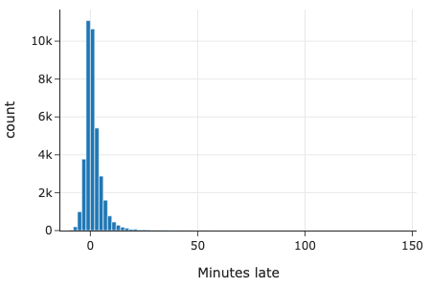
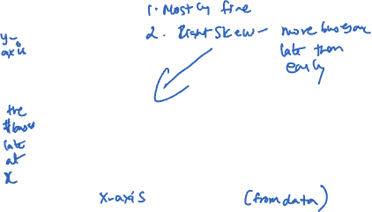
EXAMPLE (CONT’D)
Exploratory data analysis (EDA): the process of discovering traits about our data that inform future analysis.
Step 3 (Exploratory data analysis)
How many buses on Route 673?
39,157
How many buses per direction?
How many buses arrive late?
Not that interesting but helps diagnose scheduling level problems
Role | Number
Northbound | 19,686
Southbound | 19,471

Slide 11
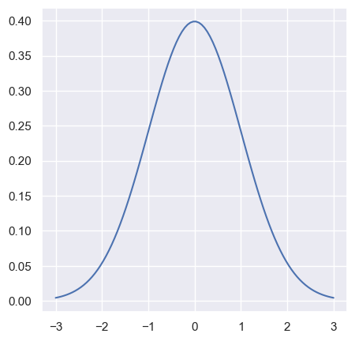
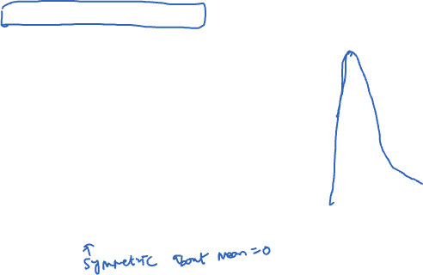
EXAMPLE (CONT’D)
Exploratory data analysis (EDA): the process of discovering traits about our data that inform future analysis.
How many buses arrive late?
Not that interesting but helps diagnose scheduling level problems
Step 3 (Exploratory data analysis)
Does the distribution of minutes late look like a Normal/Gaussian distribution?

Slide 12
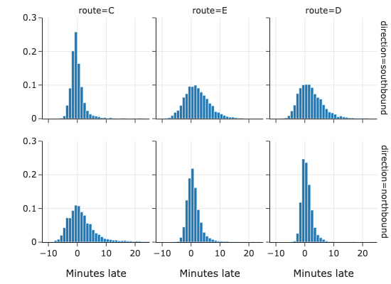
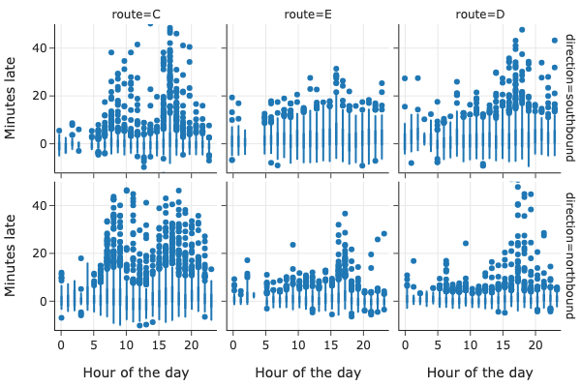
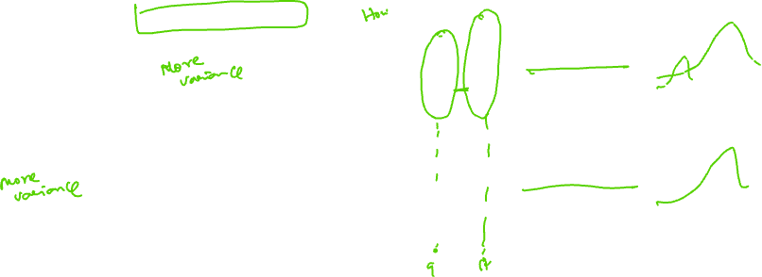
EXAMPLE (CONT’D)
Exploratory data analysis (EDA): the process of discovering traits about our data that inform future analysis.
How about other routes?
What is the effect of time of day?

Slide 13
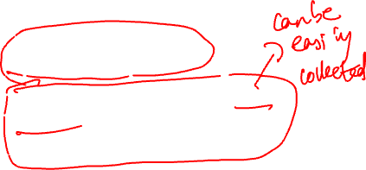
EXAMPLE (CONT’D)
Back to Step 1 (New question formulation): Do the bus arrival and scheduled times tell us anything about the customer experience in the route?
Step 2 (Data acquisition and cleaning)
Arrival Data
Passenger Arrival Times
Simulate the arrival of, say, five hundred people at the bus stop throughout the day.
In practice, ask customers to use app or report
 | OPD_DATE | VEHICLE_ID | RTE | DIR | ... | direction | scheduled | actual | minutes_late
0 | 2016-03-26 | 6201 | 673 | S | ... | southbound | 2016-03-26 01:11:57 | 2016-03-26 01:13:19 | 1.37
1 | 2016-03-26 | 6201 | 673 | S | ... | southbound | 2016-03-26 23:19:57 | 2016-03-26 23:16:13 | -3.73
2 | 2016-03-26 | 6201 | 673 | S | ... | northbound | 2016-03-26 21:19:57 | 2016-03-26 21:18:46 | -1.18

Slide 14
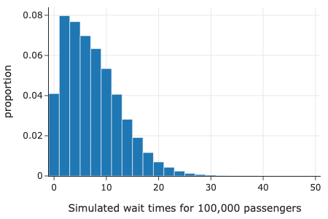
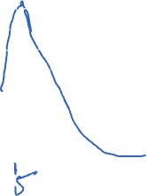
EXAMPLE (CONT’D)
Exploratory data analysis (EDA): the process of discovering traits about our data that inform future analysis.
If I leave now how long before I catch my bus?
Can do simple prediction based on counts!
Step 3 (Exploratory data analysis)
How long do customers wait for a bus on an average?
Wait time | >=5 mins | <=5 mins | All
Current time
08:00 | 50 | 150 | 200
08:30 | 90 | 110 | 200
09:00 | 120 | 80 | 200
… | … | … | …

Slide 15

EXAMPLE (CONT’D)
Step 4 (Draw conclusions)
What can we learn from the arrival time data?
There are about 40, 000 buses that arrived at a bus stop over 2 months.
Many buses arrive earlier than scheduled. This was not very interesting!
If we use the customer arrival data, what can we learn about our customers’ wait times?
Estimated to be about 6.49 minutes.
We also did some fun exploration of the time of day but didn’t actually ask or answer any questions about it.

Slide 16
PROVENANCE OF DATA
Provenance: “the place of origin of something”
In other words, where did the data come from? What are the data biases you should be aware of?

Slide 17
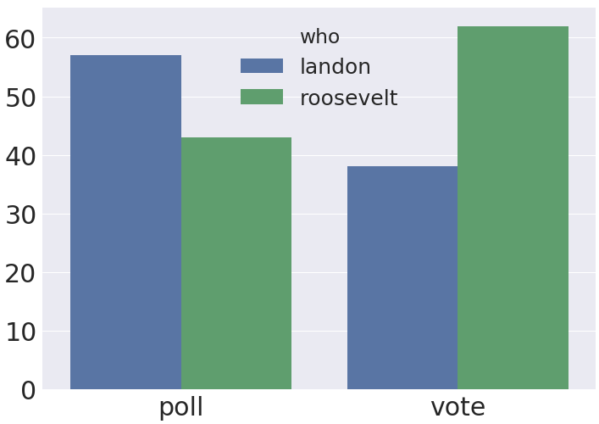
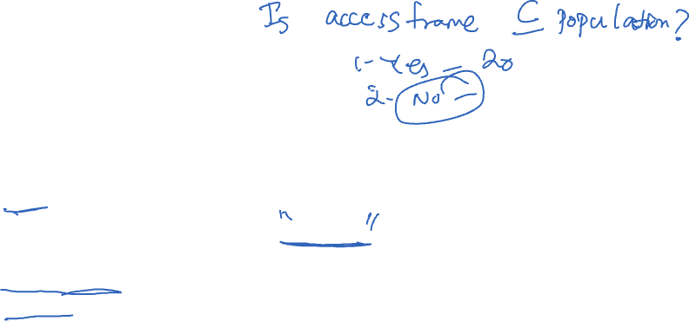
LITERARY DIGEST, 1936
The Literary Digest (popular magazine) polled and predicted correct candidate to win Presidential race in 1916, 1920, 1924, 1928, and 1932.
In 1936:
~40 million voters expected (target population)
Literary Digest sent out 10 million mock ballots (access frame), received back 2.4 million (sample)!
Prediction: Landon 57%, Roosevelt 43%
Actual result: Landon 38%, Roosevelt 62%.

Slide 18
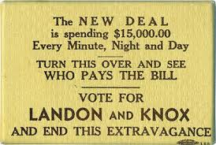
LITERARY DIGEST, 1936: WHAT HAPPENED?
What do you think?
The other side was a pocket mirror.

Slide 19
LITERARY DIGEST, 1936: WHAT HAPPENED?
A 1988 study* showed there were two major flaws:
The 10 million voters who received mock ballots were not representative of the electorate (coverage and selection bias)
Drawn from wealthier voters
The 2.4 million who responded were not representative of those who received mock ballots (non-response bias)
More passionate voters more likely to respond
The other side was a pocket mirror.
The fundamental problem: Poor data provenance. Big data ≠ good data.
*Source: https://www.jstor.org/stable/2749114?seq=1#page_scan_tab_contents

Slide 20
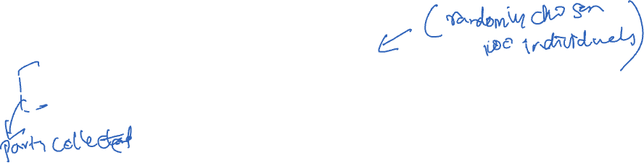
BIG DATA CANNOT REASONABLY COMPENSATE FOR SAMPLE BIAS
Meng 2014, “I Got More Data, My Model is More Refined, but My Estimator is Getting Worse! Am I Just Dumb?” *
Meng observed that given two choices:
A simple random sample (SRS) of 100 individuals.
An administrative dataset (AD) with a mild correlation between the thing you’re looking for and the probability of its being recorded
E.g., people in dataset more likely to vote for Landon than people not in dataset
The SRS can outperform ADs that include even 90% of the total population!
*Source: https://dash.harvard.edu/handle/1/10886849

Slide 21
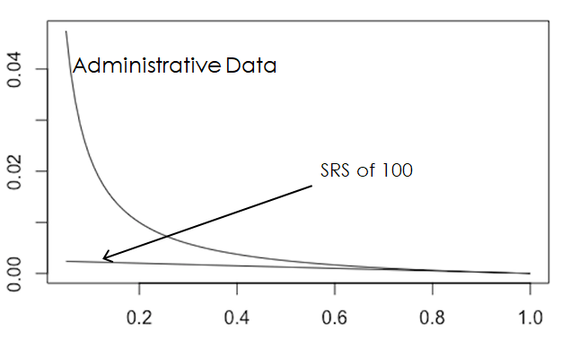
BIG DATA CANNOT REASONABLY COMPENSATE FOR SAMPLE BIAS
Error
Fraction of Population
Source: https://dash.harvard.edu/handle/1/10886849

Slide 22
DATASET TERMINOLOGY
Does the data form a census, defined as information on all subjects or is it a subset a.k.a. a sample?
Terms:
Census: Information on all subjects.
Subset or sample: Information on some subjects. The subset of subjects included in a sample can depend on many factors:
Self-selected sample: Subset is whoever chooses to answer
Convenience sample: Subset is whomever is convenient for researcher.
Judgment sample: Subset is whomever researcher deliberately selects.
Probability sample: Subset involves some probabilistic selection.
Administrative dataset: A dataset collected as part of administrative work (e.g. social security names, restaurant safety ratings, etc.)

