Slide 1
Data lifecycle (cntd) and Pandas
CS 418 Introduction to Data Science
Prof. Sathya Ravi
September 03, 2024

Slide 2

ANNOUNCEMENTS
Quiz 0 background survey – last day to fill the form. Link to setup your UIC Google Account: https://help.uillinois.edu/TDClient/37/uic/KB/ArticleDet?ID=627
Should have setup Python with jupyter notebook, pandas, matplotlib, and numpy packages
Homework 1 out – due on 09/19 (Thu). Please get started as soon as possible – at least make sure you are able to run the practice part in the notebook.
We will be using Autograder, but it is not setup yet but will be soon (by Thu), I will send a Piazza post once it is setup. There are some basic pen-paper questions on probability also which does not require Python but you may use if you wish to verify

Slide 3
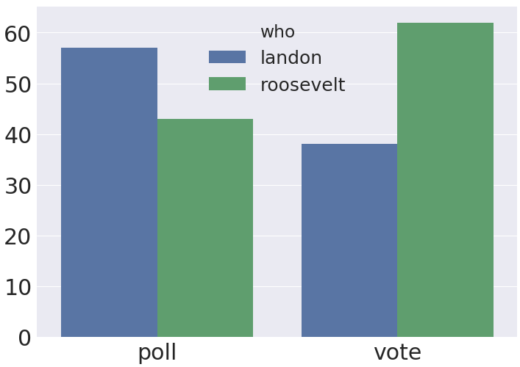
LITERARY DIGEST, 1936
The Literary Digest (popular magazine) polled and predicted correct candidate to win Presidential race in 1916, 1920, 1924, 1928, and 1932.
In 1936:
~40 million voters expected (target population)
Literary Digest sent out 10 million mock ballots (access frame), received back 2.4 million (sample)!
Prediction: Landon 57%, Roosevelt 43%
Actual result: Landon 38%, Roosevelt 62%.

Slide 4
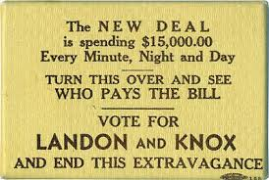
LITERARY DIGEST, 1936: WHAT HAPPENED?
A 1988 study* showed there were two major flaws:
The 10 million voters who received mock ballots were not representative of the electorate (coverage and selection bias)
Drawn from wealthier voters
The 2.4 million who responded were not representative of those who received mock ballots (non-response bias)
More passionate voters more likely to respond
The other side was a pocket mirror.
The fundamental problem: Poor data provenance. Big data ≠ good data.
*Source: https://www.jstor.org/stable/2749114?seq=1#page_scan_tab_contents

Slide 5
BIG DATA CANNOT REASONABLY COMPENSATE FOR SAMPLE BIAS
Meng 2014, “I Got More Data, My Model is More Refined, but My Estimator is Getting Worse! Am I Just Dumb?” *
Meng observed that given two choices:
A simple random sample (SRS) of 100 individuals.
An administrative dataset (AD) with a mild correlation between the thing you’re looking for and the probability of its being recorded
E.g., people in dataset more likely to vote for Landon than people not in dataset
The SRS can outperform ADs that include even 90% of the total population!
*Source: https://dash.harvard.edu/handle/1/10886849

Slide 6
DATASET TERMINOLOGY
Does the data form a census, defined as information on all subjects or is it a subset a.k.a. a sample?
Terms:
Census: Information on all subjects.
Subset or sample: Information on some subjects. The subset of subjects included in a sample can depend on many factors:
Self-selected sample: Subset is whoever chooses to answer
Convenience sample: Subset is whomever is convenient for researcher.
Judgment sample: Subset is whomever researcher deliberately selects.
Probability sample: Subset involves some probabilistic selection.
Administrative dataset: A dataset collected as part of administrative work (e.g. social security names, restaurant safety ratings, etc.)

Slide 7
PROBABILITY SAMPLING
When collecting data, probability sampling is a powerful tool
We will provide an overview of sampling techniques
We will just focus on sampling techniques for data collection
Won’t discuss advanced/proof techniques
However, let’s take a quick sneak peek at a few popular ways to sample

Slide 8
PROBABILITY SAMPLING: SIMPLE RANDOM SAMPLE (SRS)
A Simple Random Sample is a “sample drawn from a population at random without replacement.”
Chapter 3 in LDS has many nice examples, including election polls, so please read them
Example: Suppose we have 6 people named A, B, C, D, E, and F and we want to sample 2 of them.
15 possible samples of size 2 are: AB, AC, AD, AE, AF, BC, BD, BE, BF, CD, CE, CF, DE, DF, EF
If we have an SRS:
P(AB)=P(AC)=...P(EF) = 1/15
P(A) = 5/15 = 1/3

Slide 9
PROBABILITY SAMPLING: CLUSTER SAMPLING
An alternate approach is to divide population into clusters (or groups). We then use SRS to choose clusters instead of individuals. Example cluster: Everyone in a town.
Suppose we again have 6 people and want to sample 2 of them.
First we create clusters. I’ve chosen (A, B), (C, D), and (E, F) arbitrarily.
Then we use SRS to pick one cluster, e.g. (A, B).
 | SRS | Cluster Sampling
P(AB) | 1/15 | ???
P(AE) | 1/15 | ???
P(A) | 1/3 | ???

Slide 10
PROBABILITY SAMPLING: STRATIFIED SAMPLING
Yet another approach is to divide population into strata based on some characteristic (e.g., Graduate, Undergraduate). Then create one SRS per strata.
Suppose we again have 6 people and want to sample 2 of them.
First we create strata. Say stratas are given as {A, B, C, D} and {E, F}
Use SRS to pick one person from each strata.
 | SRS | Cluster Sampling | Stratified Sampling
P(AB) | 1/15 | 1/3 | ???
P(AE) | 1/15 | 0 | ???
P(A) | 1/3 | 1/3 | ???

Slide 11

ARE FIRST BORNS MORE LIKELY TO ATTEND HARVARD?
Harvard Philosopher Michael Sandel (among others) argues that birth order has a significant impact on work ethic and therefore life outcomes.
Asked in class what fraction of students were first born, and found that 75-80% were consistently first born! P(F | H) = 75 to 80%
F – first born (yes/no) H – attend Harvard (yes/no)
What’s going on?

Slide 12
STATS REVIEW
Random variable: function that maps event outcomes X to real values P(X)
E.g., number of children a mother has
Types of random variables:
Categorical/nominal/discrete, e.g., first-born {yes,no}
Real numbers, e.g., grade on midterm
Expected value of a categorical random variable: a predicted value of a variable, calculated as the sum of all possible values X each multiplied by the probability of its occurrence P(X).
E.g. Fertility rate, the average number of children mothers with college age children have
 | Number of Children
X | 1 | 2 | 3 | 4
P(X) | 21% | 43% | 23% | 13%
E(X) = 1*21% + 2*43% + 3*23% + 4*13% = 2.28

Slide 13
ARE FIRST BORNS MORE LIKELY TO ATTEND HARVARD?
Obvious question, what fraction of children are first born?
US Census Data for mothers with college age children is:
Percent first born:
P(F)=100/(21 + 43*2 + 23*3 + 13*4)=44%
Harvard Philosopher Michael Sandel (among others) argues that birth order has a significant impact on work ethic and therefore life outcomes.
Asked in class what fraction of students were first born, and found that 75-80% were consistently first born! P(F | H) = 75 to 80%
F – first born (yes/no) H – attend Harvard (yes/no)
What’s going on?
Number of Children
1 | 2 | 3 | 4
21% | 43% | 23% | 13%
Notes:
all 100% have one first born

Slide 14
INFORMAL EXPLANATION OF WHY SANDEL’S ARGUMENT IS INCONCLUSIVE
Measuring P(F | H) = 80% and comparing to national average of 44% is not sufficient to say that first born children have an advantage over siblings getting into Harvard. It also matters how many children Harvard mothers tend to have!
If Harvard mothers tend to have very few children, maybe it’s the greater fraction of first borns we’re seeing, not the advantages of being a first born.

Slide 15
AN ERRONEOUS ANALYSIS
A 2012 article* walks through the math regarding Sandel’s argument in great detail. Sandel measures P(F | H), but what he cares about is a different quantity.
Sandel wants to show that being a firstborn conveys an advantage over NOT being firstborn. In other words, he wants to show that r = P(H | F) / P(H | F^{c}) is greater than 1.
P(H | F): Probability of attending Harvard given you are firstborn.
P(H | F^{c}): Probability of attending Harvard given you are NOT firstborn.
Suppose r = 3: This means being firstborn makes you 3 times as likely to get into Harvard.
If r > 1, that implies being firstborn gives you some sort of “magic touch” (smarter? harder working? assisted by invisible demons?) that gets you into fancy schools.
*Source: https://rss.onlinelibrary.wiley.com/doi/epdf/10.1111/j.1740-9713.2012.00576.x

Slide 16
AN ERRONEOUS ANALYSIS
Sandel wants to show that being a firstborn gives you a “magic touch”. In other words, he wants to show that r = P(H | F) / P(H | F^{c}) is greater than 1.
P(H | F): Probability of getting into Harvard given you are firstborn.
P(H | F^{c}): Probability of getting into Harvard given you are NOT firstborn.
r > 1: Implies there exists some magic touch!
The quantity he is measuring in class is P(F | H) does not fully determine r!
Crucially: Relationship between r and P(F | H) is given by fertility rate of mothers λ.

Slide 17

MORE MATHEMATICALLY PRECISE VERSION OF SANDEL’S FLAW
In the 2012 article*, they give the exact relationship between r, P(F | H) and λ as:
Sandel measured that P(F | H) ~= 0.8, but if λ = 1.25, i.e. Harvard mothers have 1.25 kids on average, then r = 1 and thus there is no magic touch!
Are first born children more likely to take CS 418?
*Source: https://rss.onlinelibrary.wiley.com/doi/epdf/10.1111/j.1740-9713.2012.00576.x

Slide 18
SURVEY
Q2: Are you a firstborn?
Q1: Number of students whose mothers have:
1 kid
2 kids
3 kids
4 kids
5 kids
6 kids
7 kids
…
How many children on average does a mother have (lambda)?
Bonus question: Would it have been better, worse, or about the same if we had been able to ask your mom about her child count?
What percent are firstborn?

Slide 19
MORE MATHEMATICALLY PRECISE VERSION OF SANDEL’S FLAW
In the 2012 article*, they give the exact relationship between r, P(F | H) and λ as:
We measured that P(F | CS 418) ~= X.
Using your data (a =sample of CS 418 students), λ is Y
r = X/(1-X)*(Y-1) = ?
Issues with this?
We’re only looking at CS 418.
Self-selection bias
Bias from the fact that we’re oversampling from families of 2 or more
*Source: https://rss.onlinelibrary.wiley.com/doi/epdf/10.1111/j.1740-9713.2012.00576.x

Slide 20
CLASS PROJECT
How to come up with a good question/problem?
Ideally, it should be a question whose answer you are interested in
There are questions all around us that could be answered with data
For example, on NPR: Should Illinois increase the number of video gambling machines in the state?
pewresearch.org website has a lot of studies and reports

Slide 21


Slide 22
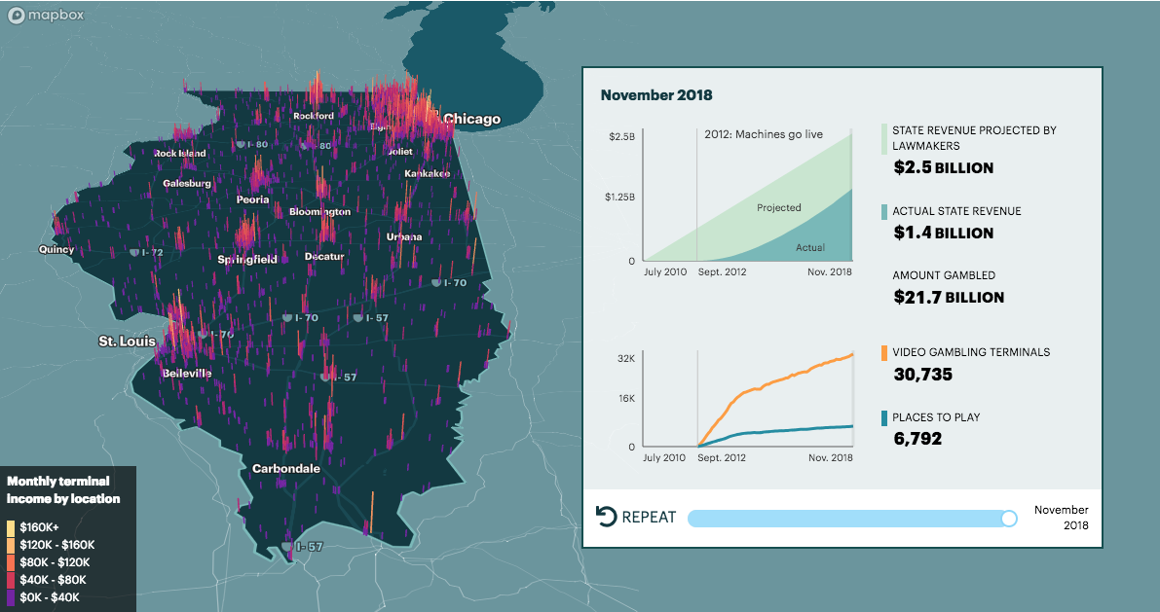
Link: https://features.propublica.org/the-bad-bet/how-illinois-bet-on-video-gambling-and-lost/

Slide 23
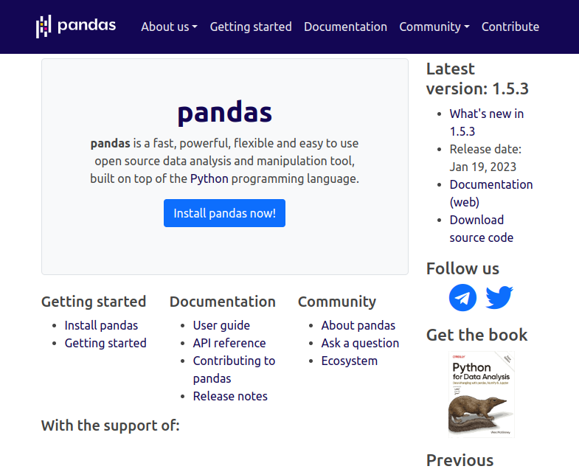
Rest of the lecture
DATA SCIENCE JOKE
Question: What do data scientists and zoo keepers have in common?
Answer: They both import pandas
Introduce Pandas: https://pandas.pydata.org/
Key data structures
Operations on the data structures, including aggregation operations
Solve some very basic data science problems using pandas

Slide 24
RECTANGULAR DATA
We prefer rectangular data for data analysis (why?)
Regular structures are easy to manipulate and analyze
A big part of data cleaning is about transforming data to be more rectangular
Some rectangular data representations you may be familiar with
Tables in Excel
Relations in Databases
Matrices (numpy.matrix)
Next: pandas.DataFrame
Fields/Attributes/ Features/Columns
Records/Rows

Slide 25
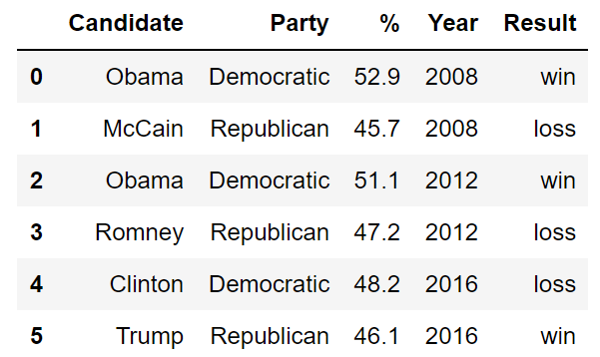
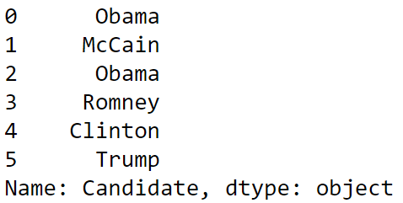
PANDAS DATA STRUCTURES
There are three fundamental data structures in pandas:
Data Frame: 2D data tabular data.
Series: 1D data (a column).
Index: A sequence of row labels.
Series
Data Frame
Index

Slide 26
SIMPLE ATTRIBUTES AND FUNCTIONS
head(): Displays only the top few rows.
describe(): Provides basic statistics of the data (dependent on data type).
size: Gives the total number of data points.
shape: Gives the size of the data in rows and columns.
index: Returns the index (a.k.a. row labels).
columns: Returns the labels for the columns

Slide 27
RELATIONSHIP BETWEEN DATA FRAMES, SERIES, AND INDICES
We can think of a Data Frame as a collection of Series that all share the same Index.
Candidate, Party, %, Year, and Result Series all share an index from 0 to 5.
%
Series
Year Series
Candidate Series
Party Series
Result Series

Slide 28
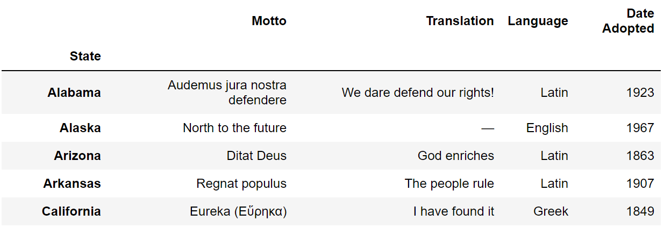
INDICES ARE NOT NECESSARILY ROW NUMBERS
Indices (a.k.a. row labels) can also:
Be non-numeric.
Have a name, e.g. “State”.

Slide 29
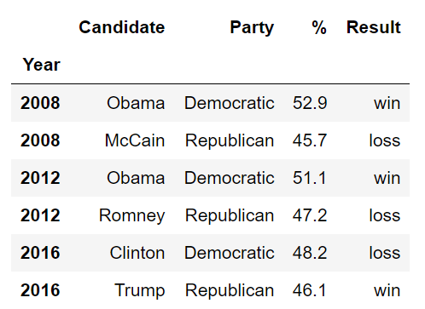
INDICES
The row labels that constitute an index do not have to be unique.
Left: The index values are all unique and numeric, acting as a row number.
Right: The index values are named and non-unique.

Slide 30
COLUMN NAMES MUST BE UNIQUE!
Column names in Pandas are always unique!
Example: Can’t have two columns named “Candidate”.

Slide 31
INDEXING WITH LOC AND ILOC
Notes:
“(Label) Location” and “integer location”

Slide 32
LOC AND ILOC
Loc and iloc are alternate ways to index into a DataFrame.
They take a bit of getting used to! I’ll go over common usages (see docs for weirder ones).
loc: https://pandas.pydata.org/pandas-docs/stable/reference/api/pandas.DataFrame.loc.html
iloc: https://pandas.pydata.org/pandas-docs/stable/reference/api/pandas.DataFrame.iloc.html
More general docs on indexing and selecting: https://pandas.pydata.org/pandas-docs/stable/user_guide/indexing.html
Loc does two things:
Access values by labels.
Access values using a boolean array (a la Boolean Array Selection).
Notes:
Documentation and ideas behind them are quite complex.

Slide 33
LOC WITH LISTS
The most basic use of loc is to provide a list of row and column labels, which returns a DataFrame.

Slide 34
LOC WITH SLICES
Loc is also commonly used with slices.
Slicing works with all label types, not just numeric labels.
Slices with loc are inclusive, not exclusive.

Slide 35
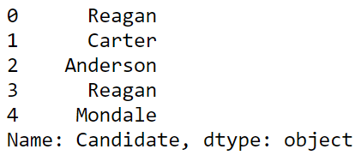
LOC WITH SINGLE VALUES FOR COLUMN LABEL
If we provide only a single label as column argument, we get a Series.

Slide 36
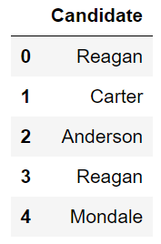
LOC WITH SINGLE VALUES FOR COLUMN LABEL
As before with the [] operator, if we provide a list of only one label as an argument, we get back a dataframe.

Slide 37
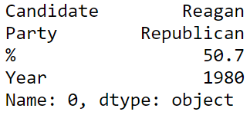

LOC WITH SINGLE VALUES FOR ROW LABEL
If we provide only a single row label, we get a Series.
Instead of the Series being one of the columns from the original data frame, it is a Series made up of the values from the requested row.
The index of this Series is the names of the columns from the data frame.
Putting the single row label in a list yields a dataframe version.

Slide 38


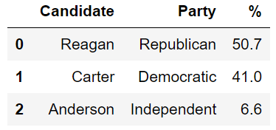
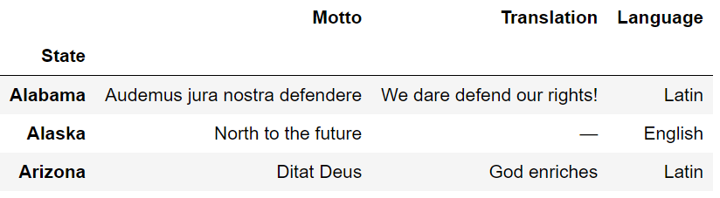
ILOC: INTEGER-BASED INDEXING FOR SELECTION BY POSITION
In contrast to loc, iloc doesn’t think about labels at all. Instead, it returns the items that appear in the numerical positions specified (slices are exclusive).
Advantages of loc over iloc:
Harder to make mistakes.
Easier to read code.
Not vulnerable to changes to the ordering of rows/cols in raw data files.
Nonetheless, iloc can be more convenient. Use iloc judiciously.

Slide 39
INDEXING WITH THE [] OPERATOR

Slide 40
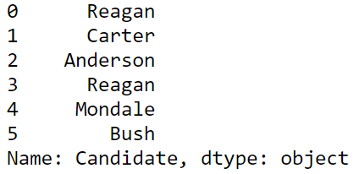
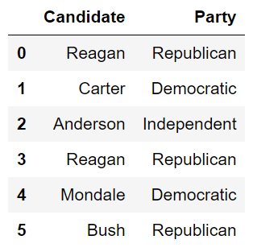
INDEXING BY COLUMN NAMES USING []
Given a dataframe, it is common to extract a Series or a collection of Series. This process is also known as “Column Selection” or sometimes “indexing by column”.
Column name argument to [] yields Series.
List argument to [] yields a Data Frame.
What about: ?
DataFrame. B. Series. C. Neither.
Notes:
A

Slide 41

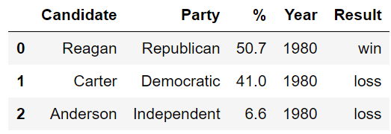
INDEXING BY ROW SLICES USING []
We can also index by row numbers using the [] operator.
Numeric slice argument to [] yields rows.
Example: [0:3] yields rows 0 to 2.

Slide 42
NOTE: ROW SELECTION REQUIRES SLICING!!
elections[0] will not work unless the elections data frame has a column whose name is the numeric zero.
Note: It is actually possible for columns to have names that are non-String types, e.g. numeric, datetime etc.

Slide 43
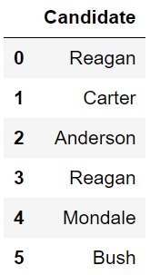
[] SUMMARY
Name
[]
Series
Single Column Selection
List
[]
DataFrame
Multiple Column Selection
Numeric Slice
[]
DataFrame
(Multiple) Row Selection

Slide 44
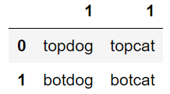
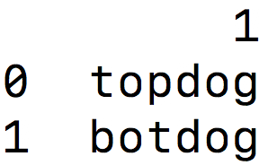
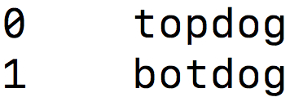
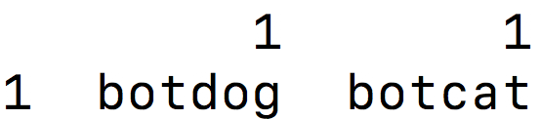
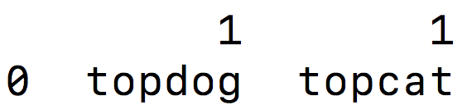
QUESTION 1
Try to predict the output of the following:
weird[1]
Name
[]
Series
Single Column Selection
List
[]
DataFrame
Multiple Column Selection
A.
B.
Numeric Slice
[]
DataFrame
(Multiple) Row Selection
C.
D.
Notes:
A

Slide 45
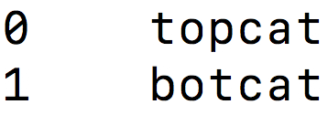
QUESTION 2
Try to predict the output of the following:
weird[“1”]
Name
[]
Series
Single Column Selection
List
[]
DataFrame
Multiple Column Selection
A.
B.
Numeric Slice
[]
DataFrame
(Multiple) Row Selection
C.
D.
Notes:
B

Slide 46
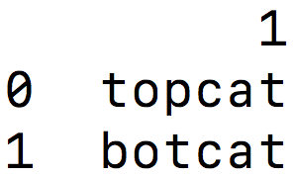
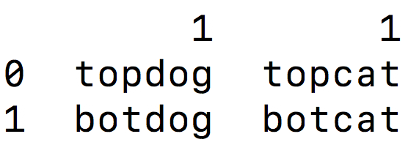
QUESTION 3
Try to predict the output of the following:
weird[1:]
Name
[]
Series
Single Column Selection
List
[]
DataFrame
Multiple Column Selection
A.
B.
Numeric Slice
[]
DataFrame
(Multiple) Row Selection
C.
D.
Notes:
C

Slide 47
BOOLEAN ARRAY SELECTION

Slide 48
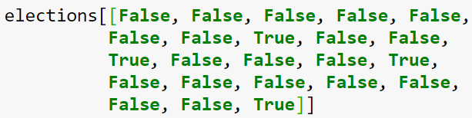
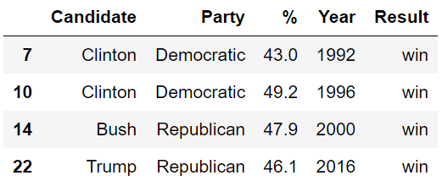

BOOLEAN ARRAY INPUT
Yet another input type supported by [] is the boolean array.

Slide 49
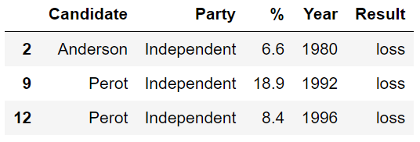
BOOLEAN ARRAY INPUT
Useful because boolean arrays can be generated by using logical operators on Series.
Length 23 Series where every entry is “Republican”, “Democrat” or “Independent.”
Length 23 Series where every entry is either “True” or “False”, where “True” occurs for every independent candidate.

Slide 50

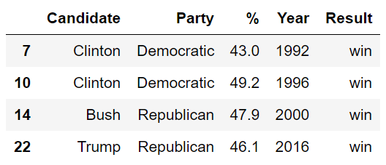
BOOLEAN ARRAY INPUT
Boolean Series can be combined using the & operator, allowing filtering of results by multiple criteria.

Slide 51
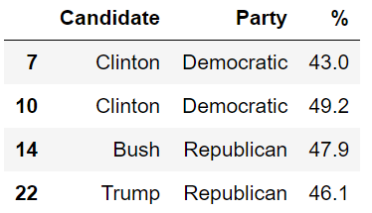
LOC SUPPORTS BOOLEAN ARRAYS
Loc supports Boolean Arrays exactly as you’d expect.

Slide 52
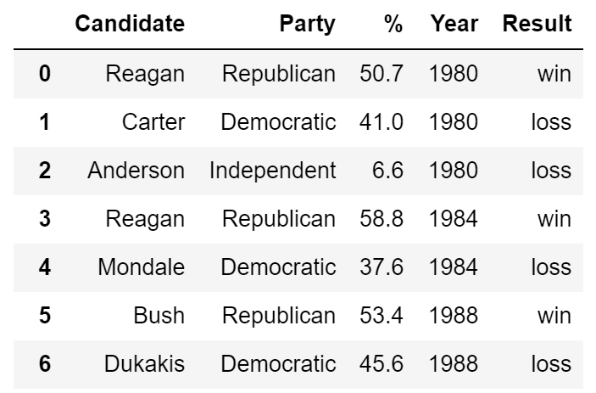
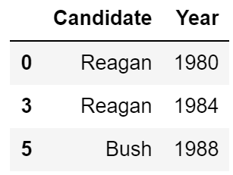
ANNOYING QUESTION CHALLENGE
Which of the following pandas statements returns a DataFrame of the first 3 Candidate names only for candidates that won with more than 50% of the vote?
elections2.iloc[[0, 3, 5], [0, 3]]
elections2.loc[[0, 3, 5], "Candidate":"Year"]
elections2.loc[elections2["%"] > 50, ["Candidate", "Year"]].head(3)
elections2.loc[elections2["%"] > 50, ["Candidate", "Year"]].iloc[0:2, :]

Slide 53
HANDY PROPERTIES AND UTILITY FUNCTIONS FOR SERIES AND DATAFRAMES

Slide 54
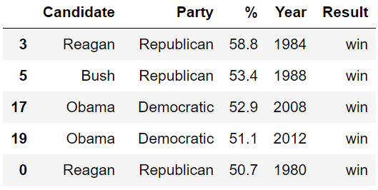
THE SORT_VALUES METHOD
One incredibly useful method for DataFrames is sort_values, which creates a copy of a DataFrame sorted by a specific column

Slide 55
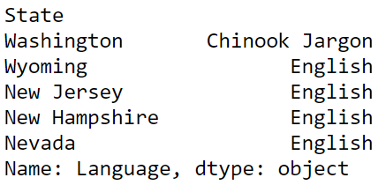
THE SORT_VALUES METHOD
We can also use sort_values on a Series, which returns a copy with the values in order.
Assuming mottos is a DataFrame, what
would happen if I run
mottos[[‘Language’]].sort_values()

Slide 56
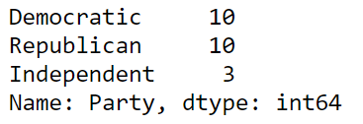
THE VALUE_COUNTS METHOD
Series also has the function value_counts, which creates a new Series showing the counts of every value.

Slide 57

THE UNIQUE METHOD
Another handy method for Series is unique, which returns all unique values as an array.

Slide 58

ISIN
We saw how to build boolean arrays for filtering, e.g.
If we have a list of valid items, e.g. “Republican” or “Democratic”, we could use the | operator (| means or), but a better way is to use isin.
Ugly:
Better:

Slide 59
GROUPBY
Often we want to perform aggregate analysis across data points that share some feature, for example:
What was the average share of the vote across all U.S. elections for each political party?
What was the size of the average class in each department at UIC in each term?
Which instructors taught the largest classes at UIC and how large were they?
groupby is an incredibly powerful tool for these sorts of questions.

Slide 60

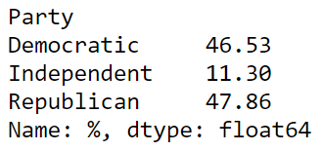
GROUPBY KEY CONCEPTS: SERIES
If we call groupby on a Series:
The resulting output is a SeriesGroupBy object.
The Series passed as arguments to groupby must share an index with the calling Series.
SeriesGroupBy objects can then be aggregated back into a Series using an aggregation method.
indices

Slide 61
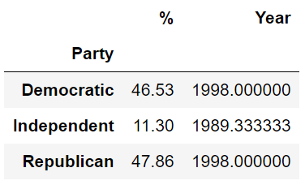
GROUPBY ON DATAFRAME
If we call groupby on a DataFrame, the resulting output is a DataFrameGroupBy object.
DataFrameGroupBy objects can then be aggregated back into a DataFrame or a Series using an aggregation method.

Slide 62
GROUPBY AND AGG
Most of the built-in handy aggregation methods are just shorthand for a universal aggregation method called agg.
Example, .mean() is just .agg(np.mean).

Slide 63
SERIES GROUPBY/AGG SUMMARY
groupby
.agg(f), where f = sum
A
3
A
3
A
1
B
1
A
2
C
4
B
1
A
1
A
6
B
5
B
5
B
12
B
6
C
9
C
13
A
2
C
4
D
5
D
5
C
9
B
6
D
5

Slide 64
DATAFRAME GROUPBY/AGG SUMMARY
groupby
.agg(f), where f = max
A
3
ak
A
3
ak
A
1
hi
B
1
tx
A
2
ca
C
4
fl
A
1
hi
B
1
tx
A
3
hi
B
5
mi
B
5
mi
B
6
tx
C
9
ak
B
6
nc
C
9
sd
A
2
ca
C
4
fl
C
5
sd
C
9
ak
B
6
nc
C
5
sd

Slide 65
ACKNOWLEDGMENTS
These slides use materials by the Berkeley DS 100 team

