Slide 1
Pandas and data wrangling
CS 418 Introduction to Data Science
Prof. Sathya Ravi
September 05, 2024

Slide 2

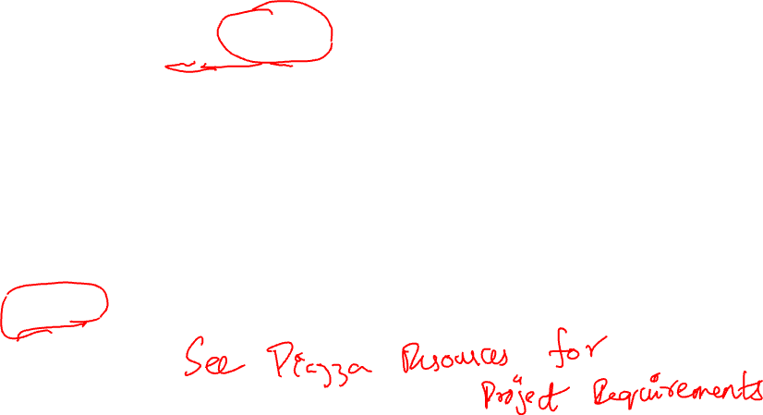
ANNOUNCEMENTS
Project Proposal due next Thu, Sep 12 Individual submission that means everybody has to submit. Worth 4% of project credit
You are encouraged to discuss with others but not necessary
One page Word or Markdown document with 4 short paragraphs (each 3-4 lines) containing:
Project name and motivation, other classmates (names, emails) that you have discussed the project,
Problem or Question,
Desired data to answer the question, possible data sources, how you plan to collect data, effort needed in data collection etc.,
Plausible approach, scope of the project, end result, techniques etc.
After this, you will be assigned a team with who you will finalize the team proposal (due on Tue, Oct 1). Worth 1% project credit

Slide 3

PROJECTS
Look to your left ←
Look to your right →
Those could be your project group members! (5 or 6 /group)
The type of data/questions I am interested in are…
Political, Civil, Finance, Sports, Twitter, Yelp, Geographic,
ChatGPT, Census, Recommendations, …

Slide 4

CLASS PROJECT: DATA
https://www.data.gov/
https://data.world/
https://datasetsearch.research.google.com/
https://github.com/awesomedata/awesome-public-datasets
https://www.pewresearch.org/download-datasets/
https://data.cityofchicago.org/
COVID-19 related datasets:
https://aylien.com/blog/free-coronavirus-news-dataset
https://research.usc.edu/coronavirus/covid19-resources/#datasets
https://github.com/echen102/COVID-19-TweetIDs

Slide 5



EXAMPLE QUESTIONS
Should companies adjust salaries for employees who choose to work remotely and move to cheaper areas?
Should Illinois increase the number of video gambling machines in the state?
Should elementary schools have moved to remote learning to avoid spread of COVID-19?

Slide 6
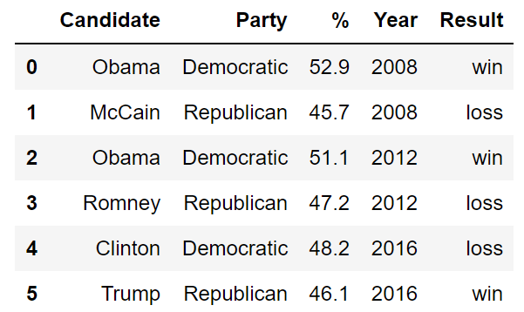
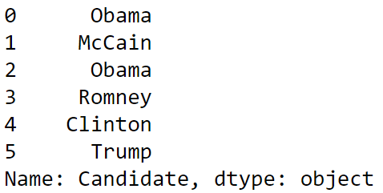

Reminder: PANDAS DATA STRUCTURES
There are three fundamental data structures in pandas:
Data Frame: 2D data tabular data.
Series: 1D data (a column).
Index: A sequence of row labels.
Data Frame
Series
Index

Slide 7
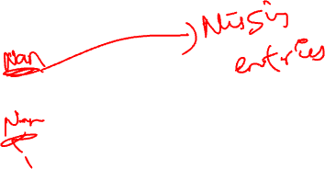
RELATIONSHIP BETWEEN DATA FRAMES, SERIES, AND INDICES
We can think of a Data Frame as a collection of Series that all share the same Index.
Candidate, Party, %, Year, and Result Series all share an index from 0 to 5.
%
Series
Year Series
Candidate Series
Party Series
Result Series

Slide 8
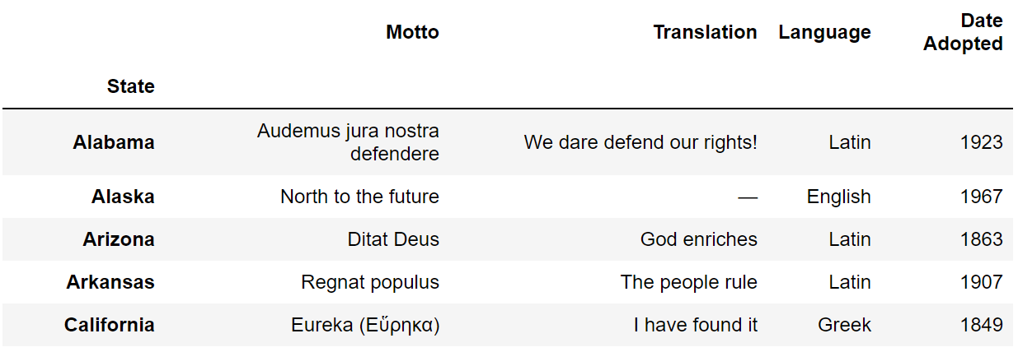

INDICES ARE NOT NECESSARILY ROW NUMBERS
Indices (a.k.a. row labels) can also:
Be non-numeric.
Have a name, e.g. “State”.

Slide 9
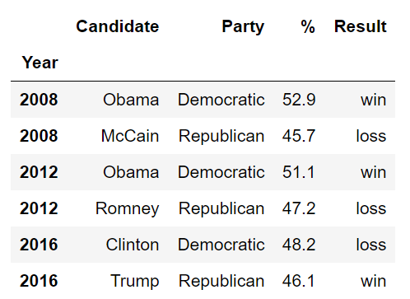
INDICES
The row labels that constitute an index do not have to be unique.
Left: The index values are all unique and numeric, acting as a row number.
Right: The index values are named and non-unique.

Slide 10
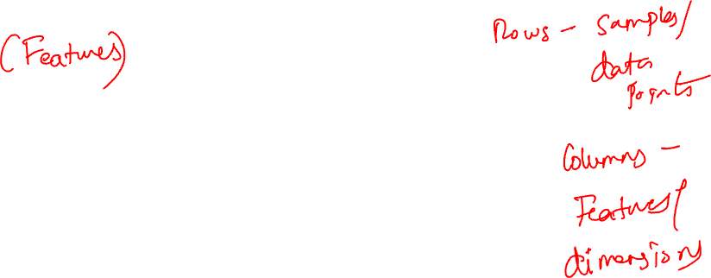
COLUMN NAMES MUST BE UNIQUE!
Column names in Pandas are always unique!
Example: Can’t have two columns named “Candidate”.

Slide 11
INDEXING WITH LOC AND ILOC
Notes:
“(Label) Location” and “integer location”

Slide 12

LOC AND ILOC
Loc and iloc are alternate ways to index into a DataFrame.
They take a bit of getting used to! I’ll go over common usages (see docs for weirder ones).
loc: https://pandas.pydata.org/pandas-docs/stable/reference/api/pandas.DataFrame.loc.html
iloc: https://pandas.pydata.org/pandas-docs/stable/reference/api/pandas.DataFrame.iloc.html
More general docs on indexing and selecting: https://pandas.pydata.org/pandas-docs/stable/user_guide/indexing.html
Loc does two things:
Access values by labels.
Access values using a boolean array (a la Boolean Array Selection).

Slide 13

LOC WITH LISTS
The most basic use of loc is to provide a list of row and column labels, which returns a DataFrame.

Slide 14
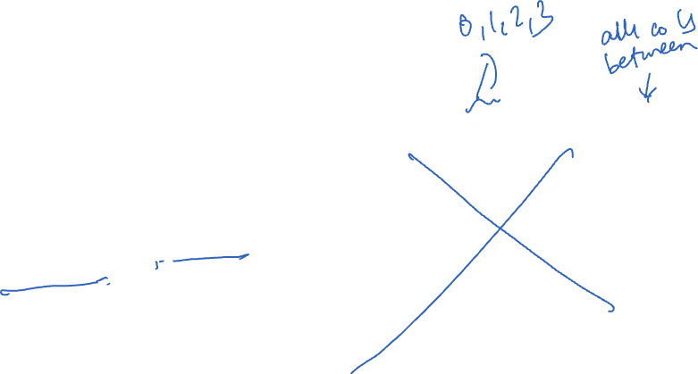
LOC WITH SLICES
Loc is also commonly used with slices.
Slicing works with all label types, not just numeric labels.
Slices with loc are inclusive, not exclusive.

Slide 15
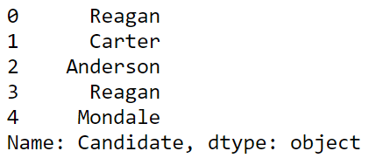
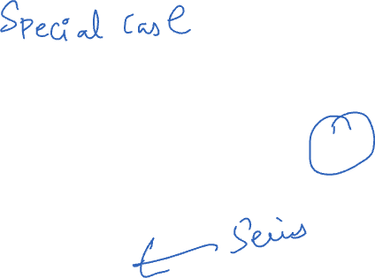
LOC WITH SINGLE VALUES FOR COLUMN LABEL
If we provide only a single label as column argument, we get a Series.

Slide 16
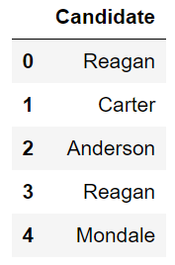
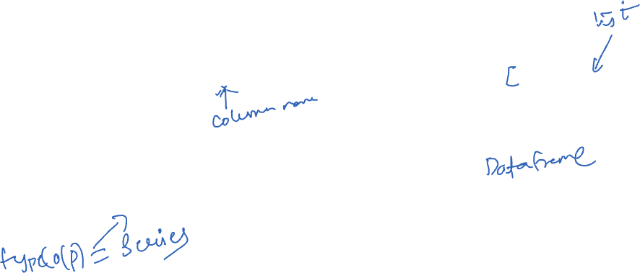
LOC WITH SINGLE VALUES FOR COLUMN LABEL
As before with the [] operator, if we provide a list of only one label as an argument, we get back a dataframe.

Slide 17
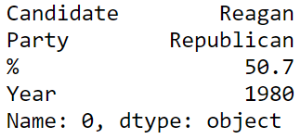


LOC WITH SINGLE VALUES FOR ROW LABEL
If we provide only a single row label, we get a Series.
Instead of the Series being one of the columns from the original data frame, it is a Series made up of the values from the requested row.
The index of this Series is the names of the columns from the data frame.
Putting the single row label in a list yields a dataframe version.

Slide 18


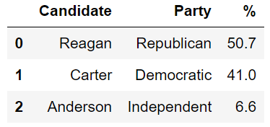
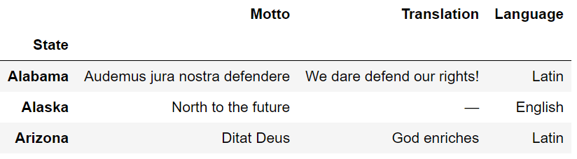
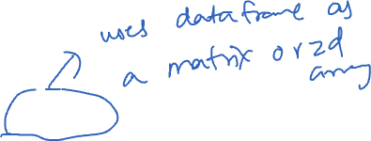
ILOC: INTEGER-BASED INDEXING FOR SELECTION BY POSITION
In contrast to loc, iloc doesn’t think about labels at all. Instead, it returns the items that appear in the numerical positions specified (slices are exclusive).
Advantages of loc over iloc:
Harder to make mistakes.
Easier to read code.
Not vulnerable to changes to the ordering of rows/cols in raw data files.
Nonetheless, iloc can be more convenient. Use iloc judiciously.

Slide 19
INDEXING WITH THE [] OPERATOR

Slide 20
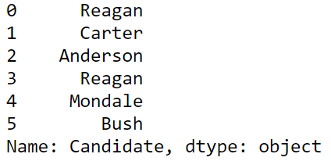
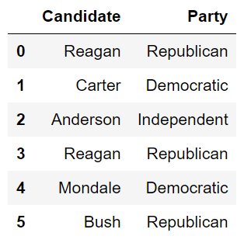

INDEXING BY COLUMN NAMES USING []
Given a dataframe, it is common to extract a Series or a collection of Series. This process is also known as “Column Selection” or sometimes “indexing by column”.
Column name argument to [] yields Series.
List argument to [] yields a Data Frame.
What about: ?
DataFrame. B. Series. C. Neither.

Slide 21

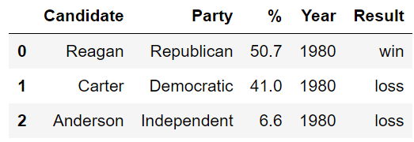
INDEXING BY ROW SLICES USING []
We can also index by row numbers using the [] operator.
Numeric slice argument to [] yields rows.
Example: [0:3] yields rows 0 to 2.

Slide 22

NOTE: ROW SELECTION REQUIRES SLICING!!
elections[0] will not work unless the elections data frame has a column whose name is the numeric zero.
Note: It is actually possible for columns to have names that are non-String types, e.g. numeric, datetime etc.

Slide 23
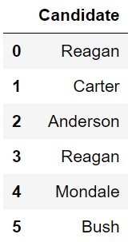
[] SUMMARY
Name
[]
Series
Single Column Selection
List
[]
DataFrame
Multiple Column Selection
Numeric Slice
[]
DataFrame
(Multiple) Row Selection

Slide 24
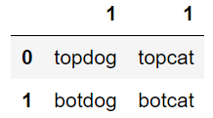
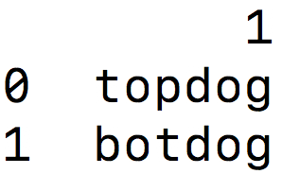
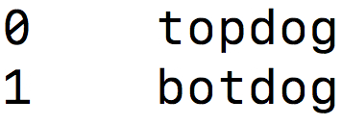
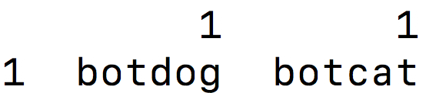
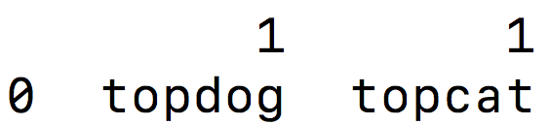
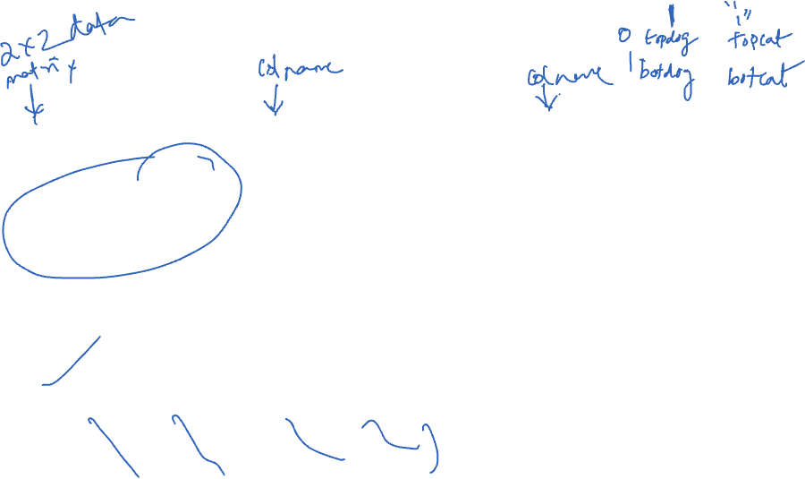
QUESTION 1
Try to predict the output of the following:
weird[1]
Name
[]
Series
Single Column Selection
List
[]
DataFrame
Multiple Column Selection
A.
B.
Numeric Slice
[]
DataFrame
(Multiple) Row Selection
C.
D.

Slide 25
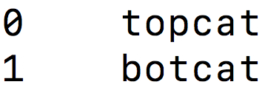

QUESTION 2
Try to predict the output of the following:
weird[“1”]
Name
[]
Series
Single Column Selection
List
[]
DataFrame
Multiple Column Selection
A.
B.
Numeric Slice
[]
DataFrame
(Multiple) Row Selection
C.
D.

Slide 26
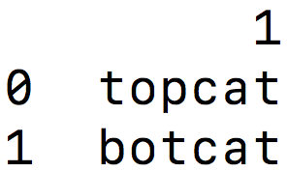
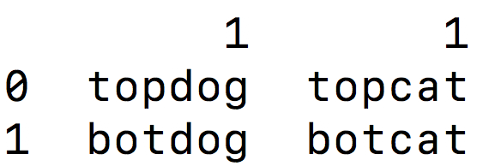

QUESTION 3
Try to predict the output of the following:
weird[1:]
Name
[]
Series
Single Column Selection
List
[]
DataFrame
Multiple Column Selection
A.
B.
Numeric Slice
[]
DataFrame
(Multiple) Row Selection
C.
D.

Slide 27
BOOLEAN ARRAY SELECTION

Slide 28
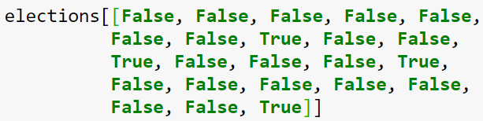
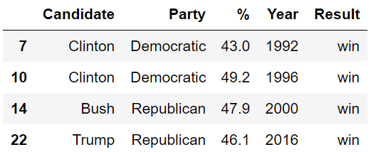

BOOLEAN ARRAY INPUT
Yet another input type supported by [] is the boolean array.

Slide 29
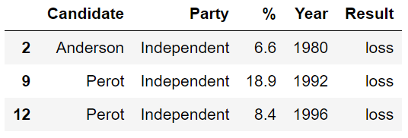
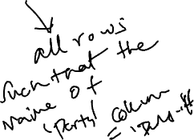
BOOLEAN ARRAY INPUT
Useful because boolean arrays can be generated by using logical operators on Series.
Length 23 Series where every entry is “Republican”, “Democrat” or “Independent.”
Length 23 Series where every entry is either “True” or “False”, where “True” occurs for every independent candidate.

Slide 30

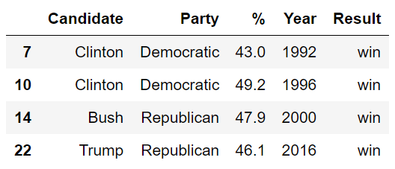
BOOLEAN ARRAY INPUT
Boolean Series can be combined using the & operator, allowing filtering of results by multiple criteria.

Slide 31
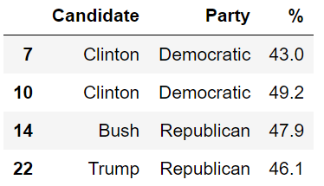
LOC SUPPORTS BOOLEAN ARRAYS
Loc supports Boolean Arrays exactly as you’d expect.

Slide 32
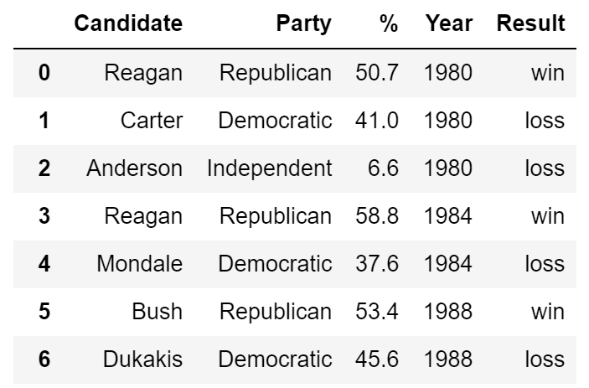
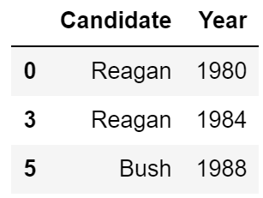

ANNOYING QUESTION CHALLENGE
Which of the following pandas statements returns a DataFrame of the first 3 Candidate names only for candidates that won with more than 50% of the vote?
elections2.iloc[[0, 3, 5], [0, 3]]
elections2.loc[[0, 3, 5], "Candidate":"Year"]
elections2.loc[elections2["%"] > 50, ["Candidate", "Year"]].head(3)
elections2.loc[elections2["%"] > 50, ["Candidate", "Year"]].iloc[0:2, :]

Slide 33
HANDY PROPERTIES AND UTILITY FUNCTIONS FOR SERIES AND DATAFRAMES

Slide 34
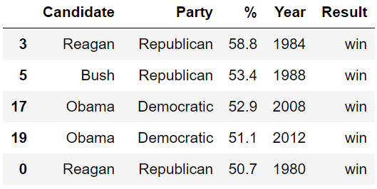

THE SORT_VALUES METHOD
One incredibly useful method for DataFrames is sort_values, which creates a copy of a DataFrame sorted by a specific column

Slide 35
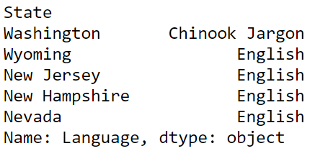
THE SORT_VALUES METHOD
We can also use sort_values on a Series, which returns a copy with the values in order.
Assuming mottos is a DataFrame, what
would happen if I run
mottos[[‘Language’]].sort_values()

Slide 36
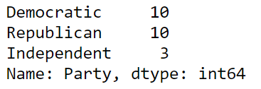

THE VALUE_COUNTS METHOD
Series also has the function value_counts, which creates a new Series showing the counts of every value.

Slide 37

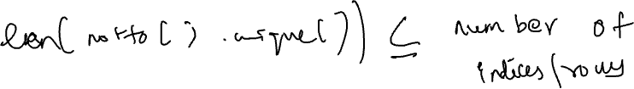
THE UNIQUE METHOD
Another handy method for Series is unique, which returns all unique values as an array.

Slide 38

ISIN
We saw how to build boolean arrays for filtering, e.g.
If we have a list of valid items, e.g. “Republican” or “Democratic”, we could use the | operator (| means or), but a better way is to use isin.
Ugly:
Better:

Slide 39

Now
Formulate Question or Problem
Acquire and Clean Data
Data acquisition
Data wrangling/cleaning
Structure
Data types
Granularity
Exploratory Data Analysis
Draw Conclusions
Reports, Decisions, and Solutions

Slide 40
DATA ACQUISITION AND CLEANING
What data do we have and what data do we need?
How will we collect more data?
How do we organize the data for analysis?
You will typically acquire data in one of four ways:
Directly download a data file (or files) manually (HW2)
Query data from a database – later in the course
Query an API (usually web-based, these days)
Scrape data from a webpage using HTTP requests
The last two are the topic of HW1
Acquire and Clean Data

Slide 41
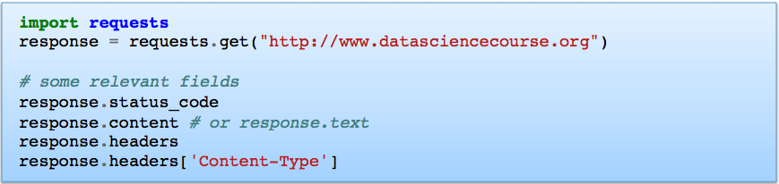
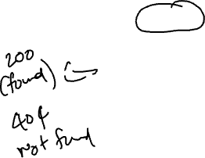
ISSUING HTTP QUERIES
One way to acquire data is through HTTP requests
You can implement your own HTTP client but it’s unnecessary
Requests library is an HTTP library for Python, an HTTP client interface
http://docs.python-requests.org/
(“https://www.yelp.com/biz/the-jibarito-stop-chicago-2”)
Notes:
200- found
404- not found
Headers contains meta data such as domain, encoding, etc

Slide 42
RESPONSE.HEADERS
>>> response.headers
{'Connection': 'keep-alive', 'content-type': 'text/html; charset=UTF-8', 'set-cookie': 'pid=; Domain=.yelp.com; Max-Age=0; Path=/; expires=Wed, 31-Dec-97 23:59:59 GMT, bse=720d7ce5c8aa48ddb8ec6e540a04c86a; Domain=.yelp.com; Path=/; HttpOnly, hl=en_US; Domain=.yelp.com; Max-Age=630720000; Path=/; expires=Wed, 15-Jan-2042 15:52:09 GMT, wdi=1|BC950BD9E27FA84F|0x1.87a614983bbc3p+30|6c114782f31bd6de; Domain=.yelp.com; Path=/; Max-Age=630720000; Expires=Wed, 15 Jan 2042 15:52:09 GMT; HttpOnly; SameSite=Lax', 'x-routing-service': 'routing-main--useast1-77b688657c-sq72d; site=www', 'x-node': 'www_all, yelp-main-main--useast1-595654bc94-dv67w', 'x-zipkin-id': 'eafd558baa129697', 'x-b3-sampled': '0', 'referrer-policy': 'origin-when-cross-origin', 'strict-transport-security': 'max-age=31536000; includeSubDomains; preload', 'x-xss-protection': '1; report=https://www.yelp.com/xss_protection_report', 'x-content-type-options': 'nosniff', 'server': 'envoy', 'x-cloudmap': 'routing_useast1', 'x-mode': 'ro', 'x-proxied': '10-65-91-109-useast1aprod', 'content-encoding': 'gzip', 'x-extlb': '10-65-91-109-useast1aprod', 'cache-control': 'max-age=0, no-store, private, no-transform', 'Accept-Ranges': 'bytes', 'Date': 'Thu, 20 Jan 2022 15:52:09 GMT', 'Via': '1.1 varnish', 'X-Served-By': 'cache-chi21140-CHI', 'X-Cache': 'MISS', 'X-Cache-Hits': '0', 'X-Timer': 'S1642693926.047126,VS0,VE3375', 'Vary': 'Accept-Encoding', 'transfer-encoding': 'chunked'}

Slide 43
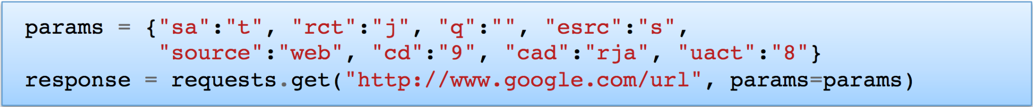
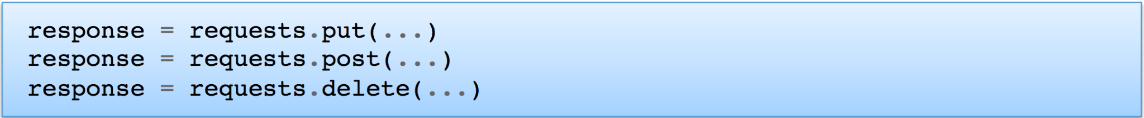
HTTP REQUEST BASICS
You’ve seen URLs like these: https://www.google.com/url?sa=t&rct=j&q=&esrc=s&source=web&cd=9&cad=rja&uact=8…
The weird statements after the url are parameters, you would provide them using the requests library like this:
HTTP GET is the most common method, but there are also PUT, POST, DELETE methods that change some state on the server

Slide 44
REST API
If you move beyond just querying web pages to web APIs, you’ll most likely encounter REST APIs (Representational State Transfer)
REST is more of a design architecture, but a few key points:
Uses standard HTTP interface and methods (GET, PUT, POST, DELETE)
Stateless – the server doesn’t remember what you were doing
Rule of thumb: if you’re sending your account key along with each API call, you’re probably using a REST API

Slide 45
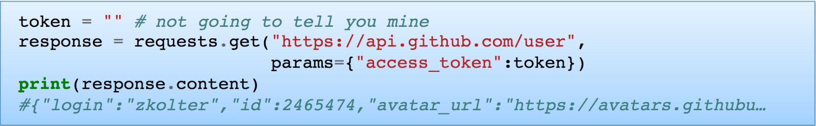

QUERYING A REST API
You query a REST API similar to standard HTTP requests, but will almost always need to include parameters
Get your own access token at https://github.com/settings/tokens/new
GitHub API uses GET/PUT/DELETE to let you query or update elements in your GitHub account automatically
Example of REST: server doesn’t remember your last queries, for instance you always need to include your access token if using it this way
<user>
*****

Slide 46
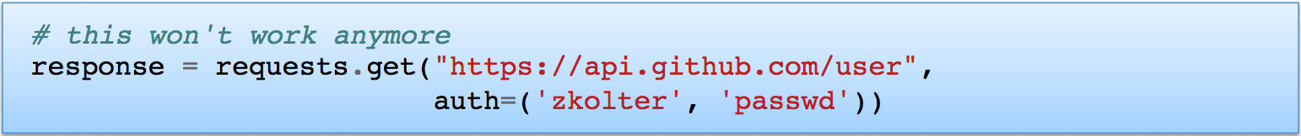
AUTHENTICATION
Basic authentication has traditionally been the most common approach to access control for web pages
Most APIs have replaced this with some form of API Keys (you’ll get familiar with API Keys in the homework)
<user>

Slide 47

COMMON DATA FORMATS
The three most common formats:
CSV/TSV (comma/tab separated value) files
JSON (Javascript object notation) files and strings
HTML/XML (hypertext markup language / extensible markup language) files and strings

Slide 48
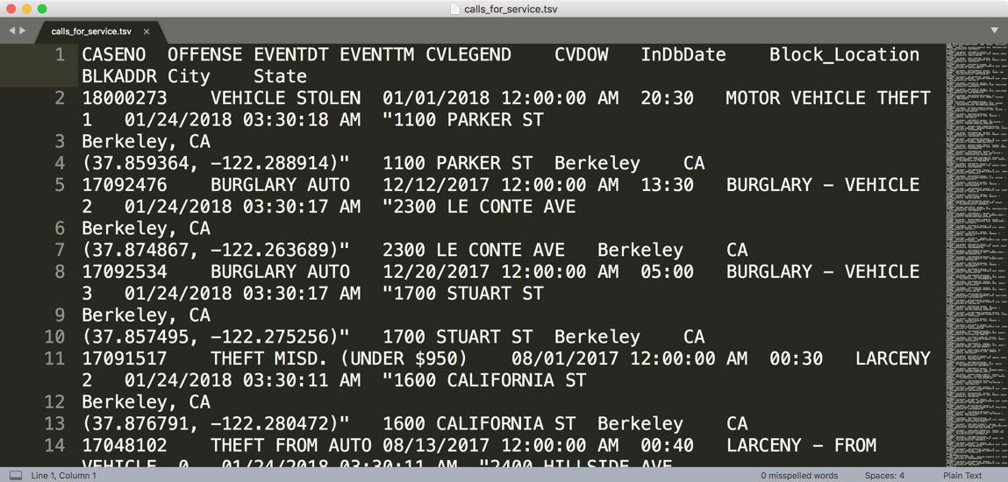
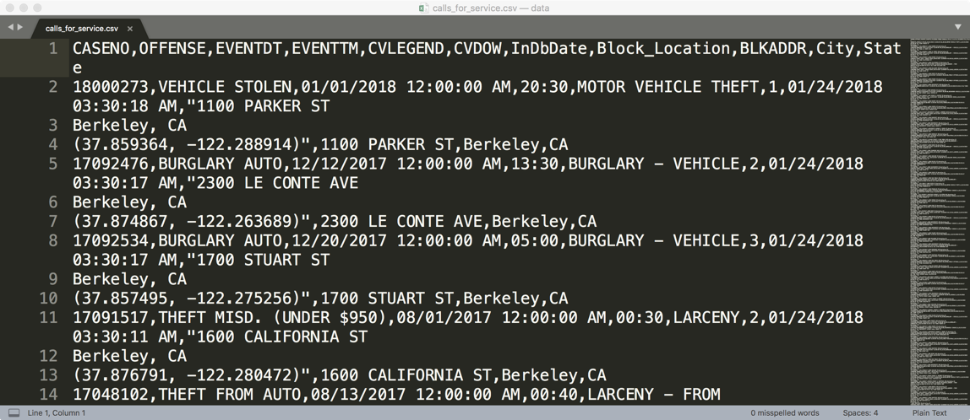

COMMA AND TAB SEPARATED VALUES FILES
Tabular data where
records are delimited by a newline: “\n”, “\r\n”
Fields are delimited by ‘,’ (comma) or ‘\t’ (tab)
Very Common!
Issues?
Commas, tabs in records
Quoting
…
Notes:
\r\n = CR + LF → Used as a new line character in Windows
\n = LF (Line Feed) → Used as a new line character in Unix/Mac OS X
\r = CR (Carriage Return) → Used as a new line character in Mac OS before X
If quotation marks are needed within a quote, you need to double quote “She said “”Hey”””

Slide 49
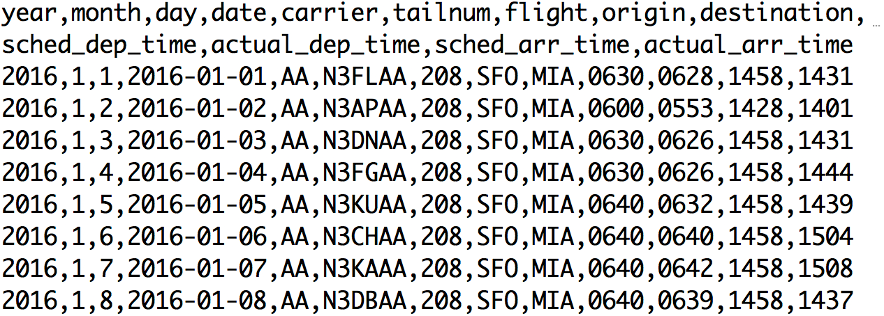

EXAMPLE CSV DATA
Refers to any delimited text file (not always separated by commas)

Slide 50

JAVASCRIPT OBJECT NOTATION (JSON)
JSON originated as a way of encapsulating JavaScript objects
Widely used file format for nested data
Natural maps to python dictionaries (many tools for loading)
Strict formatting ”quoting” addresses some issues in CSV/TSV
Supports a number of data types (numbers, strings, lists and dictionaries)
Issues (harder to make tabular)
Each record can have different fields
Nesting means records can contain records → complicated

Slide 51
JSON FILES / STRING
A number of different data types can be represented
Number: 1.0 (always assumed to be floating point)
String: "string"
Boolean: true or false
List (Array): [item1, item2, item3,…]
Dictionary (Object in Javascript): {"key":value}
Lists and Dictionaries can be embedded within each other
[{"key":[value1, [value2, value3]]}]
Notes:
If quotes are needed within a string, you can use backslash before \”

Slide 52



EXAMPLE JSON DATA

Slide 53

PARSING JSON IN PYTHON
Built-in library to read/write Python objects from/to JSON files.
Try this on the terminal!
Can also use pandas.read_json

Slide 54

XML / HTML FILES
The main format for the web (though XML seems to be losing a bit of popularity to JSON for use in APIs / file formats)
XML files contain hierarchical content delineated by tags
HTML is syntactically like XML but horrible (e.g., open tags are not always closed), more fundamentally, HTML is meant to describe appearance

Slide 55
XML (ANOTHER KIND OF NESTED DATA)
<catalog>
<plant type='a'>
<common>Bloodroot</common>
<botanical>Sanguinaria canadensis</botanical>
<zone>4</zone>
<light>Mostly Shady</light>
<price>2.44</price>
<availability>03/15/2006</availability>
<description>
<color>white</color>
<petals>true</petals>
</description>
<indoor>true</indoor>
</plant>
…
</catalog>
Nested structure

Slide 56

PARSING XML/HTML IN PYTHON
There are a number of XML/HTML parsers for Python, but a nice one for data science is the BeautifulSoup library (focused on getting data out of XML/HTML).
Try this!
You’ll play some with BeautifulSoup in HW1

Slide 57
LOG DATA
Is this a csv file? tsv?
JSON/XML?
169.237.46.168 - - [26/Jan/2014:10:47:58 -0800] "GET /stat141/Winter04 HTTP/1.1" 301 328 "http://anson.ucdavis.edu/courses/" "Mozilla/4.0 (compatible; MSIE 6.0; Windows NT 5.0; .NET CLR 1.1.4322)”
169.237.6.168 - - [8/Jan/2014:10:47:58 -0800] "GET /stat141/Winter04/ HTTP/1.1" 200 2585 "http://anson.ucdavis.edu/courses/" "Mozilla/4.0 (compatible; MSIE 6.0; Windows NT 5.0; .NET CLR 1.1.4322)"

Slide 58
ACKNOWLEDGMENTS
These slides use materials by the Berkeley DS 100 team, Zico Kolter, Elene Zheleva, and Brian Ziebart

