Slide 1
data wrangling
CS 418 Introduction to Data Science
Prof. Sathya Ravi
September 10, 2024

Slide 2
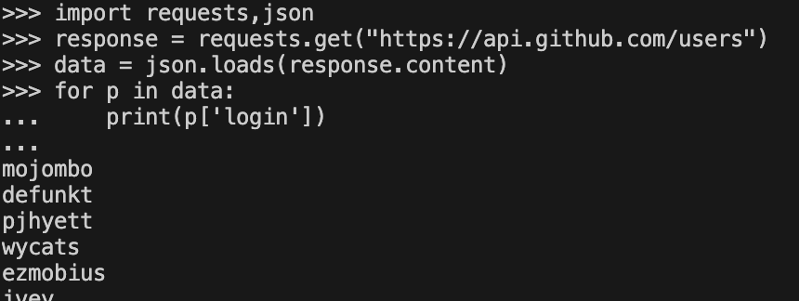
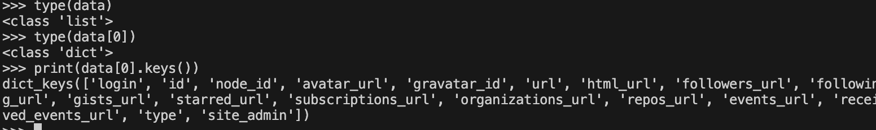
PARSING JSON IN PYTHON
Built-in library to read/write Python objects from/to JSON files. Can also use pandas.read_json .Try this on the terminal!

Slide 3
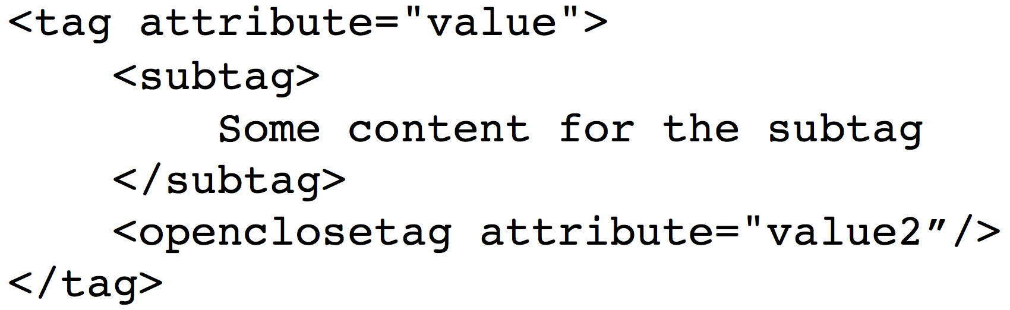
XML / HTML FILES
The main format for the web (though XML seems to be losing a bit of popularity to JSON for use in APIs / file formats)
XML files contain hierarchical content delineated by tags
HTML is syntactically like XML but horrible (e.g., open tags are not always closed), more fundamentally, HTML is meant to describe appearance

Slide 4
XML (ANOTHER KIND OF NESTED DATA)
<catalog>
<plant type='a'>
<common>Bloodroot</common>
<botanical>Sanguinaria canadensis</botanical>
<zone>4</zone>
<light>Mostly Shady</light>
<price>2.44</price>
<availability>03/15/2006</availability>
<description>
<color>white</color>
<petals>true</petals>
</description>
<indoor>true</indoor>
</plant>
…
</catalog>
Nested structure

Slide 5
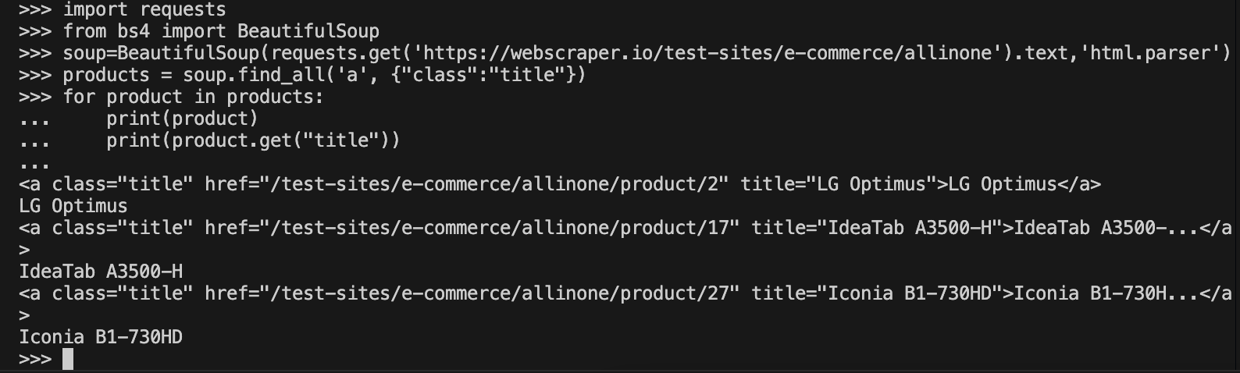
PARSING XML/HTML IN PYTHON
There are a number of XML/HTML parsers for Python, but a nice one for data science is the BeautifulSoup library (focused on getting data out of XML/HTML).
Try this!
Homework has data that you will get with BeautifulSoup.
Reference: https://beautiful-soup-4.readthedocs.io/en/latest/#kinds-of-objects, https://beautiful-soup-4.readthedocs.io/en/latest/#find-all

Slide 6
Now
Formulate Question or Problem
Acquire and Clean Data
Data acquisition
Data wrangling
Structure
Data types
Granularity
Exploratory Data Analysis
Draw Conclusions
Reports, Decisions, and Solutions

Slide 7
DATA WRANGLING
Data can be split across files of different types and reference other data
Data wrangling is the process of cleaning and unifying messy and complex data sets for easy access and analysis
transforming and mapping data from one "raw" data format into another format
Three important pieces towards understanding the data:
Structure
Data types
Granularity

Slide 8
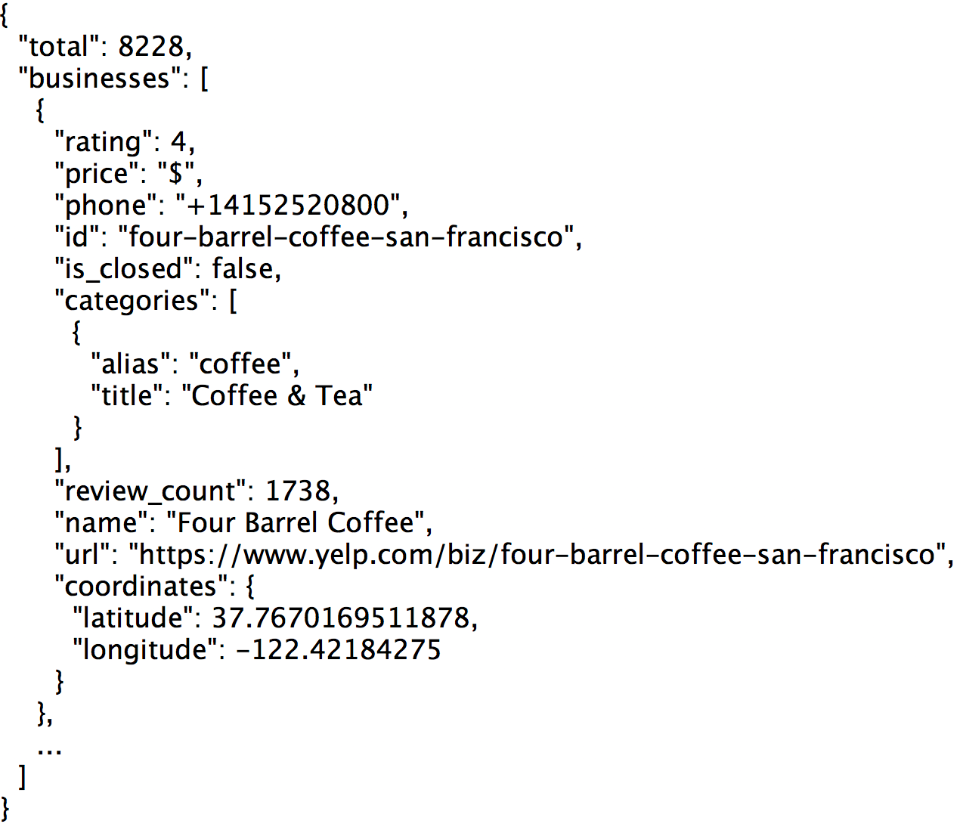
TRANSFORMING DATA
A big part of data wrangling is about transforming data to be more rectangular
Fields/Attributes/ Features/Columns
Records/Rows
Notes:
Discussion

Slide 9
QUESTIONS TO ASK ABOUT STRUCTURE
Is the data in a standard format?
Tabular data: CSV, TSV, Excel, SQL
Nested data: JSON or XML
Is the data organized in “records”?
No: Can we define records by parsing the data?
Is the data nested? (records contained within records…)
Yes: Can we reasonably un-nest the data?
Does the data reference other data?
Yes: can we join/merge the data
What are the fields in each record?
How are they encoded? (e.g., strings, numbers, binary, dates …)
What is the type of the data?

Slide 10
STRUCTURE: KEYS
Purchases.csv
OrderNum | ProdID | Quantity
1 | 42 | 3
1 | 999 | 2
2 | 42 | 1
Foreign Key
Orders.csv
Often data will reference other pieces of data
Primary key: the column or set of columns in a table that determine the values of the remaining columns
Primary keys are unique
Examples: SSN, ProductIDs, …
Foreign keys: the column or sets of columns that reference primary keys in other tables.
OrderNum | CustID | Date
1 | 171345 | 8/21/2017
2 | 281139 | 8/30/2017
Products.csv
ProdID | Cost
42 | 3.14
999 | 2.72
Primary Key
Customers.csv
CustID | Addr
171345 | Harmon..
281139 | Main ..

Slide 11
JOINING TWO TABLES
OrderNum | ProdID | Name
1 | 42 | Gum
2 | 999 | Towel
2 | 42 | Gum
OrderId | Cust Name | Date
1 | Joe | 8/21/2017
2 | Arthur | 8/14/2017
x
Left “key”
Right “key”
OrderNum | ProdID | Name | OrderId | Cust Name | Date
1 | 42 | Gum | 1 | Joe | 8/21/2017
1 | 42 | Gum | 2 | Arthur | 8/14/2017
2 | 999 | Towel | 1 | Joe | 8/21/2017
2 | 999 | Towel | 2 | Arthur | 8/14/2017
2 | 42 | Gum | 1 | Joe | 8/21/2017
2 | 42 | Gum | 2 | Arthur | 8/14/2017
Drop rows that don’t match on the key

Slide 12
JOINING TWO TABLES
Left “key”
Right “key”
OrderNum | ProdID | Name | OrderId | Cust Name | Date
1 | 42 | Gum | 1 | Joe | 8/21/2017
1 | 42 | Gum | 2 | Arthur | 8/14/2017
2 | 999 | Towel | 1 | Joe | 8/21/2017
2 | 999 | Towel | 2 | Arthur | 8/14/2017
2 | 42 | Gum | 1 | Joe | 8/21/2017
2 | 42 | Gum | 2 | Arthur | 8/14/2017
Drop rows that don’t match on the key
OrderNum | ProdID | Name | OrderId | Cust Name | Date
1 | 42 | Gum | 1 | Joe | 8/21/2017
2 | 999 | Towel | 2 | Arthur | 8/14/2017
2 | 42 | Gum | 2 | Arthur | 8/14/2017
import pandas as pd purchases=pd.read_csv(“Purchases.csv”)
orders=pd.read_csv(“Orders.csv”)
purchases.merge(orders, how=“inner”, left_on=“OrderNum”, right_on=“OrderId”)
In Python (with pandas)

Slide 13
KINDS OF
Data
Note that categorical data can also be numbers and quantitative data may be stored as strings.
Categorical Data
Quantitative Data
Numbers with meaningful
ratios or intervals.
Ordinal
Nominal
Examples:
Price
Quantity
Temperature
Date
…
Categories with orders but no consistent meaning if magnitudes or intervals
Categories with no
specific ordering.
Examples:
Preferences
Level of education
…
Examples:
Political Affiliation
Product Type
OS
…

Slide 14
Quiz
Price in dollars of a product?
(A) Quantitative, (B) Ordinal, (C) Nominal
Star Rating on Yelp?
(A) Quantitative, (B) Ordinal, (C) Nominal
Date an item was sold?
(A) Quantitative, (B) Ordinal, (C) Nominal
What is your Credit Card Number?
(A) Quantitative, (B) Ordinal, (C) Nominal
Notes:
A (quantitative), B (ordinal but sometimes treated as quantitative), A(Quantitative), C(nominal)

Slide 15
QUIZ
Price in dollars of a product?
(A) Quantitative, (B) Ordinal, (C) Nominal
Star Rating on Yelp?
(A) Quantitative, (B) Ordinal, (C) Nominal
Date an item was sold?
(A) Quantitative, (B) Ordinal, (C) Nominal
What is your Credit Card Number?
(A) Quantitative, (B) Ordinal, (C) Nominal

Slide 16

DATA GRANULARITY
→ What does each row represent?
→ How fine/coarse is each datum?
Rec. 1
Rec. 1
Rec. 2
Rec. 3
Rec. 1
Rec. 2
Rec. 3
Fine Grained
Coarse
Grained

Slide 17
QUESTIONS TO ASK ABOUT GRANULARITY
What does each record represent?
Examples: a purchase, a person, a group of users
Do all records capture granularity at the same level?
Some data will include summaries as records
If the data are coarse, how was it aggregated?
Sampling, averaging, …
What kinds of aggregation is possible/desirable?
From individual people to demographic groups?
From individual events to totals across time or regions?
Hierarchies (city/county/state, second/minute/hour/days)
Understanding and manipulating granularity can help reveal patterns

Slide 18
MANIPULATING GRANULARITY: GROUP BY
Key
Data
A
A
3
3
B
B
1
1
C
C
4
4
A
A
1
1
B
B
5
5
C
C
9
9
A
A
2
2
B
B
6
6
C
C
5
5

Slide 19
MANIPULATING GRANULARITY: GROUP BY
Key
Data
A
3
A
3
A
1
B
B
1
1
A
2
C
C
4
4
A
1
B
B
5
5
C
C
9
9
A
2
B
B
6
6
C
C
5
5

Slide 20
MANIPULATING GRANULARITY: GROUP BY
Key
Data
A
3
A
3
Aggregate
Function
A
A
6
A
1
6
B
1
A
2
C
4
A
1
B
1
Split into
Groups
Aggregate
Function
B
B
12
B
5
B
5
12
C
9
B
6
A
2
C
4
B
6
Aggregate
Function
C
9
C
C
18
18
C
5
C
5

Slide 21
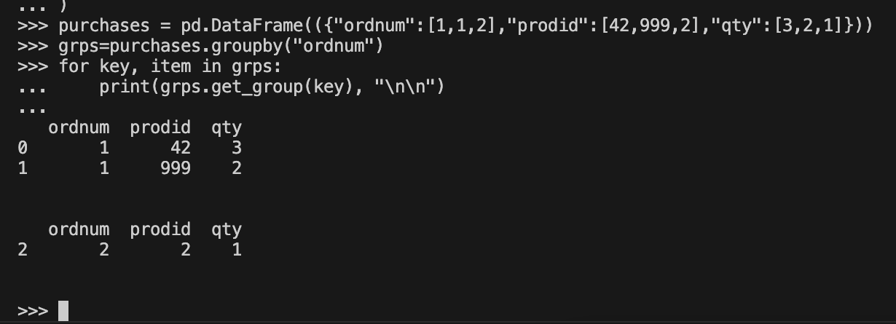
MANIPULATING GRANULARITY: GROUP BY
Example:
Key
Data
OrderNum | ProdID | Quantity
1 | 42 | 3
1 | 999 | 2
2 | 42 | 1
A
3
A
3
A
1
B
1
A
2
C
4
In Python (with pandas)
A
1
B
1
Split into
Groups
B
5
B
5
C
9
B
6
A
2
C
4
B
6
C
9
C
5
C
5

Slide 22
MANIPULATING GRANULARITY: GROUP BY
Key
Data
A
3
A
3
A
1
Aggregate
Function
A
6
B
1
A
2
C
4
A
6
A
1
B
1
Split into
Groups
Merge
Results
B
12
B
5
B
5
Aggregate
Function
B
12
C
18
C
9
B
6
A
2
C
4
B
6
Aggregate
Function
C
9
C
18
C
5
C
5

Slide 23
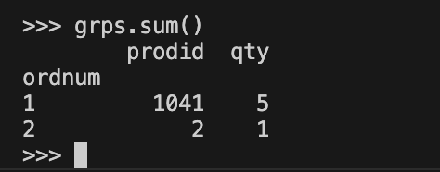
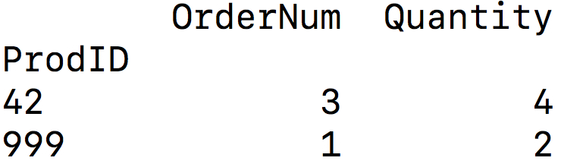
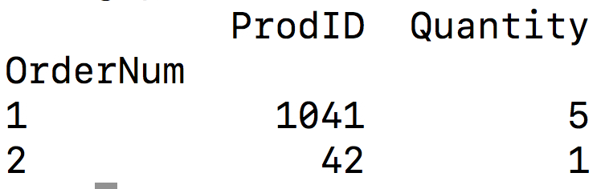
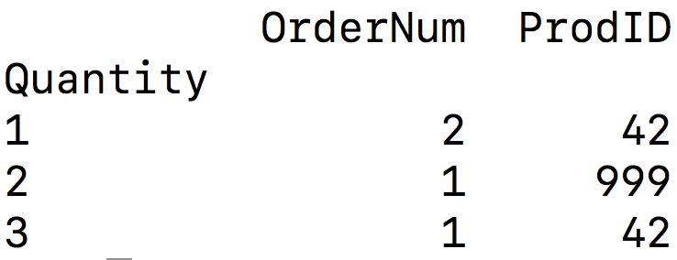
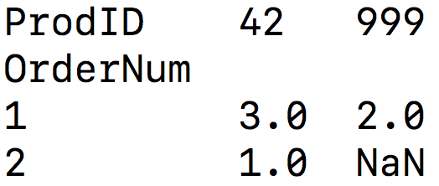
MANIPULATING GRANULARITY: GROUP BY
Example:
In Python (with pandas)
OrderNum | ProdID | Quantity
1 | 42 | 3
1 | 999 | 2
2 | 42 | 1
import pandas as pd purchases=pd.read_csv(“Purchases.csv”)
grps=purchases.groupby(“OrderNum”)
grps.sum()
Try to predict the output of the code above:
A.
B.
C.
D.
Notes:
B

Slide 24
MANIPULATING GRANULARITY: PIVOT
Key R
Key
C
Data
A
A
U
U
3
3
B
B
V
V
1
1
C
C
U
U
4
4
A
A
V
V
1
1
B
B
U
U
5
5
C
C
V
V
9
9
A
A
U
U
2
2
B
B
V
V
6
6
D
D
U
U
5
5

Slide 25
ACKNOWLEDGMENTS
These slides use materials by Berkeley’s DS 100 team, Isabel Cruz, Jiawei Han, Micheline Kamber, Jian Pei, and Elena Zheleva

