Slide 1

Databases with sql
CS 418 Introduction to Data Science
Prof. Sathya Ravi
September 10, 2024

Slide 2
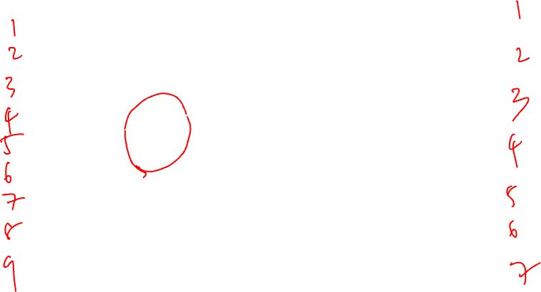
MANIPULATING GRANULARITY: PIVOT
Key R
Key
C
A
U
3
Data
Aggregate
Function
A
U
5
A
U
3
A
U
2
B
V
1
Aggregate
Function
A
V
1
A
V
1
C
U
4
Aggregate
Function
B
U
5
B
U
5
A
V
1
Split into
Groups
B
V
1
Aggregate
Function
B
V
7
B
U
5
B
V
6
C
V
9
C
U
4
Aggregate
Function
C
U
4
A
U
2
C
V
9
Aggregate
Function
C
V
9
B
V
6
D
U
5
D
U
5
Aggregate
Function
D
U
5

Slide 3
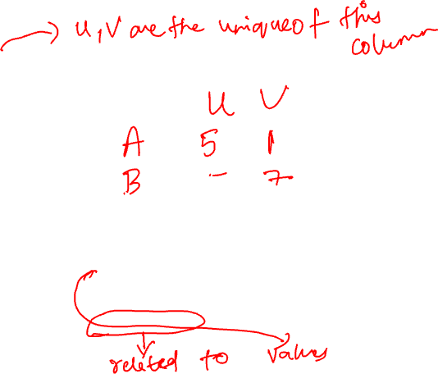
MANIPULATING GRANULARITY: PIVOT
Key R
Key
C
A
U
3
Data
Aggregate
Function
A
U
5
A
U
5
Example:
A
U
3
A
U
2
OrderNum | ProdID | Quantity
1 | 42 | 3
1 | 999 | 2
2 | 42 | 1
B
V
1
Aggregate
Function
A
V
1
A
V
1
A
V
1
C
U
4
Aggregate
Function
B
U
5
B
U
5
B
U
5
A
V
1
Split into
Groups
B
V
1
Aggregate
Function
B
V
7
B
U
5
B
V
7
In Python (with pandas)
B
V
6
C
V
9
pd.pivot_table(purchases,
values=‘Quantity’, #what to aggregate over
index=‘OrderNum’, #the row grouping attributes
columns=‘ProdID’, #the column grouping attributes
aggfunc=np.sum) #the aggregating function
C
U
4
Aggregate
Function
C
U
4
C
U
4
A
U
2
Aggregate
Function
C
V
9
B
V
6
C
V
9
C
V
9
D
U
5
D
U
5
Aggregate
Function
D
U
5
D
U
5

Slide 4


MANIPULATING GRANULARITY: PIVOT
Key R
Key
C
A
U
3
Aggregate
Function
U
V
Data
A
U
5
A
U
3
A
U
2
A
1
A
5
B
V
1
Aggregate
Function
A
V
1
A
V
1
V
B
5
7
C
U
4
Aggregate
Function
B
U
5
B
U
5
U
C
4
9
A
V
1
Split into
Groups
B
V
1
D
5
Aggregate
Function
Need to address missing values
B
V
7
B
U
5
V
B
V
6
C
V
9
C
U
4
Aggregate
Function
C
U
4
U
A
U
2
Aggregate
Function
C
V
9
B
V
6
C
V
9
V
D
U
5
D
U
5
Aggregate
Function
D
U
5
U

Slide 5
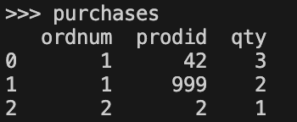
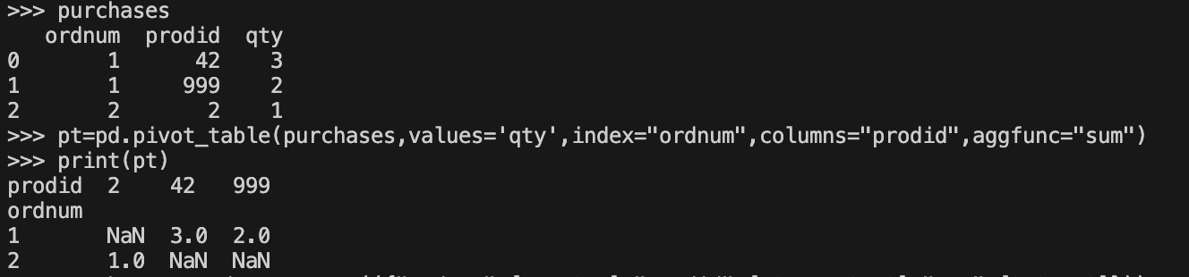
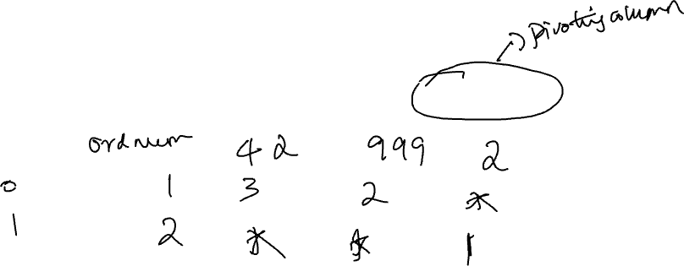
Let’s Try this in our example

Slide 6
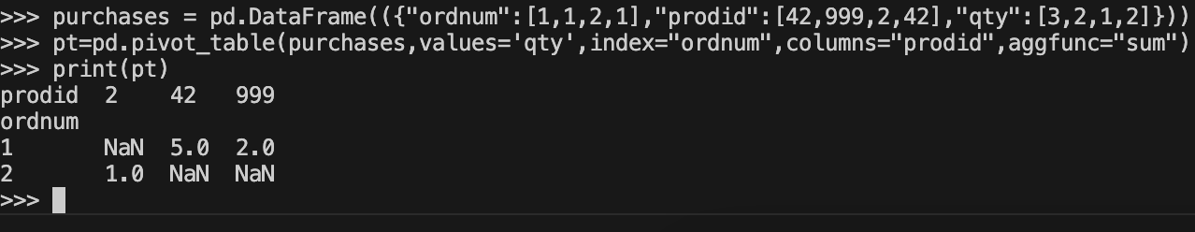
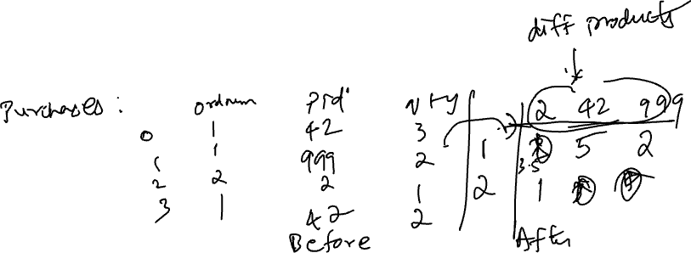
MANIPULATING GRANULARITY: To see Aggregation, consider this
Key R
Key
C
Data
A
U
3
B
V
1
C
U
4
A
V
1
Split into
Groups
B
U
5
C
V
9
A
U
2
B
V
6
D
U
5

Slide 7

QUALITY CHECKS BASED ON SCOPE
Does my data cover my area of interest?
Example: I am interested in studying crime in Illinois but I only have Chicago crime data.
Is my data too expansive?
Example: I am interested in student grades for CS 418 but have student grades for all CS classes.
Solution: Filtering → Implications on sample?
If the data is a sample I may have poor coverage after filtering …
Population
Data
Population
Data
Need more data
Need to Filter
Need to Filter

Slide 8

QUALITY CHECKS BASED ON TEMPORALITY
Does my data cover the right time frame?
Data changes → When was the data collected! (e.g., file age)
What is the meaning of the time and date fields?
When the “event” happened?
When the data was collected or was entered into the system?
Date the data was copied into a database (look for many matching timestamps)
Time depends on where! (Time zones & daylight savings)
Check out the use of datetime python library
Multiple string representation (depends on region): 07/08/09?
Are there strange null values?
January 1st 1970, January 1st 1900
Is there periodicity? Diurnal/daily patterns

Slide 9
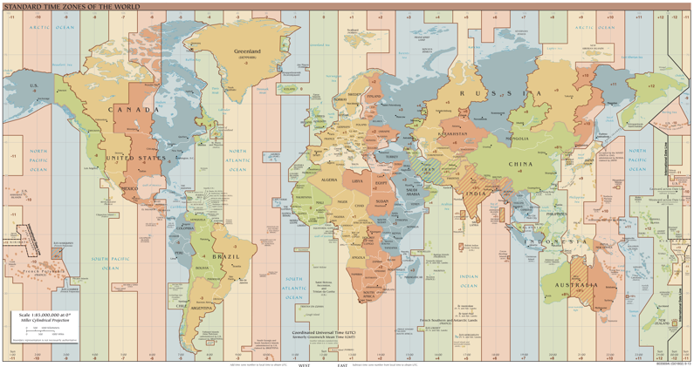
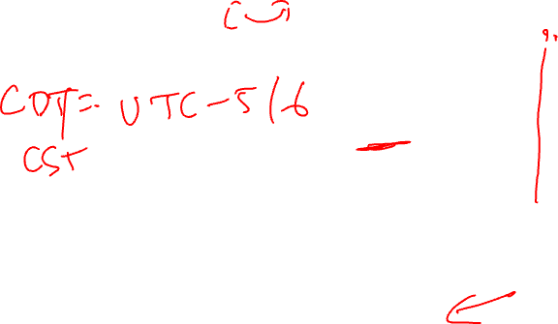
UNIX TIME / POSIX TIME
Time measured in seconds since January 1st 1970 UTC
Unix time follows Coordinated Universal Time (UTC)
International time standard
Measured at 0 degrees latitude
Similar to Greenwich Mean Time (GMT)
No daylight savings
Time codes
Time Zones:
Chicago (UTC-6) without daylight savings
https://en.wikipedia.org/wiki/Coordinated_Universal_Time

Slide 10
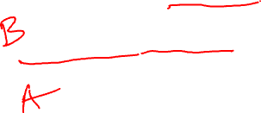
TEMPORALITY
Imagine that you are a data scientist for an international e-commerce site
You are working with transaction data that has timestamps in the local time zone where the transaction occurred (e.g. 14:31:15 CST)
Case 1: The company needs to schedule maintenance for some of its systems. You are tasked to figure out when is a good time to do that by finding when users are least likely to make purchases.
Case 2: Leadership would like to understand the shopping behavior of its customers, e.g., do they mostly shop early in the morning, during work hours, during lunch break, in the evening, etc.
You perform frequency analysis of transaction times by plotting the frequency of transactions per minute:
Without converting timestamps to a common time zone.
First ensure that all timestamps are converted to a common time zone.

Slide 11
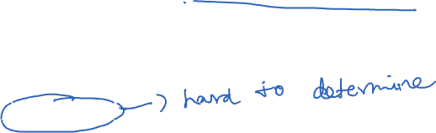
QUALITY CHECKS BASED ON FAITHFULNESS
Does my data contain unrealistic or “incorrect” values?
Examples?
Dates in the future for events in the past
Locations that don’t exist
Negative counts
Misspellings of names
Large outliers
Does my data violate obvious dependencies?
E.g., age and birthday don’t match
Was the data entered by hand?
Spelling errors, fields shifted …
Did the form require fields or provide default values?
Are there obvious signs of curb stoning (data falsification):
Repeated names, fake looking email addresses, repeated use of uncommon names or fields.

Slide 12
SIGNS THAT YOUR DATA MAY NOT BE FAITHFUL
Missing Values/Default values: (0, -1, 999, 12345, NaN, Null, 1970, 1900, … others?)
Soln 1: Drop records with missing values → implications on your sample!
Soln 2: Impute missing values → Bias your conclusions
Time Zone Inconsistencies
Soln 1: convert to a common timezone (e.g., UTC)
Soln 2: convert to the timezone of the location – useful in modeling behavior.
Duplicated Records or Fields
Soln: identify and eliminate (use primary key) → implications on sample?
Spelling Errors
Soln: Apply corrections or drop records not in a dictionary → implications on sample?
Units not specified or consistent
Solns: Infer units, check values are in reasonable ranges for data
Truncated data (early excel limits: 65536 Rows, 255 Columns)
Soln: be aware of consequences in analysis → how did truncation affect sample?
Others…

Slide 13
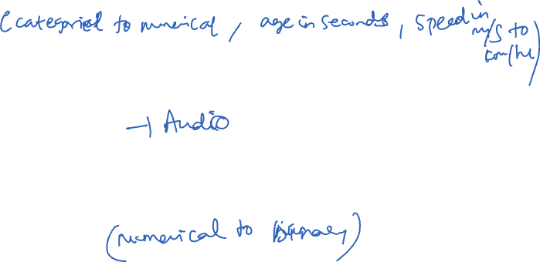
FEATURE TRANSFORMATIONS
Sometimes, we need to transform columns/features to enable meaningful analysis
This process is known as feature engineering in data mining and machine learning
Type conversion
To improve existing features – e.g. convert string price “$2.75” to float “2.75”
Mathematical transformations
To derive new features (create new columns) – e.g., BMI from height and weight
Extraction
To derive new features – e.g., whether a zip code is in Chicago or not

Slide 14
RECAP: HOW DO YOU DO DATA WRANGLING?
Examine data and meta-data:
What is the scope, structure and granularity of the data?
Examine each field/attribute/dimension individually
Examine pairs of related dimensions
Stratifying earlier analysis: break down grades by major …
Along the way:
Visualize/summarize the data
Validate assumptions about data and collection process
Identify and address anomalies
Apply data transformations and corrections
Record everything you do! (why?)

Slide 15
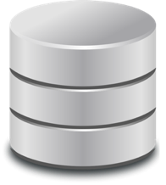


Onward
Formulate Question or Problem
Acquire and Clean Data
?
So far:
Pandas basics
Now: larger dataset collection tools
Databases and SQL
Prediction
and inference
Exploratory Data Analysis
Reports, Decisions, and Solutions

Slide 16
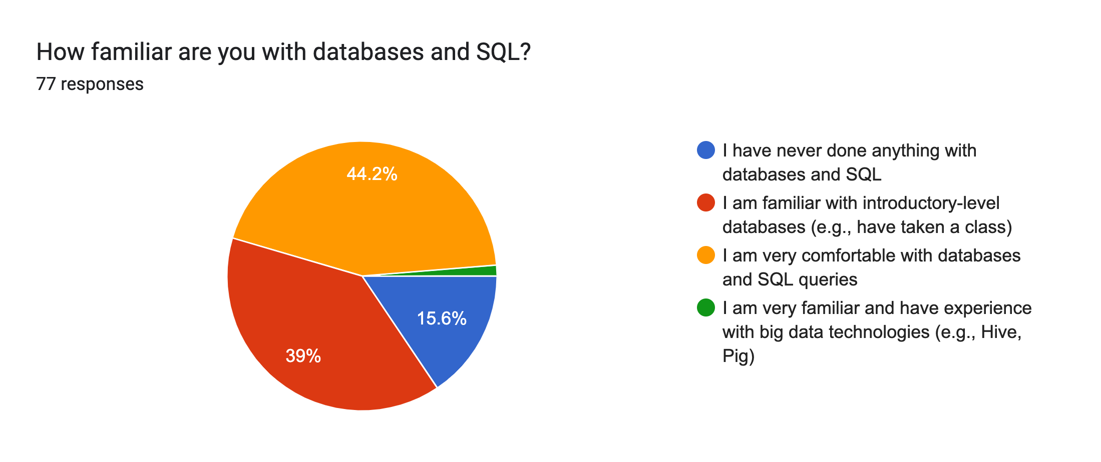

BASED ON QUIZ 0

Slide 17
WHAT IS A DATABASE?

Slide 18


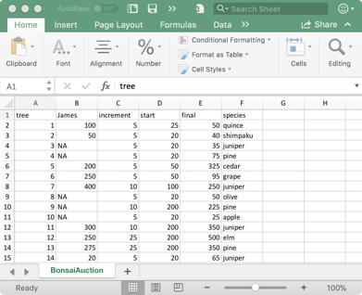
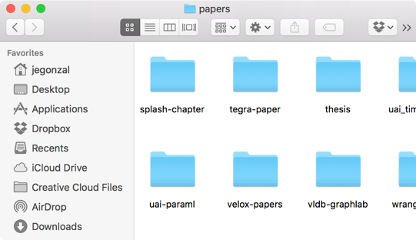
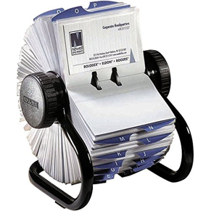
DEFINING DATABASES
A database is an organized collection of data.
A database management systems (DBMS) is a software system that stores, manages, and facilitates access to one or more databases.

Slide 19

Data storage
Provide reliable storage to survive system crashes and disk failures
Special data-structures to improve performance
Data management
Configure how data is logically organized and who has access
Ensure data consistency properties (e.g., positive bank account values)
Facilitate access
Enable efficient access to the data
Supports user defined computation (queries) over data
DATABASE MANAGEMENT SYSTEMS

Slide 20
IS PANDAS A DATABASE MANAGEMENT SYSTEM?
Data Storage?
Pandas doesn’t store data, this is managed by the filesystem
Data Management?
Pandas does support changing the organization of data but doesn’t manage who can access the data
Facilitate Access?
Pandas does support rich tools for computation over data
Pandas is not generally considered a database management system but it often interacts with DBMSs

Slide 21
IS YOUR FILE-SYSTEM A DBMS
Data Storage?
File systems reliably store data on your computer
Data Management?
File systems offer tools to manage access and reorganize data.
Data organization at the granularity of files … (coarse)
Facilitate Access?
Can read files but provides limited computational facilities.
The file-system is not generally considered a DBMS though it is sometimes used in place of one … (not a good idea)

Slide 22
WHY SHOULD I USE A DBMS?
Why can’t I just have my CSV files?
DBMSs organize many related sources of information
DBMSs enforce guarantees on the data
Can be used to prevent data anomalies
Ensure safe concurrent operations on data
DBMSs can be scalable
Optimized to compute on data that does not fit in memory
Parallel computation and optimized data structures
DBMSs can prevent data loss from software/hardware failures

Slide 23
WIDELY USED DBMS TECHNOLOGIES

Slide 24
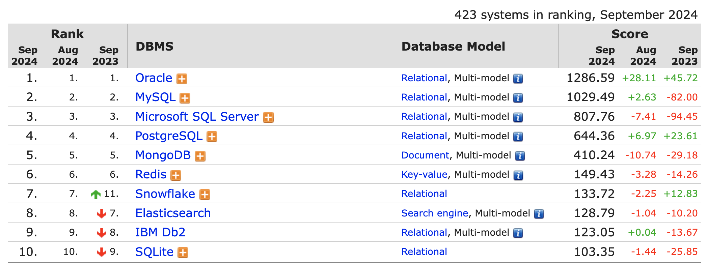
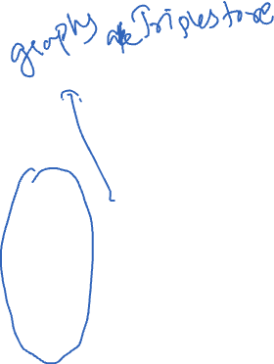
COMMON DBMS SYSTEMS
https://db-engines.com/en/ranking
Relational database management systems are widely used!
Notes:
Multi-model: can do also graph db and/or document store and/or RDF (Resource Description Framework )
Method of calculating the scores of the DB-Engines Ranking
The DB-Engines Ranking is a list of database management systems ranked by their current popularity. We measure the popularity of a system by using the following parameters:
Number of mentions of the system on websites, measured as number of results in search engines queries. At the moment, we use Google, Bing and Yandex for this measurement. In order to count only relevant results, we are searching for <system name> together with the term database, e.g. "Oracle" and "database".
General interest in the system. For this measurement, we use the frequency of searches in Google Trends.
Frequency of technical discussions about the system. We use the number of related questions and the number of interested users on the well-known IT-related Q&A sites Stack Overflow and DBA Stack Exchange.
Number of job offers, in which the system is mentioned. We use the number of offers on the leading job search engines Indeed and Simply Hired.
Number of profiles in professional networks, in which the system is mentioned. We use the internationally most popular professional networks LinkedIn and Upwork.
Relevance in social networks. We count the number of Twitter tweets, in which the system is mentioned.

Slide 25

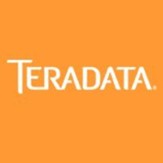




RELATIONAL DATABASE MANAGEMENT SYSTEMS
Relational databases are the traditional DBMS technology
Logically organize data in relations (tables)
Describes relationship:
Name purchased Prod at Price.
Sales relation:
Name | Prod | Price
Sue | iPod | $200.00
Joey | Bike | $333.99
Alice | Car | $999.00
Tuple (row)
How is data physically stored?
Attribute (column)

Slide 26
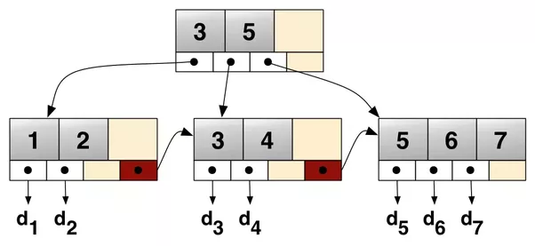



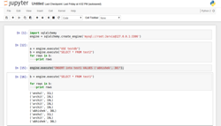

RELATIONAL DATA ABSTRACTION
Relations (Tables)
Name | Prod | Price
Sue | iPod | $200.00
Joey | Bike | $333.99
Alice | Car | $999.00
Database Management System
Optimized Data Structures
B+Trees
sid | sname | rating | age
28 | yuppy | 9 | 35.0
31 | lubber | 8 | 55.5
44 | guppy | 5 | 35.0
58 | rusty | 10 | 35.0
Abstraction
Page 1
Page 2
Optimized Storage
Page 3
Page 4
bid | bname | color
101 | Interlake | blue
102 | Interlake | red
104 | Marine | red
103 | Clipper | green
Page Header
Page 5
Page 6
Notes:
Database tables and indexes may be stored on disk in one of a number of forms, including ordered/unordered flat files, ISAM, heap files, hash buckets, or B+ trees.

Slide 27
Physical Data Independence:
Database management systems hide how data is stored from end user applications
→ System can optimize storage and computation without changing applications.
Big Idea in Data Structures
Data Systems &
Computer Science
It wasn’t always like this …

Slide 28
In a time long ago …
Before 1970’s databases were not routinely organized as tables.
Instead they exposed specialized data structures designed for specific applications.
Notes:
In the past, data was stored in specialized data structures that were designed for specific tasks. For example, airlines might record flight bookings in a different format than a bank managing an account ledger.

Slide 29
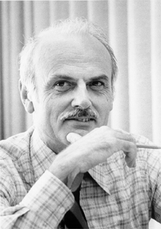
TED CODD AND THE RELATIONAL MODEL
[1969] Relational model: a mathematical abstraction of a database as sets
Independence of data from the physical properties of stage storage and representation
[1972] Relational Algebra & Calculus: a collection of operations and a way of defining logical outcomes for data transformations
Algebra: beginning of technologies like Pandas
Calculus: the foundation of modern SQL
Edgar F. “Ted” Codd (1923 - 2003)
Turing Award 1981
Notes:
In 1969, Ted Codd introduced the relational model as a general method of storing data. Data is stored in two-dimensional tables called relations, consisting of individual observations in each row (commonly referred to as tuples). Each tuple is a structured data item that represents the relationship between certain attributes (columns). Each attribute of a relation has a name and data type.

Slide 30
RELATIONAL DATABASE MANAGEMENT SYSTEMS
Relational databases are the traditional DBMS technology
Logically organize data in relations (tables)
Structured Query Language (SQL) to define, manipulate and compute on data.
A common language spoken by many data systems
Some variations and deviations from the standard …
Describes logical organization of data as well as computation on data.

Slide 31
SQL
What not How

Slide 32

SQL IS A DECLARATIVE LANGUAGE (REVIEW)
Declarative: “Say what you want, not how to get it.”
Declarative Example: I want a table with columns “x” and “y” constructed from tables “A” and ”B” where the values in “y” are greater than 100.00.
Imperative Example: For each record in table “A” find the corresponding record in table “B” then drop the records where “y” is less than or equal to 100 then return the ”x” and “y” values.
Advantages of declarative programming
Enable the system to find the best way to achieve the result.
Often more compact and easier to learn for non-programmers
Challenges of declarative programming
System performance depends heavily on automatic optimization
Limited language (not Turing complete)
Notes:
In computability theory, a system of data-manipulation rules (such as a computer's instruction set, a programming language, or a cellular automaton) is said to be Turing complete or computationally universal if it can be used to simulate any Turing machine. This means that this system is able to recognize or decide other data-manipulation rule sets.
Most modern programming languages are Turing-complete. To show that something is Turing complete, it is enough to show that it can be used to simulate some Turing complete system.

Slide 33
RELATIONAL TERMINOLOGY
Database: Set of Relations (i.e., one or more tables)
Relation (Table):
Schema: description of columns, their types, and constraints
Instance: data satisfying the schema
Attribute (Column)
Tuple (Record, Row)
Schema of database is set of schemas of its relations
Name | Prod | Price
Sue | iPod | $200.00
Joey | Bike | $333.99
Alice | Car | $999.00
Tuple (row)
Attribute (column)

Slide 34
ACKNOWLEDGMENTS
These slides use materials by Berkeley’s DS 100 team, Isabel Cruz, Jiawei Han, Micheline Kamber, Jian Pei, and Elena Zheleva

