Slide 1
Databases with sql
CS 418 Introduction to Data Science
Prof. Sathya Ravi
September 17, 2024

Slide 2

ANNOUNCEMENTS
Additional TA support (yay!): Aneesh Potnis, will hold office hours on W from 2 to 3 pm. Zoom link: https://uic.zoom.us/j/87303073840?pwd=F6Xe1L0PHM3nFLEgohmhzHsoLcH1Ti.1
Homework due this Thu – please do not use other packages. If in doubt, please ask me or TAs – Ellen, Aneesh
First Quiz next Thu, so please plan to be here on time. Quiz will be half the lecture, and then we will resume lecture
Everything covered until this Thu 09/19 will be covered in the quiz
Expect project team assignment to be completed by this Thu or latest by weekend

Slide 3
SQL IS A DECLARATIVE LANGUAGE (REVIEW)
Declarative: “Say what you want, not how to get it.”
Declarative Example: I want a table with columns “x” and “y” constructed from tables “A” and ”B” where the values in “y” are greater than 100.00.
Imperative Example: For each record in table “A” find the corresponding record in table “B” then drop the records where “y” is less than or equal to 100 then return the ”x” and “y” values.
Advantages of declarative programming
Enable the system to find the best way to achieve the result.
Often more compact and easier to learn for non-programmers
Challenges of declarative programming
System performance depends heavily on automatic optimization
Limited language (not Turing complete)

Slide 4
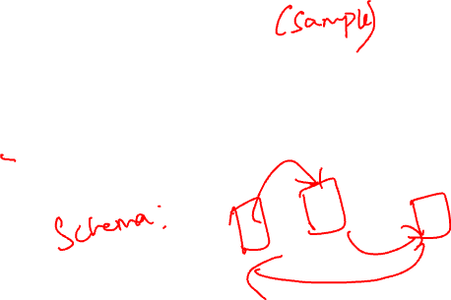
RELATIONAL TERMINOLOGY
Database: Set of Relations (i.e., one or more tables)
Relation (Table):
Schema: description of columns, their types, and constraints
Instance: data satisfying the schema
Attribute (Column)
Tuple (Record, Row)
Schema of database is set of schemas of its relations
Name | Prod | Price
Sue | iPod | $200.00
Joey | Bike | $333.99
Alice | Car | $999.00
Tuple (row)
Attribute (column)

Slide 5

TWO SUBLANGUAGES OF SQL
DDL – Data Definition Language
Define and modify schema
DML – Data Manipulation Language
For interacting with the data itself
CAPITALIZATION IS optional BUT … DATABASE PEOPLE PREFER TO YELL
SELECT * FROM THINGS;
Notes:
Basic command present in DDL are CREATE, DROP, RENAME, ALTER etc.

Slide 6
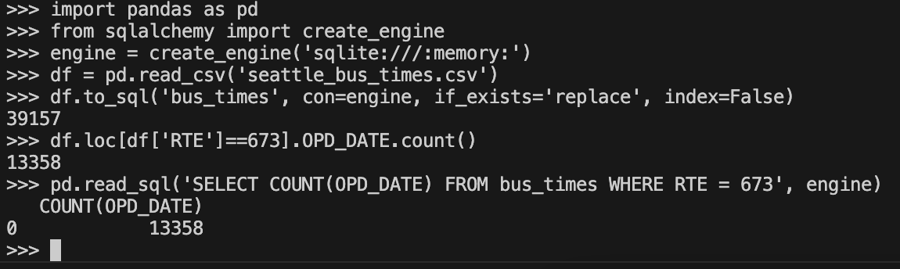
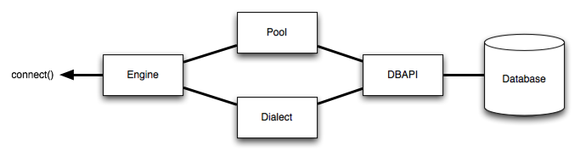
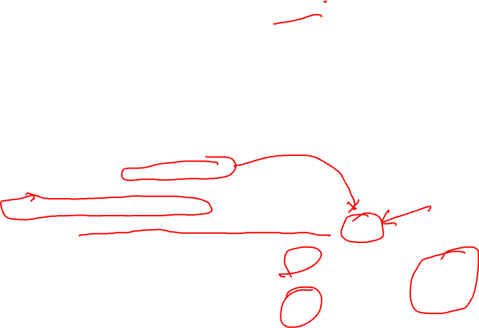
INTERACTING WITH A DBMS IN PANDAS
Typical workflow:
Create SQLAlchemy Engine object.
Use pd.read_sql_query(query, engine) to perform queries.
Other workflows exist, examples:
Executing SQL queries directly using an Engine object.
Using the to_sql method for dataframes.
Example by ”simulating” SQL within Pandas
Notes:
In our course, we’ll almost always interact with a DBMS using Pandas.
Let’s try out a quick demo.

Slide 7
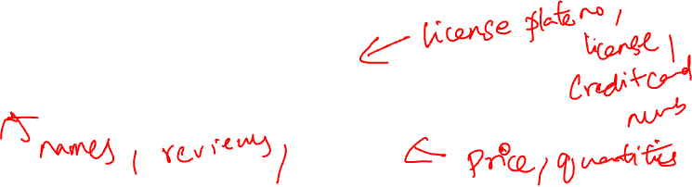
COMMON SQL TYPES (THERE ARE OTHERS...)
CHAR(size): Fixed number of characters
TEXT: Arbitrary number of character strings
INTEGER & BIGINT: Integers of various sizes
REAL & DOUBLE PRECISION: Floating point numbers
DATE & DATETIME: Date and Date+Time formats
See documentation for database system (e.g., Postgres)

Slide 8
CREATING TABLES & POPULATING TABLES

Slide 9
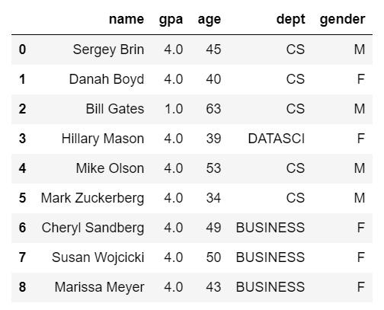
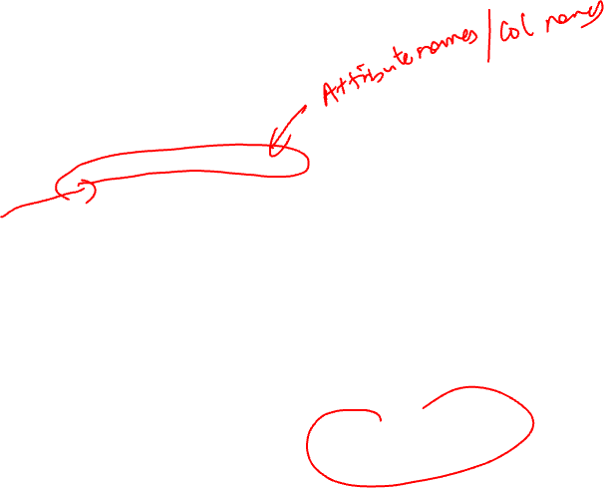
CREATING TABLES
CREATE TABLE students(
name TEXT PRIMARY KEY,
gpa REAL CHECK (gpa >= 0.0 and gpa <= 4.0),
age INTEGER,
dept TEXT,
gender CHAR);
Imposing Integrity Constraints
Useful to ensure data quality…
Question: Is this query from Data Definition Language (DDL) or Data Manipulation Language (DML)?
Note: These GPA values are totally arbitrary.

Slide 10

INSERTING RECORDS INTO A TABLE
(name, gpa, age, dept, gender) → Optional
INSERT INTO students
VALUES
('Sergey Brin', 2.8, 45, 'CS', 'M'),
('Danah Boyd', 3.9, 40, 'CS', 'F'),
('Bill Gates', 1.0, 63, 'CS', 'M'),
('Hillary Mason', 4.0, 39, 'DATASCI', 'F'),
('Mike Olson', 3.7, 53, 'CS', 'M'),
('Mark Zuckerberg', 3.8, 34, 'CS', 'M'),
('Cheryl Sandberg', 3.6, 49, 'BUSINESS', 'F'),
('Susan Wojcicki', 3.8, 50, 'BUSINESS', 'F'),
('Marissa Meyer', 2.6, 43, 'BUSINESS', 'F’)
-- This is a comment.
-- Does the order matter?
Fields must be entered in order (record)
Comma between records
Must use the single quote (’) for strings.
No
Q #2: Is this query from Data Definition Language (DDL) or Data Manipulation Language (DML)?
http://sqlfiddle.com/#!9/120e17/1/0
Note: These GPA values are totally arbitrary.
Notes:
DML INSERT INTO students
VALUES
('Sergey Brin', 2.8, 45, 'CS', 'M'),
('Danah Boyd', 3.9, 40, 'CS', 'F'),
('Bill Gates', 1.0, 63, 'CS', 'M'),
('Hillary Mason', 4.0, 39, 'DATASCI', 'F'),
('Mike Olson', 3.7, 53, 'CS', 'M'),
('Mark Zuckerberg', 3.8, 34, 'CS', 'M'),
('Cheryl Sandberg', 3.6, 49, 'BUSINESS', 'F'),
('Susan Wojcicki', 3.8, 50, 'BUSINESS', 'F'),
('Marissa Meyer', 2.6, 43, 'BUSINESS', 'F’)

Slide 11
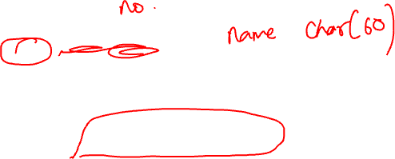
Multiple tables aka schema
Often data will reference other pieces of data
Primary key: the column or set of columns in a table that determine the values of the remaining columns
Primary keys are unique
Examples: SSN, ProductIDs, …
-- Will this work?
CREATE TABLE students(
name TEXT PRIMARY KEY,
gpa REAL CHECK (gpa >= 0.0 and gpa <= 4.0),
age INTEGER,
dept TEXT,
gender CHAR, primary key (name));
Foreign keys: the column or sets of columns that reference primary keys in other tables.

Slide 12
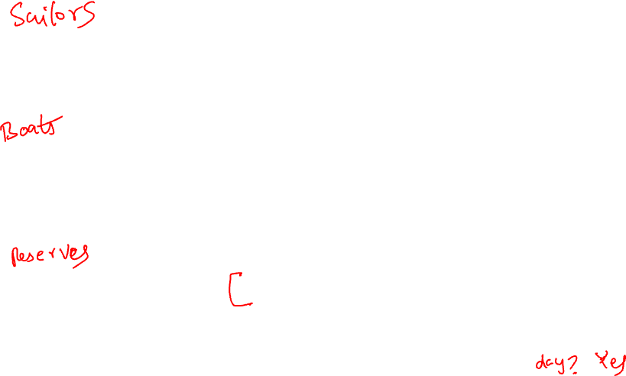
CREATE TABLE Sailors (
sid INTEGER,
sname CHAR(20),
rating INTEGER,
age REAL,
PRIMARY KEY (sid));
CREATE TABLE Boats (
bid INTEGER,
bname CHAR (20),
color CHAR(10),
PRIMARY KEY (bid));
CREATE TABLE Reserves (
sid INTEGER,
bid INTEGER,
day DATE,
PRIMARY KEY (sid, bid, day),
FOREIGN KEY (sid) REFERENCES Sailors (sid),
FOREIGN KEY (bid) REFERENCES Boats (bid));
Columns have names and types
sid | sname | rating | age
1 | Fred | 7 | 22
2 | Jim | 2 | 39
3 | Nancy | 8 | 27
Specify Primary Key column(s)
bid | bname | color
101 | Nina | red
102 | Pinta | blue
103 | Santa Maria | red
Specify Foreign Key relationships
sid | bid | day
1 | 102 | 9/12
2 | 102 | 9/13
Semicolon at end of command
Q #3: Based on this schema, can a sailor reserve more than one boat on the same day?
Notes:
CREATE TABLE Sailors (
sid INTEGER,
sname CHAR(20),
rating INTEGER,
age REAL,
PRIMARY KEY (sid));
CREATE TABLE Boats (
bid INTEGER,
bname CHAR (20),
color CHAR(10),
PRIMARY KEY (bid));
CREATE TABLE Reserves (
sid INTEGER,
bid INTEGER,
day DATE,
PRIMARY KEY (sid, bid, day),
FOREIGN KEY (sid) REFERENCES Sailors (sid),
FOREIGN KEY (bid) REFERENCES Boats (bid));
insert into sailors values
(1,'Fred', 7.0, 22),
(2,'Jim', 2.0, 39),
(3,'Fred', 7.0, 22)
;
insert into boats values
(101,'Nina', 'Red'),
(102,'Pinta', 'Red'),
(103,'Santa Maria', 'Red')
;
insert into reserves values
(1,102, '2012-01-01'),
(2,102, '2012-01-02'),
(1,103, '2012-01-01')
;
SELECT * FROM sailors;
SELECT * FROM boats;
SELECT * FROM reserves;

Slide 13
DELETING AND MODIFYING RECORDS
Records are deleted by specifying a condition:
Modifying records
Note: There is no way to modify records by location
DELETE FROM students
WHERE LOWER(name) = 'sergey brin'
String Function
UPDATE students
SET gpa = 1.0 + gpa
WHERE dept = ‘CS’;

Slide 14
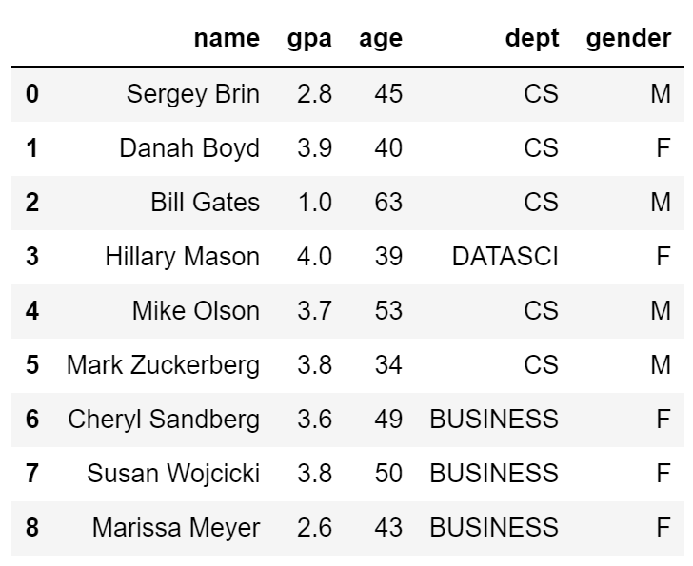
DELETING AND MODIFYING RECORDS
What is wrong with the following
UPDATE students
SET gpa = 1.0 + gpa
WHERE dept = ‘CS’;
CREATE TABLE students(
name TEXT PRIMARY KEY,
gpa FLOAT CHECK (gpa >= 0.0 and gpa <= 4.0),
age INTEGER,
dept TEXT,
gender CHAR);
Update would violate Integrity/bound Constraints

Slide 15
DROPPING TABLES
To delete a table entirely from our database, we can use the “DROP TABLES” command.
Example: DROP TABLE tips;
Be careful, there is no easy way to undo this command.

Slide 16
QUERYING TABLES

Slide 17

SQL DML: BASIC SINGLE-TABLE QUERIES
SELECT [DISTINCT] <column expression list> FROM <single table> [WHERE <predicate>] [GROUP BY <column list> [HAVING <predicate>] ] [ORDER BY <column list>];
Elements of the basic select statement
[Square brackets] are optional expressions.

Slide 18
BASIC SINGLE-TABLE QUERIES
SELECT [DISTINCT] <column expression list> FROM <single table> [WHERE <predicate>] [GROUP BY <column list> [HAVING <predicate>] ] [ORDER BY <column list>] ;
Simplest version is straightforward
Produce all tuples in the table that satisfy the predicate
Output the expressions in the SELECT list
Expression can be a column reference, or an arithmetic expression over column refs

Slide 19
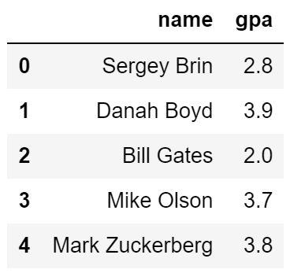
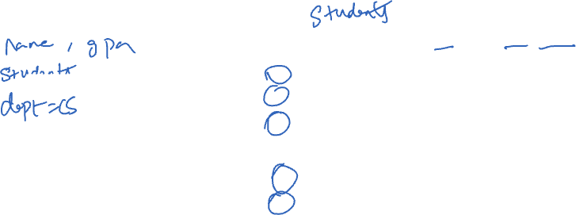
FIND THE NAME AND GPA FOR ALL CS STUDENTS
SELECT name, gpa FROM students WHERE dept = 'CS'
http://sqlfiddle.com/#!9/c1f0e01/1

Slide 20
FIND THE NAME AND GPA FOR ALL CS STUDENTS
SELECT name, gpa FROM students WHERE dept = 'CS'

Slide 21
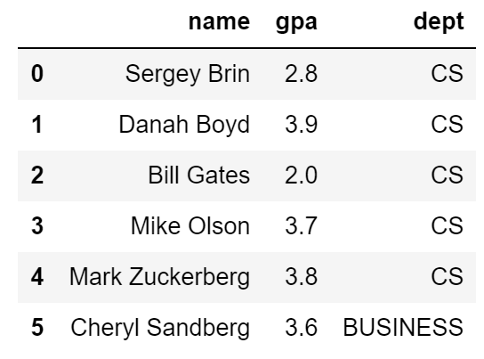

COMBINING PREDICATES WITH OR AND AND
SELECT name, gpa, dept FROM students WHERE dept = 'CS’ OR name < ‘D’

Slide 22
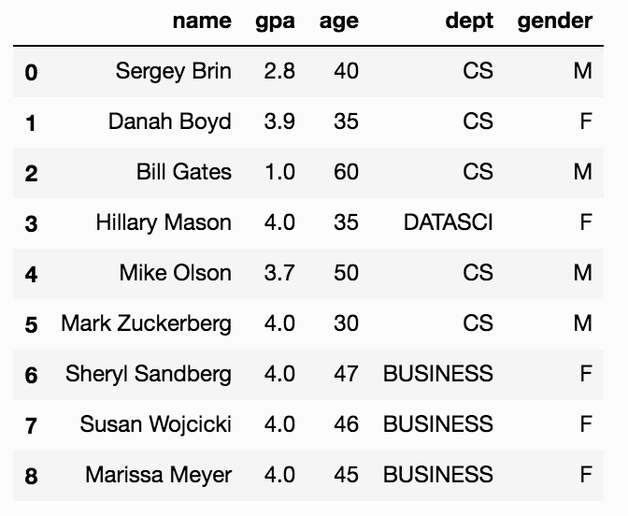
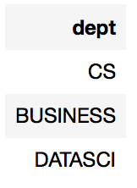

SELECT DISTINCT
SELECT DISTINCT dept FROM students [WHERE <predicate>] [GROUP BY <column list> [HAVING <predicate>] ] [ORDER BY <column list>] ;
DISTINCT flag specifies removal of duplicates before output

Slide 23
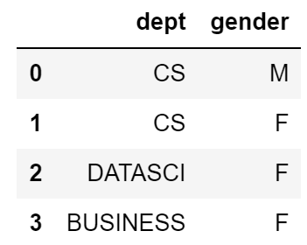

SELECT DISTINCT
SELECT DISTINCT dept, gender FROM students [WHERE <predicate>] [GROUP BY <column list> [HAVING <predicate>] ] [ORDER BY <column list>] ;
DISTINCT flag specifies removal of duplicates before output
DISTINCT operates at the tuple level, not the column level

Slide 24
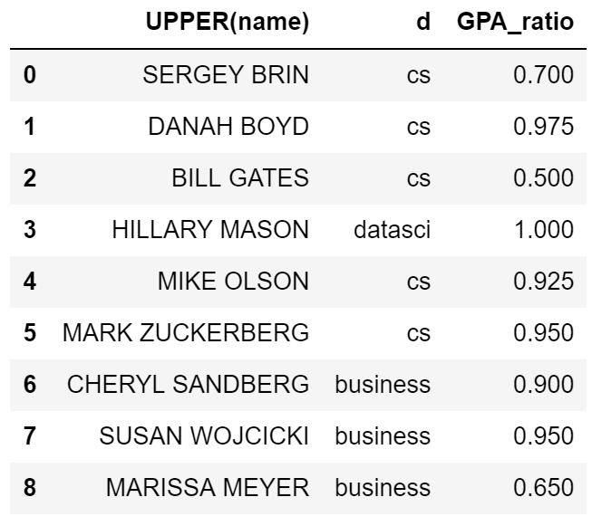
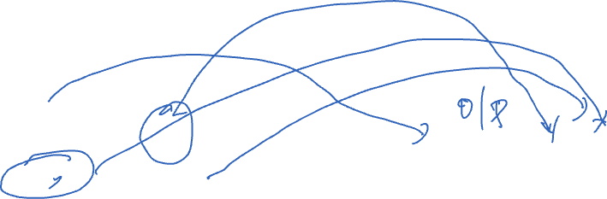
FUNCTIONS IN THE SELECT LIST
SELECT UPPER(name), LOWER(dept) AS d, gpa/4.0 AS GPA_ratio FROM students [WHERE <predicate>] [GROUP BY <column list> [HAVING <predicate>] ] [ORDER BY <column list>] ;
Can provide functions in selection list.
AS lets us alias (name) our columns.

Slide 25

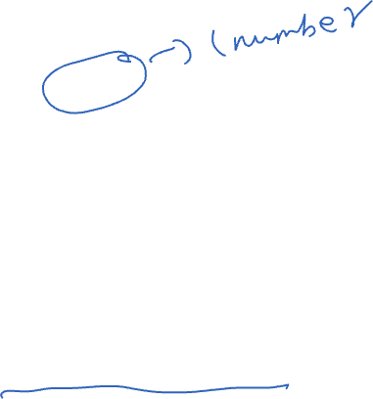
AGGREGATES
SELECT AVG(age) FROM students WHERE dept = 'CS' [GROUP BY <column list> [HAVING <predicate>] ] [ORDER BY <column list>] ;
Before producing output, compute a summary statistic
Aggregates include: SUM, COUNT, MAX, MIN, …
Produces 1 row of output → Still a table
Note: can use DISTINCT inside the agg function
SELECT COUNT(DISTINCT name) …

Slide 26
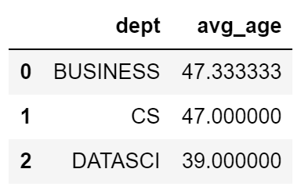

GROUP BY
SELECT dept, AVG(age) FROM students [WHERE <predicate>] GROUP BY dept [HAVING <predicate>] [ORDER BY <column list>] ;
Partition table into groups with same GROUP BY column values
Group By takes a list of columns
Produce an aggregate result per group

Slide 27
WHAT IF WE WANTED TO ONLY CONSIDER DEPARTMENTS THAT HAVE GREATER THAN TWO STUDENTS?
SELECT dept, AVG(age) FROM students [WHERE <predicate>] GROUP BY dept [HAVING <predicate>] [ORDER BY <column list>] ;

Slide 28
WHAT IF WE WANTED TO ONLY CONSIDER DEPARTMENTS THAT HAVE GREATER THAN TWO STUDENTS?
SELECT dept, AVG(age) FROM students WHERE COUNT(*) > 2 GROUP BY dept [HAVING <predicate>] [ORDER BY <column list>] ;
?
Doesn’t work …
WHERE clause is applied before GROUP BY
You cannot have aggregation functions in the where clause

Slide 29
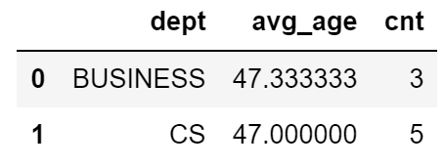
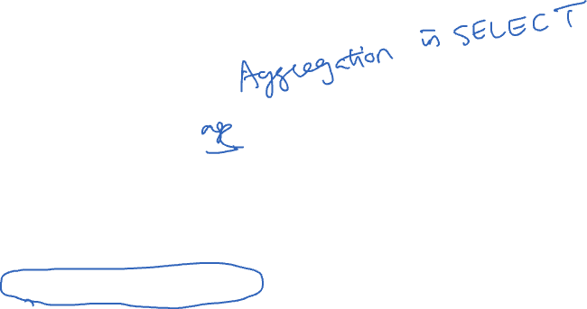
HAVING
SELECT dept, AVG(gpa) as avg_age, COUNT(*) as cnt FROM students [WHERE <predicate>] GROUP BY dept HAVING COUNT(*) > 2 [ORDER BY <column list>] ;
The HAVING predicate is applied after grouping and aggregation
Hence can contain anything that could go in the SELECT list
HAVING can only be used in aggregate queries

Slide 30
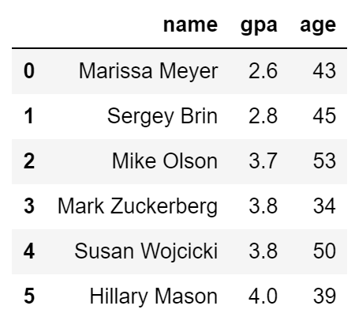
ORDER BY
SELECT name, gpa, age FROM students WHERE name > ‘E' [GROUP BY <column list> [HAVING <predicate>] ] ORDER BY gpa, name;
ORDER BY clause specifies output to be sorted
Lexicographic ordering

Slide 31
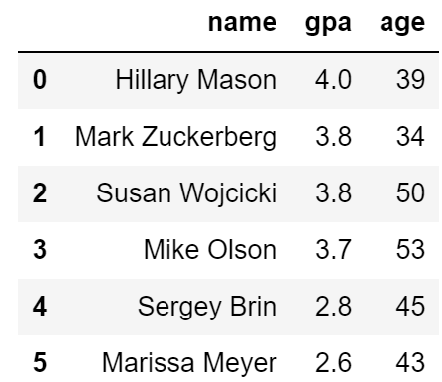
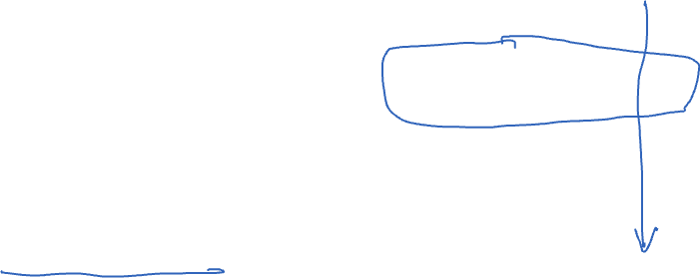
ORDER BY
SELECT name, gpa, age FROM students WHERE name > ‘E' [GROUP BY <column list> [HAVING <predicate>] ] ORDER BY gpa DESC, name ASC;
Ascending order by default
DESC flag for descending, ASC for ascending
Can mix and match, lexicographically

Slide 32
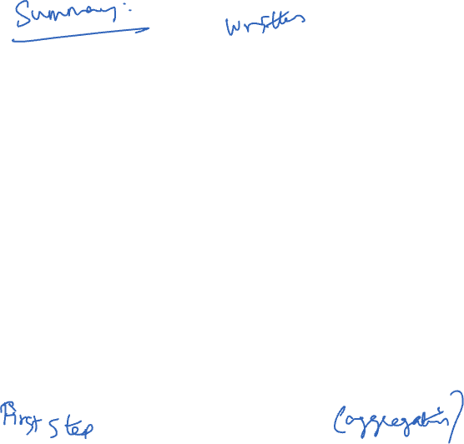
CONCEPTUAL SQL EVALUATION
SELECT [DISTINCT] target-list
FROM relation-list
WHERE qualification
GROUP BY grouping-list
HAVING group-qualification
Try Queries Here
http://sqlfiddle.com/#!17/67109/12
Form groups & aggregate
GROUP BY
[DISTINCT]
Eliminate duplicates
Project away columns
(just keep those used in SELECT, GBY, HAVING)
Apply selections
(eliminate rows)
WHERE
SELECT
One or more tables to use
(cross product …)
Eliminate groups
FROM
HAVING

Slide 33
LIMIT
SELECT [DISTINCT] <column expression list> FROM <single table> [WHERE <predicate>] [GROUP BY <column list> [HAVING <predicate>] ] [ORDER BY <column list>]
[LIMIT <number>];
The LIMIT clause lets us specify the maximum number of results to return. Similar to head().
Does not return a random sample!

Slide 34
TEST YOUR UNDERSTANDING #1
SELECT dept, AVG(gpa) AS avg_gpa, COUNT(*) AS size FROM students WHERE gender = 'F' GROUP BY dept HAVING COUNT(*) > 2 ORDER BY avg_gpa DESC
What does this compute?
GROUP BY
[DISTINCT]
WHERE
SELECT
FROM
HAVING

Slide 35
TEST YOUR UNDERSTANDING #1
SELECT dept, AVG(gpa) AS avg_gpa, COUNT(*) AS size FROM students WHERE gender = 'F' GROUP BY dept HAVING COUNT(*) > 2 ORDER BY avg_gpa DESC
What does this compute?
The average GPA of female students and number of female students in each department where there are at least 3 female students in that department. The results are ordered by the average GPA.
GROUP BY
[DISTINCT]
WHERE
SELECT
FROM
HAVING

Slide 36
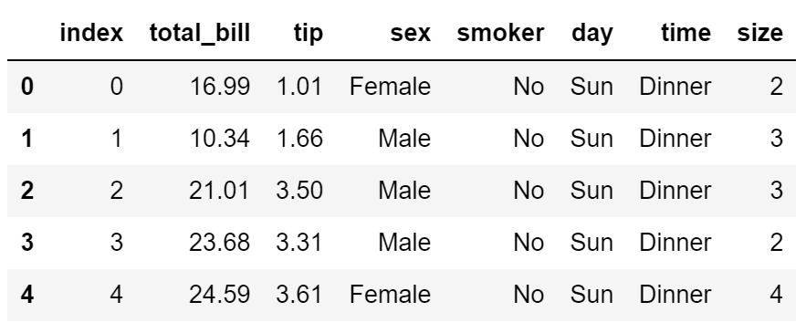
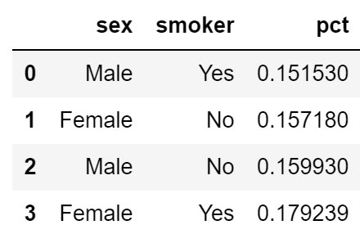
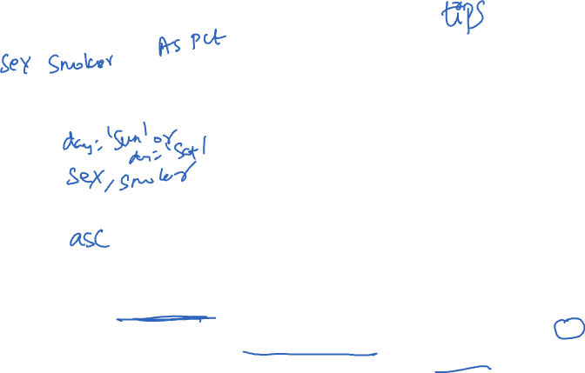
TEST YOUR UNDERSTANDING #2
SELECT ???? FROM tips WHERE ???? GROUP BY ???? HAVING ???? ORDER BY ????
Suppose we want to compare smoker vs. non-smoker and female vs. male tips for weekend diners. Create a table ordered by percentage tip that gives the average tip for all four possibilities.

Slide 37
TEST YOUR UNDERSTANDING #2
SELECT sex, smoker, avg(tip/total_bill) as pct FROM tips WHERE day = 'Sun' OR day = 'Sat' GROUP BY sex, smoker HAVING ORDER BY pct
Suppose we want to compare smoker vs. non-smoker and female vs. male tips for weekend diners. Create a table ordered by percentage tip that gives the average tip for all four possibilities.

Slide 38
DATA IN THE ORGANIZATION
Alert: Watch out for lots of buzzwords

Slide 39
MULTIDIMENSIONAL DATA MODEL
Sales Fact Table
Locations
pid | timeid | locid | sales
11 | 1 | 1 | 25
11 | 2 | 1 | 8
11 | 3 | 1 | 15
12 | 1 | 1 | 30
12 | 2 | 1 | 20
12 | 3 | 1 | 50
12 | 1 | 1 | 8
13 | 2 | 1 | 10
13 | 3 | 1 | 10
11 | 1 | 2 | 35
11 | 2 | 2 | 22
11 | 3 | 2 | 10
12 | 1 | 2 | 26
12 | 2 | 2 | 45
12 | 3 | 2 | 20
13 | 1 | 2 | 20
13 | 2 | 2 | 40
13 | 3 | 2 | 5
locid | city | state | country
1 | Omaha | Nebraska | USA
2 | Seoul |  | Korea
5 | Richmond | Virginia | USA
Dimension
Tables
Products
Fact Table
minimizes redundant info.
Reduces data errors
Dimensions
easy to manage and summarize
Rename: Galaxy1 🡪 Phablet
pid | pname | category | price
11 | Corn | Food | 25
12 | Galaxy 1 | Phones | 18
13 | Peanuts | Food | 2
Time
timeid | Date | Day
1 | 3/30/16 | Wed.
2 | 3/31/16 | Thu.
3 | 4/1/16 | Fri.

Slide 40
CONNECTIONS BETWEEN TABLE
Products
Time
pid | pname | category | price
timeid | Date | Day
Sales Fact Table
pid | timeid | locid | sales
How do we do analysis?
Joins!!!!!
Locations
locid | city | state | country
Trivia: This approach is sometimes called a “star schema” because drawing resembles a star with our fact table at the center, and other tables at the points.

Slide 41
JOINS!
Bringing tables together for decades.

Slide 42
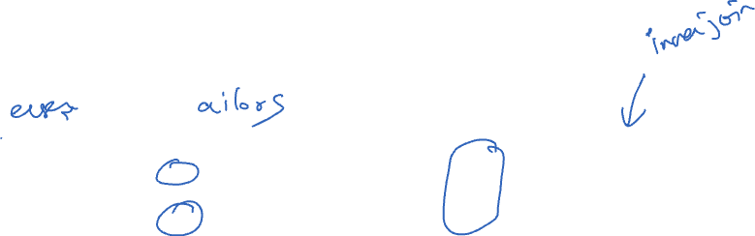
JOINS
We’ve seen the idea of joining tables many times.
Joins can be thought of as a 2-step process:
Form the cartesian product (see next slide).
Select the rows where common attributes are equal.
Symbol for join (Rel. Alg.)
R:
S:
R ⋈ S
sid | bid | day
22 | 101 | 10/10/96
58 | 103 | 11/12/96
sid | sname | rating | age
22 | dustin | 7 | 45.0
31 | lubber | 8 | 55.5
58 | rusty | 10 | 35.0
sid | bid | day | sid | sname | rating | age
22 | 101 | 10/10/96 | 22 | dustin | 7 | 45.0
58 | 103 | 11/12/96 | 58 | rusty | 10 | 35.0
http://sqlfiddle.com/#!17/53815/1140/0

Slide 43
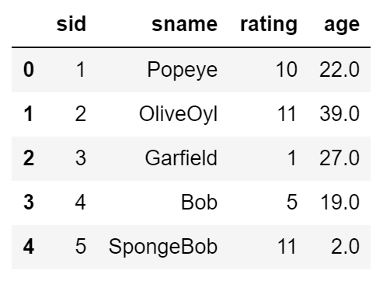
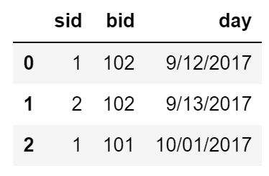
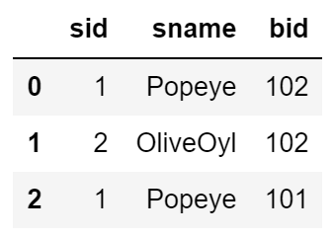
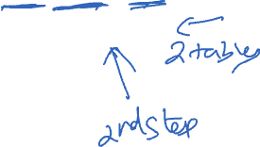
BASIC JOINS
Sailors
Reserves
SELECT s.sid, s.sname, r.bid
FROM Sailors s, Reserves r
WHERE s.sid = r.sid
AND s.age > 20;
Can select from multiple tables.
By ensuring sids are equal we get an inner join.
http://sqlfiddle.com/#!17/4215a/10

Slide 44



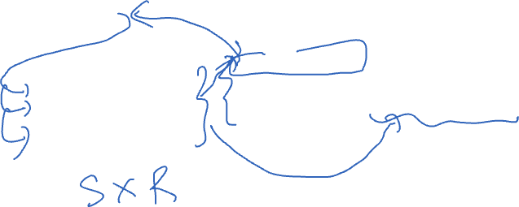
THE CARTESIAN PRODUCT (×)
R × S: Each row of R paired with each row of S
R:
R × S
sid | bid | day
22 | 101 | 10/10/96
58 | 103 | 11/12/96
sid | bid | day | sid | sname | rating | age
22 | 101 | 10/10/96 | 22 | dustin | 7 | 45.0
22 | 101 | 10/10/96 | 31 | lubber | 8 | 55.5
22 | 101 | 10/10/96 | 58 | rusty | 10 | 35.0
58 | 103 | 11/12/96 | 22 | dustin | 7 | 45.0
58 | 103 | 11/12/96 | 31 | lubber | 8 | 55.5
58 | 103 | 11/12/96 | 58 | rusty | 10 | 35.0
×
S:
=
sid | sname | rating | age
22 | dustin | 7 | 45.0
31 | lubber | 8 | 55.5
58 | rusty | 10 | 35.0
How many rows in the result?
|R| * |S|
More general idea in set theory:
2
1
2,a
2,b
2,c
1,a
1,b
1,c
Sometimes called the cross product.
a b c

Slide 45
THE CARTESIAN PRODUCT IN SQL
R × S
SELECT * FROM Reserves AS R, Sailors AS S;
sid | bid | day | sid | sname | rating | age
22 | 101 | 10/10/96 | 22 | dustin | 7 | 45.0
22 | 101 | 10/10/96 | 31 | lubber | 8 | 55.5
22 | 101 | 10/10/96 | 58 | rusty | 10 | 35.0
58 | 103 | 11/12/96 | 22 | dustin | 7 | 45.0
58 | 103 | 11/12/96 | 31 | lubber | 8 | 55.5
58 | 103 | 11/12/96 | 58 | rusty | 10 | 35.0
R:
S:
sid | bid | day
22 | 101 | 10/10/96
58 | 103 | 11/12/96
sid | sname | rating | age
22 | dustin | 7 | 45.0
31 | lubber | 8 | 55.5
58 | rusty | 10 | 35.0

Slide 46
JOINING SAILORS AND RESERVATIONS
R ⋈ S
Joins can be thought of as a 2-step process:
Form the cartesian product.
Select the rows where common attributes are equal.
sid | bid | day | sid | sname | rating | age
22 | 101 | 10/10/96 | 22 | dustin | 7 | 45.0
22 | 101 | 10/10/96 | 31 | lubber | 8 | 55.5
22 | 101 | 10/10/96 | 58 | rusty | 10 | 35.0
58 | 103 | 11/12/96 | 22 | dustin | 7 | 45.0
58 | 103 | 11/12/96 | 31 | lubber | 8 | 55.5
58 | 103 | 11/12/96 | 58 | rusty | 10 | 35.0
R:
S:
sid | bid | day
22 | 101 | 10/10/96
58 | 103 | 11/12/96
sid | sname | rating | age
22 | dustin | 7 | 45.0
31 | lubber | 8 | 55.5
58 | rusty | 10 | 35.0
R ⋈ S
sid | bid | day | sid | sname | rating | age
22 | 101 | 10/10/96 | 22 | dustin | 7 | 45.0
58 | 103 | 11/12/96 | 58 | rusty | 10 | 35.0

Slide 47
RELATIONAL ALGEBRA
R ⋈ S
Joins can be thought of as a 2-step process:
Form the cartesian product.
Select the rows where common attributes are equal.
If this seems cool, consider learning about relational algebra.
Provides a mathematical foundation for databases.
Video 1: [Link]
Video 2: [Link]
sid | bid | day | sid | sname | rating | age
22 | 101 | 10/10/96 | 22 | dustin | 7 | 45.0
22 | 101 | 10/10/96 | 31 | lubber | 8 | 55.5
22 | 101 | 10/10/96 | 58 | rusty | 10 | 35.0
58 | 103 | 11/12/96 | 22 | dustin | 7 | 45.0
58 | 103 | 11/12/96 | 31 | lubber | 8 | 55.5
58 | 103 | 11/12/96 | 58 | rusty | 10 | 35.0
R ⋈ S
sid | bid | day | sid | sname | rating | age
22 | 101 | 10/10/96 | 22 | dustin | 7 | 45.0
58 | 103 | 11/12/96 | 58 | rusty | 10 | 35.0

Slide 48
JOINING SAILORS AND RESERVATIONS IN SQL
R ⋈ S
SELECT * FROM Reserves AS R, Sailors AS S WHERE R.sid = S.sid;
sid | bid | day | sid | sname | rating | age
22 | 101 | 10/10/96 | 22 | dustin | 7 | 45.0
22 | 101 | 10/10/96 | 31 | lubber | 8 | 55.5
22 | 101 | 10/10/96 | 58 | rusty | 10 | 35.0
58 | 103 | 11/12/96 | 22 | dustin | 7 | 45.0
58 | 103 | 11/12/96 | 31 | lubber | 8 | 55.5
58 | 103 | 11/12/96 | 58 | rusty | 10 | 35.0
R:
S:
sid | bid | day
22 | 101 | 10/10/96
58 | 103 | 11/12/96
sid | sname | rating | age
22 | dustin | 7 | 45.0
31 | lubber | 8 | 55.5
58 | rusty | 10 | 35.0
R ⋈ S
sid | bid | day | sid | sname | rating | age
22 | 101 | 10/10/96 | 22 | dustin | 7 | 45.0
58 | 103 | 11/12/96 | 58 | rusty | 10 | 35.0

Slide 49
JOINING SAILORS AND RESERVATIONS IN SQL
SELECT * FROM Reserves AS R, Sailors AS S WHERE R.sid = S.sid;
Conceptually useful to think of joining as:
Form the cartesian product.
Select the rows where common attributes are equal.
However, SQL engine does not implement joins this way.
Query optimizer does something much more efficient.

Slide 50

RANGE VARIABLES AND AS
The right hand side of AS keyword are “range variables”.
Also possible to define range variables without AS keyword.
Range variables often technically optional, but do use them!
SELECT R.sid, sname, age FROM Reserves AS R, Sailors AS S WHERE R.sid = S.sid;
SELECT R.sid, sname, age FROM Reserves R, Sailors S WHERE R.sid = S.sid;
sid | sname | age
22 | dustin | 45.0
58 | rusty | 35.0
SELECT Reserves.sid, sname, age FROM Reserves, Sailors WHERE Reserves.sid = Sailors.sid;
Technically might work, but not recommended…

Slide 51
NONEQUI JOINS
The joins we’ve seen so far are equi joins: rows from two tables are matched based only on equality conditions.
If rows are matched some other way, then we have a nonequi join.
SELECT S1.sname as junior_name, S1.age as junior_age,
S2.sname as senior_name, S2.age as senior_age
FROM Sailors AS S1, Sailors AS S2
WHERE S1.age < S2.age
Sailors
sid | sname | rating | age
22 | dustin | 7 | 45.0
31 | lubber | 8 | 55.5
58 | rusty | 10 | 35.0
S1 |  | S2
junior_name | junior_age | senior _name | senior_age
rusty | 35.0 | dustin | 45.0
dustin | 45.0 | lubber | 55.5
rusty | 35.0 | lubber | 55.5
http://sqlfiddle.com/#!17/53815/4

Slide 52

INNER/NATURAL JOINS
Sailors
Boats
sid | sname | rating | age
1 | Fred | 7 | 22
2 | Jim | 2 | 39
3 | Nancy | 8 | 27
bid | bname | color
101 | Nina | red
102 | Pinta | blue
103 | Santa Maria | red
SELECT s.sid, s.sname, r.bid
FROM Sailors s, Reserves r
WHERE s.sid = r.sid
AND s.age > 20;
SELECT s.sid, s.sname, r.bid
FROM Sailors s INNER JOIN Reserves r
ON s.sid = r.sid
WHERE s.age > 20;
SELECT s.sid, s.sname, r.bid
FROM Sailors s NATURAL JOIN Reserves r WHERE s.age > 20;
Reserves
sid | bid | day
1 | 102 | 9/12
2 | 102 | 9/13
“NATURAL” means equijoin for each pair of attributes with the same name
Most common format!
all 3 are equivalent!
http://sqlfiddle.com/#!17/4215a/10

Slide 53
JOIN VARIANTS
SELECT (column_list)
FROM table_name
[INNER | LEFT OUTER |RIGHT OUTER | FULL OUTER] JOIN table_name
ON qualification_list
WHERE …
INNER is default
Inner join is akin to what we have seen so far.
FULL OUTER is the equivalent of join=‘outer’ in pandas.
“OUTER” is optional, but recommended for clarity.

Slide 54
LEFT JOIN
Returns all matched rows, and preserves all unmatched rows from the table on the left of the join clause
(use nulls in fields of non-matching tuples)
SELECT s.sid, s.sname, r.bid
FROM Sailors2 s LEFT OUTER JOIN Reserves2 r
ON s.sid = r.sid;
Returns all sailors & bid for boat in any of their reservations
Note: If there is a sailor without a boat reservation then the sailor is matched with the NULL bid.

Slide 55
SELECT S.SID, S.SNAME, R.BID FROM SAILORS2 S LEFT OUTER JOIN RESERVES2 R ON S.SID = R.SID;
Sailors2
Reserves2
sid | sname | rating | age
22 | Dustin | 7 | 45
31 | Lubber | 8 | 55.5
95 | Bob | 3 | 63.5
sid | bid | day
22 | 101 | 1996-10-10
95 | 103 | 1996-11-12
sid | sname | bid
22 | Dustin | 101
95 | Bob | 103
31 | Lubber | (null)
http://sqlfiddle.com/#!17/54a88/2

Slide 56
LEFT JOIN VS. LEFT OUTER JOIN
SELECT s.sid, s.sname, r.bid
FROM Sailors2 s LEFT OUTER JOIN Reserves2 r
ON s.sid = r.sid;
is the exact same as:
SELECT s.sid, s.sname, r.bid
FROM Sailors2 s LEFT JOIN Reserves2 r
ON s.sid = r.sid;
Also called a Left Outer Join (note that there is no such thing as a Left Inner Join)

Slide 57
RIGHT JOIN
Right join returns all matched rows, and preserves all unmatched rows from the table on the right of the join clause
SELECT r.sid, b.bid, b.bname
FROM Reserves2 r RIGHT OUTER JOIN Boats2 b
ON r.bid = b.bid;
Returns all boats & information on which ones are reserved.
No match for b.bid? r.sid IS NULL!
As before, there is no such thing as a right inner join!

Slide 58
SELECT R.SID, B.BID, B.BNAME FROM RESERVES2 R RIGHT OUTER JOIN BOATS2 B ON R.BID = B.BID;
Boats2
Reserves2
bid | bname | color
101 | Interlake | blue
102 | Interlake | red
103 | Clipper | green
104 | Marine | red
sid | bid | day
22 | 101 | 1996-10-10
95 | 103 | 1996-11-12
sid | bid | bname
22 | 101 | Interlake
95 | 103 | Clipper
(null) | 104 | Marine
(null) | 102 | Interlake
Result:
http://sqlfiddle.com/#!17/a7b2f/1

Slide 59
FULL OUTER JOIN
Full Outer Join returns all (matched or unmatched) rows from the tables on both sides of the join clause
SELECT r.sid, b.bid, b.bname
FROM Reserves2 r FULL OUTER JOIN Boats2 b
ON r.bid = b.bid
If no boat for a sailor? 🡪 b.bid IS NULL AND b.bname IS NULL!
If no sailor for a boat? 🡪 r.sid IS NULL!
Is this the same as Cartesian Product?

Slide 60
SELECT R.SID, B.BID, B.BNAME FROM RESERVES3 R FULL JOIN BOATS2 B ON R.BID = B.BID
Boats2
Reserves3
bid | bname | color
101 | Interlake | blue
102 | Interlake | red
103 | Clipper | green
104 | Marine | red
sid | bid | day
22 | 101 | 1996-10-10
95 | 103 | 1996-11-12
38 | 42 | 2010-08-21
Result:
sid | bid | bname
22 | 101 | Interlake
95 | 103 | Clipper
38 | (null) | (null)
(null) | 104 | Marine
(null) | 102 | Interlake
http://sqlfiddle.com/#!17/e1f3a/3/0

Slide 61
NULL VALUES
Field values are sometimes unknown
SQL provides a special value NULL for such situations.
Every data type can be NULL
The presence of null complicates many issues. E.g.:
Selection predicates (WHERE)
Aggregation
But NULLs are common after outer joins

Slide 62
NULL IN THE WHERE CLAUSE
Consider a tuple where rating IS NULL.
If we run the following query
Jack Sparrow will not be included in the output.
INSERT INTO sailors VALUES (11, 'Jack Sparrow', NULL, 35);
SELECT * FROM sailors
WHERE rating > 8;
http://sqlfiddle.com/#!17/36ca9/2

Slide 63
NULL IN COMPARATORS
What entries are in the output of all these queries?
SELECT rating = NULL FROM sailors;
SELECT rating < NULL FROM sailors;
SELECT rating >= NULL FROM sailors;
SELECT * FROM sailors WHERE rating = NULL;
Rule: (x op NULL) evaluates to … NULL!
All of these queries evaluate to null!
Even this one!
http://sqlfiddle.com/#!17/f35aa/6

Slide 64
EXPLICIT NULL CHECKS
To check if a value is NULL you must use explicit NULL checks
SELECT * FROM sailors WHERE rating IS NULL;
SELECT * FROM sailors WHERE rating IS NOT NULL;
http://sqlfiddle.com/#!17/f35aa/4

Slide 65
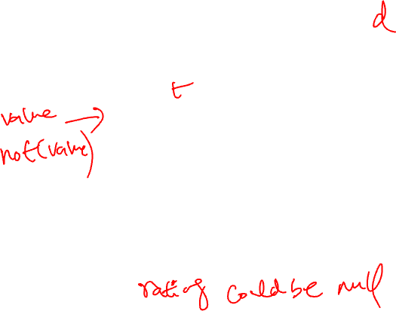
NULL IN BOOLEAN LOGIC
And
Or
 | T | F | N
T | T | F | N
F | F | F | F
N | N | F | N
 | T | F | N
T | T | T | T
F | T | F | N
N | T | N | N
Three-valued logic:
SELECT * FROM sailors WHERE rating > 8 AND TRUE;
SELECT * FROM sailors WHERE rating > 8 OR TRUE;
SELECT * FROM sailors WHERE NOT (rating > 8);
Not
T | F | N
F | T | N
http://sqlfiddle.com/#!17/f35aa/2

Slide 66
NULL AND AGGREGATION
SELECT count(rating) FROM sailors;
4
SELECT sum(rating) FROM sailors;
27
SELECT avg(rating) FROM sailors;
??
SELECT count(*) FROM sailors;
??
sid | sname | rating | age
1 | Popeye | 10 | 22
2 | OliveOyl | 11 | 39
3 | Garfield | 1 | 27
4 | Bob | 5 | 19
11 | Jack Sparrow | (null) | 35
http://sqlfiddle.com/#!17/f35aa/7

Slide 67
NULL AND AGGREGATION
SELECT count(rating) FROM sailors;
4
SELECT sum(rating) FROM sailors;
27
SELECT avg(rating) FROM sailors;
(10+11+1+5) / 4 = 6.75
SELECT count(*) FROM sailors;
5
sid | sname | rating | age
1 | Popeye | 10 | 22
2 | OliveOyl | 11 | 39
3 | Garfield | 1 | 27
4 | Bob | 5 | 19
11 | Jack Sparrow | (null) | 35
http://sqlfiddle.com/#!17/f35aa/7

Slide 68
NULLS: SUMMARY
NULL op NULL is NULL
WHERE NULL: do not send to output
Boolean connectives: 3-valued logic
Aggregates ignore NULL-valued inputs

Slide 69
