Slide 1
Hypothesis Testing: Bonferroni correction

Slide 2

Project Check-in
Have you signed up for Github Classroom? Please accept the individual assignment (not graded, just Github basics) and the team assignment
Have a team on Github? Join the team – you can find the team number in the team assignment email
Then have a project proposal for the team in ppt format (Gradescope Submission)

Slide 3


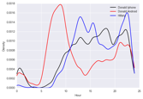
NOW
Formulate Question or Problem
Acquire and Clean Data
?
Inferential statistics
Hypothesis testing
Prediction
and inference
Exploratory Data Analysis
Reports, Decisions, and Solutions

Slide 4
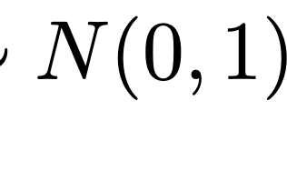
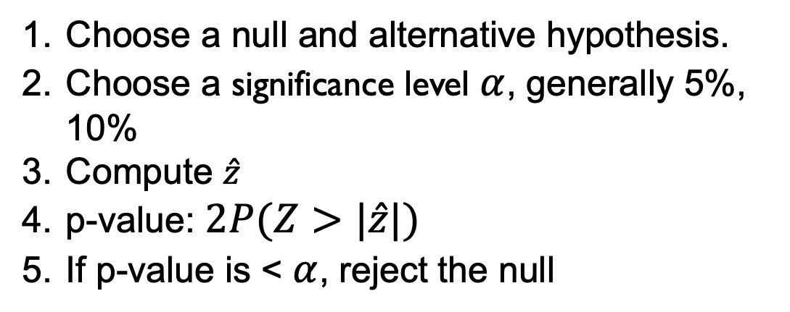

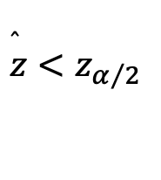
Running a Hypothesis Test
Choose a null and alternative hypothesis.
Choose a significance level $α$, generally 5%, 10%
Compute $\hat{z}$
p-value: $2P(Z>|\hat{z}|)$
If p-value is < $α$, reject the null
$$\overset{̂}{z}<z_{α/2}$$

Slide 5

P-VALUE
A 𝒑-value is the probability of obtaining a result that is as extreme or more extreme than the observed data if the null hypothesis were true
If the 𝒑-value is less than the specified significance level 𝜶 (commonly set at 0.05), then we conclude that the null hypothesis is false and the alternative hypothesis provides a better explanation of the observed data
The lower the p-value, the less likely that the observed data supports the null
This does not exclude the possibility that our conclusion commits a error
A statistically significant result differs enough from the null hypothesis that a conclusion can be inferred about the population
Statistical significance does not necessarily imply practical significance of a result
Notes:
p 值的含义：
p 值提供了一种衡量方式，表示在假设 H0H_0H0​ 为真的前提下，观察到的数据有多么极端。p 值越小，意味着在假设 H0H_0H0​ 成立的情况下，观察到数据的概率越小，从而让我们更倾向于认为 H0H_0H0​ 不成立。
与显著性水平的比较：
显著性水平 α\alphaα 是预设的阈值，用于判断是否可以拒绝 H0H_0H0​。常用的显著性水平是 0.05，表示有 5% 的容许错误概率。如果 p 值小于 α\alphaα，则结果被视为统计上显著，我们可以拒绝 H0H_0H0​ 而支持备择假设 HaH_aHa​。
p 值与支持原假设的可能性：
较低的 p 值表示在假设 H0H_0H0​ 为真的情况下获得观察结果的概率非常小。因此，小 p 值表示我们的数据与 H0H_0H0​ 的假设差异较大，从而减弱了对 H0H_0H0​ 的支持。
错误可能性：
尽管小 p 值可能导致我们拒绝 H0H_0H0​，但这不意味着绝对正确。我们仍有可能犯错误，例如在 H0H_0H0​ 真实的情况下错误地拒绝它（称为第一类错误）。因此，p 值只是概率性判断，而非绝对性结论。
统计显著性 vs. 实际显著性：
统计显著性仅指在统计上差异足够大，但这并不一定表示该差异在实际中有重要性。例如，一个实验可能显示两种治疗方法在统计上有显著差异，但实际效果差异可能很小，不具有临床意义。因此，统计显著性和实际显著性是两个不同的概念，前者强调数据差异的概率性，后者强调差异在现实应用中的重要性。

Slide 6

P-VALUE (WORD OF CAUTION)
“𝒑-values are not substitutes for common sense.”
The American Statistical Association (ASA) provides a set of principles for the proper use and interpretation of 𝒑-values, including:
𝒑-values do not measure the probability that the studied hypothesis is true, or the probability that the data were produced by random chance alone.”
“Scientific conclusions and business or policy decisions should not be based only on whether a 𝒑-value passes a specific threshold.”
“Proper inference requires full reporting and transparency.”
“A 𝒑-value, or statistical significance, does not measure the size of an effect or the importance of a result.”
“By itself, a 𝒑-value does not provide a good measure of evidence regarding a model or hypothesis.”
Source: https://doi.org/10.1080/00031305.2016.1154108
Notes:
p 值是统计推断的一部分，但不能孤立地作为决策的依据。有效的推断和决策需要结合常识、上下文信息和对数据的全面理解，确保结论的科学性和合理性。

Slide 7

HOW TO COMPUTE A P-VALUE IN GENERAL?
Multiple tests exist for computing the p-value (in cases beyond Binary Variables) and providing a comprehensive review is beyond the scope of this class
Differ based on the assumptions they make
Different tests may be best suited to different hypothesis tests and data
We may cover more tests later in the semester (e.g., when we talk about A/B testing)
We will go over two generic and popular ways to compute a p-value:
z-test
t-test

Slide 8
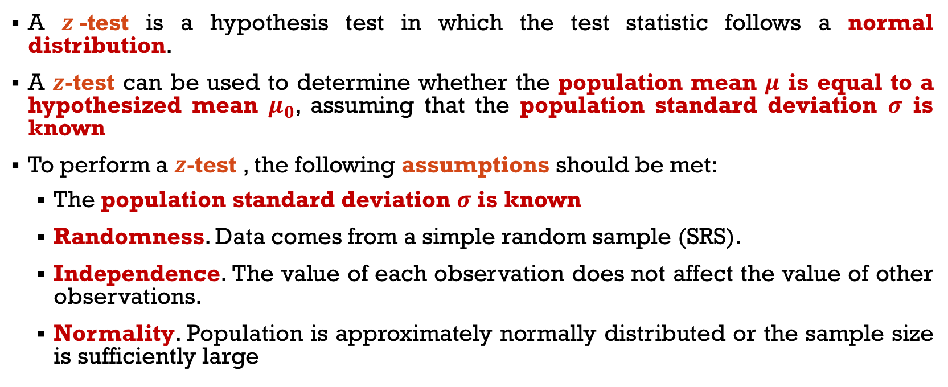
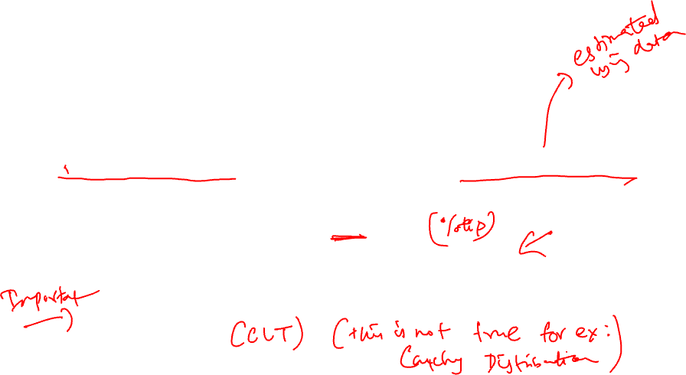
GENERAL Z-TEST FOR POPULATION MEANS
Notes:
(typically, more than 30 observations)

Slide 9
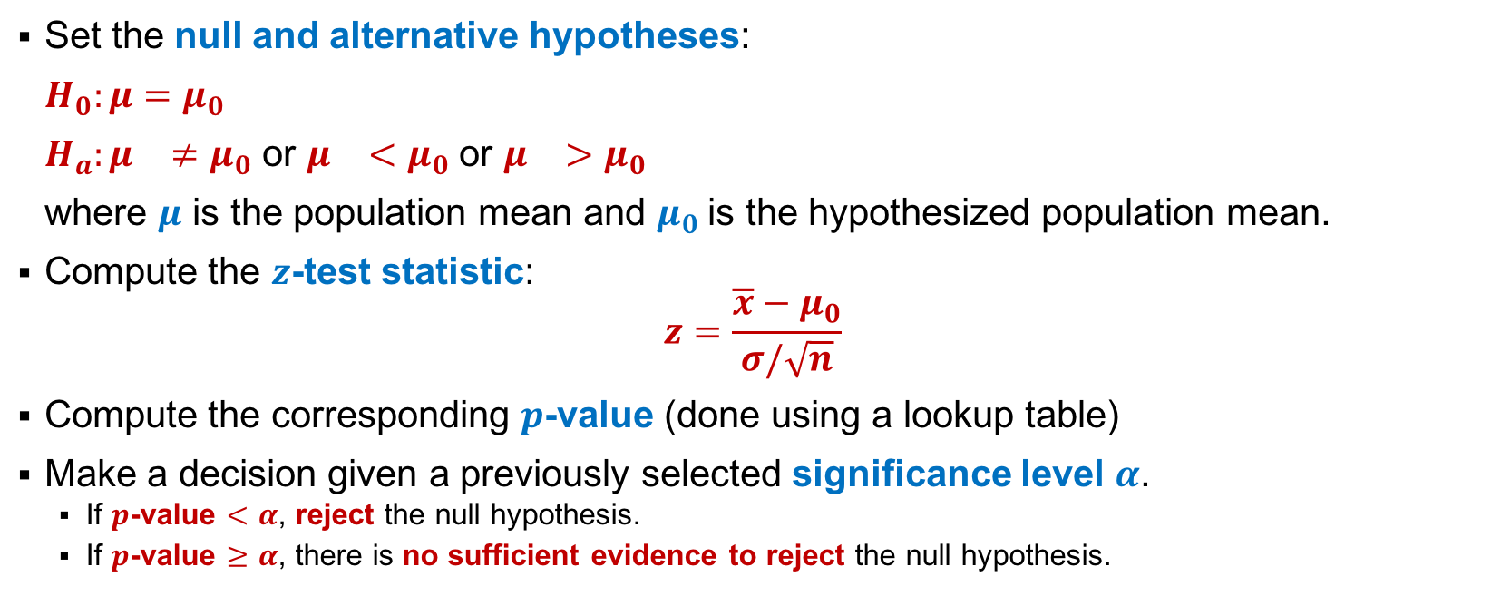
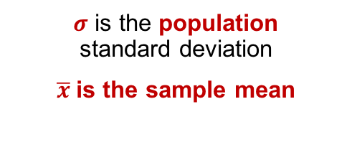
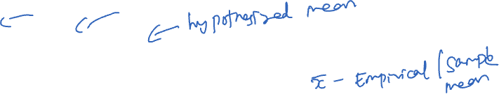
GENERAL Z-TEST FOR POPULATION MEANS
Notes:
would the sample give us enough evidence to reject the null?

Slide 10
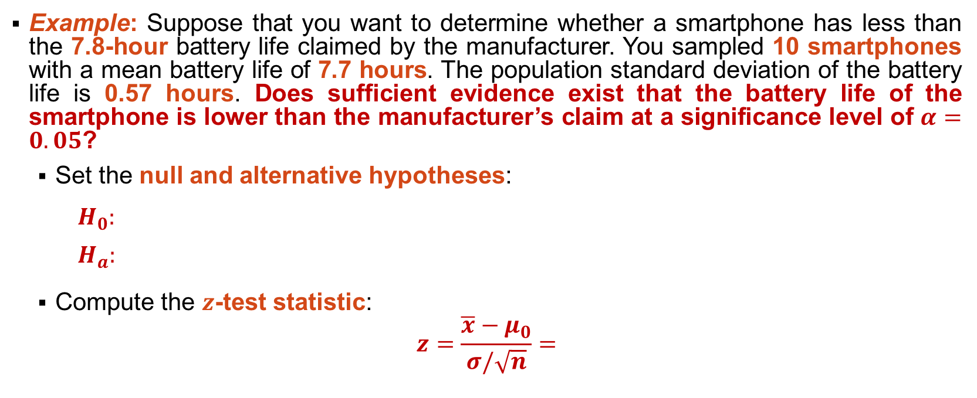

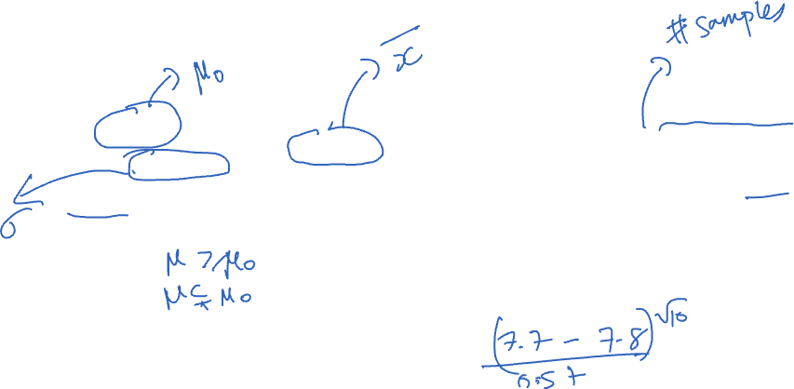
Z-TEST EXAMPLE
Notes:
H0: Battery life is more than or equal to 7.8 hours
H1: Battery life is less than 7.8 hours
Left-tailed test

Slide 11
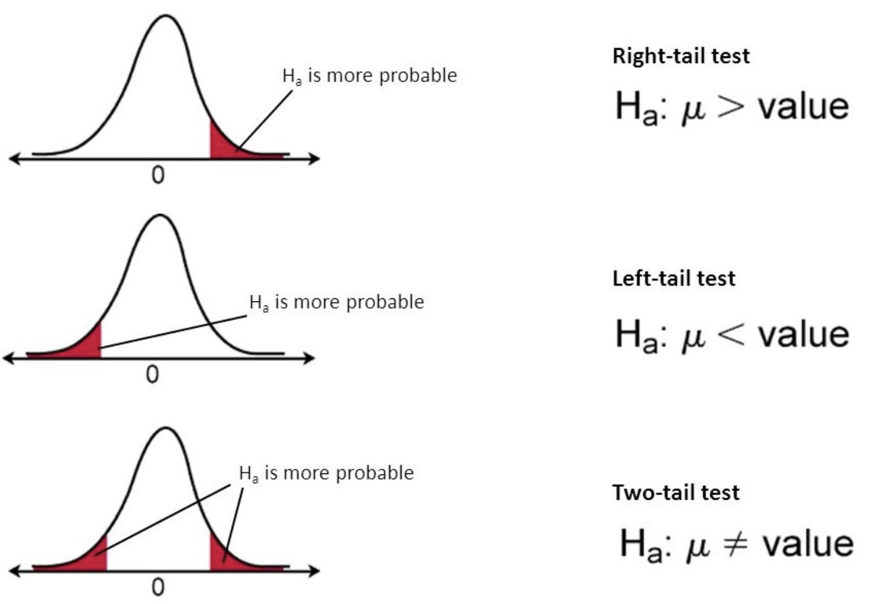
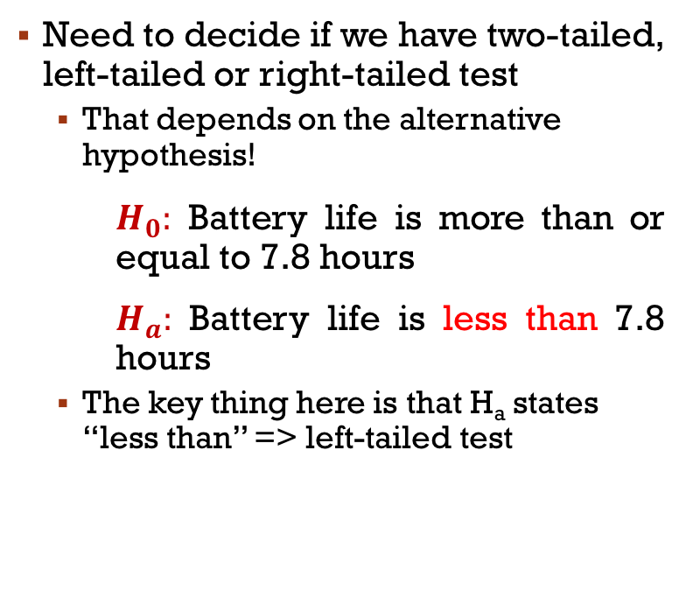
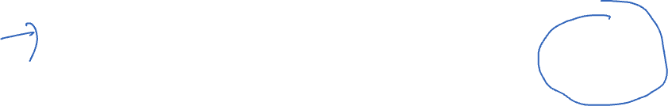
Z-TEST EXAMPLE
Notes:
https://www.statisticshowto.datasciencecentral.com/how-to-decide-if-a-hypothesis-test-is-a-left-tailed-test-or-a-right-tailed-test/
Draw a normal distribution (+/- sigma = 68%, +/- 2sigma = 95%, +/-3sigma = 99.7% data)

Slide 12
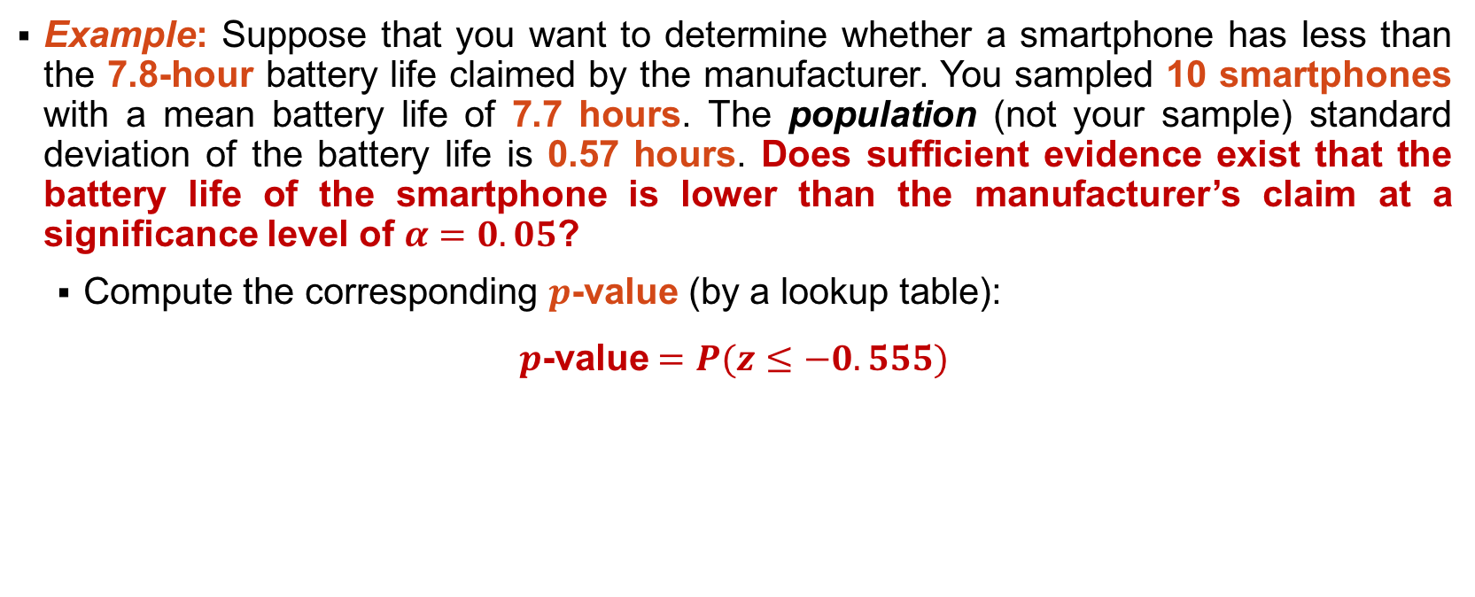

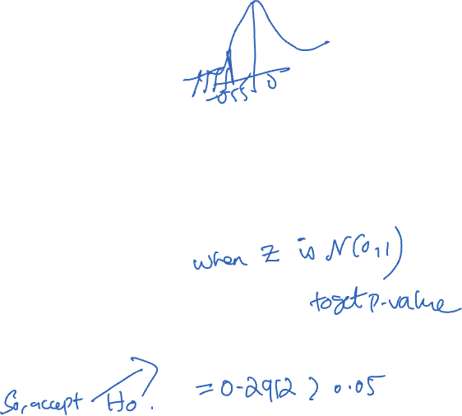
Z-TEST FOR POPULATION MEANS
Reject the null.
Not reject the null.
In Python (with scipy):
A 𝒑-value is the probability of obtaining a result that is as extreme or more extreme than the observed data if the null hypothesis were true
import scipy.stats as st st.norm.cdf(-0.555)

Slide 13
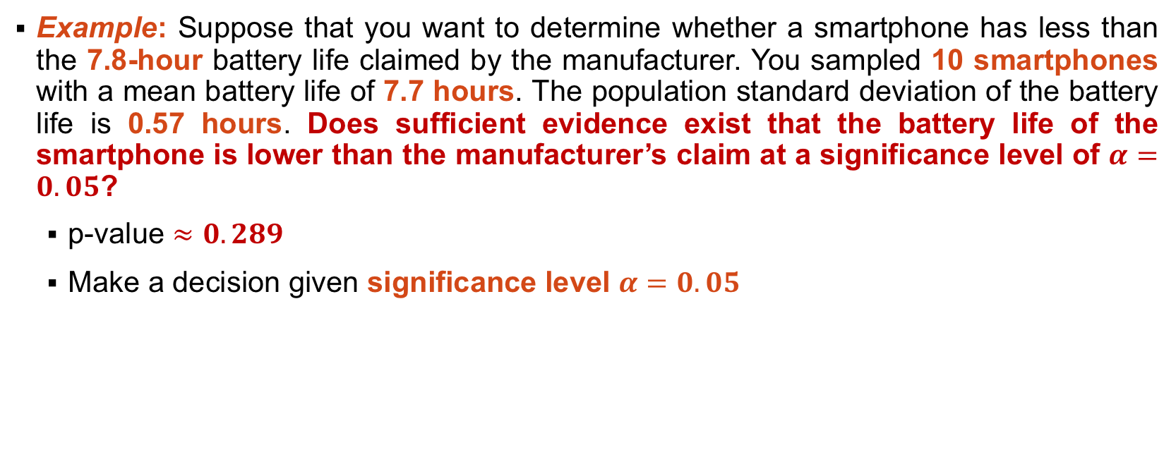
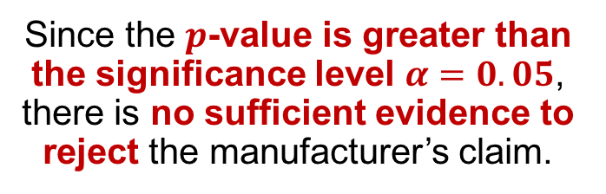
Z-TEST FOR POPULATION MEANS

Slide 14
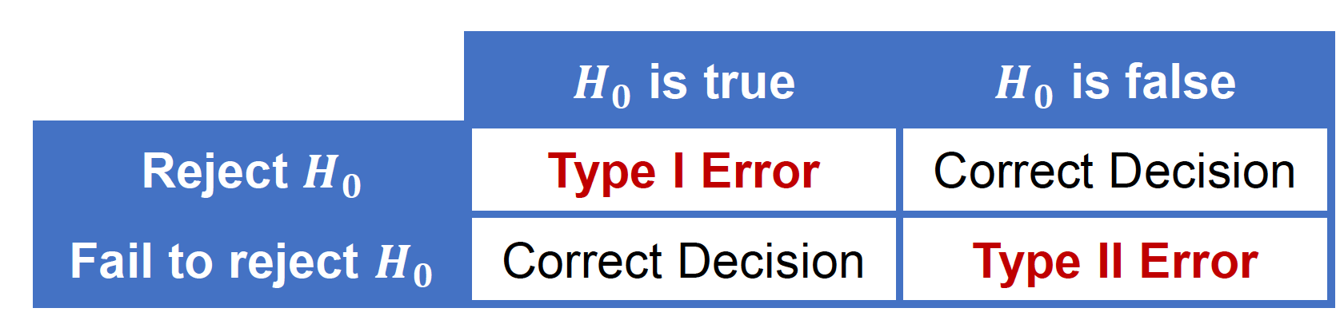
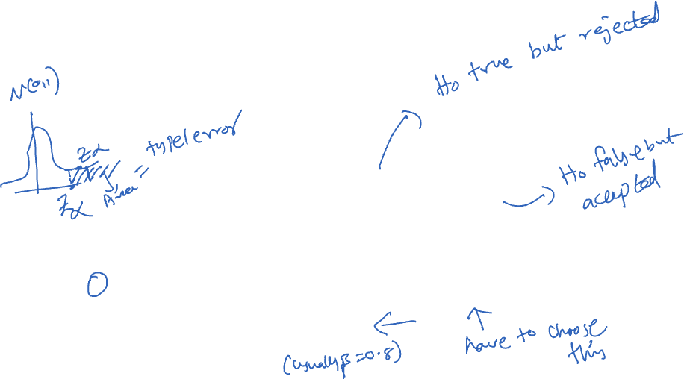
TYPE I AND TYPE II ERRORS
A hypothesis test has four possible outcomes:
Each of the errors occurs with a particular probability. Recall: A 𝒑-value is the probability of obtaining a result that is as extreme or more extreme than the observed data if the null hypothesis were true
𝜶 is the probability of rejecting the null hypothesis when the null hypothesis is true (type I error)
𝜷 is the probability of failing to reject the null hypothesis when the null hypothesis is false (type II error)
The significance level of a hypothesis test is 𝜶
The power of a hypothesis test is 𝟏−𝜷

Slide 15
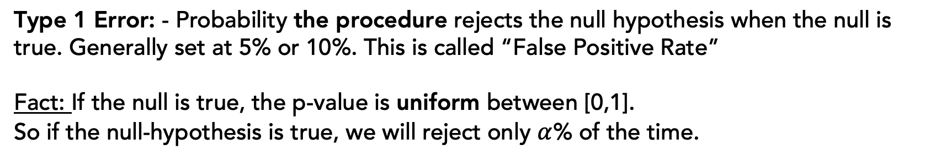
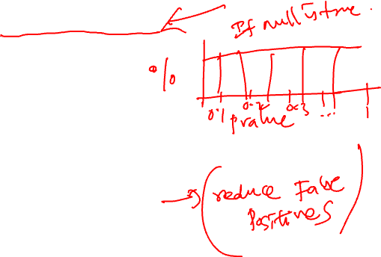
Types of Error
Type 1 Error: - Probability the procedure rejects the null hypothesis when the null is true. Generally set at 5% or 10%. This is called “False Positive Rate”
Fact: If the null is true, the p-value is uniform between [0,1].
So if the null-hypothesis is true, we will reject only $α$% of the time.
Power: If the null hypothesis is false, the probability that you reject it for the alternative. Generally set it to 80%
Type 2 Error = 1 - Power (probability of not rejecting the null when it is false). This is called as ”False Negative Rate”
Prioritize Type 1 - if the cost of switching is high.
E.g. - you have a vision system in place for detecting …

Slide 16
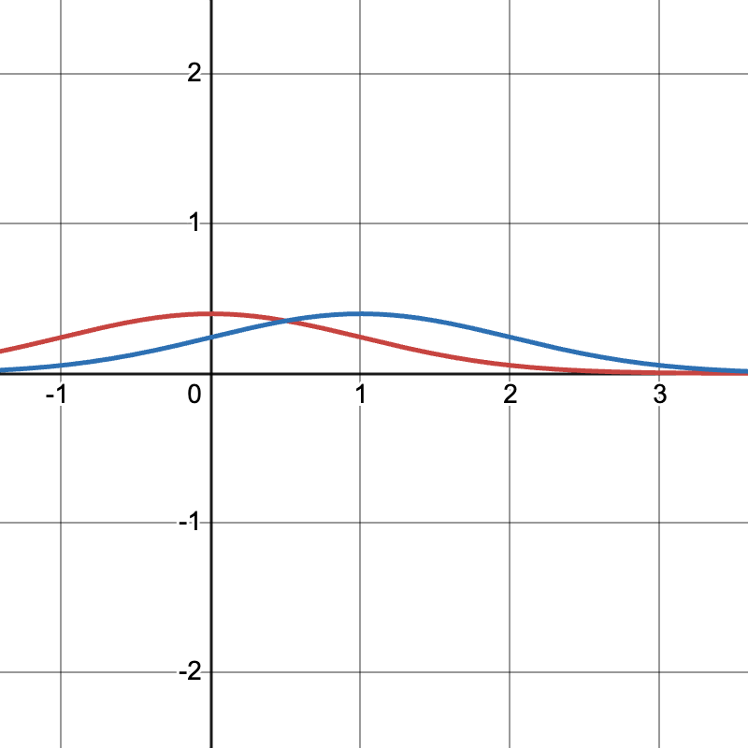
Types of Error
Power: If the null hypothesis is false, the probability that you reject it for the alternative. Generally set it to 80%
Type 2 Error = 1 - Power (probability of not rejecting the null when it is false)

Slide 17
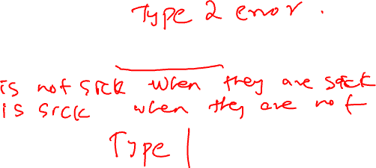
TYPE I AND TYPE II ERRORS
Suppose that the null hypothesis is that your rock climbing equipment is safe.
A. The type I error is thinking that the rock climbing equipment is not safe when, in fact, it is safe
B. The type II error is thinking that the rock climbing equipment is safe when, in fact, it is not safe.
Which error has greater consequence?
Suppose that the null hypothesis is that a patient is sick. What are the type I and type II errors?
A. Type I error:
B. Type II error:
Which error has the greater consequence?
Notes:
Climbing: greater consequence is the type II error
A. Type I error: Thinking that the patient is not sick when, in fact, they are sick
B. Type II error: Thinking that the patient is sick when, in fact, they are not sick

Slide 18
TYPE I AND TYPE II ERRORS
Suppose that the null hypothesis is that your rock climbing equipment is safe.
A. The type I error is thinking that the rock climbing equipment is not safe when, in fact, it is safe
B. The type II error is thinking that the rock climbing equipment is safe when, in fact, it is not safe.
Which error has greater consequence?
Suppose that the null hypothesis is that a patient is sick. What are the type I and type II errors?
A. Type I error: Thinking that the patient is not sick when, in fact, they are sick
B. Type II error: Thinking that the patient is sick when, in fact, they are not sick
Which error has the greater consequence?
Notes:
Climbing: greater consequence is the type II error

Slide 19
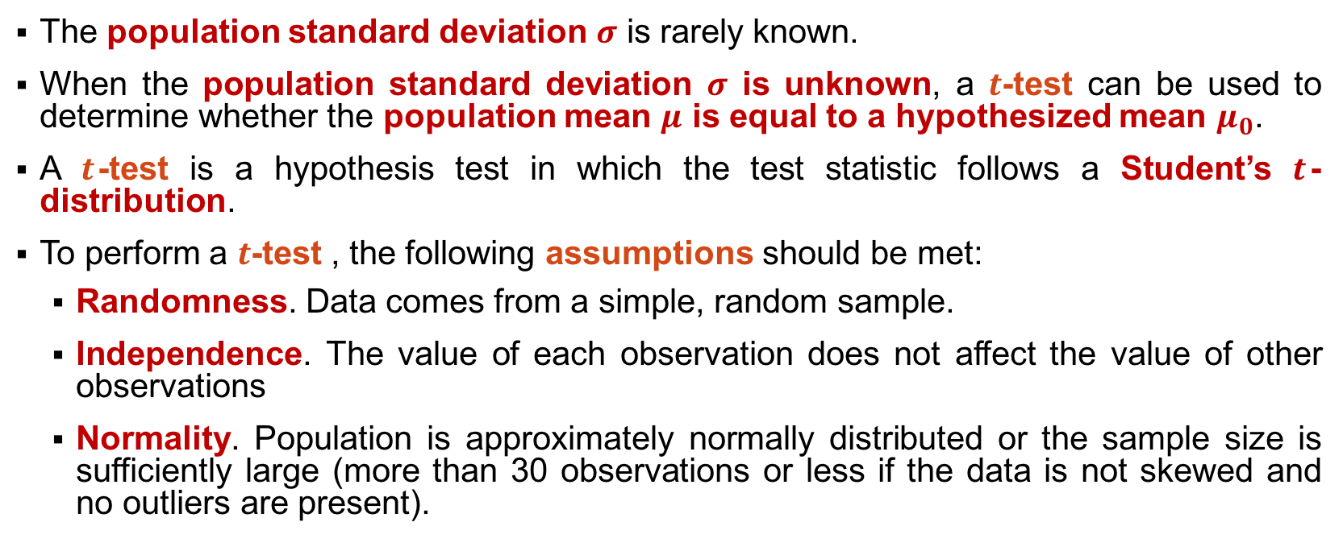
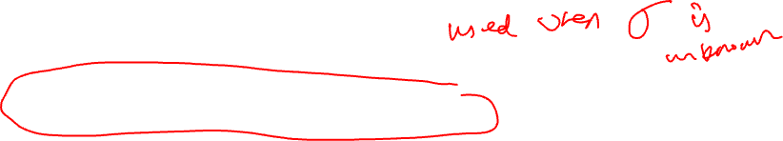
T-TEST FOR POPULATION MEANS

Slide 20
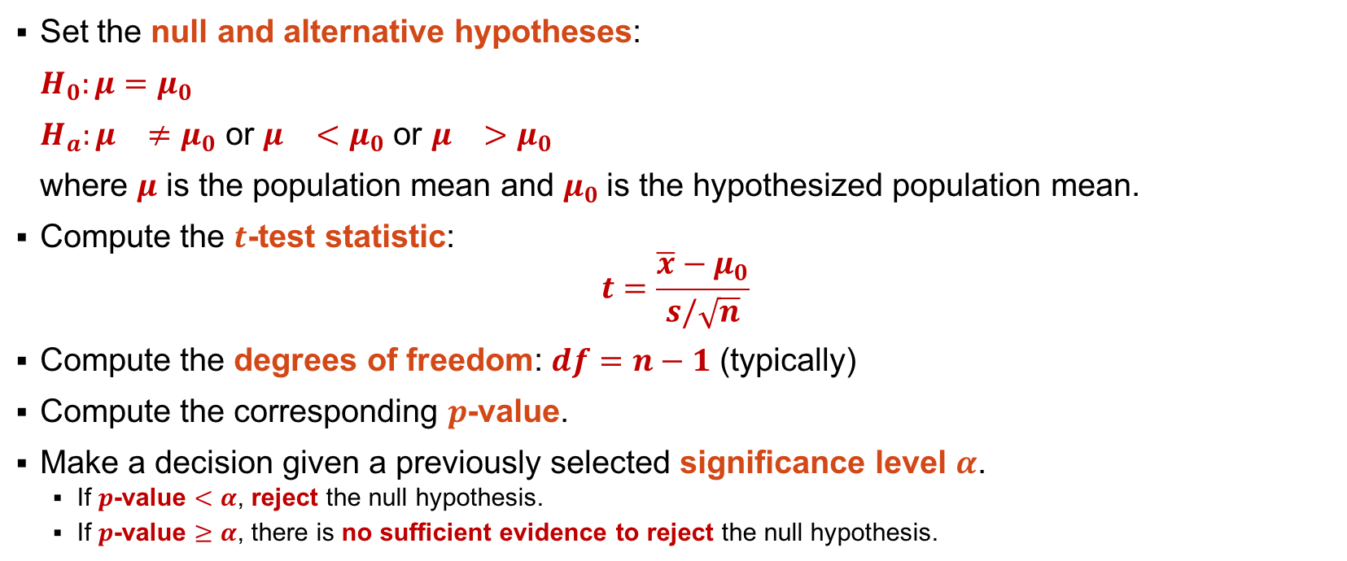
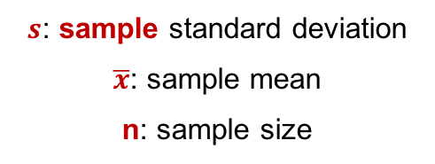
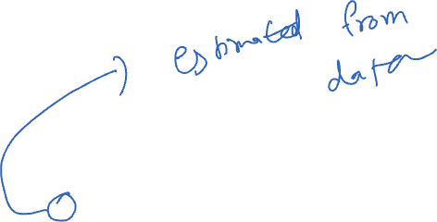
T-TEST FOR POPULATION MEANS
Notes:
degrees of freedom is equal to the sample size minus the number of intermediate parameters.

Slide 21
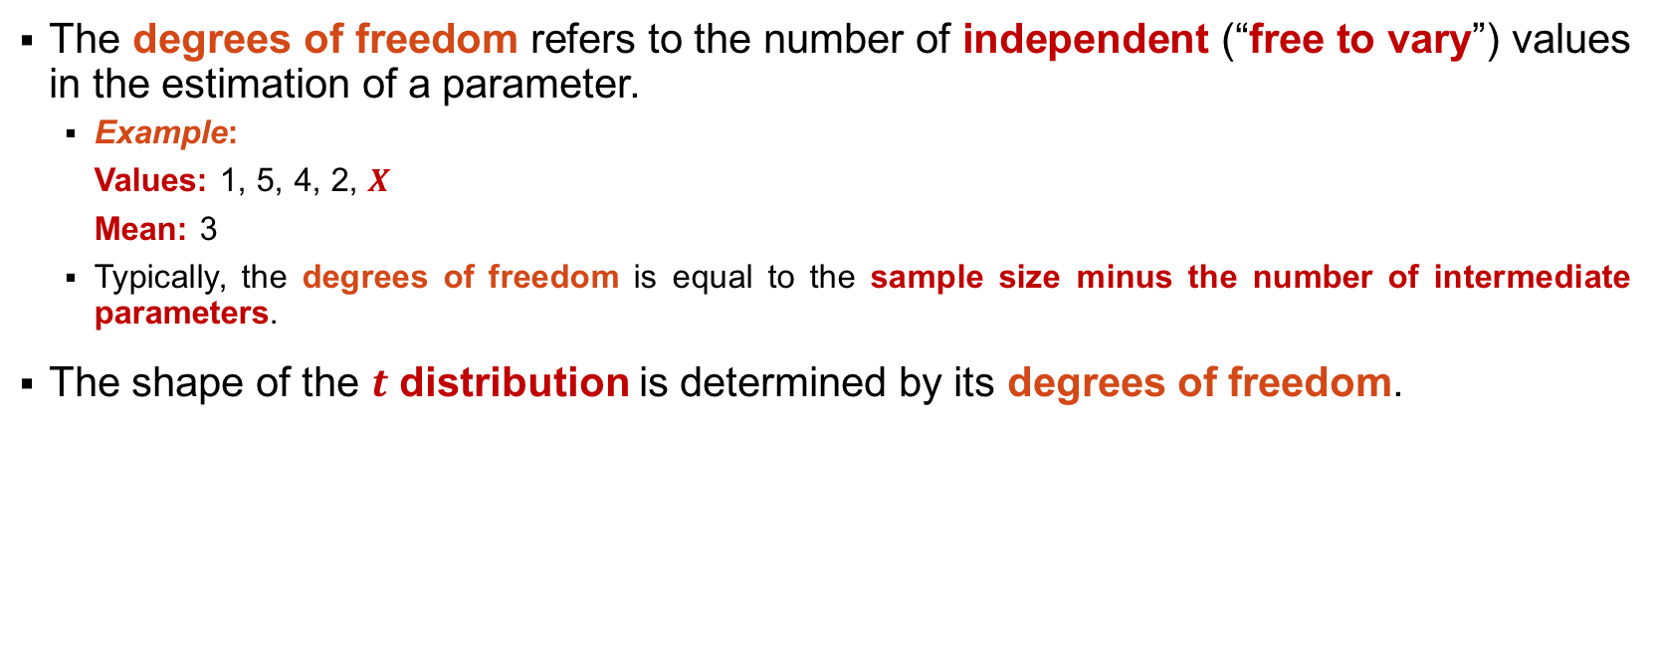

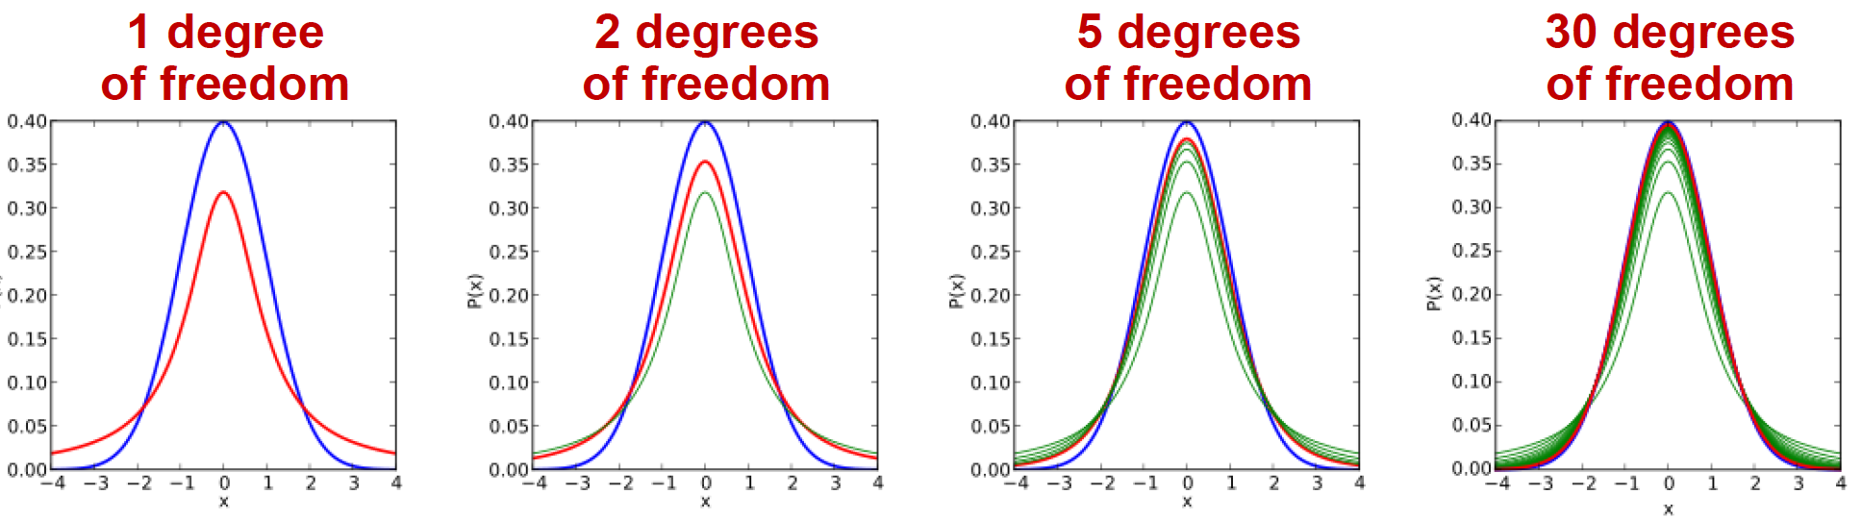
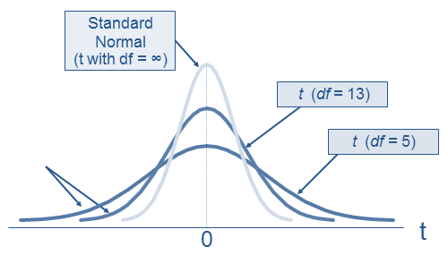
T-TEST FOR POPULATION MEANS

Slide 22
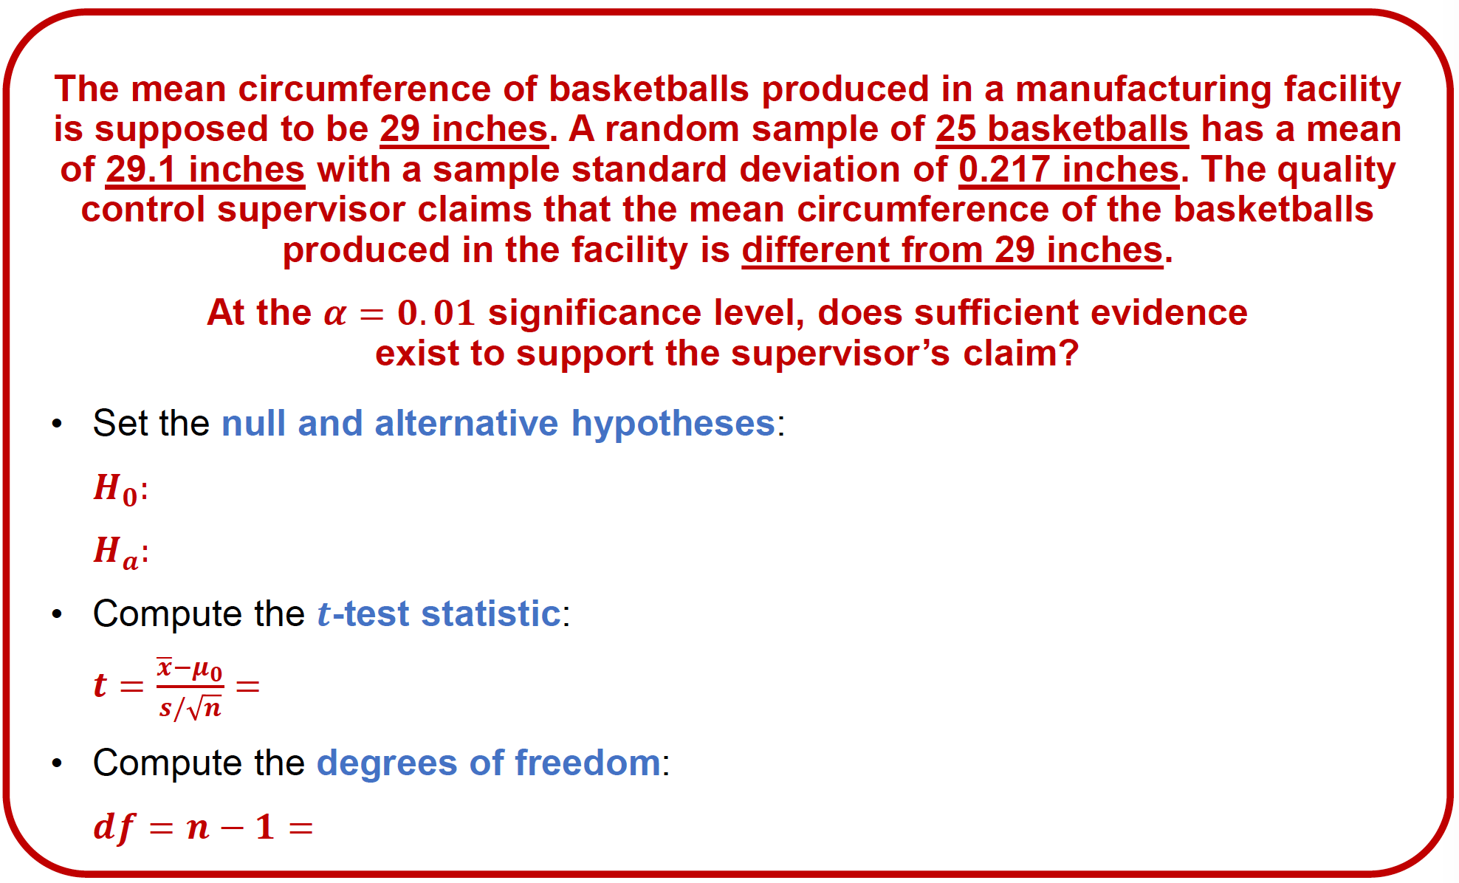
EXERCISE
Notes:
Probability of less than t is 98.49%
import scipy.stats as st
st.t.cdf((0.1*5/0.217),24)
0.984910430480964
P-value is 0.03
We cannot reject the null.

Slide 23
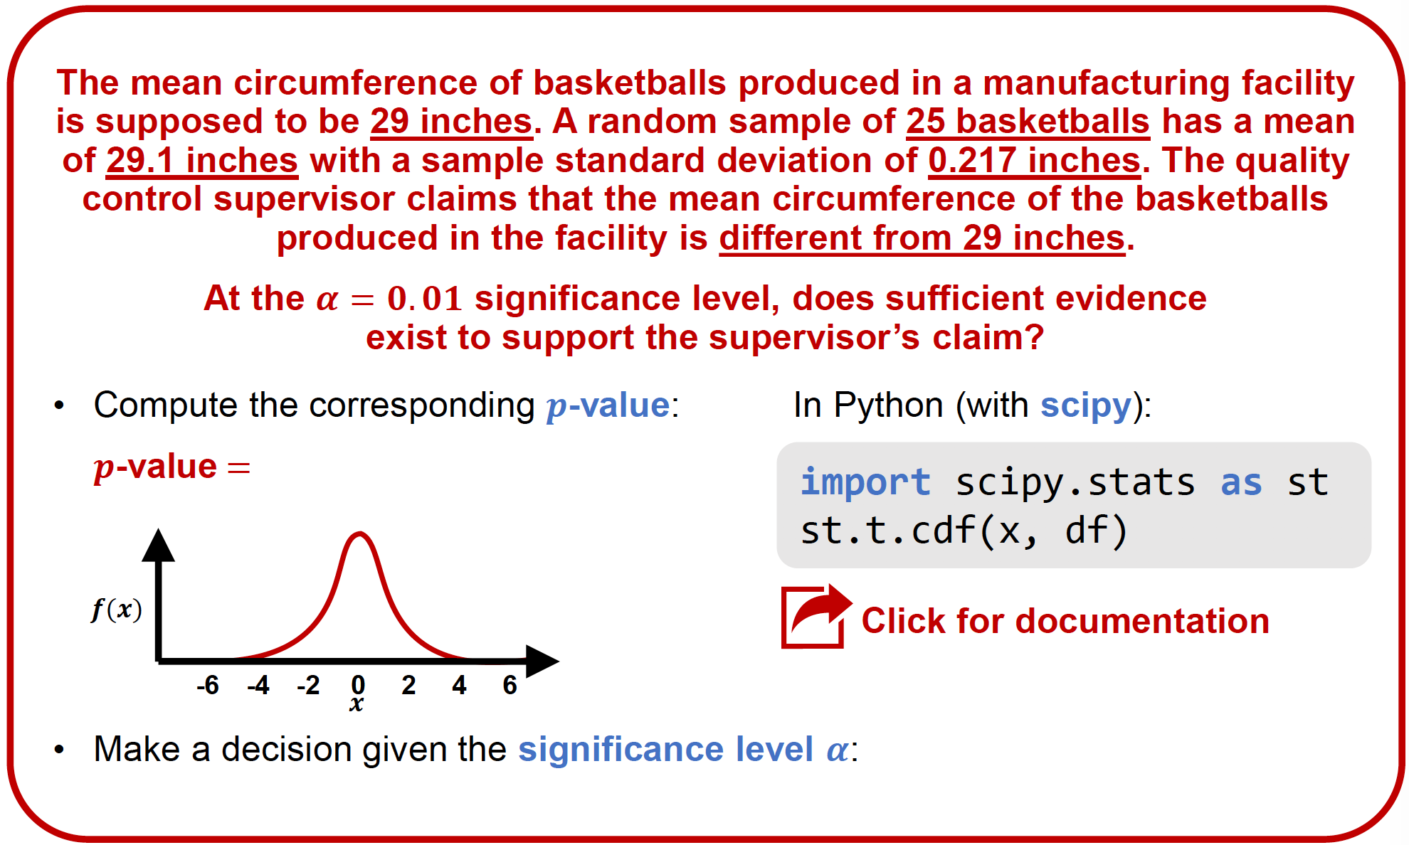
EXERCISE
Notes:
Probability of less than t is 98.49%
import scipy.stats as st
st.t.cdf((0.1*5/0.217),24)
0.984910430480964
P-value is 0.03
We cannot reject the null.

Slide 24
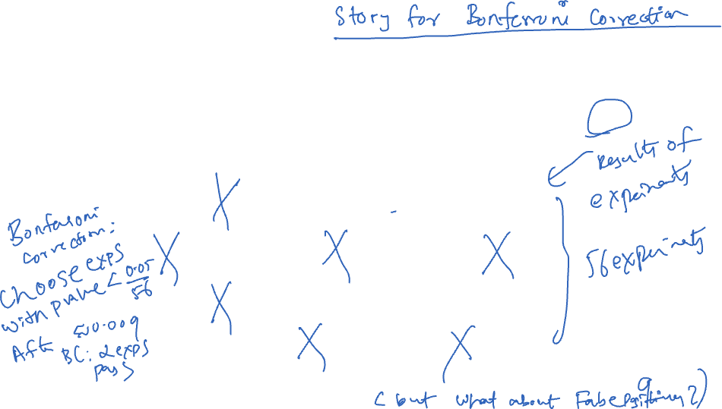
Large Scale Experimentation
Let’s assume we are running 10000 experiments this year. Each experiment can be a subpopulation for example, or various testing conditions.
In each experiment, we compute a p-value, and then reject the null at the 5% significance level.
p-values
.2
.1
.04
.22
.43
.6
.9
.2
.001
.67
.3
.5
.2
.12
.04
.1
.4
.22
.43
.6
.01
.2
.3
.72
.35
.7
.01
.21
.91
.6
.04
.003
.56
.32
.45
.2
.81
.67
.3
.6
.28
.12
.2
.34
.78
.22
.79
.02
.92
.3
.1
.67
.3
.05
.40
.12
How many experiments will we declare to be significant - i.e. declared as a discovery?

Slide 25
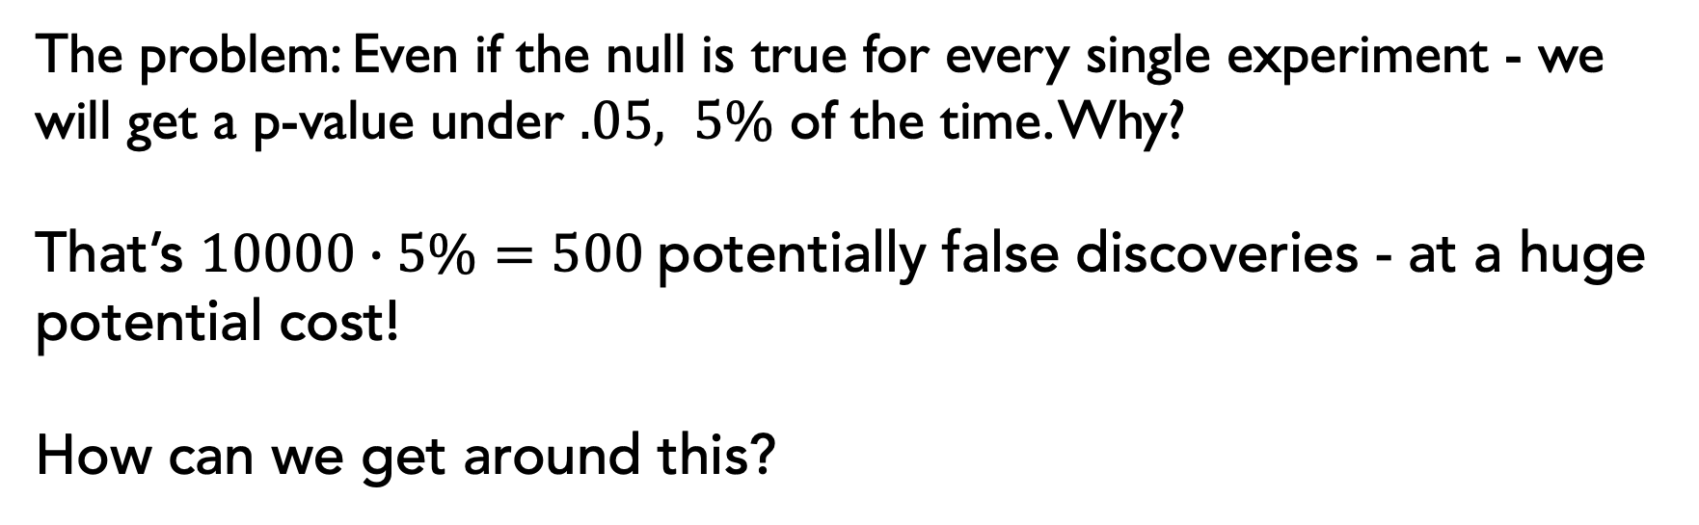

How can we correct this?
The problem: Even if the null is true for every single experiment - we will get a p-value under $.05, 5\%$ of the time. Why?
That’s $10000∙5\%=500$potentially false discoveries - at a huge potential cost!
How can we get around this?

Slide 26
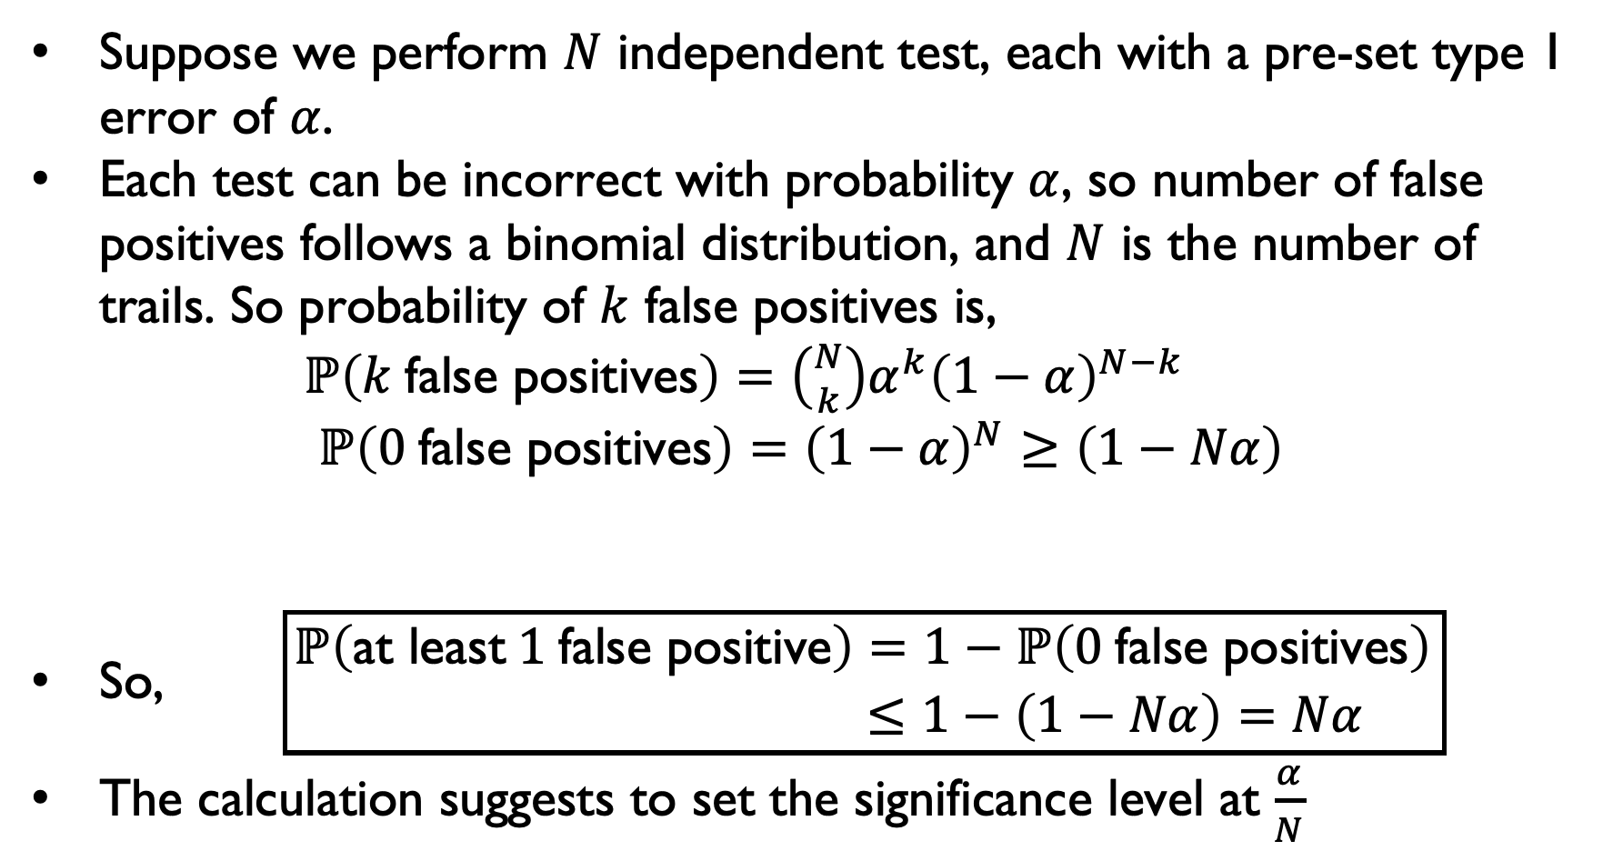
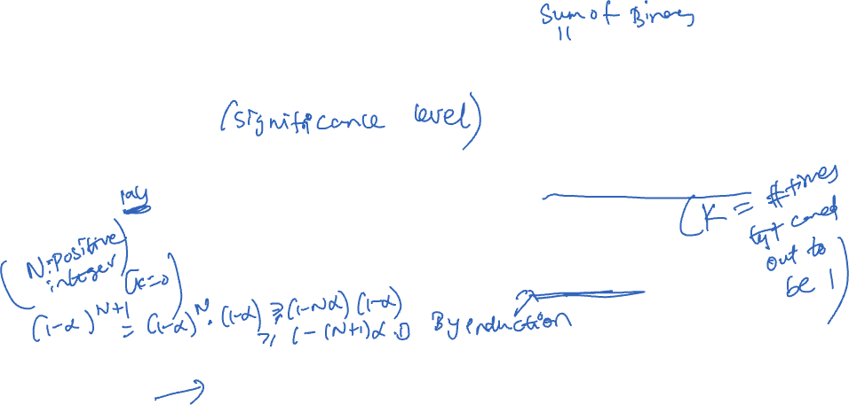
How many false positives? Intuition from Binomial Distribution
Suppose we perform $N$ independent test, each with a pre-set type 1 error of $α$.
Each test can be incorrect with probability $α$, so number of false positives follows a binomial distribution, and $N$ is the number of trails. So probability of $k$ false positives is, $ℙ\left(k \text{false} \text{positives}\right)=\left({N \atop k}\right)α^{k}{\left(1−α\right)}^{N−k}$ $ℙ\left(0 \text{false} \text{positives}\right)={\left(1−α\right)}^{N}≥\left(1−Nα\right)$
So, $\boxed{\begin{aligned}ℙ\left(\text{at} \text{least} 1 \text{false} \text{positive}\right)=1−ℙ\left(0 \text{false} \text{positives}\right) \\ ≤1−\left(1−Nα\right)=Nα \end{aligned}}$
The calculation suggests to set the significance level at $\frac{α}{N}$

Slide 27
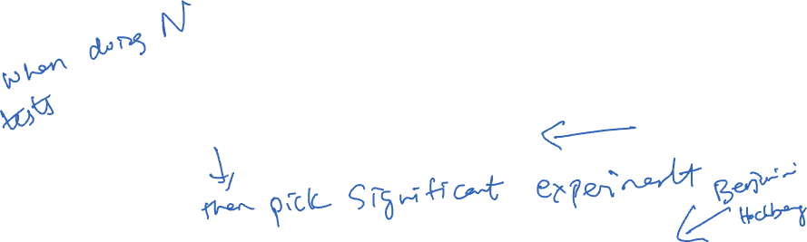
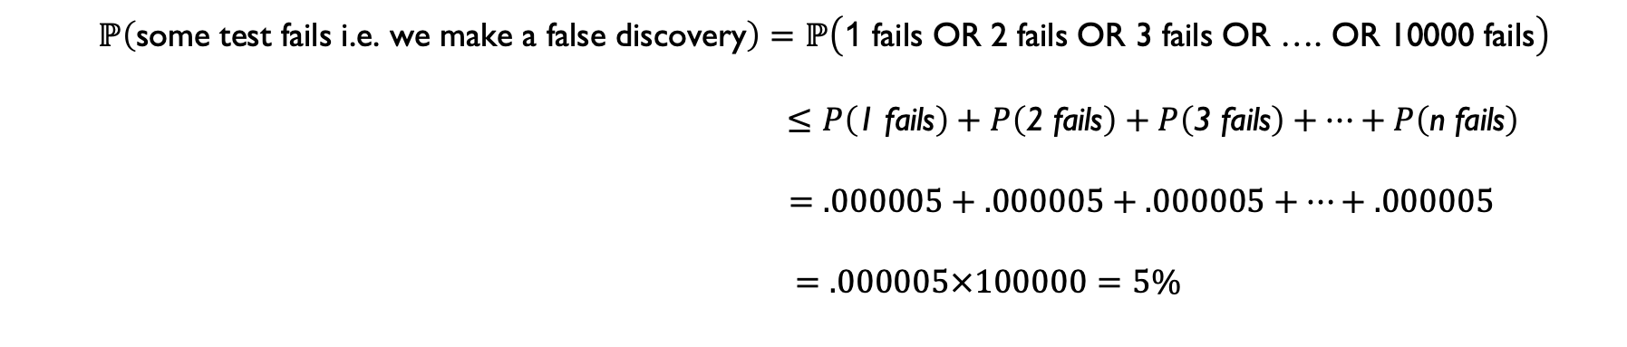
Going back to Multiple Hypothesis Testing
The calculation from before suggests to set the significance level at .000005 = .05/10000, assuming only nulls. Now, formal justification:
$$ℙ\left(\text{some} \text{test} \text{fails} \text{i}\text{.}\text{e}\text{. }\text{we} \text{make} \text{a} \text{false} \text{discovery}\right)=ℙ\left(\text{1} \text{fails} \text{OR}\text{ 2 }\text{fails} \text{OR}\text{ 3 }\text{fails} \text{OR}\text{ …. }\text{OR}\text{ 10000 }\text{fails}\right)$$
$≤P\left(\text{1 }\text{fails}\right)+P\left(\text{2 }\text{fails}\right)+P\left(\text{3 }\text{fails}\right)+⋯+P\left(\text{n} \text{fails}\right)$
$$=.000005+.000005+.000005+⋯+.000005$$
$=.000005×100000=5\%$
Bonferroni Correction: Reject the p-value if it is under $\frac{.05}{N}$
Disadvantage: Even for tests that are significant, to get this small a p-value, we will need phenomenally large sample sizes - which is not worth it to the firm!
Modern Alternative: Over the last 25 years, a different metric has emerged as the gold standard in large scale experimentation - the False Discovery Rate. We won’t discuss more about this in CS 418, but you can read about this if you are interested in this sort of thing here (use UIC library login).
Notes:
https://i-share-uic.primo.exlibrisgroup.com/permalink/01CARLI_UIC/1b4dsmk/cdi_proquest_journals_1302944220

Slide 28
ACKNOWLEDGMENTS
These slides use materials by the Berkeley DS 100 team, Elena Zheleva, Gonzalo Bello, Lalit Jain

