Slide 1
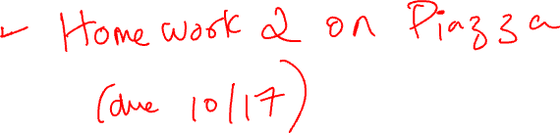
Hypothesis Testing: Chapter 17

Slide 2
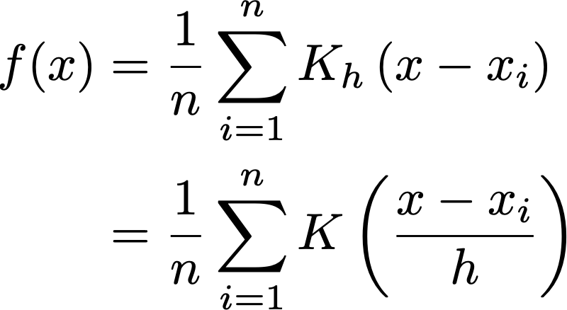
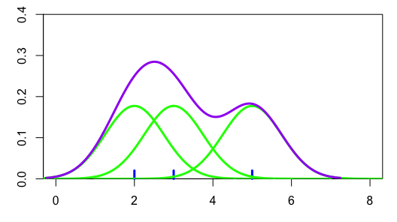
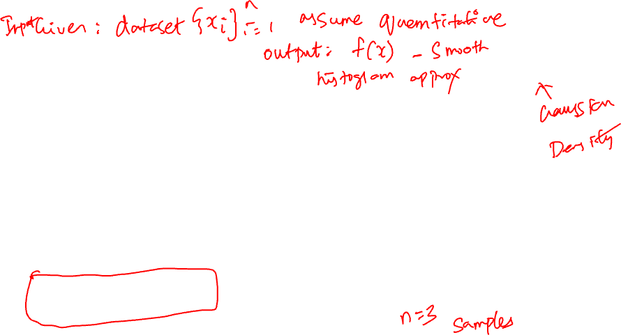
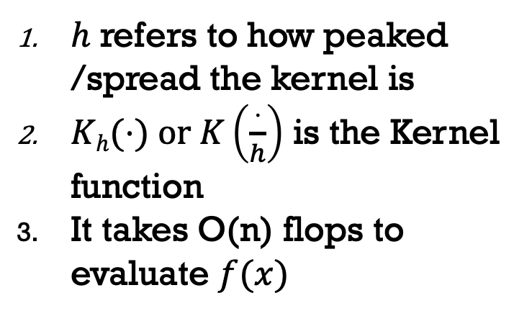
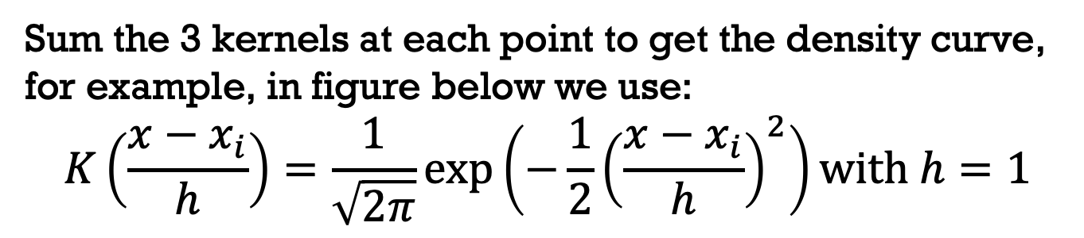
KDE – 3+ POINTS
Sum the 3 kernels at each point to get the density curve, for example, in figure below we use:
$$K\left(\frac{x−x_{i}}{h}\right)=\frac{1}{\sqrt{2π}}exp⁡\left(−\frac{1}{2}{\left(\frac{x−x_{i}}{h}\right)}^{2}\right)\text{with} h=1$$
$h$ refers to how peaked /spread the kernel is
$Kh(⋅) \text{or} K\left(\frac{⋅}{h}\right)$ is the Kernel function
It takes O(n) flops to evaluate $f(x)$

Slide 3
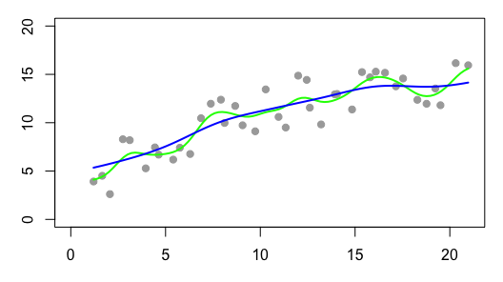
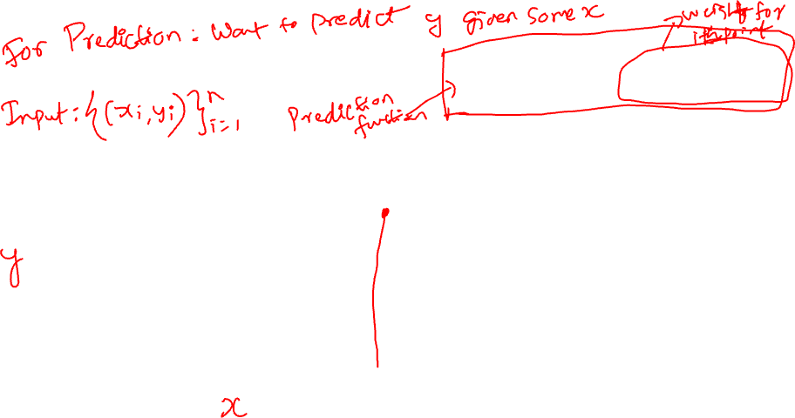
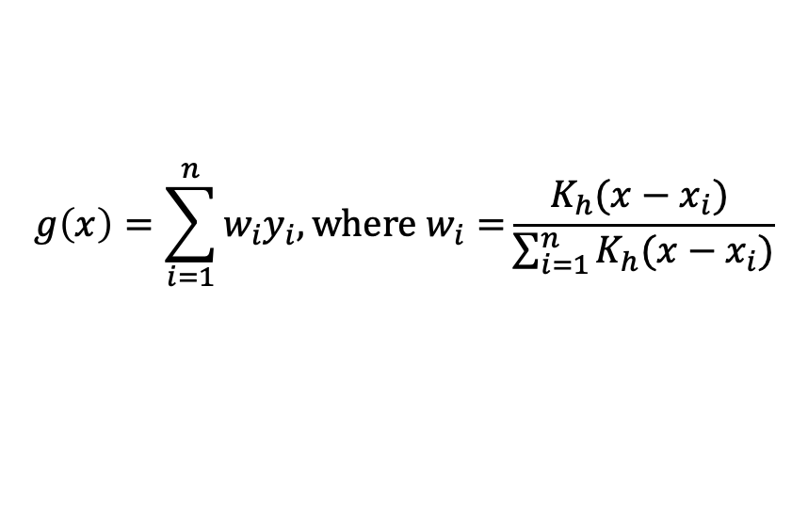
SMOOTHING SCATTER PLOTS
$$g\left(x\right)=\sum_{i=1}^{n}{w_{i}y_{i}, \text{where} w_{i}=}\frac{K_{h}(x−x_{i}) }{\sum_{i=1}^{n}{K_{h}(x−x_{i})}}$$
For each x, we find g(x) by a weighted average of the y_{i}
The y_{i} are weighted according to the kernel function.
So x_{i} far from x do not contribute much to g(x)

Slide 4

GOOD PLOT MAKING PRACTICE
Put major (quantitative) conclusions in graphical form
Provide reference information
Proof read for clarity and consistency
Graphing is an iterative process
Multiplicity is OK, i.e., two plots of the same variable may provide different messages
Make plots data rich
Scale | Conditioning | Perception | Transformation | Context | Smoothing | Philosophy
Notes:
图形化主要的（定量）结论：将数据中最重要的定量结论以直观的图形形式展示出来，帮助观众迅速理解数据的关键发现。
提供参考信息：在图表中加入数据来源、单位和说明，确保观众能够理解数据的背景和来源。
校对图表：检查图表的清晰度和一致性，确保标签、颜色、图例等元素没有歧义，数据表示清晰。
图表制作是一个迭代过程：通过不断修改和调整图表，优化数据展示效果，以确保图表最有效地传达信息。
允许多样性：同一变量可以用不同的图表展示，因为每种图表可能会带来不同的解读，增强信息的多样性和全面性。
让图表数据丰富：尽量将有价值的数据纳入图表，使得观众能够从中获取尽可能多的信息。

Slide 5

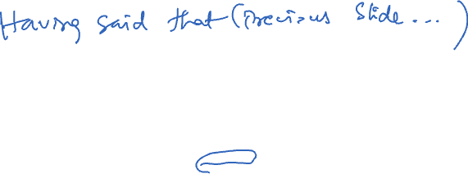
MANY VISUALIZATIONS DO NOT ABIDE BY VISUALIZATION PRINCIPLES

Slide 6
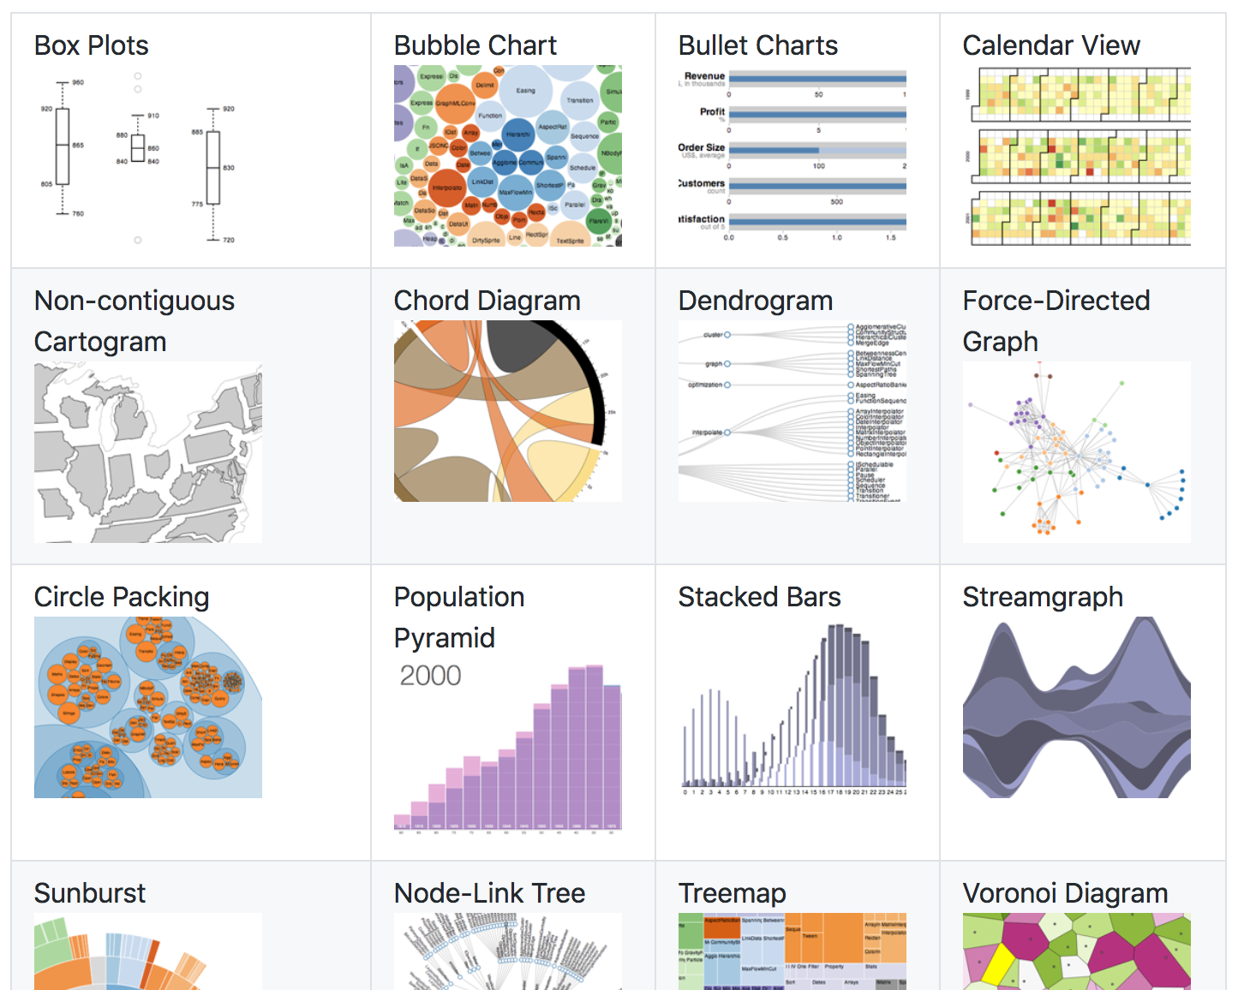

INTERACTIVE VISUALIZATIONS
D3: JavaScript library that “brings data to life”
Another: d3blocks
Allows a lot of modifications and customizations
Can include in Jupyter notebooks
Screenshot: https://github.com/d3/d3/wiki/Gallery

Slide 7
CLUSTERING (Useful detour)

Slide 8
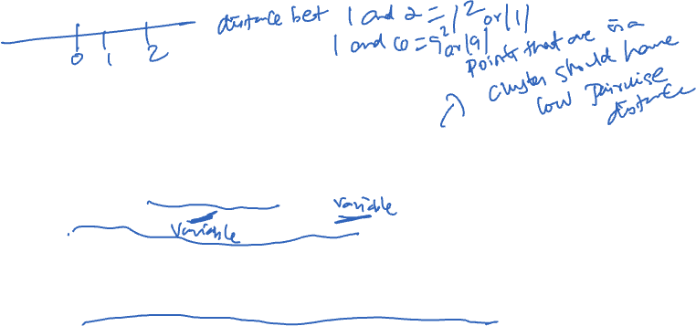
WHAT IS AND WHY TO DO CLUSTERING?
Organizing data into groups such that there is: 1. low intra-cluster distance, and 2. high inter-cluster distance (or the opposite with “similarity”)
Clustering data is useful in reducing space or for compression purposes. That is, we can convert quantitative data into ordinal data with fixed number of cardinality or bins
Summarization purposes: many clusters indicate many subgroups within data
Sometimes used to identify outliers or knowledge discovery in data (such as reoccurring patterns, topics etc.)

Slide 9
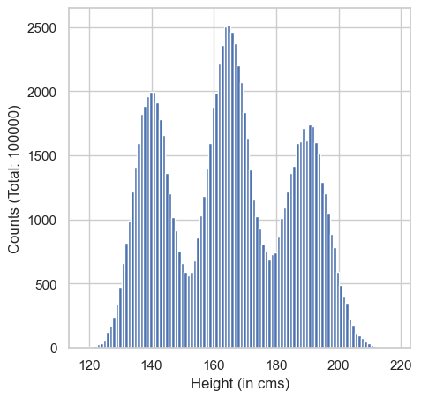

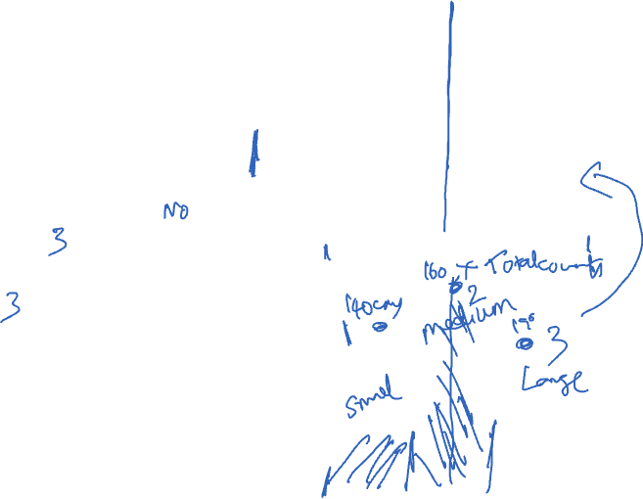
Intuition for Clustering
See the histogram to the right
Do both convey same information?
How many modes?
If you were a grouping ”height” variable, how many groups would you choose?
This is clustering! Useful for converting quantitative data into ordinal data

Slide 10
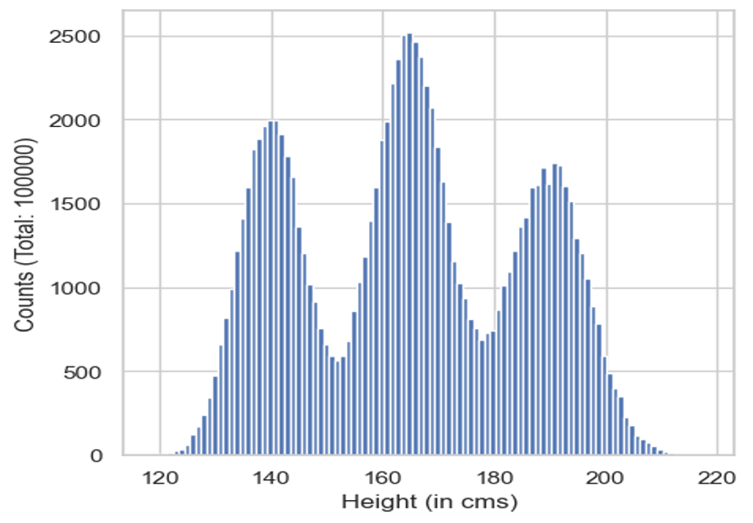
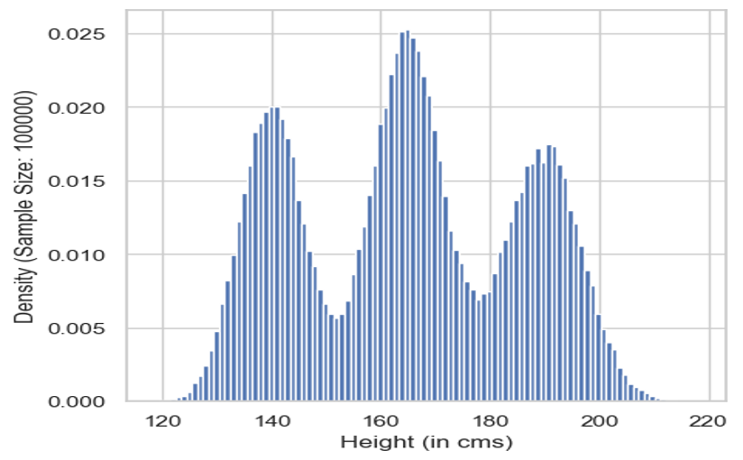
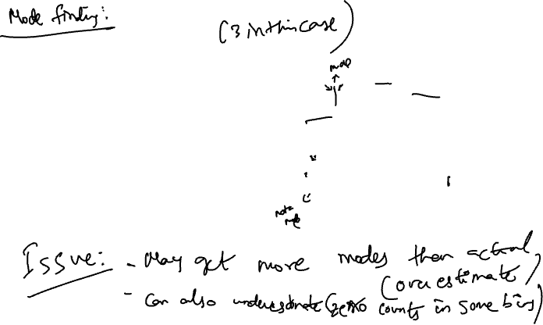
Two ways to convert: 1. Use Empirical Histograms 经验直方图
Initialize a list of cluster centers
Start from left most bin to right most bin, and
A. Get the value of current, previous, and next bin
B. If value of current bin is the greatest.
a. Then mode found, add it to cluster centers
b. Else, proceed
3. For every value in data, find closest cluster center
Problems:

Slide 11
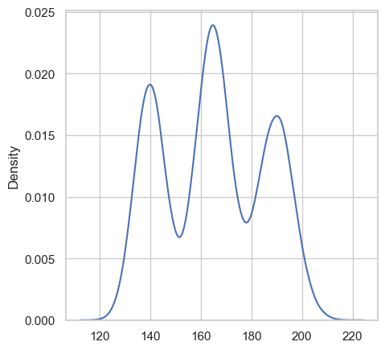
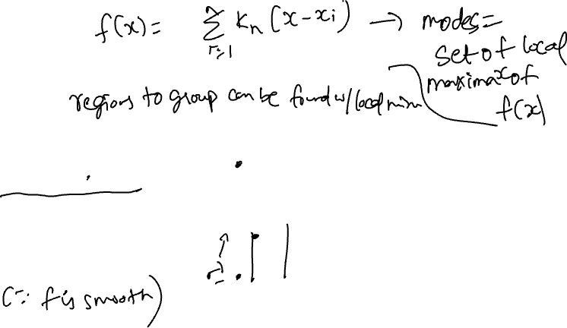
Two ways to convert: 1. Optimize KDE ESTIMATE
Find modes of KDE estimate using a numerical procedure such as gradient ascent (or any hill climbing procedure).
Advantages of using KDE:
Smooth, so modes are guaranteed to exist if they existed in the original data
Gradient method will always find some mode
Disadvantages:
Have to run gradient ascent multiple times, so have to use binning anyway
Complex implementation
Notes:
优化核密度估计
利用数值方法找到KDE估计的模式：可以使用梯度上升法（或其他爬山算法）找到局部极大值，这些局部极大值即为模式。

Slide 12


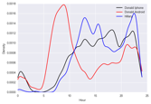

NOW
Formulate Question or Problem
Acquire and Clean Data
?
Inferential statistics 推断统计
Hypothesis testing 假设检验
Prediction
and inference
Exploratory Data Analysis
Reports, Decisions, and Solutions

Slide 13
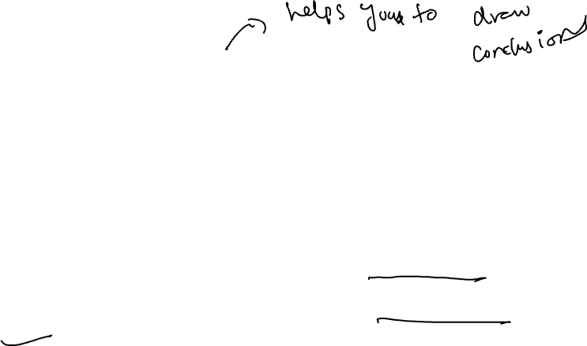
DESCRIPTIVE VS. INFERENTIAL STATISTICS
Statistics deals with the collection, analysis, interpretation, and presentation of data
Two types of statistical analysis: descriptive and inferential
Descriptive statistics focuses on summarizing data about a sample drawn from a population (our focus so far with EDA and visualizations)
Inferential statistics focuses on using information from the sample to make conclusions about the population from which the sample was drawn
One of the primary methods of inferential statistics is hypothesis testing, which allows us to compare differences between population parameters
A parameter is a numerical characteristic of a population (e.g., mean, median, standard deviation)

Slide 14

GOAL OF HYPOTHESIS TESTING
Choosing one of two (or more) viewpoints based on data
“Chocolate has no effect on cardiac disease.”
“Yes, it does.”
“This jury panel was selected at random from eligible jurors.”
“No, it has too many people with college degrees.”

Slide 15
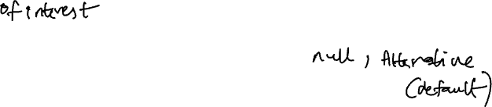
HYPOTHESIS TESTING
A hypothesis is a statement that makes a claim about the parameters of one or more populations
To determine whether a hypothesis should be retained or rejected, we perform a hypothesis test, which compares two competing hypotheses
The null hypothesis, denoted 𝑯_{𝟎}, is a statement assumed to be true unless sufficient evidence indicates otherwise
Typically, the null hypothesis asserts that the true value of a population parameter is equal to a hypothesized value or that the parameters for two populations are not different
The alternative hypothesis, denoted 𝑯_{𝒂}, is a statement that contradicts 𝐻₀
Typically, the alternative hypothesis asserts that the true value of a population parameter is not equal to a hypothesized value or that the parameters for two populations are different

Slide 16
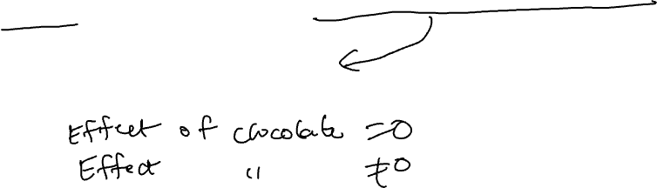
HYPOTHESIS TESTING (also known as A/B Testing)
If there is sufficient evidence favoring the alternative hypothesis, we reject the null hypothesis
Otherwise, we fail to reject the null hypothesis
Example: We want to test whether the mean GPA of college students is different from 2.0.
Null hypothesis 𝑯_{𝟎}: mean=2.0
The alternative hypothesis is 𝑯_{𝒂}: mean≠2.0
Exercise: We want to test whether chocolate has effect on cardiac disease. What are the null and alternative hypotheses?
𝑯𝟎:
𝑯𝒂:
Notes:
The word “null” reinforces the idea that if the data look different from what the null hypothesis predicts, the difference is due to nothing but chance.
From a practical perspective, the null hypothesis is a hypothesis under which you can simulate data.
The choice between the null and alternative hypotheses depends on the comparison between the observed value of the test statistic and its distribution as predicted by the null hypothesis.
If the two are not consistent with each other, then the data do not support the null hypothesis. In other words, the alternative hypothesis is better supported by the data. We say that the test rejects the null hypothesis.
If the two are consistent with each other, then the observed test statistic is in line with what the null hypothesis predicts. In other words, the null hypothesis is better supported by the data. We say that the data are consistent with the null hypothesis.

Slide 17
A/B Testing: Which of two headlines is better?
https://digiday.com/media/new-york-times-experimenting-mobile-specific-headlines/
Notes:
https://digiday.com/media/new-york-times-experimenting-mobile-specific-headlines/
“I’d love to see us doing more of that in the future, when we can,” said Mark Bulik, a senior editor at the Times who heads up its headline-testing operations.
The headline, which helped drive 26 percent more clicks on mobile, was just an experiment. But it’s a step forward for a project that began in April 2016, when the Times tasked a two-person team with optimizing its headlines, a practice that’s become standard operating procedure in digital media over the past several years.

Slide 18
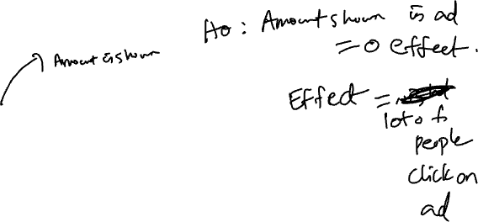
A/B Testing: Which of two ad messages is better?

Slide 19

A/B Testing: Which of two ad messages is better?
Notes:
https://adespresso.com/guides/facebook-ads-optimization/ab-testing/

Slide 20

A/B Testing: Which of these two website layouts is better?

Slide 21
More serious A/B Testing: Which of these drugs is more effective? Often we test against a placebo

Slide 22
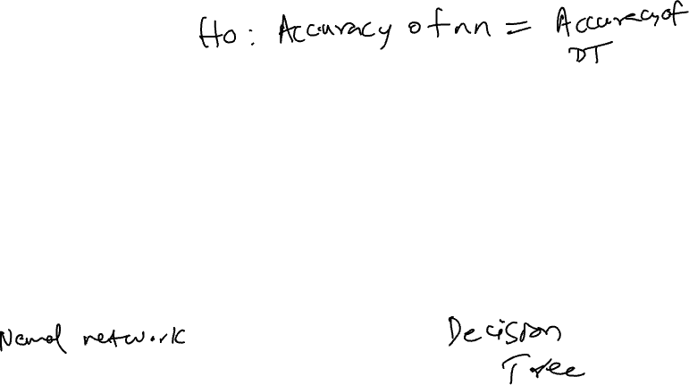
Somewhat serious A/B Testing: Which of these two classifiers is better?

Slide 23

Companies Using A/B Testing: Which Companies use A/B testing for business decision? (All of them)
A wise man once said:
Experimentation is the Analytical backbone of every business

Slide 24
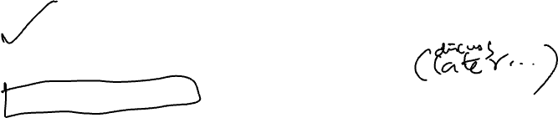
STEPS OF HYPOTHESIS TESTING
Specify the null hypothesis 𝑯𝟎 and the alternative hypothesis 𝑯𝒂
Specify the significance level threshold 𝜶_{t}
Collect the data
Calculate the test statistic
Calculate the corresponding 𝒑-value
Compare the 𝒑-value with the significance level
Determine whether to reject or fail to reject the null hypothesis 𝑯𝟎

Slide 25
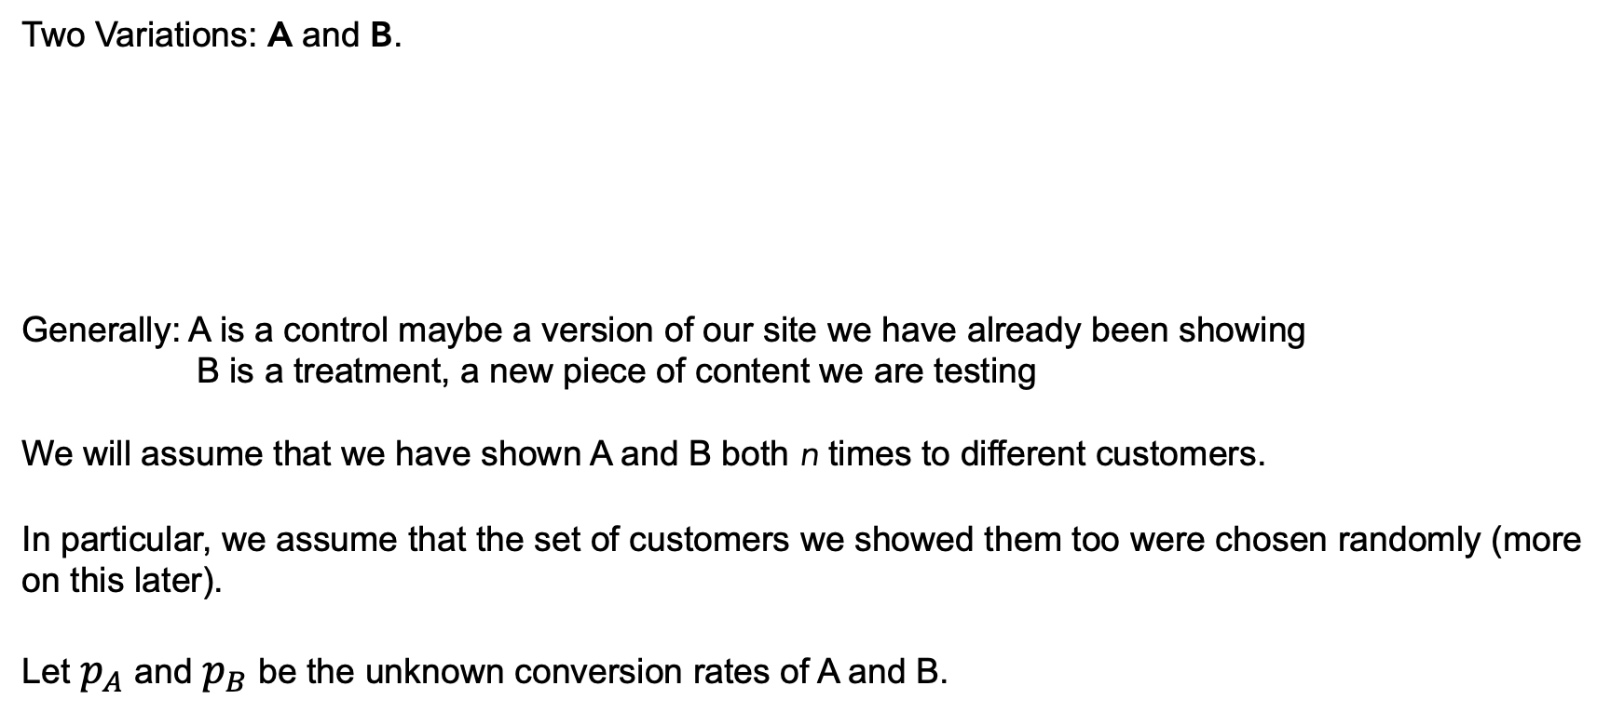
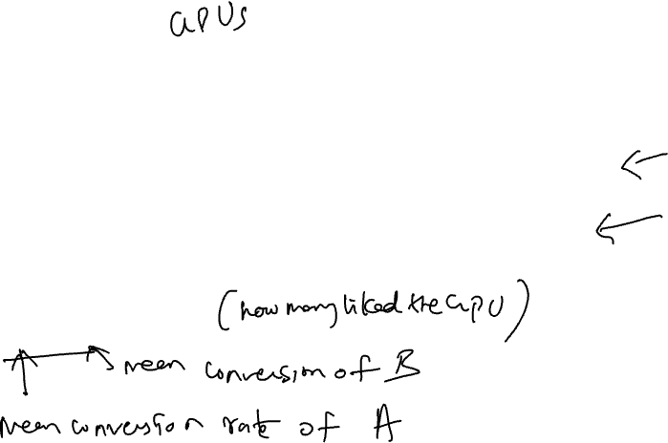
Setup
Two Variations: A and B.
Generally: A is a control maybe a version of our site we have already been showing
B is a treatment, a new piece of content we are testing
We will assume that we have shown A and B both n times to different customers.
In particular, we assume that the set of customers we showed them too were chosen randomly (more on this later).
Let $p_{A}$ and $p_{B}$ be the unknown conversion rates of A and B.

Slide 26
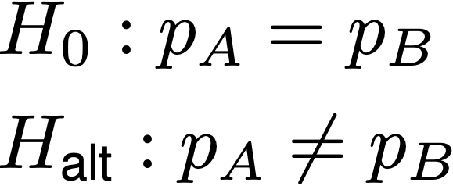
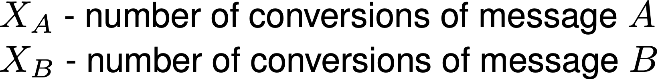
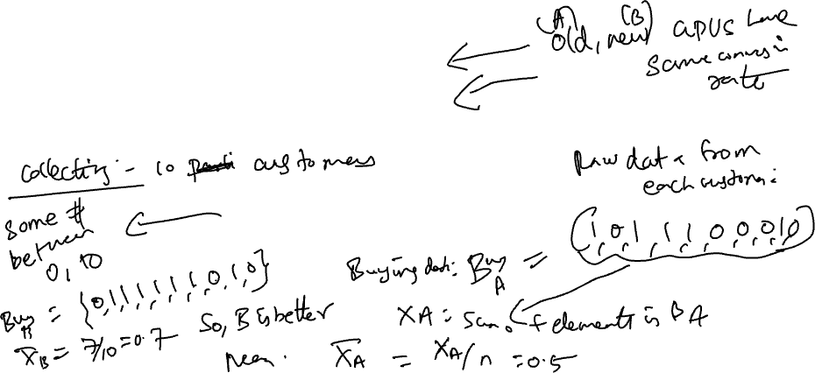
Setup
Problem Formulation: Is there a difference between the treatment and control? If there is, is it significant? Which one is better?
Experiment: Show both variations n times to customers at random
Data:
Notes:
Add n to this.
Problem Formulation
Experiment
Data
Algorithm

Slide 27
STEPS OF HYPOTHESIS TESTING
Specify the null hypothesis 𝑯𝟎 and the alternative hypothesis 𝑯𝒂
Specify the significance level threshold 𝜶_{t}
Collect the data
Calculate the test statistic
Calculate the corresponding 𝒑-value
Compare the 𝒑-value with the significance level
Determine whether to reject or fail to reject the null hypothesis 𝑯𝟎

Slide 28
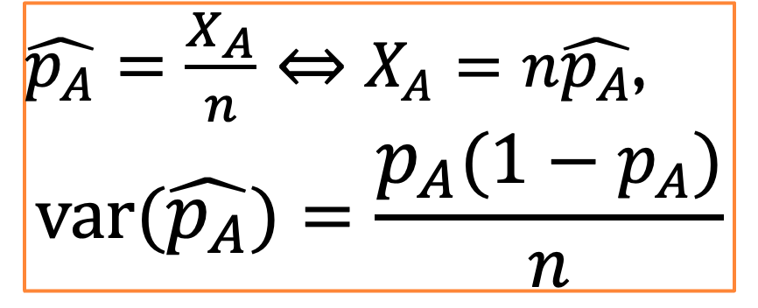
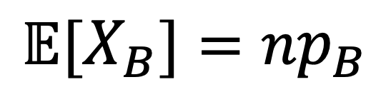
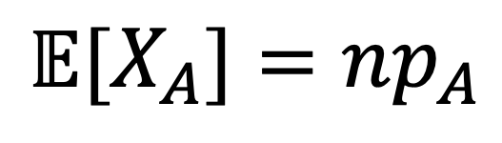
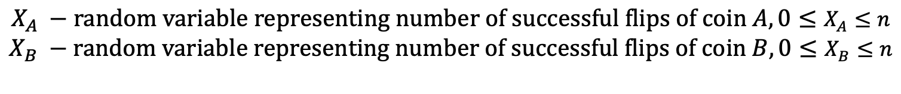
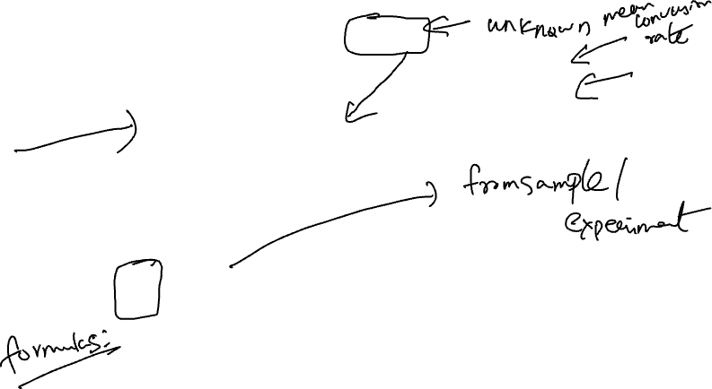
Test Statistic derivation
Represent a click, a conversion, a signup, a subscription, … a success as getting a heads on flipping two coins with bias $p_{A},p_{B}$.
$$X_{A} −\text{random} \text{variable} \text{representing} \text{number} \text{of} \text{successful} \text{flips} \text{of} \text{coin} A, 0≤X_{A}≤n$$
$$X_{B} −\text{random} \text{variable} \text{representing} \text{number} \text{of} \text{successful} \text{flips} \text{of} \text{coin} B, 0≤X_{B}≤n$$
$$𝔼[X_{A}]={np}_{A}$$
$$𝔼[X_{B}]=np_{B}$$
Estimator
(Sample mean of flips):
$\hat{p_{A}}=\frac{X_{A}}{n}⇔X_{A}=n\hat{p_{A}}$,
$$\text{var}(\hat{p_{A}})=\frac{p_{A}(1−p_{A})}{n}$$

Slide 29
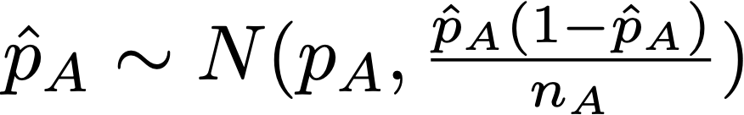
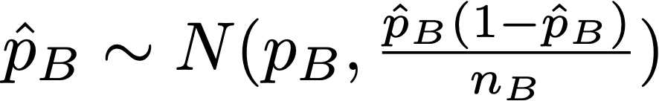
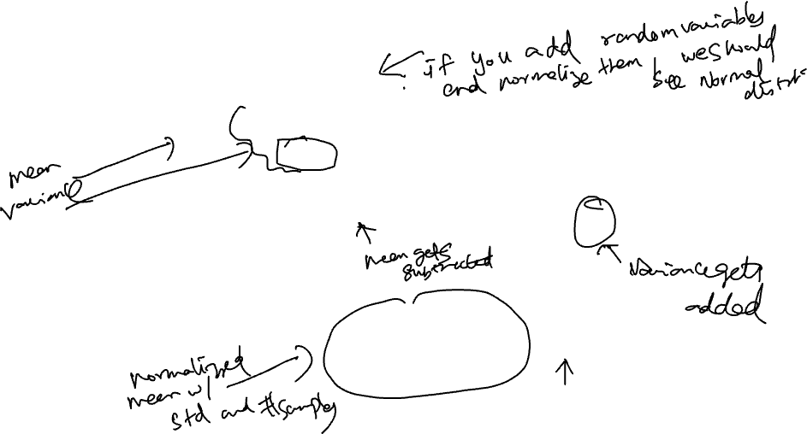
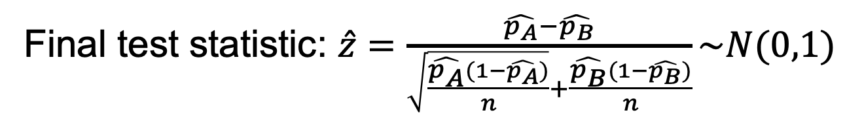
Test Statistic derivation
By the Central Limit Theorem,
By sum of independent normal random variables,
Using the null hypothesis,
Final test statistic: $\hat{z}=\frac{\hat{p_{A}}−\hat{p_{B}}}{\sqrt{\frac{\hat{p_{A}}(1−\hat{p_{A}})}{n}}+\frac{\hat{p_{B}}(1−\hat{p_{B}})}{n}}\sim N(0,1)$
Notes:
Do a sanity check - variance goes to 0 as the number of samples goes up

Slide 30
STEPS OF HYPOTHESIS TESTING
Specify the null hypothesis 𝑯𝟎 and the alternative hypothesis 𝑯𝒂
Specify the significance level threshold 𝜶_{t}
Collect the data
Calculate the test statistic
Calculate the corresponding 𝒑-value
Compare the 𝒑-value with the significance level threshold
Determine whether to reject or fail to reject the null hypothesis 𝑯𝟎

Slide 31
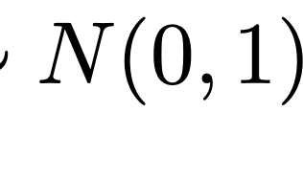
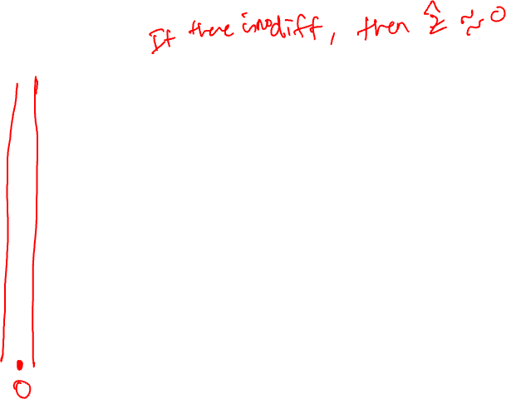
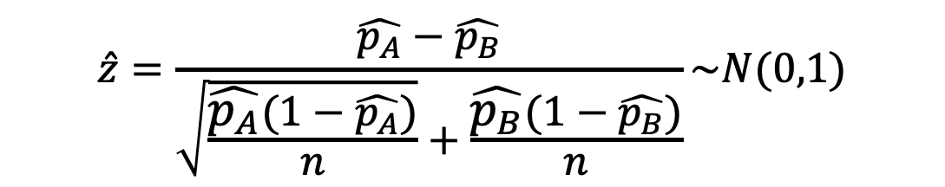
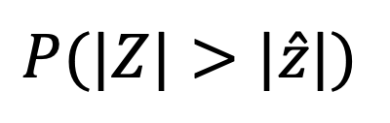
p-Value
$$\hat{z}=\frac{\hat{p_{A}}−\hat{p_{B}}}{\sqrt{\frac{\hat{p_{A}}(1−\hat{p_{A}})}{n}}+\frac{\hat{p_{B}}(1−\hat{p_{B}})}{n}}\sim N(0,1)$$
$$P(|Z|>|\hat{z}|)$$
p-value:
p-Value: If the null was true, and I redid this experiment, what is the probability of getting a result as extreme as what I got?
The gold standard in 20th century statistics for reporting the outcome of an experiment.

Slide 32
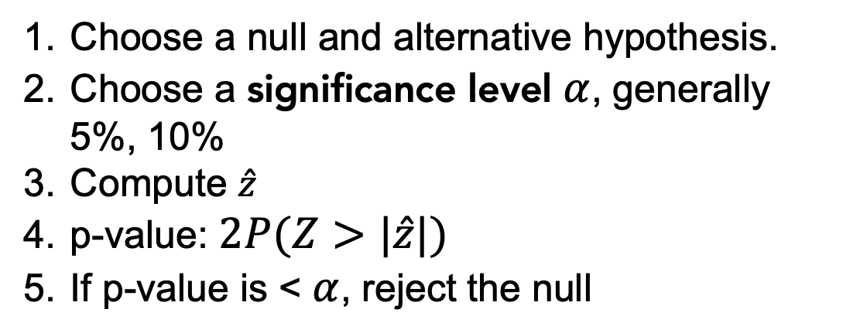
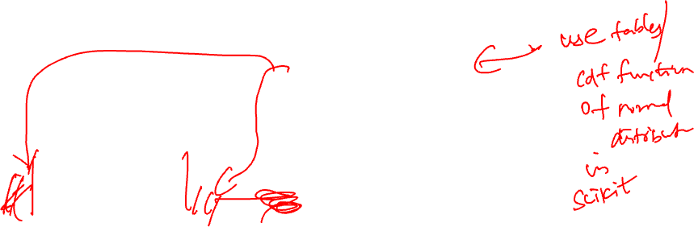
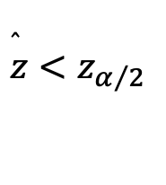
Running a Hypothesis Test
Choose a null and alternative hypothesis.
Choose a significance level $α$, generally 5%, 10%
Compute $\hat{z}$
p-value: $2P(Z>|\hat{z}|)$
If p-value is < $α$, reject the null
$$\overset{̂}{z}<z_{α/2}$$

Slide 33
P-VALUE
A 𝒑-value is the probability of obtaining a result that is as extreme or more extreme than the observed data if the null hypothesis were true
If the 𝒑-value is less than the specified significance level 𝜶 (commonly set at 0.05), then we conclude that the null hypothesis is false and the alternative hypothesis provides a better explanation of the observed data
The lower the p-value, the less likely that the observed data supports the null
This does not exclude the possibility that our conclusion commits a Type I error
A statistically significant result differs enough from the null hypothesis that a conclusion can be inferred about the population
Statistical significance does not necessarily imply practical significance of a result

Slide 34
P-VALUE (WORD OF CAUTION)
“𝒑-values are not substitutes for common sense.”
The American Statistical Association (ASA) provides a set of principles for the proper use and interpretation of 𝒑-values, including:
𝒑-values do not measure the probability that the studied hypothesis is true, or the probability that the data were produced by random chance alone.”
“Scientific conclusions and business or policy decisions should not be based only on whether a 𝒑-value passes a specific threshold.”
“Proper inference requires full reporting and transparency.”
“A 𝒑-value, or statistical significance, does not measure the size of an effect or the importance of a result.”
“By itself, a 𝒑-value does not provide a good measure of evidence regarding a model or hypothesis.”
Source: https://doi.org/10.1080/00031305.2016.1154108

Slide 35
ACKNOWLEDGMENTS
These slides use materials by the Berkeley DS 100 team, Elena Zheleva, Gonzalo Bello, and Lalit Jain

