Slide 1
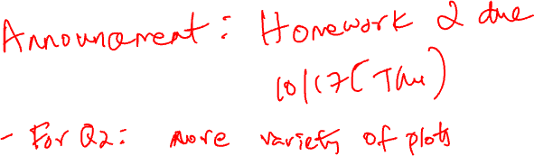
MODELS AND ESTIMATION
Chapter 15

Slide 2


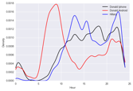
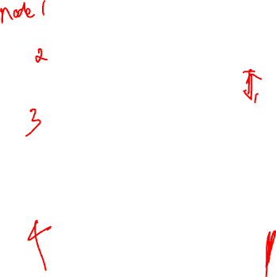
COVERED SO FAR
Formulate Question or Problem
Acquire and Clean Data
?
Data collection: Surveys, sampling, administrative data, web scraping, APIs
Data cleaning and manipulation: Pandas
Exploratory Data Analysis
Joining and grouping data
Structure, Granularity, Temporality, Faithfulness and Scope
Basic exploratory data visualization
Inferential statistics:
Hypothesis testing
Prediction
and inference
Exploratory Data Analysis
Reports, Decisions, and Solutions

Slide 3

Now
Formulate Question or Problem
Acquire and Clean Data
?
Models and estimation
Useful for prediction in the 4th node of the data lifecycle
Prediction
and inference
Exploratory Data Analysis
Reports, Decisions, and Solutions

Slide 4

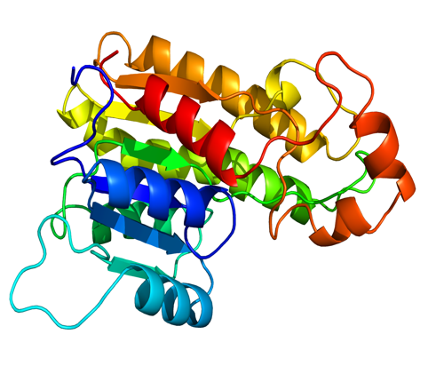
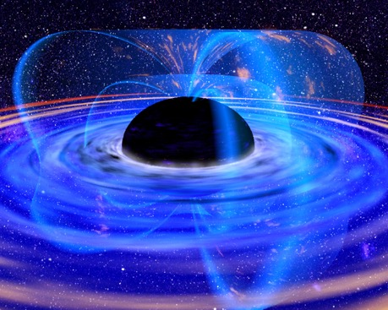

WHAT IS A MODEL?
A model is an an idealized representation of a system
Atoms don’t actually work like this…
Proteins are far more complex
We haven’t really seen one of these.
Notes:
Are atoms like little solar systems?
Do proteins really have these colors?
A Van Allen radiation belt is a zone of energetic charged particles, most of which originate from the solar wind, that are captured by and held around a planet by that planet's magnetic field.
Protein has many roles in your body. It helps repair and build your body's tissues, allows metabolic reactions to take place and coordinates bodily functions. In addition to providing your body with a structural framework, proteins also maintain proper pH and fluid balance.

Slide 5

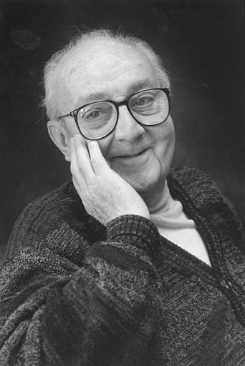
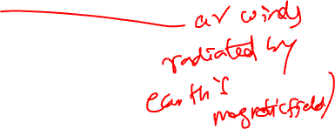
“Essentially, all models are wrong, but some are useful.”
George Box
Statistician
1919-2013
(conveyed to me Grace Wahba)
Notes:
1919-2013

Slide 6
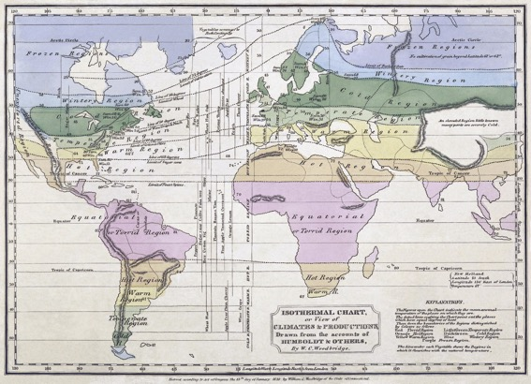


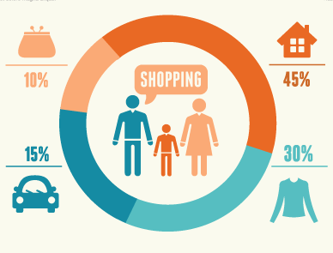

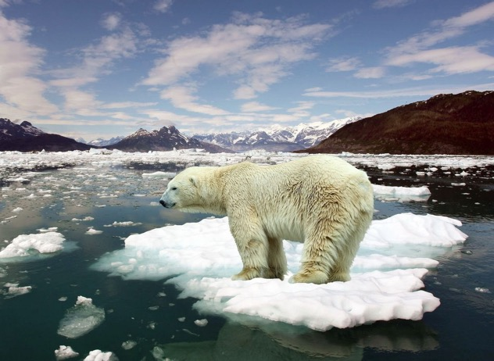
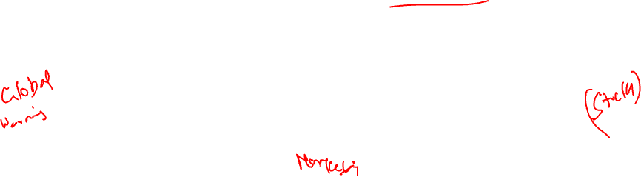
WHY DO WE BUILD MODELS?
Models enable us to make accurate predictions
→ Provide insight into complex phenomena

Slide 7
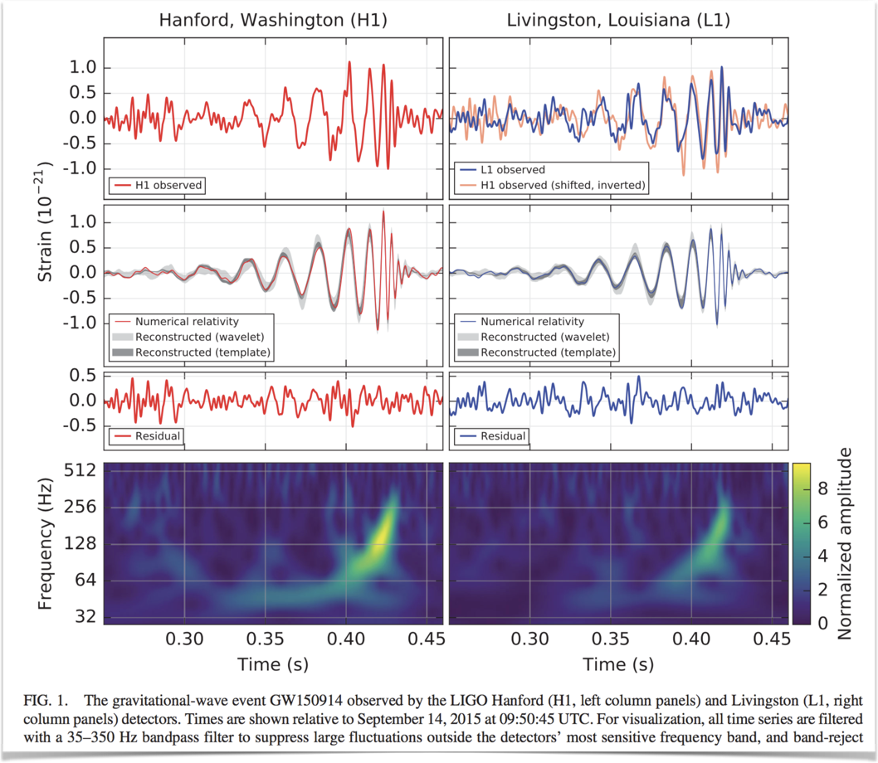
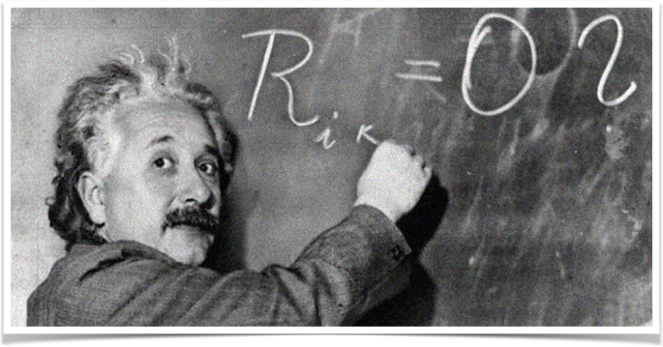
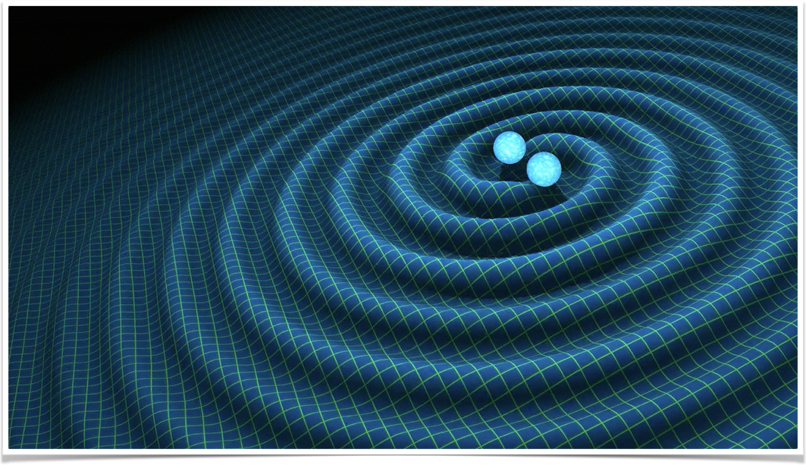
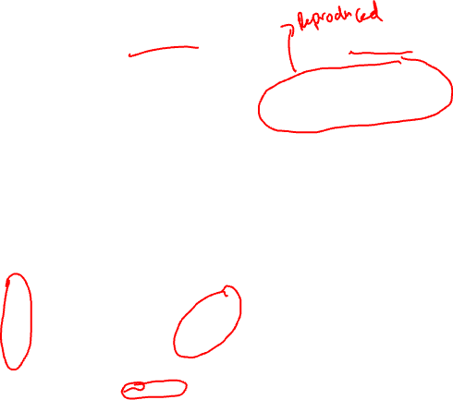
MODELS: “PHYSICAL” OR “MECHANISTIC”
Notes:
Traditionally "mechanistic models" are those that are based on mathematical description of mechanical, chemical, biological etc. phenomenon or process. Mechanistic models typically have a tangible, physical aspect, in that system components are real, solid and visible.
Gravitational waves are ripples in space-time (the fabled “fabric” of the Universe) caused by massive objects moving with extreme accelerations.
When a gravitational wave passes by Earth, it squeezes and stretches space. LIGO can detect this squeezing and stretching.
(in outer space that means objects like neutron stars or black holes orbiting around each other at ever increasing rates, or stars that blow themselves up).

Slide 8
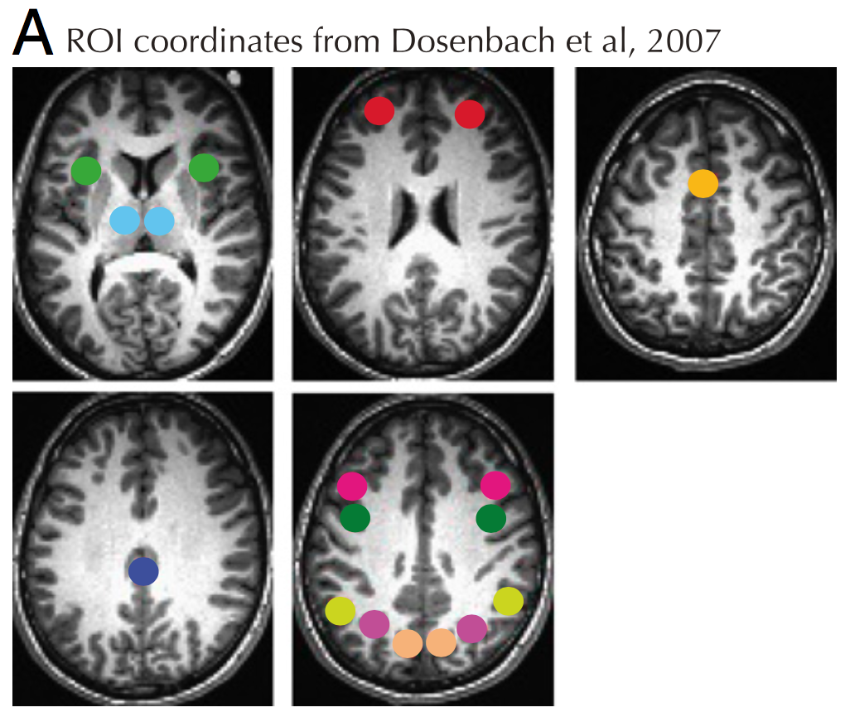
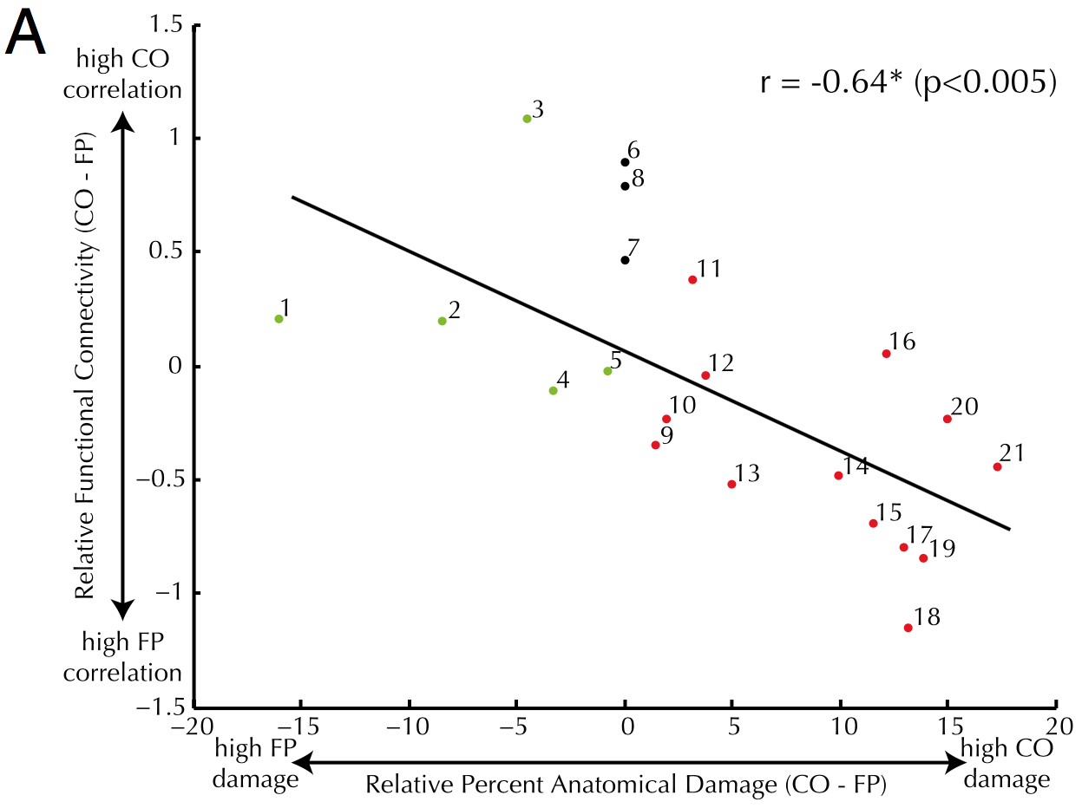
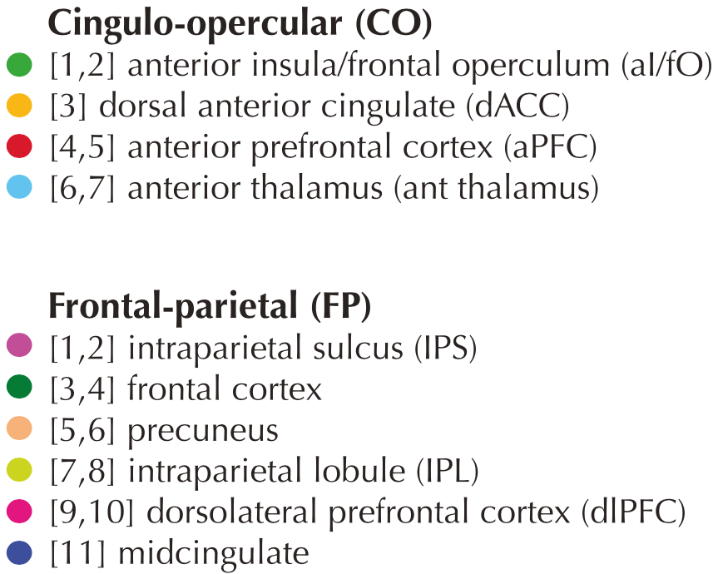
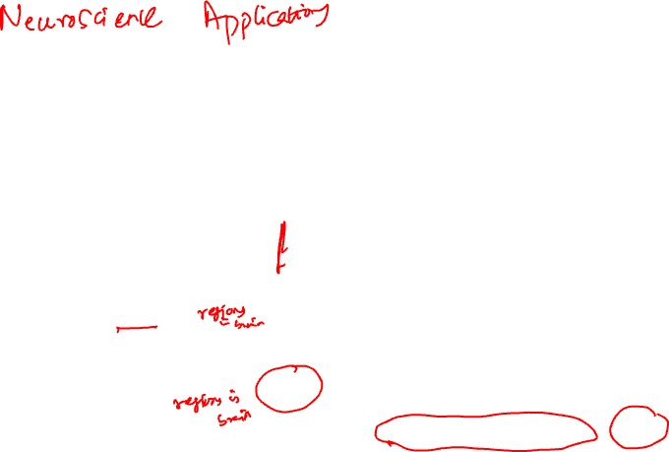
MODELS: STATISTICAL CORRELATIONS (A)
Nomura et al, PNAS 2010
Notes:
Simple linear/logistic regression
Underlying natural/causal mechanisms are assumed, though not understood.

Slide 9
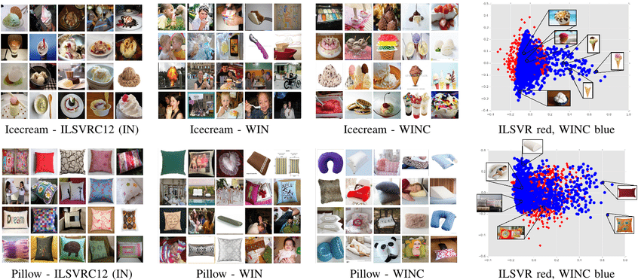
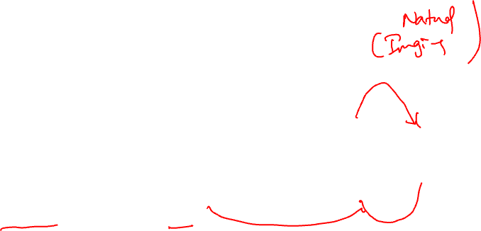
MODELS: STATISTICAL CORRELATIONS (1)
Massouh et al. IROS 2017
Notes:
Complex statistical models.
Expected to capture something about the real world (in this case) but mechanism not understood.
Can have excellent predictive accuracy.
Learning deep visual object models from noisy web data: How to make it work.

Slide 10
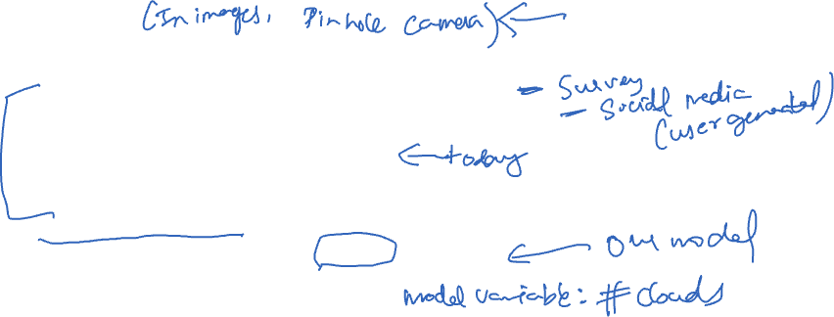
MODELS AND THE WORLD
Data Generation Process: the real-world phenomena from which the data is collected
Example: everyday there are some number of clouds and it rains or doesn’t
We don’t know or can’t compute this, could be stochastic
Model: a theory of the data generation process
Example: if there are more than X clouds then it will rain
How do we pick this model? EDA? Art?
May not reflect reality … “all models are wrong …”
Estimated Model: an instantiation of the model
Example: If there are more than 42 clouds then it will rain
How do we estimate it?
What makes the estimate “good”?

Slide 11

EXAMPLE – Air Quality Systems (AQS)
Follow along with the notebook …

Slide 12
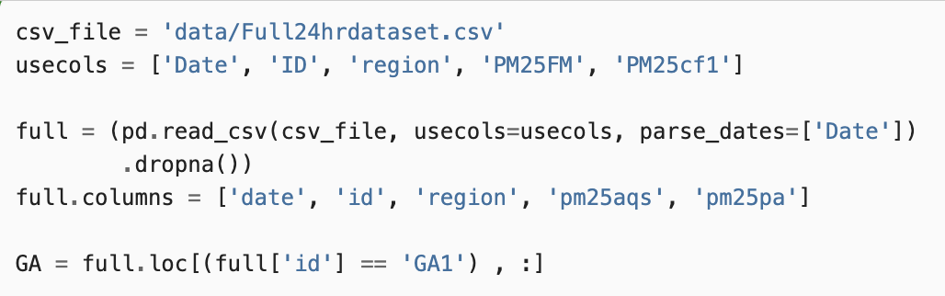
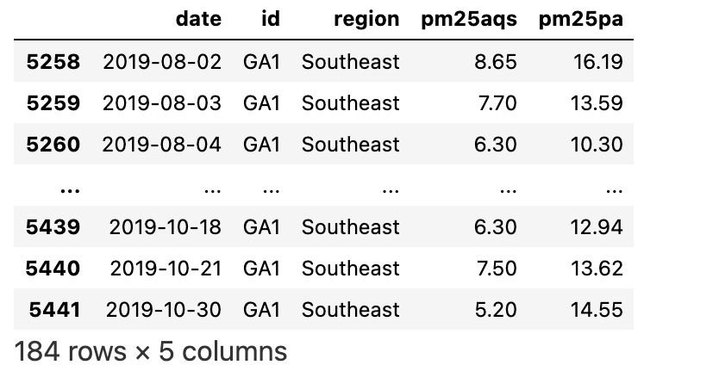
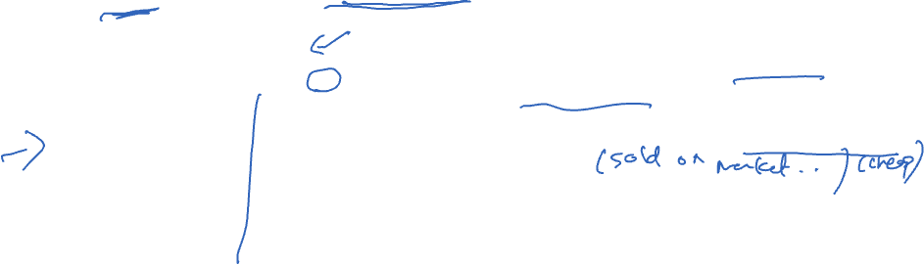
STEP 1: UNDERSTANDING THE DATA (EDA)
Data values come from neighboring instruments that measure the average daily concentration of particulate matter in the air on the same day
Why?
Predict use accurate Air Quality System (AQS) sensors operated by the US government to predict the measurements made by PurpleAir (PA) sensors
Understand relationship between the sensors so that we can AQS to make PA measurements better

Slide 13
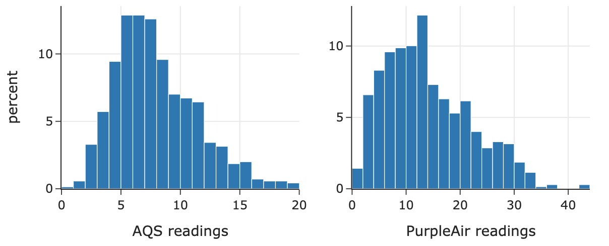
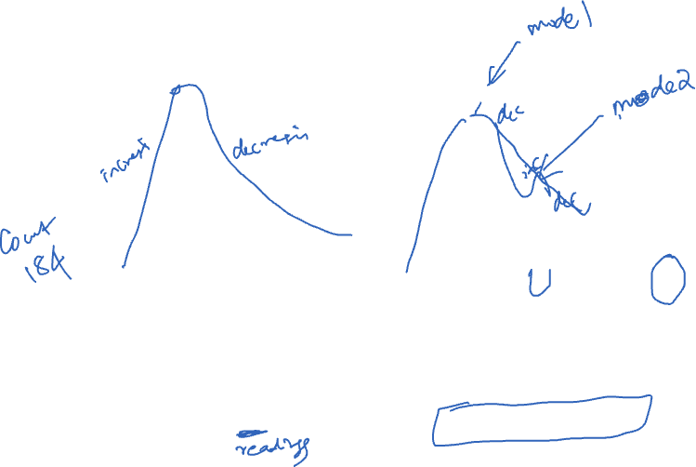
UNDERSTANDING THE VALUES
Observations:
Right skewed
Mode around 6%
Mean around 6%
No large bills
Observations:
Right skewed
Mean around 12
Possibly bimodal? → Explanations?
Large outliers → Explanations?
Notes:
Ask students for some explanations of this data.
What’s wrong with these plots?
But don’t spend too much time discussing them.

Slide 14
STEP 1: DEFINE THE MODEL
START SIMPLE!!
Notes:
* Simplest possible!!

Slide 15
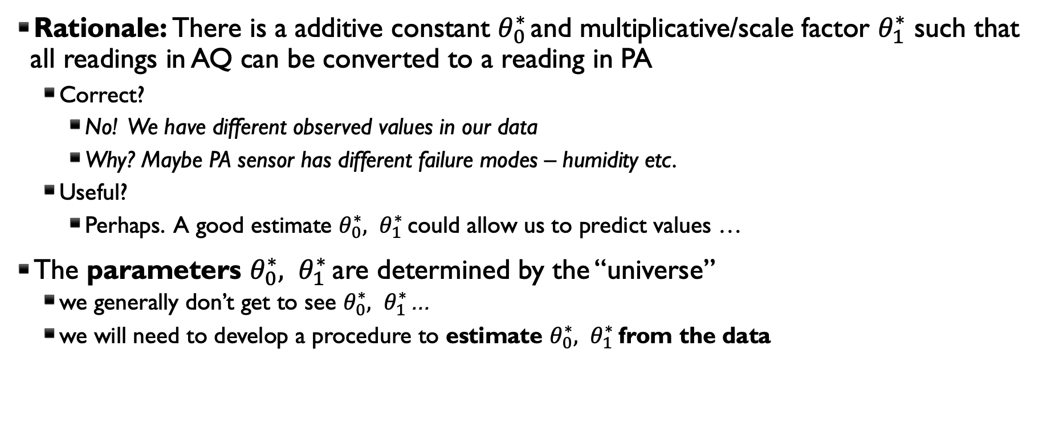
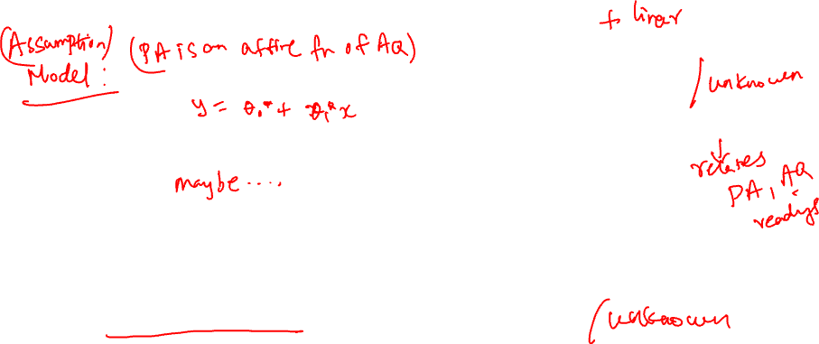

START WITH A SIMPLE MODEL: CONSTANT
$$PA=θ_{0}^{∗}+θ_{1}^{∗}AQ$$
* Means true parameter determined by universe
Rationale: There is a additive constant $θ_{0}^{∗}$ and multiplicative/scale factor $θ_{1}^{∗}$ such that all readings in AQ can be converted to a reading in PA
Correct?
No! We have different observed values in our data
Why? Maybe PA sensor has different failure modes – humidity etc.
Useful?
Perhaps. A good estimate $θ_{0}^{∗}, θ_{1}^{∗}$ could allow us to predict values …
The parameters $θ_{0}^{∗}, θ_{1}^{∗}$ are determined by the “universe”
we generally don’t get to see $θ_{0}^{∗}, θ_{1}^{∗}$ …
we will need to develop a procedure to estimate $θ_{0}^{∗}, θ_{1}^{∗}$ from the data

Slide 16

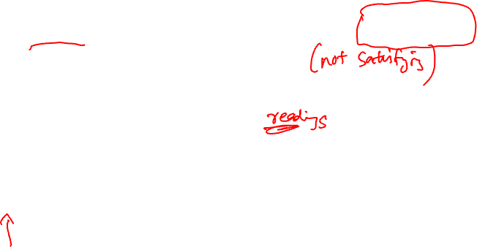
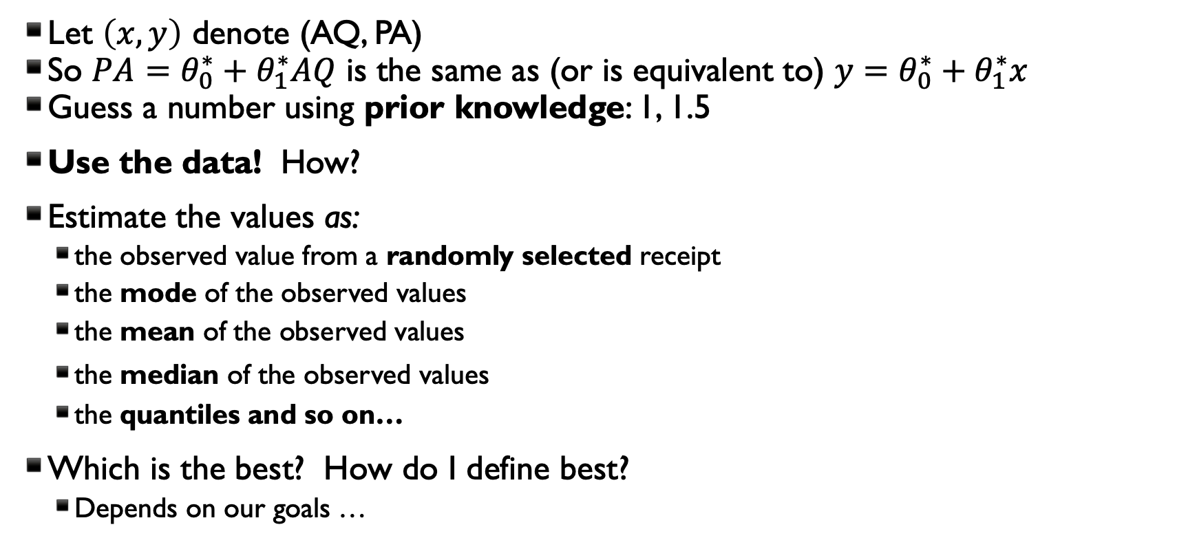
HOW DO WE ESTIMATE THE PARAMETERS $θ_{0}^{∗}, θ_{1}^{∗}$
Let $\left(x,y\right)$ denote (AQ, PA)
So $PA=θ_{0}^{∗}+θ_{1}^{∗}AQ$ is the same as (or is equivalent to) $y=θ_{0}^{∗}+θ_{1}^{∗}x$
Guess a number using prior knowledge: 1, 1.5
Use the data! How?
Estimate the values as:
the observed value from a randomly selected receipt
the mode of the observed values
the mean of the observed values
the median of the observed values
the quantiles and so on…
Which is the best? How do I define best?
Depends on our goals …

Slide 17
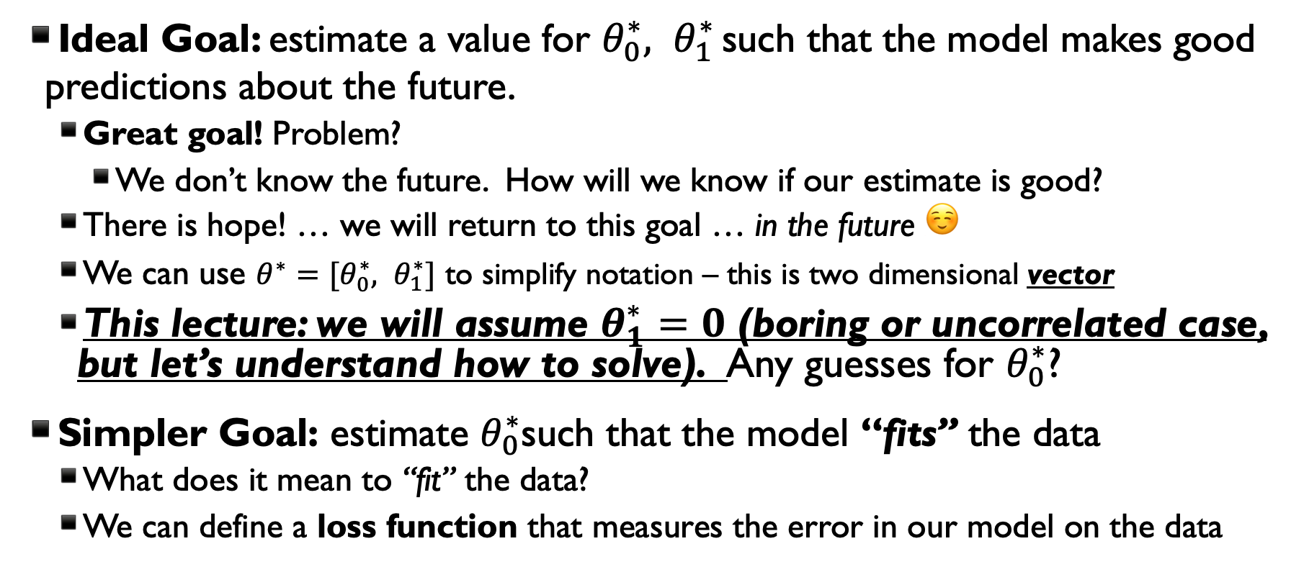
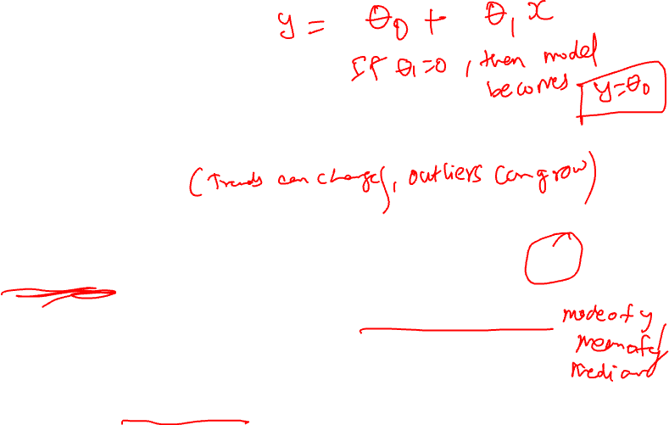
DEFINING THE OBJECTIVE (GOAL)
Ideal Goal: estimate a value for $θ_{0}^{∗}, θ_{1}^{∗}$ such that the model makes good predictions about the future.
Great goal! Problem?
We don’t know the future. How will we know if our estimate is good?
There is hope! … we will return to this goal … in the future ☺
We can use ${θ^{∗}=[θ}_{0}^{∗}, θ_{1}^{∗}]$ to simplify notation – this is two dimensional vector
This lecture: we will assume $θ_{1}^{∗}=0$ (boring or uncorrelated case, but let’s understand how to solve). Any guesses for $θ_{0}^{∗}$?
Simpler Goal: estimate $θ_{0}^{∗}$such that the model “fits” the data
What does it mean to “fit” the data?
We can define a loss function that measures the error in our model on the data
Notes:
* We’ll see how the choice of loss function impacts our value of θ*.

Slide 18
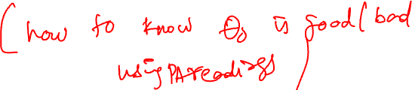
STEP 2: DEFINE THE LOSS
“Take the Loss”

Slide 19
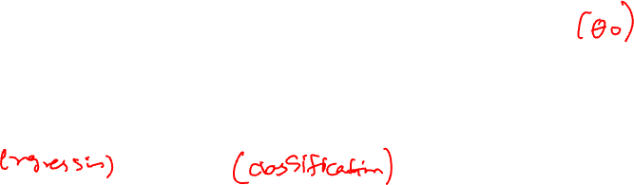
LOSS FUNCTIONS
Loss function: a function that characterizes the cost, error, or loss resulting from a particular choice of model or model parameters.
Many definitions of loss functions and the choice of loss function affects the accuracy and computational cost of estimation.
The choice of loss function depends on the estimation task
quantitative (e.g., tip) or qualitative variable (e.g., political affiliation)
Do we care about the outliers?
Are all errors equally costly? (e.g., false negative on cancer test)
Notes:
Different loss functions behave differently w/regard to outliers.
“Loss” function: because it quantifies how much our model loses compared to a perfect/ideal fit.

Slide 20
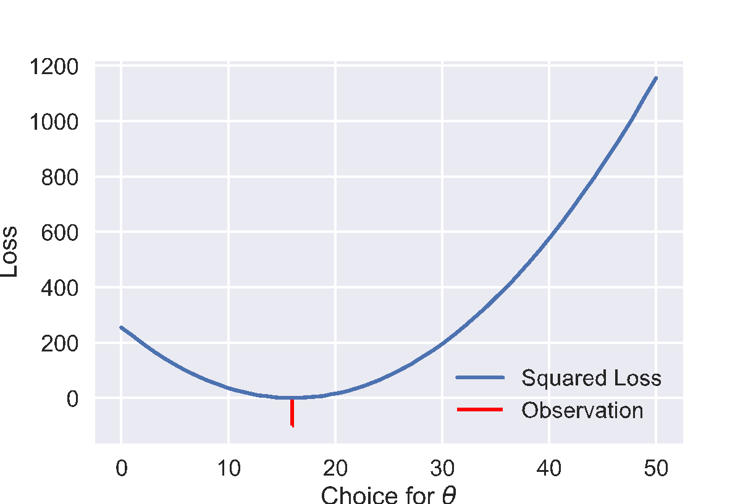
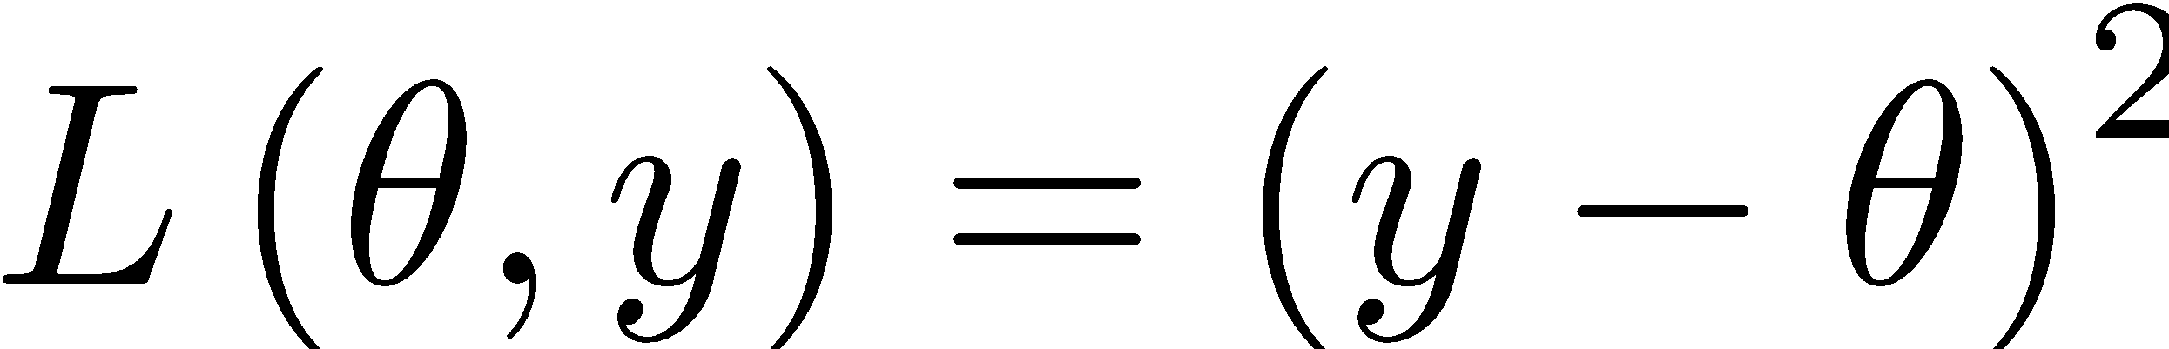
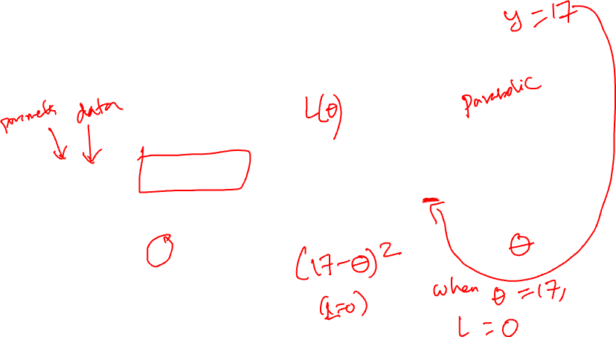

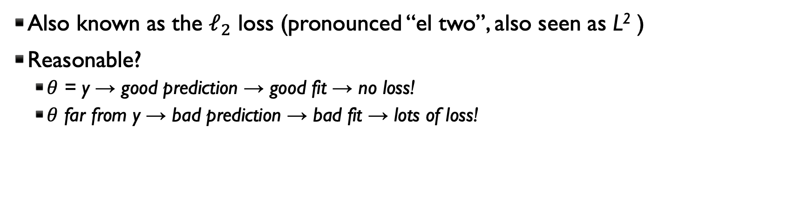
SQUARED LOSS (will use $θ^{∗}$instead of $θ_{0}^{∗}$)
Widely used loss!
The “error” in our prediction
The predicted value
An observed data point
Also known as the $ℓ_{2}$ loss (pronounced “el two”, also seen as L² )
Reasonable?
$θ$ = y → good prediction → good fit → no loss!
$θ$ far from y → bad prediction → bad fit → lots of loss!

Slide 21
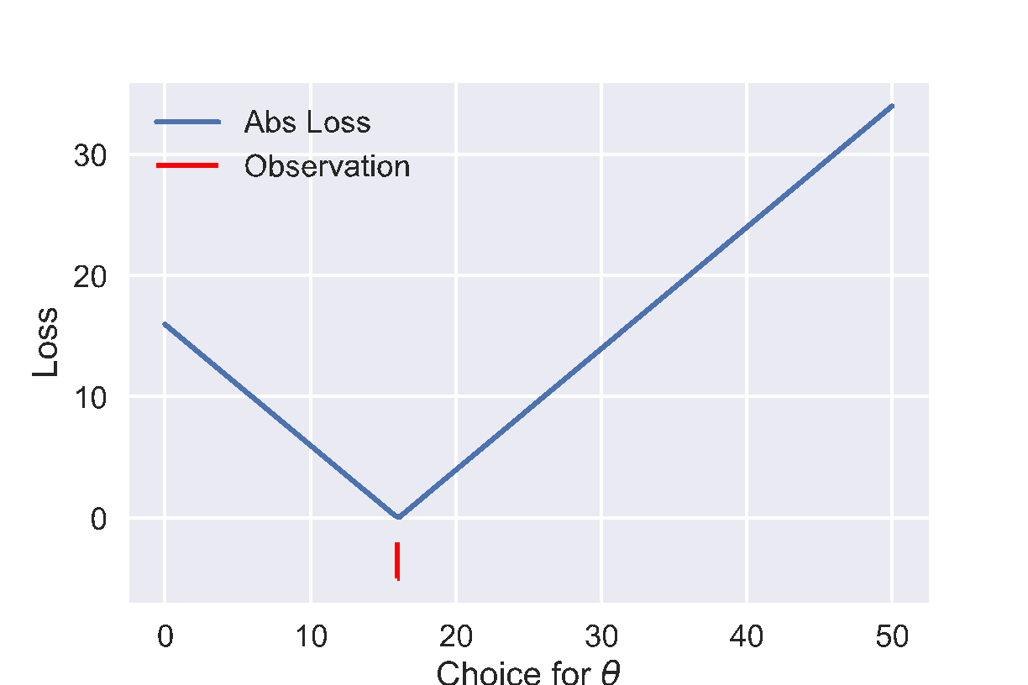
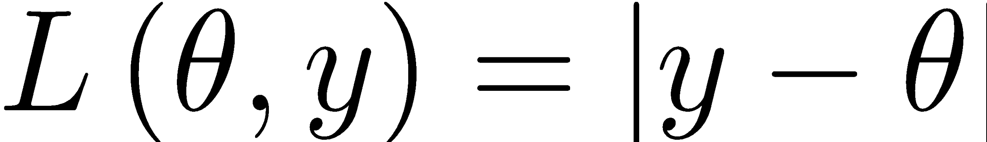
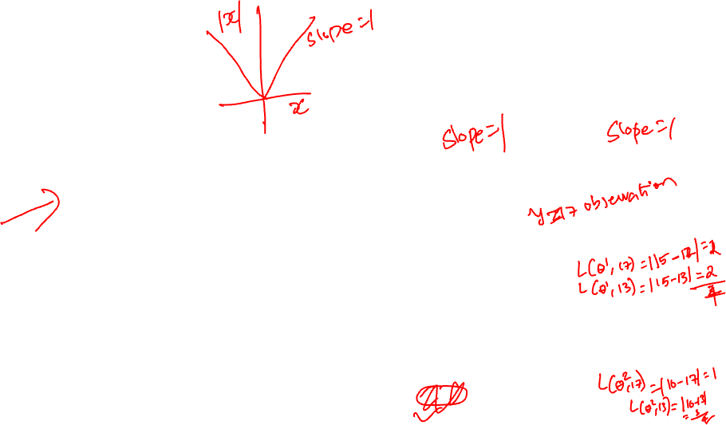


ABSOLUTE LOSS
It sounds worse than it is …
The “error” in our prediction
The predicted value
Absolute value
An observed data point
Also known as the the $ℓ_{1}$ loss (pronounced “el one”, also seen as L¹)
Reasonable?
$θ=y$ → good prediction → good fit → no loss!
$θ$ far from $y$ → bad prediction → bad fit → some loss
Quick poll: If I have two $θ$ estimates,$θ_{0}^{1}=15$, and $θ_{0}^{2}$=16, and I have two data points, y1=17 and y2=13, for which estimate is the absolute loss higher?
A. 15
B. 16
C. They have the same loss.
Notes:
Name one key difference between this plot and the previous one.
Vertical scale: L2 is much more sensitive.
Sharp corner: non-differentiable.
Curvature: L2 increasingly penalizes outliers.

Slide 22
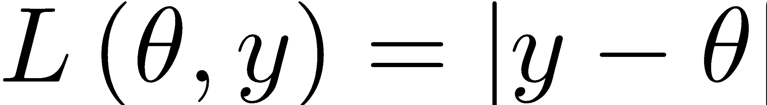
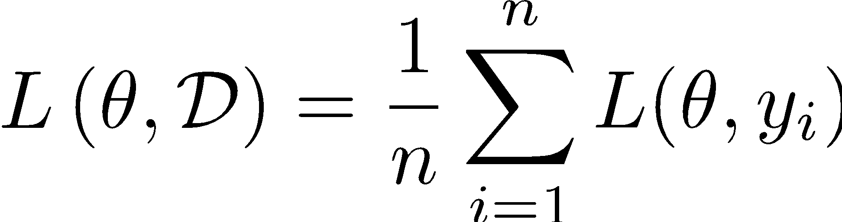

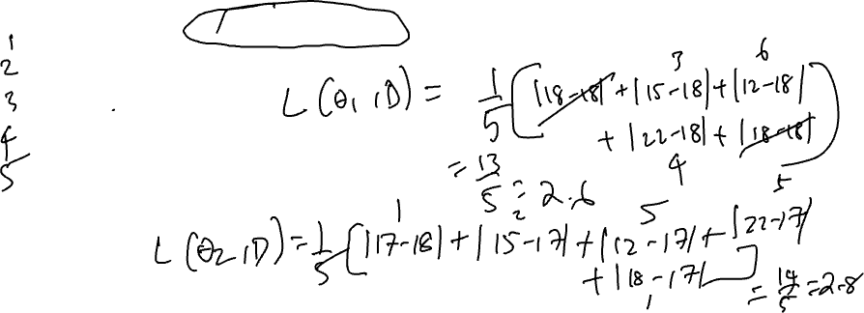
ABSOLUTE LOSS: EXAMPLE
Goal: does the mode or mean estimate for $θ_{0}$fit dataset D best?
PA reading
18
15
12
22
18
A. θ₁ based on mode: 18
B. θ₂ based on mean: 17

Slide 23

ABSOLUTE LOSS: EXAMPLE
Goal: does the mode or mean estimate for AQ Reading fit dataset D best?
PA reading
18
15
12
22
18
A. θ₁ based on mode: 18%
B. θ₂ based on mean: 17%
L1(θ₁ =18,D) = (|18-18|+|15-18|+|12-18|+|22-18|+|18-18|)/5 = 2.6
L1(θ₂ =17,D) = (|18-17|+|15-17|+|12-17|+|22-17|+|18-17|)/5 = 2.8
Do you think loss function y-θ is a good idea?

Slide 24

SUMMARY OF MODEL ESTIMATION (SO FAR…)
Define the Model: simplified representation of the world
Use domain knowledge but … keep it simple!
Introduce parameters for the unknown quantities
Define the Loss Function: measures how well a particular instance of the model “fits” the data
We introduced L² and L¹ losses for each record
Take the average loss over the entire dataset
Minimize the Loss Function: find the parameter values that minimize the loss on the data
Now we will minimize the loss analytically

Slide 25
STEP 3: MINIMIZE THE LOSS

Slide 26
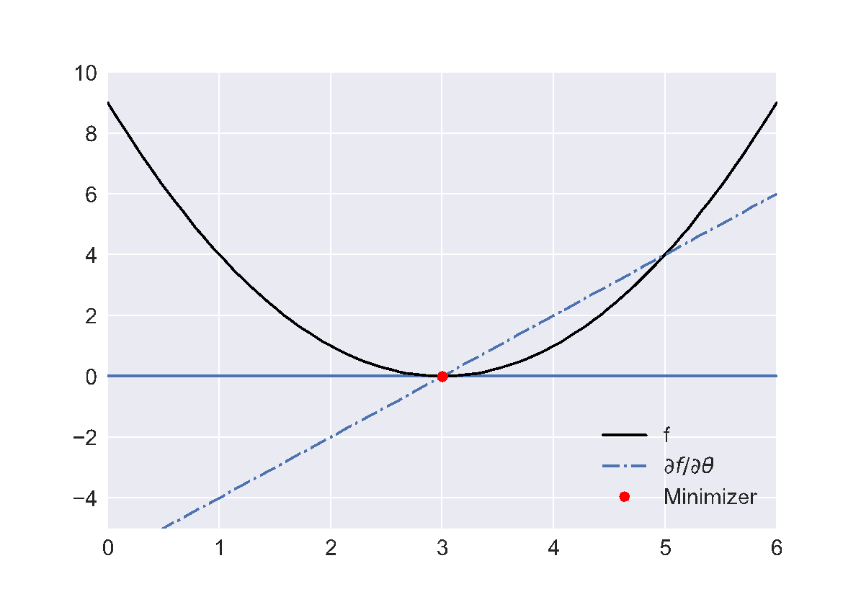
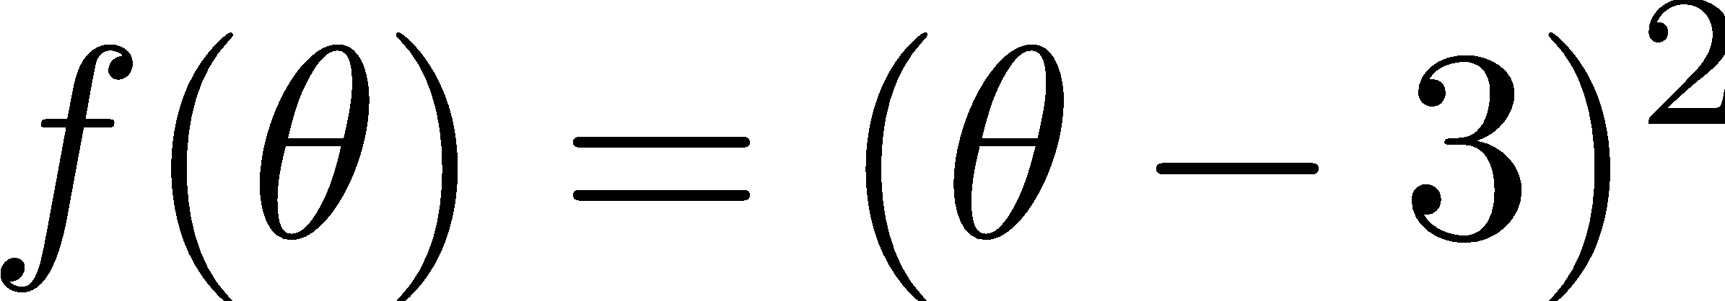
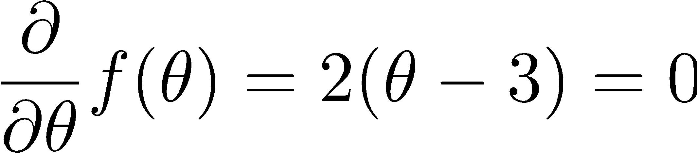

MINIMIZING A FUNCTION (CALCULUS REVIEW)
Suppose we want to minimize:
Solve for derivative = 0:
Procedure:
Take derivative
Set equal to zero
Solve for parameters

Slide 27









All of the above functions have zero derivatives at θ = 3
→ is θ=3 minimizer for all the above functions?
No!
Need to check second derivative is positive…

Slide 28





at θ = 3
Generally we are interested in convex functions with respect to the parameters θ.

Slide 29

CONVEX SETS AND POLYGONS
No line segment between any two points in the set (or on the boundary) ever leaves the polygon.
Equivalently, all angles are ≤ 180º.
The interior is a convex set.
Notes:
a subset of a Euclidean space, or more generally an affine space over the reals, is convex if, with any two points, it contains the whole line segment that joins them
凸集和凸多边形的定义
凸集（Convex Set）是一个集合，满足在集合内任意两点之间的线段都完全位于该集合内。
凸多边形（Convex Polygon）是一个多边形，它的所有内角都小于或等于 180°，并且满足凸集的定义。
凸多边形的性质
线段不会离开多边形：
对于凸多边形或凸集，任何两个在集合内的点之间画一条线段，这条线段始终会在集合内部，不会离开集合的边界。
图中圆形、三角形和五边形的例子展示了这一点。图中用黑色线段连接了集合内的两个点，线段保持在集合内，没有离开多边形的边界。
等价条件：所有角度小于等于 180°：
凸多边形的另一个特征是所有的内角都小于或等于 180°。这意味着没有“向内凹陷”的角，这也是确保任意两点间线段在集合内的条件。
内部为凸集：
凸多边形的内部是一个凸集。也就是说，如果我们选择多边形内的任意两点，那么这两个点之间的线段也会完全位于多边形的内部。
总结
凸集和凸多边形的主要特征是“保持线段在集合内”。
凸多边形的所有内角都不超过 180°，确保形状是凸的，没有凹陷的区域。

Slide 30

NON-CONVEX SETS AND POLYGONS
There is at least one line segment between two points on the boundary that leaves the set.

Slide 31




FORMAL DEFINITION OF CONVEX FUNCTIONS
Epigraph
Epigraph
All possible orange lines are:
always in epigraph or on black line
always above or equal to black line
Convex
Nonconvex
A function f is convex if and only if:
$$tf\left(a\right)+ \left(1−t\right)f\left(b\right)≥ f\left(ta + \left(1−t\right)b\right)$$ $∀a, ∀b, t ∊ [0, 1]$
Notes:
Work the algebra at home and convince yourself that the formal definition is equivalent to the one above for sets, when applied to the epigraph.
epigraph (the set of points on or above the graph of the function) is a convex set.

Slide 32





Convex or Not Convex:
Curve 1
Curve 2
Curve 3
Curve 4
Notes:
It is easy to see that every linear function -- whose graph is a straight line -- is both convex and concave.

Slide 33


ARE OUR PREVIOUS LOSS FUNCTIONS CONVEX?
Yes!
Average Loss?
Yes!
(Sum of convex functions is convex)
Notes:
Huber is quadratic for small values of x, and linear for large values

Slide 34


IS A GAUSSIAN CONVEX?
Notes:
Gaussian: a*e^{(x-b)^2/2c^2}
b=mean, c=stddev, a=1/(c*sqrt(2*pi))

Slide 35

EXPECTED LOSS
A natural way to define the loss on our entire dataset is to compute the average of the loss on each record.
In some cases we might take a weighted average (when?)
Some records might be more important or reliable
What does the average loss look like?
The set of n data points

Slide 36
ACKNOWLEDGMENTS
These slides use materials by the Berkeley DS 100 team, Elena Zheleva, Gonzalo Bello

