Slide 1
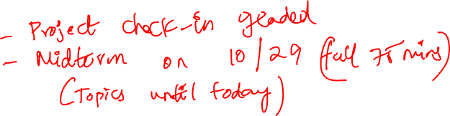
MODELS AND ESTIMATION
Chapter 15

Slide 2
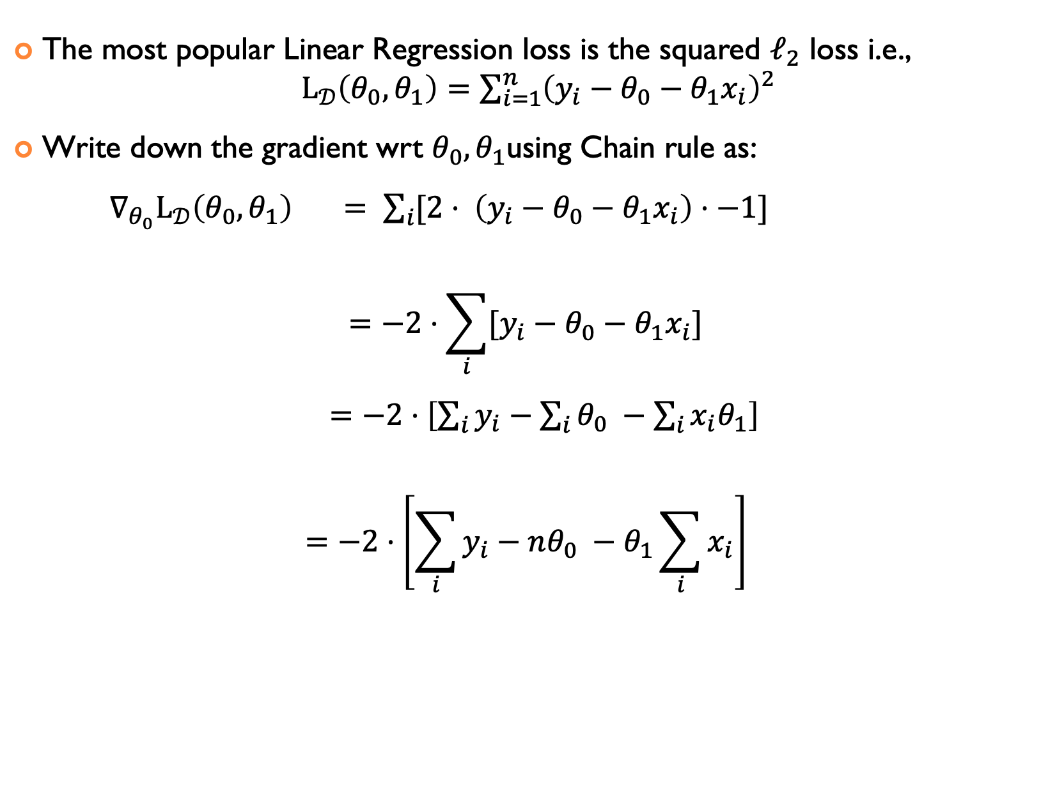

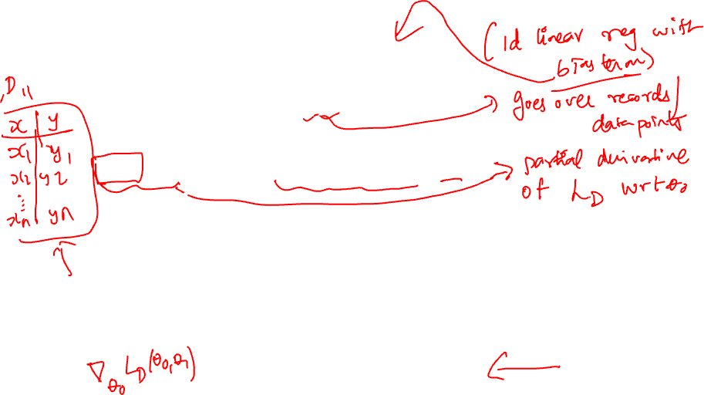
Back to $PA=θ_{0}^{∗}+θ_{1}^{∗}AQ⟺ y=θ_{0}^{∗}+θ_{1}^{∗}x$
The most popular Linear Regression loss is the squared $ℓ_{2}$ loss i.e., $L_{𝒟}\left(θ_{0},θ_{1}\right)=\sum_{i=1}^{n}{{\left(y_{i}−θ_{0}−θ_{1}x_{i}\right)}^{2}}$
Write down the gradient wrt $θ_{0},θ_{1}$using Chain rule as: $∇_{θ_{0}}L_{𝒟}\left(θ_{0},θ_{1}\right) = \sum_{i}{[2⋅ \left(y_{i}−θ_{0}−θ_{1}x_{i}\right)⋅−1]}$
$$=−2⋅\sum_{i}{[y_{i}−θ_{0}−θ_{1}x_{i}}]$$
$=−2⋅\left[\sum_{i}{y_{i}}−\sum_{i}{θ_{0}} −\sum_{i}{x_{i}θ_{1}}\right]$
$$=−2⋅\left[\sum_{i}{y_{i}}−nθ_{0} −θ_{1}\sum_{i}{x_{i}}\right]$$

Slide 3
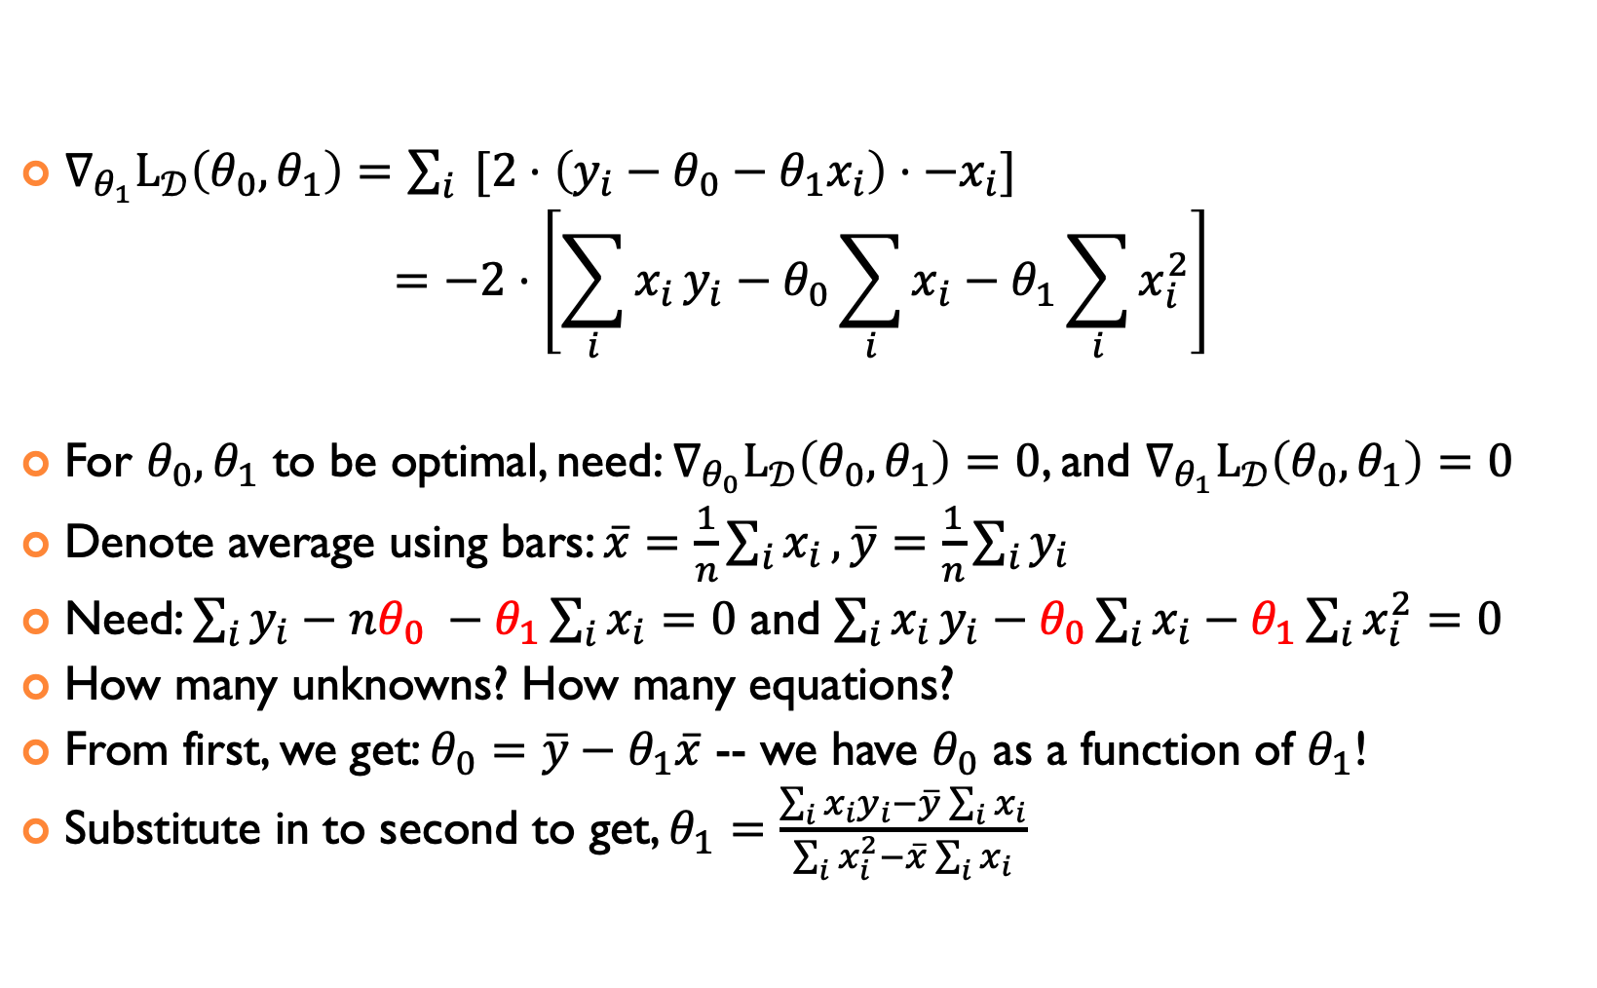
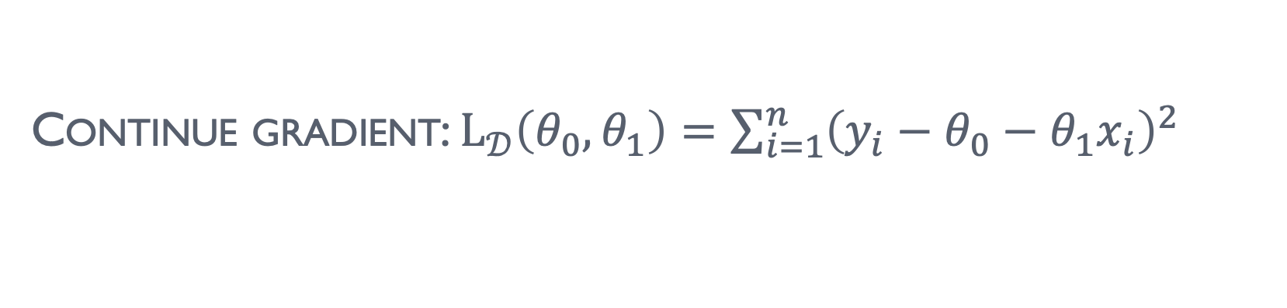
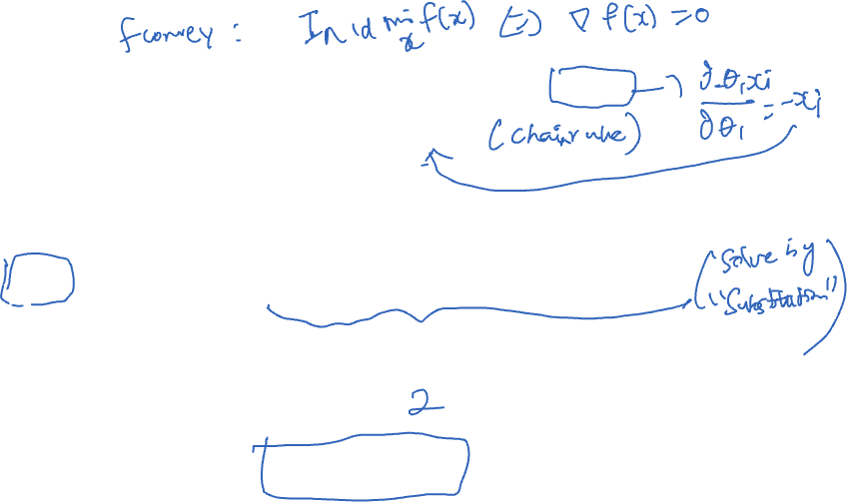
Continue gradient: $L_{𝒟}\left(θ_{0},θ_{1}\right)=\sum_{i=1}^{n}{{\left(y_{i}−θ_{0}−θ_{1}x_{i}\right)}^{2}}$
$∇_{θ_{1}}L_{𝒟}\left(θ_{0},θ_{1}\right)=\sum_{i}{ [2⋅\left(y_{i}−θ_{0}−θ_{1}x_{i}\right)⋅−x_{i}]}$
$$=−2⋅\left[\sum_{i}{x_{i}}y_{i}−θ_{0}\sum_{i}{x_{i}}−θ_{1}\sum_{i}{x_{i}^{2}}\right]$$
For $θ_{0},θ_{1}$ to be optimal, need: $∇_{θ_{0}}L_{𝒟}\left(θ_{0},θ_{1}\right)=0$, and $∇_{θ_{1}}L_{𝒟}\left(θ_{0},θ_{1}\right)=0$
Denote average using bars: $\overline{x}=\frac{1}{n}\sum_{i}{x_{i}},\overline{y}=\frac{1}{n}\sum_{i}{y_{i}}$
Need: $\sum_{i}{y_{i}}−nθ_{0} −θ_{1}\sum_{i}{x_{i}}=0$ and $\sum_{i}{x_{i}}y_{i}−θ_{0}\sum_{i}{x_{i}}−θ_{1}\sum_{i}{x_{i}^{2}=0}$
How many unknowns? How many equations?
From first, we get: $θ_{0}=\overline{y}−θ_{1}\overline{x}$ -- we have $θ_{0}$ as a function of $θ_{1}$!
Substitute in to second to get, $θ_{1}=\frac{\sum_{i}{x_{i}y_{i}−\overline{y}\sum_{i}{x_{i}}}}{\sum_{i}{x_{i}^{2}}−\overline{x}\sum_{i}{x_{i}}}$

Slide 4
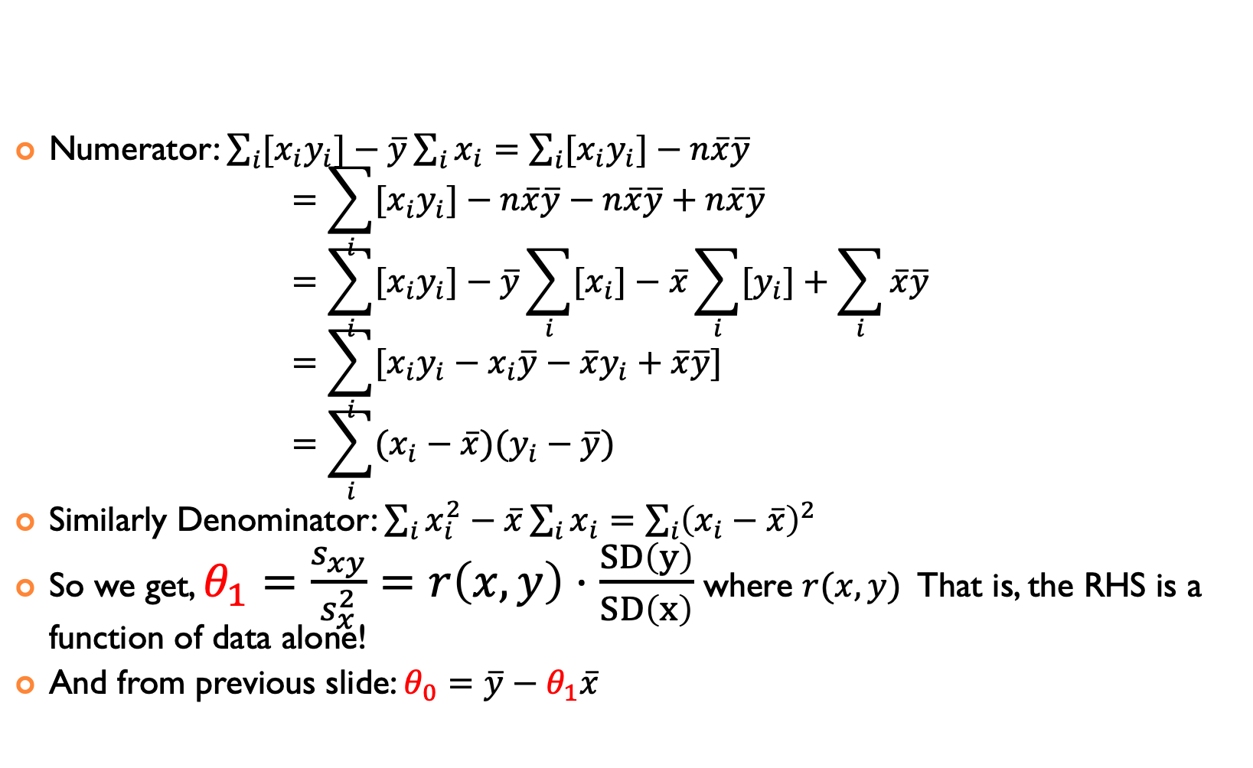

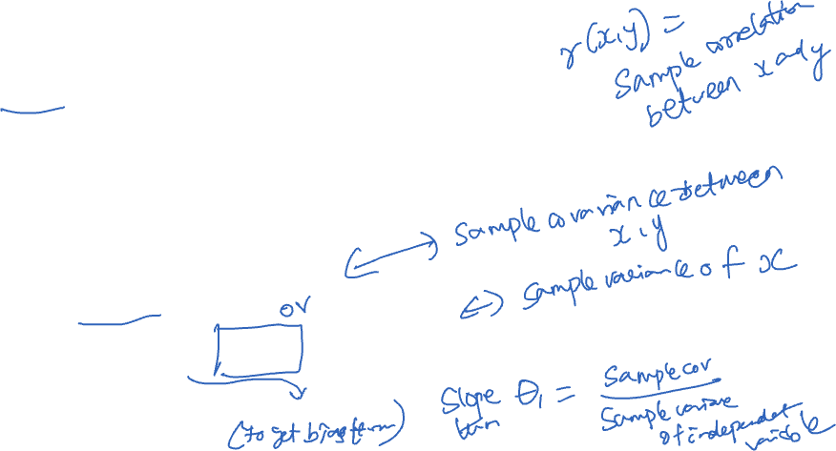
CAN SIMPLIFY EXPRESSIONS FOR $θ_{1}$with sample covariance and variance
Numerator: $\sum_{i}{{[x}_{i}y_{i}]−\overline{y}\sum_{i}{x_{i}=\sum_{i}{{[x}_{i}y_{i}]−n\overline{x}\overline{y} }}}$ $=\sum_{i}{{[x}_{i}y_{i}]−n\overline{x}\overline{y}−n\overline{x}\overline{y}+n\overline{x}\overline{y}}$ $=\sum_{i}{{[x}_{i}y_{i}]}−\overline{y}\sum_{i}{{[x}_{i}]}−\overline{x}\sum_{i}{{[y}_{i}]}+\sum_{i}{\overline{x}\overline{y}}$ $=\sum_{i}{[x_{i}y_{i}−x_{i}\overline{y}−{\overline{x}y}_{i}+\overline{x}\overline{y}]}$ $=\sum_{i}{(x_{i}−\overline{x})(y_{i}−\overline{y})}$
Similarly Denominator: $\sum_{i}{x_{i}^{2}}−\overline{x}\sum_{i}{x_{i}}=\sum_{i}{{\left(x_{i}−\overline{x}\right)}^{2}}$
So we get, $θ_{1}=\frac{s_{xy}}{s_{x}^{2}}=r\left(x,y\right)⋅\frac{SD\left(y\right)}{SD\left(x\right)}$ where $r(x,y)$ That is, the RHS is a function of data alone!
And from previous slide: $θ_{0}=\overline{y}−θ_{1}\overline{x}$

Slide 5
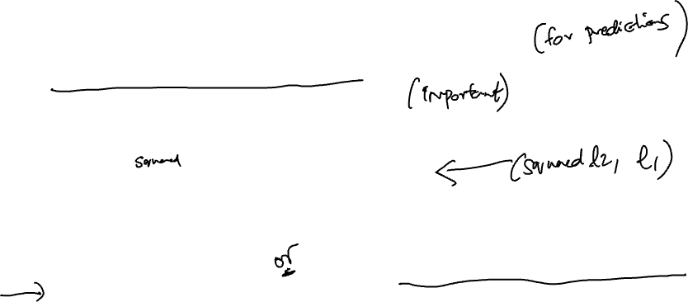
SUMMARY OF MODEL ESTIMATION SO FAR
Define the Model: simplified representation of the world
Use domain knowledge but … keep it simple!
Introduce parameters for the unknown quantities
Define the Loss Function: measures how well a particular instance of the model “fits” the data
We introduced L², L¹, and Huber losses for each record
Take the average loss over the entire dataset
Minimize the Loss Function: find the parameter values that minimize the loss on the data
Look at the graph of the function to understand its mathematical properties such as convexity
For linear regression alone, we can minimize the loss analytically using calculus
For everything else, have minimize the loss numerically (later)

Slide 6
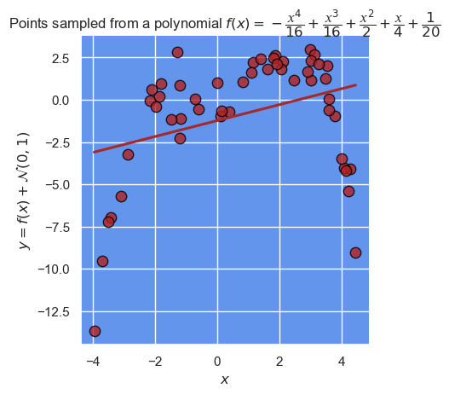
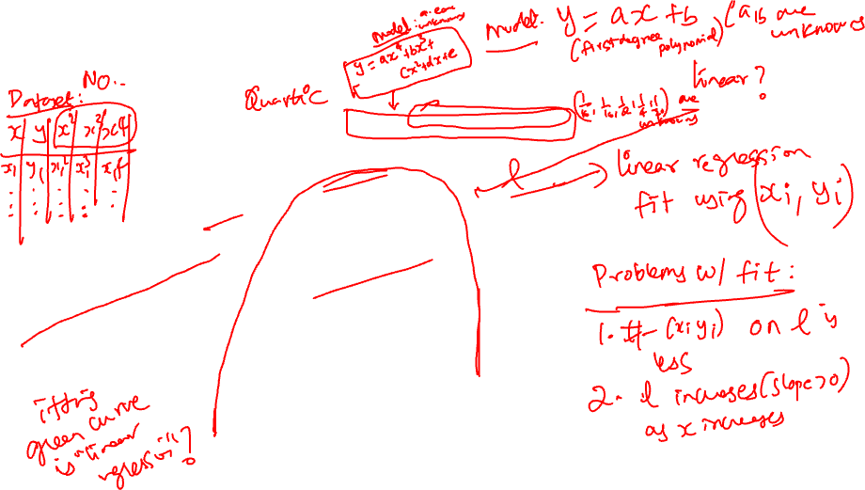

IS THIS DATA LINEAR?
What does it mean to be linear?
Notes:
sns.lmplot(x="x", y="y", data=df,
ci=None, fit_reg=True, order=1, line_kws={"color": "brown"},scatter_kws={"s": 80,"edgecolor":'black',"color":'firebrick'})\
.set(title = 'Points sampled from a polynomial $f(x)=−\\dfrac{𝑥^4}{16}+\\dfrac{𝑥^3}{16}+\\dfrac{𝑥^2}{2}+\\dfrac{𝑥}{4}+\\dfrac{1}{20} $',
xlabel = '$x$',
ylabel = '$y= f(x)+\\mathcal{N}(0,1)$');

Slide 7
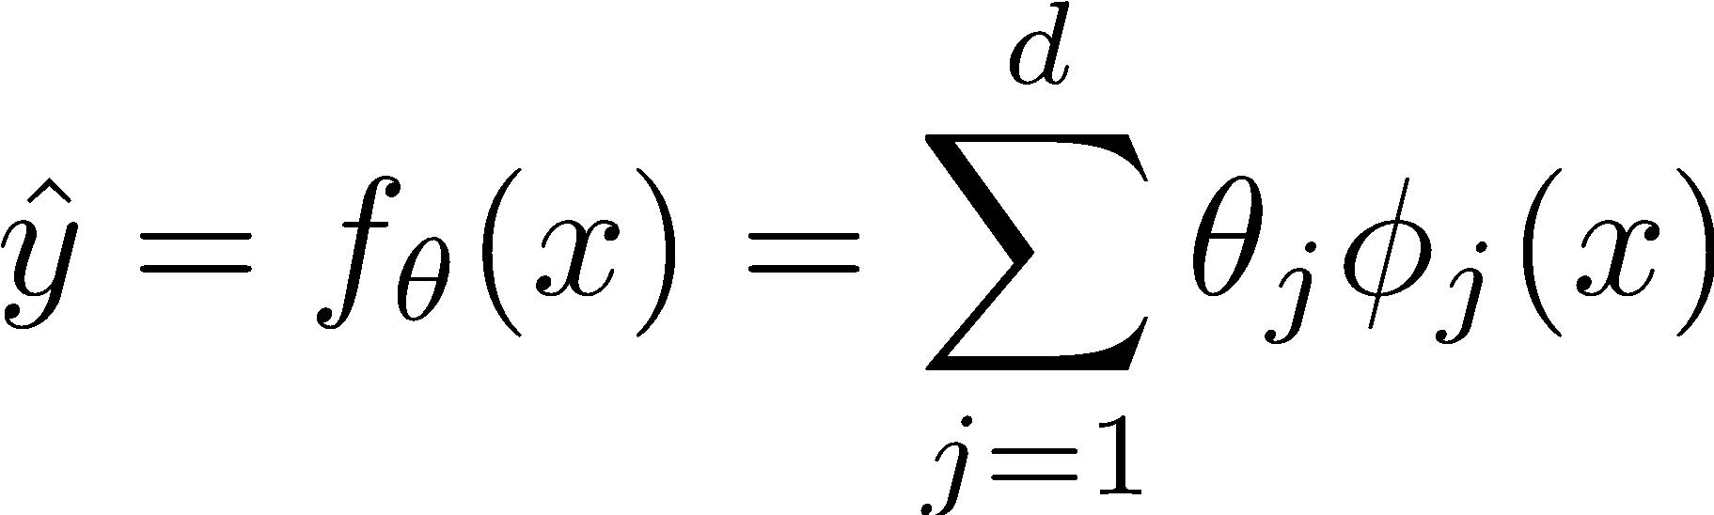





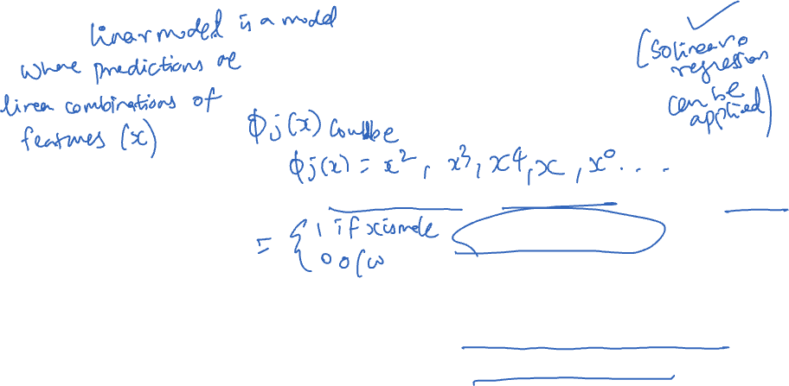
LINEAR MODELS AND FEATURE FUNCTIONS
Linear in the Parameters
Feature Functions
For Example:
Domain:
Designing the feature functions is a big part of machine learning and data science.
Feature Functions
capture domain knowledge
substantial contribute to expressivity (and complexity)
Model:
Features:
Indicator functions
are a common method to transform qualitative data into quantitative data.

Slide 8
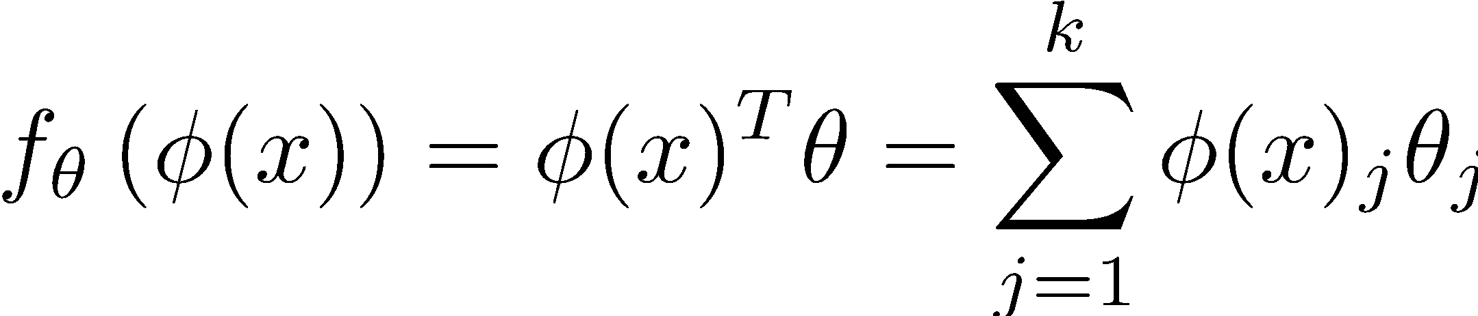
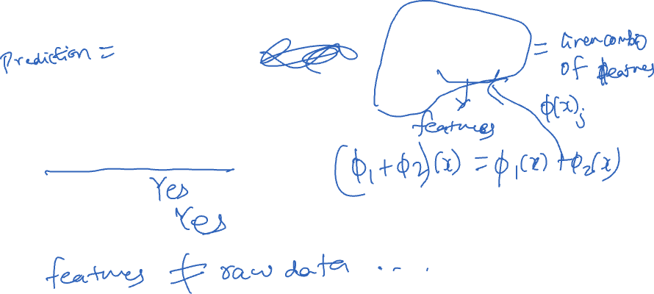
WHAT DOES IT MEAN TO BE A LINEAR MODEL?
In what sense is the above model linear?
Are linear models linear in the
the features?
the parameters?

Slide 9

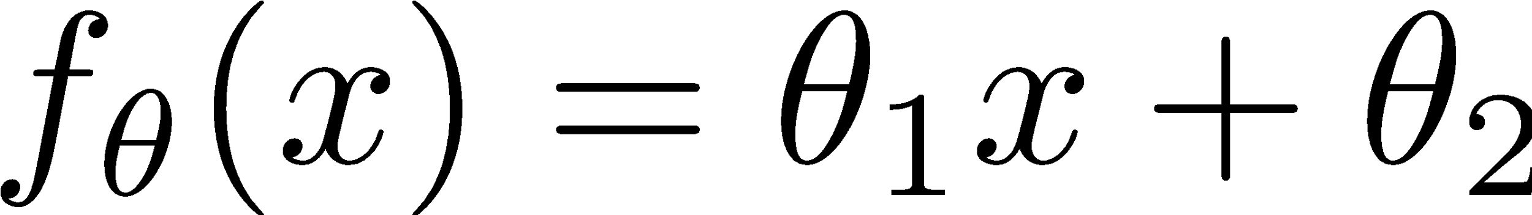
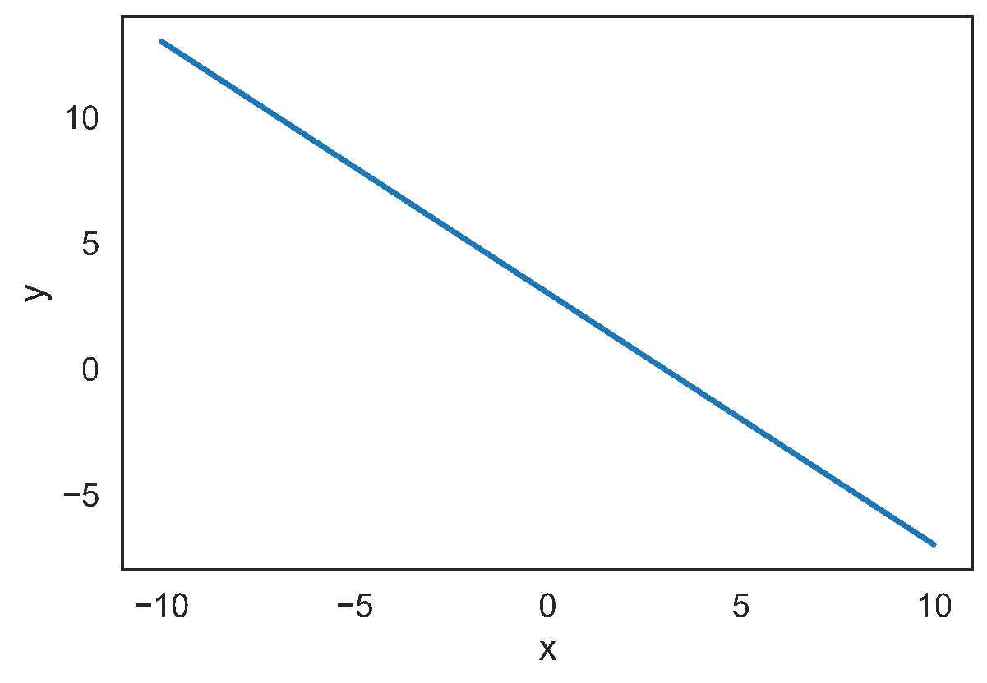
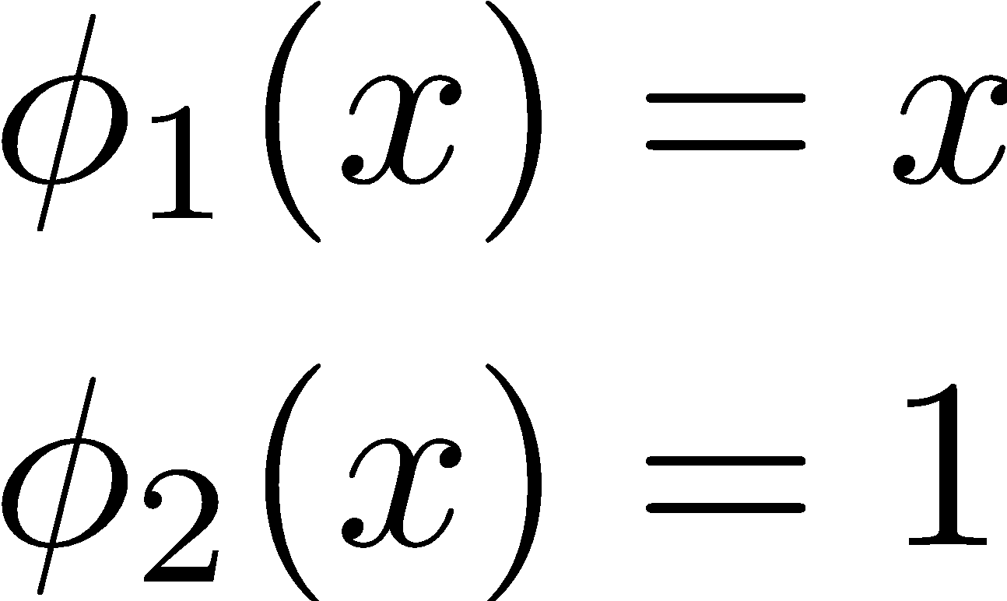
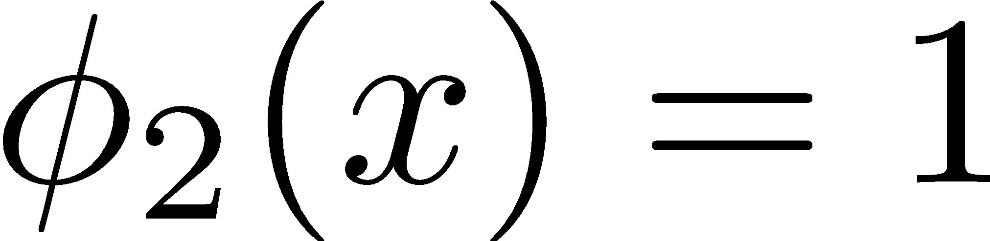
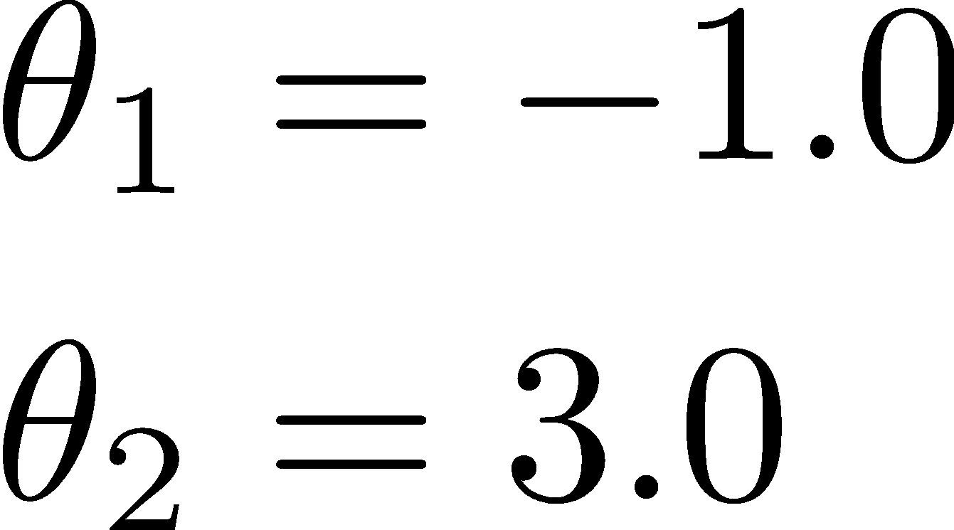
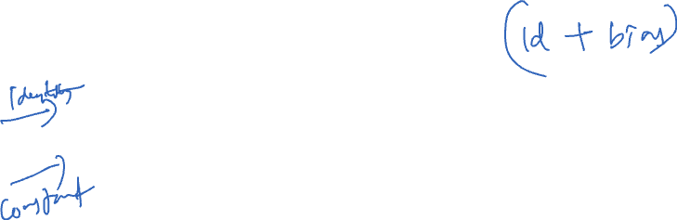
LINEAR MODELS AND FEATURE FUNCTIONS
Linear in the Parameters
Feature Functions
For Example:
Domain:
Designing the feature functions is a big part of machine learning and data science.
Feature Functions
capture domain knowledge
substantial contribute to expressivity (and complexity)
Model:
Features:
Adding a “constant” feature function
is a common method to introduce an offset (also sometimes called bias) term.
Notes:
Theta1 slope, theta2 y-intercept
Distance from origin = (theta2/sqrt(theta1^2+1))

Slide 10

LINEAR MODELS AND FEATURE FUNCTIONS
Linear in the Parameters
Feature Functions
Designing the feature functions is a big part of machine learning and data science.
Feature Functions
capture domain knowledge
substantial contribute to expressivity (and complexity)
Notes:
Theta1 slope, theta2 y-intercept
Distance from origin = (theta2/sqrt(theta1^2+1))

Slide 11
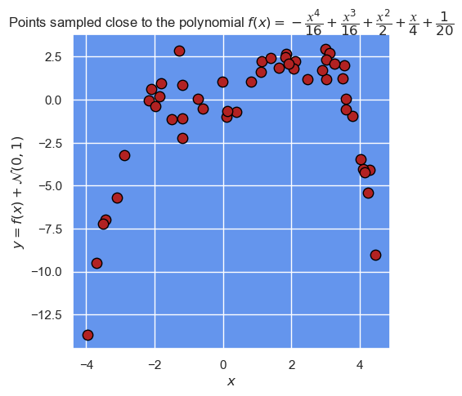
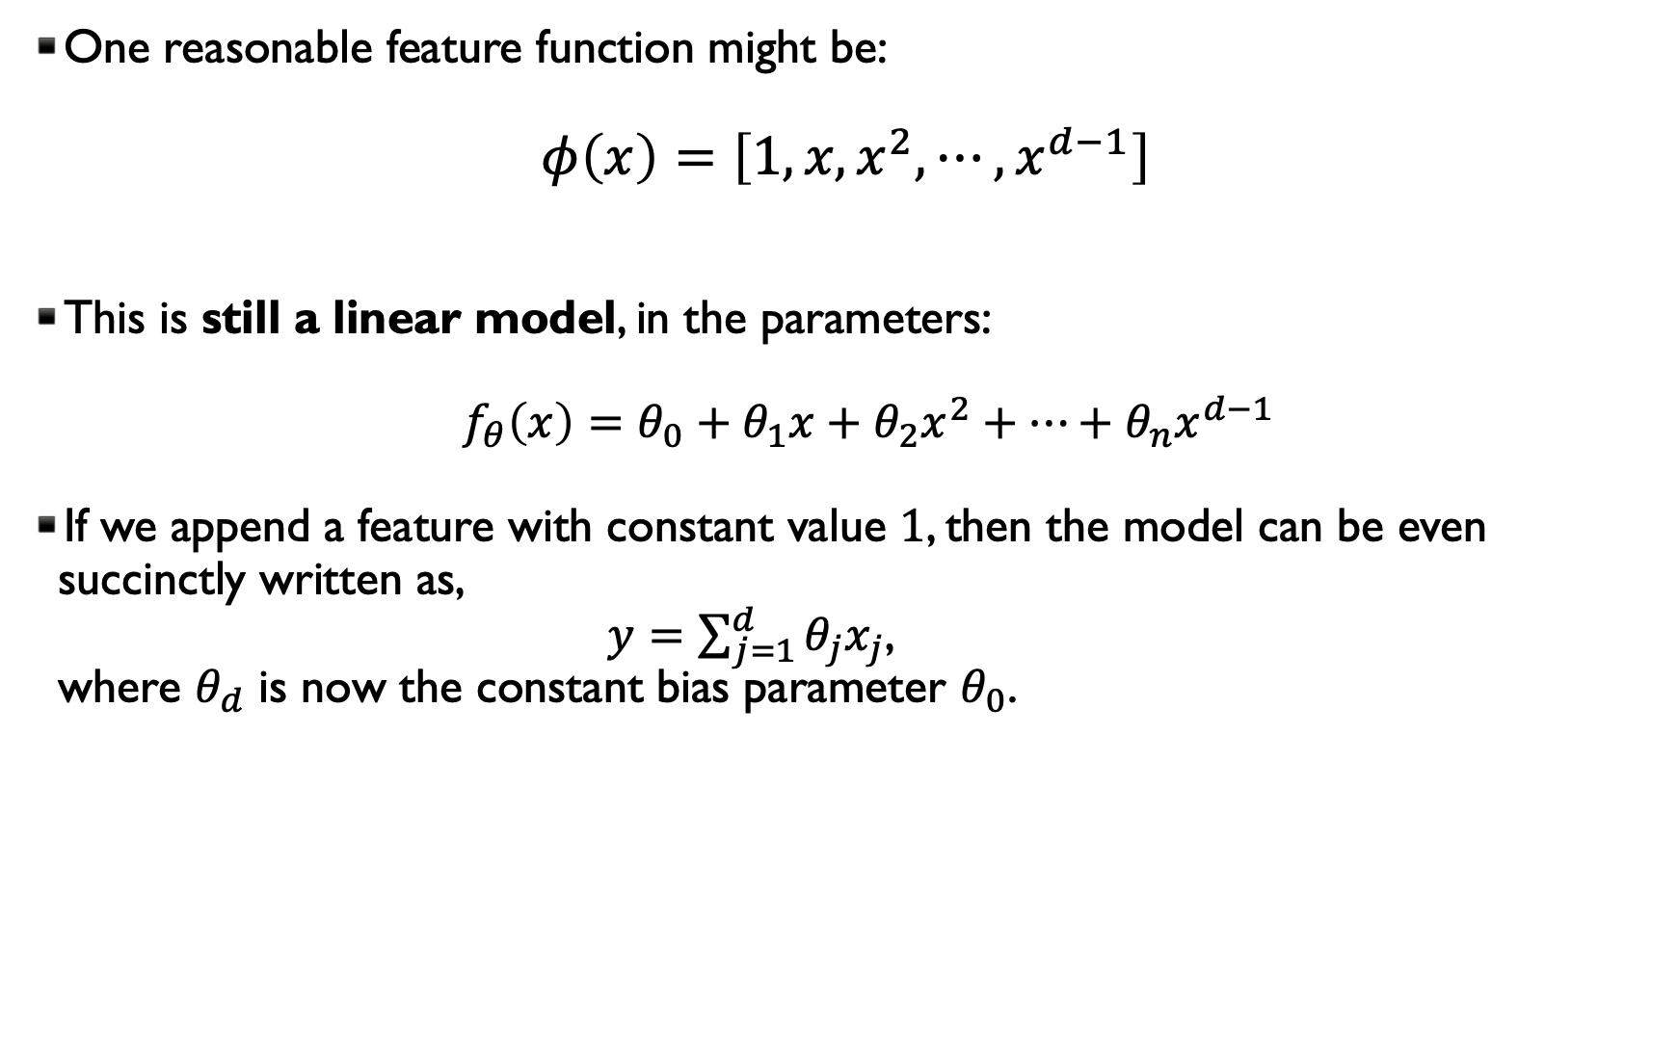
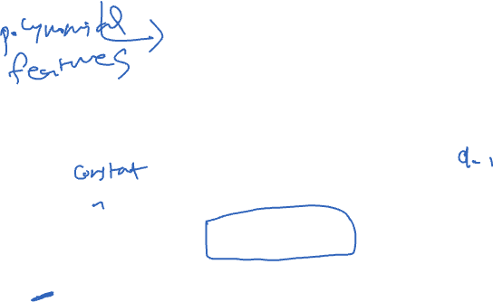
INTRODUCING NON-LINEAR FEATURE FUNCTIONS
One reasonable feature function might be:
$$φ\left(x\right)=\left[1,x,x^{2},⋯,x^{d−1}\right]$$
This is still a linear model, in the parameters: $f_{θ}\left(x\right)=θ_{0}+θ_{1}x+θ_{2}x^{2}+⋯+θ_{n}x^{d−1}$
If we append a feature with constant value $1$, then the model can be even succinctly written as, $y=\sum_{j=1}^{d}{θ_{j}x_{j}}$, where $θ_{d}$ is now the constant bias parameter $θ_{0}$.

Slide 12
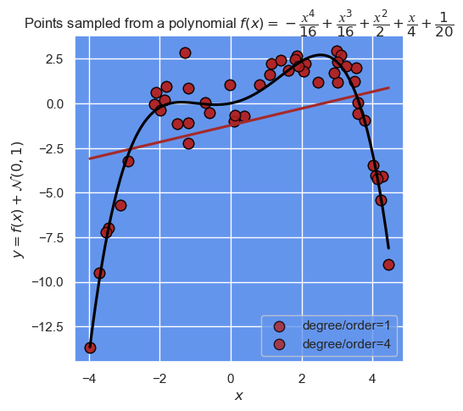
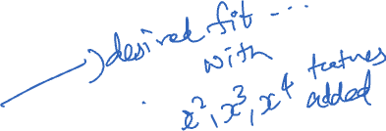
With the columns added can obtain the true fit

Slide 13
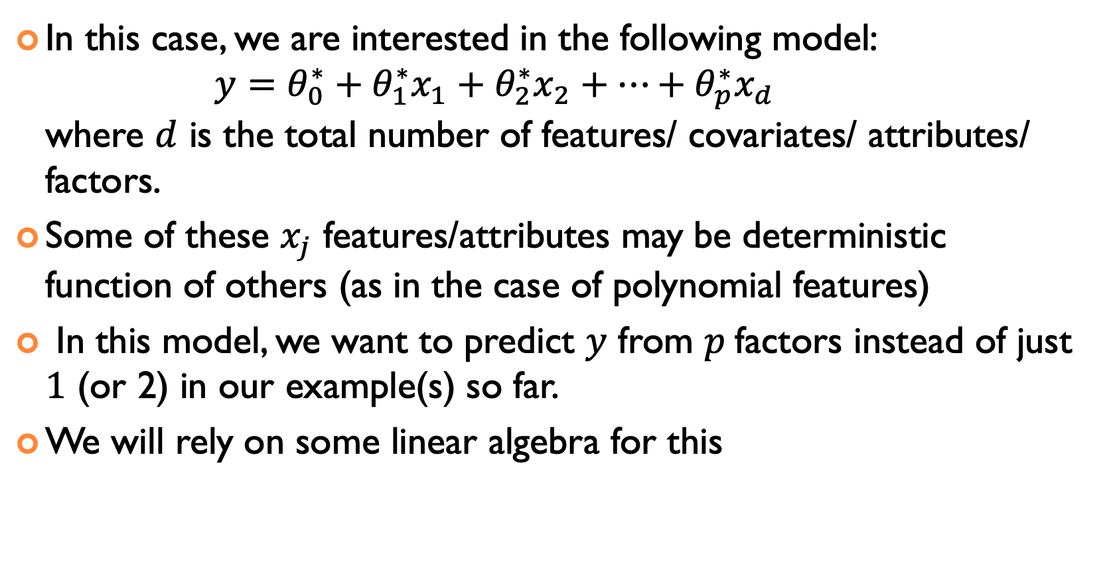
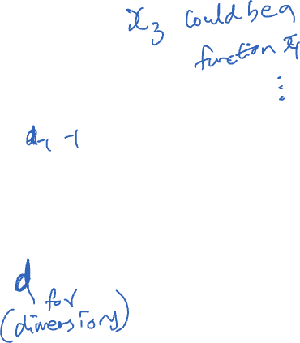
NOW TO ”MULTIPLE LINEAR REGRESSION”
In this case, we are interested in the following model: $y=θ_{0}^{∗}+θ_{1}^{∗}x_{1}+θ_{2}^{∗}x_{2}+⋯+θ_{p}^{∗}x_{d}$ where $d$ is the total number of features/ covariates/ attributes/ factors.
Some of these $x_{j}$ features/attributes may be deterministic function of others (as in the case of polynomial features)
In this model, we want to predict $y$ from $p$factors instead of just $1$ (or 2) in our example(s) so far.
We will rely on some linear algebra for this

Slide 14
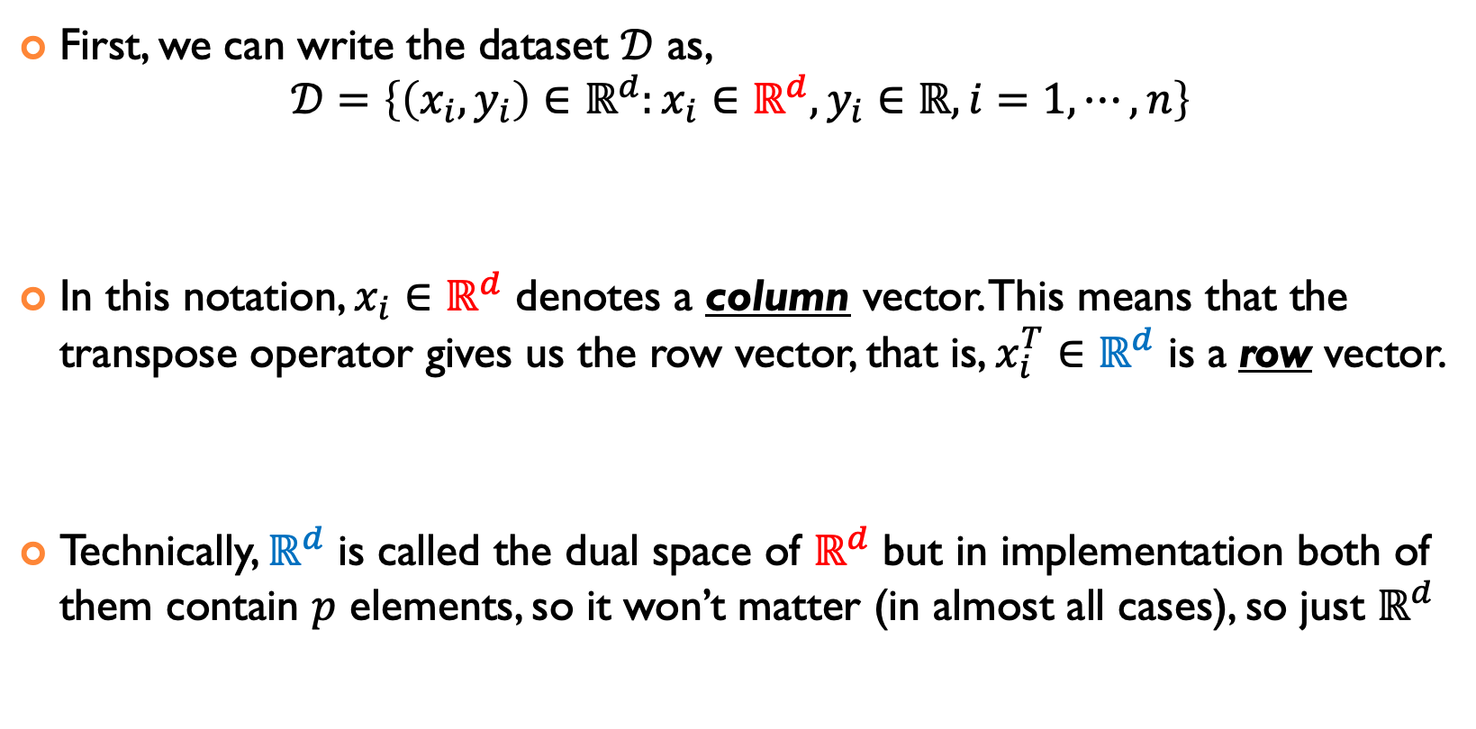
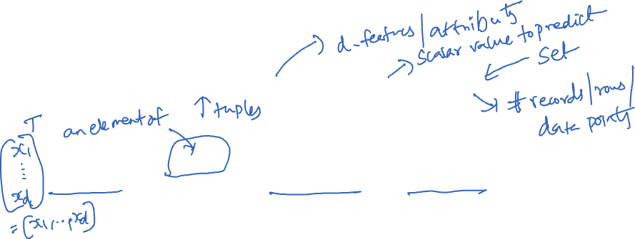
GIVEN A DATASET, WHAT TO DO?
First, we can write the dataset $𝒟$ as, $𝒟=\left\{\left(x_{i},y_{i}\right)∈ℝ^{d}:{x_{i}∈ℝ}^{d},y_{i}∈ℝ, i=1,⋯,n\right\}$
In this notation, $x_{i}∈ℝ^{d}$ denotes a column vector. This means that the transpose operator gives us the row vector, that is, $x_{i}^{T}∈ℝ^{d}$ is a row vector.
Technically, $ℝ^{d}$ is called the dual space of $ℝ^{d}$ but in implementation both of them contain $p$ elements, so it won’t matter (in almost all cases), so just $ℝ^{d}$

Slide 15
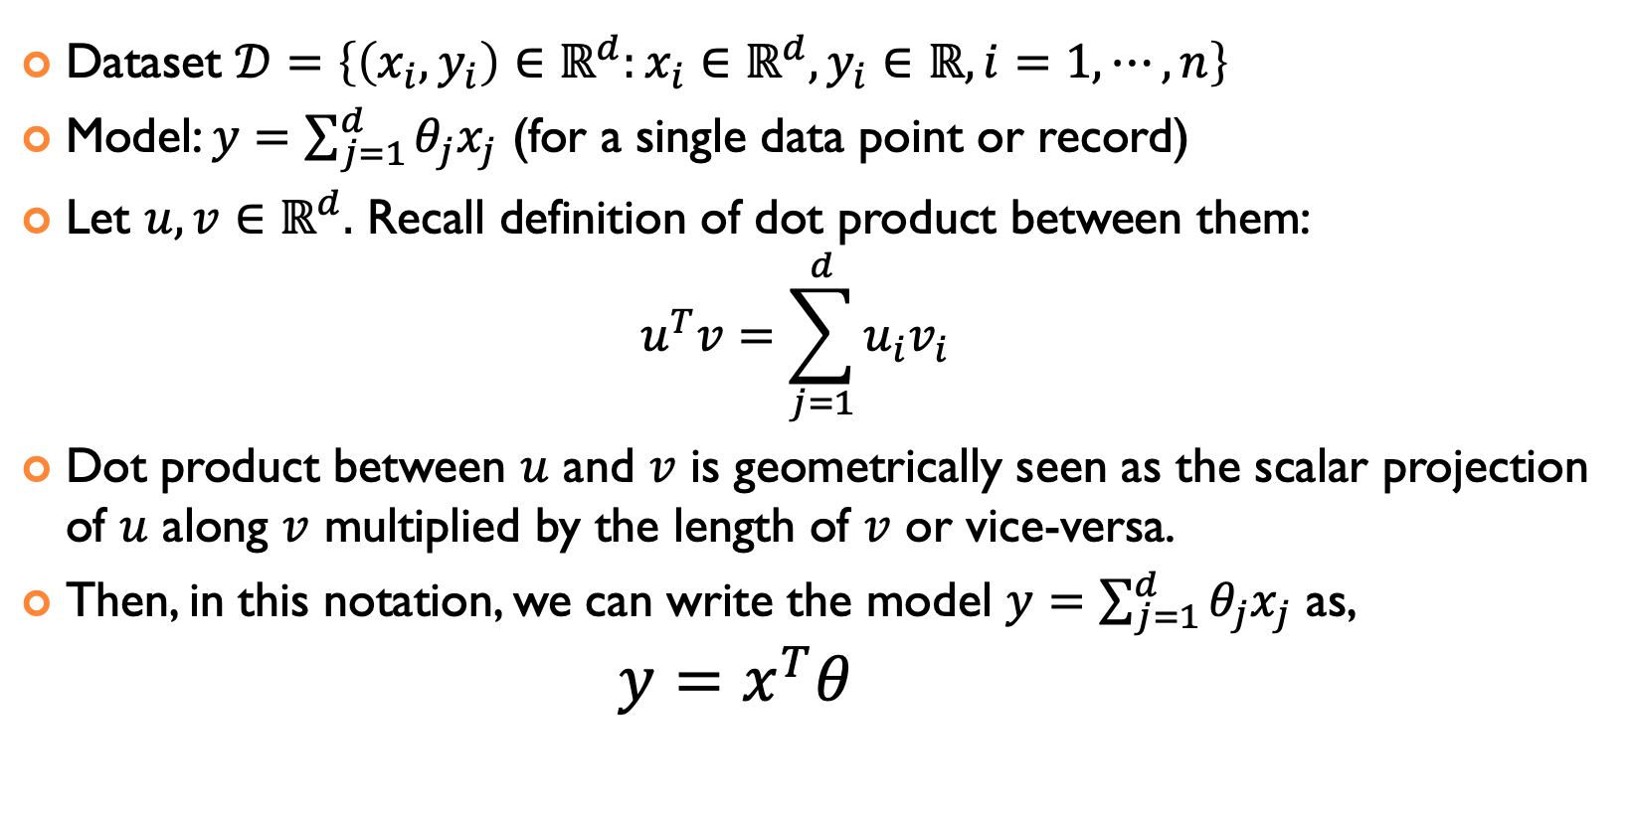
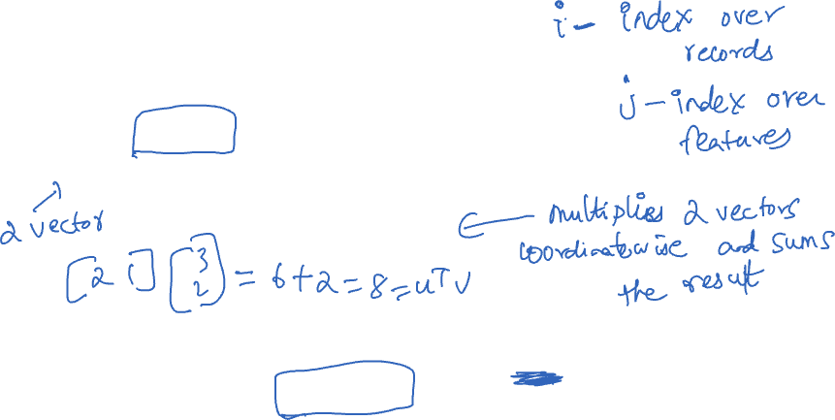
REFORMULATE/REWRITE THE MODEL
Dataset $𝒟=\left\{\left(x_{i},y_{i}\right)∈ℝ^{d}:{x_{i}∈ℝ}^{d},y_{i}∈ℝ, i=1,⋯,n\right\}$
Model: $y=\sum_{j=1}^{d}{θ_{j}x_{j}}$ (for a single data point or record)
Let $u,v∈ℝ^{d}.$ Recall definition of dot product between them: $u^{T}v=\sum_{j=1}^{d}{u_{i}v_{i}}$
Dot product between $u$ and $v$ is geometrically seen as the scalar projection of $u$ along $v$ multiplied by the length of $v$ or vice-versa.
Then, in this notation, we can write the model $y=\sum_{j=1}^{d}{θ_{j}x_{j}}$ as, $y=x^{T}θ$

Slide 16
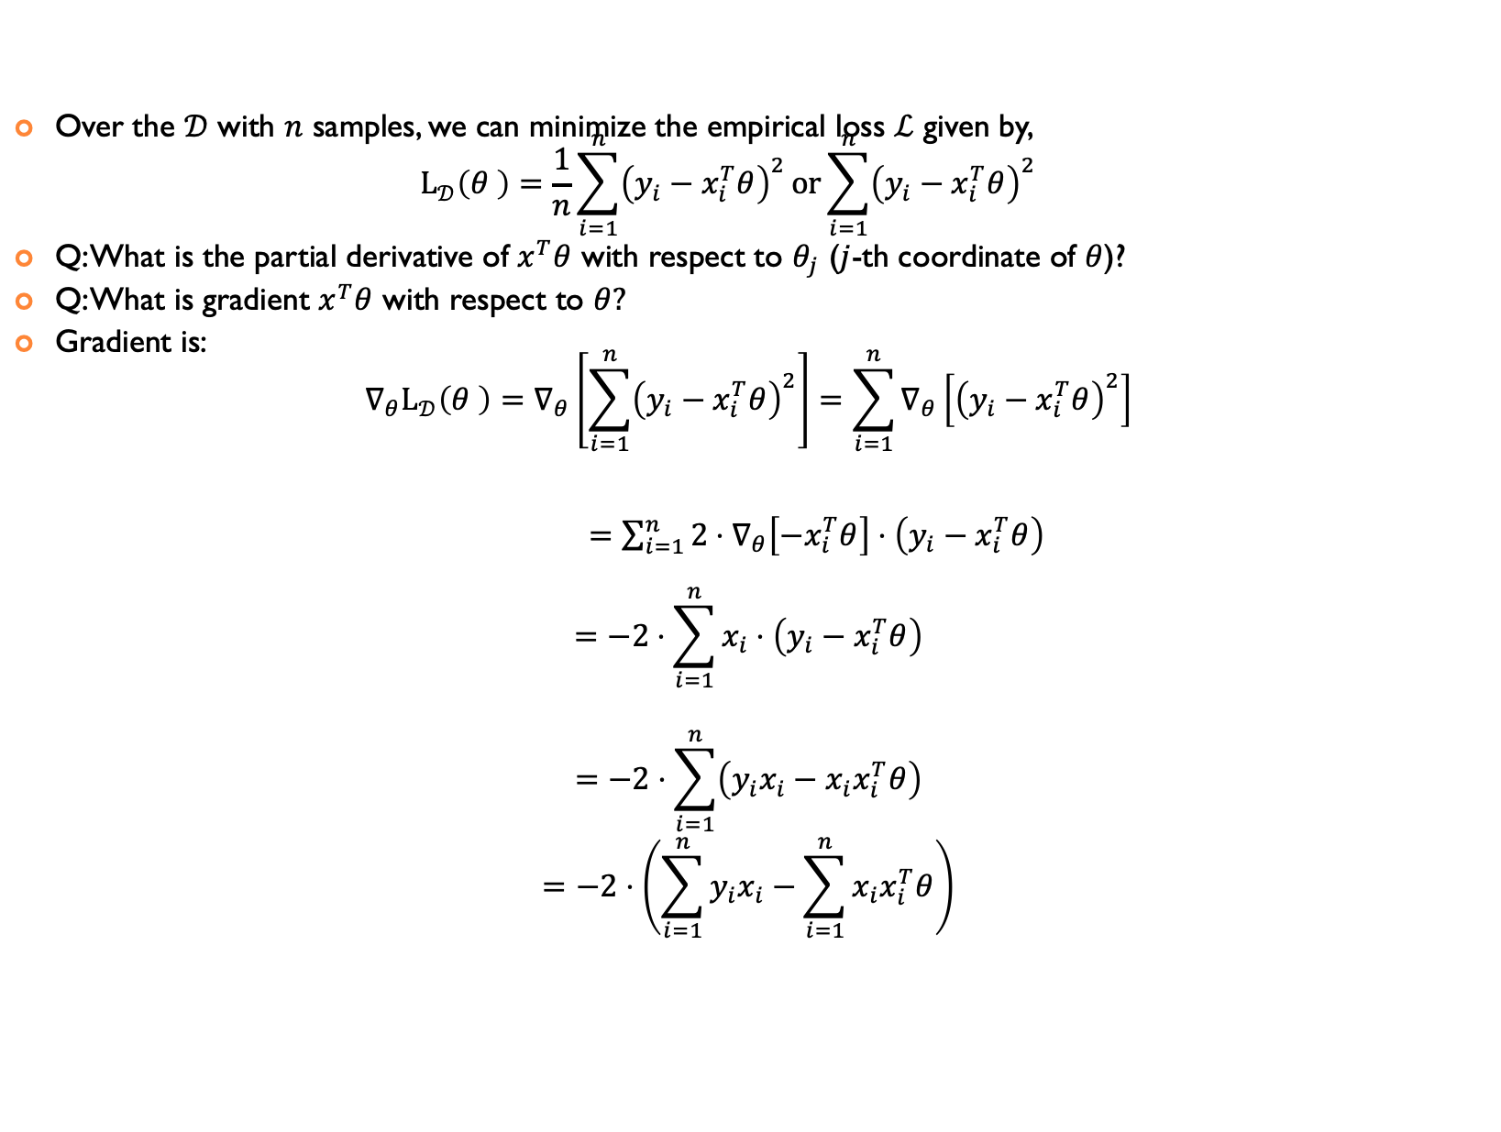
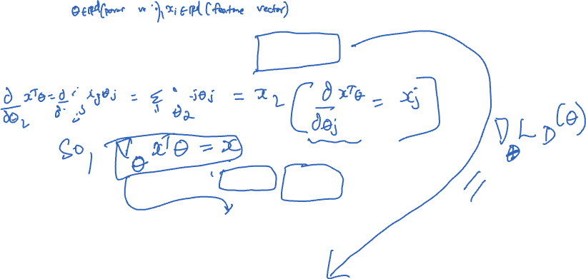
STEP 1: LOSS AND GRADIENT (TAKING DERIVATIVE)
Over the $𝒟$ with $n$ samples, we can minimize the empirical loss $ℒ$ given by, $L_{𝒟}\left(θ \right)=\frac{1}{n}\sum_{i=1}^{n}{{\left(y_{i}−x_{i}^{T}θ\right)}^{2}}or\sum_{i=1}^{n}{{\left(y_{i}−x_{i}^{T}θ\right)}^{2}}$
Q: What is the partial derivative of $x^{T}θ$ with respect to $θ_{j}$ ($j$-th coordinate of $θ$)?
Q: What is gradient $x^{T}θ$ with respect to $θ?$
Gradient is: $∇_{θ}L_{𝒟}\left(θ \right)=∇_{θ}\left[\sum_{i=1}^{n}{{\left(y_{i}−x_{i}^{T}θ\right)}^{2}}\right]=\sum_{i=1}^{n}{∇_{θ}\left[{\left(y_{i}−x_{i}^{T}θ\right)}^{2}\right]}$
$=\sum_{i=1}^{n}{2⋅∇_{θ}\left[{−x}_{i}^{T}θ\right]⋅\left(y_{i}−x_{i}^{T}θ\right)}$
$$=−2⋅\sum_{i=1}^{n}{x_{i}⋅\left(y_{i}−x_{i}^{T}θ\right)}$$
$$=−2⋅\sum_{i=1}^{n}{\left(y_{i}x_{i}−{x_{i}x}_{i}^{T}θ\right)}$$
$$=−2⋅\left(\sum_{i=1}^{n}{y_{i}x_{i}−\sum_{i=1}^{n}{x_{i}x_{i}^{T}θ}}\right)$$

Slide 17
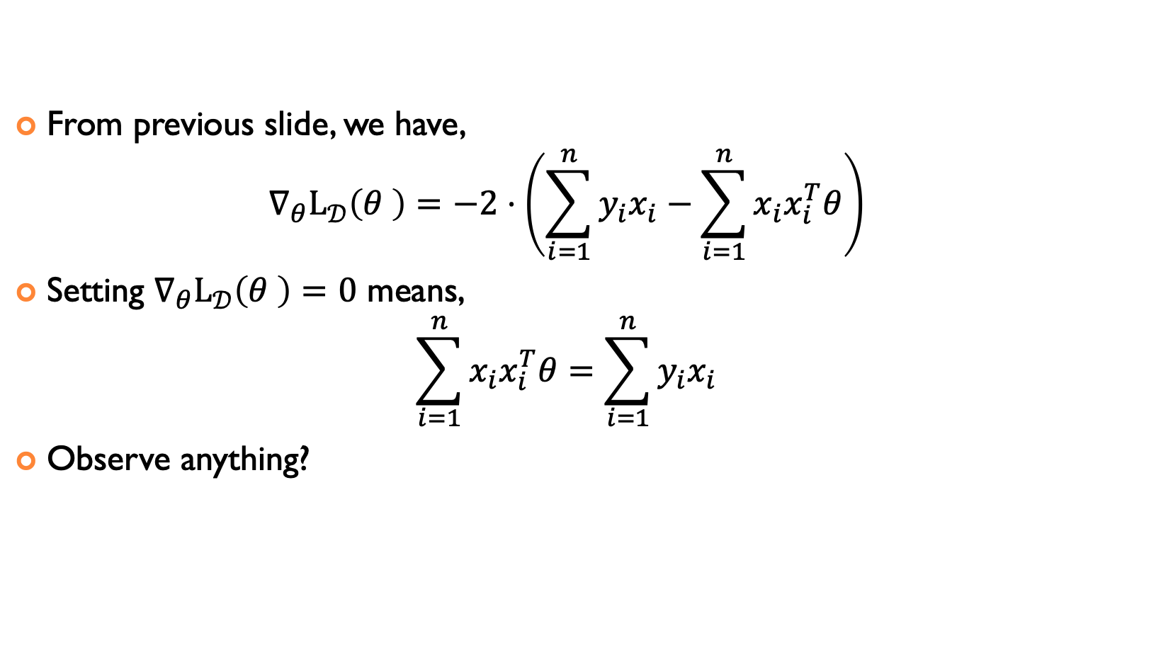
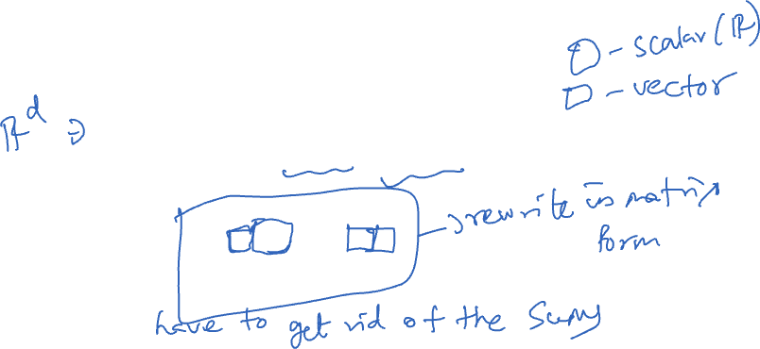
STEP 2: SET GRADIENT TO ZERO
From previous slide, we have, $∇_{θ}L_{𝒟}\left(θ \right)=−2⋅\left(\sum_{i=1}^{n}{y_{i}x_{i}−\sum_{i=1}^{n}{x_{i}x_{i}^{T}θ}}\right)$
Setting $∇_{θ}L_{𝒟}\left(θ \right)=0$ means, $\sum_{i=1}^{n}{x_{i}x_{i}^{T}θ}=\sum_{i=1}^{n}{y_{i}x_{i}}$
Observe anything?

Slide 18
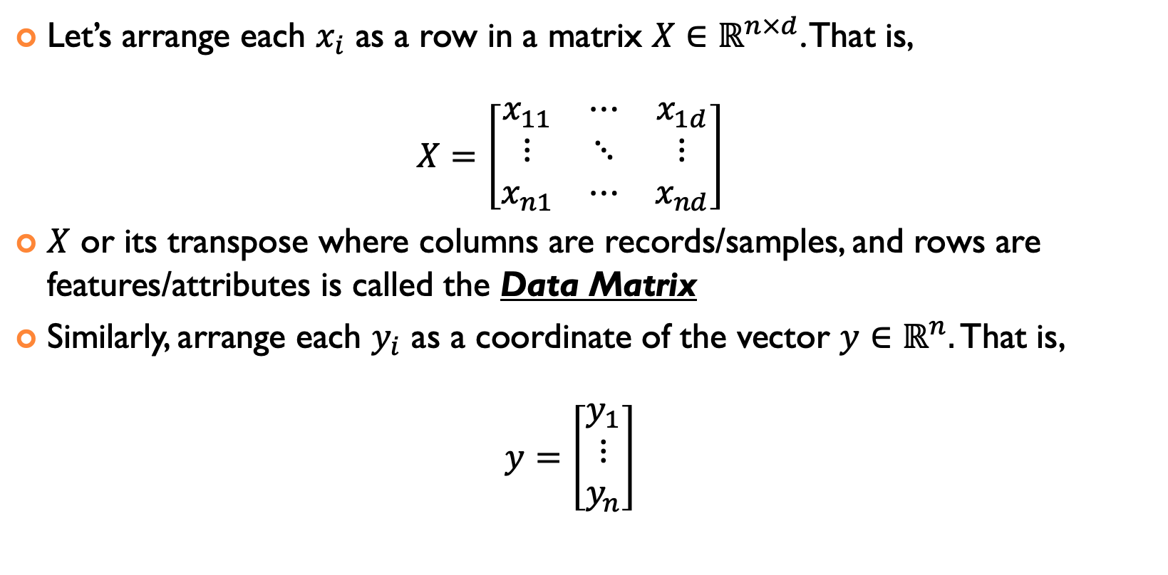
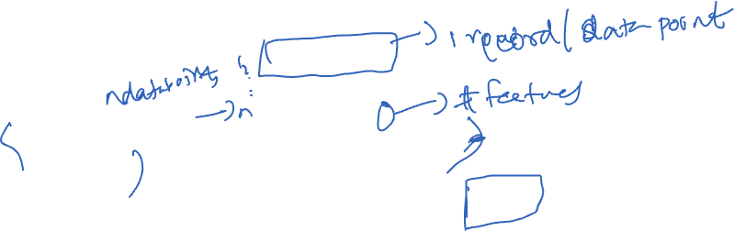
TO SOLVE FOR PARAMETERS, REWRITE IN MATRIX FORM
Let’s arrange each $x_{i}$ as a row in a matrix $X∈ℝ^{n×d}$. That is, $X=\left[\begin{matrix}x_{11} & ⋯ & x_{1d} \\ ⋮ & ⋱ & ⋮ \\ x_{n1} & ⋯ & x_{nd}\end{matrix}\right]$
$X$ or its transpose where columns are records/samples, and rows are features/attributes is called the Data Matrix
Similarly, arrange each $y_{i}$ as a coordinate of the vector $y∈ℝ^{n}.$ That is, $y=\left[\begin{matrix}y_{1} \\ ⋮ \\ y_{n}\end{matrix}\right]$

Slide 19
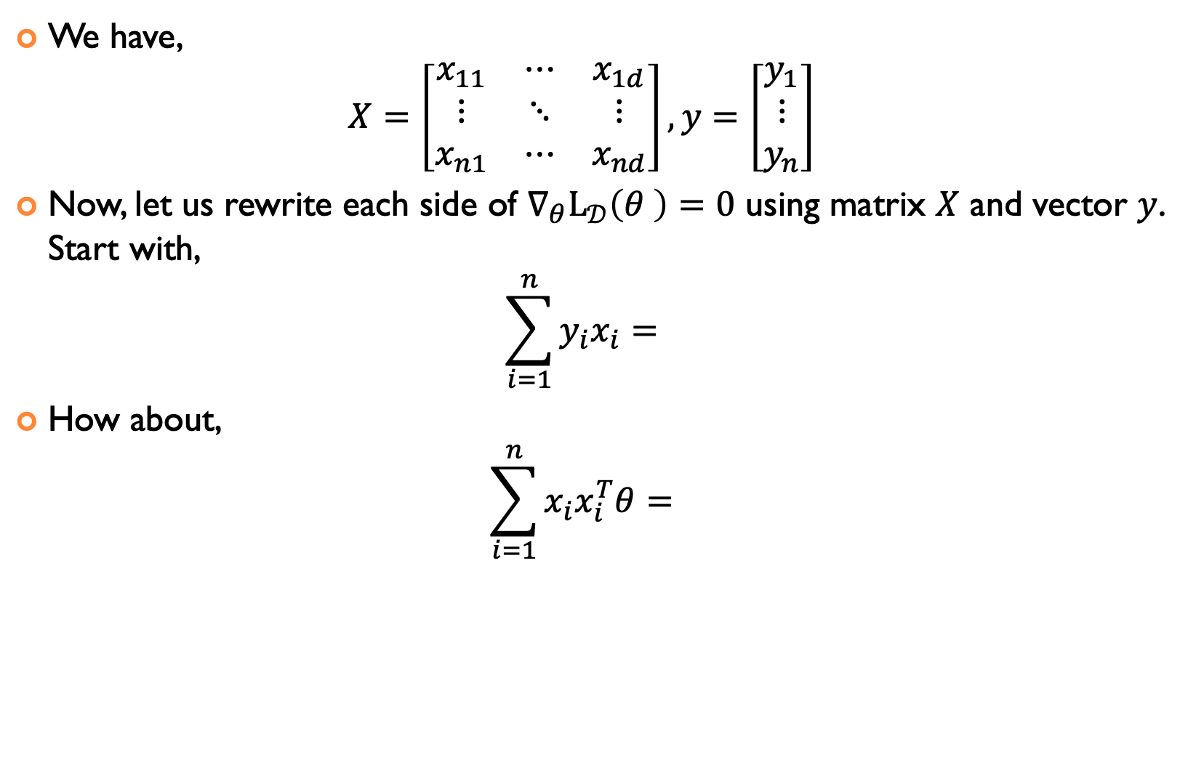
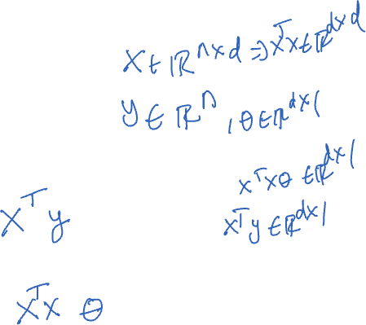
TO SOLVE FOR PARAMETERS, REWRITE IN MATRIX FORM
We have, $X=\left[\begin{matrix}x_{11} & ⋯ & x_{1d} \\ ⋮ & ⋱ & ⋮ \\ x_{n1} & ⋯ & x_{nd}\end{matrix}\right],y=\left[\begin{matrix}y_{1} \\ ⋮ \\ y_{n}\end{matrix}\right]$
Now, let us rewrite each side of $∇_{θ}L_{𝒟}\left(θ \right)=0$ using matrix $X$ and vector $y$. Start with, $\sum_{i=1}^{n}{y_{i}x_{i}}=$
How about, $\sum_{i=1}^{n}{x_{i}x_{i}^{T}θ}=$

Slide 20
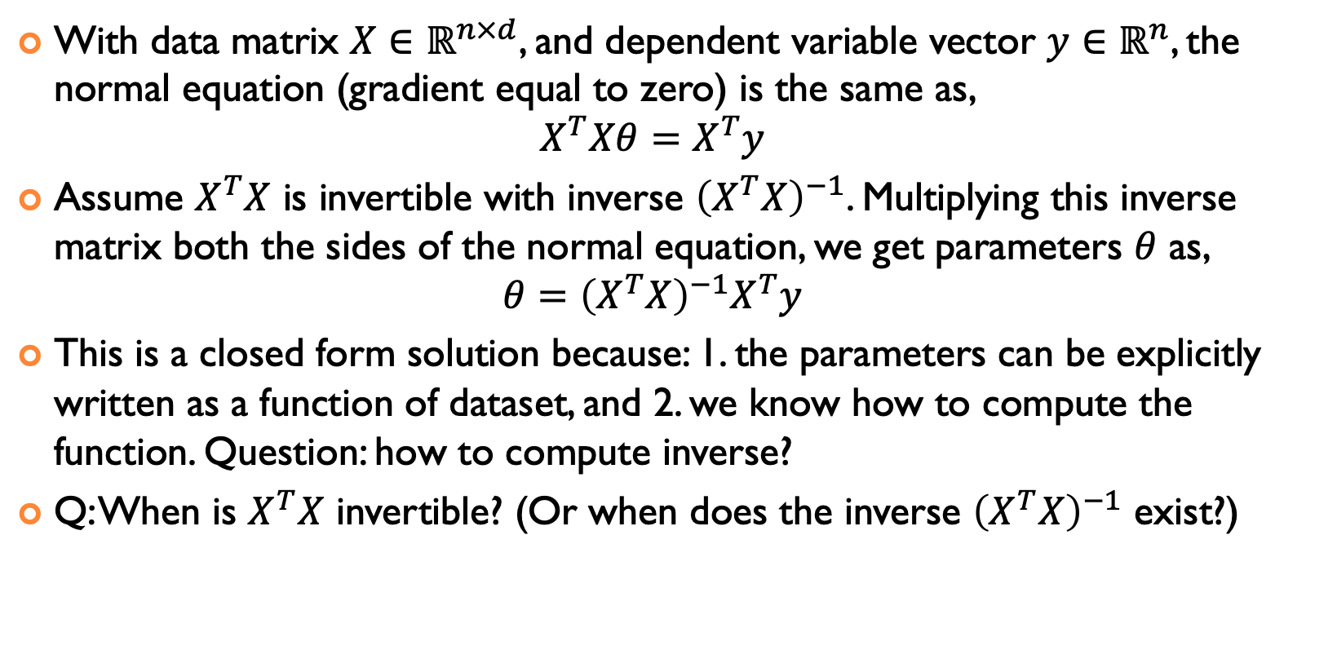
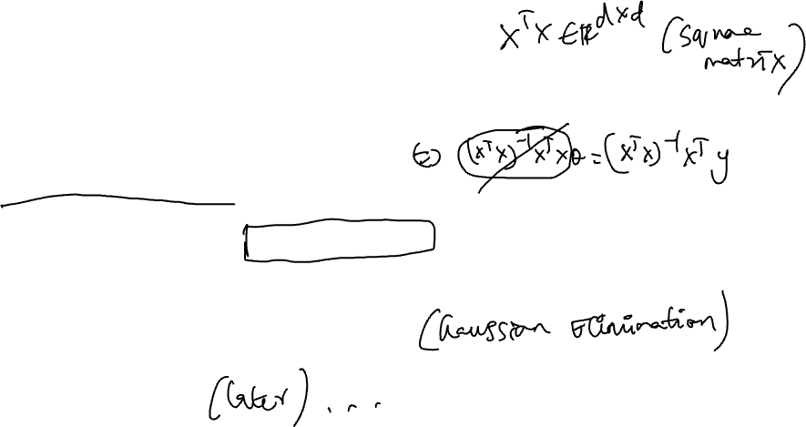
STEP 3: SOLVE FOR PARAMETERS
With data matrix $X∈ℝ^{n×d}$, and dependent variable vector $y∈ℝ^{n}$, the normal equation (gradient equal to zero) is the same as, $X^{T}Xθ=X^{T}y$
Assume $X^{T}X$ is invertible with inverse ${\left(X^{T}X\right)}^{−1}$. Multiplying this inverse matrix both the sides of the normal equation, we get parameters $θ$ as, $θ={\left(X^{T}X\right)}^{−1}X^{T}y$
This is a closed form solution because: 1. the parameters can be explicitly written as a function of dataset, and 2. we know how to compute the function. Question: how to compute inverse?
Q: When is $X^{T}X$ invertible? (Or when does the inverse ${\left(X^{T}X\right)}^{−1}$ exist?)

Slide 21
ACKNOWLEDGMENTS
These slides use materials by Brian Ziebart

