Slide 1

Psychophysiological Correlates of Categorization of Gender in Advertisements
Glenna L. Read-Bullock
PhD Candidate

Slide 2


Inclusive Advertising Consumers may favor brands with socially conscious practices (Snyder, 2015) Reflected in advertising campaigns (Jones, 2016; Mahdawi, 2016) Benefits of cultural inclusivity in advertising for brands and society (Appiah & Elias, 2008; Soldow, 2013 Vinjamuri, 2015; Zmuda, 2014)
4
Notes:
Sends message that brand is socially conscious (Vinjamuri, 2015; Zmuda, 2014)
Better reflects society and potential to attract wider audiences (Appiah & Elias, 2008; Soldow, 2013)

Slide 3
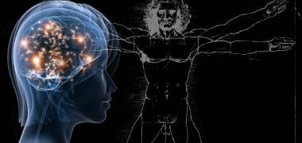
Do not rely on self-report Measure responding in real time May reveal physical processes that underlie consumer behavior (Berkman & Falk, 2013; Weber, Mathiak, & Sherry, 2008) Predictive of consumer behavior (Levy, Lazzaro, Rutledge, & Glimcher, 2011; Tusche, Bode, & Haynes, 2010)
Neurophysiology and Advertising
6

Slide 4
Dissertation Aims
Examine how news stories highlighting identities that challenge gender categories influence cognitive processing and affective responding to advertisements
Investigate cognitive processing and affective responding to advertisements featuring hard- and easy-to-categorize models in social category of gender
Examine if models’ actual transgender identities affect responding to ads
Notes:
Disadvantage = students

Slide 5
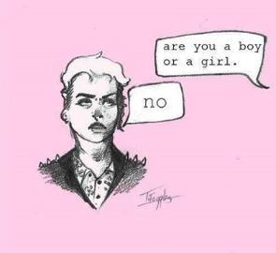
But first…. Some terms
Transgender – umbrella term to describe someone whose gender identification differs from the sex they were assigned at birth
Gender non-conforming – people who do not conform to traditional expectations of gender
These two terms are not necessarily interchangeable
Cisgender – describes someone whose gender identification is consistent with the sex they were assigned at birth

Slide 6
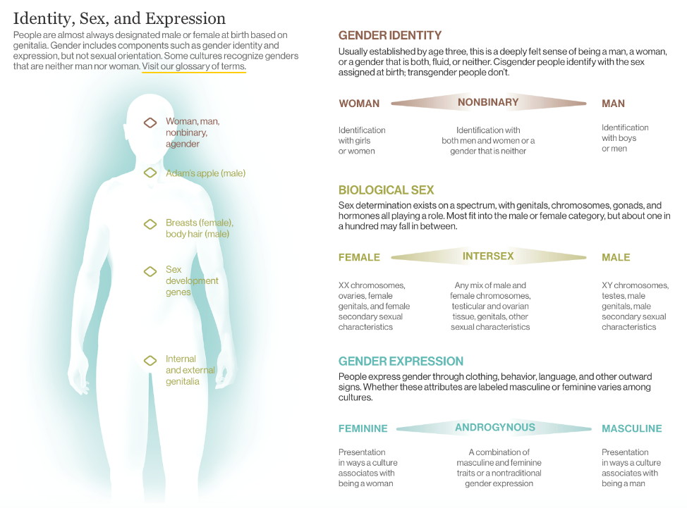

Slide 7
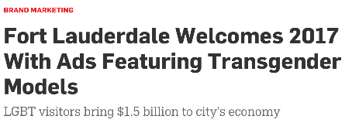


Aim 1: News Stories Influence Processing
Reveal potentially concealable identities
Transgender people may experience prejudice and discrimination (Elischberger, Glazier, Hill, & Verduzco-Baker, 2016; Lombardi, 2009; Remedios, Chasteen, & Oey, 2012; Sanchez & Bonam, 2009; Seelman, 2016)
May affect how advertising campaigns are processed by audiences
Notes:
Disadvantage = students

Slide 8
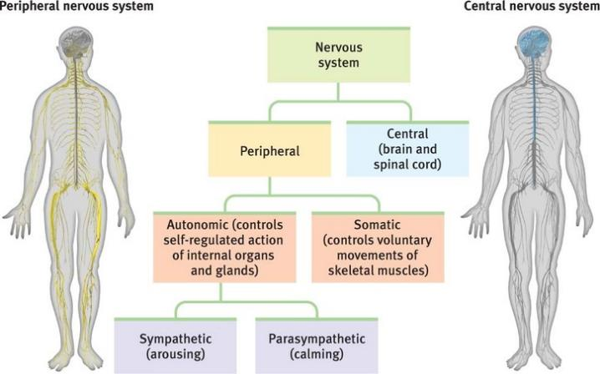
Physiological Indicators of Cognitive and Affective Processing
Notes:
Disadvantage = students

Slide 9
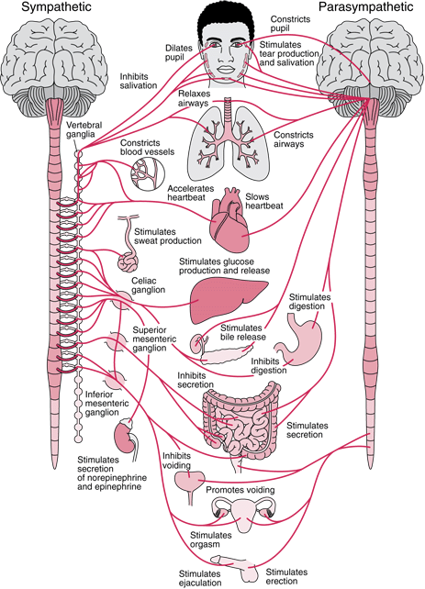
Cognitive Processing
HR: attention
decrease reflects focus (PSNS)
increase reflects disengagement (SNS)
EDA: sweat response = autonomic arousal
decrease reflects less arousal (PSNS)
increase reflects more arousal (SNS)
Notes:
Disadvantage = students

Slide 10
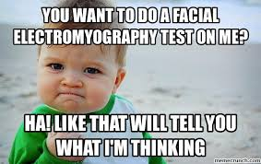
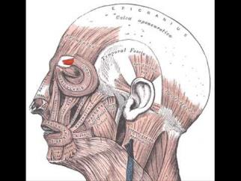
Affective responding
Facial EMG: Corrugator associated with negative affect
EMG activity in response to out-group members is associated with behavioral outcomes (Stewart et al., 2013; Vanman et al., 2004)
Notes:
Disadvantage = students

Slide 11
Aim 1: News Stories Influence Processing
H1: Attention will be decreased, but arousal and negative affect will be increased, to advertisements when participants read news stories about models’ transgender identities compared to control news stories
Notes:
Disadvantage = students

Slide 12
Influence of Individual Differences on Responding
RQ1: Will transphobia affect responses to advertisements when participants read news stories about models’ transgender identities?
Notes:
Disadvantage = students

Slide 13

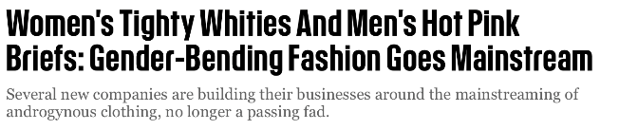

Aim 2: Ease of Categorization
*Note: Although potentially advantageous for advertisers and perceived by
consumers as socially conscious, these representations are not unproblematic
Notes:
Disadvantage = students

Slide 14

Social Categorization
Social categories = stable internal representations of the world
Humans rapidly and automatically view others as a series of social categories (Allport, 1954; Macrae & Bodenhausen, 2000)
(as opposed to viewing others as a series of unique attributes)
Notes:
Disadvantage = students

Slide 15
Rigidity and Automaticity of Social Categories
Social categories reside in the neocortical (slow-learning) system of the brain (McClelland, McNaughton, & O’Reilly, 1995)
Stored in long-term memory and resistant to change
Renders world a predictable place
Guides processing of social information
People are multiply categorizable
But categorization of race and gender occurs very early in person perception process (Ito & Urland, 2003; Macrae & Bodenhausen, 2000; Macrae & Martin, 2007; Richeson & Trawalter, 2005)
Notes:
Disadvantage = students

Slide 16
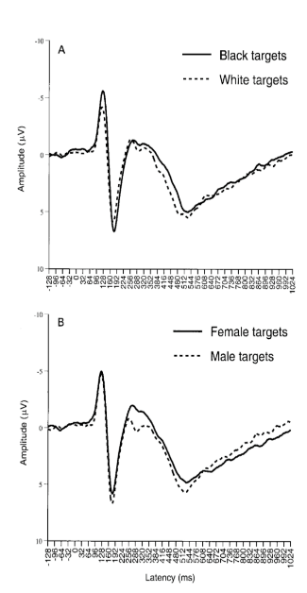
Rigidity and Automaticity of Social Categories
Ito & Urland, 2003
Notes:
Disadvantage = students

Slide 17

Overriding Automaticity of Social Categories
The hippocampal (fast-learning) system allows humans to respond rapidly to novel information by forming a temporary representation (McClelland et al., 1995)
These representations only affect stable mental models if they are repeatedly activated
Notes:
Disadvantage = students

Slide 18
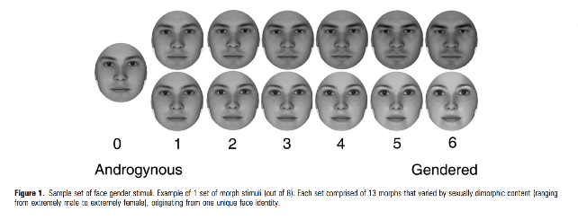
Neural Correlates of Gender Categorization
Looking at faces that range from feminine to masculine
The FFA and lateral FG tracked “objective gradiency of gender inherent in the face”
Gender perceived categorically in the OFC (p. 1320; Freeman, Rule, Adams, & Ambady, 2010)
Notes:
Disadvantage = students

Slide 19

Social Categorization and Advertising
Some find that racially ambiguous agents increase advertising effectiveness (Appiah & Elias, 2011)
Unclear if this generalizes to human models
Do androgynous models also increase advertising effectiveness?
Some suggest that they appeal to younger audiences with flexible views about gender
Notes:
Disadvantage = students

Slide 20
Aim 2: Ease of Categorization
RQ2: Will there be differences in attention, arousal, and negative affect to advertisements featuring hard to categorize models (androgynous) compared to advertisements featuring easy to categorize models (non-androgynous)?
Notes:
Disadvantage = students

Slide 21
Influence of Individual Differences on Responding
RQ3: Will transphobia affect responses to advertisements featuring hard to categorize models (androgynous)?
Notes:
Disadvantage = students

Slide 22


Aim 3: Actual Identity
Unclear if models’ actual transgender identities will influence responses
People assume others are cisgender, unless told otherwise (Lick & Johnson, 2014)
Notes:
Disadvantage = students

Slide 23
Aim 3: Actual Identity
RQ4: Will there be differences in attention, arousal, and negative affect to advertisements featuring transgender models compared to advertisements featuring cisgender models?
Notes:
Disadvantage = students

Slide 24
Influence of Individual Differences on Responding
RQ5: Will transphobia affect responses to advertisements featuring transgender models?
Notes:
Disadvantage = students

Slide 25
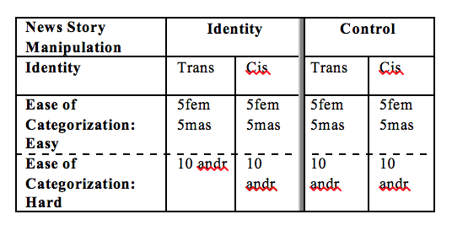
Method
Design: 2 (article prime: identity, control) x 2 (ease of categorization: hard, easy) x 2 (actual identity: trans, cis) mixed design
Between = article prime; Within = ease of categorization, and actual identity
10 message trials
Notes:
Disadvantage = students

Slide 26
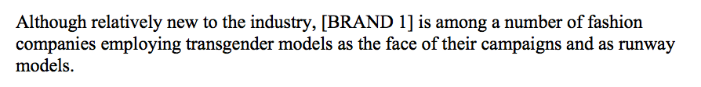
Design
Design: 2 (article prime: identity, control) x 2 (ease of categorization: hard, easy) x 2 (actual identity: transgender, cisgender) mixed design
Article prime: identity, control
Notes:
Disadvantage = students

Slide 27
Design
Design: 2 (article prime: identity, control) x 2 (ease of categorization: hard, easy) x 2 (actual identity: transgender, cisgender) mixed design
IVs: print ads professionally integrated with logo
Notes:
Disadvantage = students

Slide 28
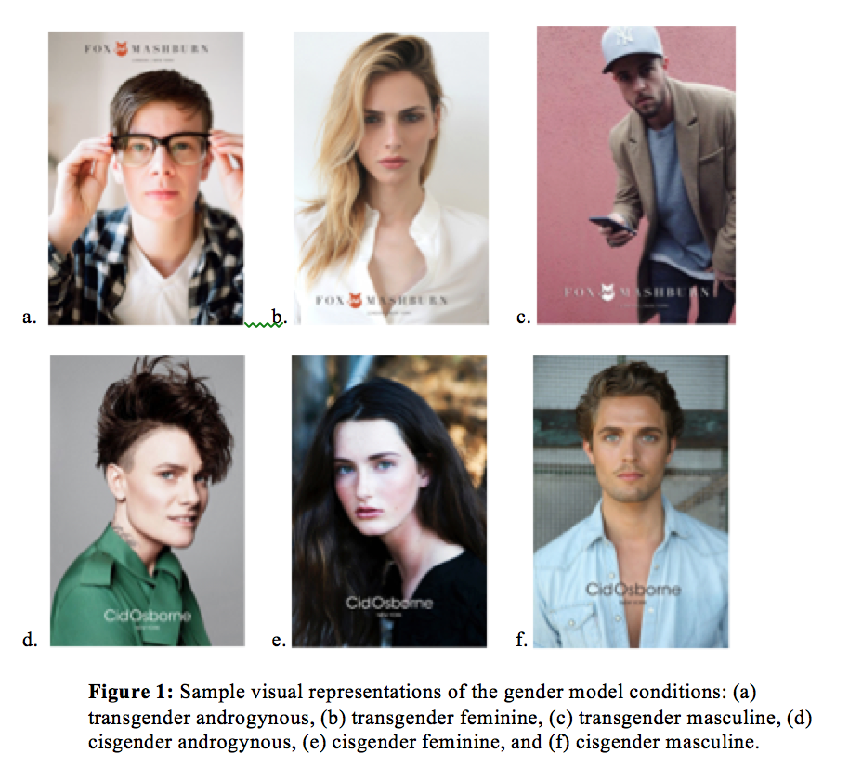
Notes:
Disadvantage = students

Slide 29
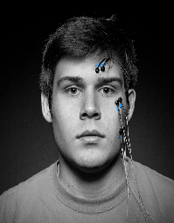

Design and Participants
Design: 2 (article prime: identity, control) x 2 (ease of categorization: hard, easy) x 2 (actual identity: transgender, cisgender) mixed design
DVs: Attention (HR), Emotion (fEMG), Arousal (SC), Preference (self-report)
Participants (n = 246)
Recruited through Mass Communications courses
Notes:
Disadvantage = students

Slide 30




Procedure
BLOCK 1:
NEWS STORY
AD 1
QUESTIONS
(Randomized)
AD 20
QUESTIONS
(Randomized)
…
BLOCK 2:
NEWS STORY
AD 1
QUESTIONS
(Randomized)
AD 20
QUESTIONS
(Randomized)
…
Notes:
Disadvantage = students

