Slide 1
T-MANGA WEB APPLICATION
Students
Nguyễn Thanh Toàn
Đỗ Công Tiến
Tôn Long Quốc Việt
Đỗ Quốc Đạt
Lecturer
Võ Ngọc Thạch

Slide 2
Agenda
Project Overview
Technologies
Database Relationship / Sitemap
Admin sites
Customer sites
References
Demo
Limitation & Improvement
Question and Answer

Slide 3
Project Overview
Description
Help customers to buy comics easily and conveniently.
Show fully the functions required of an online sales website such as: search product, product details, order, product management, order management, report,...

Slide 4
Project Overview
Control Function
Customer
Home view
Cart page
Login, Registration
Search, View product
View, Cancel order
View product detail
Order

Slide 5
Project Overview
Control Function
Customer Contact Message Management
Outcome Statistic (Daily, Monthly)
User Management
Customer Orders Management
Product Management
Admin
Multiple Languages

Slide 6






Back-end Technologies

Slide 7





Front-end Technologies

Slide 8
Technologies
Database: MySQL version 5.9
Development tools: Eclipse
Build and deployment tool: Maven and Tomcat server
Project management: SourceTree
Link:https://jdev006_group3@bitbucket.org/jdev006_group3/final_project.git

Slide 9
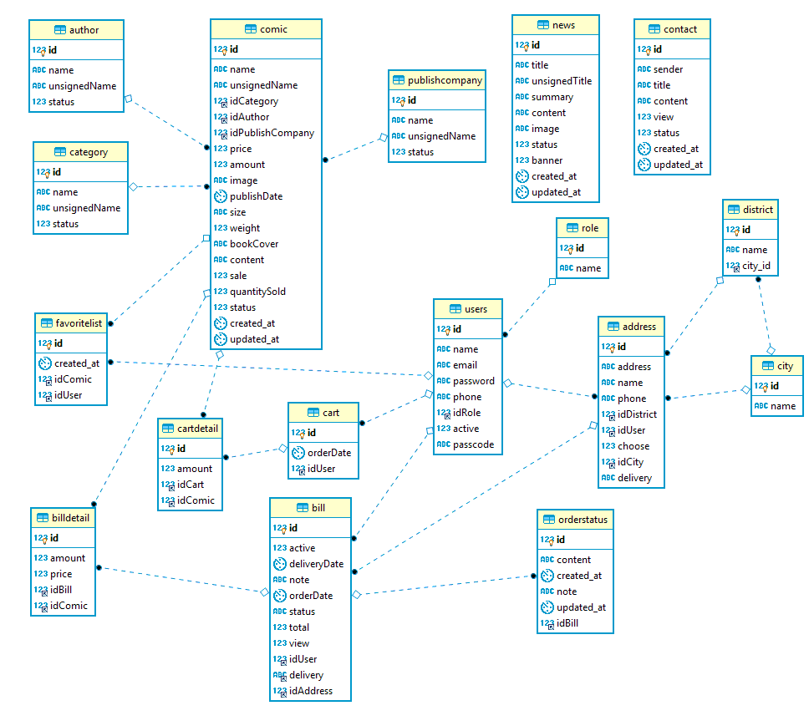
Database Relationship

Slide 10
Index
View order history
Update profile
Order
Login
Registration
View order information
View news
Cart managerment
Search product
View product
Customer
News management
View product
View orders to deliver
Update profile
Staff
Report
News management
Staff management
Order management
Product management
Admin
Feedback contact’s customer
Contact
View Staff
Update profile
View customer’s message
Category management
Author management
Publishing Company management
View category list
View author list
View Publishing Company list
SITEMAP

Slide 11
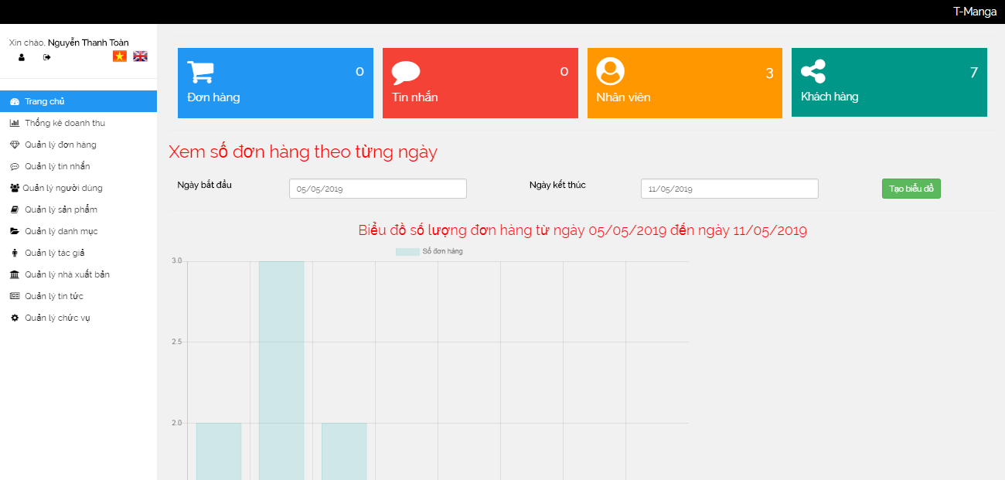
Admin sites
ADMIN HOME

Slide 12
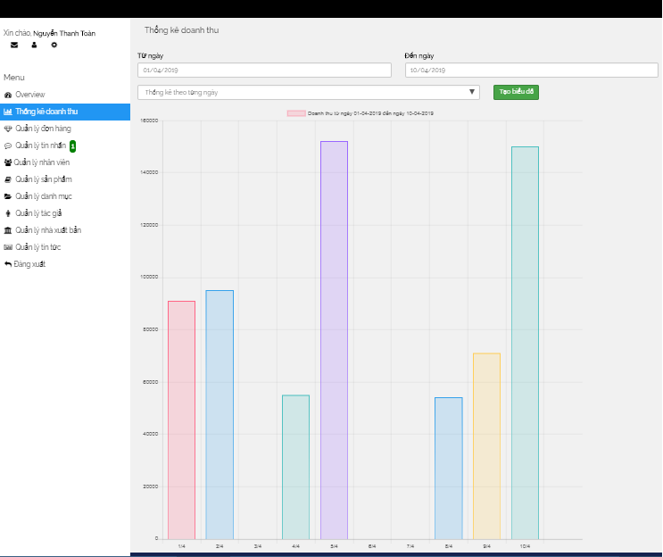
Admin sites
Statistic Page

Slide 13
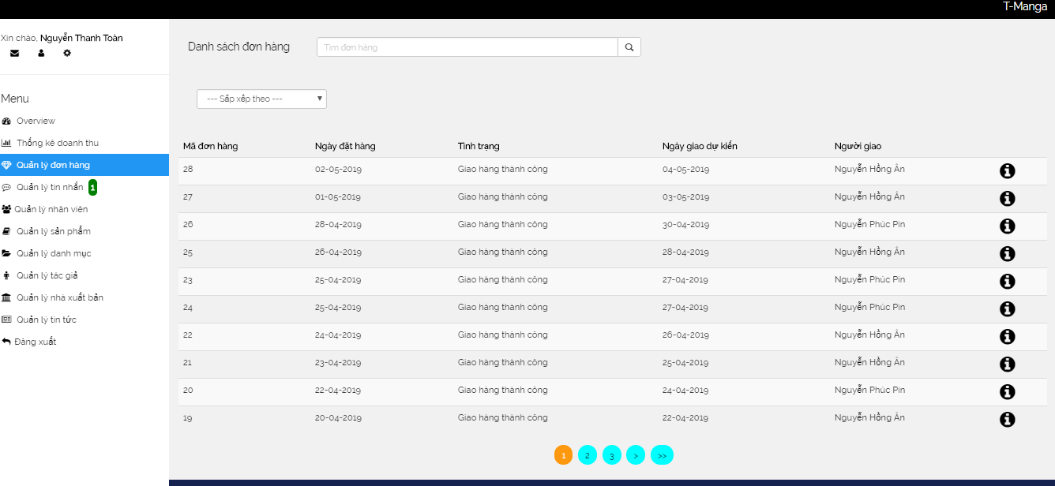
Admin sites (2)
Order Management Page

Slide 14
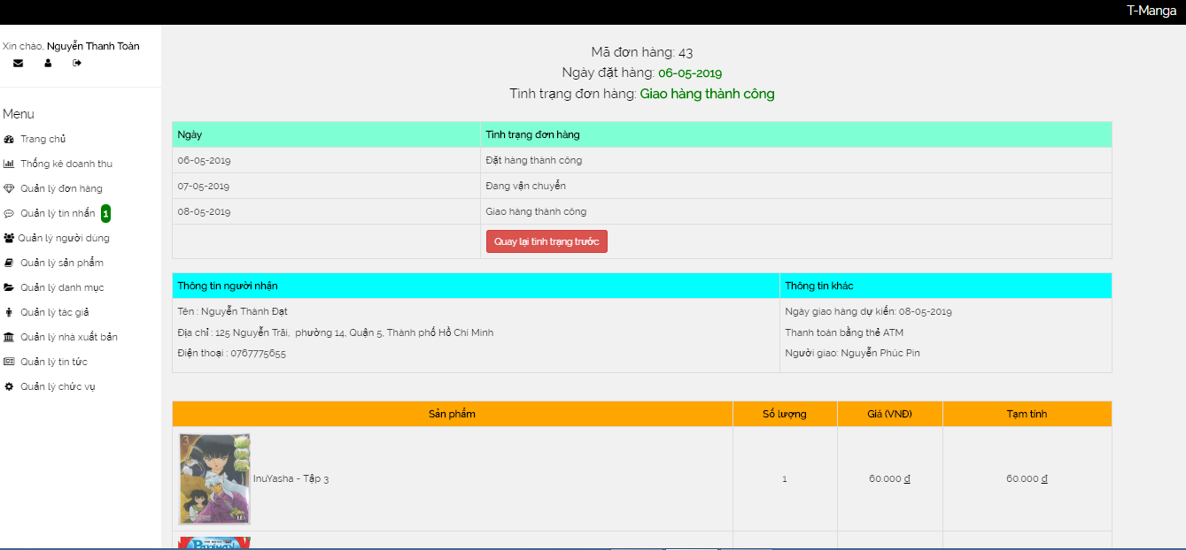
Admin sites (3)
Order Detail Page

Slide 15
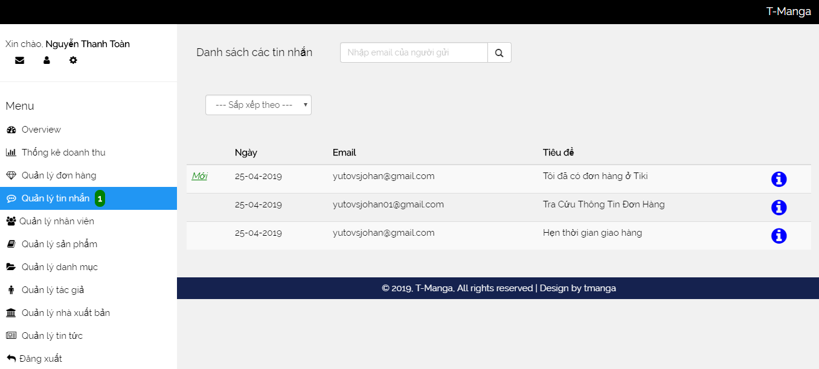
Admin sites (4)
Contact Management Page

Slide 16
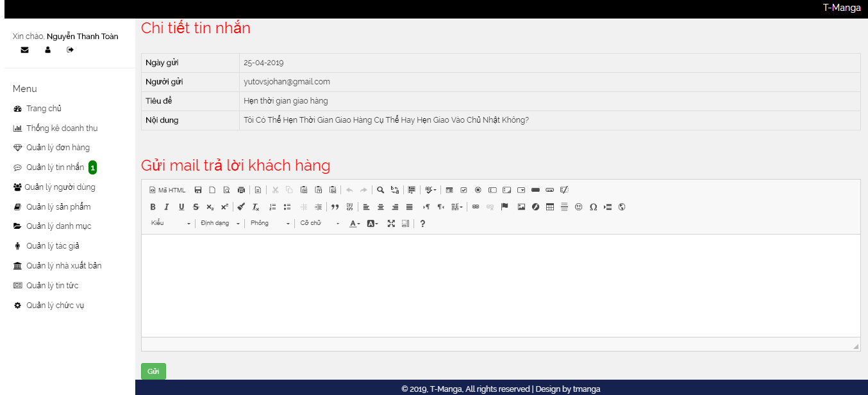
Admin sites (5)
Contact Detail Page

Slide 17
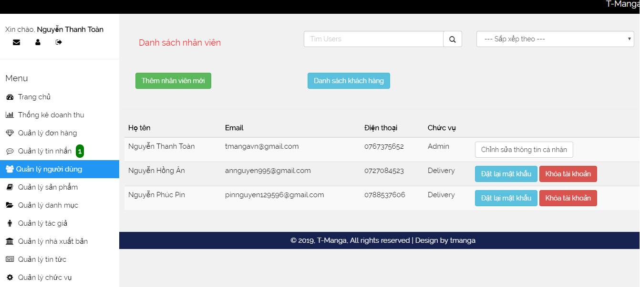
Admin sites (6)
Staff Management Page

Slide 18
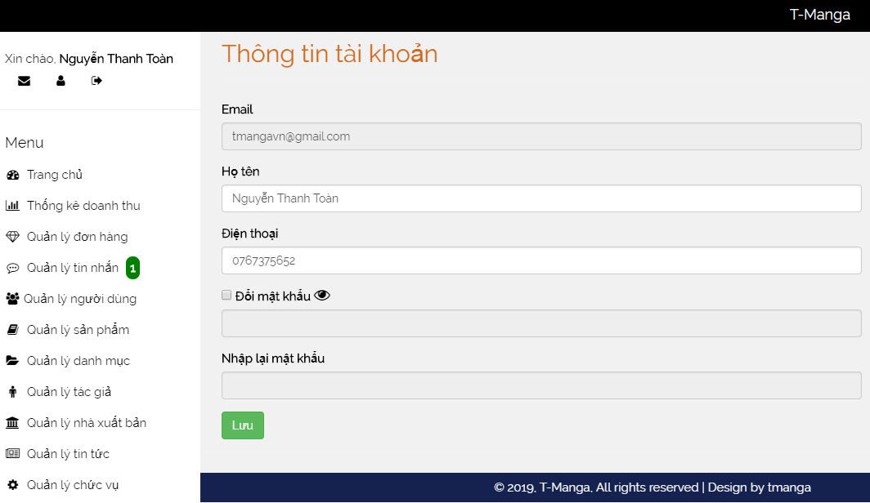
Admin sites (7)
Profile Page

Slide 19
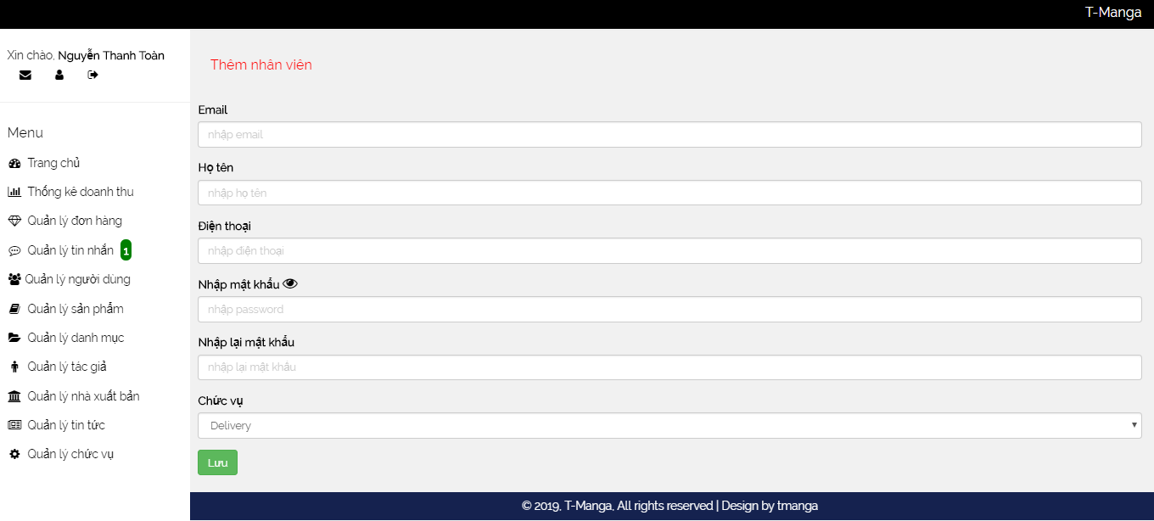
Admin sites (8)
Add Staff Page

Slide 20
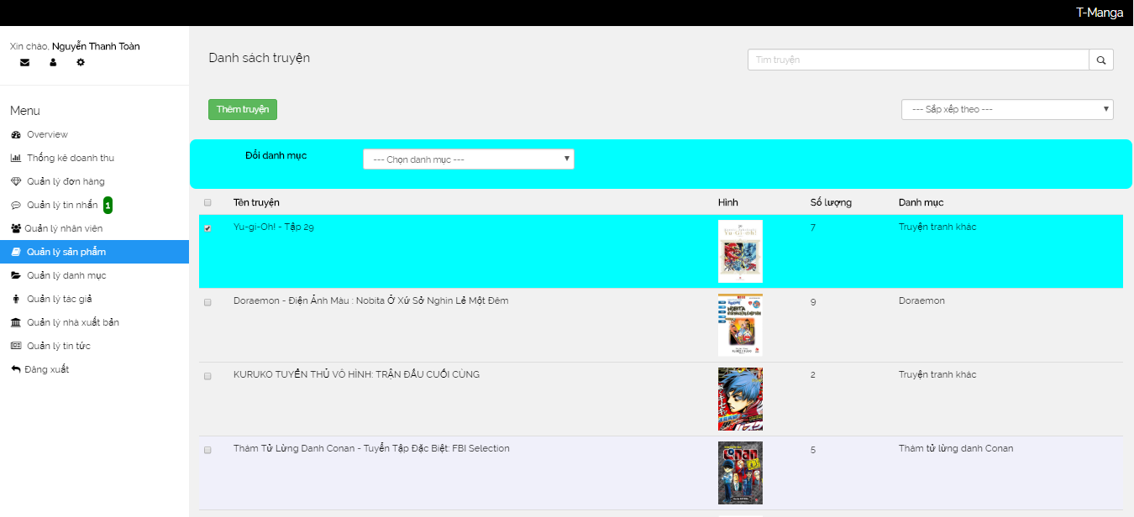
Admin sites (9)
Comic Management Page

Slide 21
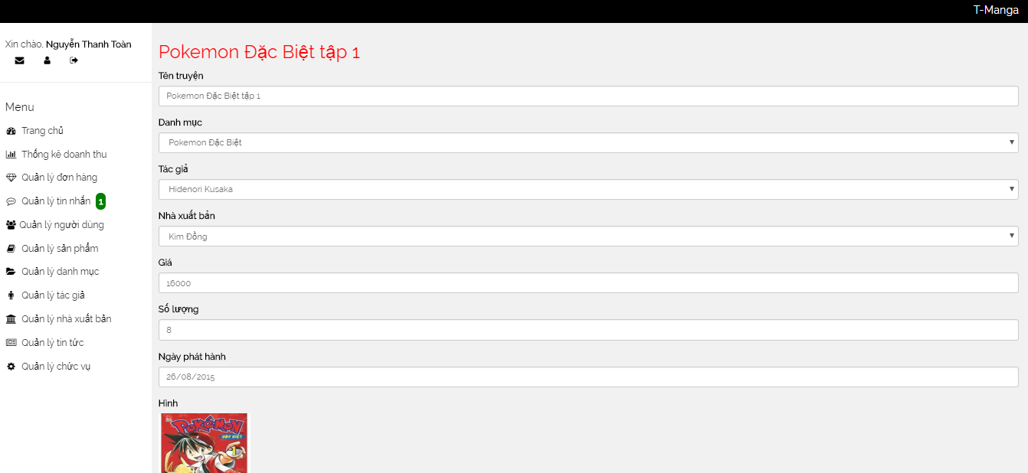
Admin sites (10)
Comic Detail Page

Slide 22
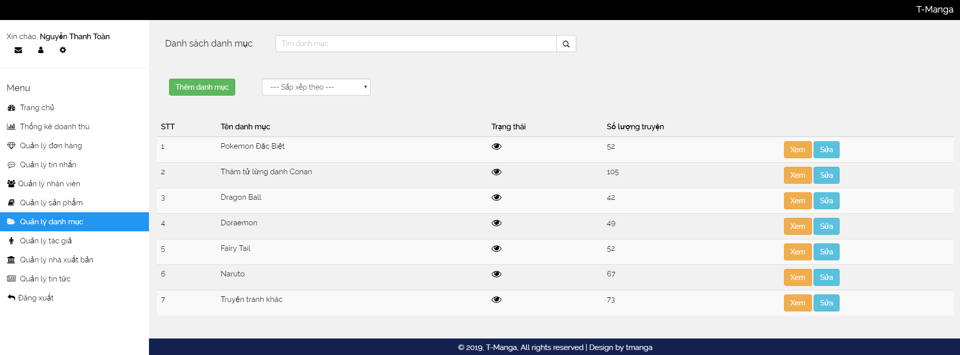
Admin sites (11)
Category Management Page

Slide 23
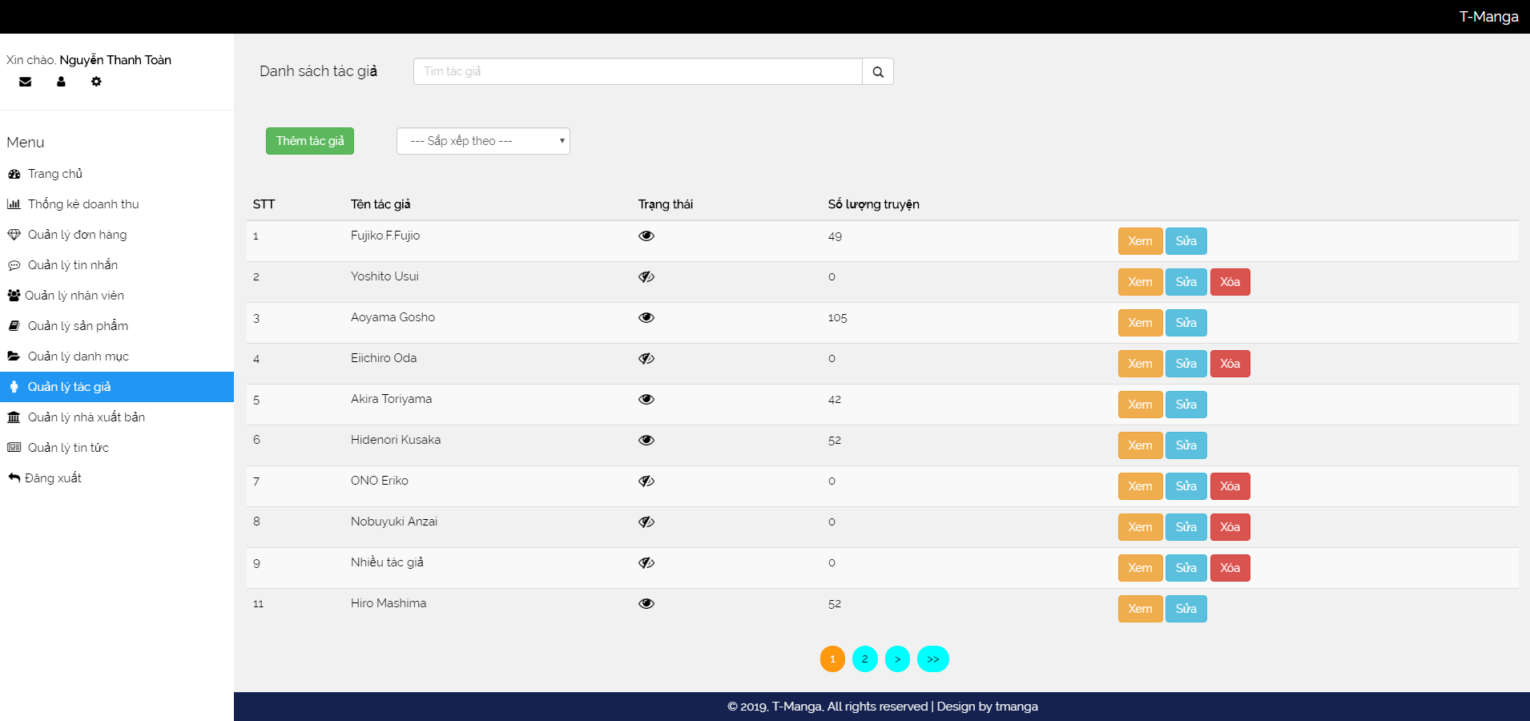
Admin sites (12)
Author Management Page

Slide 24
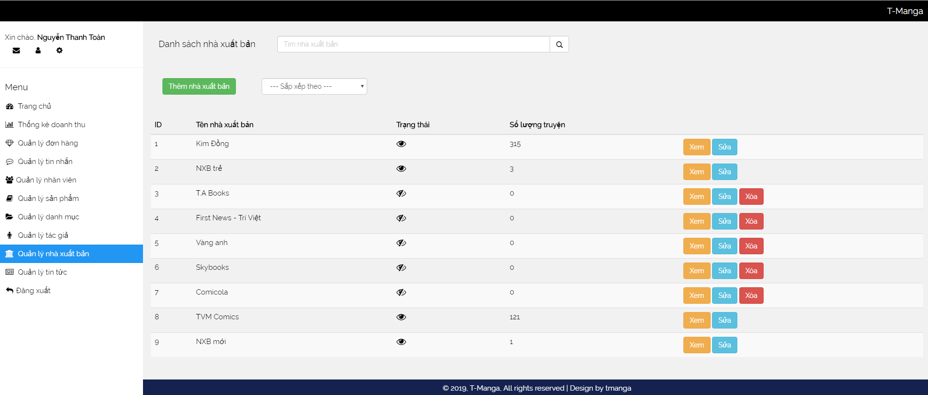
Admin sites (13)
Publishing Company Management Page

Slide 25
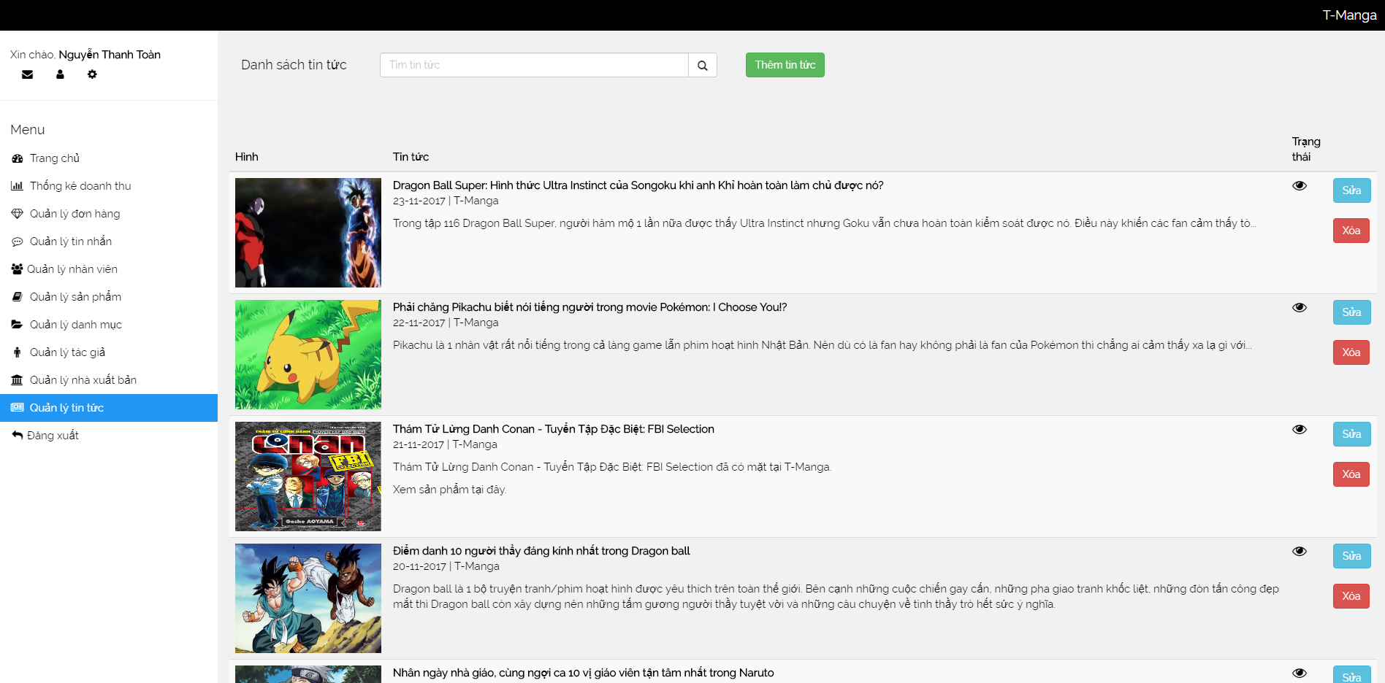
Admin sites (14)
News Management Page

Slide 26
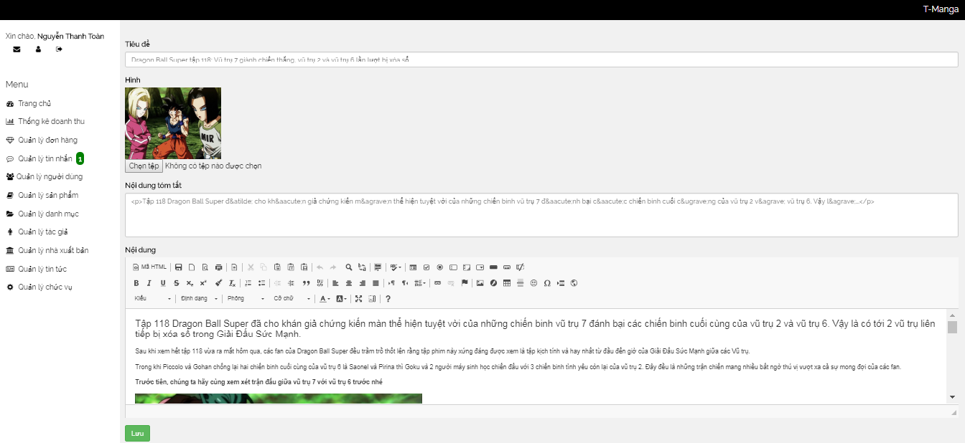
Admin sites (15)
News Detail Page

Slide 27
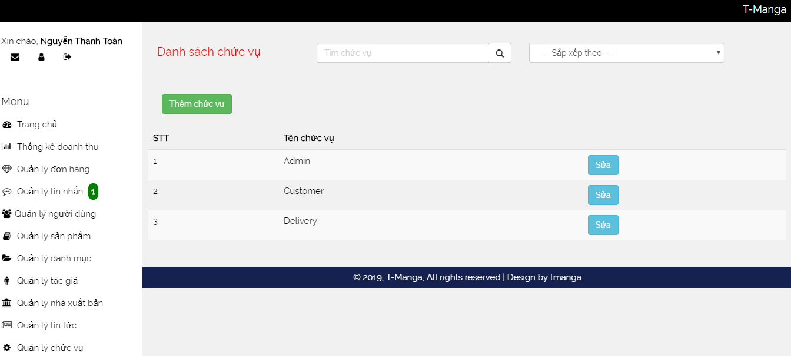
Admin sites (16)
Role Page

Slide 28
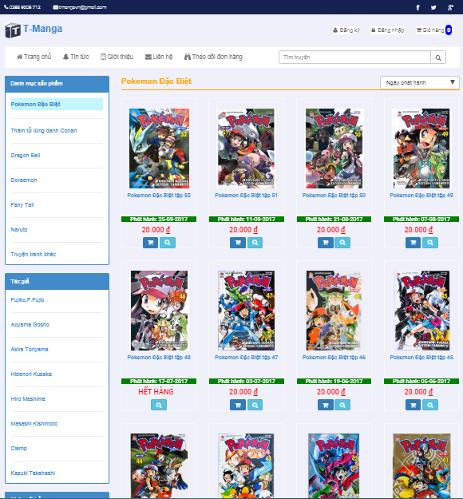
Customer sites
Product List Page

Slide 29
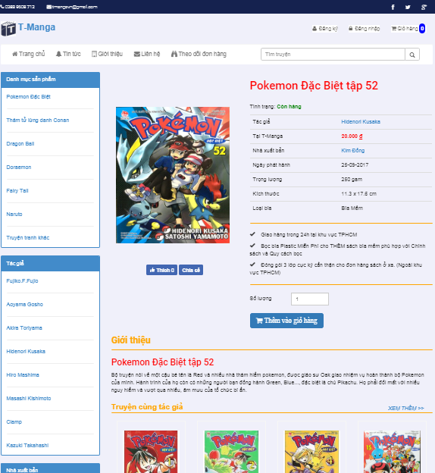
Customer sites (2)
Product Detail Page

Slide 30
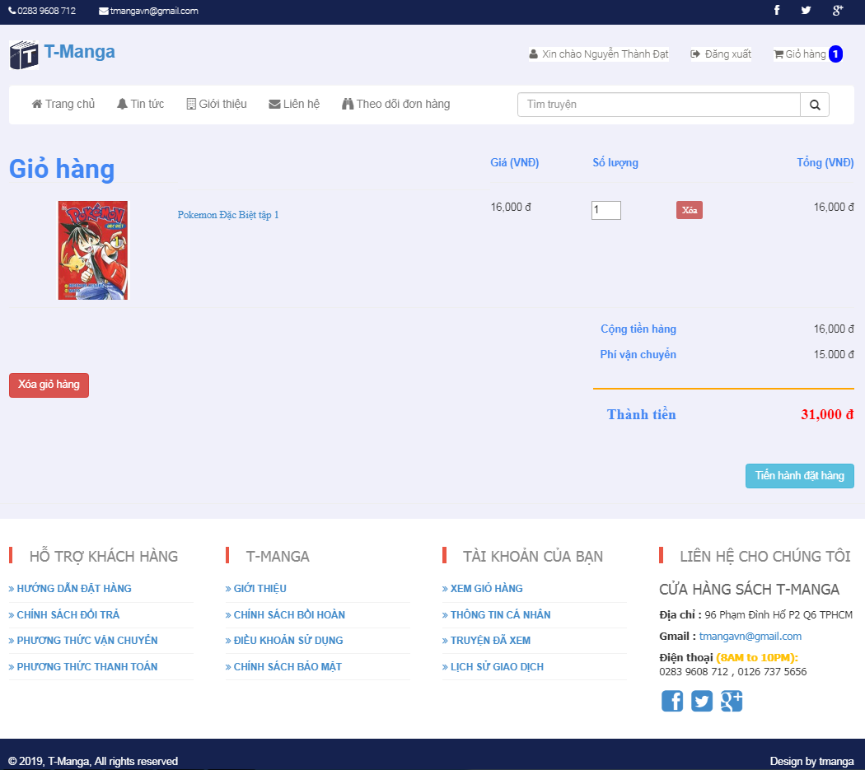
Customer sites (3)
Cart Page

Slide 31
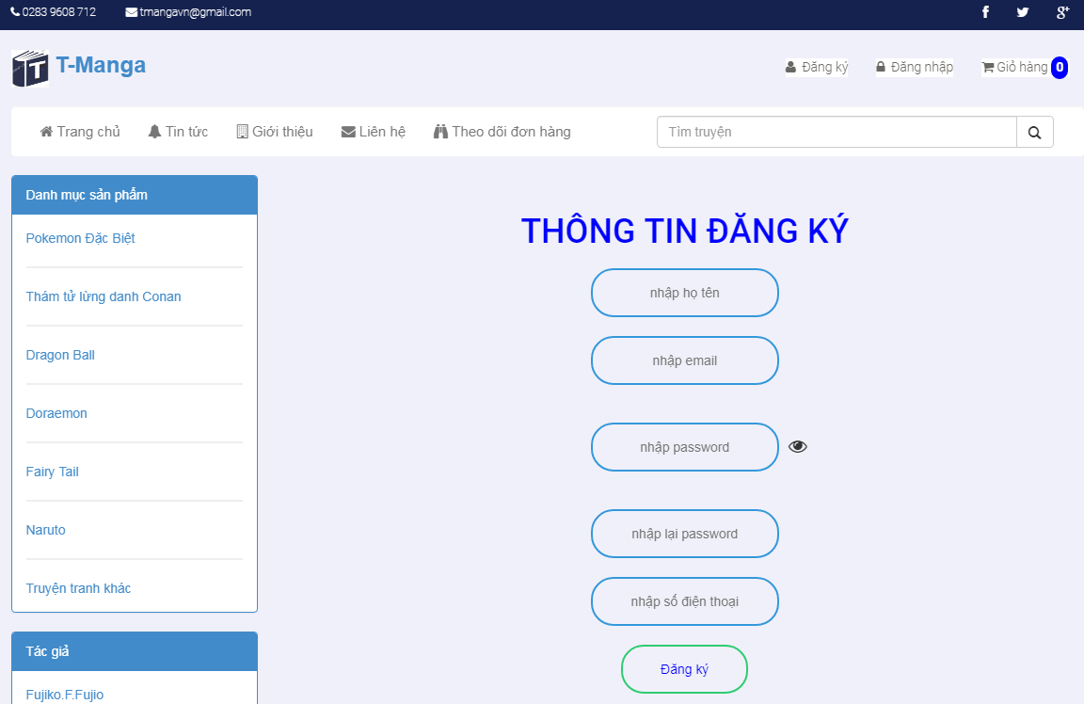
Customer sites (4)
Register Page

Slide 32
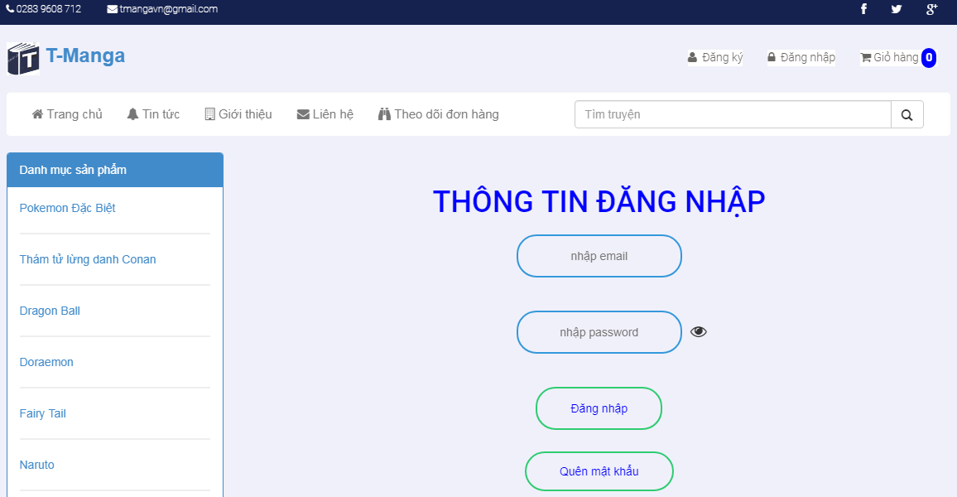
Customer sites (5)
Login Page

Slide 33
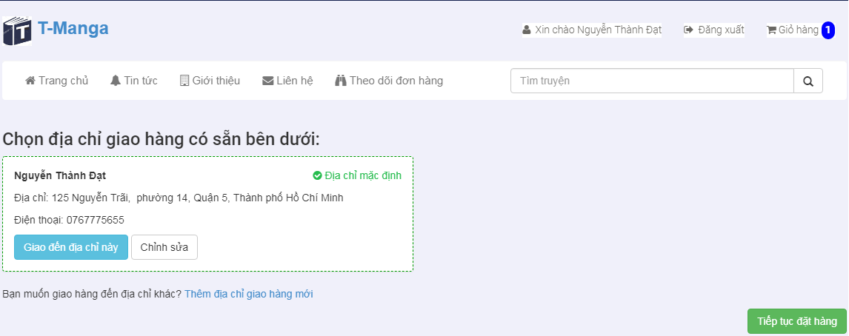
Customer sites (6)
Shipping Page

Slide 34
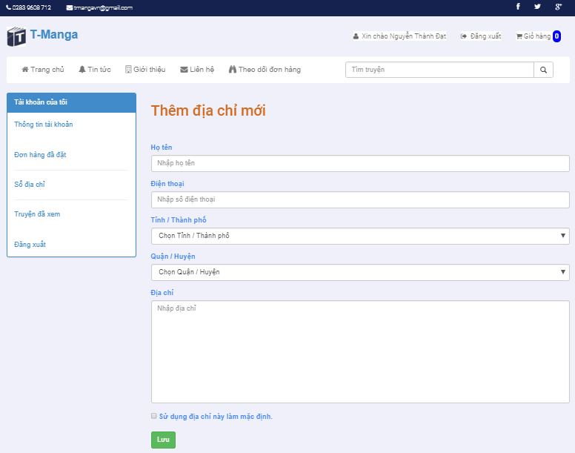
Customer sites (8)
Add new address Page

Slide 35
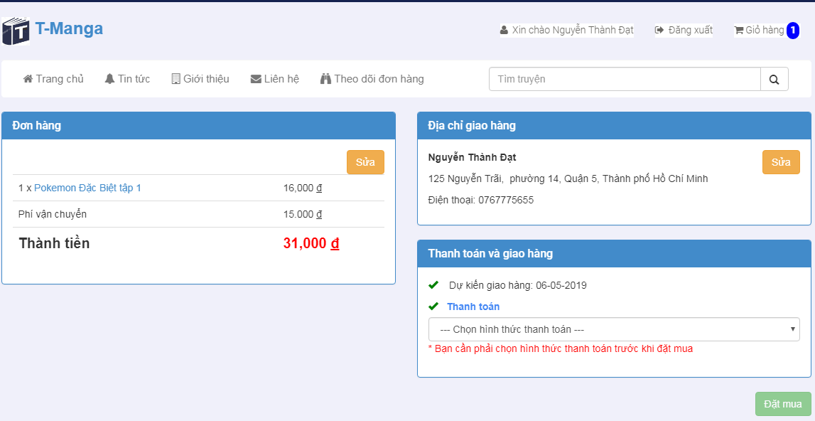
Customer sites (8)
Payment Page

Slide 36
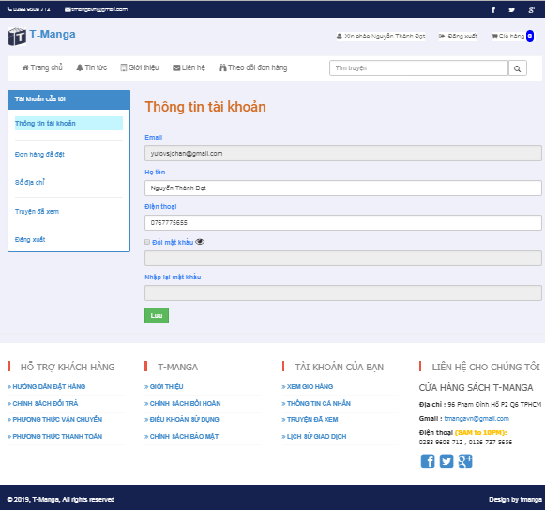
Customer sites (9)
Customer Profile Page

Slide 37
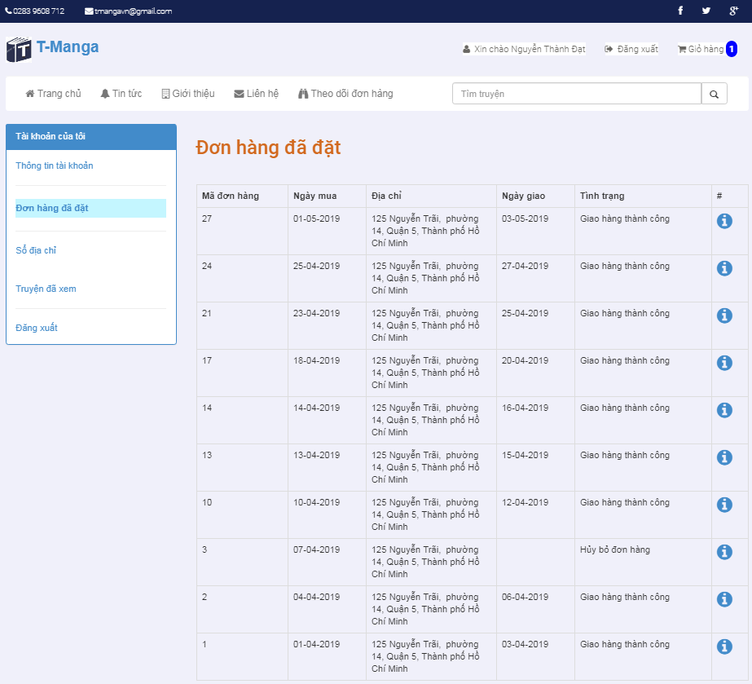
Customer sites (10)
Order History Page

Slide 38
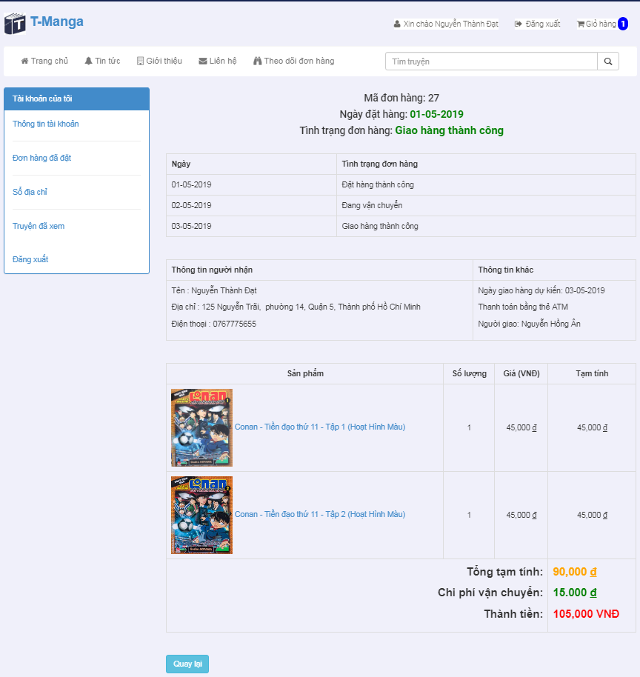
Customer sites (11)
Order Detail Page

Slide 39
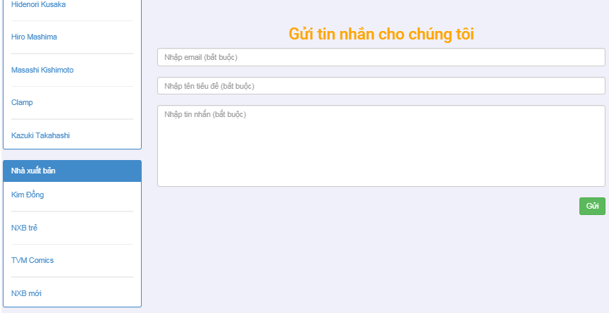
Customer sites (12)
Contact Page

Slide 40
References
http://pibook.vn/
http://truyendubo.vn/
https://tiki.vn/
http://bookbuy.vn/

Slide 41
Limitation & improvement
Notes:
Hạn chế:
Phân trang làm chưa làm bằng javascript được
Footer Customer site chưa bấm dc

Slide 42
Demo

Slide 43
Q & A

Slide 44


