Slide 1
T-MANGA WEB APPLICATION
Students
Nguyễn Thanh Toàn
Đỗ Công Tiến
Tôn Long Quốc Việt
Đỗ Quốc Đạt
Lecturer
Võ Ngọc Thạch

Slide 2
Agenda
Project Overview
Technologies
Database Relationship
Admin sites
Customer sites
Reference sites
Demo
Question and Answer

Slide 3
Project Overview
Description
Help customers to buy comics easily and conveniently in Ho Chi Minh City area.
Show fully the functions required of an online sales website such as: search product, product details, order, purchase, product management, order management,...

Slide 4
Project Overview
Control Function
Customer
Search, view product
Cart Management
Admin
Product Management
Customer Orders Management
Login / Registration
Statistic
User Management
Order, view / cancel order

Slide 5



Back-end Technologies

Slide 6



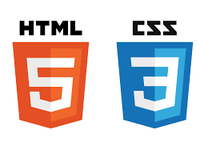
Front-end Technologies

Slide 7
Technologies
Database: MySQL xampp
Development tools: Eclipse
Build and deployment tool: Maven and Tomcat server
Project management: SourceTree
Link:https://jdev006_group3@bitbucket.org/jdev006_group3/final_project.git

Slide 8
Database Relationship

Slide 9
Admin sites

Slide 10
Customer sites

Slide 11
Reference site
http://pibook.vn/
http://truyendubo.vn/
https://tiki.vn/

Slide 12
Demo

Slide 13
Q & A

Slide 14


