Slide 1
T-MANGA WEB APPLICATION
Students
Nguyễn Thanh Toàn
Đỗ Công Tiến
Tôn Long Quốc Việt
Đỗ Quốc Đạt
Lecturer
Võ Ngọc Thạch

Slide 2
Agenda
Project Overview
Technologies
Database Relationship / Sitemap
Admin sites
Customer sites
References
Demo
Question and Answer

Slide 3
Project Overview
Description
Help customers to buy comics easily and conveniently in Ho Chi Minh City area.
Show fully the functions required of an online sales website such as: search product, product details, order, product management, order management, report,...

Slide 4
Project Overview
Control Function
Customer
Home view
Cart page
Login, Registration
Search, View product
View, Cancel order
View product detail
Order

Slide 5
Project Overview
Control Function
Customer Contact Message Management
Outcome Statistic (Daily, Monthly)
User Management
Customer Orders Management
Product Management
Admin

Slide 6






Back-end Technologies

Slide 7




Front-end Technologies

Slide 8
Technologies
Database: MySQL version 5.9
Development tools: Eclipse
Build and deployment tool: Maven and Tomcat server
Project management: SourceTree
Link:https://jdev006_group3@bitbucket.org/jdev006_group3/final_project.git

Slide 9
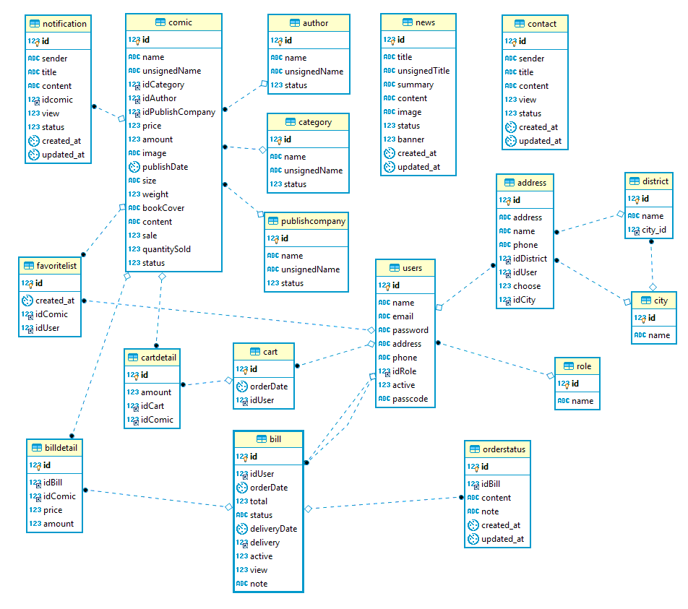
Database Relationship

Slide 10
Index
Contact
View order history
Update information
Order
Login
Registration
View order information
View news
Cart managerment
Search product
View product
Customer
News management
View product
View orders to deliver
Update information
Staff
Report
News management
Staff management
Order management
Product management
Admin
Favorite products management
Feedback contact’s customer
SITEMAP

Slide 11
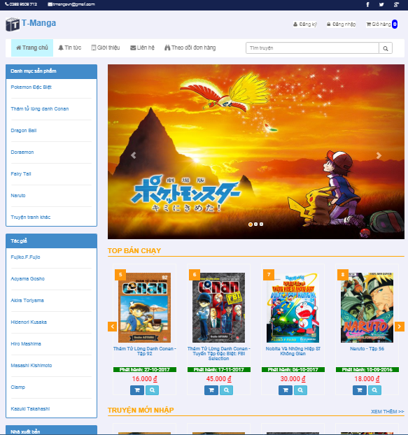
Customer sites
Index Page

Slide 12
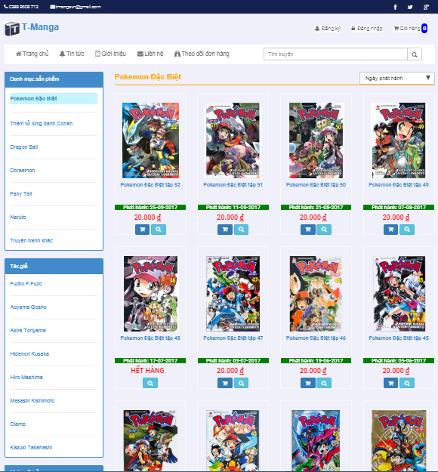
Customer sites
Product List Page

Slide 13
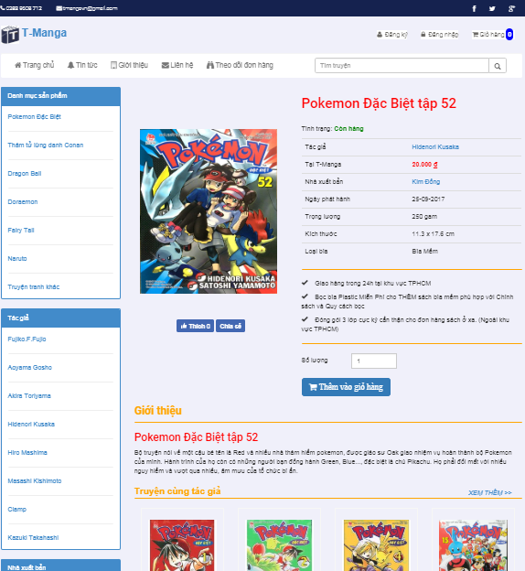
Customer sites
Product Detail Page

Slide 14
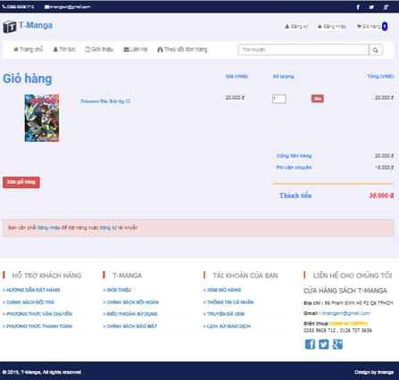
Customer sites
Cart Page

Slide 15
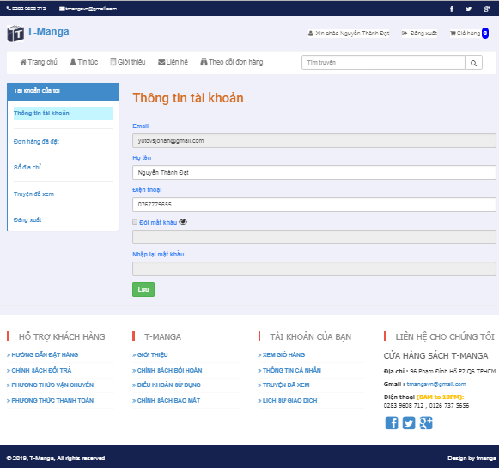
Customer sites
Customer Information Page

Slide 16
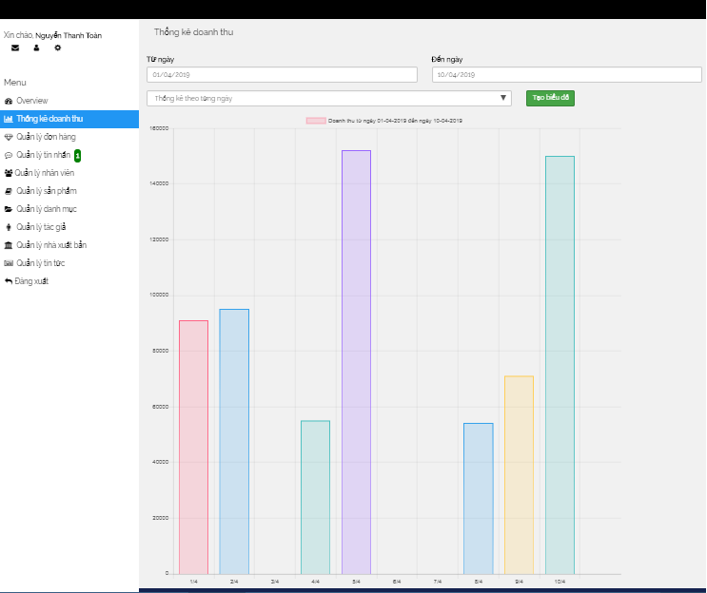
Admin sites
Statistic Page

Slide 17
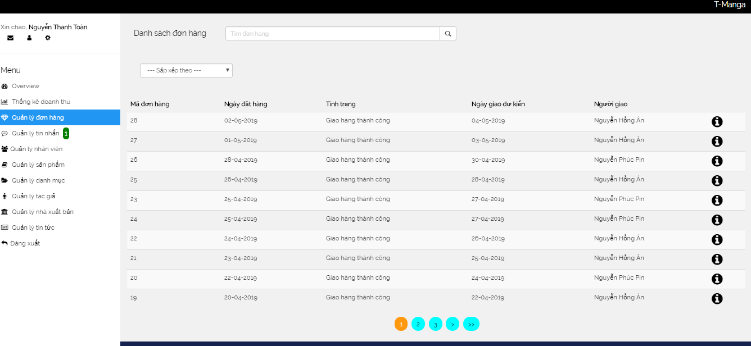
Admin sites
Order Management Page

Slide 18
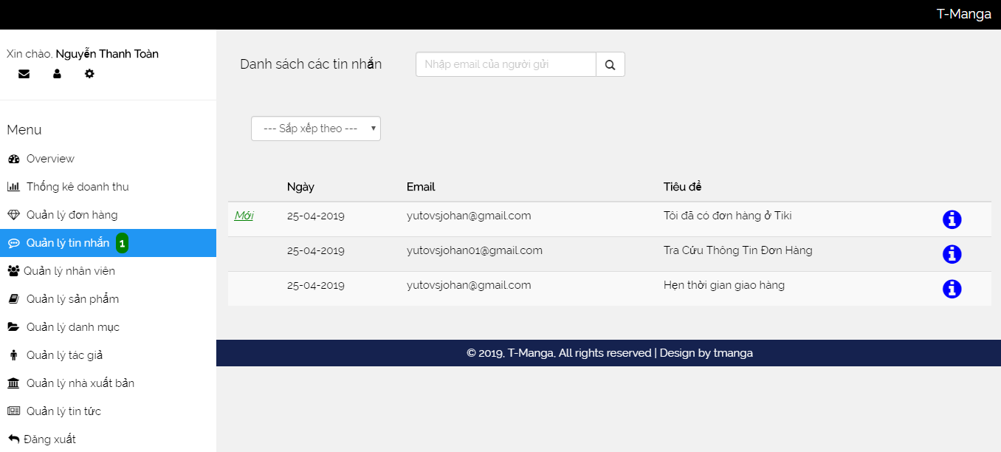
Admin sites
Contact Management Page

Slide 19
Admin sites
Contact Management Page

Slide 20
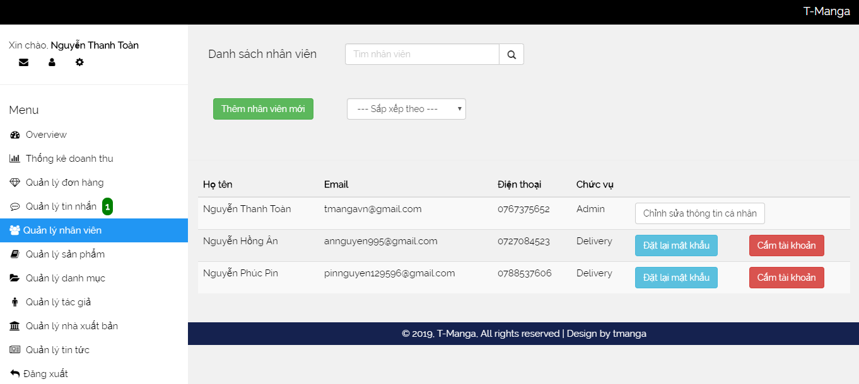
Admin sites
Staff Management Page

Slide 21
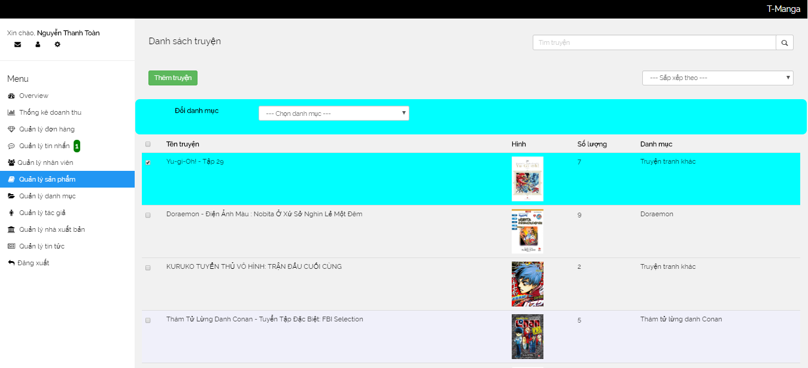
Admin sites
Comic Management Page

Slide 22
References
http://pibook.vn/
http://truyendubo.vn/
https://tiki.vn/
http://bookbuy.vn/

Slide 23
Demo

Slide 24
Q & A

Slide 25


