Slide 1

Web Development COMP 431 / COMP 531 Databases
Scott E Pollack, PhD
March 24, 2016

Slide 2
Part II – Back End Development
Homework Assignment 6 (Draft Back-End)
Due TONIGHT 3/24
Part II
Web Servers
Backend
Architecture
Unit Testing
Web Hosting
Databases
COMP 531 Front-End Review
Due Tuesday 4/5
Homework Assignment 7
(Integrated Web App)
Due Tuesday 4/12

Slide 3
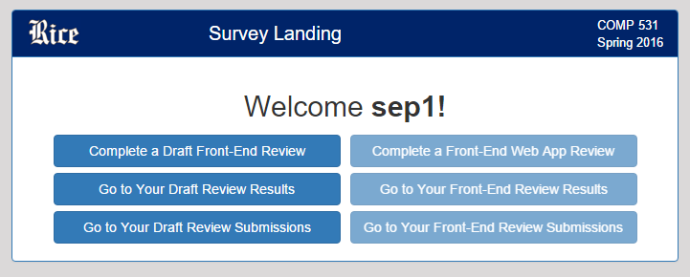
Draft Front-End Reviews are available!
http://webdev-dummy.herokuapp.com/survey
Go to this address and log in using your netid and 3-word password supplied to you by email for the dummy server

Slide 4
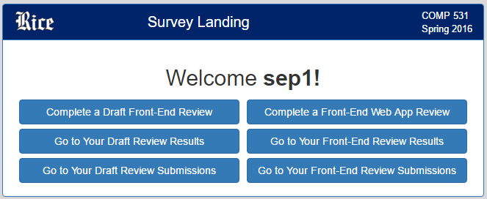
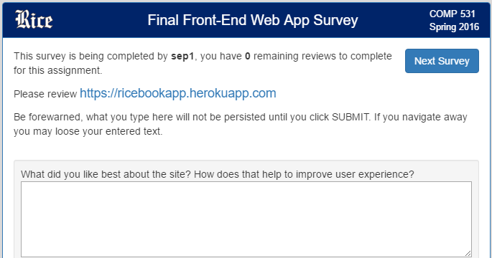
COMP 531 Front-End Review
http://webdev-dummy.herokuapp.com/survey
Go to this address and log in using your netid and 3-word password supplied to you previously for the dummy server
You will be asked to review 5 websites of your peers
Provide useful, constructive feedback
Provide a critical comparative evaluation of each site with yours

Slide 5
Assignment 7: Integrated Web App
Inclass 20
Connect to MongoDB for persistence
Authentication for user login
Manually store session as a cookie (no third-party modules)
Point your Frontend App at your Backend App
All backend endpoints are implemented
login, logout, register, add post, get posts, statuses, followers, pictures
BUT! only a stub for upload profile pictures
BUT! only make posts with body, no picture
Inclass 21
Inclass 21
Inclass 22

Slide 6

Data, data, data
It’s all about the data
Entities
A “thing”
Properties
The properties of the thing
Relationships
Things are related to other things
Triggers
When something happens do something

Slide 7

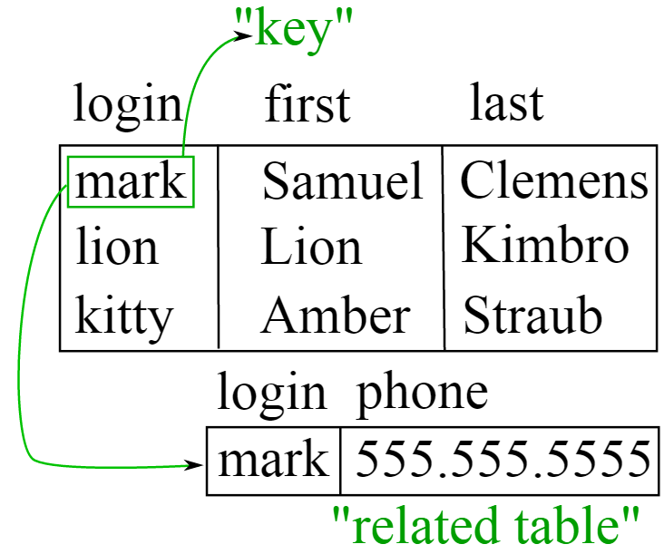
Databases
A database management system (DBMS) allows for the definition, creation, querying, update, and administration of databases
RDBMS where “R” is for relational

Slide 8
Relational Database
Composed of tables
Tables have rows (entities) and columns (fields or properties)
prices
tickers
column | datatype | nullable
date | datetime | NOT NULL
iid | int | NOT NULL
open | float | NOT NULL
high | float | NOT NULL
low | float | NOT NULL
close | float | NOT NULL
volume | long | NOT NULL
adj_close | float | NOT NULL
column | datatype | nullable
iid | int | NOT NULL
ticker | varchar(8) | NOT NULL
name | varchar(80) | NULL

Slide 9
Structured Query Language
SELECT p.date, t.ticker, p.close, p.volume
FROM price p JOIN tickers t ON p.iid = t.iid
WHERE t.ticker IN ( ‘AAPL’, ‘GOOG’ )
AND p.date BETWEEN ‘2012-01-01’ AND ‘2012-02-01’
ORDER BY p.date DESC, t.ticker LIMIT 6 ;
date ticker close volume
2012-02-01 AAPL 456.19 9644500
2012-02-01 GOOG 580.83 2320700
2012-01-31 AAPL 456.48 13988700
2012-01-31 GOOG 580.11 2142400
2012-01-30 AAPL 453.01 13547900
2012-01-30 GOOG 577.69 2330500

Slide 10

SQLite
“SQLite is a software library that implements a self-contained, serverless, zero-configuration, transactional SQL database engine. SQLite is the most widely deployed database engine in the world. The source code for SQLite is in the public domain”
> sqlite3 db.sqlite3
SQLite version 3.8.11.1 2015-07-29 20:00:57
Enter ".help" for usage hints.
sqlite> .tables
prices tickers
sqlite> select * from prices limit 10;
2000-02-01|1|104.0|105.0|100.0|100.25|11380000|24.96
2000-02-01|4|67.5|70.63|64.37|67.44|13404600|67.44

Slide 11
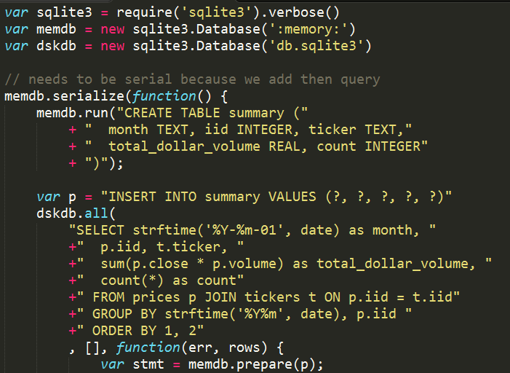
SQLite from Node

Slide 12
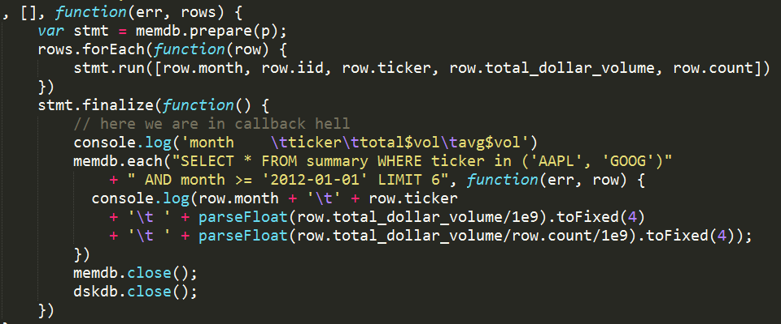
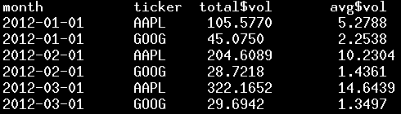
Using a prepared statement

Slide 13
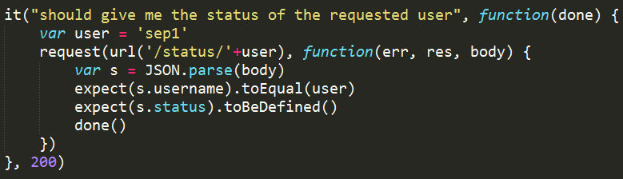
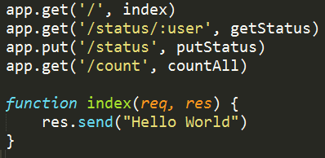
TDD

Slide 14
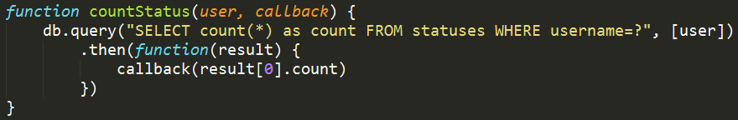
Using databases asynchronously

Slide 15
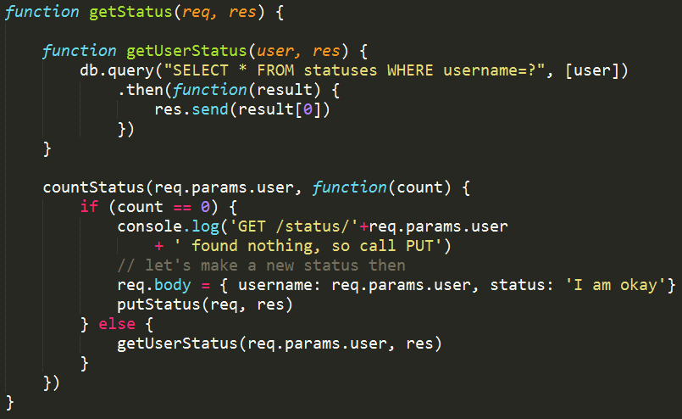
No assumptions! Be explicit: SELECT username, status FROM …

Slide 16
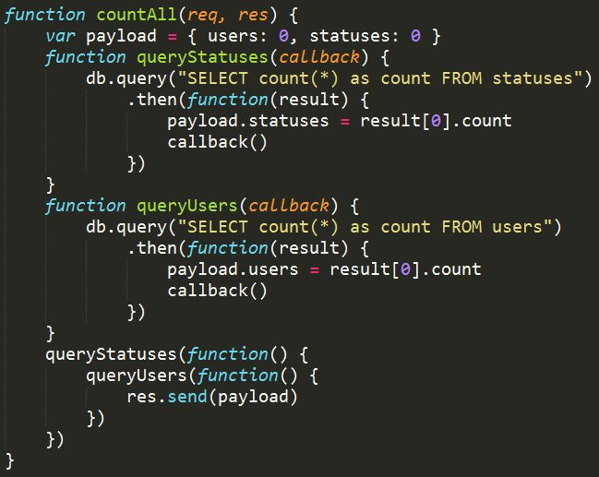

Slide 17
Node and PostgreSQL on Heroku
> heroku addons:create heroku-postgresql:hobby-dev
IDEA
Use postgres on Heroku but sqlite3 locally
WHY?
Easier than setting up a PostgreSQL server locally
HOW?
process.env.NODE_ENV = “production”

Slide 18
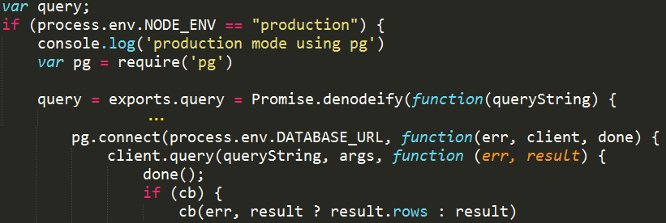
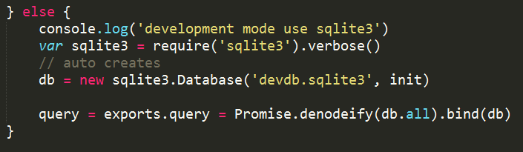
Unified database access

Slide 19
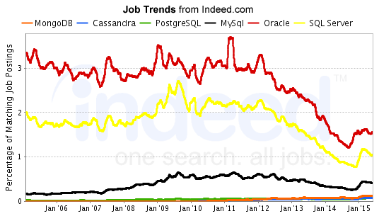
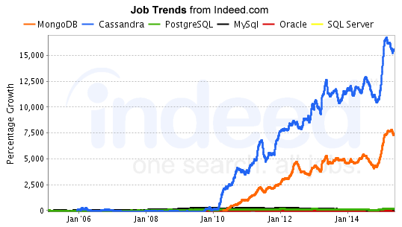
What’s hot in databases? NoSQL

Slide 20
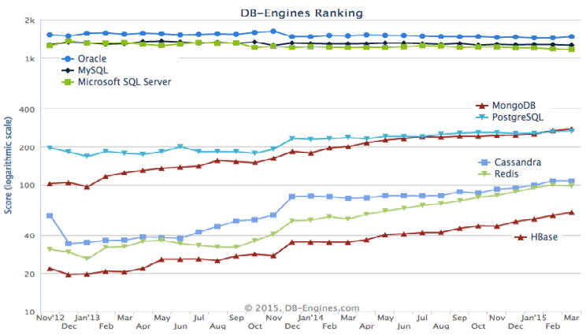

Slide 21
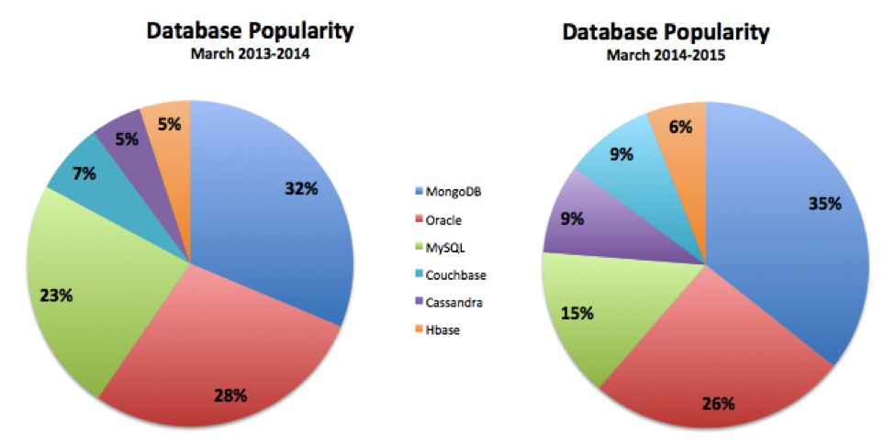
MongoDB
MySQL
MongoDB
MySQL
Oracle
Oracle

Slide 22

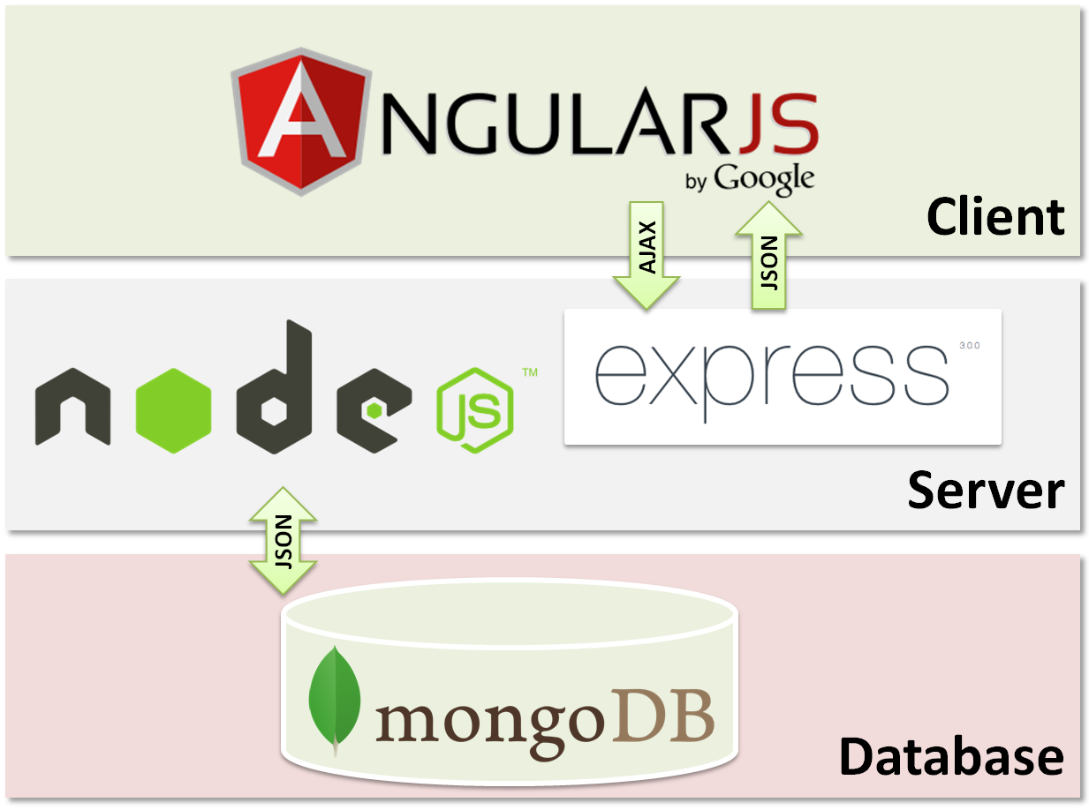
MongoDB
Designed for humongous volumes of data
Document-oriented (not row+column)
Schema-less
Extensible
No “error” checking…
JSON oriented
Binary JSON (BSON)
Documents within Documents

Slide 23
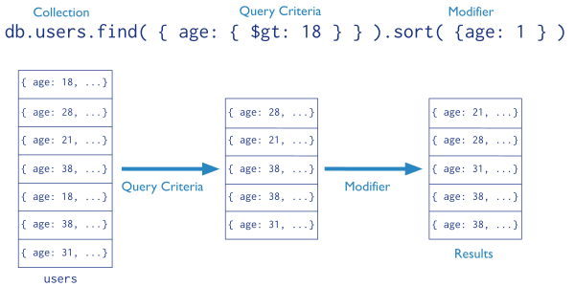
MongoDB Query

Slide 24
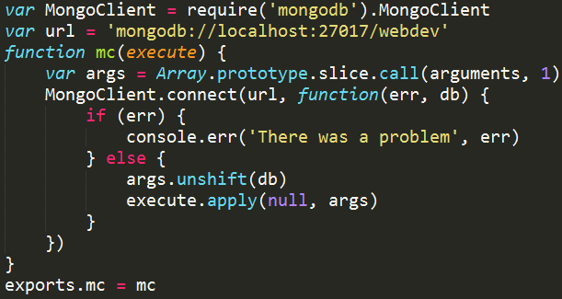
MongoDB in Node

Slide 25
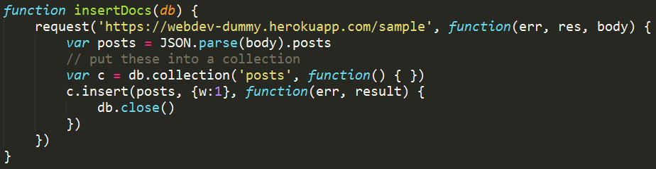
Insert some documents

Slide 26
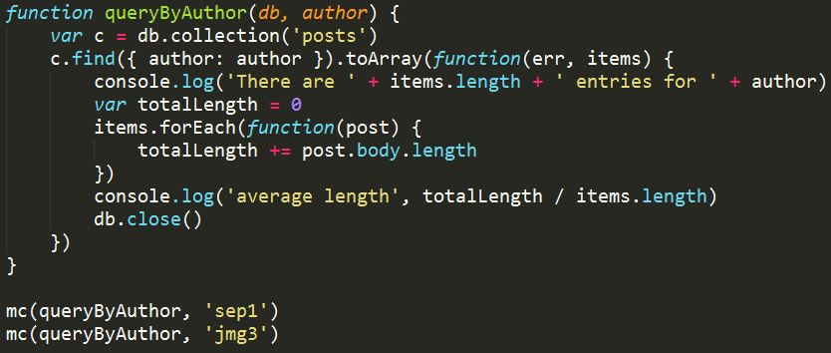
Query documents
There are 16 entries for sep1
average length 428.8125
There are 16 entries for jmg3
average length 428.126
exports.mc = mc

Slide 27
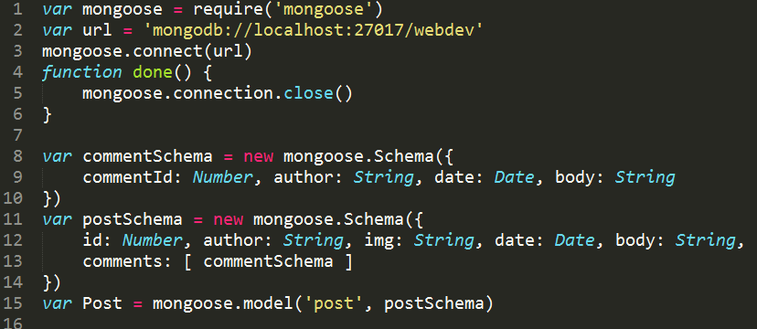
MongooseJS: an Object Document Model
exports.Post = Post

Slide 28
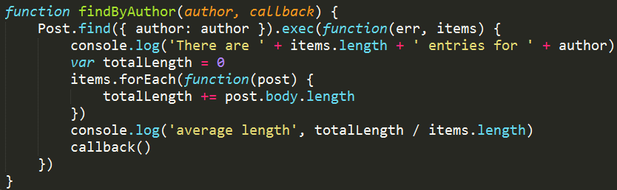
Direct vs ODM

Slide 29


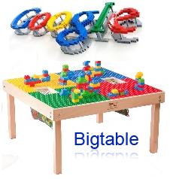





Other Solutions SQL, noSQL, newSQL

Slide 30
In-Class Exercise: Setting up MongoDB
http://www.clear.rice.edu/comp431/sample/mongooseTest.js rename this model.js
http://www.clear.rice.edu/comp431/sample/db.js
Add a free mongoDB instance to your backend
https://www.clear.rice.edu/comp431/data/database.html
> heroku addons:create mongolab
Install mongoose
> npm install mongoose --save
Put your mongoDB connection url in db.js process.env.MONGOLAB_URI heroku config | grep MONGOLAB
Integrate your backend for “posts” with MongoDB GET /posts/:id*? POST /post
Test using e.g. curl
Turnin your posts.js and model.js
COMP431-S16:inclass-20

