Slide 1
Discrete Quantum Theories and Computing
Yu-Tsung Tai
Department of Mathematics and Department of Computer Science Indiana University, Bloomington

Slide 2
Dilemma of quantum computing?
Textbook quantum mechanics is correct.
There does not exist an efficient classical factoring algorithm.
The extended Church-Turing thesis —that probabilistic Turing machines can efficiently simulate any physically realizable model of computation —is correct.
Check the compatibility of Quantum Mechanics and Computer Science.

Slide 3
Quantum Mechanics is based on continuous. How about Computer Science?
 | Discrete | Continuum
Theoretical Model | Turing machine | BCSS machine
Physical Realization | Digital Computer | Analog Computer
How the models realize? | Reliably | Not Reliably: The quality might be quantized.. The precision of an analog computer is low.
Build a more faithful Quantum Computing model?
Our Quantum Models | Quantum Theories and Computing over Finite Fields | Quantum Interval-Valued Probability Measures

Slide 4
Conventional Quantum Theory

Slide 5
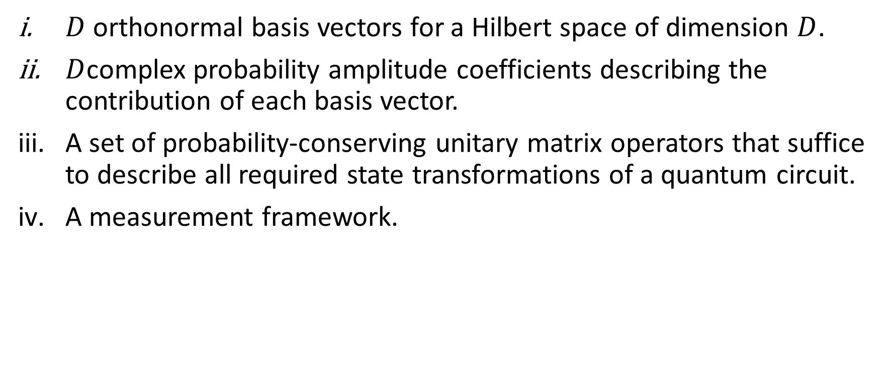
Conventional Quantum Theory
$D$ orthonormal basis vectors for a Hilbert space of dimension $D$.
$D$complex probability amplitude coefficients describing the contribution of each basis vector.
A set of probability-conserving unitary matrix operators that suffice to describe all required state transformations of a quantum circuit.
A measurement framework.

Slide 6
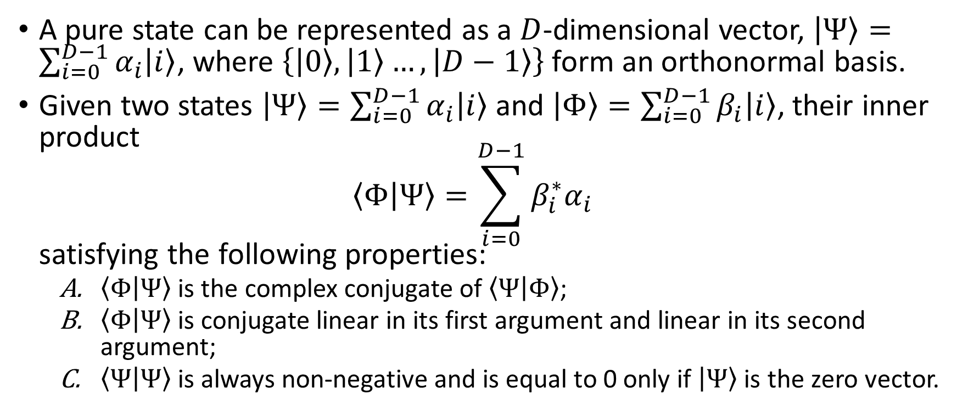
Pure State
A pure state can be represented as a $D$-dimensional vector, $\left|Ψ\right\rangle =\sum_{i=0}^{D−1}{α_{i}\left|i\right\rangle }$, where $\left\{\left|0\right\rangle ,\left|1\right\rangle …,\left|D−1\right\rangle \right\}$ form an orthonormal basis.
Given two states $\left|Ψ\right\rangle =\sum_{i=0}^{D−1}{α_{i}\left|i\right\rangle }$ and $\left|Φ\right\rangle =\sum_{i=0}^{D−1}{β_{i}\left|i\right\rangle }$, their inner product $\left\langle Φ | Ψ\right\rangle =\sum_{i=0}^{D−1}{β_{i}^{∗}α_{i}}$ satisfying the following properties:
$\left\langle Φ | Ψ\right\rangle$ is the complex conjugate of $\left\langle Ψ | Φ\right\rangle$;
$\left\langle Φ | Ψ\right\rangle$ is conjugate linear in its first argument and linear in its second argument;
$\left\langle Ψ | Ψ\right\rangle$ is always non-negative and is equal to 0 only if $\left|Ψ\right\rangle$ is the zero vector.

Slide 7
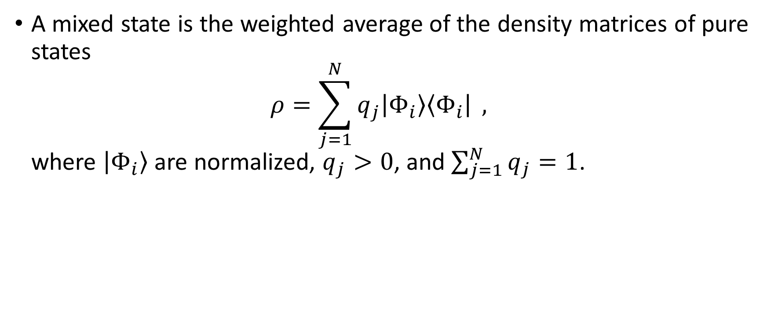
Mixed State
A mixed state is the weighted average of the density matrices of pure states $ρ=\sum_{j=1}^{N}{q_{j}\left|Φ_{i}\right\rangle \left\langle Φ_{i}\right|} ,$ where $\left|Φ_{i}\right\rangle$ are normalized, $q_{j}>0$, and $\sum_{j=1}^{N}{q_{j}}=1$.

Slide 8
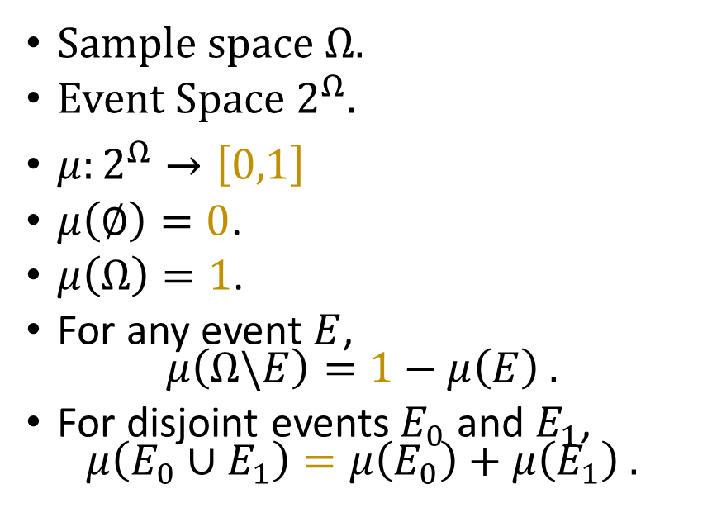
Probability Measure
Abstraction
Sample space $Ω$.
Event Space $2^{Ω}$.
$μ:2^{Ω}→\left[0,1\right]$
$μ\left(∅\right)=0$.
$μ\left(Ω\right)=1$.
For any event $E$, $μ\left(Ω\backslash E\right)=1−μ\left(E\right) .$
For disjoint events $E_{0}$ and $E_{1}$, $μ\left(E_{0}∪E_{1}\right)=μ\left(E_{0}\right)+μ\left(E_{1}\right) .$

