Slide 1
Discrete Quantum Theories and Computing
Yu-Tsung Tai
Department of Mathematics and Department of Computer Science Indiana University, Bloomington

Slide 2
Dilemma of quantum computing?
Textbook quantum mechanics is correct.
There does not exist an efficient classical factoring algorithm.
The extended Church-Turing thesis —that probabilistic Turing machines can efficiently simulate any physically realizable model of computation —is correct.
Check the compatibility of Quantum Mechanics and Computer Science.

Slide 3
Quantum Mechanics is based on continuous. How about Computer Science?
 | Discrete | Continuum
Theoretical Model | Turing machine | BCSS machine
Physical Realization | Digital Computer | Analog Computer
How the models realize? | Reliably | Not Reliably: The quality might be quantized.. The precision of an analog computer is low.
Build a more faithful Quantum Computing model?
Our Quantum Models | Quantum Theories and Computing over Finite Fields | Quantum Interval-Valued Probability Measures

Slide 4
Conventional Quantum Theory

Slide 5
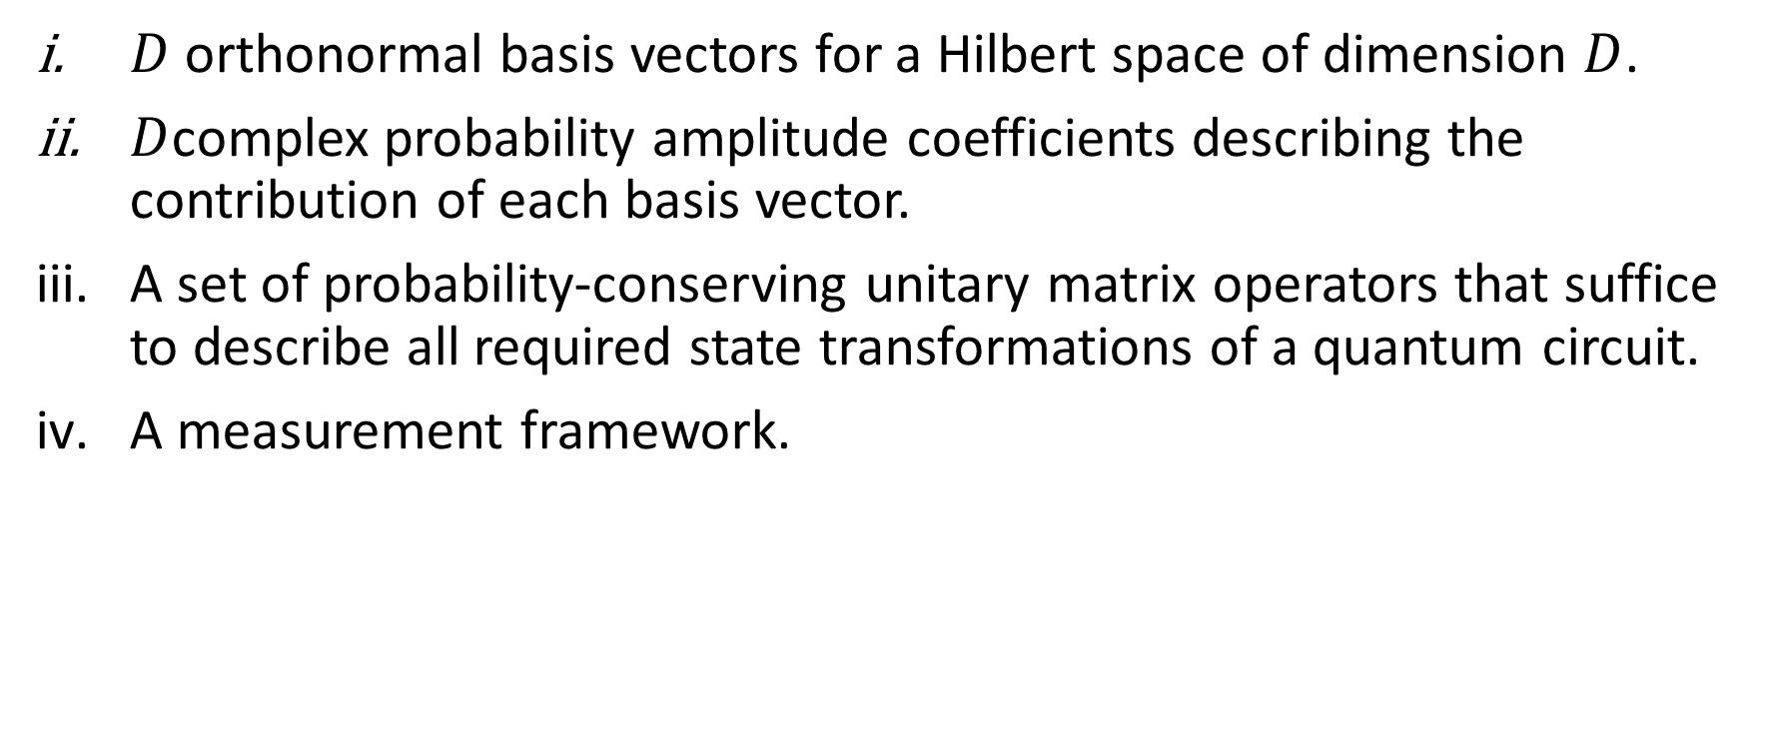
Conventional Quantum Theory
$D$ orthonormal basis vectors for a Hilbert space of dimension $D$.
$D$complex probability amplitude coefficients describing the contribution of each basis vector.
A set of probability-conserving unitary matrix operators that suffice to describe all required state transformations of a quantum circuit.
A measurement framework.

Slide 6
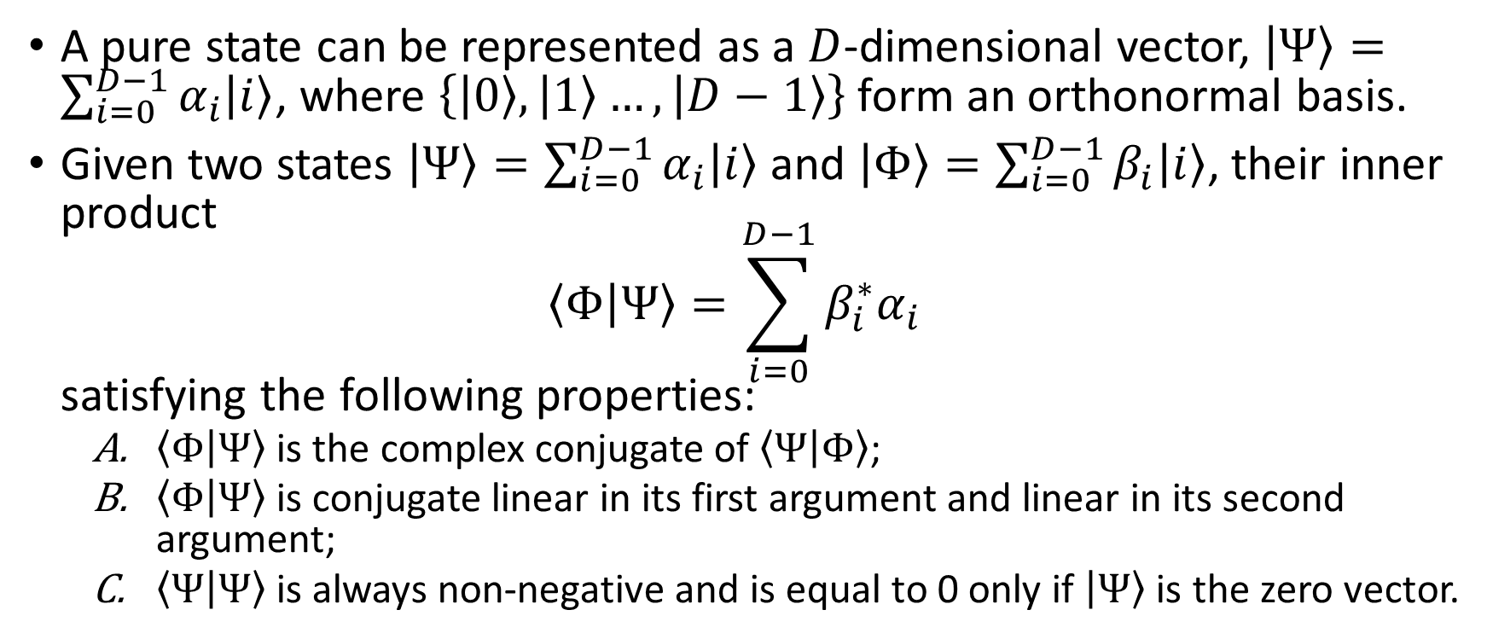
Pure State
A pure state can be represented as a $D$-dimensional vector, $\left|Ψ\right\rangle =\sum_{i=0}^{D−1}{α_{i}\left|i\right\rangle }$, where $\left\{\left|0\right\rangle ,\left|1\right\rangle …,\left|D−1\right\rangle \right\}$ form an orthonormal basis.
Given two states $\left|Ψ\right\rangle =\sum_{i=0}^{D−1}{α_{i}\left|i\right\rangle }$ and $\left|Φ\right\rangle =\sum_{i=0}^{D−1}{β_{i}\left|i\right\rangle }$, their inner product $\left\langle Φ | Ψ\right\rangle =\sum_{i=0}^{D−1}{β_{i}^{∗}α_{i}}$ satisfying the following properties:
$\left\langle Φ | Ψ\right\rangle$ is the complex conjugate of $\left\langle Ψ | Φ\right\rangle$;
$\left\langle Φ | Ψ\right\rangle$ is conjugate linear in its first argument and linear in its second argument;
$\left\langle Ψ | Ψ\right\rangle$ is always non-negative and is equal to 0 only if $\left|Ψ\right\rangle$ is the zero vector.

Slide 7
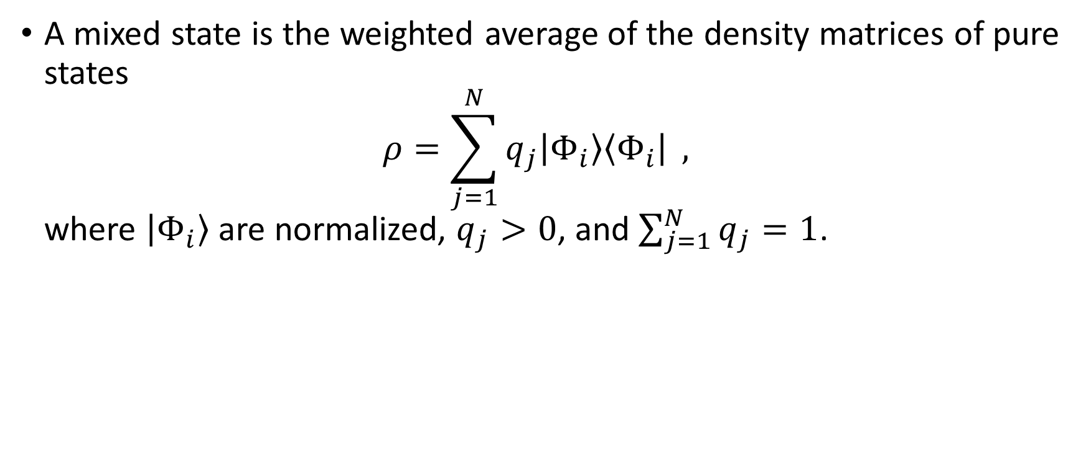
Mixed State
A mixed state is the weighted average of the density matrices of pure states $ρ=\sum_{j=1}^{N}{q_{j}\left|Φ_{i}\right\rangle \left\langle Φ_{i}\right|} ,$ where $\left|Φ_{i}\right\rangle$ are normalized, $q_{j}>0$, and $\sum_{j=1}^{N}{q_{j}}=1$.

Slide 8
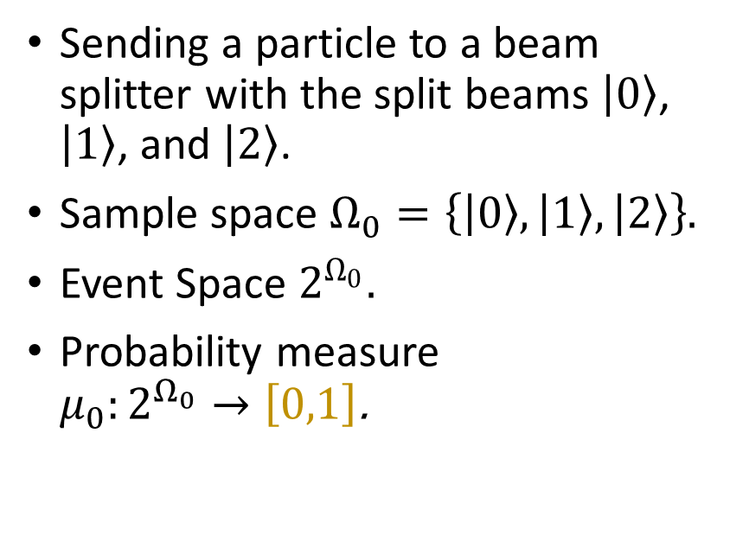
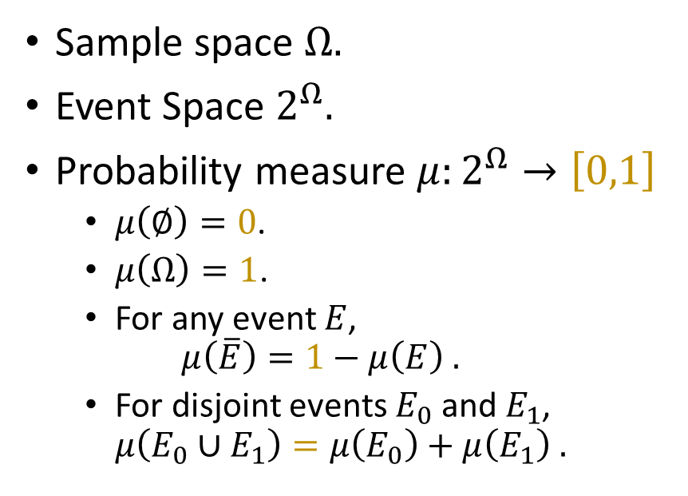
Probability Space
Abstraction
Example
Sample space $Ω$.
Event Space $2^{Ω}$.
Probability measure $μ:2^{Ω}→\left[0,1\right]$
$μ\left(∅\right)=0$.
$μ\left(Ω\right)=1$.
For any event $E$, $μ\left(\overline{E}\right)=1−μ\left(E\right) .$
For disjoint events $E_{0}$ and $E_{1}$, $μ\left(E_{0}∪E_{1}\right)=μ\left(E_{0}\right)+μ\left(E_{1}\right) .$
Sending a particle to a beam splitter with the split beams $\left|0\right\rangle$, $\left|1\right\rangle$, and $\left|2\right\rangle$.
Sample space $Ω_{0}=\left\{\left|0\right\rangle ,\left|1\right\rangle ,\left|2\right\rangle \right\}$.
Event Space $2^{Ω_{0}}$.
Probability measure $μ_{0}:2^{Ω_{0}}→\left[0,1\right]$.

Slide 9
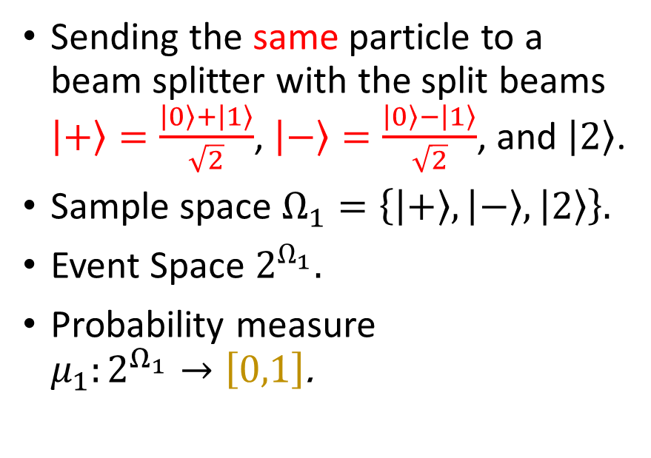

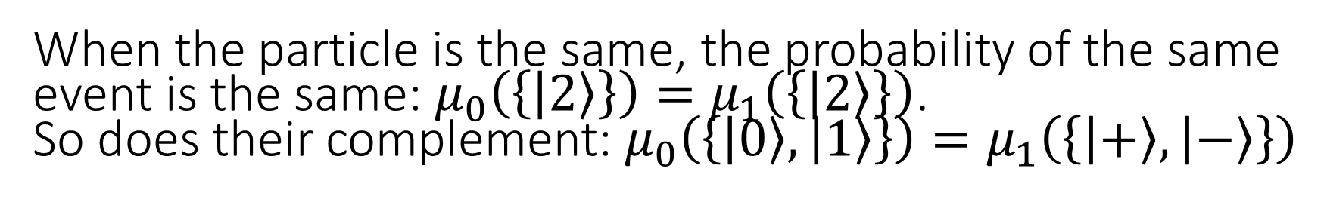
Probability Space
Example
Another Example
Sending a particle to a beam splitter with the split beams $\left|0\right\rangle$, $\left|1\right\rangle$, and $\left|2\right\rangle$.
Sample space $Ω_{0}=\left\{\left|0\right\rangle ,\left|1\right\rangle ,\left|2\right\rangle \right\}$.
Event Space $2^{Ω_{0}}$.
Probability measure $μ_{0}:2^{Ω_{0}}→\left[0,1\right]$.
Sending the same particle to a beam splitter with the split beams $\left|+\right\rangle =\frac{\left|0\right\rangle +\left|1\right\rangle }{\sqrt{2}}$, $\left|−\right\rangle =\frac{\left|0\right\rangle −\left|1\right\rangle }{\sqrt{2}}$, and $\left|2\right\rangle$.
Sample space $Ω_{1}=\left\{\left|+\right\rangle ,\left|−\right\rangle ,\left|2\right\rangle \right\}$.
Event Space $2^{Ω_{1}}$.
Probability measure $μ_{1}:2^{Ω_{1}}→\left[0,1\right]$.
When the particle is the same, the probability of the same event is the same: $μ_{0}\left(\left\{\left|2\right\rangle \right\}\right)=μ_{1}\left(\left\{\left|2\right\rangle \right\}\right)$. So does their complement: $μ_{0}\left(\left\{\left|0\right\rangle ,\left|1\right\rangle \right\}\right)=μ_{1}\left(\left\{\left|+\right\rangle ,\left|−\right\rangle \right\}\right)$

Slide 10
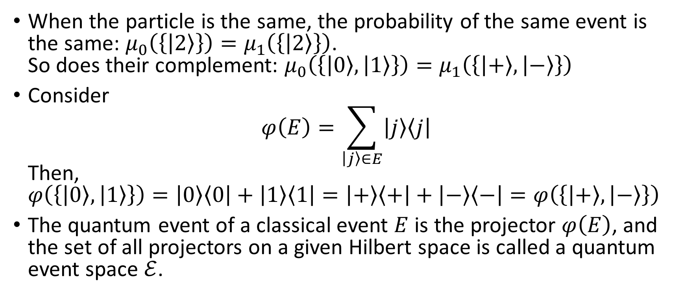
Glue Classical Event Spaces to a Quantum Event Space
When the particle is the same, the probability of the same event is the same: $μ_{0}\left(\left\{\left|2\right\rangle \right\}\right)=μ_{1}\left(\left\{\left|2\right\rangle \right\}\right)$. So does their complement: $μ_{0}\left(\left\{\left|0\right\rangle ,\left|1\right\rangle \right\}\right)=μ_{1}\left(\left\{\left|+\right\rangle ,\left|−\right\rangle \right\}\right)$
Consider $φ\left(E\right)=\sum_{\left|j\right\rangle ∈E}{\left|j\right\rangle \left\langle j\right|}$ Then, $φ\left(\left\{\left|0\right\rangle ,\left|1\right\rangle \right\}\right)=\left|0\right\rangle \left\langle 0\right|+\left|1\right\rangle \left\langle 1\right|=\left|+\right\rangle \left\langle +\right|+\left|−\right\rangle \left\langle −\right|=φ\left(\left\{\left|+\right\rangle ,\left|−\right\rangle \right\}\right)$
The quantum event of a classical event $E$ is the projector $φ\left(E\right)$, and the set of all projectors on a given Hilbert space is called a quantum event space $ℰ$.

Slide 11
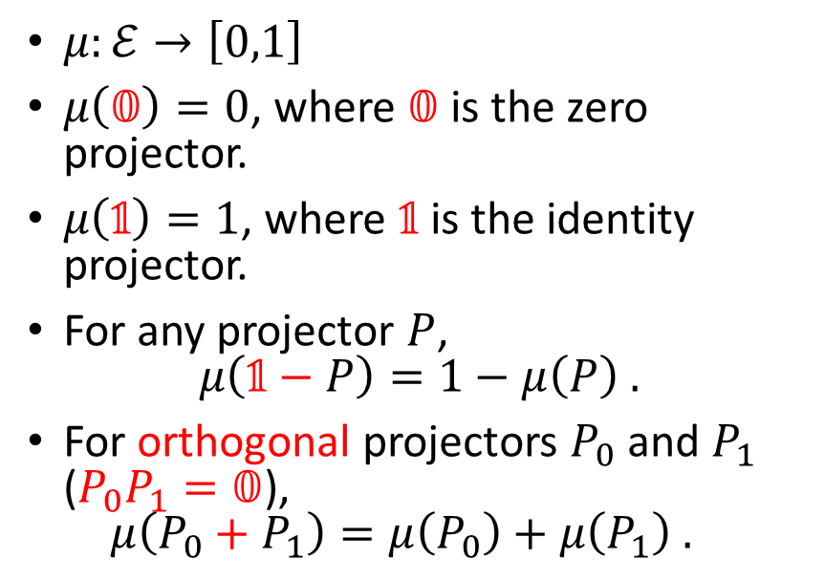
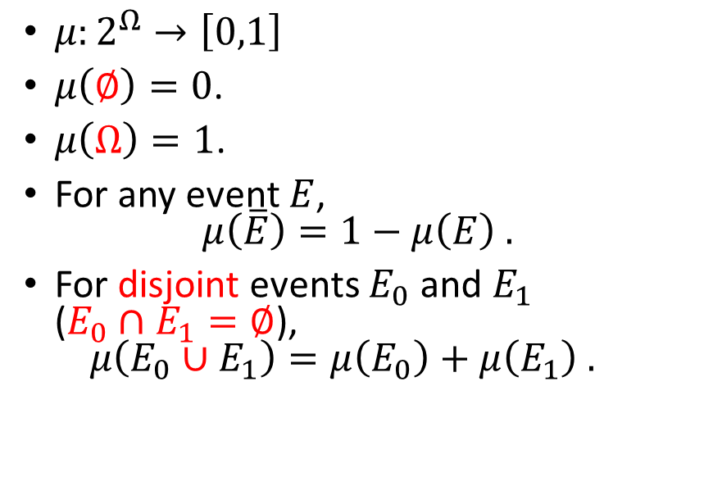
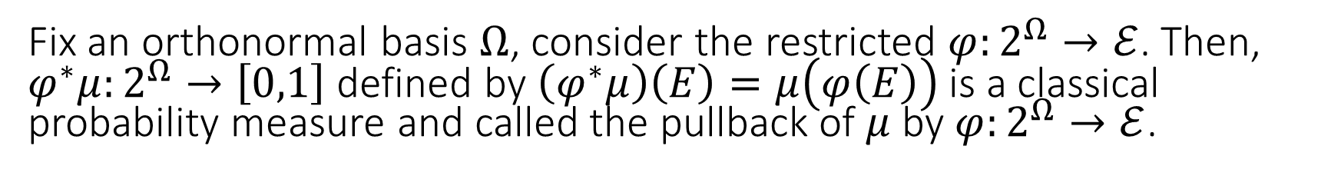
Classical and Quantum Probability Measure
Classical Probability measure
Quantum Probability measure
$μ:2^{Ω}→\left[0,1\right]$
$μ\left(∅\right)=0$.
$μ\left(Ω\right)=1$.
For any event $E$, $μ\left(\overline{E}\right)=1−μ\left(E\right) .$
For disjoint events $E_{0}$ and $E_{1}$ ($E_{0}∩E_{1}=∅$), $μ\left(E_{0}∪E_{1}\right)=μ\left(E_{0}\right)+μ\left(E_{1}\right) .$
$μ:ℰ→\left[0,1\right]$
$μ\left(𝟘\right)=0$, where $𝟘$ is the zero projector.
$μ\left(𝟙\right)=1$, where $𝟙$ is the identity projector.
For any projector $P$, $μ\left(𝟙−P\right)=1−μ\left(P\right) .$
For orthogonal projectors $P_{0}$ and $P_{1}$ ($P_{0}P_{1}=𝟘$), $μ\left(P_{0}+P_{1}\right)=μ\left(P_{0}\right)+μ\left(P_{1}\right) .$
Fix an orthonormal basis $Ω$, consider the restricted $φ:2^{Ω}→ℰ$. Then, $φ^{∗}μ:2^{Ω}→\left[0,1\right]$ defined by $\left(φ^{∗}μ\right)\left(E\right)=μ\left(φ\left(E\right)\right)$ is a classical probability measure and called the pullback of $μ$ by $φ:2^{Ω}→ℰ$.

Slide 12
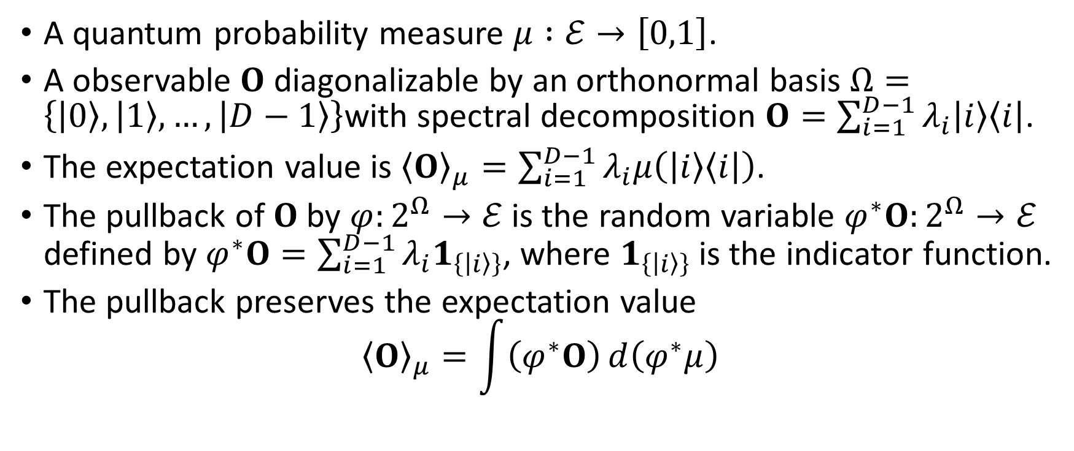
Observables and Expectation Values
A quantum probability measure $μ :ℰ→\left[0,1\right]$.
A observable $O$ diagonalizable by an orthonormal basis $Ω=\left\{\left|0\right\rangle ,\left|1\right\rangle ,…,\left|D−1\right\rangle \right\}$with spectral decomposition $O=\sum_{i=1}^{D−1}{λ_{i}\left|i\right\rangle \left\langle i\right|}$.
The expectation value is ${\left\langle O\right\rangle }_{μ}=\sum_{i=1}^{D−1}{λ_{i}μ\left(\left|i\right\rangle \left\langle i\right|\right)}$.
The pullback of $O$ by $φ:2^{Ω}→ℰ$ is the random variable $φ^{∗}O:2^{Ω}→ℰ$ defined by $φ^{∗}O=\sum_{i=1}^{D−1}{λ_{i}1_{\left\{\left|i\right\rangle \right\}}}$, where $1_{\left\{\left|i\right\rangle \right\}}$ is the indicator function.
The pullback preserves the expectation value ${\left\langle O\right\rangle }_{μ}=\int{\left(φ^{∗}O\right)ⅆ\left(φ^{∗}μ\right)}$

Slide 13
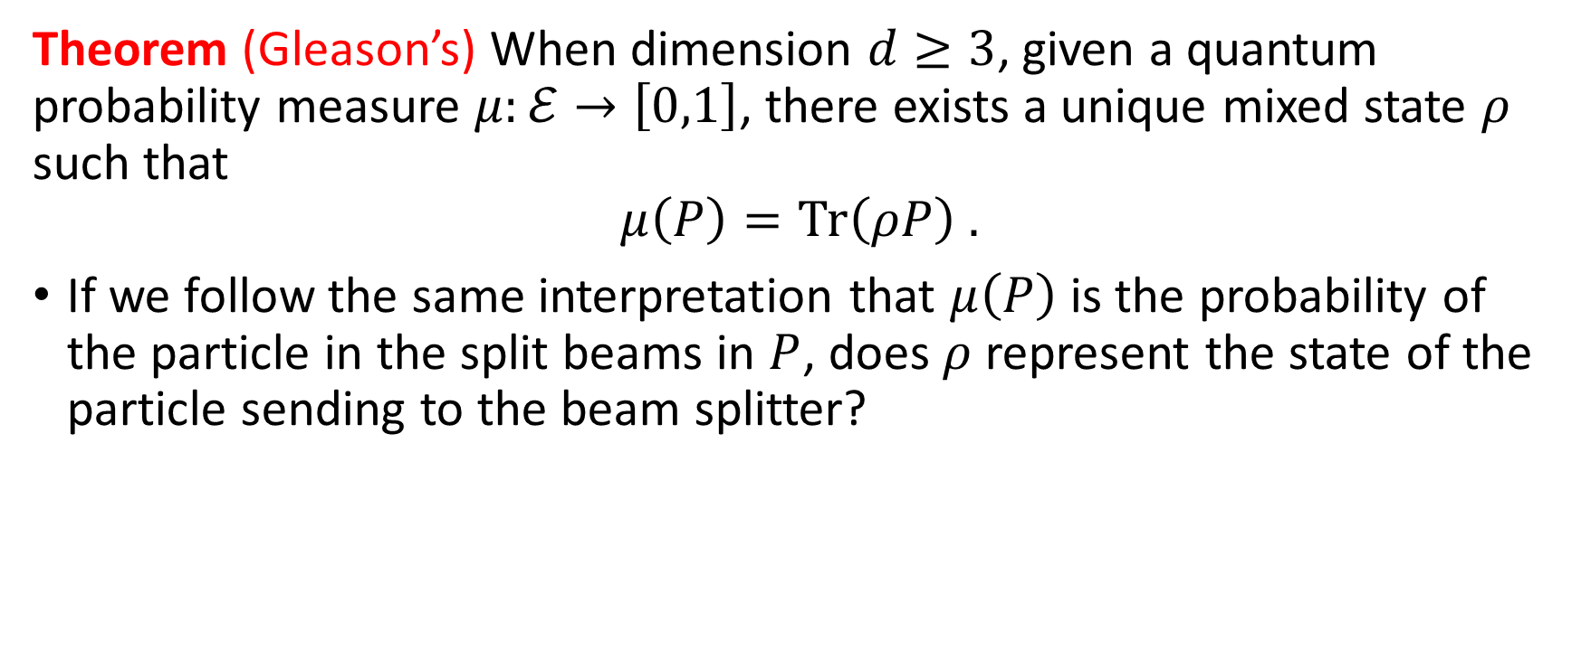
Gleason’s Theorem
Theorem (Gleason’s) When dimension $d≥3$, given a quantum probability measure $μ:ℰ→\left[0,1\right]$, there exists a unique mixed state $ρ$ such that $$μ\left(P\right)=\text{Tr}\left(ρP\right) .$$
If we follow the same interpretation that $μ\left(P\right)$ is the probability of the particle in the split beams in $P$, does $ρ$ represent the state of the particle sending to the beam splitter?

Slide 14
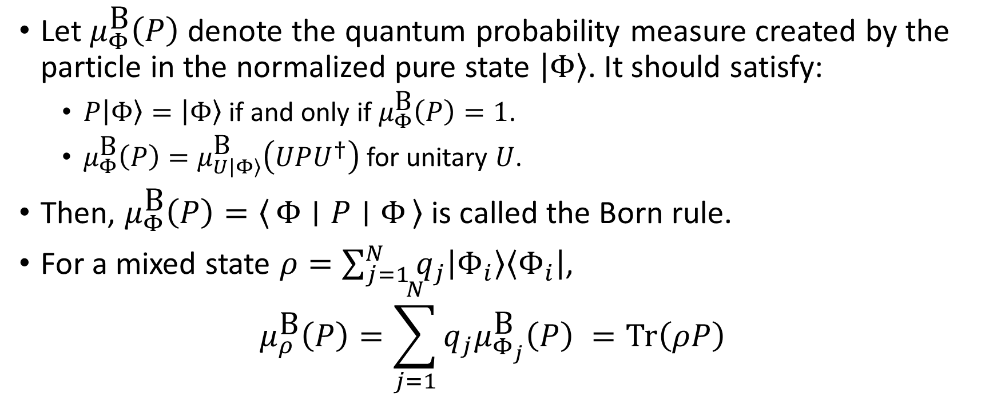
Born Rule
Let $μ_{Φ}^{\text{B}}\left(P\right)$ denote the quantum probability measure created by the particle in the normalized pure state $\left|Φ\right\rangle$. It should satisfy:
$P\left|Φ\right\rangle =\left|Φ\right\rangle$ if and only if $μ_{Φ}^{\text{B}}\left(P\right)=1$.
$μ_{Φ}^{\text{B}}\left(P\right)=μ_{U\left|Φ\right\rangle }^{\text{B}}\left(UPU^{†}\right)$ for unitary $U$.
Then, $μ_{Φ}^{\text{B}}\left(P\right)=\left\langle Φ ∣ P ∣ Φ\right\rangle$ is called the Born rule.
For a mixed state $ρ=\sum_{j=1}^{N}{q_{j}\left|Φ_{i}\right\rangle \left\langle Φ_{i}\right|}$, $μ_{ρ}^{\text{B}}\left(P\right)=\sum_{j=1}^{N}{q_{j}μ_{Φ_{j}}^{\text{B}}\left(P\right)} =\text{Tr}\left(ρP\right)$

Slide 15
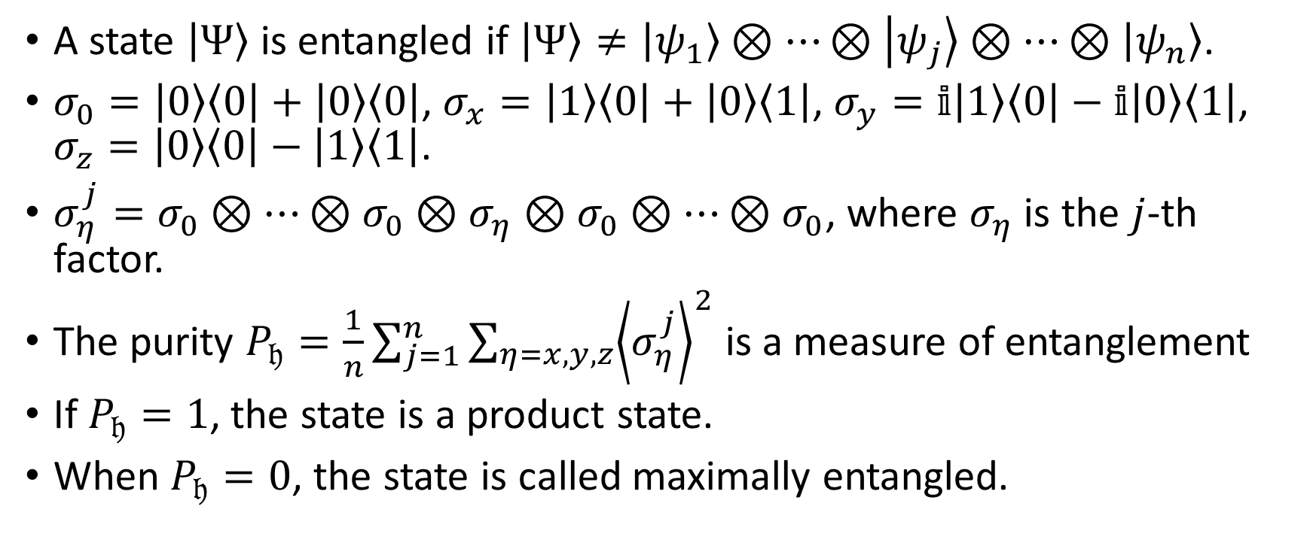
Entanglement, Pauli Operators, and Purity
A state $\left|Ψ\right\rangle$ is entangled if $\left|Ψ\right\rangle ≠\left|ψ_{1}\right\rangle ⊗…⊗\left|ψ_{j}\right\rangle ⊗…⊗\left|ψ_{n}\right\rangle$.
$σ_{0}=\left|0\right\rangle \left\langle 0\right|+\left|0\right\rangle \left\langle 0\right|$, $σ_{x}=\left|1\right\rangle \left\langle 0\right|+\left|0\right\rangle \left\langle 1\right|$, $σ_{y}=𝕚\left|1\right\rangle \left\langle 0\right|−𝕚\left|0\right\rangle \left\langle 1\right|$, $σ_{z}=\left|0\right\rangle \left\langle 0\right|−\left|1\right\rangle \left\langle 1\right|$.
$σ_{η}^{j}=σ_{0}⊗…⊗σ_{0}⊗σ_{η}⊗σ_{0}⊗…⊗σ_{0}$, where $σ_{η}$ is the $j$-th factor.
The purity $P_{𝔥}=\frac{1}{n}\sum_{j=1}^{n}{\sum_{η=x,y,z}{{\left\langle σ_{η}^{j}\right\rangle }^{2}}}$ is a measure of entanglement
If $P_{𝔥}=1$, the state is a product state.
When $P_{𝔥}=0$, the state is called maximally entangled.

Slide 16
Quantum Theories and Computing over Finite Fields

Slide 17
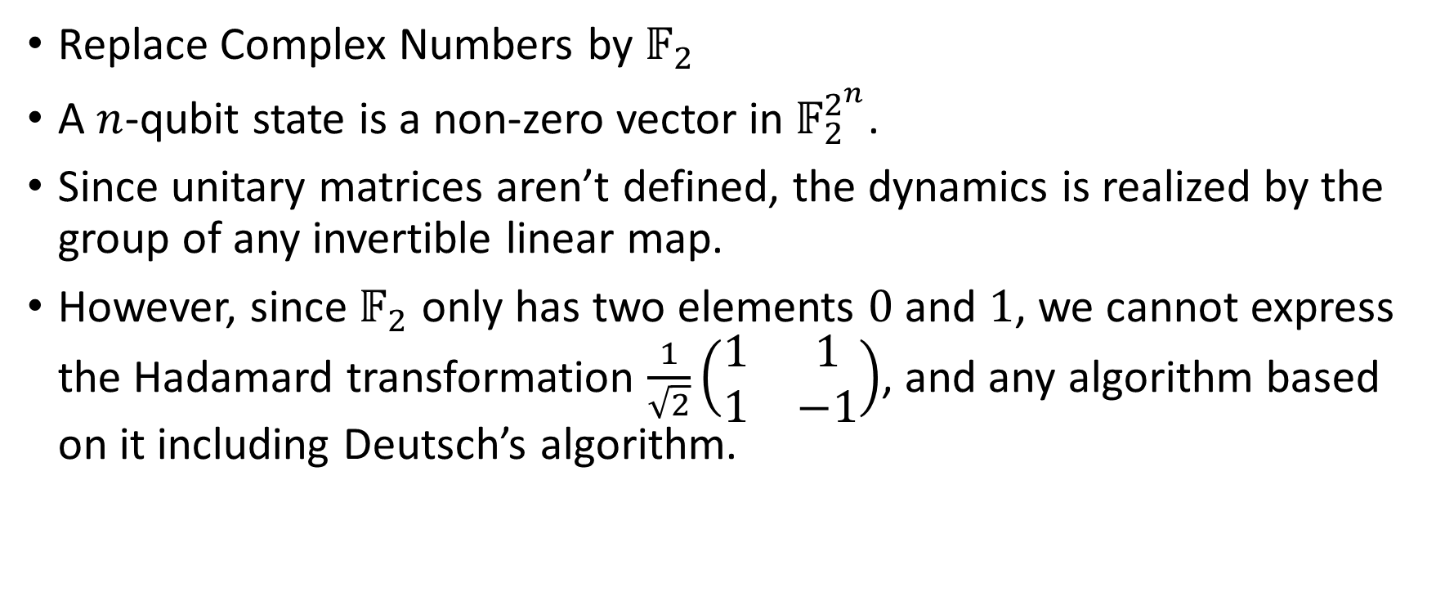
Modal Quantum Theory and Computing No Deutsch’s algorithm
Replace Complex Numbers by $𝔽_{2}$
A $n$-qubit state is a non-zero vector in $𝔽_{2}^{2^{n}}$.
Since unitary matrices aren’t defined, the dynamics is realized by the group of any invertible linear map.
However, since $𝔽_{2}$ only has two elements $0$ and $1$, we cannot express the Hadamard transformation $\frac{1}{\sqrt{2}}\left(\begin{matrix}1 & 1 \\ 1 & −1\end{matrix}\right)$, and any algorithm based on it including Deutsch’s algorithm.

Slide 18
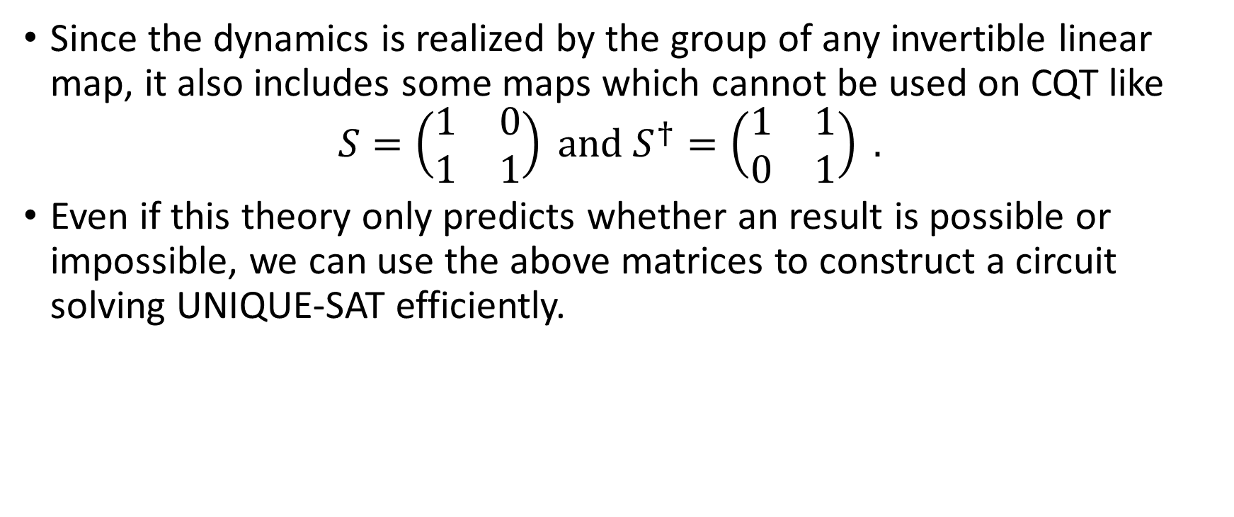
Modal Quantum Theory and Computing Has UNIQUE-SAT algorithm
Since the dynamics is realized by the group of any invertible linear map, it also includes some maps which cannot be used on CQT like $S=\left(\begin{matrix}1 & 0 \\ 1 & 1\end{matrix}\right) \text{and} S^{†}=\left(\begin{matrix}1 & 1 \\ 0 & 1\end{matrix}\right) .$
Even if this theory only predicts whether an result is possible or impossible, we can use the above matrices to construct a circuit solving UNIQUE-SAT efficiently.

Slide 19
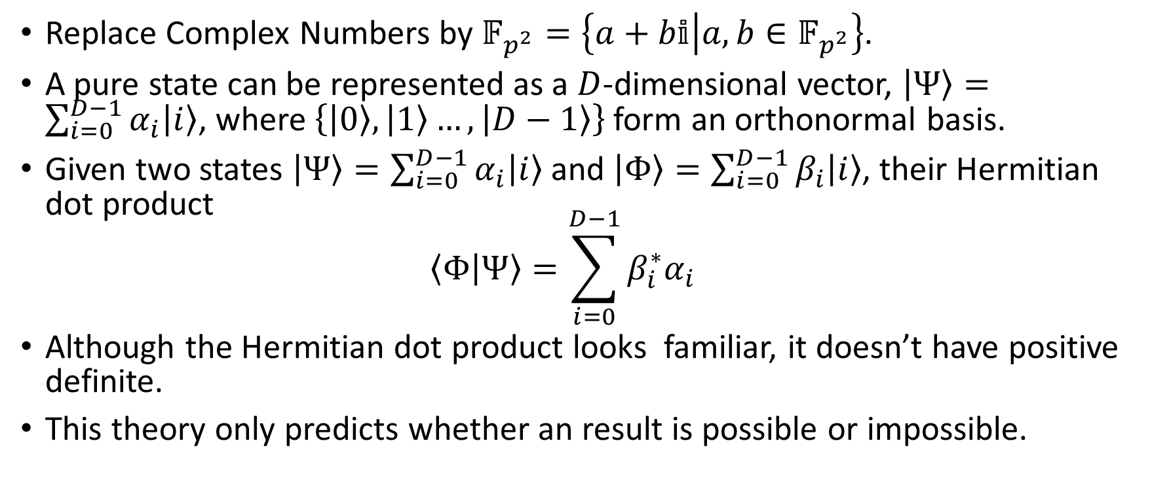
Discrete Quantum Theory I
Replace Complex Numbers by $𝔽_{p^{2}}=\left\{a+b𝕚 | a,b∈𝔽_{p^{2}}\right\}$.
A pure state can be represented as a $D$-dimensional vector, $\left|Ψ\right\rangle =\sum_{i=0}^{D−1}{α_{i}\left|i\right\rangle }$, where $\left\{\left|0\right\rangle ,\left|1\right\rangle …,\left|D−1\right\rangle \right\}$ form an orthonormal basis.
Given two states $\left|Ψ\right\rangle =\sum_{i=0}^{D−1}{α_{i}\left|i\right\rangle }$ and $\left|Φ\right\rangle =\sum_{i=0}^{D−1}{β_{i}\left|i\right\rangle }$, their Hermitian dot product $\left\langle Φ | Ψ\right\rangle =\sum_{i=0}^{D−1}{β_{i}^{∗}α_{i}}$
Although the Hermitian dot product looks familiar, it doesn’t have positive definite.
This theory only predicts whether an result is possible or impossible.

Slide 20
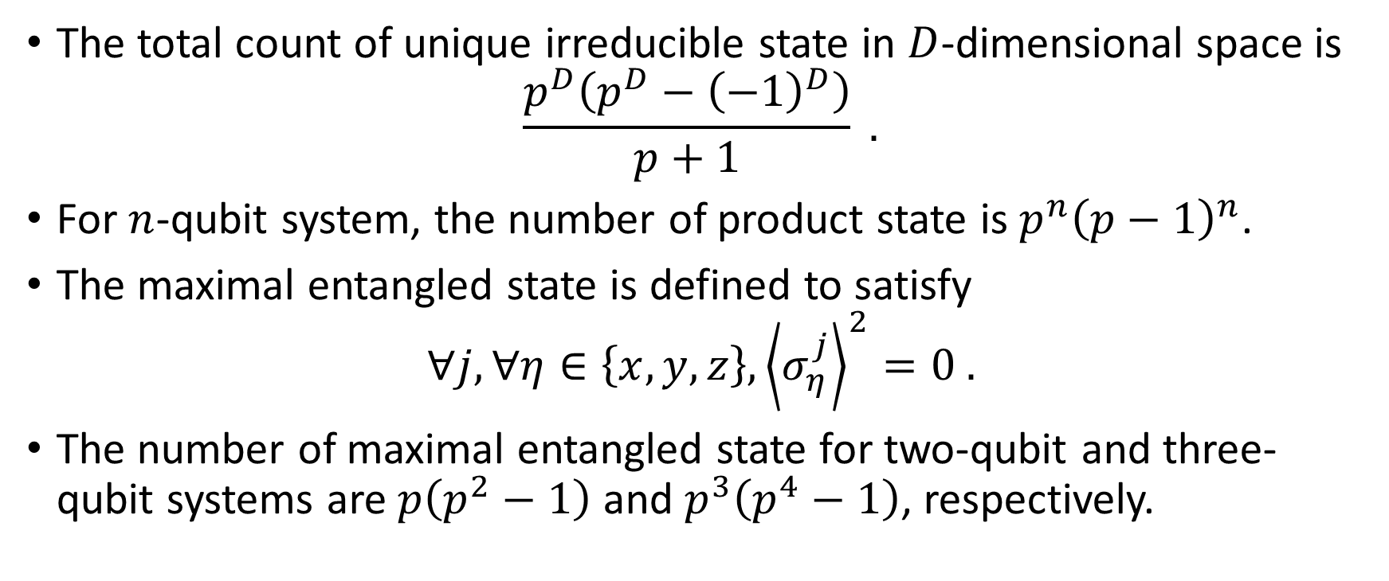
Discrete Quantum Theory I State Counting
The total count of unique irreducible state in $D$-dimensional space is $\frac{p^{D}\left(p^{D}−{\left(−1\right)}^{D}\right)}{p+1} .$
For $n$-qubit system, the number of product state is $p^{n}{\left(p−1\right)}^{n}$.
The maximal entangled state is defined to satisfy $∀j, ∀η∈\left\{x,y,z\right\},{\left\langle σ_{η}^{j}\right\rangle }^{2}=0 .$
The number of maximal entangled state for two-qubit and three-qubit systems are $p\left(p^{2}−1\right)$ and $p^{3}\left(p^{4}−1\right)$, respectively.

Slide 21

Discrete Quantum Computing I
We can express Deutsch’s algorithm.
We may have UNIQUE-SAT algorithm depending on the relation between the prime $p$ and the size of Boolean expression.

