Slide 1
Interval-Valued Quantum Probabilities
Contextuality and the Born Rule

Slide 2
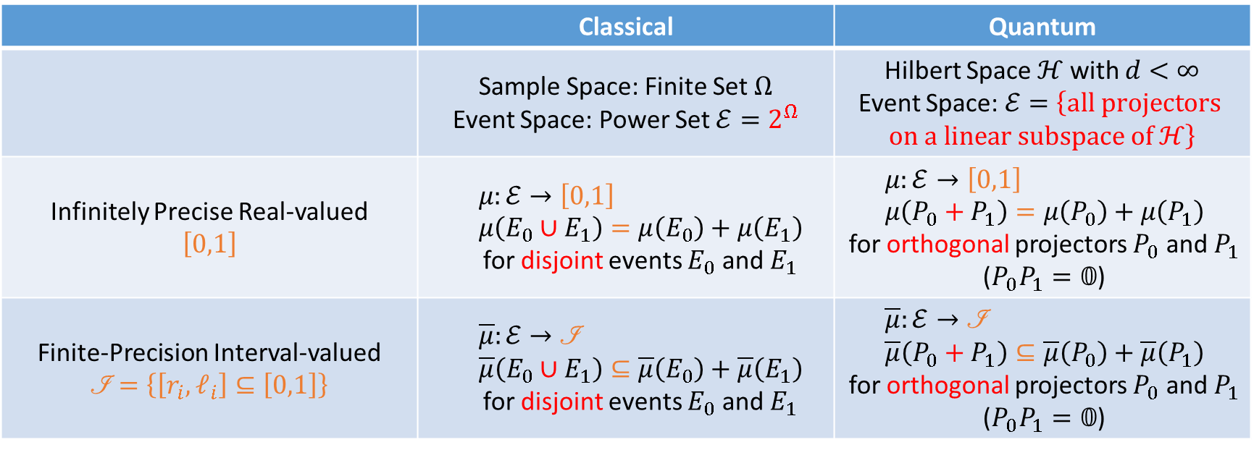
Probability Models (Big Picture)
 | Classical | Quantum
 | Sample Space: Finite Set $Ω$ Event Space: Power Set $ℰ=2^{Ω}$ | Hilbert Space $ℋ$ with $d<∞$ Event Space: $ℰ=\left\{\text{all} \text{projectors} \text{on} \text{a} \text{linear} \text{subspace} \text{of} ℋ\right\}$
Infinitely Precise Real-valued $$\left[0,1\right]$$ | $$μ:ℰ→\left[0,1\right] \\ μ\left(E_{0}∪E_{1}\right)=μ\left(E_{0}\right)+μ\left(E_{1}\right)$$ for disjoint events $E_{0}$ and $E_{1}$ | $$μ:ℰ→\left[0,1\right] \\ μ\left(P_{0}+P_{1}\right)=μ\left(P_{0}\right)+μ\left(P_{1}\right)$$ for orthogonal projectors $P_{0}$ and $P_{1}$ ($P_{0}P_{1}=𝟘$)
Finite-Precision Interval-valued $$\left.ℐ\right.=\left\{\left[r_{i},ℓ_{i}\right]⊆\left[0,1\right]\right\}$$ | $$\overline{μ}:ℰ→\text{ℐ} \\ \overline{μ}\left(E_{0}∪E_{1}\right)⊆\overline{μ}\left(E_{0}\right)+\overline{μ}\left(E_{1}\right)$$ for disjoint events $E_{0}$ and $E_{1}$ | $$\overline{μ}:ℰ→\text{ℐ} \\ \overline{μ}\left(P_{0}+P_{1}\right)⊆\overline{μ}\left(P_{0}\right)+\overline{μ}\left(P_{1}\right)$$ for orthogonal projectors $P_{0}$ and $P_{1}$ ($P_{0}P_{1}=𝟘$)

Slide 3
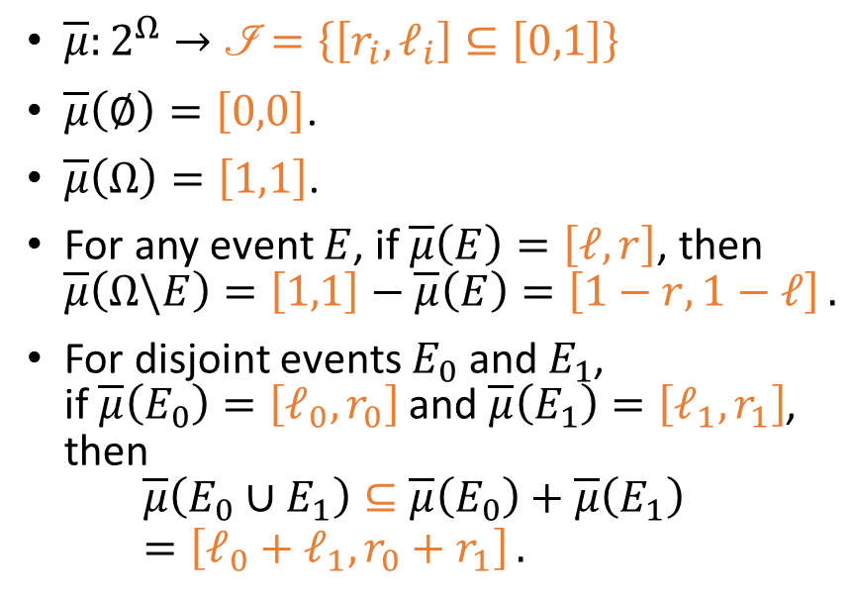
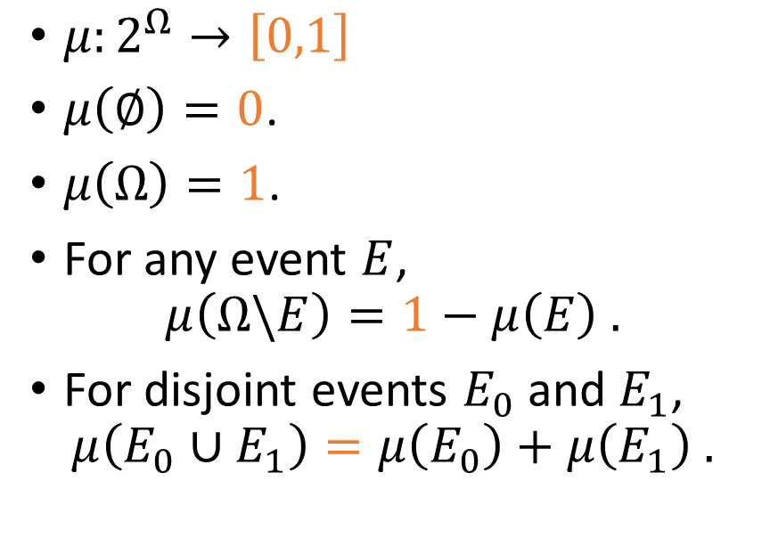
From Infinitely Precise to Finite-Precision
Classical Real-Valued Probability Measure (CRVPM)
Classical Interval-Valued Probability Measure (CIVPM)
$μ:2^{Ω}→\left[0,1\right]$
$μ\left(∅\right)=0$.
$μ\left(Ω\right)=1$.
For any event $E$, $μ\left(Ω\backslash E\right)=1−μ\left(E\right) .$
For disjoint events $E_{0}$ and $E_{1}$, $μ\left(E_{0}∪E_{1}\right)=μ\left(E_{0}\right)+μ\left(E_{1}\right) .$
$\overline{μ}:2^{Ω}→\left.ℐ\right.=\left\{\left[r_{i},ℓ_{i}\right]⊆\left[0,1\right]\right\}$
$\overline{μ}\left(∅\right)=\left[0,0\right]$.
$\overline{μ}\left(Ω\right)=\left[1,1\right]$.
For any event $E$, if $\overline{μ}\left(E\right)=\left[ℓ,r\right]$, then $\overline{μ}\left(Ω\backslash E\right)=\left[1,1\right]−\overline{μ}\left(E\right)=\left[1−r,1−ℓ\right] .$
For disjoint events $E_{0}$ and $E_{1}$, if $\overline{μ}\left(E_{0}\right)=\left[ℓ_{0},r_{0}\right]$ and $\overline{μ}\left(E_{1}\right)=\left[ℓ_{1},r_{1}\right]$, then $\overline{μ}\left(E_{0}∪E_{1}\right)⊆\overline{μ}\left(E_{0}\right)+\overline{μ}\left(E_{1}\right)=\left[ℓ_{0}+ℓ_{1},r_{0}+r_{1}\right] .$

Slide 4
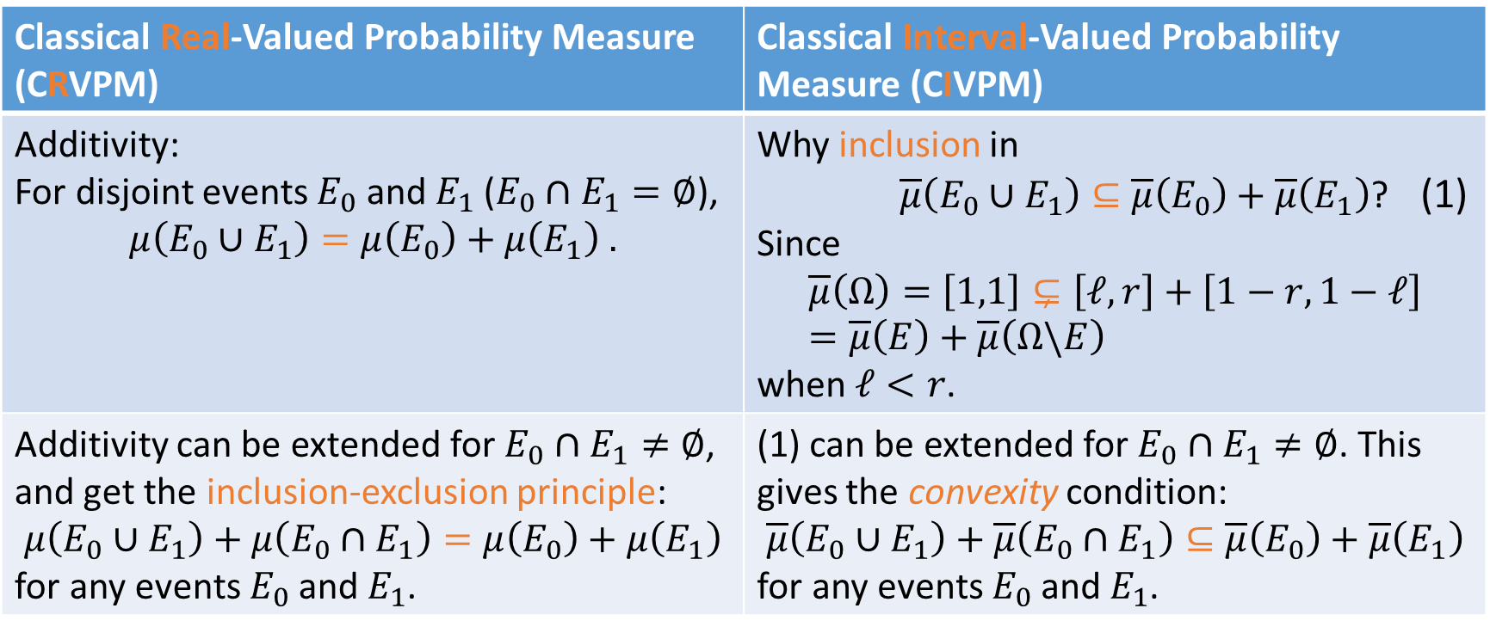
Inclusion and Convexity
Classical Real-Valued Probability Measure (CRVPM) | Classical Interval-Valued Probability Measure (CIVPM)
Additivity: For disjoint events $E_{0}$ and $E_{1}$ ($E_{0}∩E_{1}=∅$), $$μ\left(E_{0}∪E_{1}\right)=μ\left(E_{0}\right)+μ\left(E_{1}\right) .$$ | Why inclusion in $\overline{μ}\left(E_{0}∪E_{1}\right)⊆\overline{μ}\left(E_{0}\right)+\overline{μ}\left(E_{1}\right)$? (1) Since $$\overline{μ}\left(Ω\right)=\left[1,1\right]⊊\left[ℓ,r\right]+\left[1−r,1−ℓ\right]=\overline{μ}\left(E\right)+\overline{μ}\left(Ω\backslash E\right)$$ when $ℓ<r$.
Additivity can be extended for $E_{0}∩E_{1}≠∅$, and get the inclusion-exclusion principle: $$μ\left(E_{0}∪E_{1}\right)+μ\left(E_{0}∩E_{1}\right)=μ\left(E_{0}\right)+μ\left(E_{1}\right)$$ for any events $E_{0}$ and $E_{1}$. | (1) can be extended for $E_{0}∩E_{1}≠∅$. This gives the convexity condition: $$\overline{μ}\left(E_{0}∪E_{1}\right)+\overline{μ}\left(E_{0}∩E_{1}\right)⊆\overline{μ}\left(E_{0}\right)+\overline{μ}\left(E_{1}\right)$$ for any events $E_{0}$ and $E_{1}$.

Slide 5
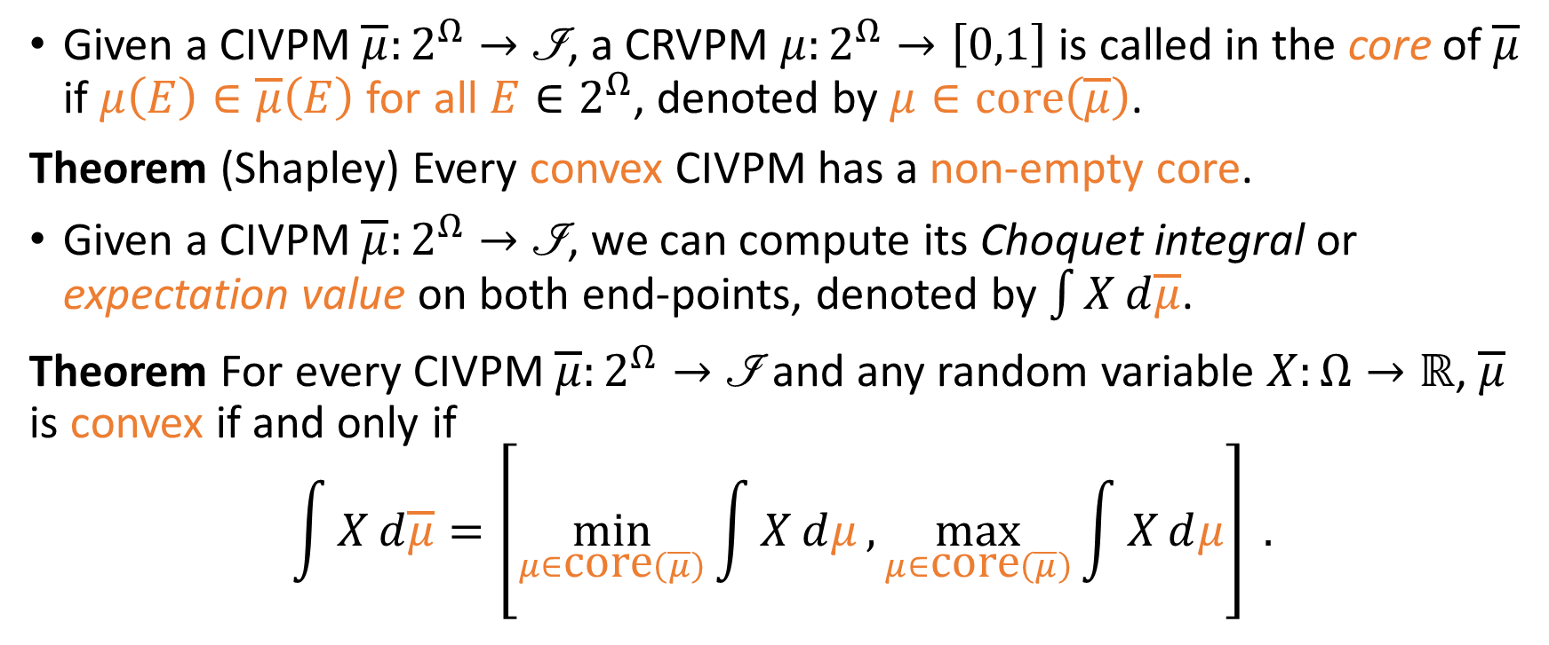
Convexity and Core
Given a CIVPM $\overline{μ}:2^{Ω}→\left.ℐ\right.$, a CRVPM $μ:2^{Ω}→\left[0,1\right]$ is called in the core of $\overline{μ}$ if $μ\left(E\right)∈\overline{μ}\left(E\right)$ for all $E∈2^{Ω}$, denoted by $μ∈\text{core}\left(\overline{μ}\right)$.
Theorem (Shapley) Every convex CIVPM has a non-empty core.
Given a CIVPM $\overline{μ}:2^{Ω}→\left.ℐ\right.$, we can compute its Choquet integral or expectation value on both end-points, denoted by $\int{X}ⅆ\overline{μ}$.
Theorem For every CIVPM $\overline{μ}:2^{Ω}→\left.ℐ\right.$ and any random variable $X:Ω→ℝ$, $\overline{μ}$ is convex if and only if $$\int{X}ⅆ\overline{μ}=\left[\min_{μ∈\text{core}\left(\overline{μ}\right)}{\int{X}ⅆμ},\max_{μ∈\text{core}\left(\overline{μ}\right)}{\int{X}ⅆμ}\right] .$$

Slide 6
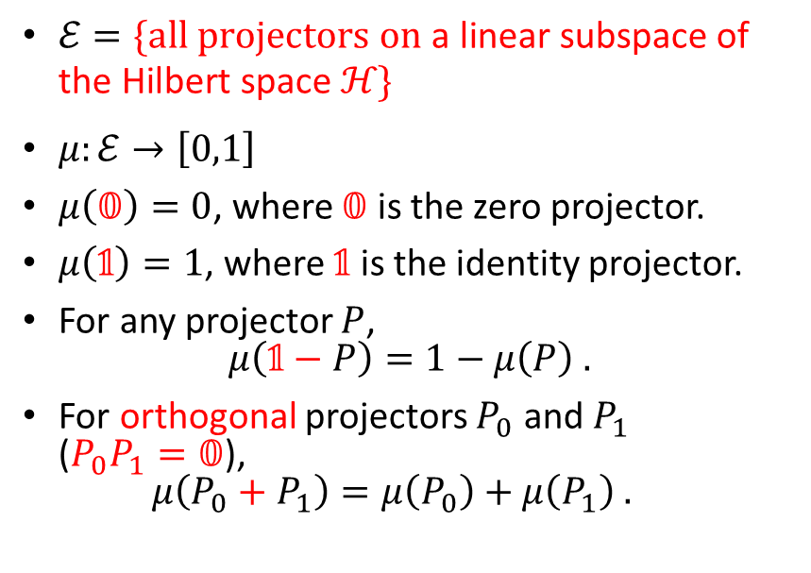
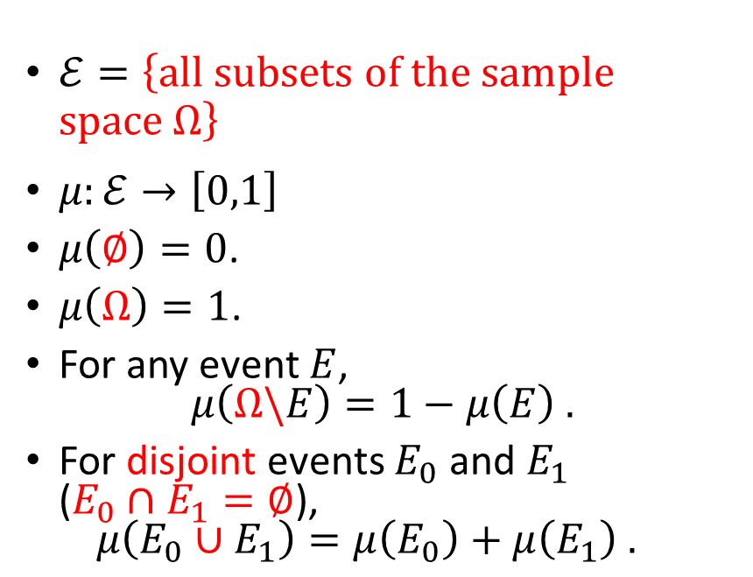
From Classical to Quantum
Classical Real-Valued Probability Measure (CRVPM)
Quantum Real-Valued Probability Measure (QRVPM)
$ℰ=\left\{\text{all} \text{subsets} \text{of} \text{the} \text{sample} \text{space} Ω\right\}$
$μ:ℰ→\left[0,1\right]$
$μ\left(∅\right)=0$.
$μ\left(Ω\right)=1$.
For any event $E$, $μ\left(Ω\backslash E\right)=1−μ\left(E\right) .$
For disjoint events $E_{0}$ and $E_{1}$ ($E_{0}∩E_{1}=∅$), $μ\left(E_{0}∪E_{1}\right)=μ\left(E_{0}\right)+μ\left(E_{1}\right) .$
$ℰ=\{\text{all} \text{projectors} \text{on} \text{a} \text{linear} \text{subspace} \text{of} \text{the} \text{Hilbert} \text{space} ℋ\}$
$μ:ℰ→\left[0,1\right]$
$μ\left(𝟘\right)=0$, where $𝟘$ is the zero projector.
$μ\left(𝟙\right)=1$, where $𝟙$ is the identity projector.
For any projector $P$, $μ\left(𝟙−P\right)=1−μ\left(P\right) .$
For orthogonal projectors $P_{0}$ and $P_{1}$ ($P_{0}P_{1}=𝟘$), $μ\left(P_{0}+P_{1}\right)=μ\left(P_{0}\right)+μ\left(P_{1}\right) .$

Slide 7
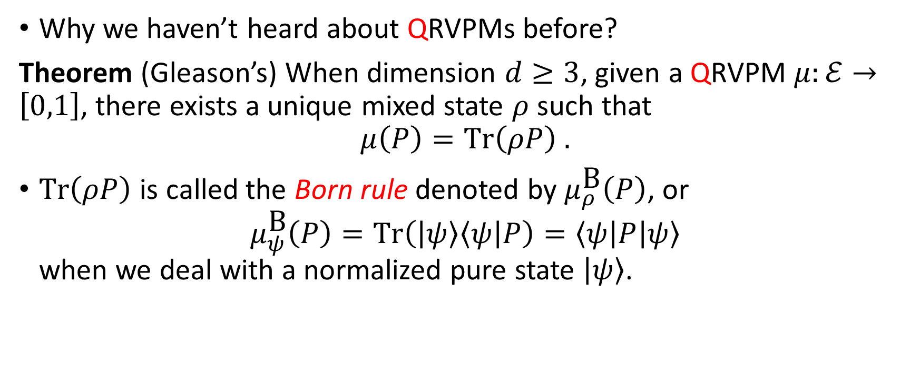
Gleason’s Theorem and the Born Rule
Why we haven’t heard about QRVPMs before?
Theorem (Gleason’s) When dimension $d≥3$, given a QRVPM $μ:ℰ→\left[0,1\right]$, there exists a unique mixed state $ρ$ such that $$μ\left(P\right)=\text{Tr}\left(ρP\right) .$$
$\text{Tr}\left(ρP\right)$ is called the Born rule denoted by $μ_{ρ}^{\text{B}}\left(P\right)$, or $μ_{ψ}^{\text{B}}\left(P\right)=\text{Tr}\left(\left|ψ\right\rangle \left\langle ψ\right|P\right)=\left\langle ψ\right|P\left|ψ\right\rangle$ when we deal with a normalized pure state $\left|ψ\right\rangle$.

Slide 8

Probability Models (Big Picture)
 | Classical | Quantum
 | Sample Space: Finite Set $Ω$ Event Space: Power Set $ℰ=2^{Ω}$ | Hilbert Space $ℋ$ with $d<∞$ Event Space: $ℰ=\left\{\text{all} \text{projectors} \text{on} \text{a} \text{linear} \text{subspace} \text{of} ℋ\right\}$
Infinitely Precise Real-valued $$\left[0,1\right]$$ | $$μ:ℰ→\left[0,1\right] \\ μ\left(E_{0}∪E_{1}\right)=μ\left(E_{0}\right)+μ\left(E_{1}\right)$$ for disjoint events $E_{0}$ and $E_{1}$ | $$μ:ℰ→\left[0,1\right] \\ μ\left(P_{0}+P_{1}\right)=μ\left(P_{0}\right)+μ\left(P_{1}\right)$$ for orthogonal projectors $P_{0}$ and $P_{1}$ ($P_{0}P_{1}=𝟘$)
Finite-Precision Interval-valued $$\left.ℐ\right.=\left\{\left[r_{i},ℓ_{i}\right]⊆\left[0,1\right]\right\}$$ | $$\overline{μ}:ℰ→\text{ℐ} \\ \overline{μ}\left(E_{0}∪E_{1}\right)⊆\overline{μ}\left(E_{0}\right)+\overline{μ}\left(E_{1}\right)$$ for disjoint events $E_{0}$ and $E_{1}$ | $$\overline{μ}:ℰ→\text{ℐ} \\ \overline{μ}\left(P_{0}+P_{1}\right)⊆\overline{μ}\left(P_{0}\right)+\overline{μ}\left(P_{1}\right)$$ for orthogonal projectors $P_{0}$ and $P_{1}$ ($P_{0}P_{1}=𝟘$)

Slide 9
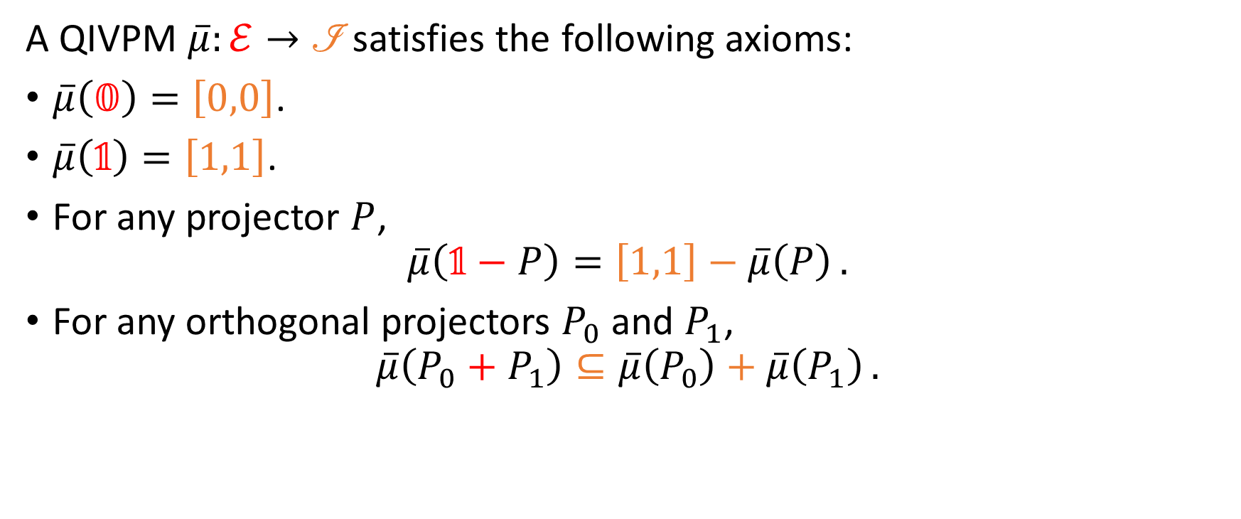
Quantum Interval-Valued Probability Measure (QIVPM)
A QIVPM $\overline{μ}:ℰ→\text{ℐ}$ satisfies the following axioms:
$\overline{μ}\left(𝟘\right)=\left[0,0\right]$.
$\overline{μ}\left(𝟙\right)=\left[1,1\right]$.
For any projector $P$, $\overline{μ}\left(𝟙−P\right)=\left[1,1\right]−\overline{μ}\left(P\right) .$
For any orthogonal projectors $P_{0}$ and $P_{1}$, $\overline{μ}\left(P_{0}+P_{1}\right)⊆\overline{μ}\left(P_{0}\right)+\overline{μ}\left(P_{1}\right) .$
Notes:
XITS font is required to display Formal Script (\mathscr) font correctly.
https://www.ctan.org/tex-archive/fonts/xits/

Slide 10
Our Main Questions
Can we define convexity and core for QIVPM?
Does a convex QIVPM have a nonempty core and a expectation value?
Can we define a Born rule for QIVPM?
Can we have Gleason’s theorem for QIVPM?
Can we recover QRVPM and CIVPM as a special case of QIVPM?
Since there is a tension between finite precision measurement and contextuality, can we have a Kochen-Specker theorem for QIVPM?

Slide 11
Recover QRVPM and CIVPM as a special case of QIVPM

Slide 12

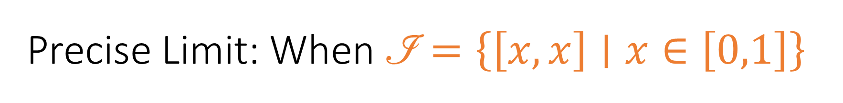

Precise Limit: When $\left.ℐ\right.=\left\{\left[x,x\right]∣x∈\left[0,1\right]\right\}$
Quantum Real-Valued Probability Measure (QRVPM)
Quantum Interval-Valued Probability Measure (QIVPM)
$μ:2^{Ω}→\left[0,1\right]$
The Born rule and Gleason’s theorem are applied.
$\overline{μ}:2^{Ω}→\left.ℐ\right.=\left\{\left[x,x\right]∣x∈\left[0,1\right]\right\}$
The Born rule and Gleason’s theorem are applied.
One-to-one correspondence

Slide 13
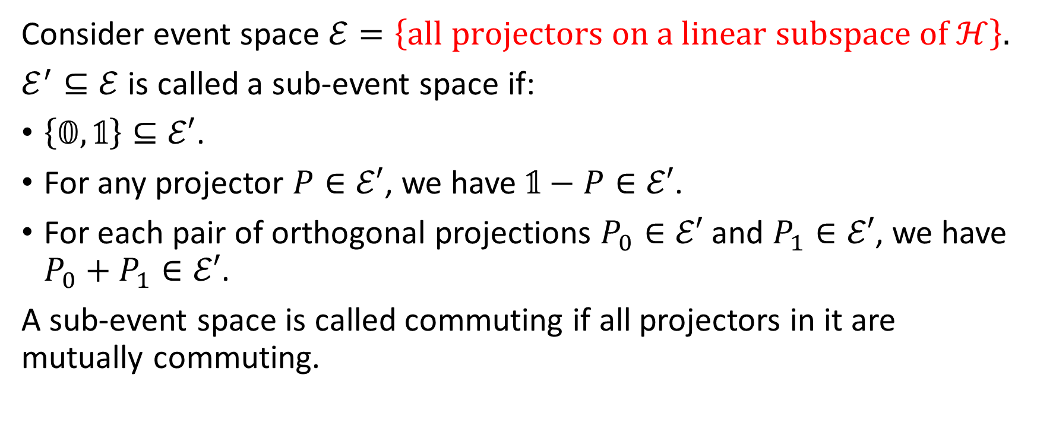
Classical Limit: On a commuting sub-event space
Consider event space $ℰ=\left\{\text{all} \text{projectors} \text{on} \text{a} \text{linear} \text{subspace} \text{of} ℋ\right\}$.
$ℰ^{′}⊆ℰ$ is called a sub-event space if:
$\left\{𝟘,𝟙\right\}⊆ℰ′$.
For any projector $P∈ℰ′$, we have $𝟙−P∈ℰ′$.
For each pair of orthogonal projections $P_{0}∈ℰ′$ and $P_{1}∈ℰ′$, we have $P_{0}+P_{1}∈ℰ′$.
A sub-event space is called commuting if all projectors in it are mutually commuting.

Slide 14
Convexity, core, and Gleason’s theorem
Yes, we can define convexity. We then unify the idea of core and Gleason’s theorem into the states consistent with a QIVPM.

Slide 15
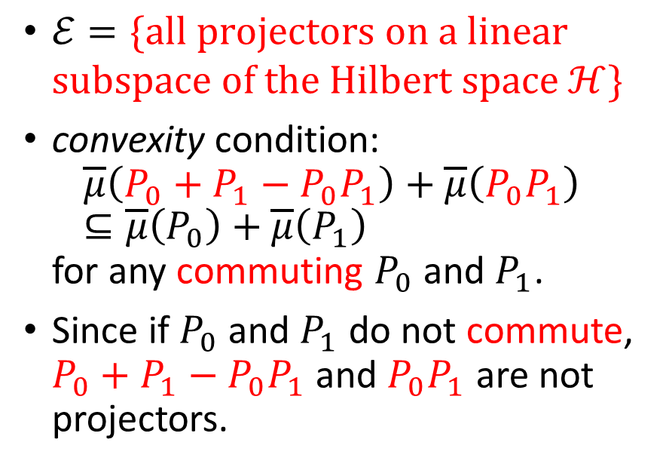
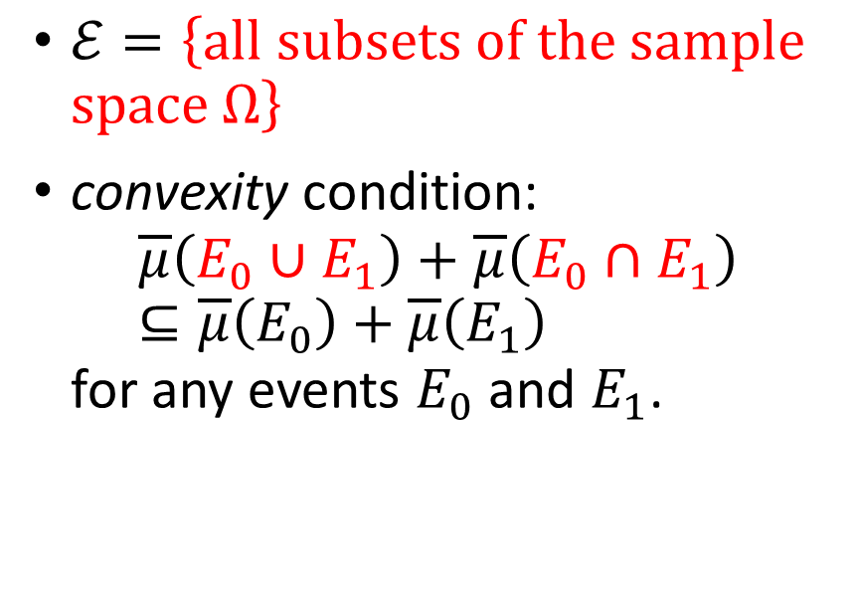
Convexity
Classical Interval-Valued Probability Measure (CIVPM)
Quantum Interval-Valued Probability Measure (QIVPM)
$ℰ=\left\{\text{all} \text{subsets} \text{of} \text{the} \text{sample} \text{space} Ω\right\}$
convexity condition: $\overline{μ}\left(E_{0}∪E_{1}\right)+\overline{μ}\left(E_{0}∩E_{1}\right)⊆\overline{μ}\left(E_{0}\right)+\overline{μ}\left(E_{1}\right)$ for any events $E_{0}$ and $E_{1}$.
$ℰ=\{\text{all} \text{projectors} \text{on} \text{a} \text{linear} \text{subspace} \text{of} \text{the} \text{Hilbert} \text{space} ℋ\}$
convexity condition: $\overline{μ}\left(P_{0}+P_{1}−P_{0}P_{1}\right)+\overline{μ}\left(P_{0}P_{1}\right)⊆\overline{μ}\left(P_{0}\right)+\overline{μ}\left(P_{1}\right)$ for any commuting $P_{0}$ and $P_{1}$.
Since if $P_{0}$ and $P_{1}$ do not commute, $P_{0}+P_{1}−P_{0}P_{1}$ and $P_{0}P_{1}$ are not projectors.

Slide 16
Expectation Value
Yes, a convex QIVPM has an expectation value.

Slide 17
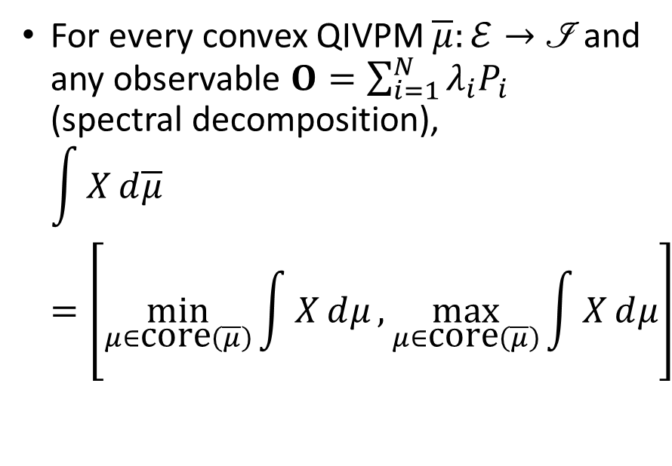
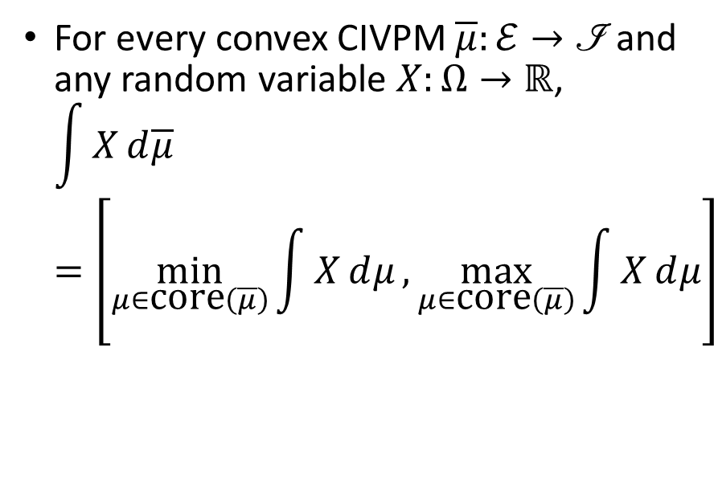
Expectation Value
Classical Interval-Valued Probability Measure (CIVPM)
Quantum Interval-Valued Probability Measure (QIVPM)
For every convex CIVPM $\overline{μ}:ℰ→\left.ℐ\right.$ and any random variable $X:Ω→ℝ$, $\int{X}ⅆ\overline{μ}=\left[\min_{μ∈\text{core}\left(\overline{μ}\right)}{\int{X}ⅆμ},\max_{μ∈\text{core}\left(\overline{μ}\right)}{\int{X}ⅆμ}\right]$
For every convex QIVPM $\overline{μ}:ℰ→\left.ℐ\right.$ and any observable $O=\sum_{i=1}^{N}{λ_{i}P_{i}}$ (spectral decomposition), $\int{X}ⅆ\overline{μ}=\left[\min_{μ∈\text{core}\left(\overline{μ}\right)}{\int{X}ⅆμ},\max_{μ∈\text{core}\left(\overline{μ}\right)}{\int{X}ⅆμ}\right]$

Slide 18
Kochen-Specker Theorem with Finite Precision Measurement
Yes, the Kochen-Specker Theorem still works even consider finite precision measurement modelled by QIVPM.

Slide 19
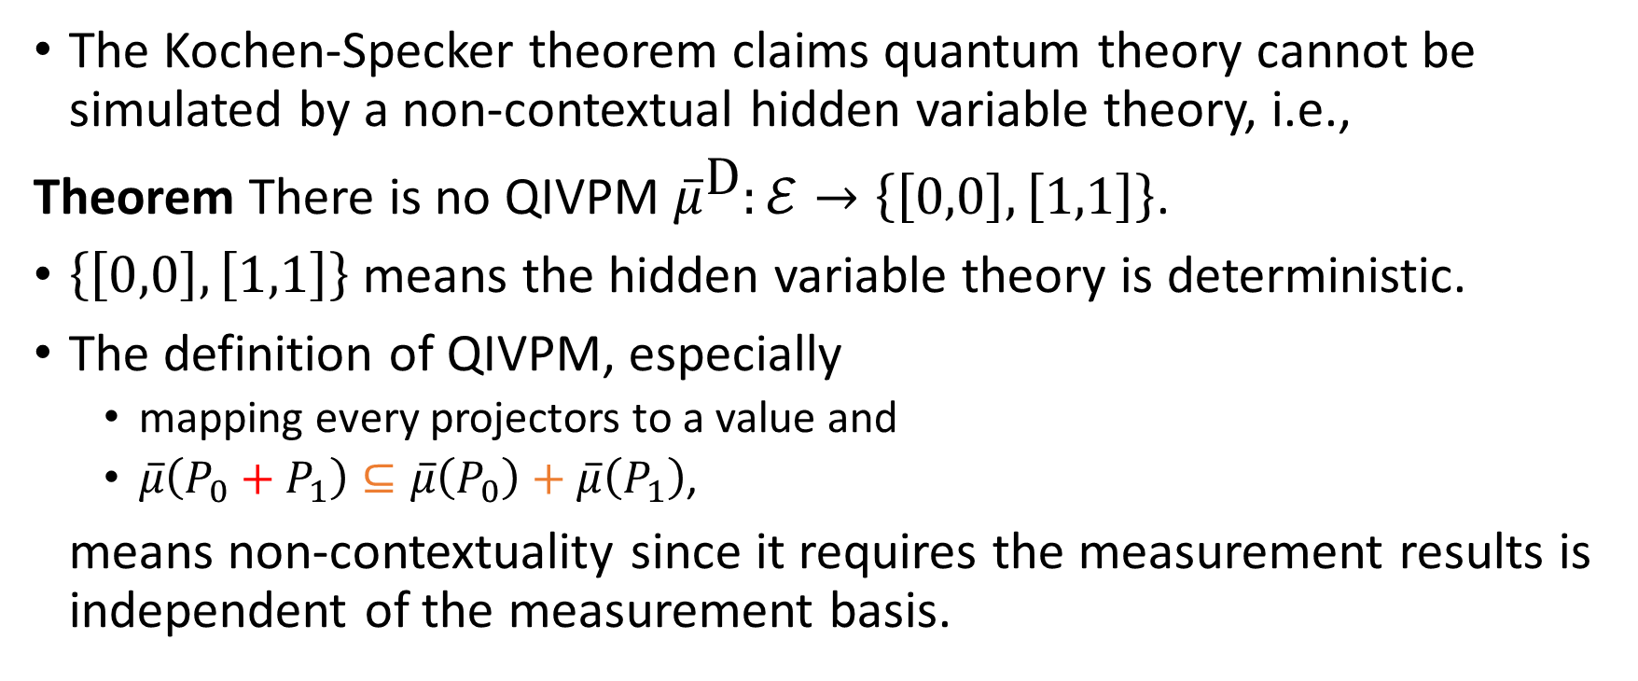
Kochen-Specker Theorem
The Kochen-Specker theorem claims quantum theory cannot be simulated by a non-contextual hidden variable theory, i.e.,
Theorem There is no QIVPM ${\overline{μ}}^{\text{D}}:ℰ→\left\{\left[0,0\right],\left[1,1\right]\right\}$.
$\left\{\left[0,0\right],\left[1,1\right]\right\}$ means the hidden variable theory is deterministic.
The definition of QIVPM, especially
mapping every projectors to a value and
$\overline{μ}\left(P_{0}+P_{1}\right)⊆\overline{μ}\left(P_{0}\right)+\overline{μ}\left(P_{1}\right)$,
means non-contextuality since it requires the measurement results is independent of the measurement basis.

Slide 20
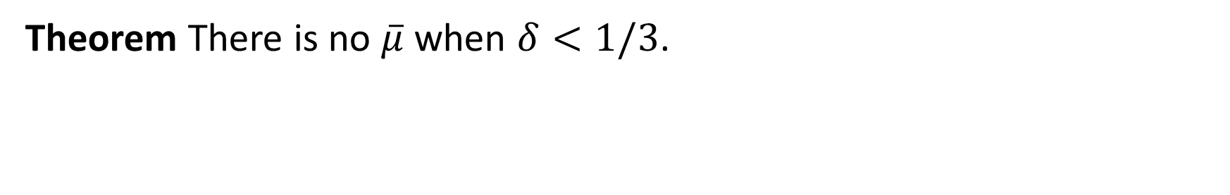
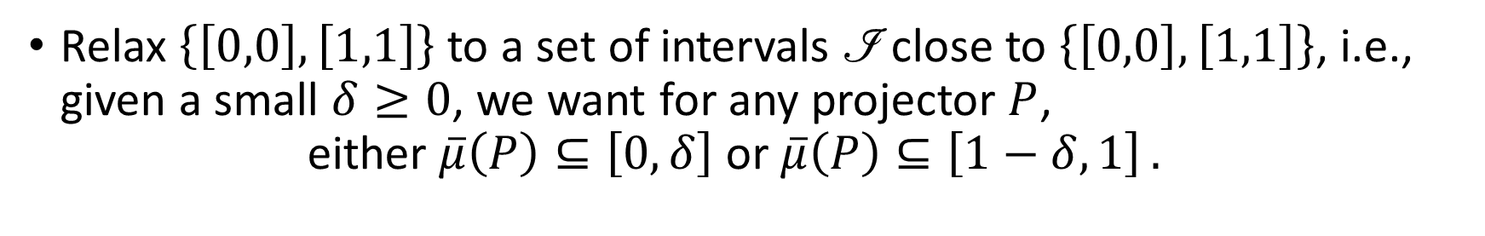
Finite Precision Measurement
Relax $\left\{\left[0,0\right],\left[1,1\right]\right\}$ to a set of intervals $\text{ℐ}$ close to $\left\{\left[0,0\right],\left[1,1\right]\right\}$, i.e., given a small $δ≥0$, we want for any projector $P$, $\text{either} \overline{μ}\left(P\right)⊆\left[0,δ\right] \text{or} \overline{μ}\left(P\right)⊆\left[1−δ,1\right] .$
Kochen-Specker Theorem with Finite Precision Measurement
Theorem There is no $\overline{μ}$ when $δ<1/3$.

Slide 21
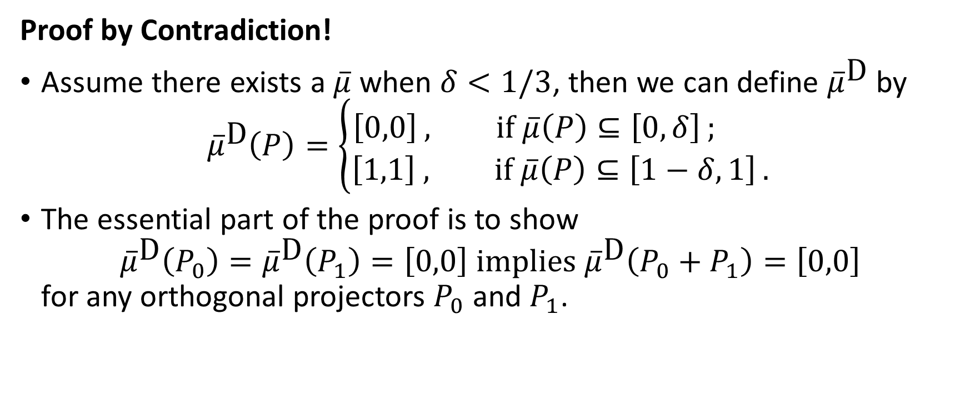
Kochen-Specker Theorem with Finite Precision Measurement
Proof by Contradiction!
Assume there exists a $\overline{μ}$ when $δ<1/3$, then we can define ${\overline{μ}}^{\text{D}}$ by ${\overline{μ}}^{\text{D}}\left(P\right)=\left\{\begin{aligned}\left[0,0\right] , \text{if} \overline{μ}\left(P\right)⊆\left[0,δ\right] ; \\ &\left[1,1\right] , \text{if} \overline{μ}\left(P\right)⊆\left[1−δ,1\right] .\end{aligned}\right.$
The essential part of the proof is to show ${\overline{μ}}^{\text{D}}\left(P_{0}\right)={\overline{μ}}^{\text{D}}\left(P_{1}\right)=\left[0,0\right] \text{implies} {\overline{μ}}^{\text{D}}\left(P_{0}+P_{1}\right)=\left[0,0\right]$ for any orthogonal projectors $P_{0}$ and $P_{1}$.

Slide 22

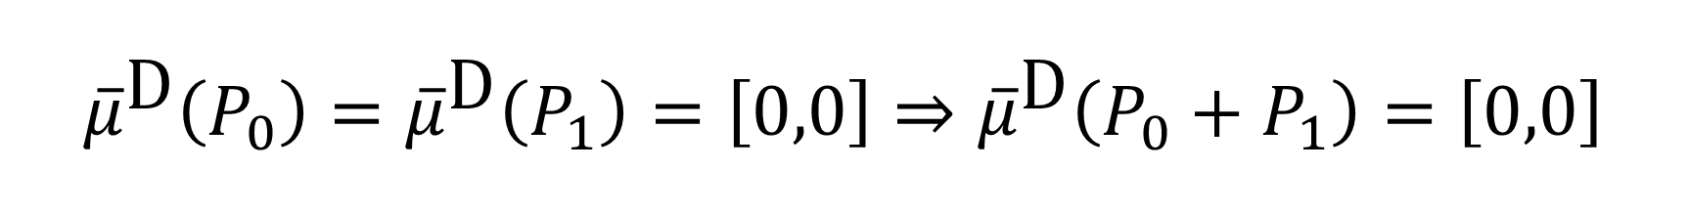







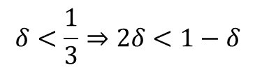
$${\overline{μ}}^{\text{D}}\left(P_{0}\right)={\overline{μ}}^{\text{D}}\left(P_{1}\right)=\left[0,0\right]⇒{\overline{μ}}^{\text{D}}\left(P_{0}+P_{1}\right)=\left[0,0\right]$$
$${\overline{μ}}^{\text{D}}\left(P_{0}\right)={\overline{μ}}^{\text{D}}\left(P_{1}\right)=\left[0,0\right] \\ ⇒\overline{μ}\left(P_{0}\right)⊆\left[0,δ\right] \text{and} \overline{μ}\left(P_{1}\right)⊆\left[0,δ\right] \\ ⇒\overline{μ}\left(P_{0}+P_{1}\right)⊆\left[0,2δ\right]$$
$\overline{μ}\left(P_{0}+P_{1}\right)$ is in this area
$$1−δ$$
$$1$$
$$0$$
$$δ$$
$$2δ$$
$$δ<\frac{1}{3}⇒2δ<1−δ$$
$\overline{μ}\left(P_{0}+P_{1}\right)$ should be in either one of these areas
$$∴\overline{μ}\left(P_{0}+P_{1}\right)⊆\left[0,δ\right] \\ ⇒{\overline{μ}}^{\text{D}}\left(P_{0}+P_{1}\right)=\left[0,0\right]$$

