Slide 1
Quantum Interval-Valued Probabilities
Contextuality and the Born Rule

Slide 2
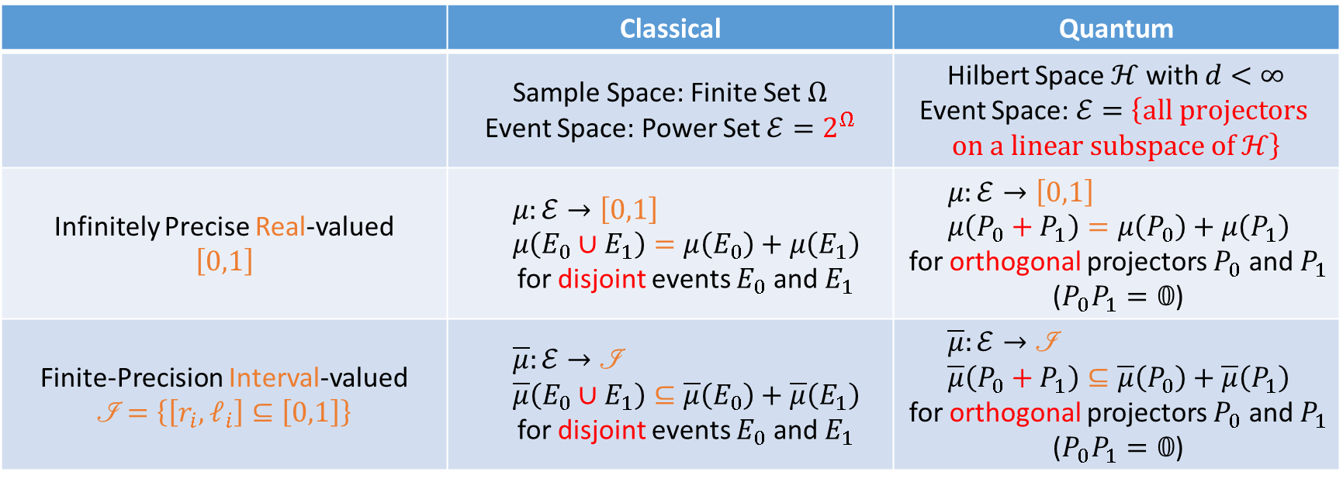
Probability Models (Big Picture)
 | Classical | Quantum
 | Sample Space: Finite Set $Ω$ Event Space: Power Set $ℰ=2^{Ω}$ | Hilbert Space $ℋ$ with $d<∞$ Event Space: $ℰ=\left\{\text{all} \text{projectors} \text{on} \text{a} \text{linear} \text{subspace} \text{of} ℋ\right\}$
Infinitely Precise Real-valued $$\left[0,1\right]$$ | $$μ:ℰ→\left[0,1\right] \\ μ\left(E_{0}∪E_{1}\right)=μ\left(E_{0}\right)+μ\left(E_{1}\right)$$ for disjoint events $E_{0}$ and $E_{1}$ | $$μ:ℰ→\left[0,1\right] \\ μ\left(P_{0}+P_{1}\right)=μ\left(P_{0}\right)+μ\left(P_{1}\right)$$ for orthogonal projectors $P_{0}$ and $P_{1}$ ($P_{0}P_{1}=𝟘$)
Finite-Precision Interval-valued $$\left.ℐ\right.=\left\{\left[r_{i},ℓ_{i}\right]⊆\left[0,1\right]\right\}$$ | $$\overline{μ}:ℰ→\text{ℐ} \\ \overline{μ}\left(E_{0}∪E_{1}\right)⊆\overline{μ}\left(E_{0}\right)+\overline{μ}\left(E_{1}\right)$$ for disjoint events $E_{0}$ and $E_{1}$ | $$\overline{μ}:ℰ→\text{ℐ} \\ \overline{μ}\left(P_{0}+P_{1}\right)⊆\overline{μ}\left(P_{0}\right)+\overline{μ}\left(P_{1}\right)$$ for orthogonal projectors $P_{0}$ and $P_{1}$ ($P_{0}P_{1}=𝟘$)

Slide 3
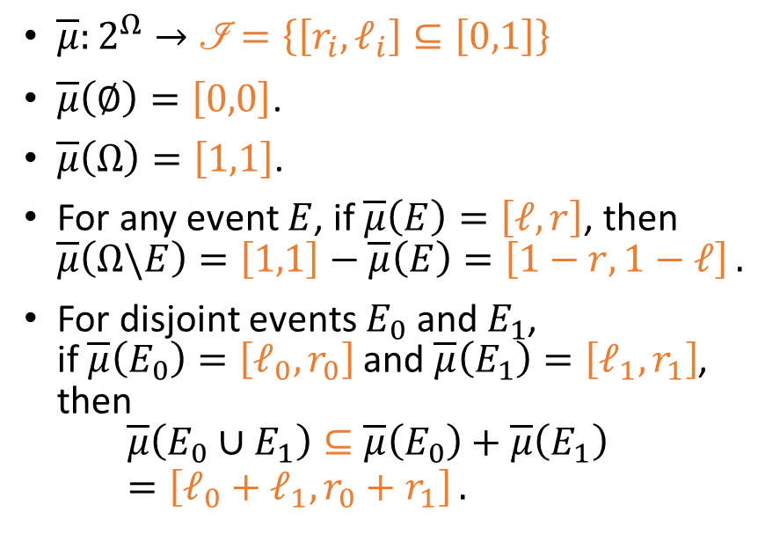
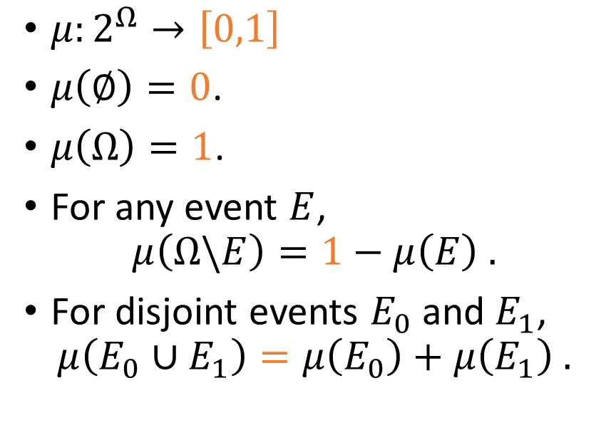
From Infinitely Precise to Finite-Precision
Classical Real-Valued Probability Measure (CRVPM)
Classical Interval-Valued Probability Measure (CIVPM)
$μ:2^{Ω}→\left[0,1\right]$
$μ\left(∅\right)=0$.
$μ\left(Ω\right)=1$.
For any event $E$, $μ\left(Ω\backslash E\right)=1−μ\left(E\right) .$
For disjoint events $E_{0}$ and $E_{1}$, $μ\left(E_{0}∪E_{1}\right)=μ\left(E_{0}\right)+μ\left(E_{1}\right) .$
$\overline{μ}:2^{Ω}→\left.ℐ\right.=\left\{\left[r_{i},ℓ_{i}\right]⊆\left[0,1\right]\right\}$
$\overline{μ}\left(∅\right)=\left[0,0\right]$.
$\overline{μ}\left(Ω\right)=\left[1,1\right]$.
For any event $E$, if $\overline{μ}\left(E\right)=\left[ℓ,r\right]$, then $\overline{μ}\left(Ω\backslash E\right)=\left[1,1\right]−\overline{μ}\left(E\right)=\left[1−r,1−ℓ\right] .$
For disjoint events $E_{0}$ and $E_{1}$, if $\overline{μ}\left(E_{0}\right)=\left[ℓ_{0},r_{0}\right]$ and $\overline{μ}\left(E_{1}\right)=\left[ℓ_{1},r_{1}\right]$, then $\overline{μ}\left(E_{0}∪E_{1}\right)⊆\overline{μ}\left(E_{0}\right)+\overline{μ}\left(E_{1}\right)=\left[ℓ_{0}+ℓ_{1},r_{0}+r_{1}\right] .$

Slide 4
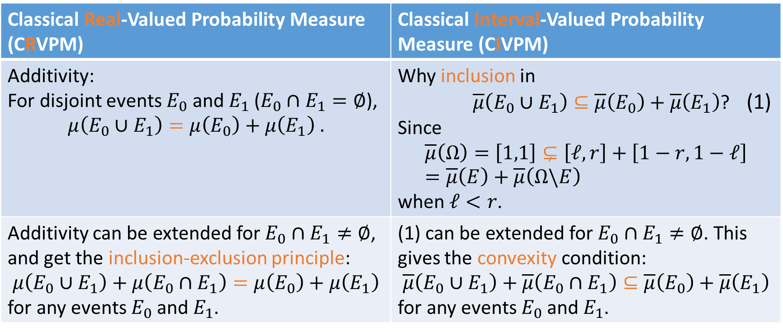
Inclusion and Convexity
Classical Real-Valued Probability Measure (CRVPM) | Classical Interval-Valued Probability Measure (CIVPM)
Additivity: For disjoint events $E_{0}$ and $E_{1}$ ($E_{0}∩E_{1}=∅$), $$μ\left(E_{0}∪E_{1}\right)=μ\left(E_{0}\right)+μ\left(E_{1}\right) .$$ | Why inclusion in $\overline{μ}\left(E_{0}∪E_{1}\right)⊆\overline{μ}\left(E_{0}\right)+\overline{μ}\left(E_{1}\right)$? (1) Since $$\overline{μ}\left(Ω\right)=\left[1,1\right]⊊\left[ℓ,r\right]+\left[1−r,1−ℓ\right]=\overline{μ}\left(E\right)+\overline{μ}\left(Ω\backslash E\right)$$ when $ℓ<r$.
Additivity can be extended for $E_{0}∩E_{1}≠∅$, and get the inclusion-exclusion principle: $$μ\left(E_{0}∪E_{1}\right)+μ\left(E_{0}∩E_{1}\right)=μ\left(E_{0}\right)+μ\left(E_{1}\right)$$ for any events $E_{0}$ and $E_{1}$. | (1) can be extended for $E_{0}∩E_{1}≠∅$. This gives the convexity condition: $$\overline{μ}\left(E_{0}∪E_{1}\right)+\overline{μ}\left(E_{0}∩E_{1}\right)⊆\overline{μ}\left(E_{0}\right)+\overline{μ}\left(E_{1}\right)$$ for any events $E_{0}$ and $E_{1}$.

Slide 5
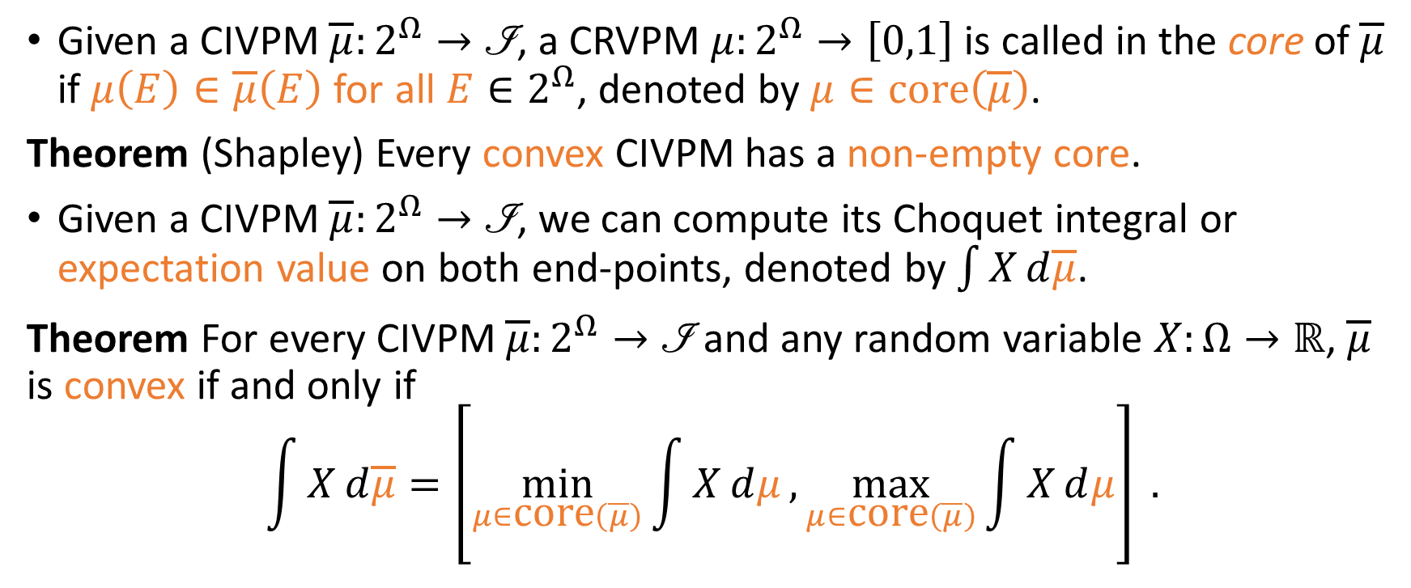
Convexity and Core
Given a CIVPM $\overline{μ}:2^{Ω}→\left.ℐ\right.$, a CRVPM $μ:2^{Ω}→\left[0,1\right]$ is called in the core of $\overline{μ}$ if $μ\left(E\right)∈\overline{μ}\left(E\right)$ for all $E∈2^{Ω}$, denoted by $μ∈\text{core}\left(\overline{μ}\right)$.
Theorem (Shapley) Every convex CIVPM has a non-empty core.
Given a CIVPM $\overline{μ}:2^{Ω}→\left.ℐ\right.$, we can compute its Choquet integral or expectation value on both end-points, denoted by $\int{X}ⅆ\overline{μ}$.
Theorem For every CIVPM $\overline{μ}:2^{Ω}→\left.ℐ\right.$ and any random variable $X:Ω→ℝ$, $\overline{μ}$ is convex if and only if $$\int{X}ⅆ\overline{μ}=\left[\min_{μ∈\text{core}\left(\overline{μ}\right)}{\int{X}ⅆμ},\max_{μ∈\text{core}\left(\overline{μ}\right)}{\int{X}ⅆμ}\right] .$$

Slide 6
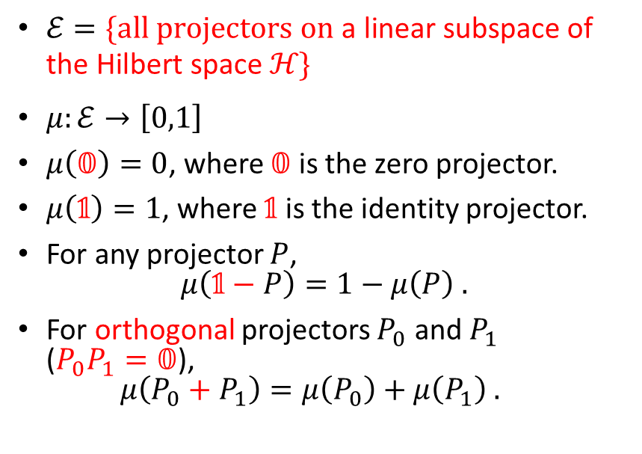
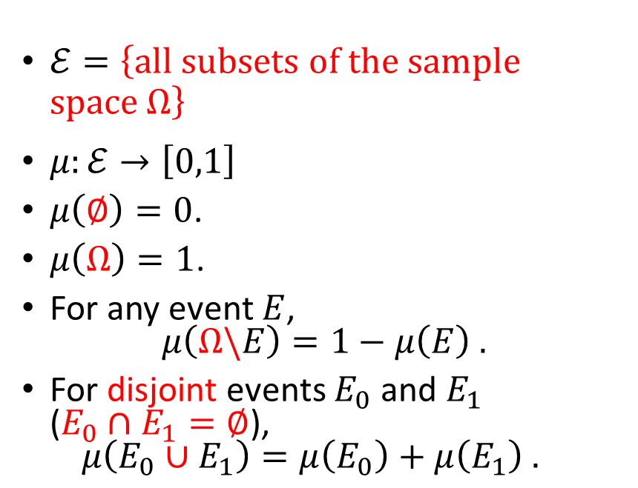
From Classical to Quantum
Classical Real-Valued Probability Measure (CRVPM)
Quantum Real-Valued Probability Measure (QRVPM)
$ℰ=\left\{\text{all} \text{subsets} \text{of} \text{the} \text{sample} \text{space} Ω\right\}$
$μ:ℰ→\left[0,1\right]$
$μ\left(∅\right)=0$.
$μ\left(Ω\right)=1$.
For any event $E$, $μ\left(Ω\backslash E\right)=1−μ\left(E\right) .$
For disjoint events $E_{0}$ and $E_{1}$ ($E_{0}∩E_{1}=∅$), $μ\left(E_{0}∪E_{1}\right)=μ\left(E_{0}\right)+μ\left(E_{1}\right) .$
$ℰ=\{\text{all} \text{projectors} \text{on} \text{a} \text{linear} \text{subspace} \text{of} \text{the} \text{Hilbert} \text{space} ℋ\}$
$μ:ℰ→\left[0,1\right]$
$μ\left(𝟘\right)=0$, where $𝟘$ is the zero projector.
$μ\left(𝟙\right)=1$, where $𝟙$ is the identity projector.
For any projector $P$, $μ\left(𝟙−P\right)=1−μ\left(P\right) .$
For orthogonal projectors $P_{0}$ and $P_{1}$ ($P_{0}P_{1}=𝟘$), $μ\left(P_{0}+P_{1}\right)=μ\left(P_{0}\right)+μ\left(P_{1}\right) .$

Slide 7
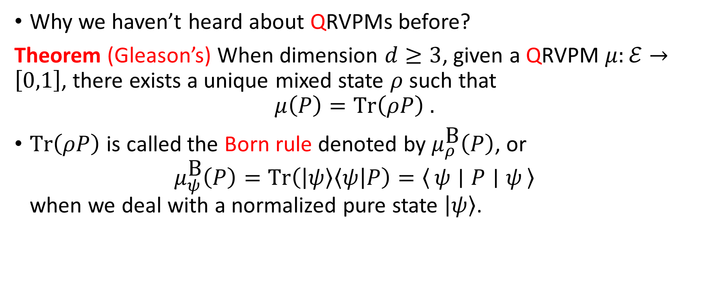
Gleason’s Theorem and the Born Rule
Why we haven’t heard about QRVPMs before?
Theorem (Gleason’s) When dimension $d≥3$, given a QRVPM $μ:ℰ→\left[0,1\right]$, there exists a unique mixed state $ρ$ such that $$μ\left(P\right)=\text{Tr}\left(ρP\right) .$$
$\text{Tr}\left(ρP\right)$ is called the Born rule denoted by $μ_{ρ}^{\text{B}}\left(P\right)$, or $μ_{ψ}^{\text{B}}\left(P\right)=\text{Tr}\left(\left|ψ\right\rangle \left\langle ψ\right|P\right)=\left\langle ψ ∣ P ∣ ψ\right\rangle$ when we deal with a normalized pure state $\left|ψ\right\rangle$.

Slide 8
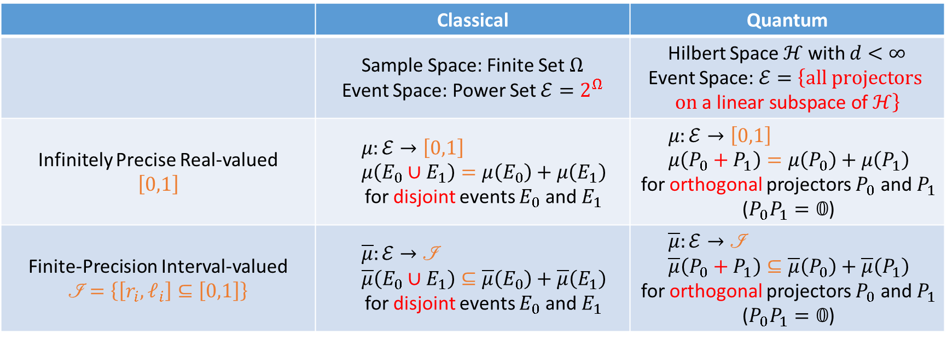
Probability Models (Big Picture)
 | Classical | Quantum
 | Sample Space: Finite Set $Ω$ Event Space: Power Set $ℰ=2^{Ω}$ | Hilbert Space $ℋ$ with $d<∞$ Event Space: $ℰ=\left\{\text{all} \text{projectors} \text{on} \text{a} \text{linear} \text{subspace} \text{of} ℋ\right\}$
Infinitely Precise Real-valued $$\left[0,1\right]$$ | $$μ:ℰ→\left[0,1\right] \\ μ\left(E_{0}∪E_{1}\right)=μ\left(E_{0}\right)+μ\left(E_{1}\right)$$ for disjoint events $E_{0}$ and $E_{1}$ | $$μ:ℰ→\left[0,1\right] \\ μ\left(P_{0}+P_{1}\right)=μ\left(P_{0}\right)+μ\left(P_{1}\right)$$ for orthogonal projectors $P_{0}$ and $P_{1}$ ($P_{0}P_{1}=𝟘$)
Finite-Precision Interval-valued $$\left.ℐ\right.=\left\{\left[r_{i},ℓ_{i}\right]⊆\left[0,1\right]\right\}$$ | $$\overline{μ}:ℰ→\text{ℐ} \\ \overline{μ}\left(E_{0}∪E_{1}\right)⊆\overline{μ}\left(E_{0}\right)+\overline{μ}\left(E_{1}\right)$$ for disjoint events $E_{0}$ and $E_{1}$ | $$\overline{μ}:ℰ→\text{ℐ} \\ \overline{μ}\left(P_{0}+P_{1}\right)⊆\overline{μ}\left(P_{0}\right)+\overline{μ}\left(P_{1}\right)$$ for orthogonal projectors $P_{0}$ and $P_{1}$ ($P_{0}P_{1}=𝟘$)

Slide 9
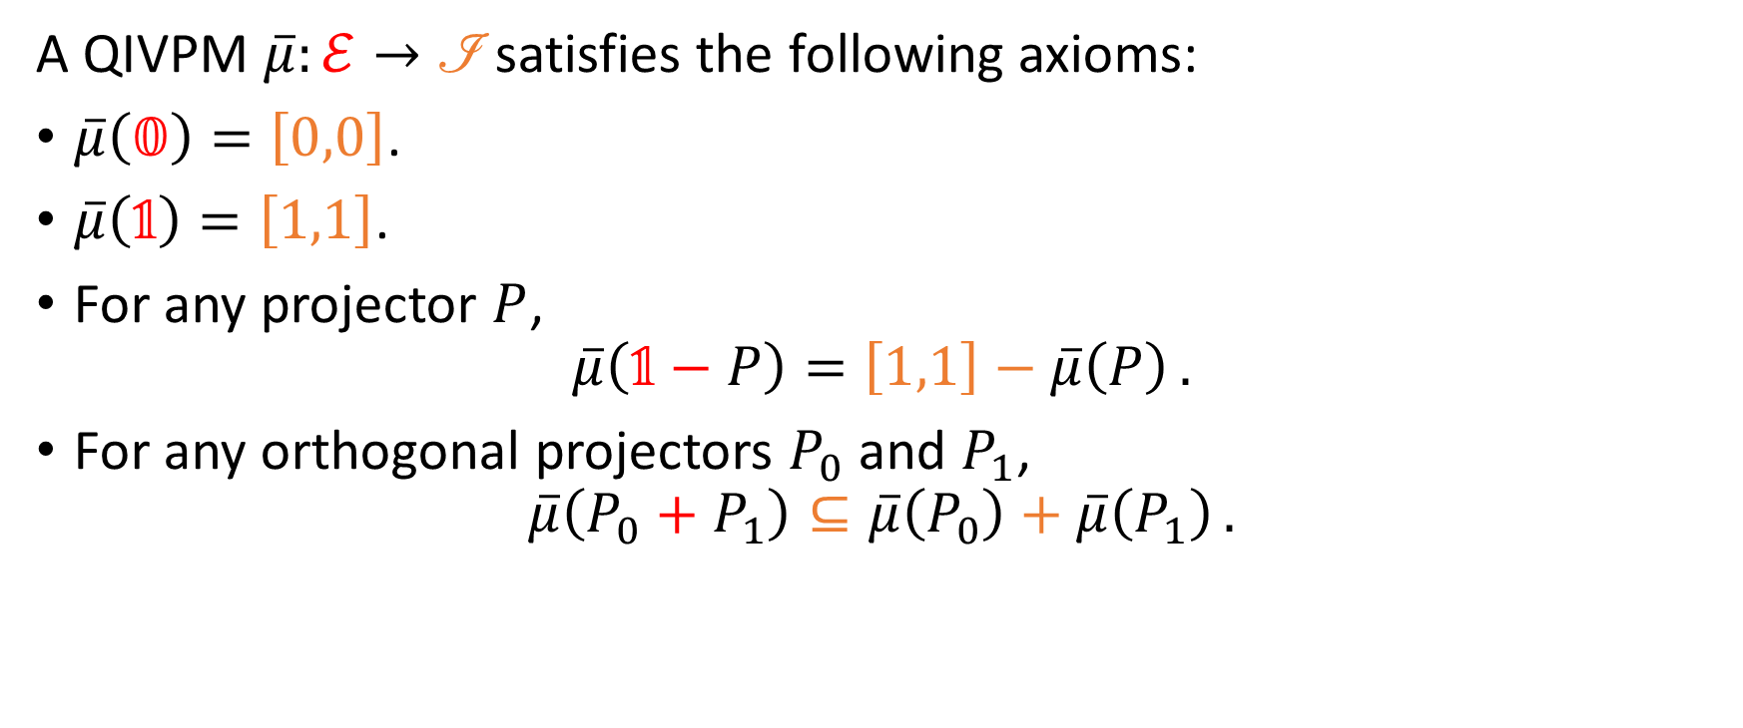
Quantum Interval-Valued Probability Measure (QIVPM)
A QIVPM $\overline{μ}:ℰ→\text{ℐ}$ satisfies the following axioms:
$\overline{μ}\left(𝟘\right)=\left[0,0\right]$.
$\overline{μ}\left(𝟙\right)=\left[1,1\right]$.
For any projector $P$, $\overline{μ}\left(𝟙−P\right)=\left[1,1\right]−\overline{μ}\left(P\right) .$
For any orthogonal projectors $P_{0}$ and $P_{1}$, $\overline{μ}\left(P_{0}+P_{1}\right)⊆\overline{μ}\left(P_{0}\right)+\overline{μ}\left(P_{1}\right) .$
Notes:
XITS font is required to display Formal Script (\mathscr) font correctly.
https://www.ctan.org/tex-archive/fonts/xits/

Slide 10
Our Main Questions
Can we recover QRVPM and CIVPM as a special case of QIVPM?
Can we define convexity and core for QIVPM?
Does a convex QIVPM have a nonempty core and a expectation value (Choquet integral)?
Can we define a Born rule for QIVPM?
Can we have Gleason’s theorem for QIVPM?
Since there is a tension between finite precision measurement and contextuality, can we have a Kochen-Specker theorem for QIVPM?

Slide 11
Recover QRVPM and CIVPM as a special case of QIVPM
And we can define convexity for QIVPM as well.

Slide 12



Precise Limit: When ${\left.ℐ\right.}_{∞}=\left\{\left[x,x\right]∣x∈\left[0,1\right]\right\}$
Quantum Real-Valued Probability Measure (QRVPM)
Quantum Interval-Valued Probability Measure (QIVPM)
$μ:2^{Ω}→\left[0,1\right]$
The Born rule and Gleason’s theorem are applied.
$\overline{μ}:2^{Ω}→{\left.ℐ\right.}_{∞}=\left\{\left[x,x\right]∣x∈\left[0,1\right]\right\}$
The Born rule and Gleason’s theorem are applied.
One-to-one correspondence

Slide 13
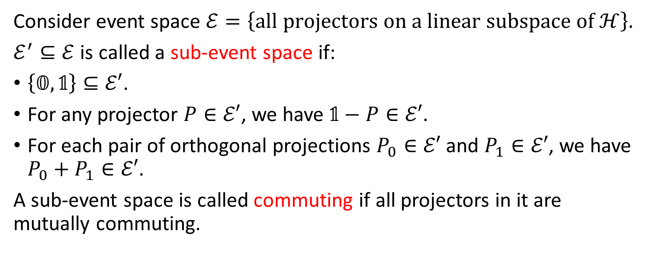
Classical Limit: On a commuting sub-event space
Consider event space $ℰ=\left\{\text{all} \text{projectors} \text{on} \text{a} \text{linear} \text{subspace} \text{of} ℋ\right\}$.
$ℰ^{′}⊆ℰ$ is called a sub-event space if:
$\left\{𝟘,𝟙\right\}⊆ℰ′$.
For any projector $P∈ℰ′$, we have $𝟙−P∈ℰ′$.
For each pair of orthogonal projections $P_{0}∈ℰ′$ and $P_{1}∈ℰ′$, we have $P_{0}+P_{1}∈ℰ′$.
A sub-event space is called commuting if all projectors in it are mutually commuting.

Slide 14
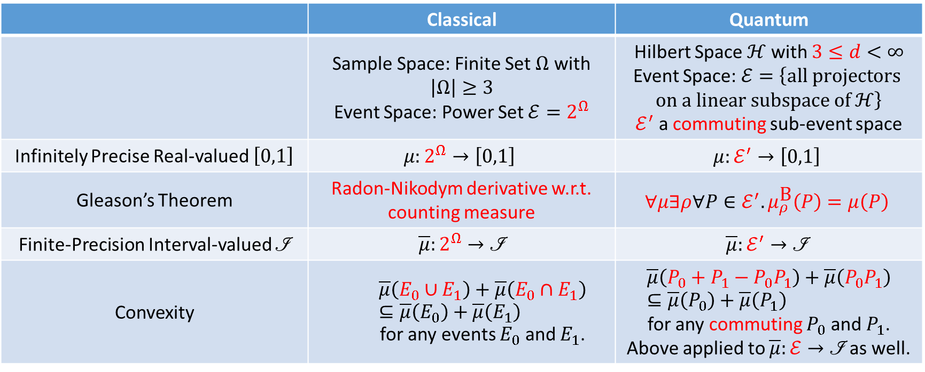
Classical Limit: On a commuting sub-event space
 | Classical | Quantum
 | Sample Space: Finite Set $Ω$ with $\left|Ω\right|≥3$ Event Space: Power Set $ℰ=2^{Ω}$ | Hilbert Space $ℋ$ with $3≤d<∞$ Event Space: $ℰ=\left\{\text{all} \text{projectors} \text{on} \text{a} \text{linear} \text{subspace} \text{of} ℋ\right\}$ $ℰ^{′}$ a commuting sub-event space
Infinitely Precise Real-valued $\left[0,1\right]$ | $$μ:2^{Ω}→\left[0,1\right]$$ | $$μ:ℰ^{′}→\left[0,1\right]$$
Gleason’s Theorem | Radon-Nikodym derivative w.r.t. counting measure | $$∀μ∃ρ∀P∈ℰ^{′}. μ_{ρ}^{\text{B}}\left(P\right)=μ\left(P\right)$$
Finite-Precision Interval-valued $\left.ℐ\right.$ | $$\overline{μ}:2^{Ω}→\text{ℐ}$$ | $$\overline{μ}:ℰ^{′}→\text{ℐ}$$
Convexity | $$\overline{μ}\left(E_{0}∪E_{1}\right)+\overline{μ}\left(E_{0}∩E_{1}\right)⊆\overline{μ}\left(E_{0}\right)+\overline{μ}\left(E_{1}\right)$$ for any events $E_{0}$ and $E_{1}$. | $$\overline{μ}\left(P_{0}+P_{1}−P_{0}P_{1}\right)+\overline{μ}\left(P_{0}P_{1}\right)⊆\overline{μ}\left(P_{0}\right)+\overline{μ}\left(P_{1}\right)$$ for any commuting $P_{0}$ and $P_{1}$. Above applied to $\overline{μ}:ℰ→\text{ℐ}$ as well.

Slide 15
Core and Gleason’s theorem
We can unify the idea of core and Gleason’s theorem into the states consistent with a QIVPM.

Slide 16
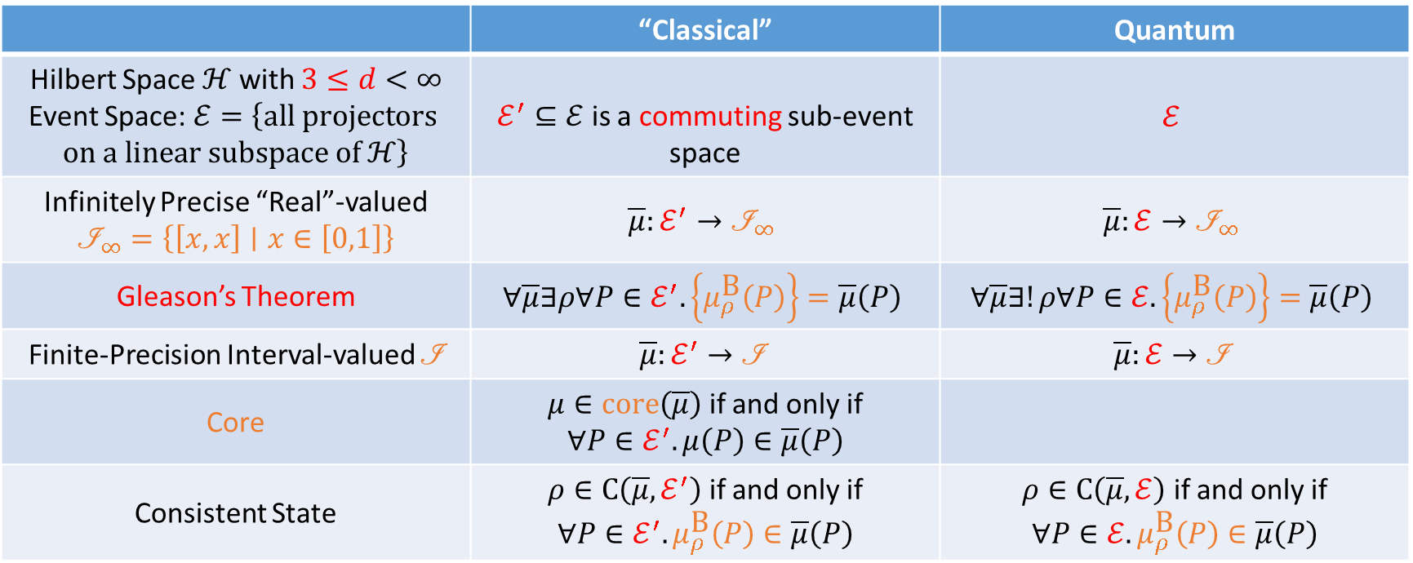
Core Gleason’s theorem
Consistent State
 | “Classical” | Quantum
Hilbert Space $ℋ$ with $3≤d<∞$ Event Space: $ℰ=\left\{\text{all} \text{projectors} \text{on} \text{a} \text{linear} \text{subspace} \text{of} ℋ\right\}$ | $ℰ^{′}⊆ℰ$ is a commuting sub-event space | $$ℰ$$
Infinitely Precise “Real”-valued $${\left.ℐ\right.}_{∞}=\left\{\left[x,x\right]∣x∈\left[0,1\right]\right\}$$ | $$\overline{μ}:ℰ^{′}→{\left.ℐ\right.}_{∞}$$ | $$\overline{μ}:ℰ→{\left.ℐ\right.}_{∞}$$
Gleason’s Theorem | $$∀\overline{μ}∃ρ∀P∈ℰ^{′}.\left\{μ_{ρ}^{\text{B}}\left(P\right)\right\}=\overline{μ}\left(P\right)$$ | $$∀\overline{μ}∃!ρ∀P∈ℰ.\left\{μ_{ρ}^{\text{B}}\left(P\right)\right\}=\overline{μ}\left(P\right)$$
Finite-Precision Interval-valued $\left.ℐ\right.$ | $$\overline{μ}:ℰ^{′}→\text{ℐ}$$ | $$\overline{μ}:ℰ→\text{ℐ}$$
Core | $μ∈\text{core}\left(\overline{μ}\right)$ if and only if $$∀P∈ℰ^{′}.μ\left(P\right)∈\overline{μ}\left(P\right)$$
Consistent State | $ρ∈\text{C}\left(\overline{μ},ℰ^{′}\right)$ if and only if $$∀P∈ℰ^{′}.μ_{ρ}^{\text{B}}\left(P\right)∈\overline{μ}\left(P\right)$$ | $ρ∈\text{C}\left(\overline{μ},ℰ\right)$ if and only if $$∀P∈ℰ.μ_{ρ}^{\text{B}}\left(P\right)∈\overline{μ}\left(P\right)$$

Slide 17
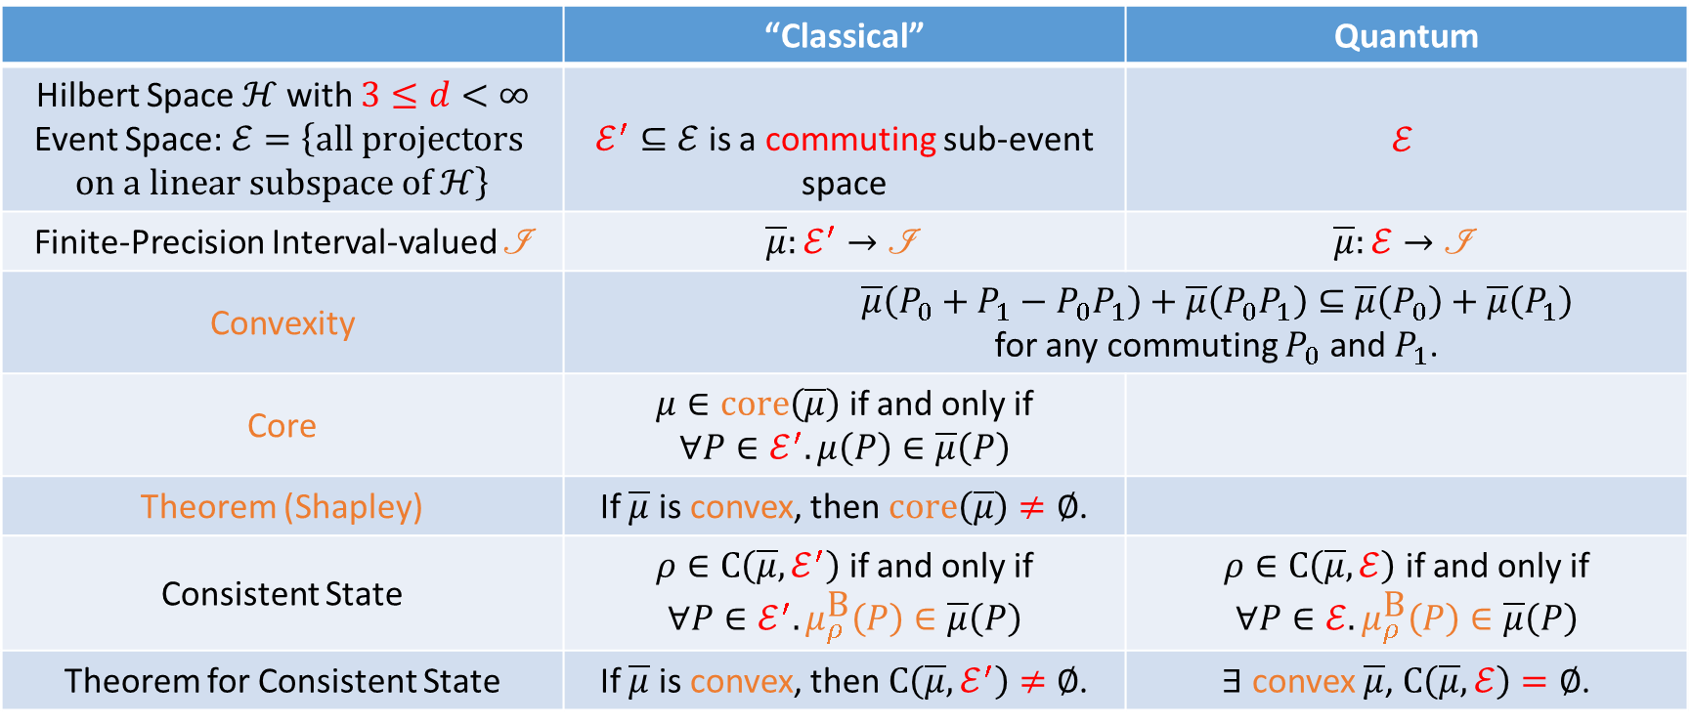
Convexity vs Consistent State
 | “Classical” | Quantum
Hilbert Space $ℋ$ with $3≤d<∞$ Event Space: $ℰ=\left\{\text{all} \text{projectors} \text{on} \text{a} \text{linear} \text{subspace} \text{of} ℋ\right\}$ | $ℰ^{′}⊆ℰ$ is a commuting sub-event space | $$ℰ$$
Finite-Precision Interval-valued $\left.ℐ\right.$ | $$\overline{μ}:ℰ^{′}→\text{ℐ}$$ | $$\overline{μ}:ℰ→\text{ℐ}$$
Convexity | $$\overline{μ}\left(P_{0}+P_{1}−P_{0}P_{1}\right)+\overline{μ}\left(P_{0}P_{1}\right)⊆\overline{μ}\left(P_{0}\right)+\overline{μ}\left(P_{1}\right)$$ for any commuting $P_{0}$ and $P_{1}$.
Core | $μ∈\text{core}\left(\overline{μ}\right)$ if and only if $$∀P∈ℰ^{′}.μ\left(P\right)∈\overline{μ}\left(P\right)$$
Theorem (Shapley) | If $\overline{μ}$ is convex, then $\text{core}\left(\overline{μ}\right)≠∅$.
Consistent State | $ρ∈\text{C}\left(\overline{μ},ℰ^{′}\right)$ if and only if $$∀P∈ℰ^{′}.μ_{ρ}^{\text{B}}\left(P\right)∈\overline{μ}\left(P\right)$$ | $ρ∈\text{C}\left(\overline{μ},ℰ\right)$ if and only if $$∀P∈ℰ.μ_{ρ}^{\text{B}}\left(P\right)∈\overline{μ}\left(P\right)$$
Theorem for Consistent State | If $\overline{μ}$ is convex, then $\text{C}\left(\overline{μ},ℰ^{′}\right)≠∅$. | $∃$ convex $\overline{μ}$, $\text{C}\left(\overline{μ},ℰ\right)=∅$.

Slide 18
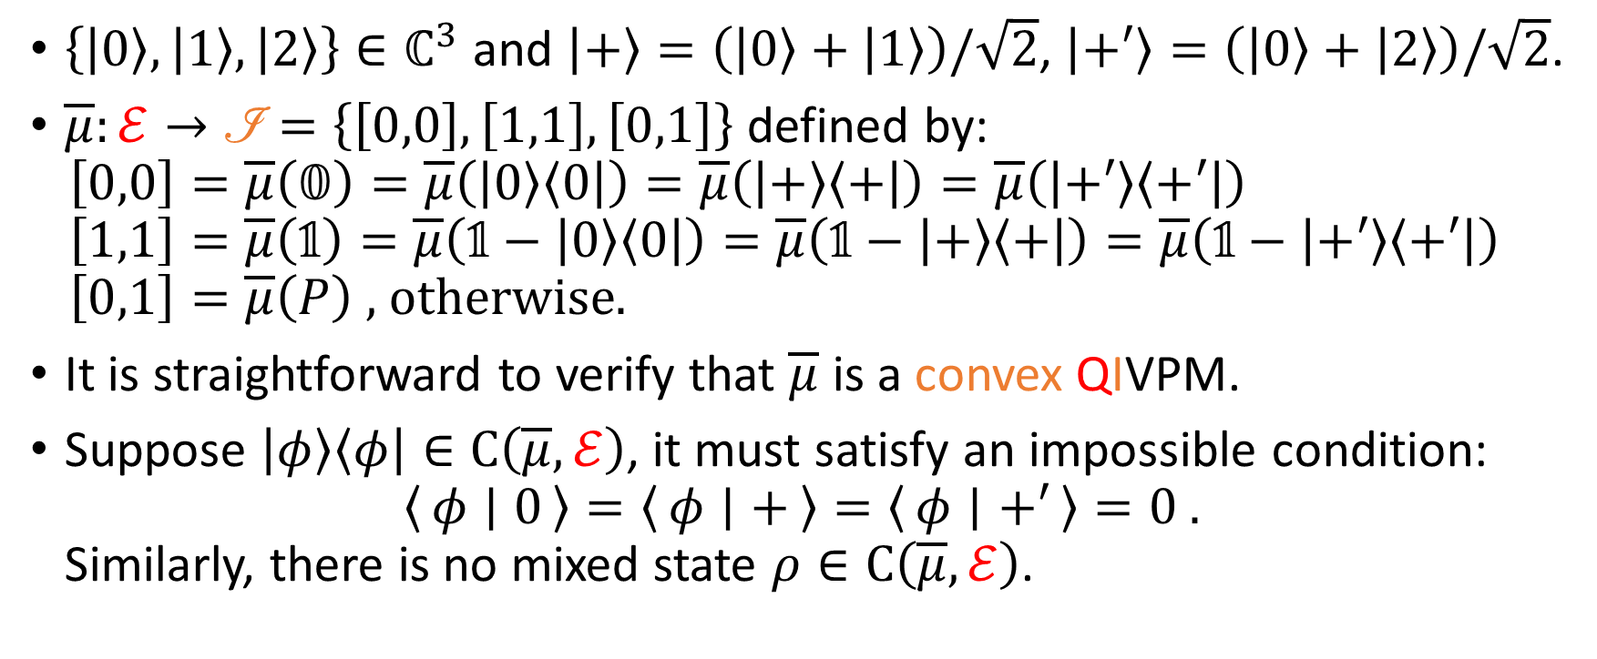
A Convex QIVPM Without a Consistent State
$\left\{\left|0\right\rangle ,\left|1\right\rangle ,\left|2\right\rangle \right\}∈ℂ^{3}$ and $\left|+\right\rangle =\left(\left|0\right\rangle +\left|1\right\rangle \right)/\sqrt{2}$, $\left|+′\right\rangle =\left(\left|0\right\rangle +\left|2\right\rangle \right)/\sqrt{2}$.
$\overline{μ}:ℰ→\text{ℐ}=\left\{\left[0,0\right],\left[1,1\right],\left[0,1\right]\right\}$ defined by: $\left[0,0\right]=\overline{μ}\left(𝟘\right)=\overline{μ}\left(\left|0\right\rangle \left\langle 0\right|\right)=\overline{μ}\left(\left|+\right\rangle \left\langle +\right|\right)=\overline{μ}\left(\left|+′\right\rangle \left\langle +′\right|\right)$ $\left[1,1\right]=\overline{μ}\left(𝟙\right)=\overline{μ}\left(𝟙−\left|0\right\rangle \left\langle 0\right|\right)=\overline{μ}\left(𝟙−\left|+\right\rangle \left\langle +\right|\right)=\overline{μ}\left(𝟙−\left|+′\right\rangle \left\langle +′\right|\right)$ $\left[0,1\right]=\overline{μ}\left(P\right)\text{ , }\text{otherwise}\text{.}$
It is straightforward to verify that $\overline{μ}$ is a convex QIVPM.
Suppose $\left|φ\right\rangle \left\langle φ\right|∈\text{C}\left(\overline{μ},ℰ\right)$, it must satisfy an impossible condition: $\left\langle φ ∣ 0\right\rangle =\left\langle φ ∣ +\right\rangle =\left\langle φ ∣ +′\right\rangle =0 .$ Similarly, there is no mixed state $ρ∈\text{C}\left(\overline{μ},ℰ\right)$.

Slide 19
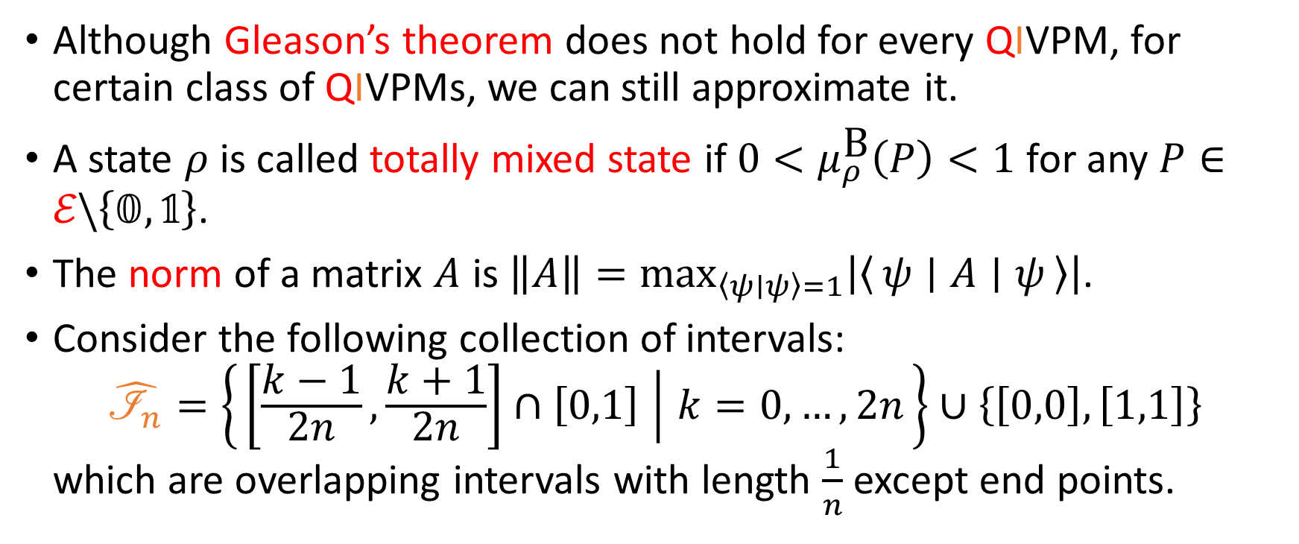
Approximating Gleason’s Theorem
Although Gleason’s theorem does not hold for every QIVPM, for certain class of QIVPMs, we can still approximate it.
A state $ρ$ is called totally mixed state if $0<μ_{ρ}^{\text{B}}\left(P\right)<1$ for any $P∈ℰ\backslash \left\{𝟘,𝟙\right\}$.
The norm of a matrix $A$ is $\left\|A\right\|=\max_{\left\langle ψ∣ψ\right\rangle =1}\left|\left\langle ψ ∣ A ∣ ψ\right\rangle \right|$.
Consider the following collection of intervals: $\hat{ℐ_{n}}=\left\{\left[\frac{k−1}{2n},\frac{k+1}{2n}\right]∩\left[0,1\right] ∣ k=0,…,2n\right\}∪\left\{\left[0,0\right],\left[1,1\right]\right\}$ which are overlapping intervals with length $\frac{1}{n}$ except end points.

Slide 20
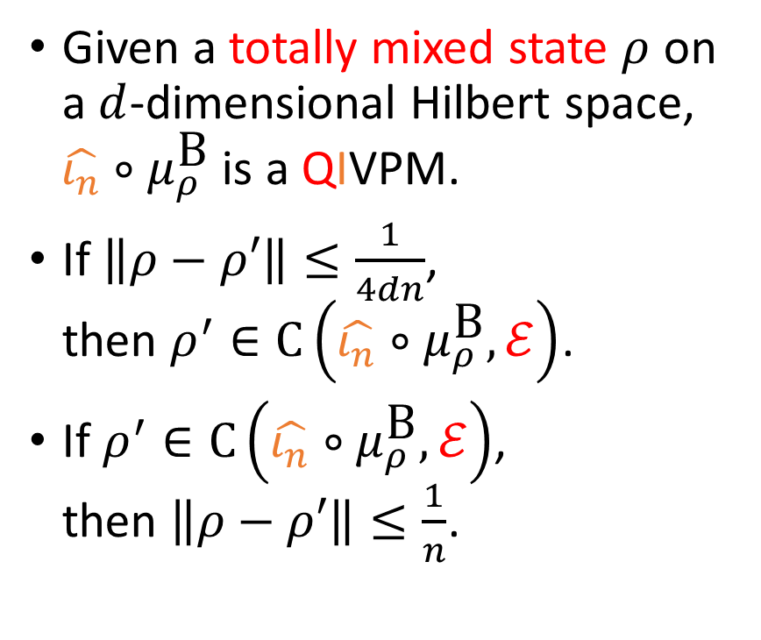
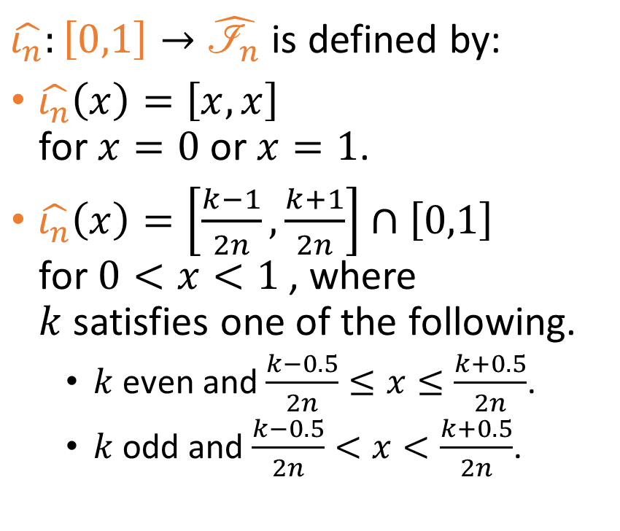
Approximating Gleason’s Theorem
$\hat{ι_{n}}:\left[0,1\right]→\hat{ℐ_{n}}$ is defined by:
$\hat{ι_{n}}\left(x\right)=\left[x,x\right]$ for $x=0$ or $x=1$.
$\hat{ι_{n}}\left(x\right)=\left[\frac{k−1}{2n},\frac{k+1}{2n}\right]∩\left[0,1\right]$ for $0<x<1$, where $k$ satisfies one of the following.
$k$ even and $\frac{k−0.5}{2n}≤x≤\frac{k+0.5}{2n}$.
$k$ odd and $\frac{k−0.5}{2n}<x<\frac{k+0.5}{2n}$.
Given a totally mixed state $ρ$ on a $d$-dimensional Hilbert space, $\hat{ι_{n}}∘μ_{ρ}^{\text{B}}$ is a QIVPM.
If $\left\|ρ−ρ′\right\|≤\frac{1}{4dn}$, then $ρ^{′}∈\text{C}\left(\hat{ι_{n}}∘μ_{ρ}^{\text{B}},ℰ\right)$.
If $ρ^{′}∈\text{C}\left(\hat{ι_{n}}∘μ_{ρ}^{\text{B}},ℰ\right)$, then $\left\|ρ−ρ′\right\|≤\frac{1}{n}$.

Slide 21
Expectation Value and the Kochen-Specker theorem
Yes, a convex QIVPM has an expectation value, and the Kochen-Specker Theorem still works even consider finite precision measurement modelled by QIVPM.

Slide 22
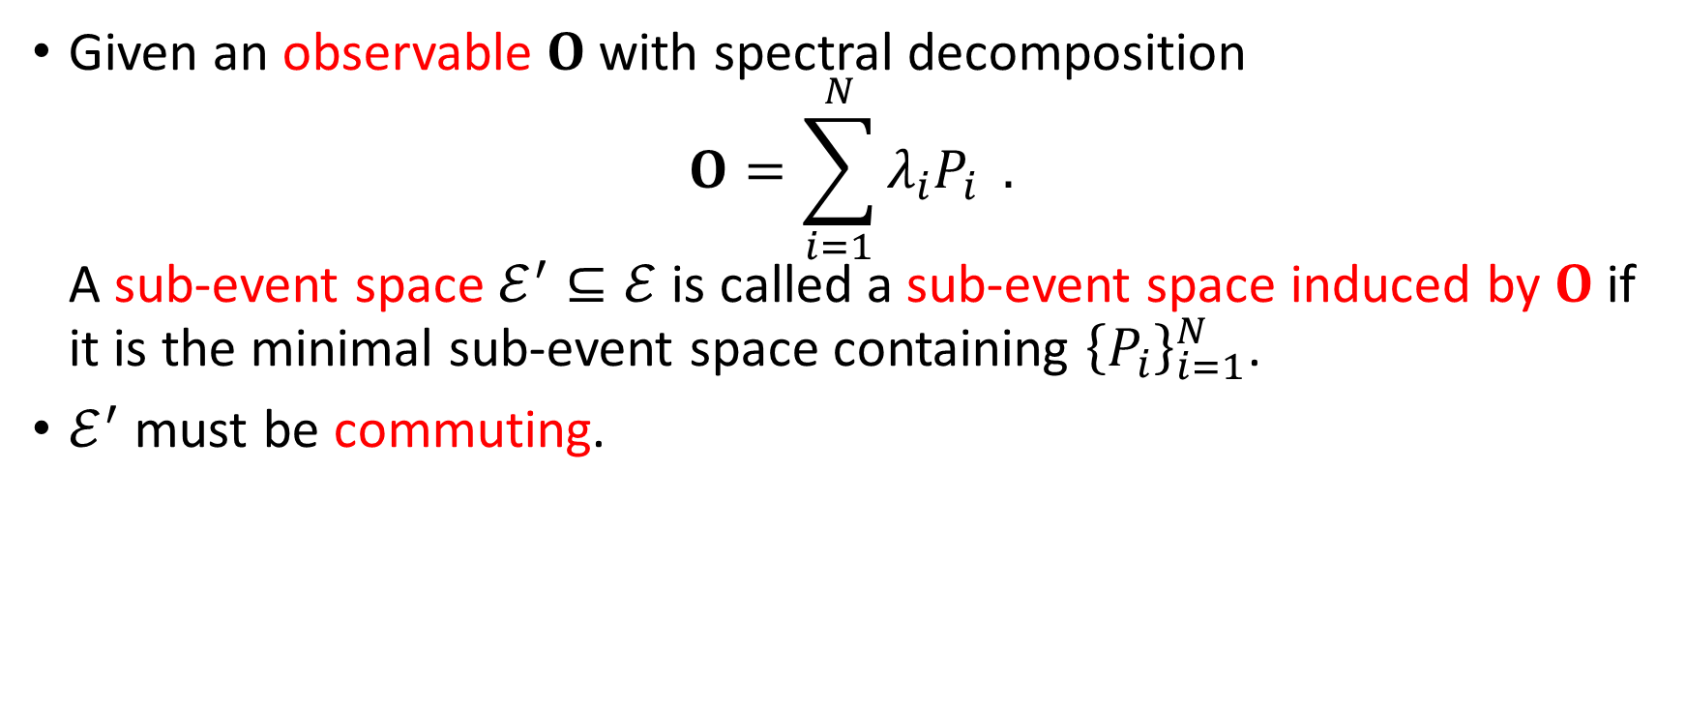
Observable and Sub-event Space
Given an observable $O$ with spectral decomposition $O=\sum_{i=1}^{N}{λ_{i}P_{i}} .$ A sub-event space $ℰ^{′}⊆ℰ$ is called a sub-event space induced by $O$ if it is the minimal sub-event space containing ${\left\{P_{i}\right\}}_{i=1}^{N}$.
$ℰ^{′}$ must be commuting.

Slide 23
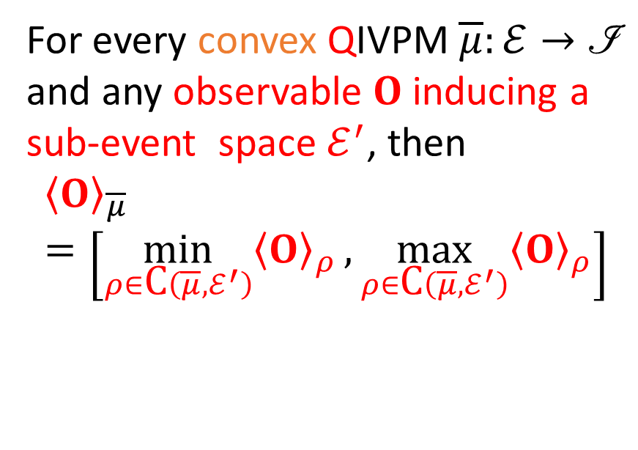
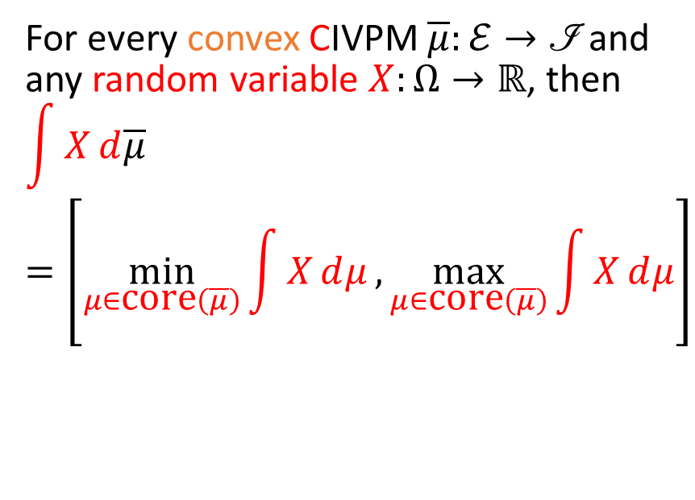
Expectation Value (Choquet integral)
Classical Interval-Valued Probability Measure (CIVPM)
Quantum Interval-Valued Probability Measure (QIVPM)
For every convex CIVPM $\overline{μ}:ℰ→\left.ℐ\right.$ and any random variable $X:Ω→ℝ$, then $$\int{X}ⅆ\overline{μ}=\left[\min_{μ∈\text{core}\left(\overline{μ}\right)}{\int{X}ⅆμ},\max_{μ∈\text{core}\left(\overline{μ}\right)}{\int{X}ⅆμ}\right]$$
For every convex QIVPM $\overline{μ}:ℰ→\left.ℐ\right.$ and any observable $O$ inducing a sub-event space $ℰ^{′}$, then $${\left\langle O\right\rangle }_{\overline{μ}}=\left[\min_{ρ∈\text{C}\left(\overline{μ},ℰ^{′}\right)}{{\left\langle O\right\rangle }_{ρ}},\max_{ρ∈\text{C}\left(\overline{μ},ℰ^{′}\right)}{{\left\langle O\right\rangle }_{ρ}}\right]$$

Slide 24
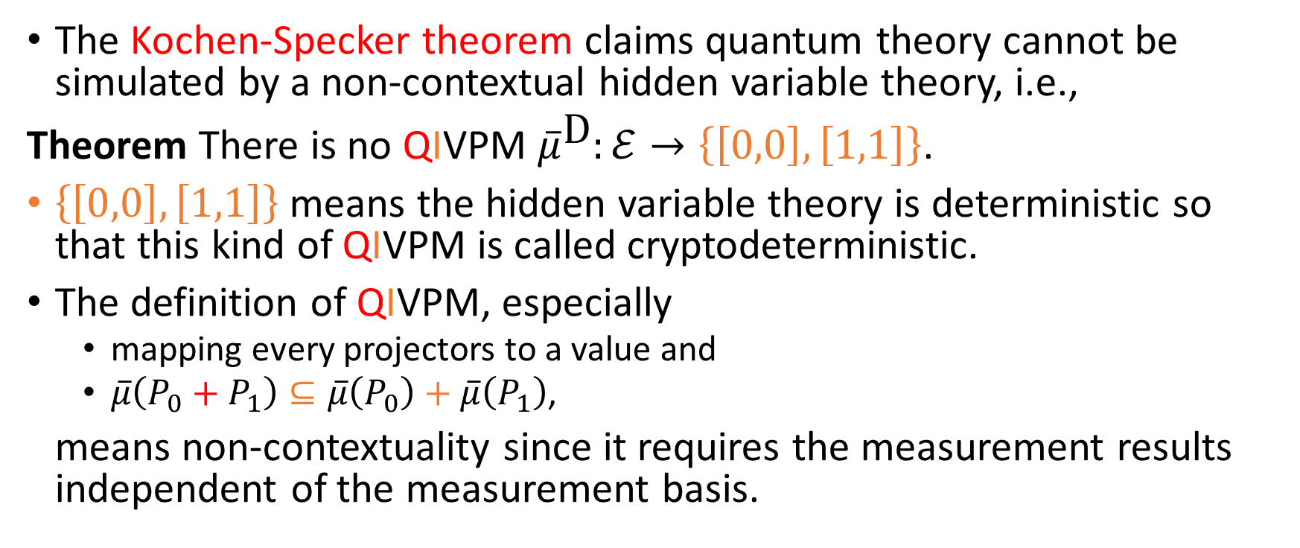
Kochen-Specker Theorem
The Kochen-Specker theorem claims quantum theory cannot be simulated by a non-contextual hidden variable theory, i.e.,
Theorem There is no QIVPM ${\overline{μ}}^{\text{D}}:ℰ→\left\{\left[0,0\right],\left[1,1\right]\right\}$.
$\left\{\left[0,0\right],\left[1,1\right]\right\}$ means the hidden variable theory is deterministic so that this kind of QIVPM is called cryptodeterministic.
The definition of QIVPM, especially
mapping every projectors to a value and
$\overline{μ}\left(P_{0}+P_{1}\right)⊆\overline{μ}\left(P_{0}\right)+\overline{μ}\left(P_{1}\right)$,
means non-contextuality since it requires the measurement results independent of the measurement basis.
Notes:
Put cryptodeterministic CIVPM?

Slide 25
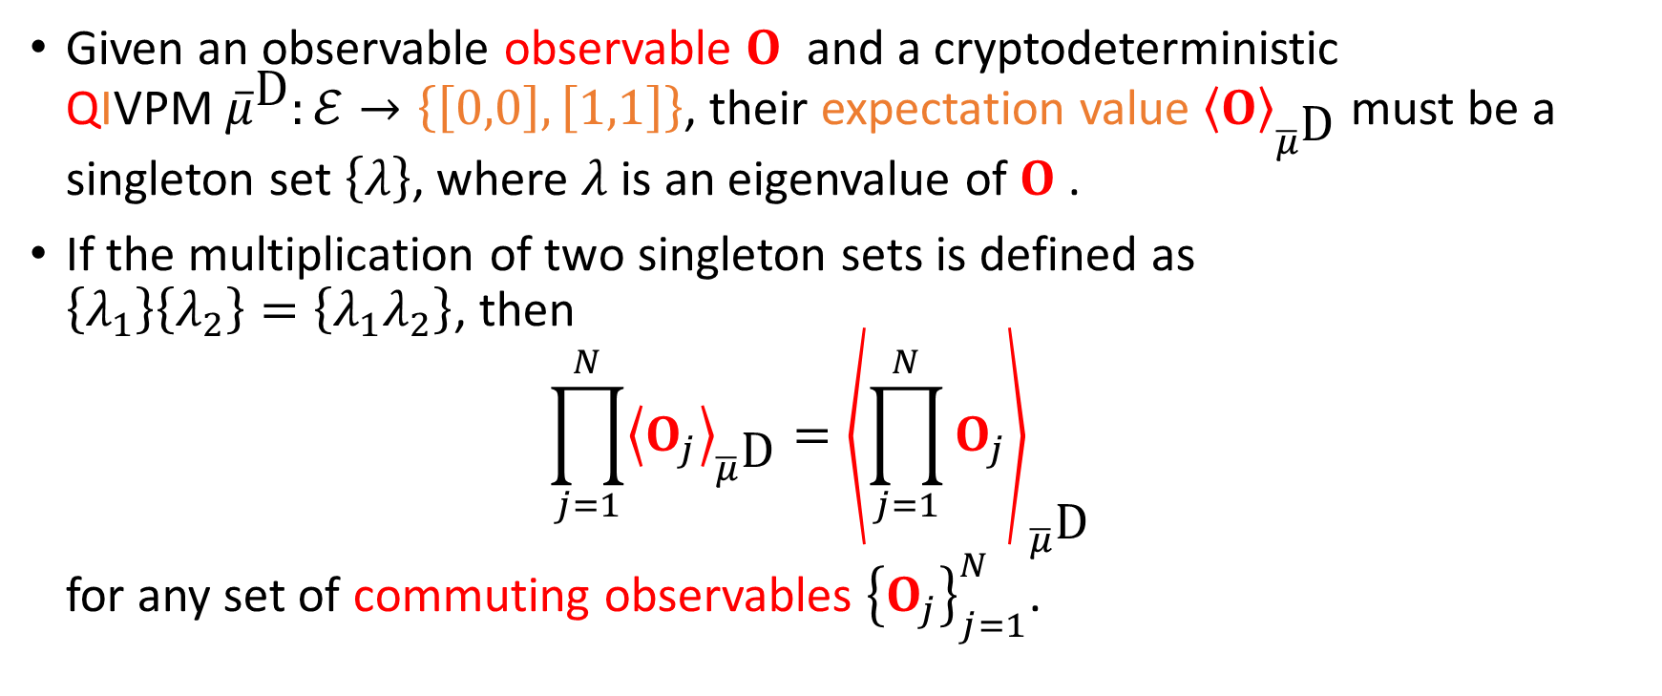
Properties of Cryptodeterministic QIVPM
Given an observable observable $O$ and a cryptodeterministic QIVPM ${\overline{μ}}^{\text{D}}:ℰ→\left\{\left[0,0\right],\left[1,1\right]\right\}$, their expectation value ${\left\langle O\right\rangle }_{{\overline{μ}}^{\text{D}}}$ must be a singleton set $\left\{λ\right\}$, where $λ$ is an eigenvalue of $O$.
If the multiplication of two singleton sets is defined as $\left\{λ_{1}\right\}\left\{λ_{2}\right\}=\left\{λ_{1}λ_{2}\right\}$, then $\prod_{j=1}^{N}{{\left\langle O_{j}\right\rangle }_{{\overline{μ}}^{\text{D}}}}={\left\langle \prod_{j=1}^{N}{O_{j}}\right\rangle }_{{\overline{μ}}^{\text{D}}}$ for any set of commuting observables ${\left\{O_{j}\right\}}_{j=1}^{N}$.

Slide 26
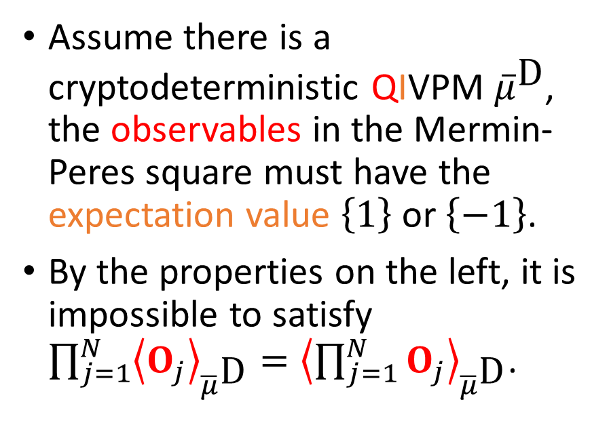
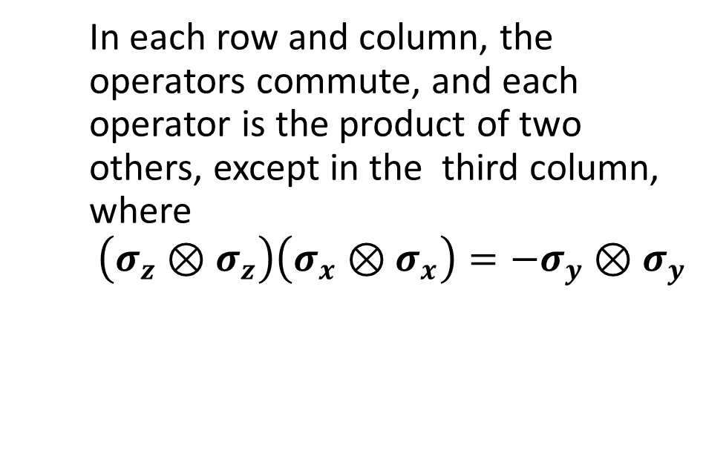
Prove the Kochen-Specker Theorem with QIVPM
Mermin-Peres Square
Proof by Contradiction!
$$𝟙⊗σ_{z}$$ | $$σ_{z}⊗𝟙$$ | $$σ_{z}⊗σ_{z}$$
$$σ_{x}⊗𝟙$$ | $$𝟙⊗σ_{x}$$ | $$σ_{x}⊗σ_{x}$$
$$σ_{x}⊗σ_{z}$$ | $$σ_{z}⊗σ_{x}$$ | $$σ_{z}⊗σ_{z}$$
Assume there is a cryptodeterministic QIVPM ${\overline{μ}}^{\text{D}}$, the observables in the Mermin-Peres square must have the expectation value $\left\{1\right\}$ or $\left\{−1\right\}$.
By the properties on the left, it is impossible to satisfy $\prod_{j=1}^{N}{{\left\langle O_{j}\right\rangle }_{{\overline{μ}}^{\text{D}}}}={\left\langle \prod_{j=1}^{N}{O_{j}}\right\rangle }_{{\overline{μ}}^{\text{D}}}$.
In each row and column, the operators commute, and each operator is the product of two others, except in the third column, where $$\left.\left(σ_{z}⊗σ_{z}\right.\right)\left.\left(σ_{x}⊗σ_{x}\right.\right)=−σ_{y}⊗σ_{y}$$

Slide 27
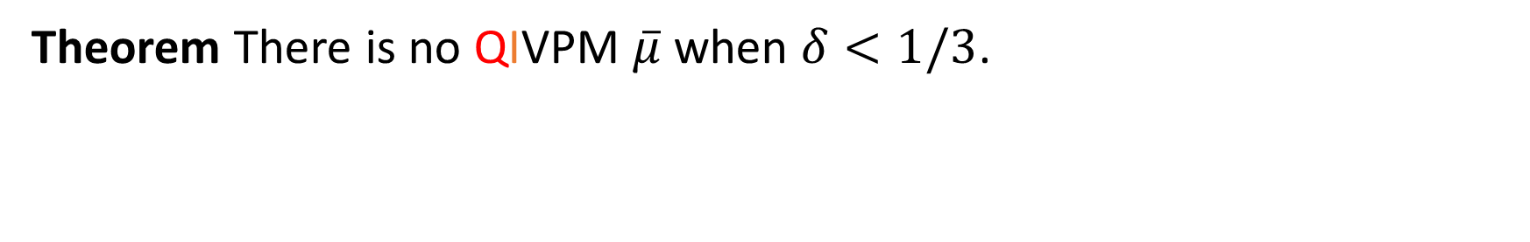
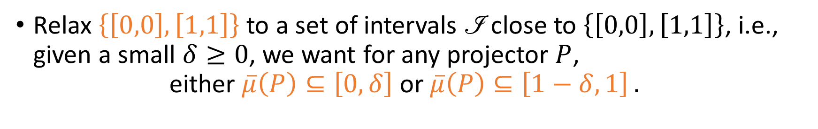
Finite Precision Measurement
Relax $\left\{\left[0,0\right],\left[1,1\right]\right\}$ to a set of intervals $\text{ℐ}$ close to $\left\{\left[0,0\right],\left[1,1\right]\right\}$, i.e., given a small $δ≥0$, we want for any projector $P$, $\text{either} \overline{μ}\left(P\right)⊆\left[0,δ\right] \text{or} \overline{μ}\left(P\right)⊆\left[1−δ,1\right] .$
Kochen-Specker Theorem with Finite Precision Measurement
Theorem There is no QIVPM $\overline{μ}$ when $δ<1/3$.

Slide 28
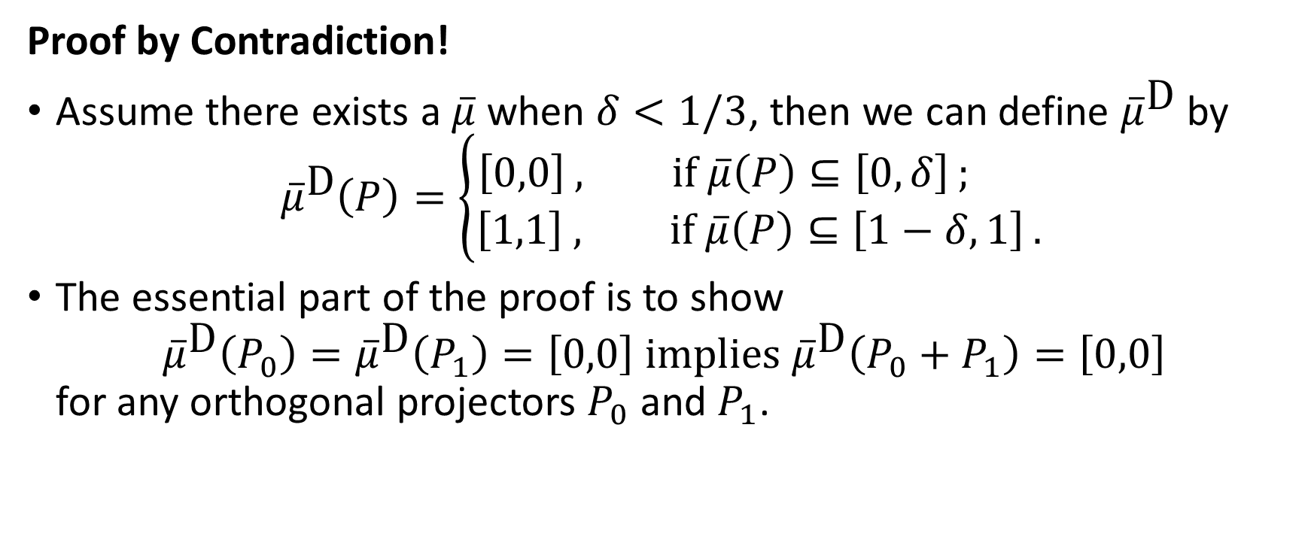
Kochen-Specker Theorem with Finite Precision Measurement
Proof by Contradiction!
Assume there exists a $\overline{μ}$ when $δ<1/3$, then we can define ${\overline{μ}}^{\text{D}}$ by ${\overline{μ}}^{\text{D}}\left(P\right)=\left\{\begin{aligned}\left[0,0\right] , \text{if} \overline{μ}\left(P\right)⊆\left[0,δ\right] ; \\ &\left[1,1\right] , \text{if} \overline{μ}\left(P\right)⊆\left[1−δ,1\right] .\end{aligned}\right.$
The essential part of the proof is to show ${\overline{μ}}^{\text{D}}\left(P_{0}\right)={\overline{μ}}^{\text{D}}\left(P_{1}\right)=\left[0,0\right] \text{implies} {\overline{μ}}^{\text{D}}\left(P_{0}+P_{1}\right)=\left[0,0\right]$ for any orthogonal projectors $P_{0}$ and $P_{1}$.

Slide 29

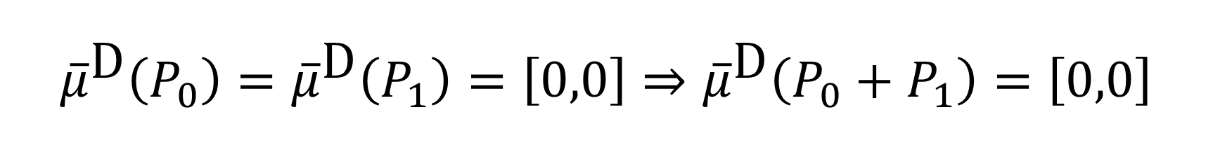







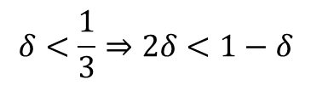
$${\overline{μ}}^{\text{D}}\left(P_{0}\right)={\overline{μ}}^{\text{D}}\left(P_{1}\right)=\left[0,0\right]⇒{\overline{μ}}^{\text{D}}\left(P_{0}+P_{1}\right)=\left[0,0\right]$$
$${\overline{μ}}^{\text{D}}\left(P_{0}\right)={\overline{μ}}^{\text{D}}\left(P_{1}\right)=\left[0,0\right] \\ ⇒\overline{μ}\left(P_{0}\right)⊆\left[0,δ\right] \text{and} \overline{μ}\left(P_{1}\right)⊆\left[0,δ\right] \\ ⇒\overline{μ}\left(P_{0}+P_{1}\right)⊆\left[0,2δ\right]$$
$\overline{μ}\left(P_{0}+P_{1}\right)$ is in this area
$$1−δ$$
$$1$$
$$0$$
$$δ$$
$$2δ$$
$$δ<\frac{1}{3}⇒2δ<1−δ$$
$\overline{μ}\left(P_{0}+P_{1}\right)$ should be in either one of these areas
$$∴\overline{μ}\left(P_{0}+P_{1}\right)⊆\left[0,δ\right] \\ ⇒{\overline{μ}}^{\text{D}}\left(P_{0}+P_{1}\right)=\left[0,0\right]$$

Slide 30
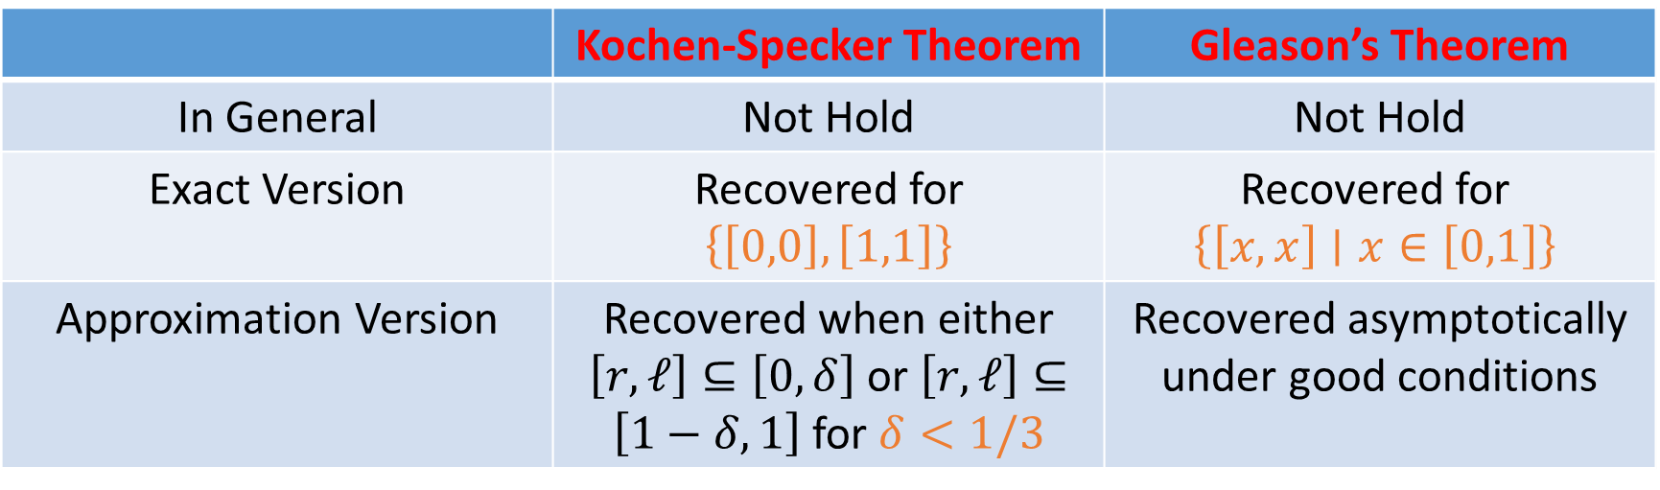
Conclusion
QIVPM can model experimental imperfections and finite precision measurement.
 | Kochen-Specker Theorem | Gleason’s Theorem
In General | Not Hold | Not Hold
Exact Version | Recovered for $\left\{\left[0,0\right],\left[1,1\right]\right\}$ | Recovered for $$\left\{\left[x,x\right]∣x∈\left[0,1\right]\right\}$$
Approximation Version | Recovered when either $\left[r,ℓ\right]⊆\left[0,δ\right]$ or $\left[r,ℓ\right]⊆\left[1−δ,1\right]$ for $δ<1/3$ | Recovered asymptotically under good conditions

Slide 31
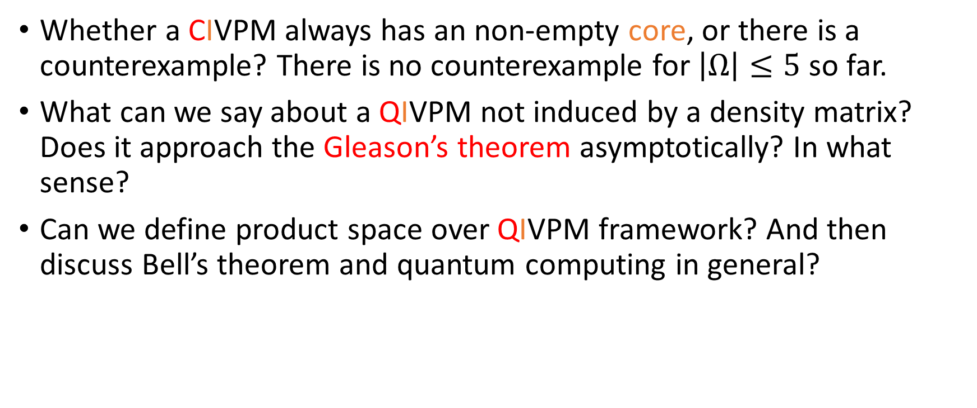
Further Questions
Whether a CIVPM always has an non-empty core, or there is a counterexample? There is no counterexample for $\left|Ω\right|≤5$ so far.
What can we say about a QIVPM not induced by a density matrix? Does it approach the Gleason’s theorem asymptotically? In what sense?
Can we define product space over QIVPM framework? And then discuss Bell’s theorem and quantum computing in general?

