Slide 1
AN E-Authoring
Arya Noble Audit Systems
Web Application manual : Admin

Slide 2
Table of Contents
1. How to Login
1.1. Homepage
2. Version Header
2.1. Create or Update Content Type
2.2. Create or Update Tags / Doctor Type
2.3. Create or Update Product Category
2.4. Create or Update Treatment Category
3. Doctor Profile
3.1. Create Doctor Profile
3.2. Update Doctor Profile
3.3. Upload Doctor Profile Data Through Excel
4. Banner Menu and Function
4.1. Create Banner
4.2. Update Banner
5. News Menu and Function
5.1. Create or Update News
6. Product Menu and Function
6.1. Create or Update Function
7. Article
7.1. Create or Update Article
8. Skinlogy
8.1. Create or Update Skinlogy
9. Treatment
9.1. Create or Update Treatment
10. Frequently Asked Question (FAQ)

Slide 3
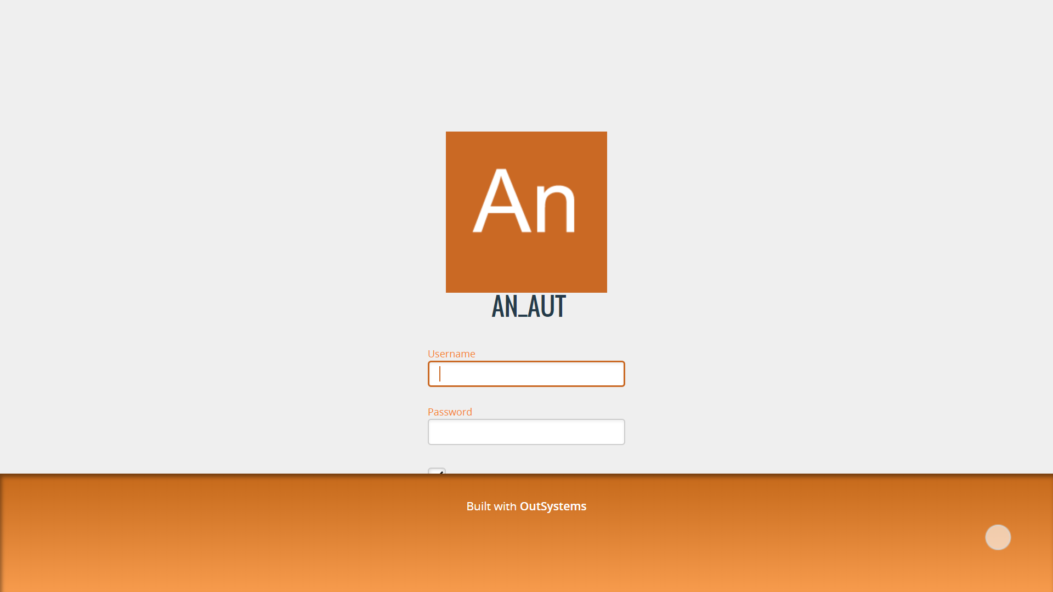
1. Access AN_Authoring with your browser through the link: https://aryanoble-tst.outsystemsenterprise.com/AN_AUT/ 2. The login page will appear as shown in the image on the left 3. Input your username and password to login. 4. Clicking on the “Remember” checklist below the password to make login easier when you close your browser.
Login
Note : Use username and password from your Arya Noble account. If the password that you submitted is not correct, you can try using “Arya2019” as the password (make sure you type the first a using the upper case letter “A”. If you still fail in logging into AN_AUT, try to contact AN_AUT Team for help.

Slide 4
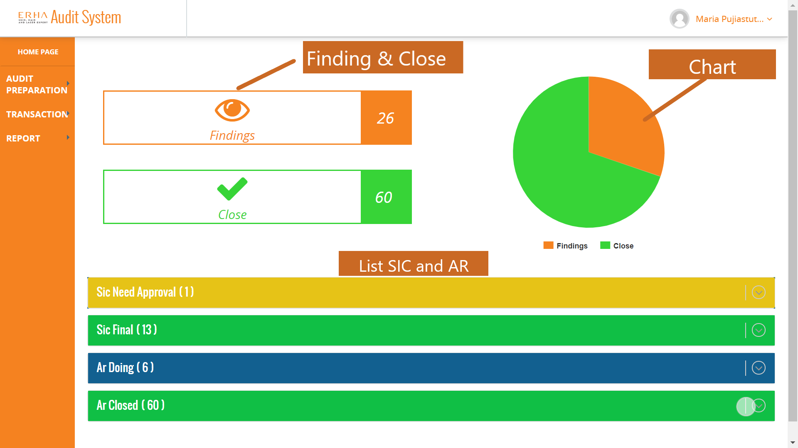
After successfully logged in, you will redirected to the pages as shown on the left. There will shown 3 menu bar : 1. Audit Preparation 2. Transaction 3. Report In the main screen the website will shown your name, Finding & Close, Chart, and List SIC and AR
Homepage for Audit Lead
Homepage for Audit Lead
Explanation for Main Screen :
Finding and Close : On the main screen will shown findings and audit report which already closed of all clinic.
Chart : Shown Finding and Close AR based by data from Findings & Close
List SIC and AR : This Feature shown SIC Need Approval, Final SIC, AR Doing (Need Approval AR by Audit Lead or Auditor) and AR Closed (AR which already approved by Audit Lead or Auditor).

Slide 5
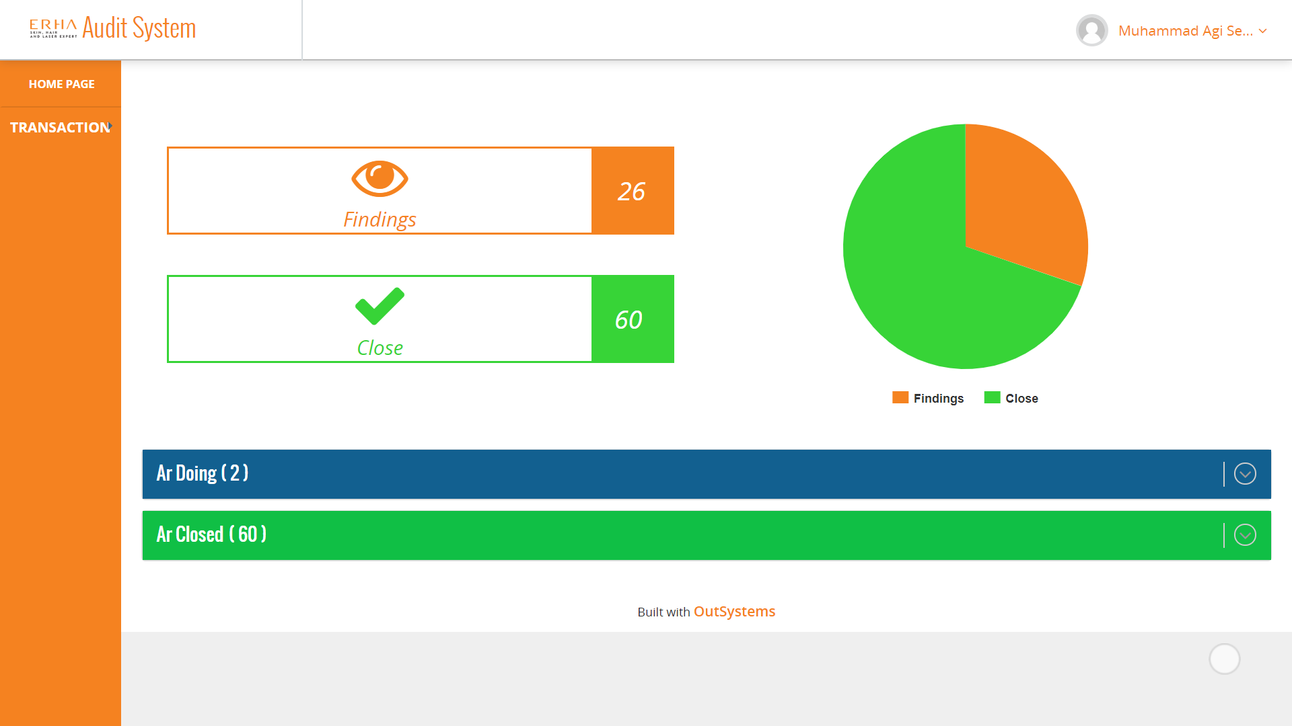
Homepage for Auditor
On Role Auditor, Homepage will shown Finding & Close, Chart, AR List ( Need Approval ), Closed AR and Transaction Bar
Homepage for auditor
Explanation :
AR List, Auditor can only approved AR which need approved by Audit Lead or Auditor, on close AR data same as Audit Lead Homepage which shown approved AR from all clinic.
On MenuBar, Auditor can only have transaction bar (this menu we will discuss on Transaction section

Slide 6
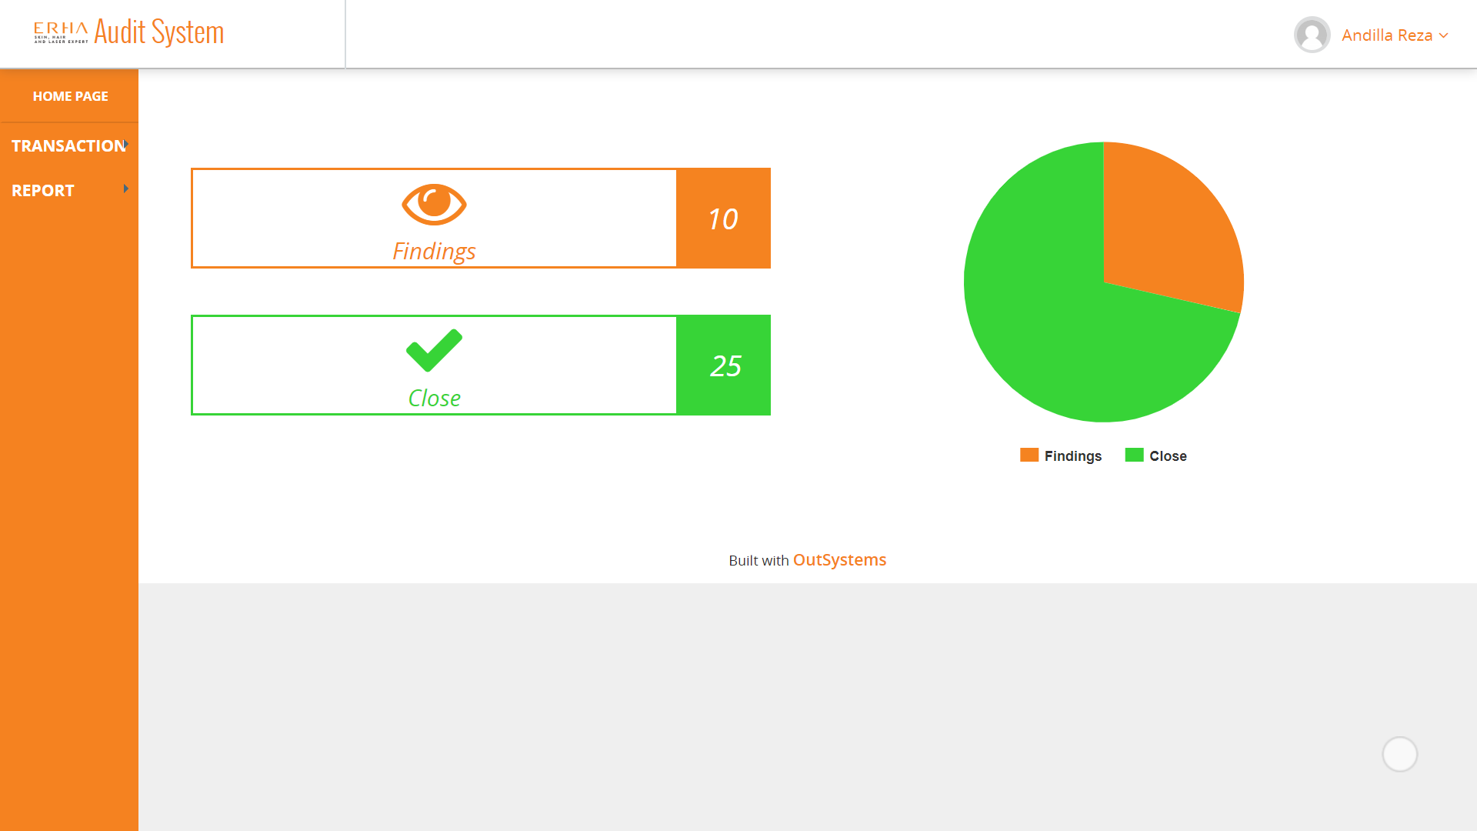
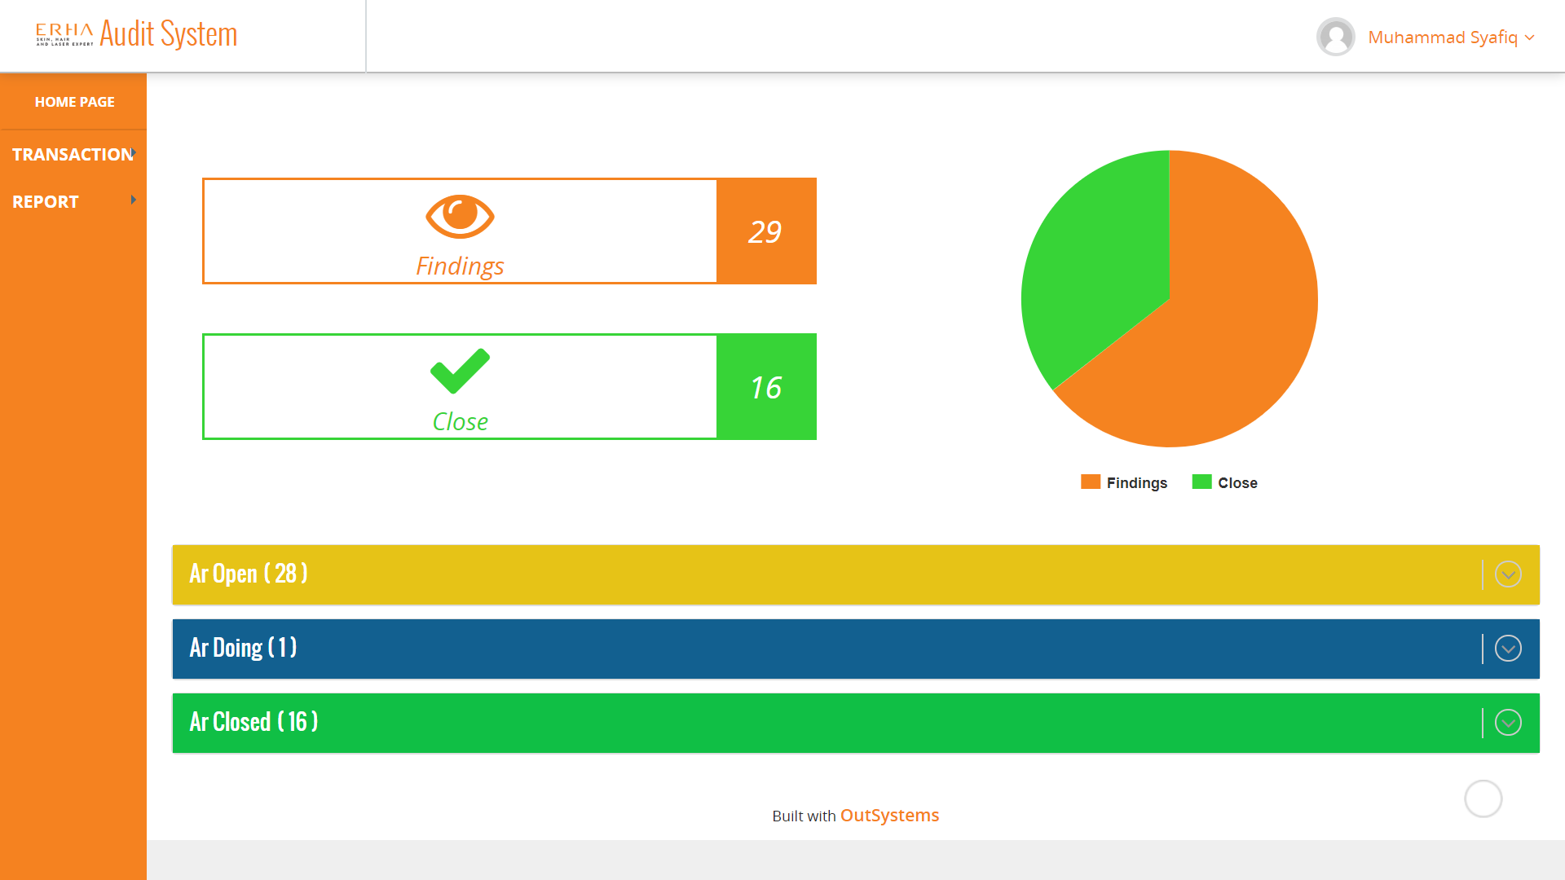
Homepage for Area Manager and Supervisor
On role Area Manager, homepage will shown Findings and Close, Chart, Transaction Bar and Report Bar. Findings and Close based by data from clinic groups who held by Area Manager.
Area Manager have Transaction and Report bar (this bar we will discuss in menu bar section
Homepage for Area Manager
On role Supervisor, homepage will shown Findings and Close, Chart, AR Open (AR which already assigned to supervisor and need to fixing their findings), AR Doing( current status for AR after submitted by supervisor), AR Close (Approved AR from each supervisor clinic), Transaction Bar and Report Bar.
Findings and Close based by data from their clinic. Supervisor have Transaction and Report bar (this bar we will discuss in menu bar section
Homepage for Supervisor

Slide 7
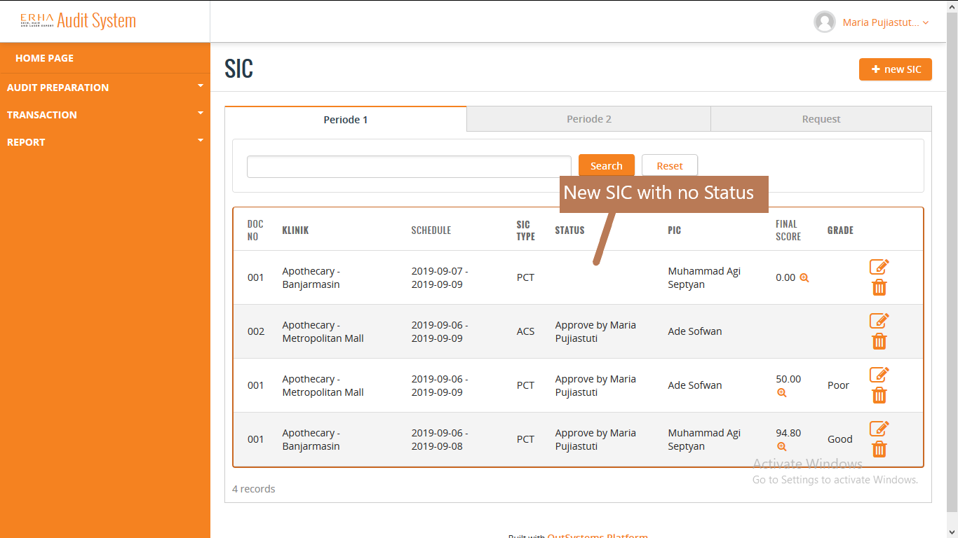
SIC List for Audit Lead
On Role Audit Lead, on transaction menu, on SIC sub menu, SIC List will shown three tab of SIC List based on the periode
SIC List for Audit Lead
Explanation :
SIC List, Audit Lead can see all SIC from all schedule of clinic divide by three tab of periode.
Audit Lead can also see the details of SIC that have been made by Auditor and help making new SIC.
Audit Lead can delete SIC that the schedule doesn't have Audit Report.
Audit Lead can search based on schedule date, SIC Type, and Clinic name.

Slide 8
SIC List for Auditor
On Role Auditor, on transaction menu, on SIC sub menu, SIC List will shown three tab of SIC List based on the periode
SIC List for Auditor
Explanation :
SIC List, Auditor can see all SIC too from all schedule of clinic divide by three tab of periode.
Auditor can made new SIC or see the detail of existing SIC.
Auditor can delete SIC that the schedule doesn't have Audit Report.
Auditor can search based on schedule date, SIC Type, and Clinic name.

Slide 9
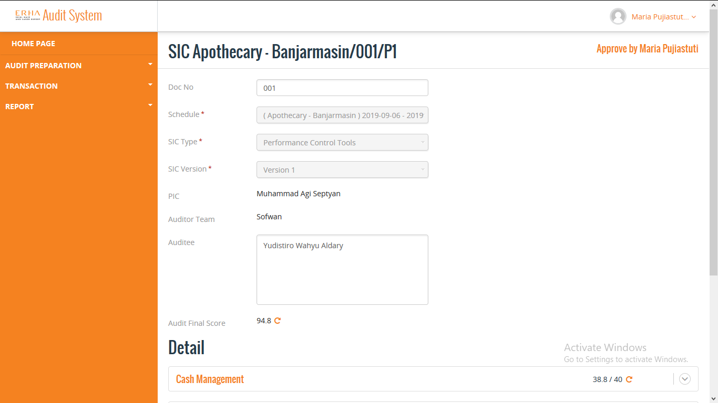
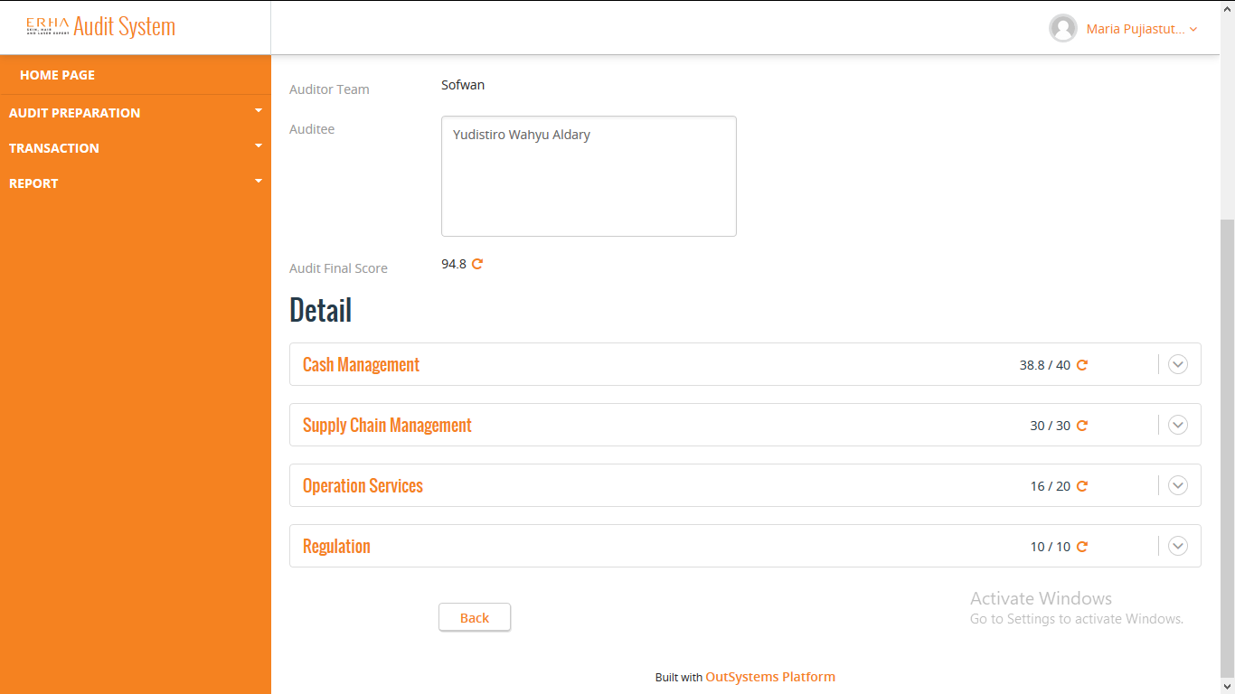
SIC Detail for Audit Lead
On Role Audit Lead, SIC Detail will shown the detail of existing SIC
SIC Detail for Audit Lead
Explanation :
SIC Detail, Audit Lead can approve or reject SIC that been submitted by Auditor after checking the SIC.
Audit Lead can help fixing the SIC if there is a mistake.
If Audit Lead reject a SIC, there will be email sent to Auditor request fixing.
SIC Detail for Audit Lead

Slide 10


SIC Detail for Auditor
On Role Auditor, SIC Detail will shown the detail of existing SIC
SIC Detail for Auditor
Explanation :
SIC Detail, Auditor can submit SIC that been made.
If Auditor submit a SIC, there will be email sent to Audit Lead requesting approval.
SIC Detail for Auditor

Slide 11
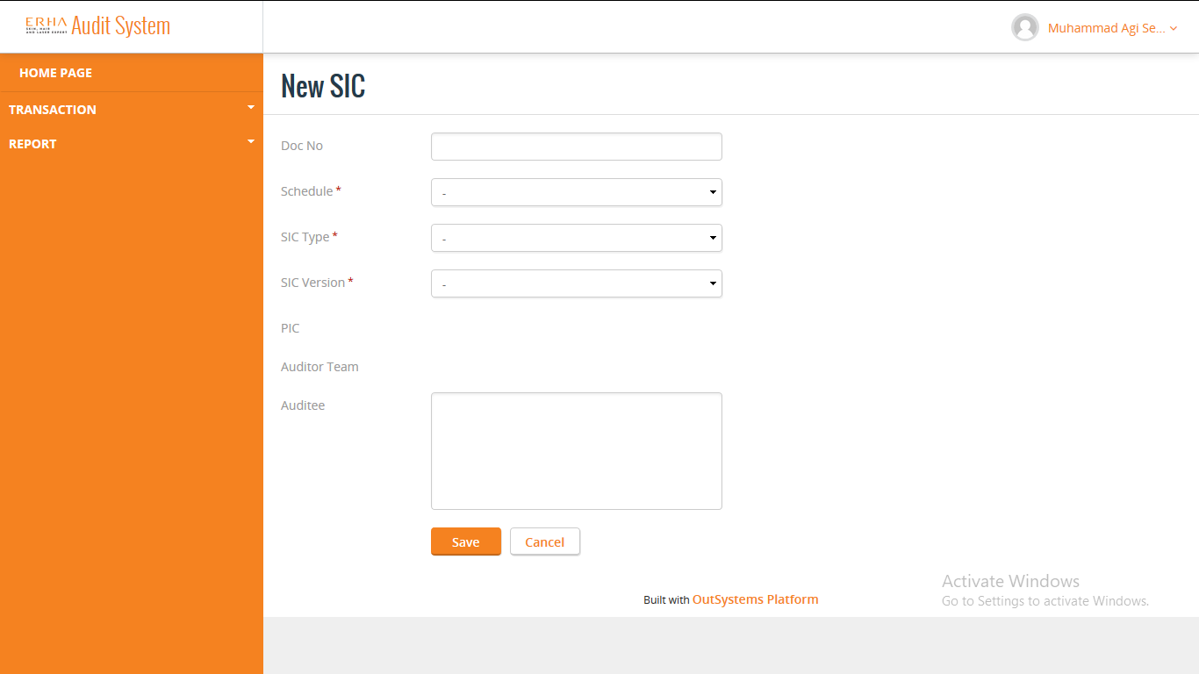
New SIC for Auditor
On Role Auditor, New SIC will shown form to fill before showing list of SIC to fill
New SIC for Auditor
Explanation :
New SIC, Auditor can fill the form first for new SIC.
After that Auditor can fill the list of SIC based on their auditing.

Slide 12
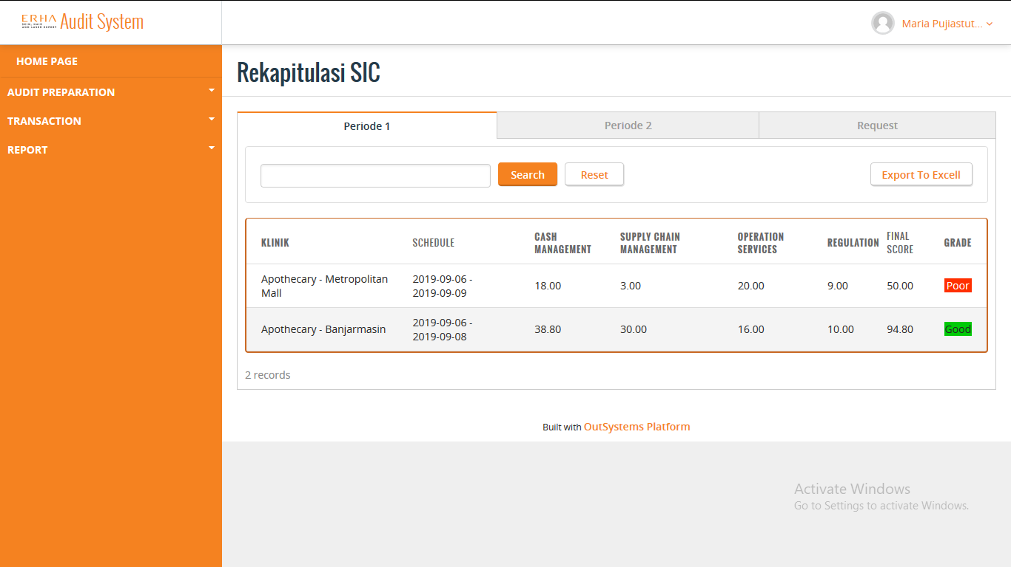
SIC Recapitulation for Audit Lead and Auditor
On Role Audit Lead and Auditor, on report menu, on Rekapitulasi SIC sub menu, SIC Recapitulation will shown three tab of SIC List based on the periode and only PCT Type of SIC
SIC Recapitulation for Audit Lead and Auditor
Explanation :
SIC Recaptulation, Audit Lead and Auditor can see all SIC from all schedule of clinic divide by three tab of periode and only PCT Type of SIC.
Audit Lead and Auditor can also Export the SIC Recapitulation into Excell.
Audit Lead and Auditor can search based on schedule date and Clinic name.

Slide 13
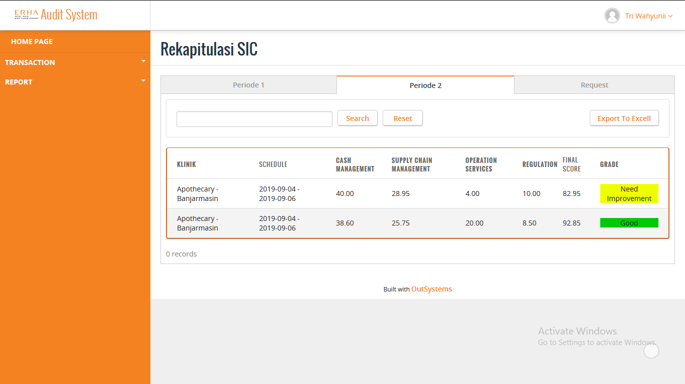
SIC Recapitulation for Supervisor
On Role Supervisor, SIC Recapitulation will shown three tab of SIC List based on the periode and only PCT Type of SIC
SIC Recapitulation for Supervisor
Explanation :
SIC Recapitulation, Supervisor can see SIC only from the clinic they supervised, divide by three tab of periode and only PCT Type of SIC.
Supervisor can also Export the SIC Recapitulation from the clinic they supervised into Excell.
Supervisor can search based on schedule date and Clinic name.

Slide 14

SIC Recapitulation for Area Manager
On Role Area Manager, SIC Recapitulation will shown three tab of SIC List based on the periode and only PCT Type of SIC
SIC Recapitulation for Area Manager
Explanation :
SIC Recapitulation, Area Manager can see SIC from all the clinic in the area they manage, divide by three tab of periode and only PCT Type of SIC.
Area Manager can also Export the SIC Recapitulation from the clinic in the area they manage into Excell.
Area Manager can search based on schedule date and Clinic name.

Slide 15
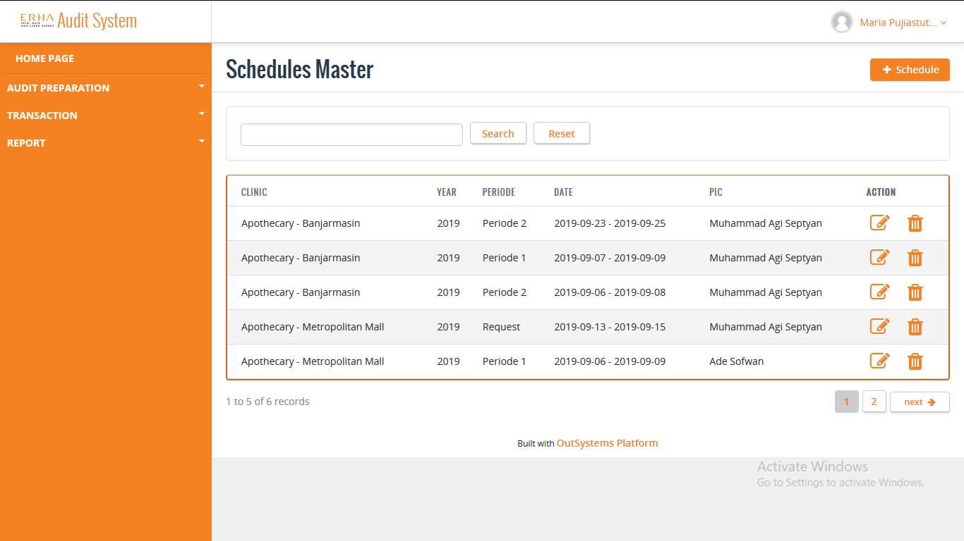
Schedule Master for Audit Lead
On Role Audit Lead, on transaction menu, on Schedule Master sub menu, Schedule Master will shown List of auditing Schedule for Auditor. Schedule Master used only for creating auditing Schedule
Schedule Master for Audit Lead
Explanation :
Schedule Master, Audit Lead can see all list of auditing Schedule.
Audit Lead can create new auditing Schedule for Auditor.
Audit Lead can see the detail of Schedule and edit the Schedule.
Audit Lead can delete the Schedule, if there's no SIC or AR in the Schedule.
Audit Lead can search based on the PIC name.

Slide 16
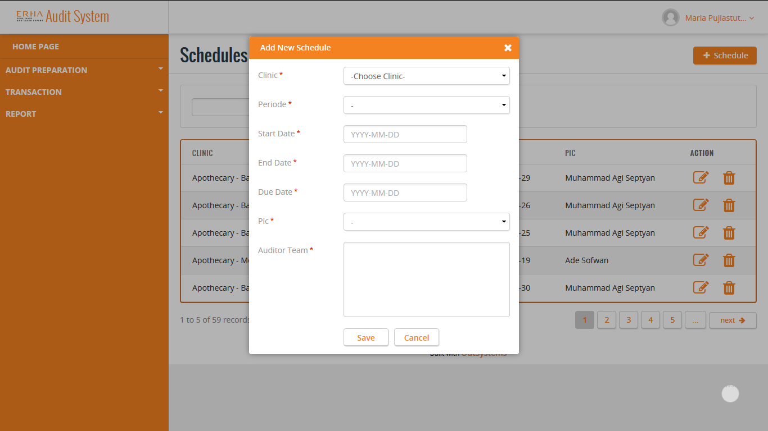
New Schedule Master for Audit Lead
On Role Audit Lead, new Schedule Master will shown pop up form
New Schedule Master for Audit Lead
Explanation :
New Schedule Master, Audit Lead can fill the form for new Schedule.

Slide 17

Schedule Master Detail for Audit Lead
On Role Audit Lead, Schedule Master Detail will shown pop up detail of the Schedule
Schedule Master Detail for Audit Lead
Explanation :
Schedule Master, Audit Lead can see the pop up detail of the selected Schedule and edit the Schedule, if there's something to be fix.

Slide 18
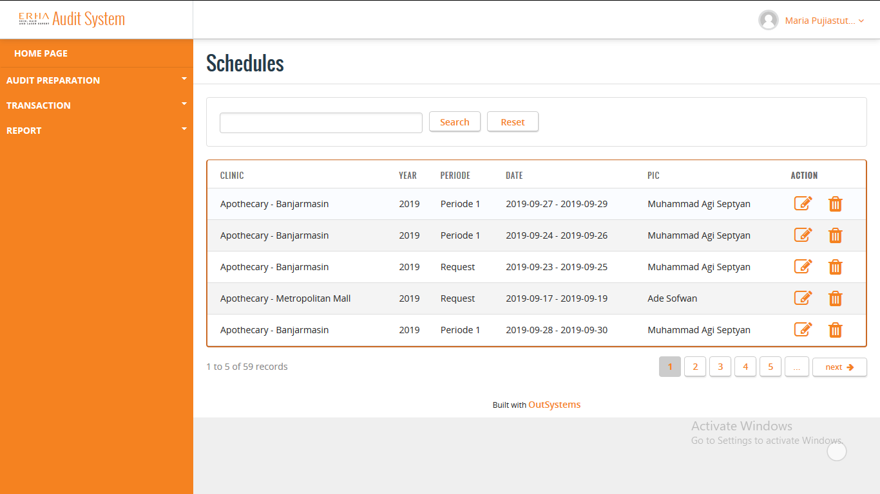
Schedule for Audit Lead
On Role Audit Lead, on transaction menu, on Schedule sub menu, Schedule will shown all List of Schedule. Schedule used for listing all SIC and AR for the Schedule
Schedule for Audit Lead
Explanation :
Schedule, Audit Lead can see all list of Schedule.
Audit Lead can see the detail of Schedule that contain SIC and AR.
Audit Lead can delete the Schedule, if there's no SIC or AR in the Schedule.
Audit Lead can search based on the PIC name.

Slide 19
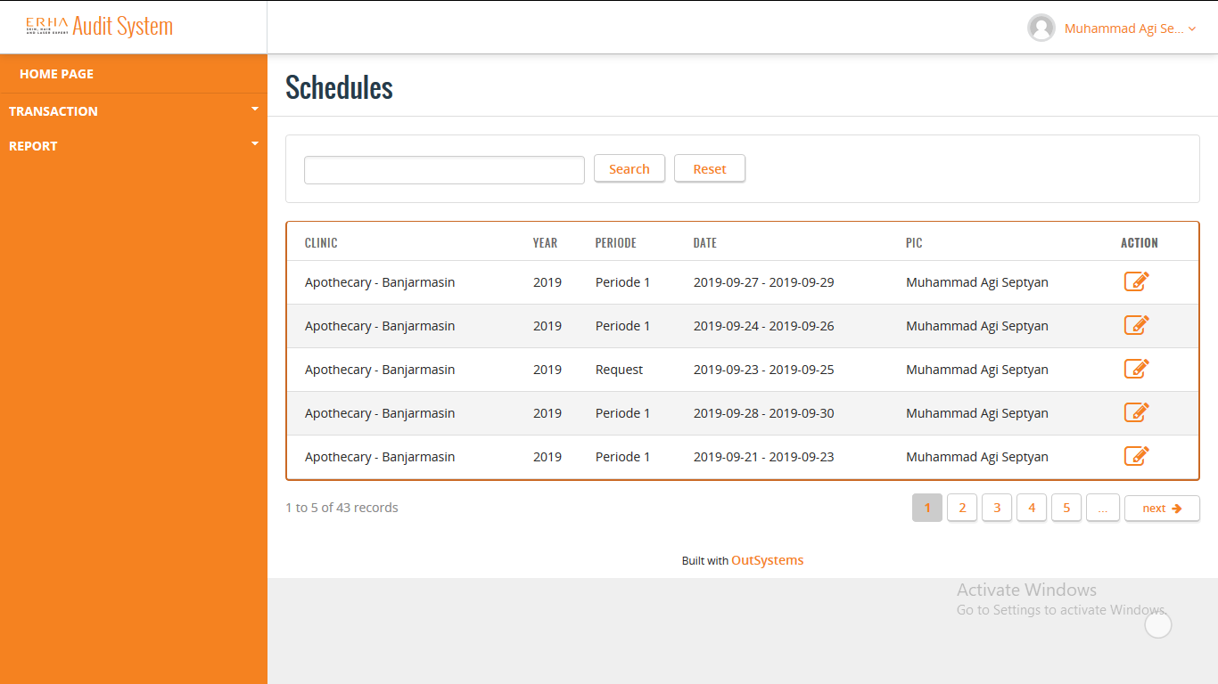
Schedule for Auditor
On Role Auditor, Schedule will shown the list that only assigned to them
Schedule for Auditor
Explanation :
Schedule, Auditor can see the list that only assigned to them.
Auditor can see the detail of Schedule that contain SIC and AR.
Auditor can delete the Schedule, if there's no SIC or AR in the Schedule.
Auditor can search based on the PIC name.

Slide 20

Schedule for Supervisor
On Role Supervisor, Schedule will shown the list that only from the clinic they supervised
Schedule for Supervisor
Explanation :
Schedule, Supervisor can see the list that only from the clinic they supervised.
Schedule list only appear in Supervisor Schedule menu when AR in Draft Final state by Auditor.
Supervisor can see the detail of Schedule that contain SIC and AR.
Supervisor can search based on the PIC name.

Slide 21

Schedule for Area Manager
On Role Area Manager, Schedule will shown the list from all the clinic they manage
Schedule for Area Manager
Explanation :
Schedule, Area Manager can see the list from all the clinic they manage.
Schedule list only appear in Area Manager menu when SIC have been approve by Audit Lead and all AR have been close.
Area Manager can see the detail of Schedule that contain SIC and AR.
Area Manager can search based on the PIC name.

